Slide 1
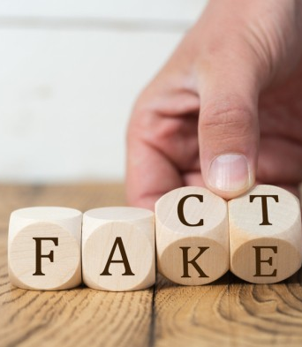


Text Analysis: Health Misinformation
Mason Womble
Sharon Jepkosgei
Kendall Goodland

Slide 2
“Scientists Warn People to Stop Eating Instant Noodles Due to Cancer and Stroke Risks”
2

Slide 3

Introduction
How many times have you seen such unproven statements online?
Yet, 80% of people online use the internet to search for health information (Zadrozny, 2019)
Objective – Establish recurring themes, prominent words, and dissemination patterns associated with health misinformation
3

Slide 4

Research Questions
1.Is health misinformation characterized by specific themes, topics, or words?
2. Which channels and platforms are primarily utilized to disseminate fake health information?
4

Slide 5
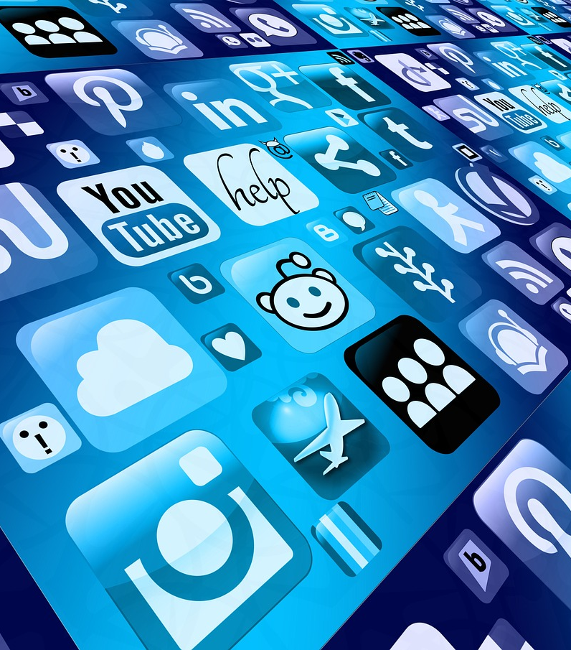
Research Hypothesis
1. Health misinformation exhibits distinct thematic patterns, with certain words and topics recurring more frequently than others.
2. Fake health information is disseminated through specific channels and platforms, contributing to its persistence and amplification.
5

Slide 6



How we get there
Data
Datasets with Fake vs. Accurate information
HealthNewsReview.org - story or release
CoAID
YouTube data
Technique
Text analysis - Natural Language Processing tools
Visualization
Word Clouds
Network diagrams
6
Notes:
Informed Medical Decisions Foundation and Laura and John Arnold Foundation

Slide 7




Analysis Plan
Keywords Analysis
Thematic Patterns
Language Usage
Topic Modeling
- Bag of Words
-Word frequency analysis
N-gram analysis
Sentiment analysis:
-NRC Lexicon
-Polarity Score
Latent Dirichlet Allocation (LDA)

Slide 8
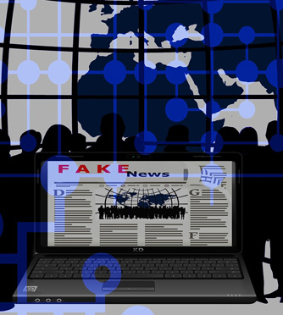
Summary
Analyzing themes, words, and patterns of information dissemination allows for us to understand variations between fake and credible health news . It may help identify a set of features for future supervised learning.
8

Slide 9
Works Cited
Hayawi, K., Shahriar, S., Serhani, M. A., Taleb, I., & Mathew, S. S. (2022). ANTi-Vax: a novel Twitter dataset for COVID-19 vaccine misinformation detection. Public health, 203, 23–30. https://doi.org/10.1016/j.puhe.2021.11.022
Zadrozny, B. (2019, December 29). These are the fake health news that went viral in 2019. NBCNews.com. https://www.nbcnews.com/news/us-news/social-media-hosted-lot-fake-health-news-year-here-s-n1107466

Slide 10




Thank you

