Slide 1

Music Generation Using GAN
Computational Intelligence
S.Mohammad Saleh Mirzatabatabei
Dr. Abdollahi
Salman Ami Motlaq
Fall 2020
Aria Espahbodi

Slide 2
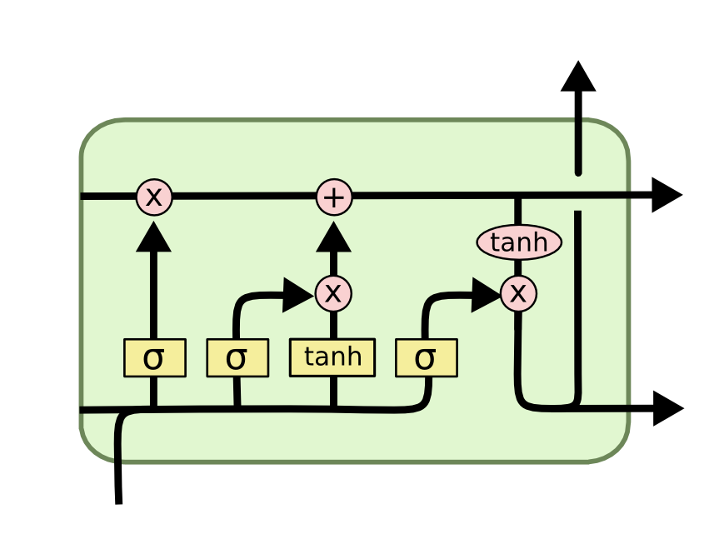
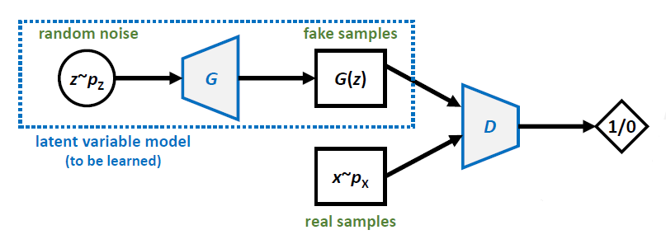
Generative Adversarial Network (GAN) vs. LSTM

Slide 3
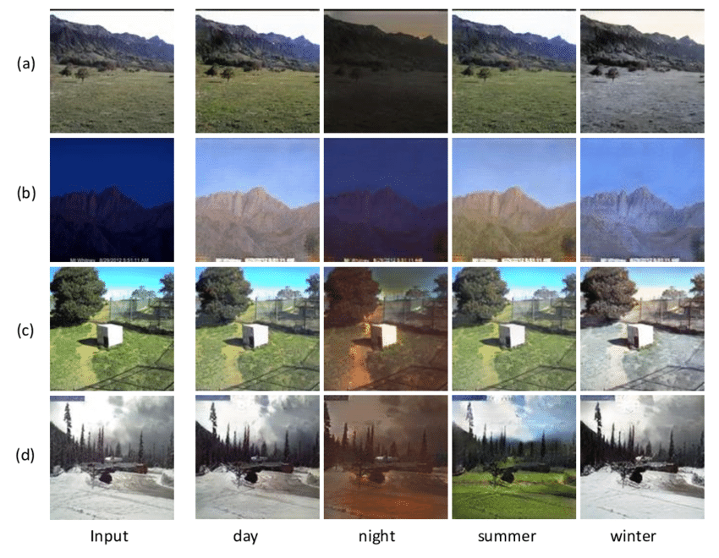
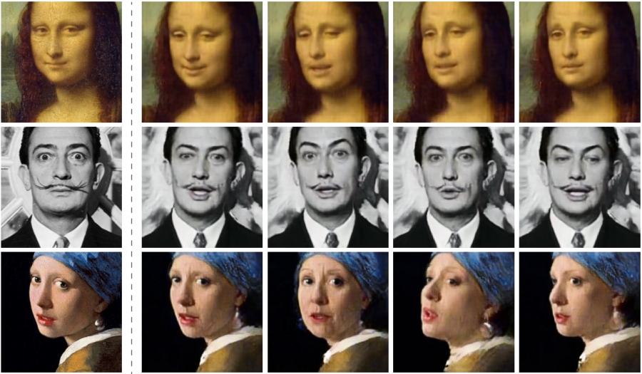
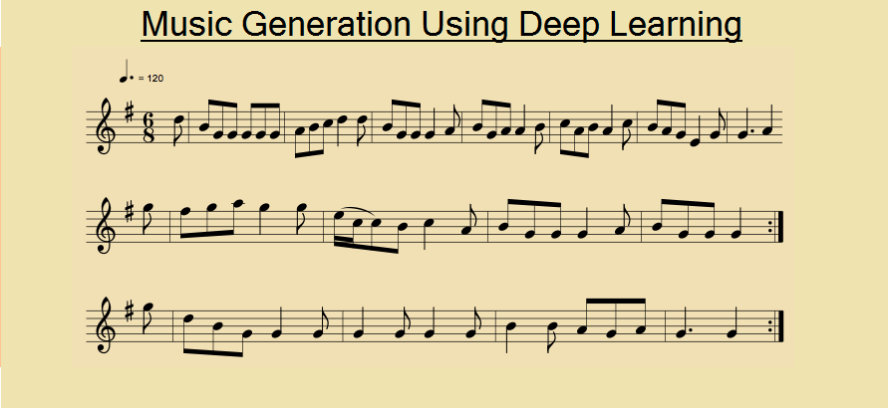
Generative Adversarial Networks (GAN) and LSTM Applications
Some real-life uses:
Domain translation
Deep fake
Music

Slide 4
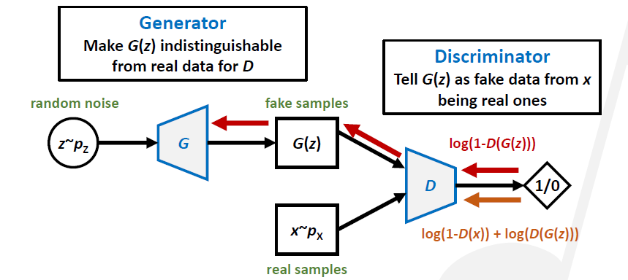
Loss functions and training the networks

Slide 5
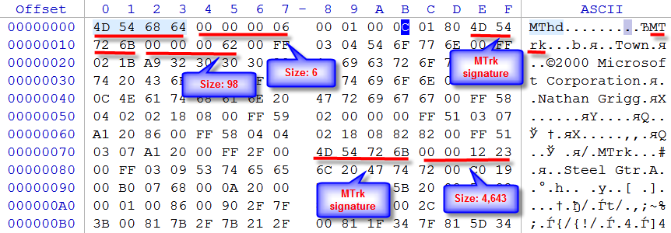

MIDI format
an acronym for Musical Instrument Digital Interface, a technical standard that describes a communications protocol, digital interface, and electrical connectors that connect a wide variety of electronic musical instruments, computers.

Slide 6
But how to read MIDI with Python ?
Music21 is a powerful library in python whose tools are very helpful for creating, analysis and processing of audio files like songs, melodies and etc..
In this project, we have used this library for our purposes of converting the MIDI files into notes, categorizing of notes for preparing the training data, and choosing the playing instruments for the output of our GAN and converting it back to MIDI.

Slide 7
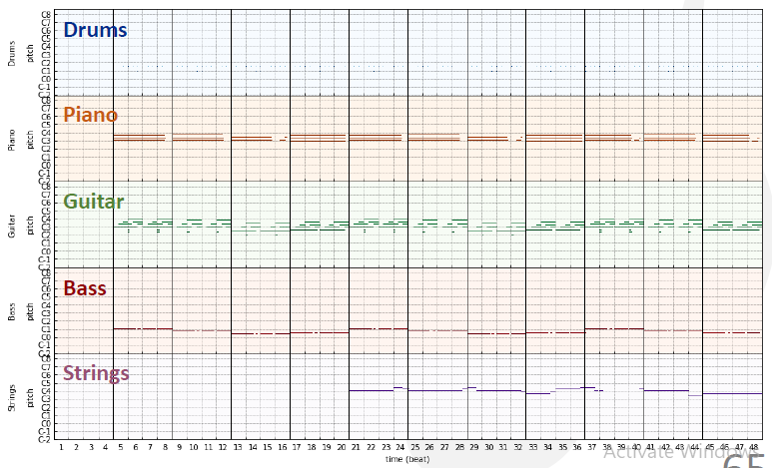
PyPianoRoll

Slide 8
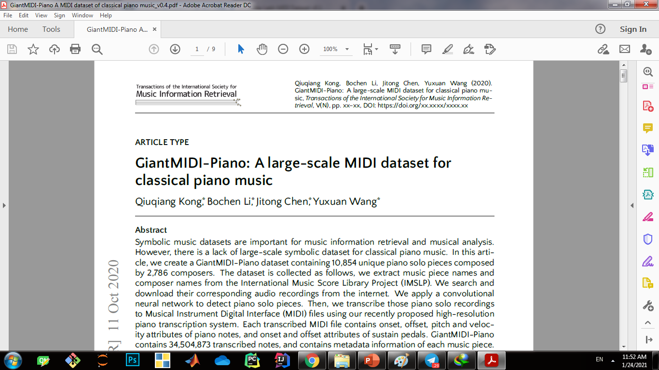
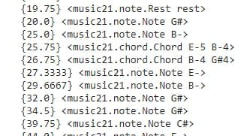
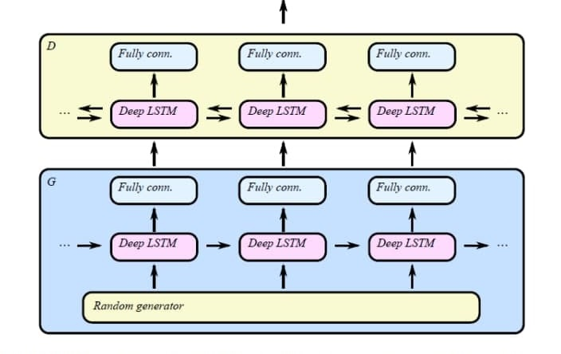
Algorithm:
Steps:
Parsing MIDI file and preparing the training data
Mp3 to MIDI file
C-RNN-GAN Network

Slide 9
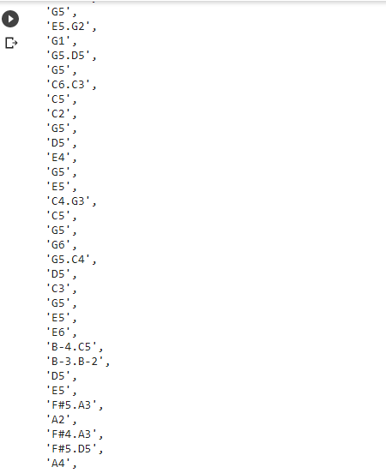
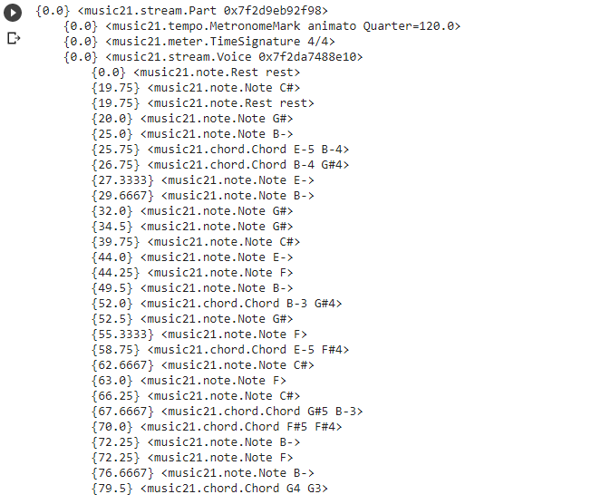
Preparing data for C-RNN-GAN network

Slide 10
Classes
MIDI Class
Method:
- Parser
- sequence preparation
- MIDI creation
Model Class
Method:
- Discriminator
- Generator
- Train
- Plot loss function
- Save model

Slide 11
GPU Computing
CUDA is a parallel computing platform interface that allows software developers to use GPUs for ML computing.

Slide 12
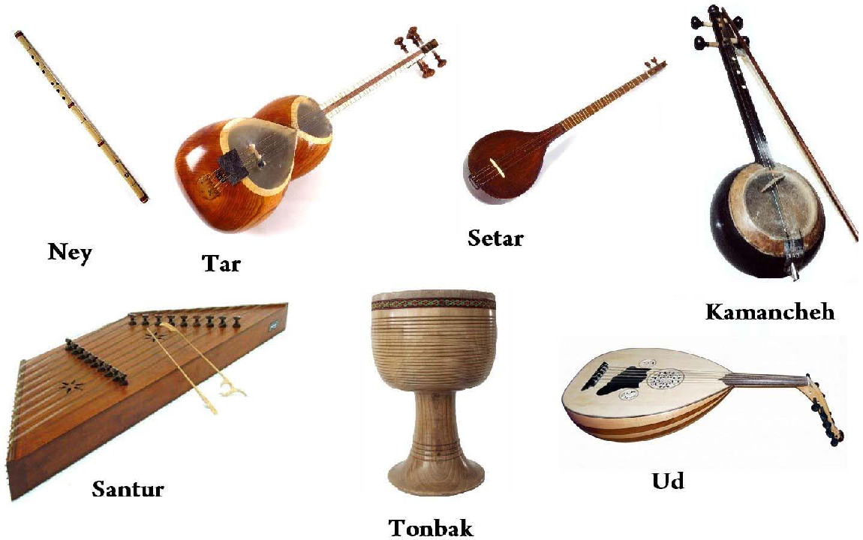
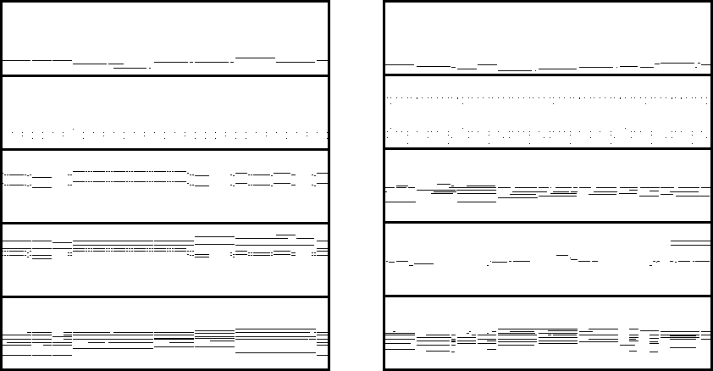
Datasets:
Some real-life uses:
GiantMIDI-Piano
Persian MIDI dataset
The Lakh MIDI Dataset
Over 11000 MIDI data
Persian Instruments data
Multi-Instrument data

Slide 13
Future Works
1- Multi-instrument by partitioning and joining each part (Muic21 Instrument package)
2- Use offset, duration, velocity with pyPianoroll package
3- UI mobile and desktop application to create music
4- using CGANs network to avoid
falchs

Slide 14
Refrences and Citation:
[1] Qiuqiang Kong, Bochen Li, Jitong Chen, and Yuxuan Wang. "GiantMIDI-Piano: A large-scale MIDI dataset for classical piano music." arXiv preprint arXiv:2010.07061 (2020). https://arxiv.org/pdf/2010.07061
[2] C-RNN-GAN: Continuous recurrent neural networks with adversarial training
[3] Generative Adversarial Networks - Ian J. Goodfellow, Jean Pouget-Abadie, Mehdi Mirza, Bing Xu, David Warde-Farley, Sherjil Ozair, Aaron Courville, Yoshua Bengio 2014
[4] “Lead sheet generation and arrangement by conditional GAN,” ISMIR LBD 2018
[5] MuseGAN : Multi track sequential GANs for symbolic music generation and accompaniment,” AAAI 2018

Slide 15
THANKS!
Any questions?

