Slide 1
Ultrasound mechanical ablation of ovary walls

Slide 2
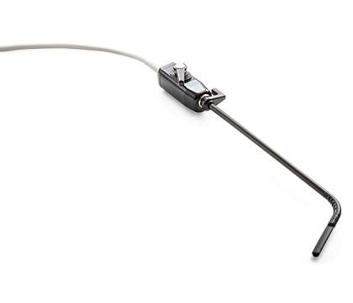
Requirements & constrictions
Induce acoustic cavitation at a depth of 4 cm
Cause a damage of size ~4mm X 4mm X 4mm

Slide 3
Option 1: mechanical ablation (Histotripsy)
Advantages:
No thermal (diffusive) effect
Can be assisted by microbubbles
Disadvantages:
Requires high pressure
Semi-real-time monitoring

Slide 4
Simulation

Slide 5
Frequency comparison
Frequency | 0.2MHz | 0.5MHz | 1MHz | 5MHz | 10MHz
Lateral resolution [mm] | 6 | 2 | 3
Axial resolution [mm] | 30 | 22 | 23
Max pressure [Pa] | 200kPa | 500 kPa | 500 kPa

