Slide 1
Design Patterns
Elements of Reusable Object-Oriented Software
Mei Xuelan
2013. 8

Slide 2
Simple
Useful

Slide 3
Examples

Slide 4
Example One
Bubble Sort

Slide 5
Change
The purpose of design

Slide 6
void bubbleSort(Student students[], int headCount) {
for (int j = headCount; j > 0; j--)
for (int i = 0; i < j - 1; i++)
if (students[i].score > students[i+1].score)
SWAP(students, i, i + 1);
}
if (students[i].score > students[i+1].score)

Slide 7
Base Class
Interface
Abstract
Order
boolean inOrder(S s1, S s2)
Sub Class
Implementation
Concrete
HighToLow
LowToHigh
boolean inOrder(S s1, S s2)
boolean inOrder(S s1, S s2)
return s1 > s2;
return s1 < s2;

Slide 8
bubbleSort
Order
boolean inOrder(S s1, S s2)
HighToLow
LowToHigh
boolean inOrder(S s1, S s2)
boolean inOrder(S s1, S s2)
Strategy Pattern

Slide 9
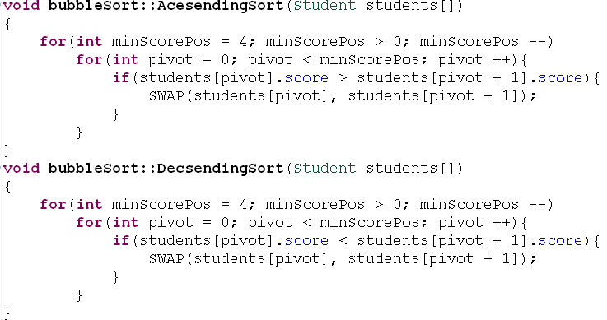
So what …
No duplication
Notes:
If there is a mistake exist in original function, now it becomes 2
Hard to extend, New requirement coming makes duplication expose

Slide 10
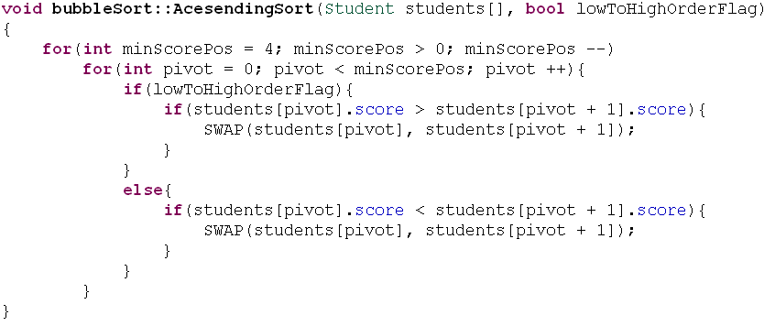
So what …
No nested condition
Notes:
Lose the point, most of the lines is dealing with the order picking logic instead of sorting
Hard to extend

Slide 11
So what …
Open to extension, close to modification
void bubbleSort(…, Order * order) {
for (int j = headCount; j > 0; j--)
for (int i = 0; i < j - 1; i++)
if (!order->inOrder(students[i], students[i+1]))
SWAP(students, i, i + 1);
}

Slide 12
Example one: Summary
Polymorphism
Strategy Pattern
Open Close Principle
Encapsulate what varies
Notes:
Encapsulate, hide difference, looks the same outside to the client

Slide 13
Example one: Summary
Polymorphism
Strategy Pattern
Open Close Principle
Encapsulate what varies

Slide 14
Example two
Timer

Slide 15
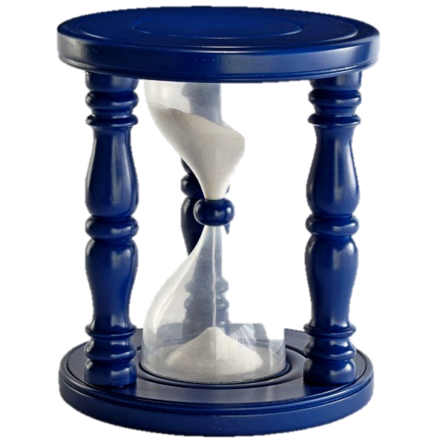
MusicTimer
Time expireTime;
Player player;
Song song;
Timer(Time, Song);
~Timer()
void start();
void expired()
player.play(song);

Slide 16
Change
The purpose of design

Slide 17
MusicTimer
Time expireTime;
Player player;
Song song;
Timer(Time, Song);
~Timer()
void start();
void expired()
Player.play(song)
Different Variable
PosTimer
player.play(song);
Different behavior
Time expireTime;
GPS gps;
Timer(Time);
~Timer()
void start();
void expired()
gps.recordPos();
Notes:
In previous example, the sort one, we hide the difference in operator of <, >
This time we have more than logic to hide

Slide 18
MusicTimer
Time expireTime;
PlayMusic cmd;
PlayMusic
Player player;
Song song;
Timer(Time, Song);
~Timer()
void start();
void expired()
cmd.execute();
execute()
player.play(song);
PosTimer
player.play(song);
Time expireTime;
RecordPos cmd;
RecordPosition
GPS gps;
Timer(Time);
~Timer()
void start();
void expired()
cmd.execute();
execute()
gps.recordPos();
Notes:
In previous example, the sort one, we hide the difference in operator of <, >
This time we have more than logic to hide

Slide 19
Timer
Time expireTime;
Command * command;
Command
execute()
Timer(Time, command);
~Timer()
void start();
void expired()
PlayMusic
RecordPosition
command->execute()
Player player;
Song song;
GPS gps;
execute()
execute()
player.play(song);
gps.recordPos();
Notes:
Recall 多态

Slide 20
Demo
How it looks in real code

Slide 21
Command Pattern
Client
Invoker
Command
do()
Receiver
ConcreteCommand
action()
do()
Receiver.action()
Notes:
Simple pattern may look scary

Slide 22
So what …
No duplication
Open to extension, close to modification
Decoupling of knowing and doing
And more …

Slide 23
If (TRUE == conditionA){
rc = allocateResouceA(paraA1, paraA2);
}
if(RC_ERROR == rc){
continue:
}
If (TRUE == conditionB){
rc = allocateResouceB(paraB1, paraB2);
}
if(RC_ERROR == rc){
if(TRUE == conditionA){
releaseResourceA(paraA1, paraA2…);
continue:
}
If(TRUE == conditionC){
rc = allocateResourceC(paraC1, paraC2…);
}
If(RC_ERROR == rc)
{
if(TRUE == conditionA){
releaseResourceA(para…);
}
if(TRUE == conditionB){
releaseREsourceB(para…);
}
}
If(TRUE == conditionD){
rc = allocateResourceC(paraD1, paraD2…);
}
If(RC_ERROR == rc)
{
if(TRUE == conditionA){
releaseResourceA(para…);
}
if(TRUE == conditionB){
releaseREsourceB(para…);
}
if(TRUE == conditionC){
releaseResourceC(para…);
}
}
Code Smells
Long function
Duplication
Dependence
Notes:
Even with guard clause when there are more than 10 types of resources to allocate for a RL, as we have in our real product, the function smells
It has 3 problem
1st, it’s a long function
It’s really annoying that most of its code are error handling code, even this function is to allocate resources, but most of it’s code are to release resource, it’s really weird
2nd, it has duplications, and there are 2 types of duplications within it
One type of duplication is the if condition, e.g. if(TRUE == conditionA), it’s first appear to tell whether to allocate resource A or not, and it’s repeated in every error handling code after, to tell whether to release resource A, if there is any inconsistency within these duplications, there will come resource leak problem
The other type of duplication is the error handling code, if we take a look at the error handling code for resource C and D, they are almost the same, except there is one addition step to release resource C in the error handling code for resource D
Duplication is evil
3rd problem is dependency
Assume that we want to add a new type of resource to allocate, we will need to understand all other type resource allocated in this function, when they are allocated and how they are released, just for error handling purpose
It’s painful.

Slide 24
rc = allocateResouceA(paraA1, paraA2…);
Different Function Name
Different Parameter List
rc = allocateResouceB(paraB1, paraB2..);
Encapsulate
rc = command.execute();
Notes:
If we want to do resource allocation in a loop, the resource allocation code have to have the exactly the same form
However, resources allocation are different from each other
They have different function name, and different parameter list
What we do?
The idea is to “encapsulate what varies” which is a big idea in object oriented programming

Slide 25
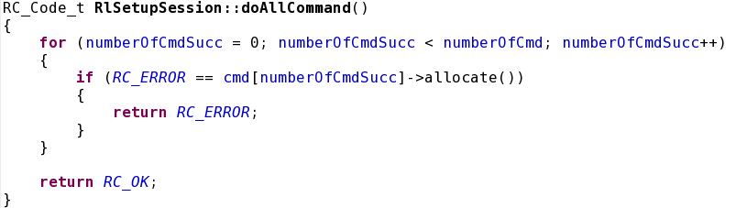
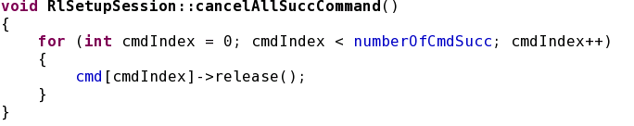
Notes:
This is the function to do all command
Loop over a list, all the resource to allocate has the same shape cmd[index].allocate(), and they are in a loop
The 2nd function is to release all success command
Loop over the list again as the resource release are in the same shape as well ☺

Slide 26
Example two: Summary
Polymorphism
Encapsulate what varies
Open Close Principle
Command Pattern
Notes:
Encapsulate, hide difference, looks the same outside to the client

Slide 27
Example two: Summary
Polymorphism
Encapsulate what varies
Open Close Principle
Command Pattern
Notes:
Encapsulate, hide difference, looks the same outside to the client

Slide 28
What Is Pattern
One good thief is worth ten scholars

Slide 29
Draw a Bridge
1
2
3
4

Slide 30
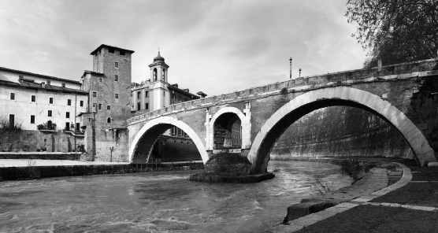
The Ponte Fabricio in Rome built in 62 BC

Slide 31
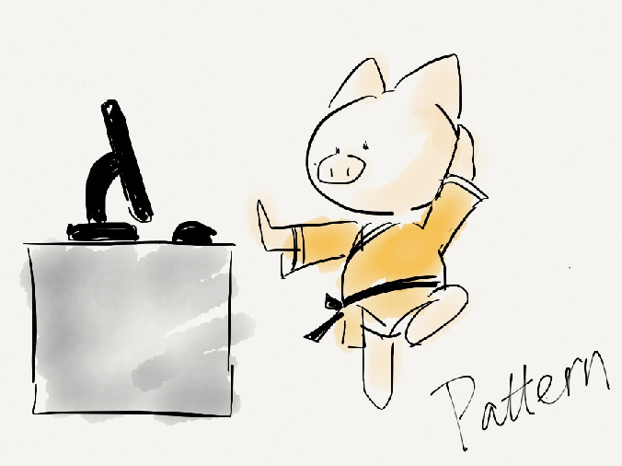
Pattern Language
Name: communication
Problem: relative priorities of the forces
Solution: avoid effort waste on “known” problems

Slide 32
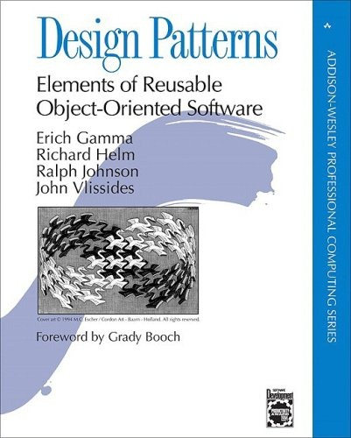

Slide 33
Example three
Draw rectangle

Slide 34
void whateverFunction(){
…
//to draw a rectangle
…
}

Slide 35
SWT IBM
AWT Oracle
GC
Graphics
OR
drawRectangle
drawRect
Notes:
Can we try to make them no difference

Slide 36
void whateverFunction(){
…
//to draw a rectangle
myGraphic.drawRect();
…
}
MyGraphic
drawRect();
SWTAdaptor
SWT IBM
GC
GC gc;
drawRectangle()
drawRect();
gc.drawRectangle();

Slide 37
void whateverFunction(){
…
//to draw a rectangle
myGraphic.drawRect();
…
}
MyGraphic
drawRect();
AWTAdaptor
AWT Oracle
Graphics
Graphics g;
drawRect()
drawRect();
g.drawRect();

Slide 38
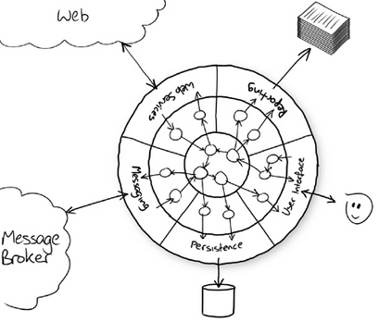
Architecture: Ports and Adapters
Notes:
Not limited to graphics
Isolate our applications from devices, infrastucture
Assuming that you are develop a game on iOS, Adriod, Windows …
Very convinient
2, you don’t need to consider technical details or infrustructure ahead.
3, they can be replaced easily in the future
Why, open & close
Again – encapsulate what varies

Slide 39

What we have so far?
Design
that
open to extension
and
close to modification
Encapsulate what varies
Notes:
May be or may be not a pattern

Slide 40

Decorator Pattern
function(input){
keyOperations();
}
function(input){
trackItsInput();
keyOperations();
}
function(input){
recordCallingtime();
trackItsInput();
keyOperations();
calculateDuration();
}

Slide 41
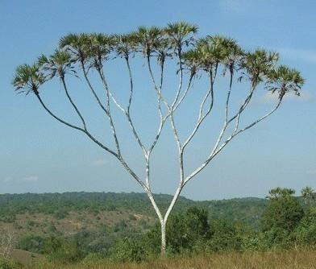
Compositor
Pattern
One
to
Many

Slide 42
Visitor Pattern
 | National | International
Record | ID | Passport
Book tickets | national | international
Tax | No return | Return of tax

Slide 43

Factory Pattern

Slide 44
Structural
Adaptor
Decorator
Behavioral
Command
Strategy
Creational
Factory

Slide 45
Why patterns

Slide 46
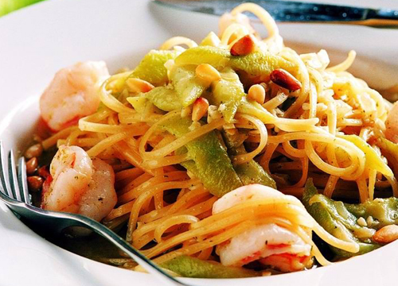

Slide 47
Reuse == saving
Communication
Learn from good design

Slide 48

Refactoring to pattern
Encapsulate what varies (SOC)
OCP

Slide 50
Working Effectively With Legacy Code
Edit & Pray or Try an alternative way

Slide 51

Quick Solution -- Sprout

Slide 52
Quick Solution -- Decorator

Slide 53
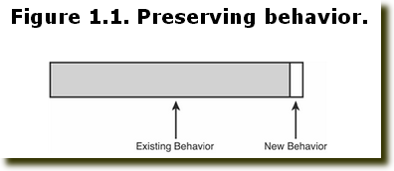
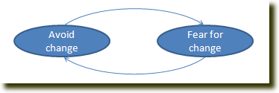

Slide 54
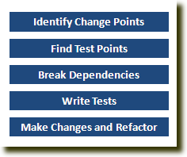
Cover & Modify

Slide 55
Write Unit Test
Seam
Link Seam
Object Seam
Preprocessor Seam
Quick Feedback
Independent

Slide 56
Refactoring
Abstract Function
Object Method

Slide 57

Technical Excellence
ATDD:
Bridge customer requirement with design via test
Design and Unit Test：
Design for high quality SW
Clean Code：
Implementation perfection

Slide 58
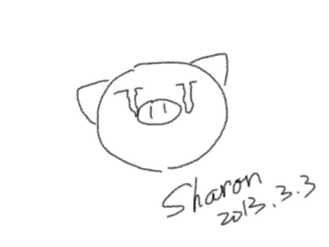

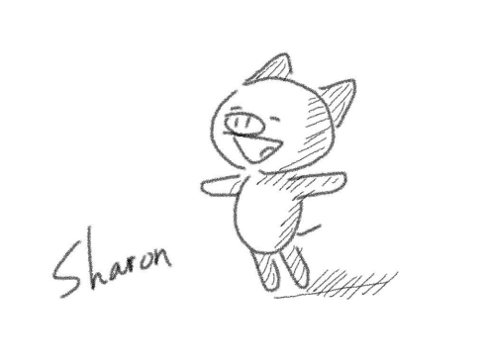
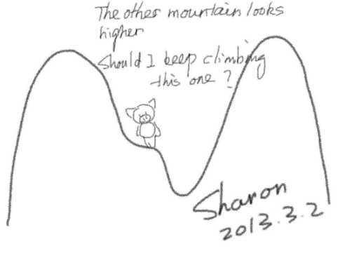

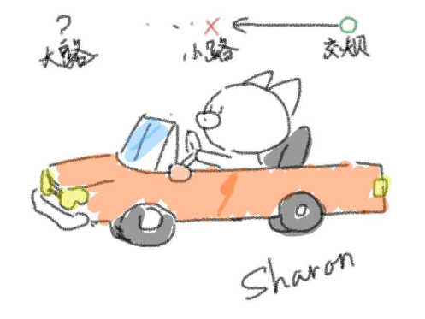


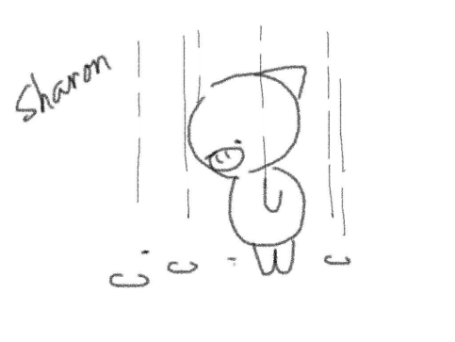
Thank you!
@SharonMei1219

