Slide 1
Unit Test
Sharon Mei

Slide 2
Unit Test Basic
What is UT
Why UT
How to write UT

Slide 3
What is UT
Run fast
Very limited scope

Slide 4
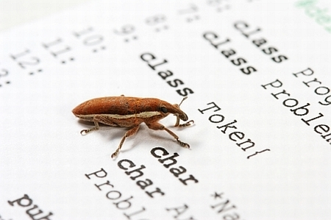
Why UT
UT is about confidence
Having good UT == Having Good Design
Correctness
Communication
Reusable
Extension

Slide 5
Practice I: code review
void SWAP(Student students[], int i, int j) {
Student tmp = students[j];
students[i] = students[j];
students[j] = tmp;
}
void bubbleSort(Student students[], int headCount){
for (int j = 0; j < headCount; j++)
for (int i = 0; i < j; i++)
if (students[i].score > students[i+1].score)
SWAP(students, i, i+1);
}

Slide 6

Practice I: summary
Make up some data
Simulate computer’s behavior in human brain
Figuring out result and compare it with our expectation

Slide 7

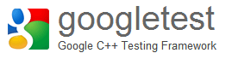


How
Java
C++

Slide 8
CppUTest
#include "CppUTest/TestHarness.h"
TEST_GROUP(TestUTBasicPractice) {};
TEST(TestUTBasicPractice, testTheSumOfOnePlusOneIsTwo) {
int sum = 1+1;
CHECK_EQUAL(2, sum);
}

Slide 9
Practice II: Write UT
SWAP
SWAP to order
The highest score to the left
All students in order
1. SWAP
2. SWAP to order
1
2
2
1
2
1
1
2
1
2
1
2
3. Max to the right
3
2
1
4. Bubble Sort
3
2
1
2
1
3
1
2
3

Slide 10
Test in very limited scope One thing at a time

Slide 11
Run Fast Quick feedback

Slide 12
It’s easy!!

Slide 13
Correctness Communication Reusability
Good SW

Slide 14
UT advanced
Why not UT
Write UT among complicated dependencies
Write UT for ease of mantainence

Slide 15

Why not UT
Fragile
I have no idea why it fails
Slow
Erratic
I need to watch over it

Slide 16

Hard to test! For the complicated dependencies

Slide 17
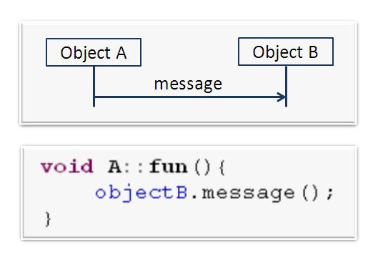
Example I:
Class A depends on Class B
Challenges
To test A, need to add B
Hard to tell whether A had send a message to B

Slide 18
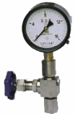
Test Double
Separate
Sensing

Slide 19
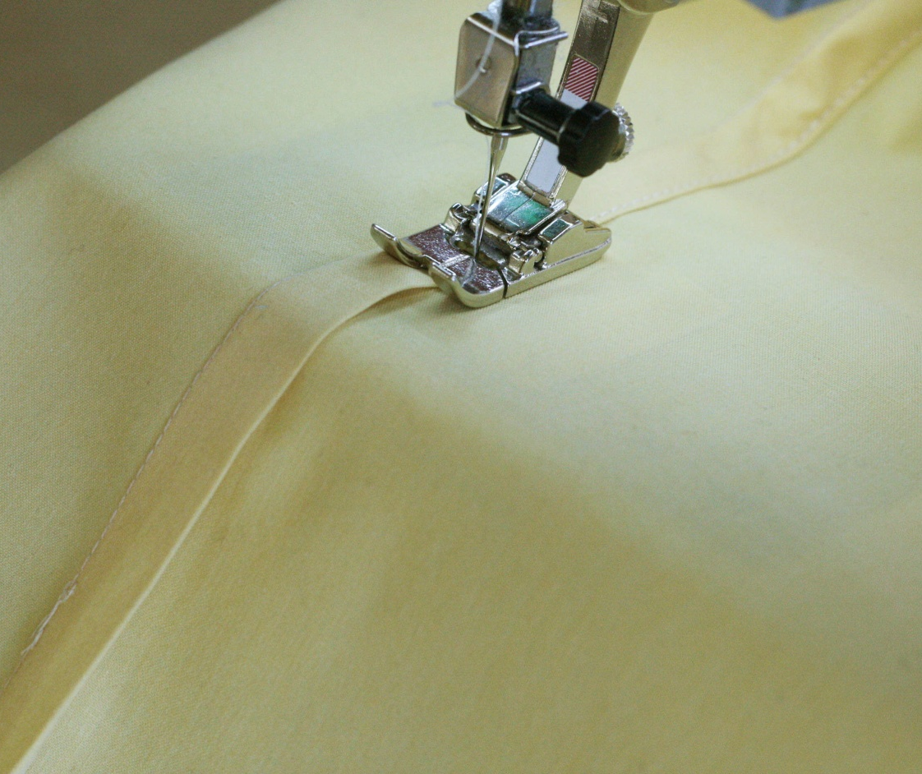
SEAM
Link SEAM
Preprocessor SEAM
Object SEAM
Subclass SEAM

Slide 20
Dependence Injection
<<interface>>
Dependencies
Tested Function
Concrete
Dependencies
Mock/Stub

Slide 21
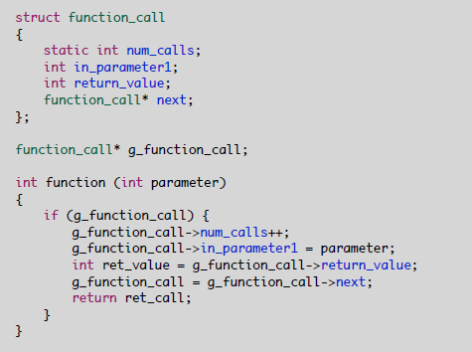
Recording Stub
Global variable to record the collaborate
Stub to replace the collaborators
Recording the collaboration

Slide 22
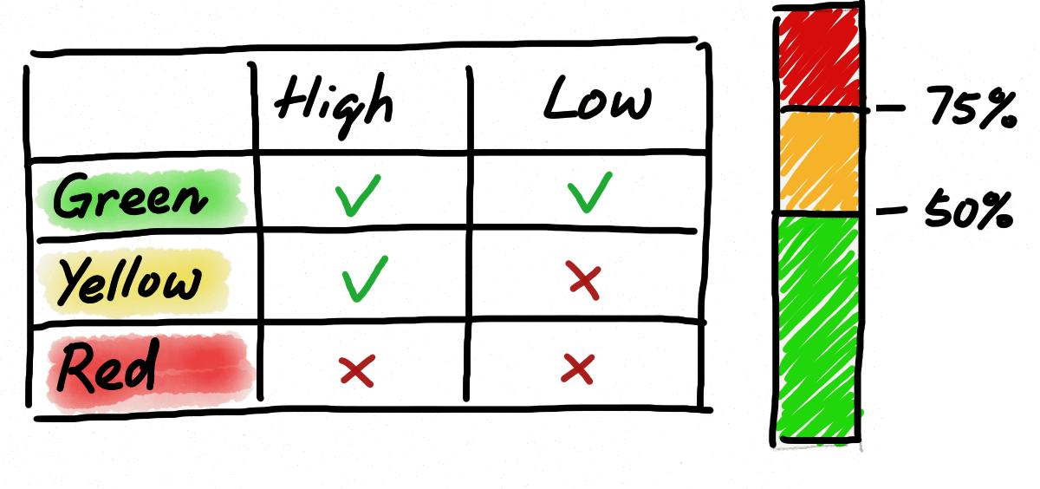
Practice III: Test Double

Slide 23
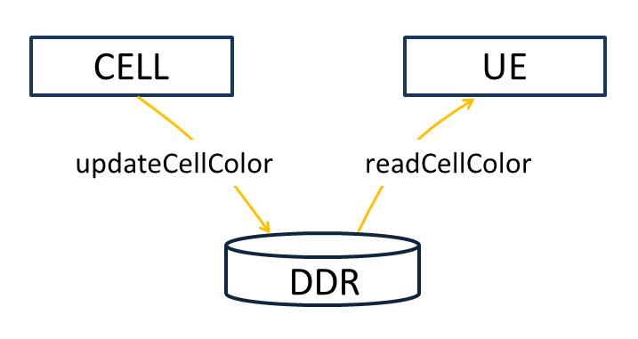

Slide 24

Difficult to construct
Hardware
Slow

Slide 25
Mock
void B::message(int input){
mock().actualCall(“message”).withParameter(“input”, input);
}
TEST(MockExample, setExpectation){
mock().expectOneCall(“message”).withParameter(“input”, 5);
objA.fun();
mock().checkExpectation();
}

Slide 26

Hard to maintain!
Fragile
No idea why it fails
Slow
Erratic
I need to watch it over

Slide 27
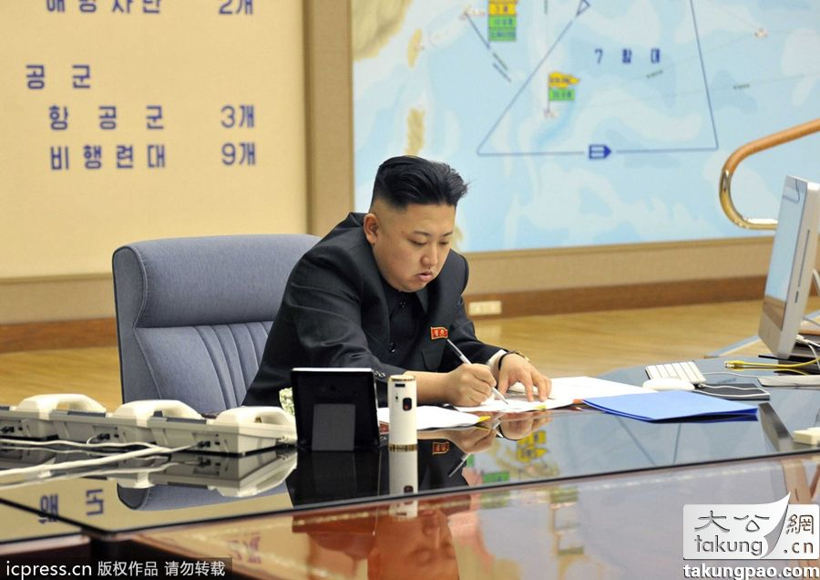
To the point
one case failed for only one reason
One assertion
Meaningful setup
Avoid branching

Slide 28
Test Fixture
TEST_GROUP(Example){
void setup(){
//hide setup steps here
}
void teardown(){
//hide teardown steps here
}
}

Slide 29
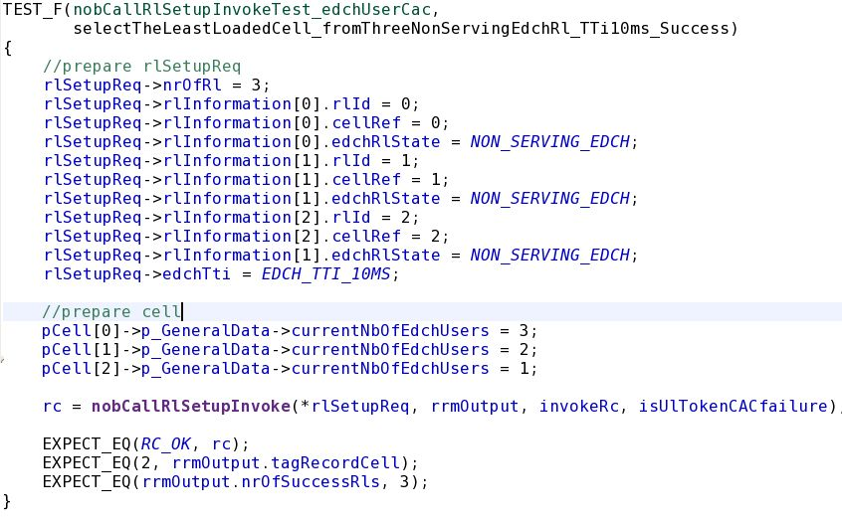
Data preparation can be mess

Slide 30
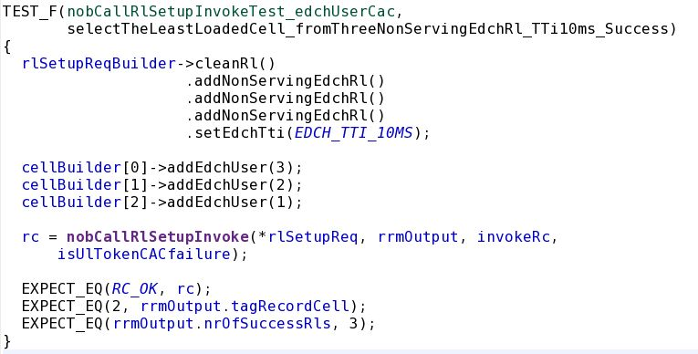
Data Builder

Slide 31
Readable
Name well
given – when – then
Structure well
setup – execute - check

Slide 32

FIRST Principle
Fast
Independent
Repeatable
Self-validate
Timely

Slide 33
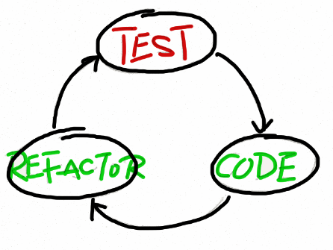
TDD
Testability == Reusability
Loose coupling
Single Responsibility

Slide 34
Correctness Communication Reusability
Good SW

Slide 35
Summary:
What is UT
How to write UT
Why UT
Dependence Breaking
Principles lead to clean UT

Slide 36
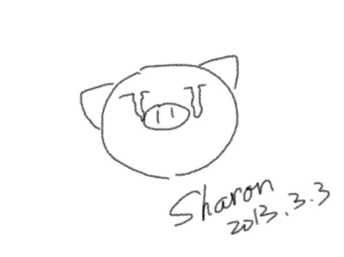




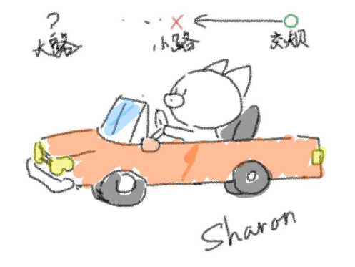


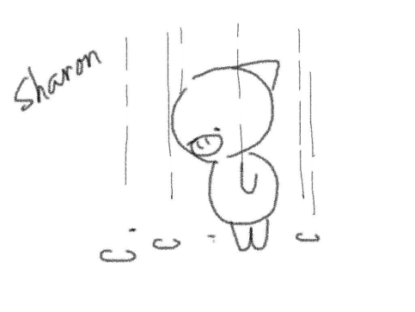
Thank you!
@SharonMei1219

