Slide 1


Global Payments
Transaction and
Tracking Dashboard
Presented by: Sharon Rhoda
2520040001

Slide 2
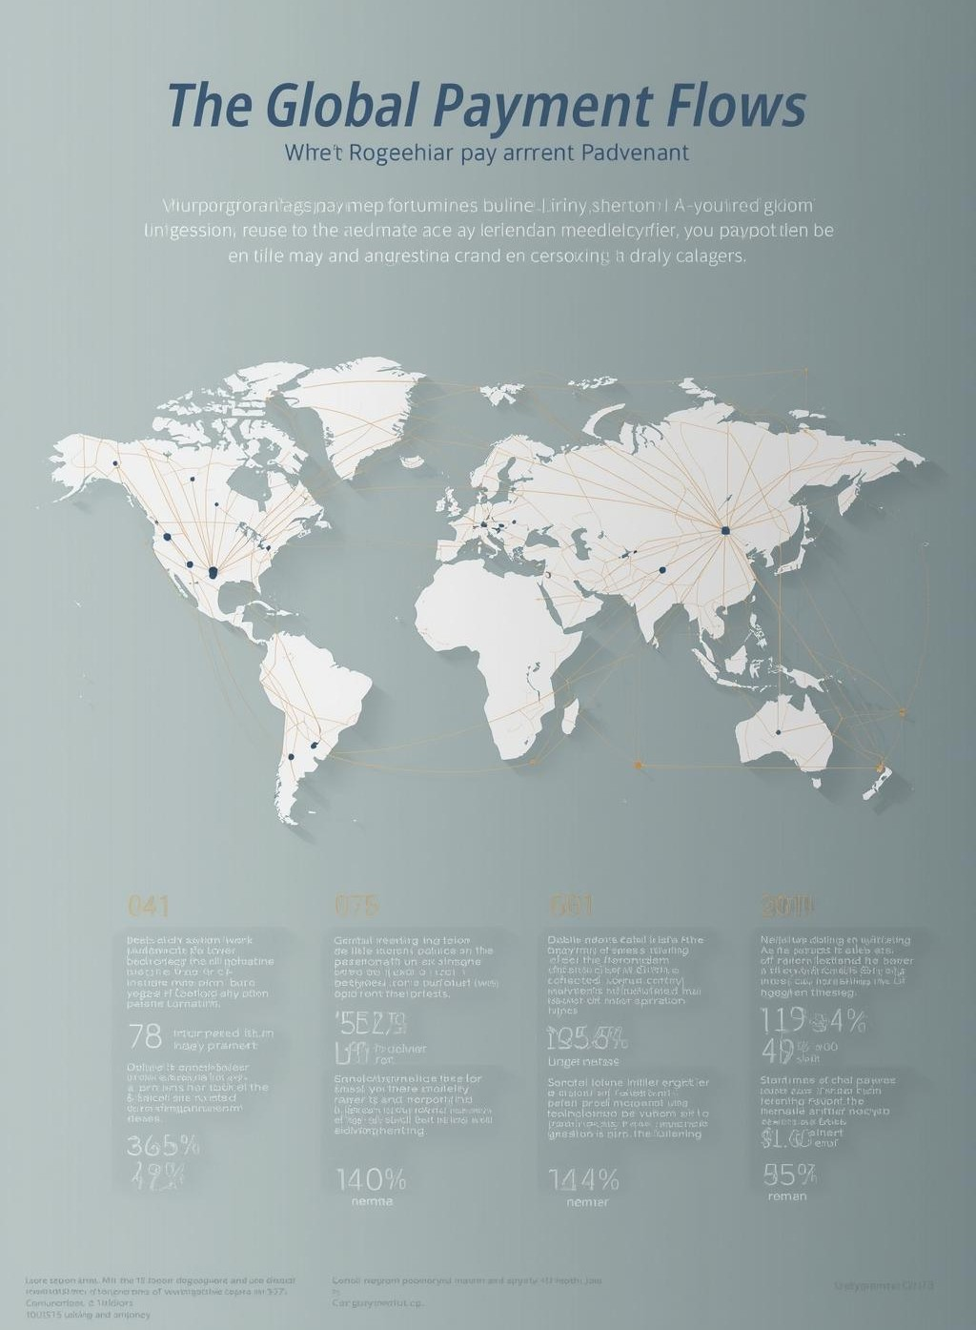
Abstract
Global payment transactions involve multiple stages, intermediaries, and geographical regions, making them complex and difficult to track. Users often face challenges in understanding the current status of a payment, identifying delays, or knowing the reasons behind transaction failures. The lack of transparency in international payment flows can lead to confusion, reduced trust, and inefficiencies for individuals and organizations involved in cross-border transactions

Slide 3
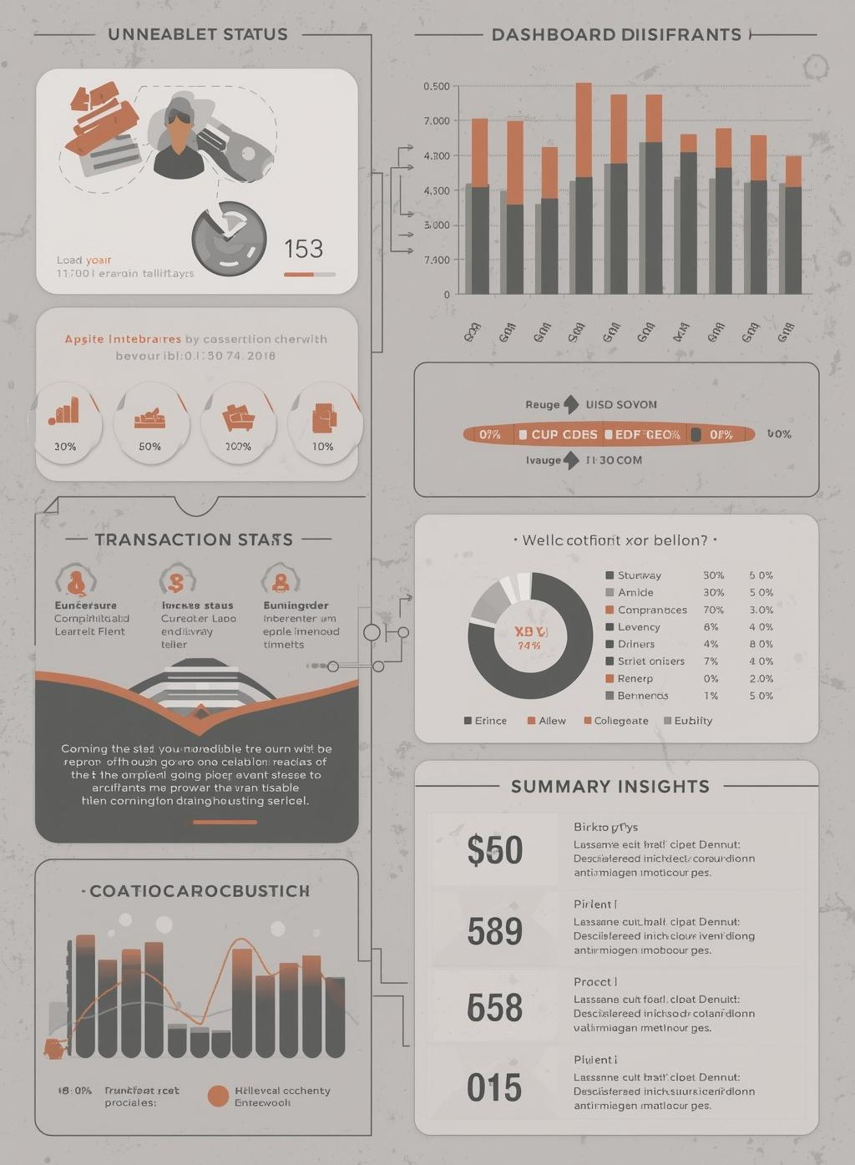
Proposed Solution
The Global Payment Transactions and Tracking Dashboard aims to address this issue by providing a centralized and user-friendly interface that visually represents the journey of global payments. The dashboard displays transaction status, movement across countries, currency flow, and summary insights in a clear and structured manner. By transforming complex payment data into easy to-understand visual information, the project enhances transparency, improves user awareness, and serves as an effective tool for learning, monitoring, and demonstrating global payment processes.

Slide 4
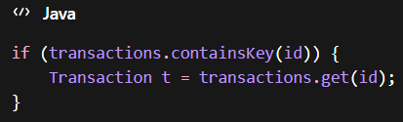

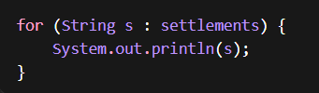
Project Modules and Course Outcomes
CO-1 : Searching and Sorting
CO-2 : Linked Lists

Slide 5


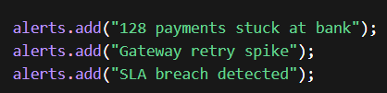

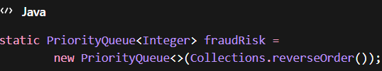
CO-3: Stacks and Queues

Slide 6

CO-4: Hashing

Slide 7
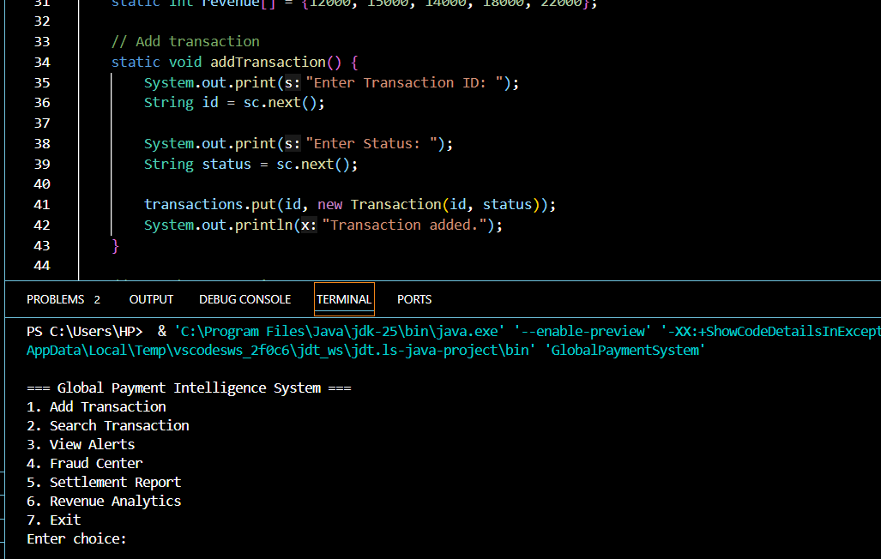
Project ScreenShots

Slide 8
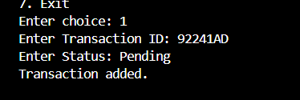
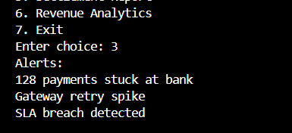
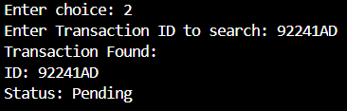

Slide 9
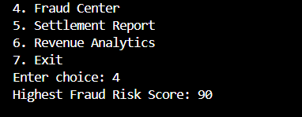
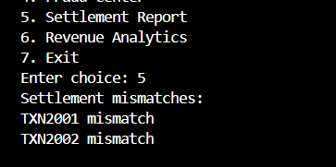
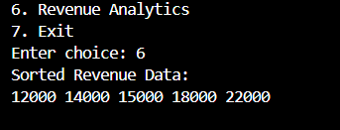


Slide 10
Conclusion:
The Global Payment Transactions and Tracking Dashboard improves visibility and transparency in complex cross-border payment systems.
It enables real-time monitoring of transactions, helping users quickly identify delays, failures, and system issues.
Features such as analytics, fraud alerts, reconciliation, and system health monitoring enhance operational efficiency.
Overall, the platform simplifies global payment tracking and helps build greater reliability and trust in digital financial transactions.

Slide 11
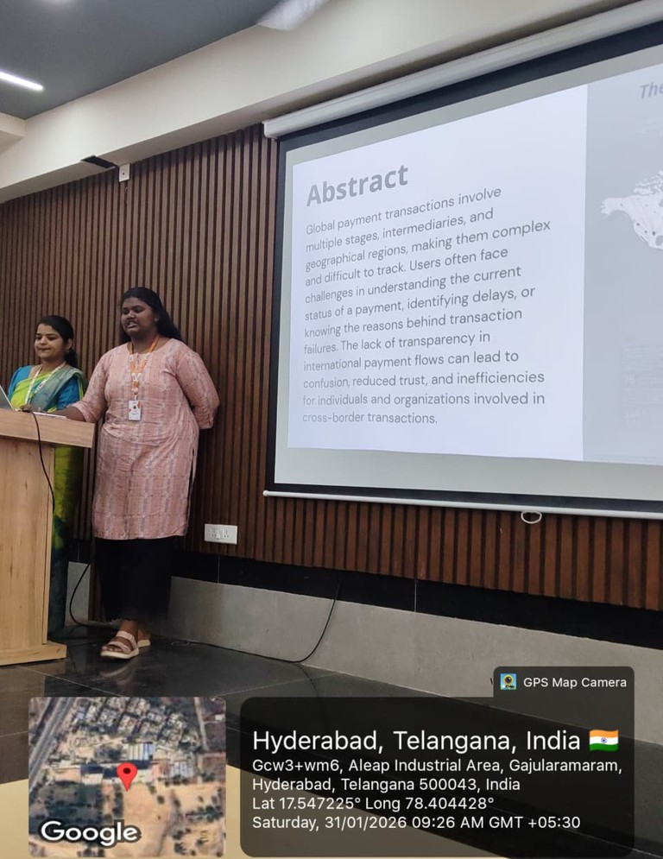
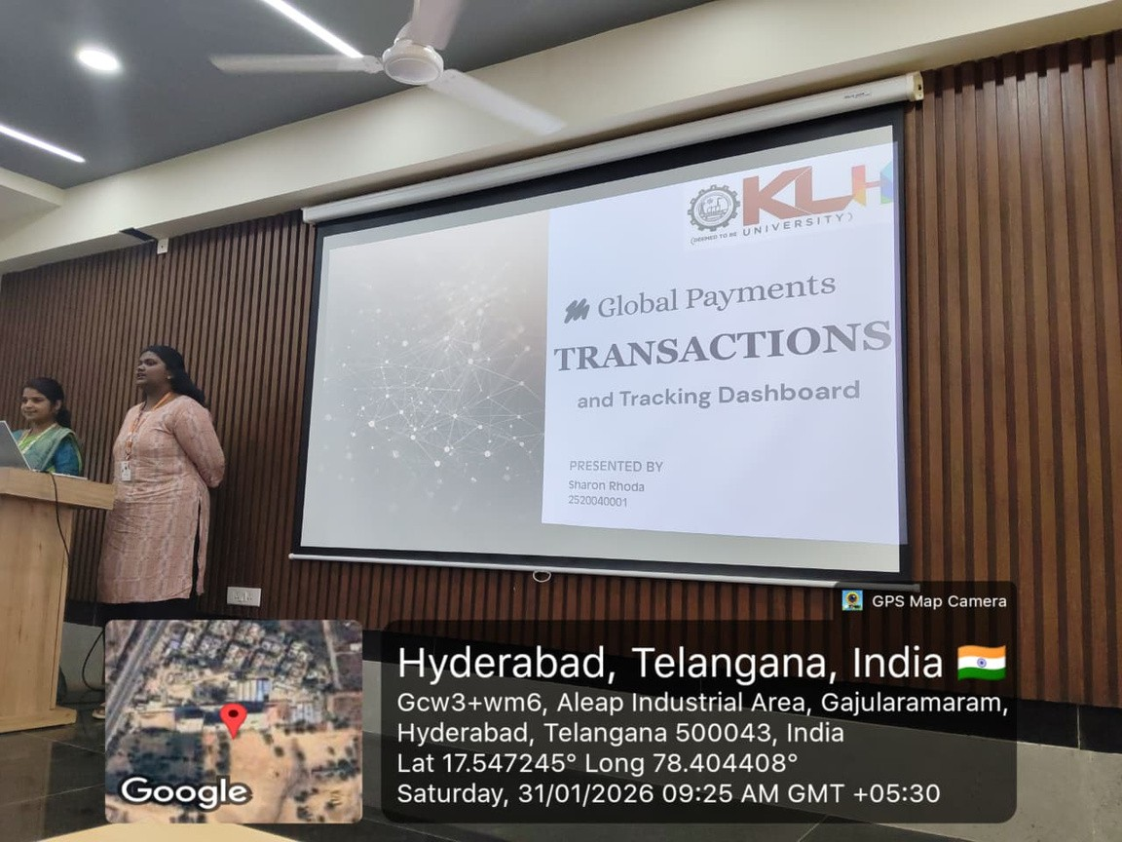
Geo-tagged pictures

Slide 12
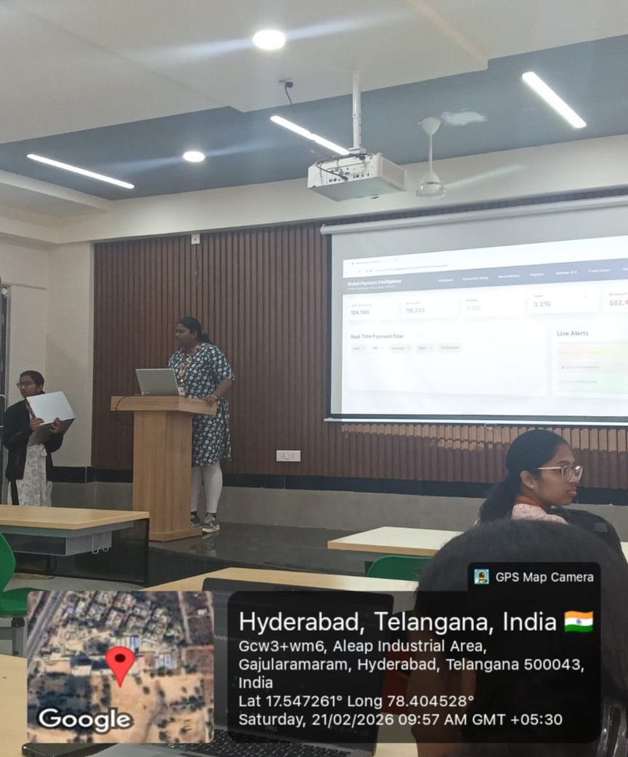
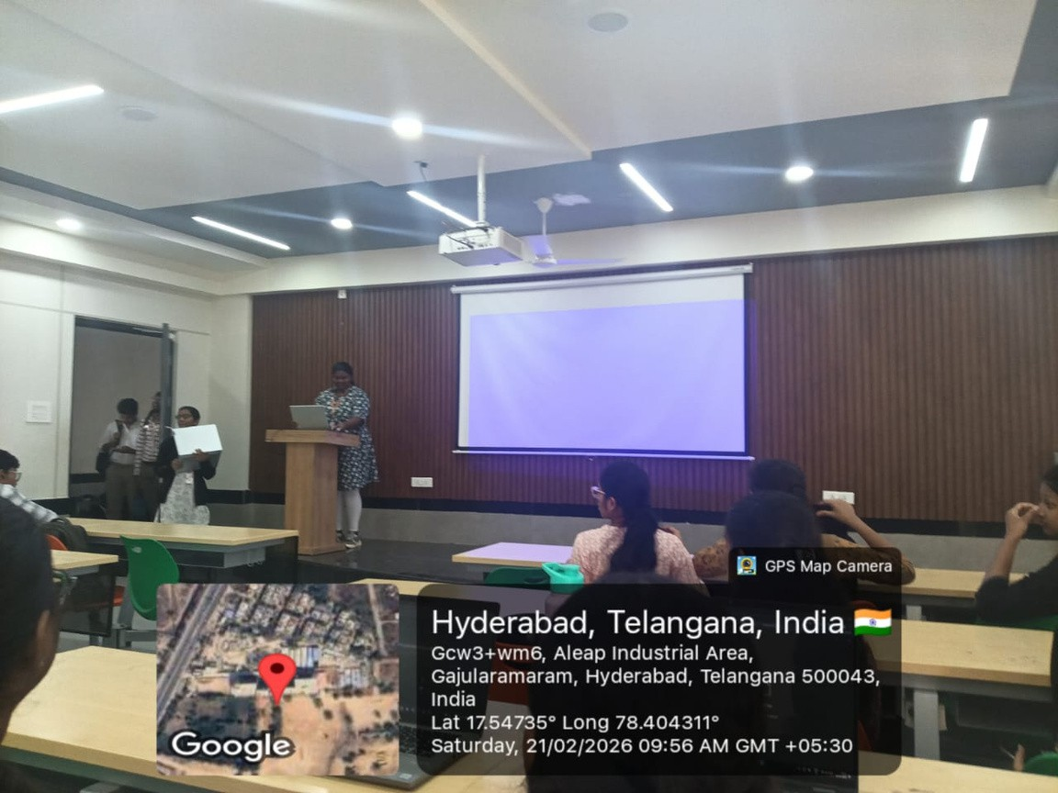

Slide 13
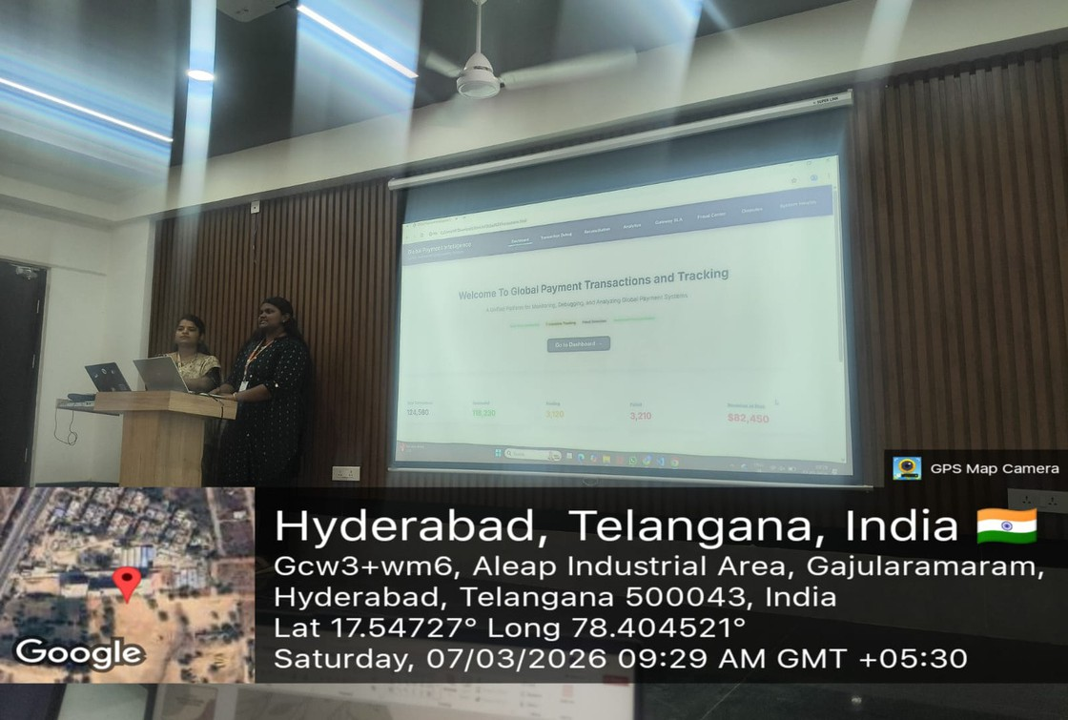
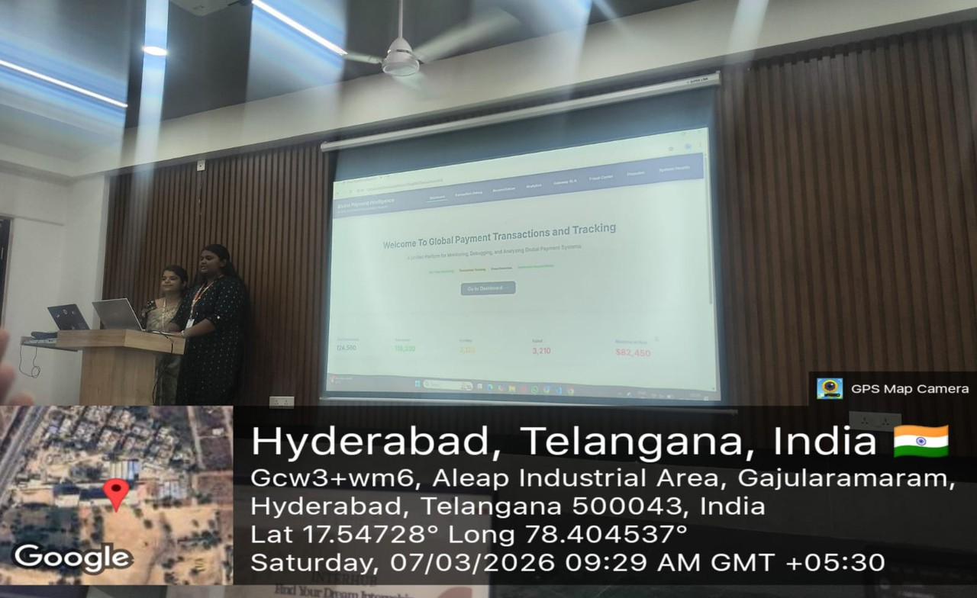

Slide 14


