Slide 1
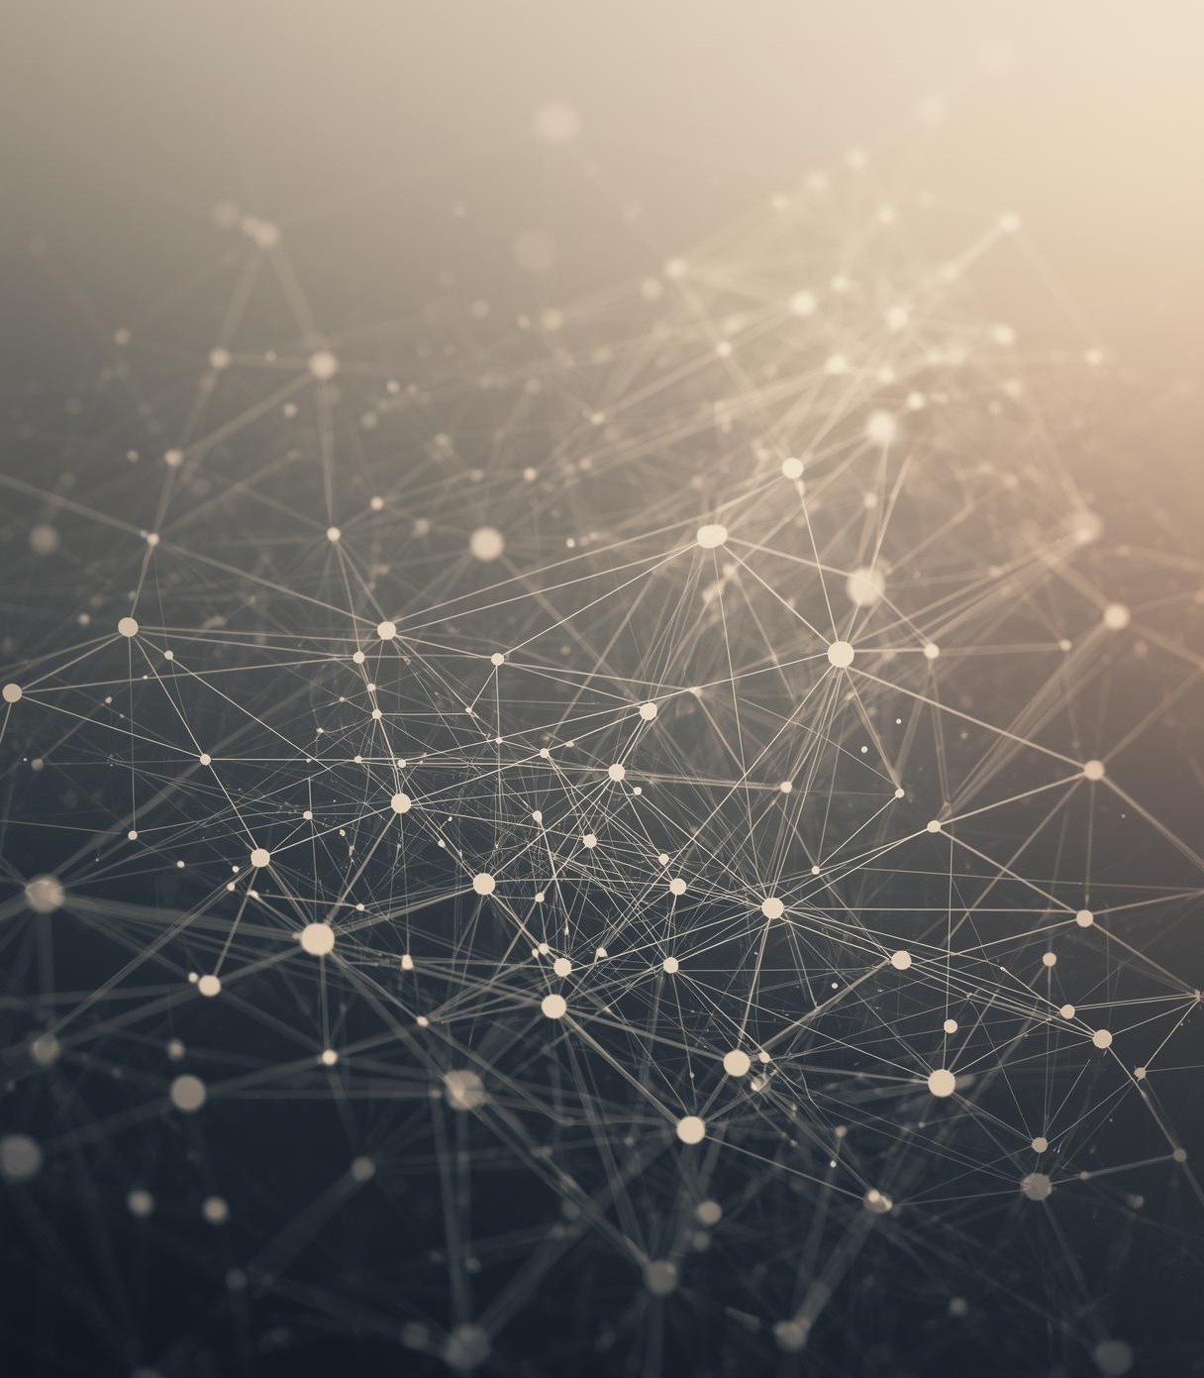

Global Payments
TRANSACTIONS and
Tracking Dashboard
PRESENTED BY
Sharon Rhoda 2520040001

Slide 2
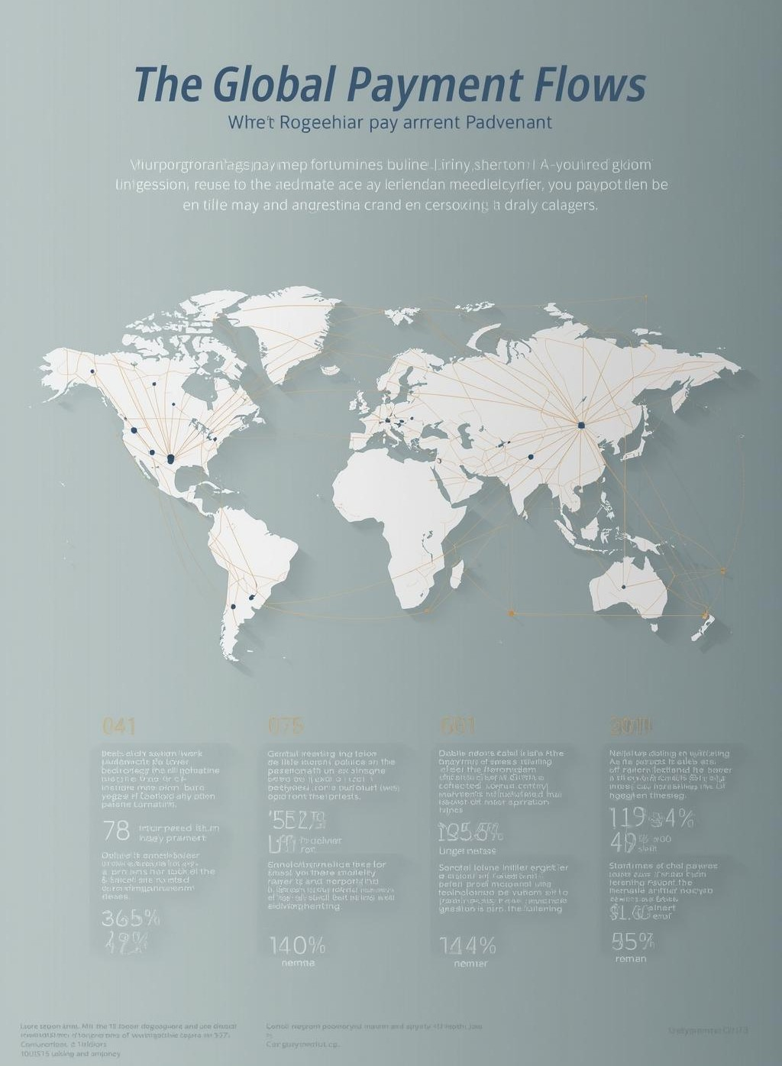
Abstract
Global payment transactions involve multiple stages, intermediaries, and geographical regions, making them complex and difficult to track. Users often face challenges in understanding the current status of a payment, identifying delays, or knowing the reasons behind transaction failures. The lack of transparency in international payment flows can lead to confusion, reduced trust, and inefficiencies for individuals and organizations involved in cross-border transactions

Slide 3
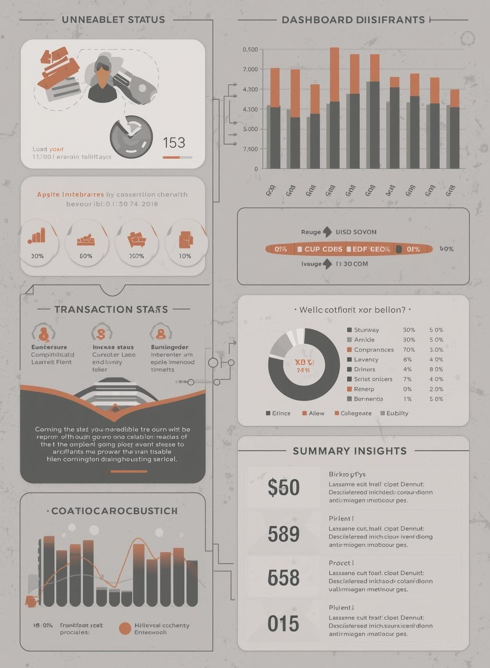
Proposed Solution
The Global Payment Transactions and Tracking Dashboard aims to address this issue by providing a centralized and user-friendly interface that visually represents the journey of global payments. The dashboard displays transaction status, movement across countries, currency flow, and summary insights in a clear and structured manner. By transforming complex payment data into easy to-understand visual information, the project enhances transparency, improves user awareness, and serves as an effective tool for learning, monitoring, and demonstrating global payment processes.

Slide 4
Project Modules and Course Outcomes
CO-1 : Internet Fundamentals, HTML & Introductory CSS Styling

Slide 5
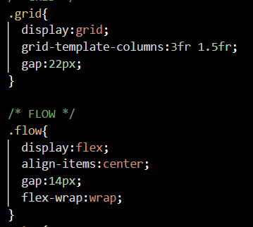

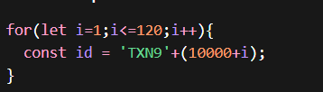
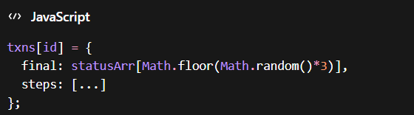
CO-2: HTML Forms, Semantic Tags & CSS Layouts
CO-3: JavaScript Programming Essentials

Slide 6


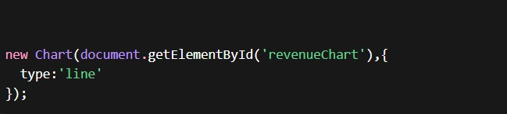
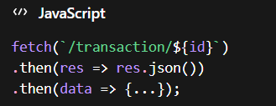
CO-5: Advanced Web Development & Deployment
CO-4: JavaScript Interactivity, DOM & Events

Slide 7
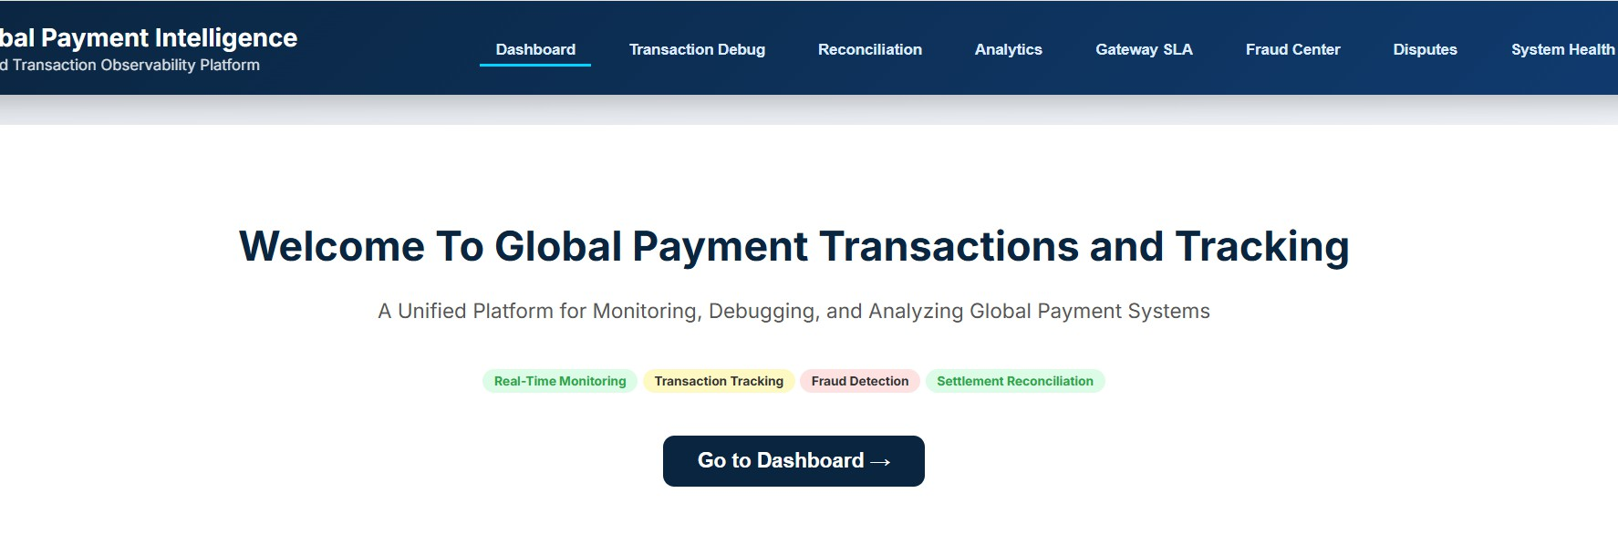
Project ScreenShots

Slide 8
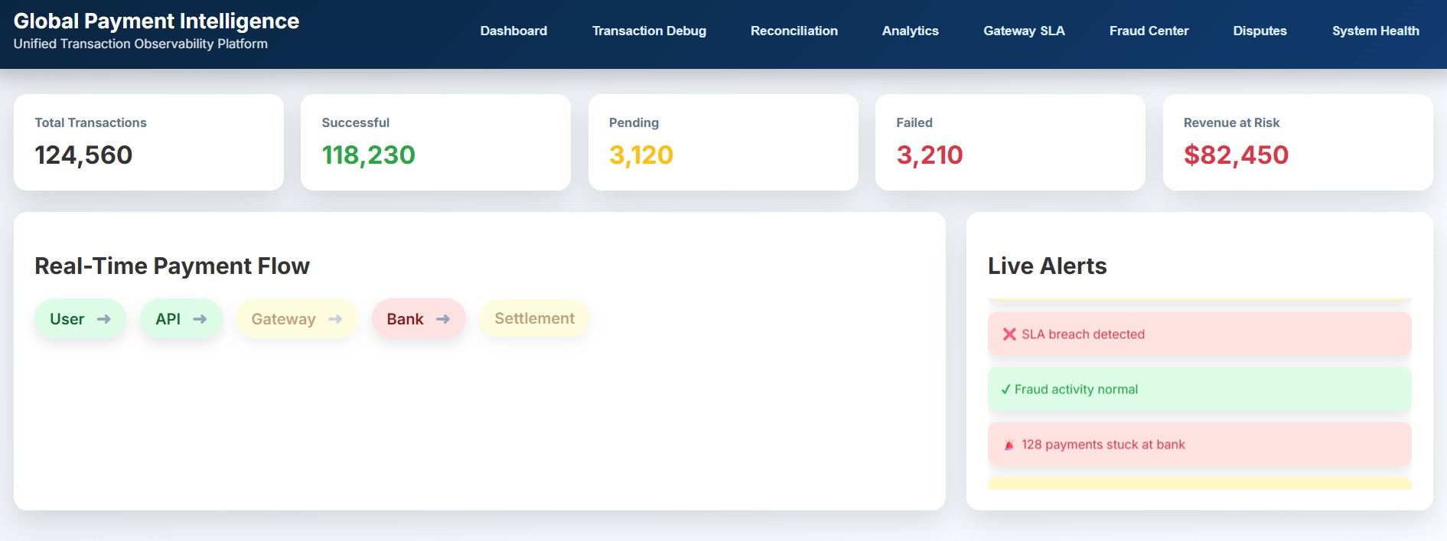

Slide 9
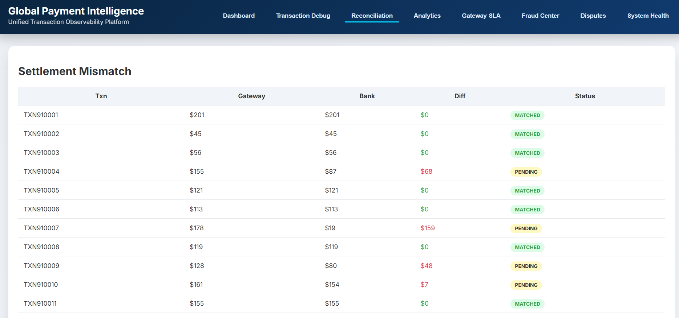

Slide 10
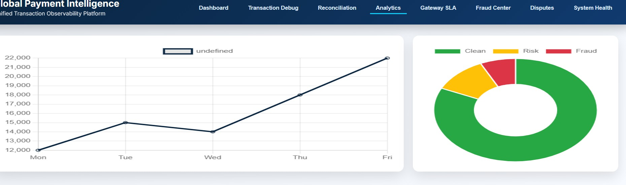
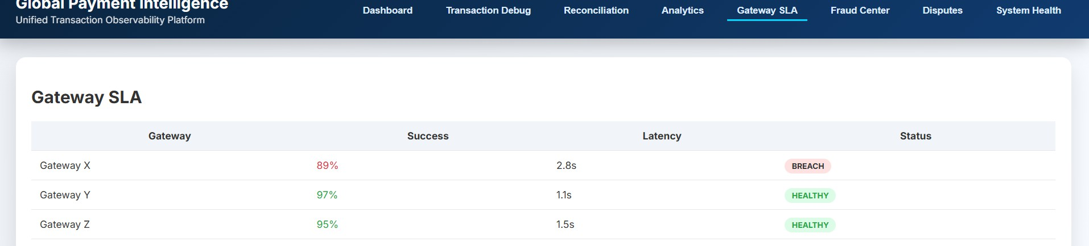

Slide 11
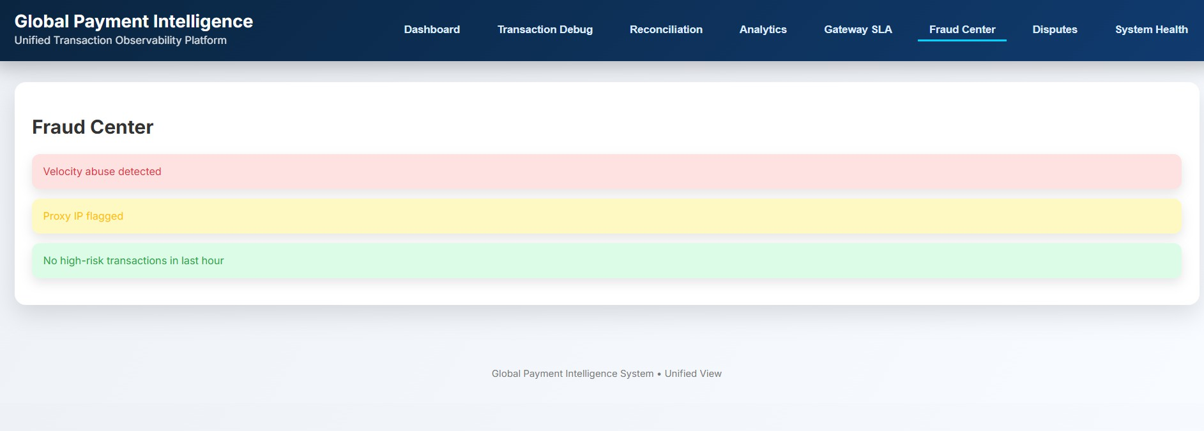

Slide 12
Conclusion:
The Global Payment Transactions and Tracking Dashboard improves visibility and transparency in complex cross-border payment systems.
It enables real-time monitoring of transactions, helping users quickly identify delays, failures, and system issues.
Features such as analytics, fraud alerts, reconciliation, and system health monitoring enhance operational efficiency.
Overall, the platform simplifies global payment tracking and helps build greater reliability and trust in digital financial transactions.

Slide 13
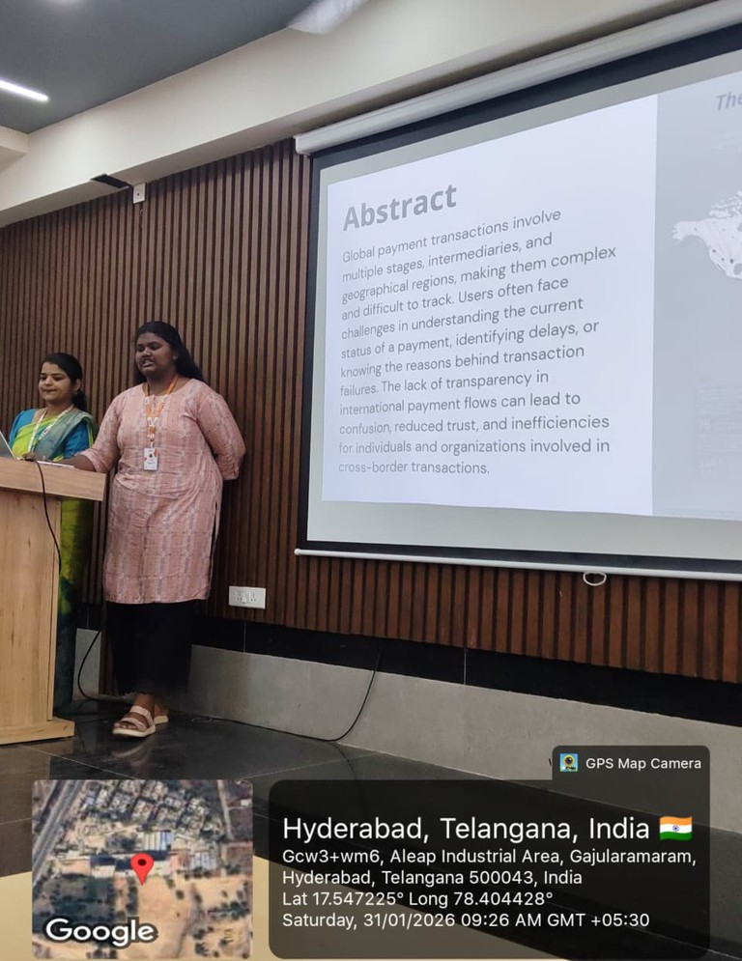
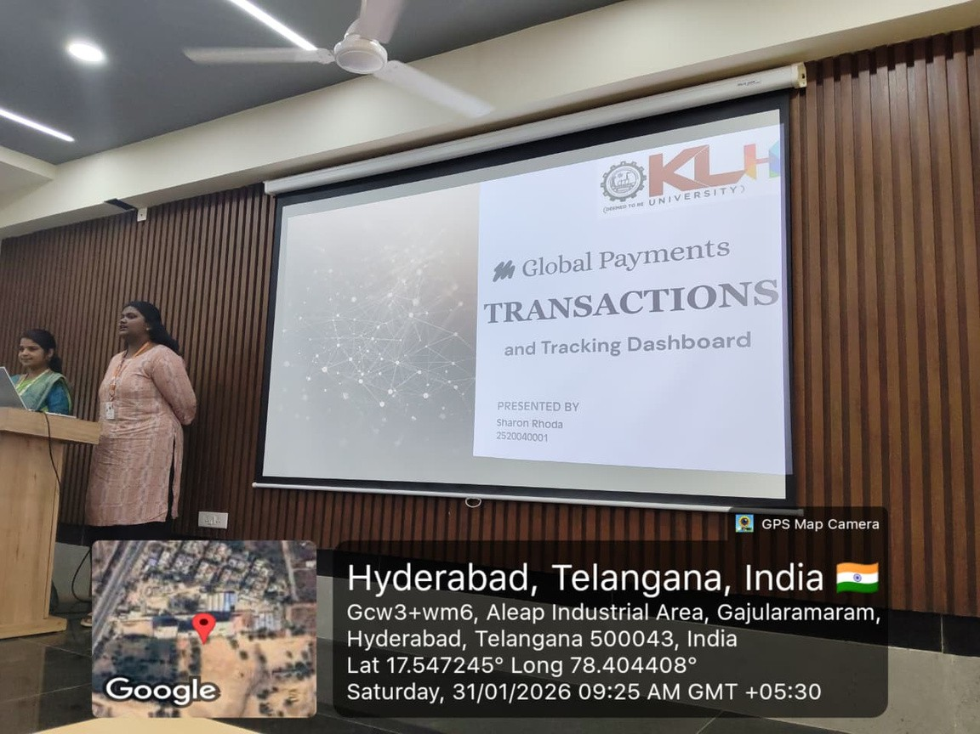
Geo-tagged pictures

Slide 14
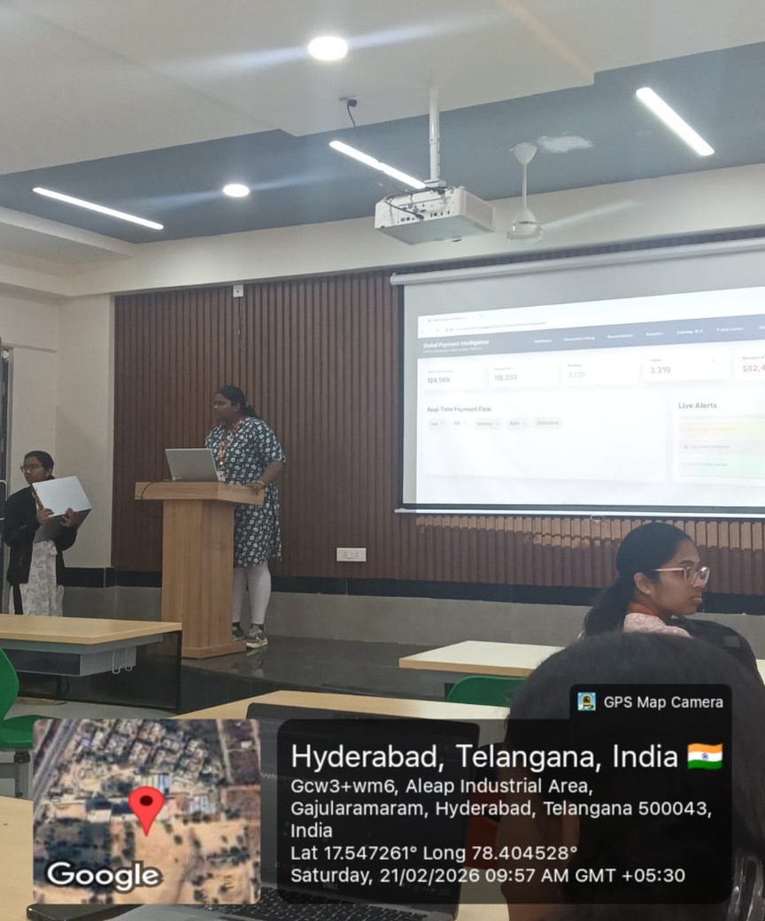
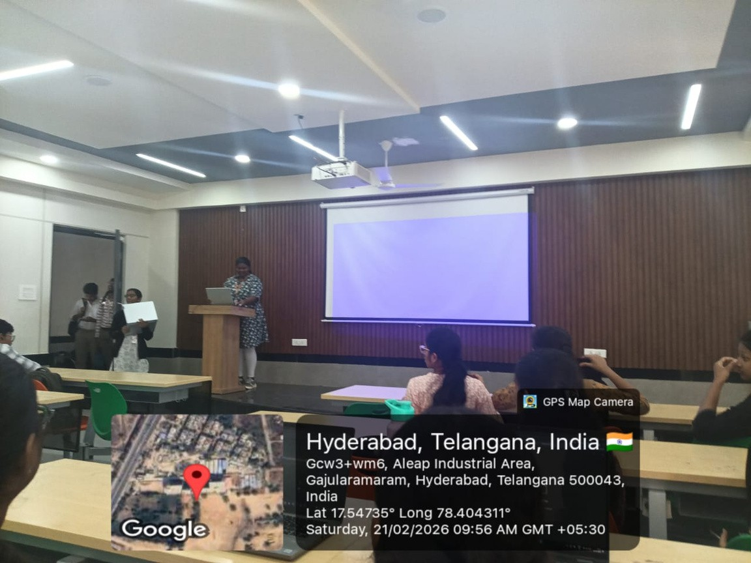

Slide 15
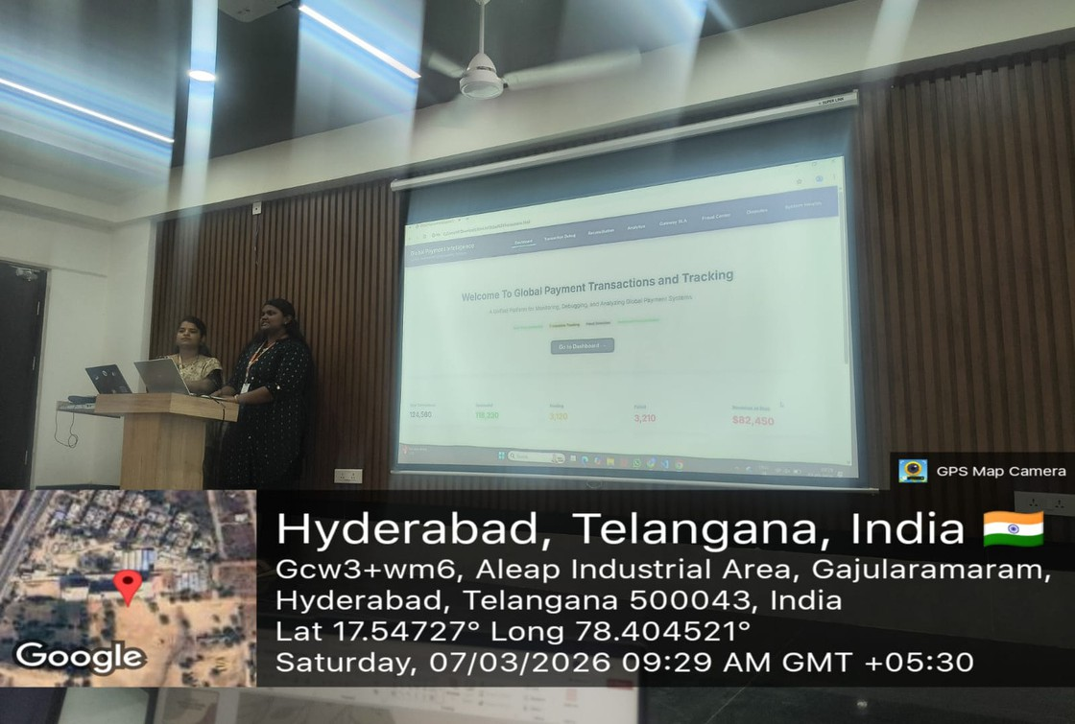
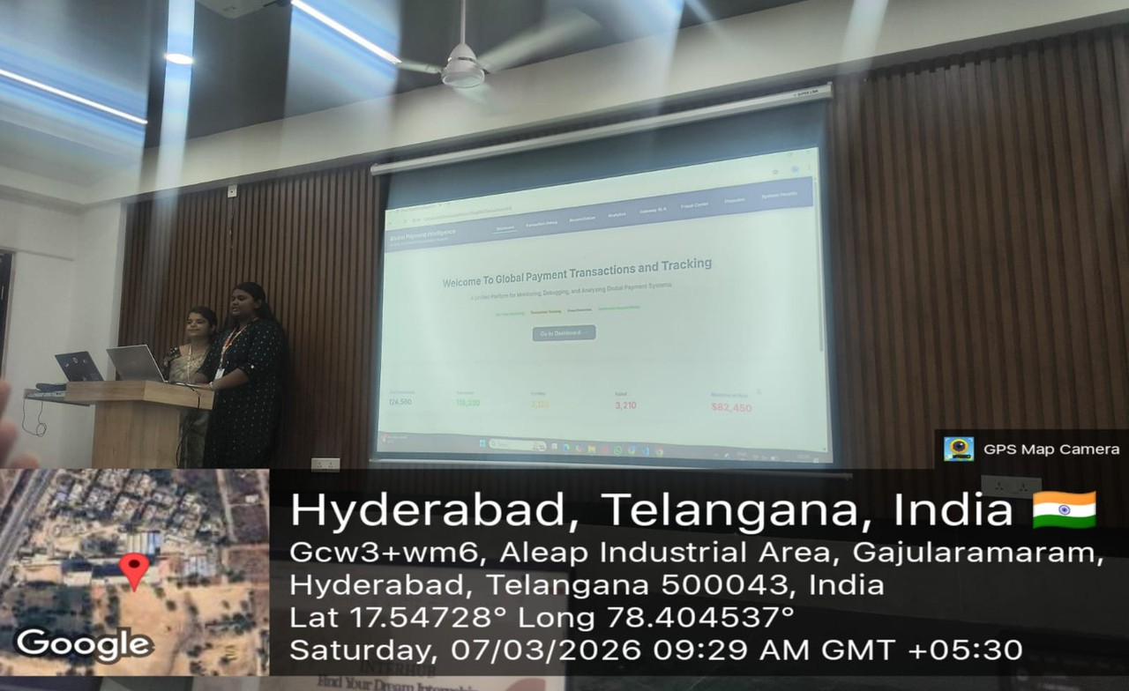

Slide 16


