Slide 1
Cloud Computing

Slide 2
Course plan
Learning session 1
Intro
What is cloud

Slide 3
“What Is Cloud” lecture plan
What do we need to run a product?
Pitfalls of on-premise solutions
What is Cloud?
Cloud types
Cloud pros/cons
Cloud Resource Management

Slide 4
What do we need to run a Product?

Slide 5
What do we need to run a Product?
Product examples:
Global:
Dropbox
Slack
Amazon (shop)
Small:
Local shop homepage
https://declarations.com.ua/en/

Slide 6
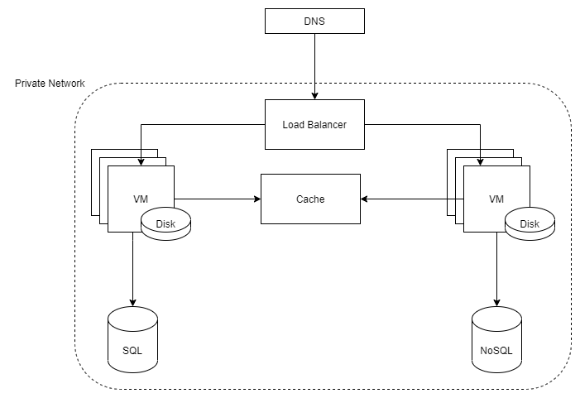
What do we need to run a Product?

Slide 7
What do we need to run a Product?
On-premise - hardware, which is managed by a product team

Slide 8
Pitfalls of on-premise solutions
Notes:
In-groups discussions: what are pitfalls of on-premise systems

Slide 9
Pitfalls of on-premise solutions
Manage VM
Add a new machine or replace existing
Patch OS or software
Handle load spikes

Slide 10
Pitfalls of on-premise solutions
Manage network and security
Connectivity and network bandwidth
Networking software and rules

Slide 11
Pitfalls of on-premise solutions
Manage physical infrastructure
Electricity, cooling
Natural disasters and wars (or just leaking roof)
Legal issues

Slide 12
Pitfalls of on-premise solutions
Add a new service type
Provision infrastructure resources
Learn how to manage new service type

Slide 13
What is Cloud?

Slide 14
What is Cloud?
Cloud is someone else's computers
Cloud is a pool of resources, provisioned and managed by a third-party

Slide 15
What is Cloud?
Clouds could be grouped:
- By owner
Public (shared among several customers)
Private (one customer)
Hybrid
By type
Infrastructure as a Service (IaaS)
Platform as a Service (PaaS)
Software as a Service (SaaS)

Slide 16
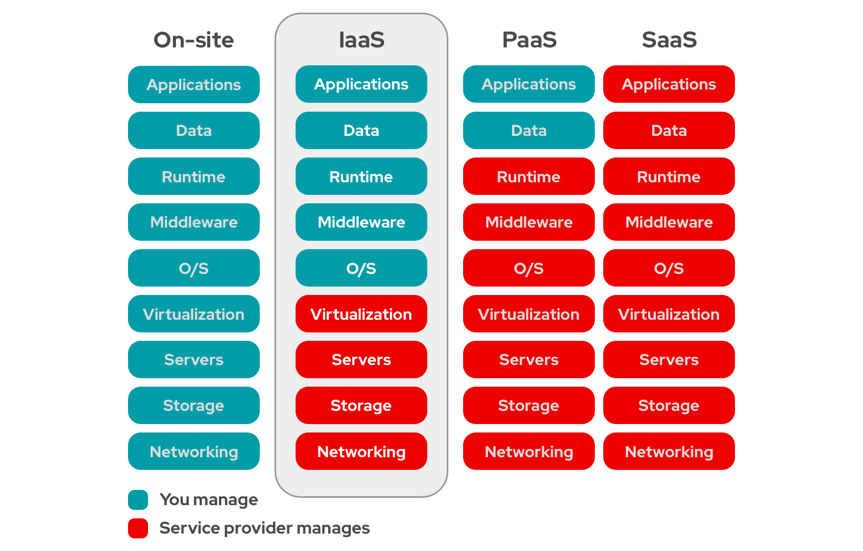
What is Cloud?
https://www.redhat.com/en/topics/cloud-computing/what-is-iaas

Slide 17
What is Cloud?
Infrastructure as a Service (IaaS)
Managed VMs, Storage, Network
hosted in Data Centers,
that are organized into Availability Zones,
and provisioned in multiple Regions
p.s.
Also, interface to provision, scale, deprovision resources
Notes:
IaaS are online services that provide high-level APIs used to dereference various low-level details of underlying network infrastructure like physical computing resources, location, data partitioning, scaling, security, backup etc.

Slide 18
What is Cloud?
IaaS examples
AWS
Azure
GCE
Digital Ocean
…

Slide 19
What is Cloud?
AWS regions vs Azure regions vs GCP regions
Azure underwater Data Center

Slide 20
What is Cloud?
When to use IaaS
You want to control your software, but you do not want to bother with hardware
Scalability and agility: ready-to-go resources at any point in time
(often) cost efficiency: pay-as-you-go, pre-paid, spot-instances

Slide 21
What is Cloud?
There are small and big IaaS providers
small providers often are cheaper
but big providers get more customers:
they offer more services
more engineers know how to use them
often, they are easier to use

Slide 22
What is Cloud?
Platform as a Service (PaaS)
A set of integrated services to cover a complete business use-case
Opinionated user-flow
Notes:
PaaS is a platform allowing customers to develop, run, and manage applications without the complexity of building and maintaining the infrastructure typically associated with developing and launching an app

Slide 23
What is Cloud?
PaaS examples:
Heroku
Google App Engine
IoT Platforms: Everyware Cloud, Azure IoT Hub, …
AWS Lambda

Slide 24
What is Cloud?
When to use PaaS
- “One ring to rule them all” – do not bother about separate apps, but use a complete platform

Slide 25
What is Cloud?
Software as a Service (SaaS)
Ready to use application
No need (or less need) to manage software
Interface to create, update, delete your instance
Support
Notes:
SaaS is a software licensing and delivery model in which software is licensed on a subscription basis and is centrally hosted.

Slide 26
What is Cloud?
SaaS examples
DBaaS: Elastic Cloud, Confluent cloud, Redis cloud
Slack
Gitlab
Office365
Notes:
SaaS is a software licensing and delivery model in which software is licensed on a subscription basis and is centrally hosted.

Slide 27
What is Cloud?
When to use SaaS
You just want to use the application, but do not want to manage it
Unique offering, which is not available otherwise
Lack of human-resources to manage it in-house

Slide 28
What is Cloud?
Demo

Slide 29
Cloud pros and cons
Notes:
Warm-up discussion: cloud pros/cons

Slide 30
Cloud pros
Faster pace
Less operators to manage services
Agility
(often) cost efficiency
Scalability
Shifting risk

Slide 31
Cloud pros and cons
What if I can …
“apply cloud” to VM management?
Press a button (or run a script) to:
restart VM and apply security patch or update
scale in/out

Slide 32
Cloud pros
What if I can …
“apply cloud” to physical infrastructure?
Press a button (or run a script) to:
add new Region;
implement geo-redundant data replication;
change network throughput.

Slide 33
Cloud pros
What if I can …
“apply cloud” to adding new service type?
Press a button (or run a script) to provision managed:
database;
workload-orchestrator;
event-streaming service;
data-analytics.

Slide 34
Cloud pros
What if I can …
“apply cloud” to resource demand spikes?
viral article/discussion/trend;
seasonal load (holidays, black-friday)
daily/nightly traffic

Slide 35
Cloud cons
(sometimes) more expensive
(sometimes) slower
Less control
Vendor locks
Could fail not because of you ¯\_(ツ)_/¯

Slide 36
Cloud pros and cons
Neither side is a silver bullet. It very depends on:
TEAM
Technical design
Configuration
Available resources

Slide 37
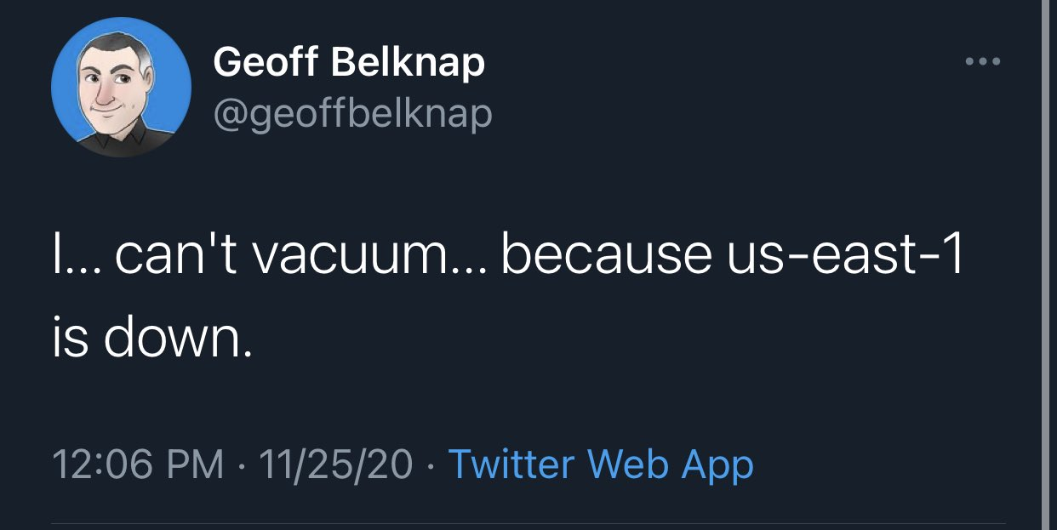
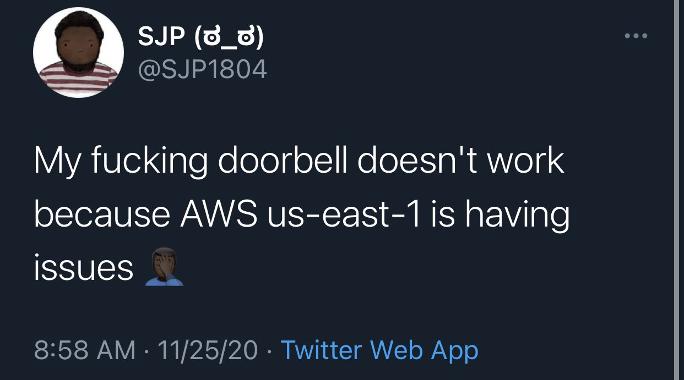
Cloud pros and cons
Cloud also can fail

Slide 38
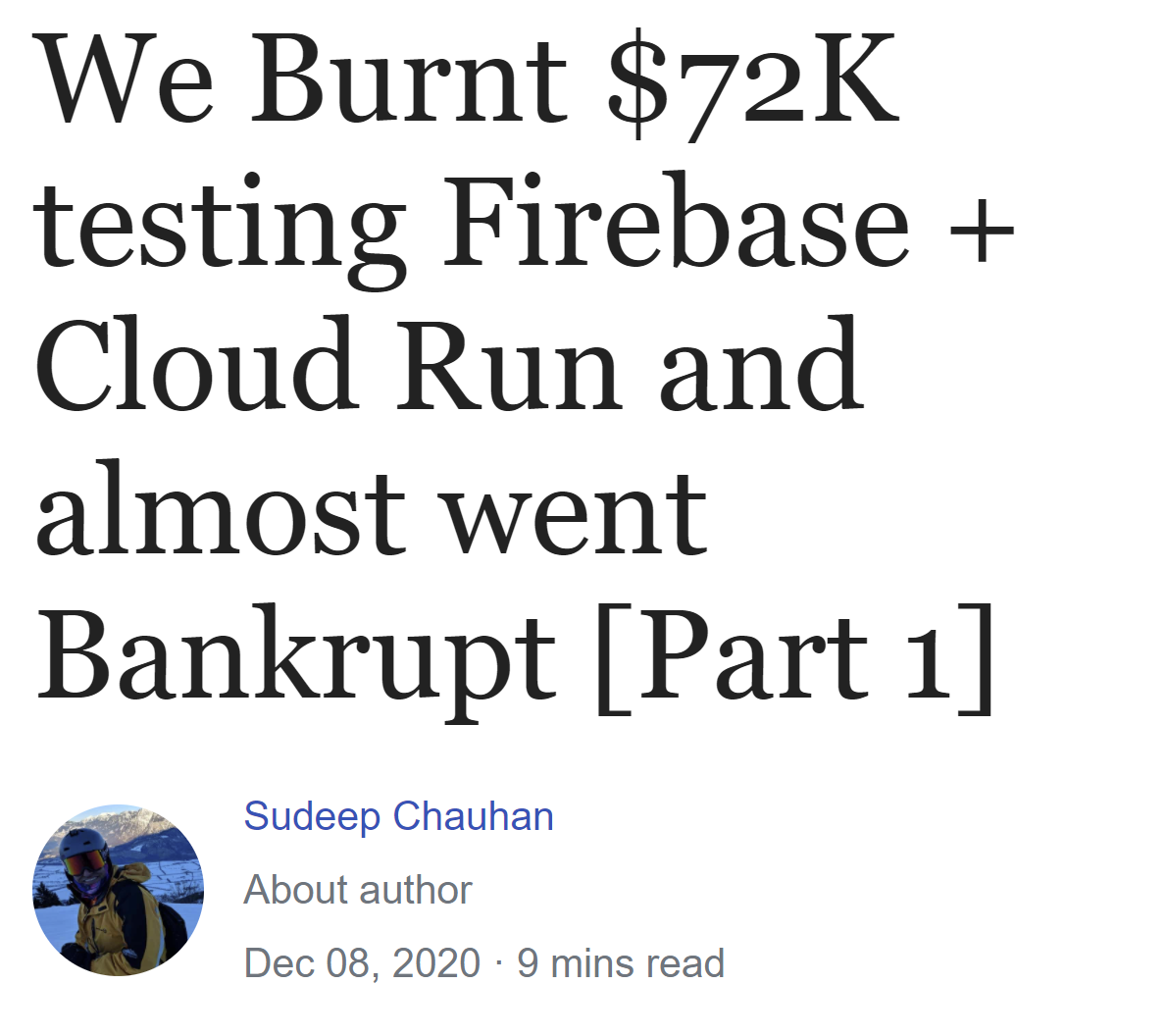
Cloud pros and cons
... and be expensive

Slide 39
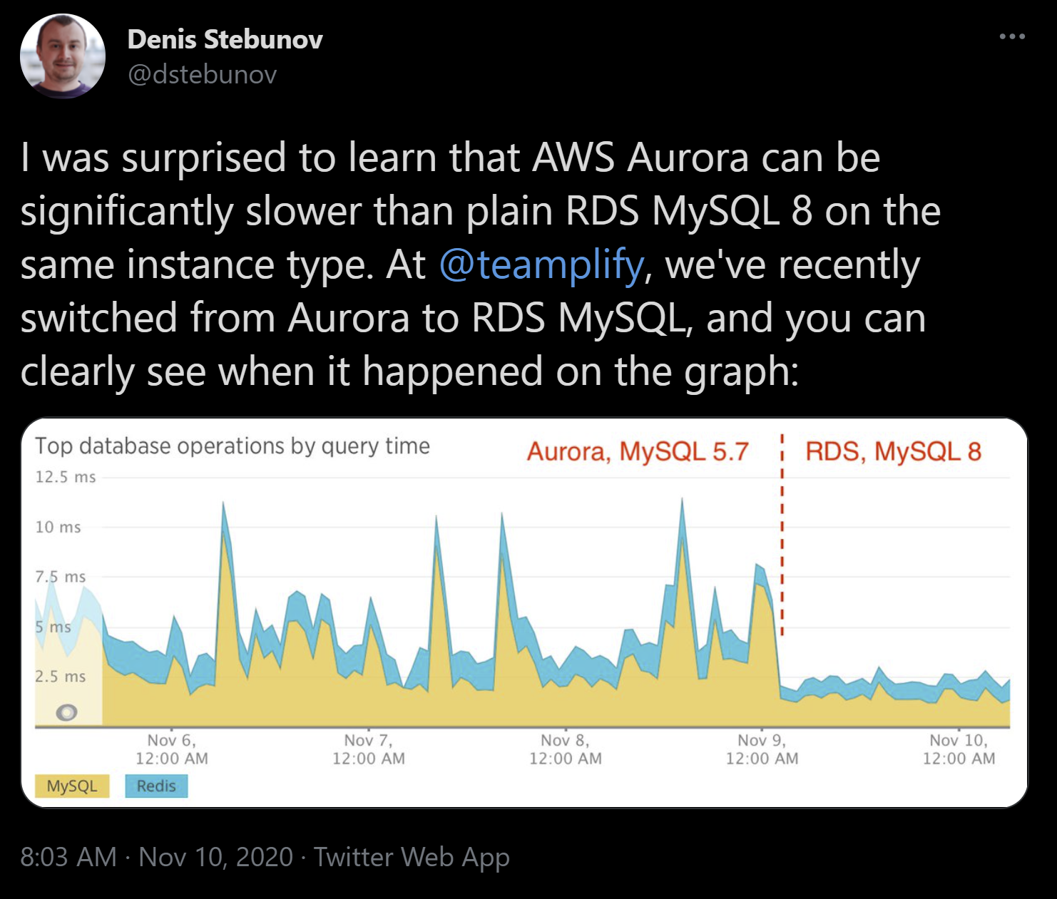
Cloud pros and cons
… and be slower

Slide 40
Cloud pros and cons
Sometimes, you just do not need 99.999 availability
How do you get to be 10 times cheaper than the cloud? … when you drop that requirements from 99.999% to just 99%, you are making an incredible amount of savings on the infrastructure…

Slide 41
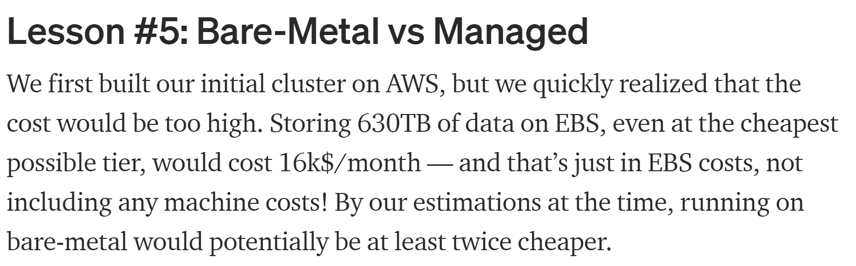
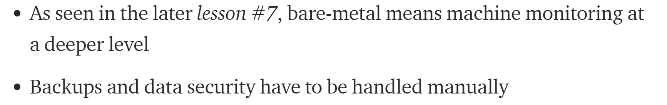

Cloud pros and cons
Or your team has enough expertise to run on-premise with lower bill

Slide 42
Cloud pros and cons
… or you just have hardware already

Slide 43
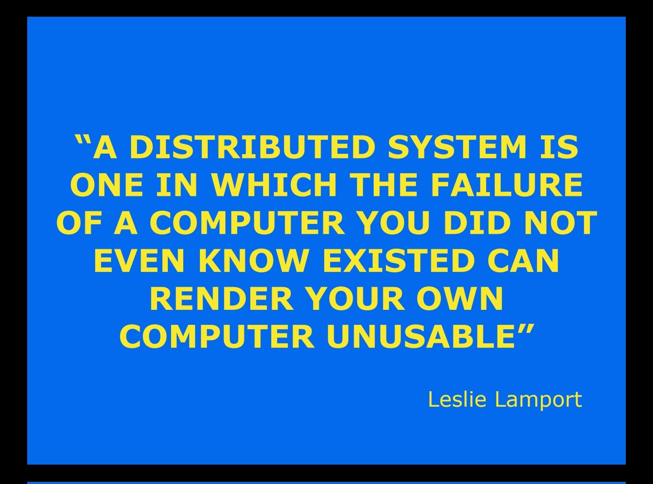
p.s.

Slide 44
Resource Management

Slide 45
Resource Management
Interface to create, update, delete components
Service to (de)provision components as a result of API request
Monitoring

Slide 46
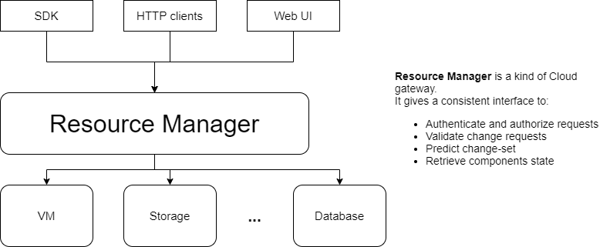
Resource Management

Slide 47
Resource Management
Tools:
Native
aws: Cloud Formation or Cloud Development Kit
azure: ARM templates (is being replaced by bicep)
gcp: Cloud Deployment Manager
cli
Terraform
Pulumi

Slide 48
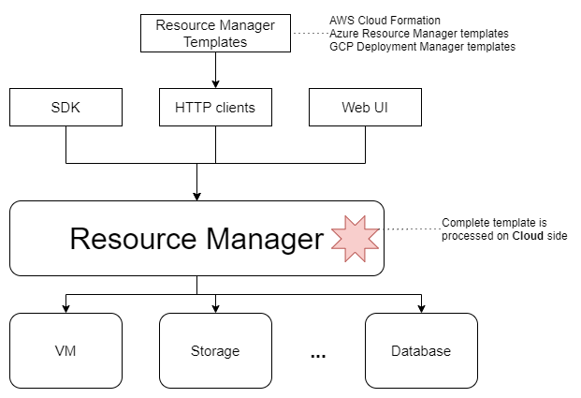
Resource Management

Slide 49
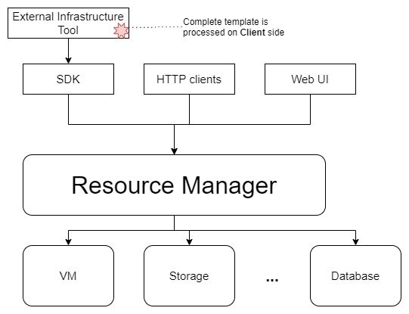
Resource Management

Slide 50
Resource Management
Why do I need a tool?
Repeatable and predictable deployments;
Provision a bunch of services in one go
Store everything as a code (infrastructure, configuration, policies):
Validation
Collaboration: Pull-Requests and reviews, sharing
Versioning

Slide 51
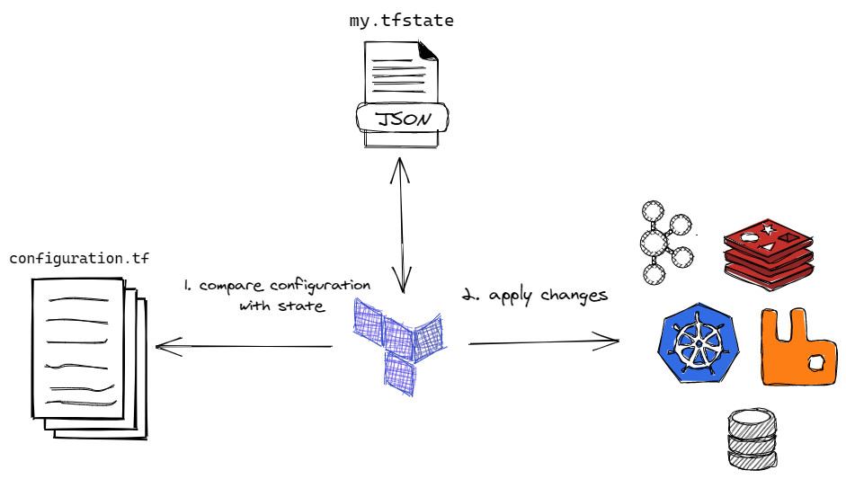
Resource Management: terraform

Slide 52
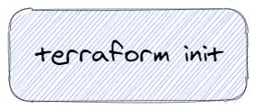
Resource Management: terraform

Slide 53
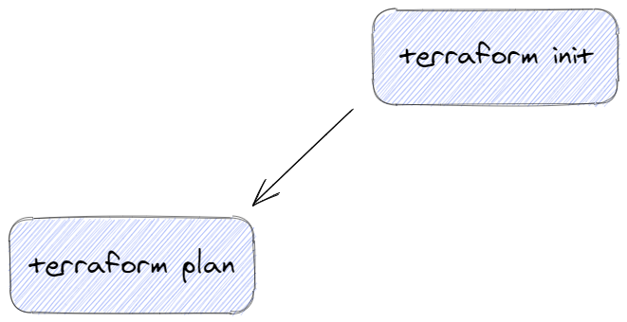
Resource Management: terraform

Slide 54
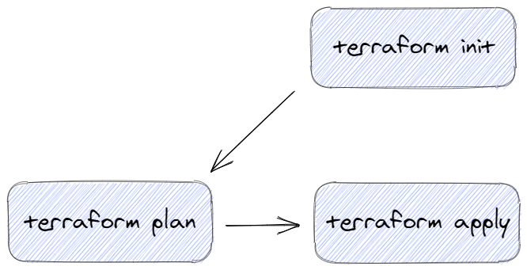
Resource Management: terraform

Slide 55
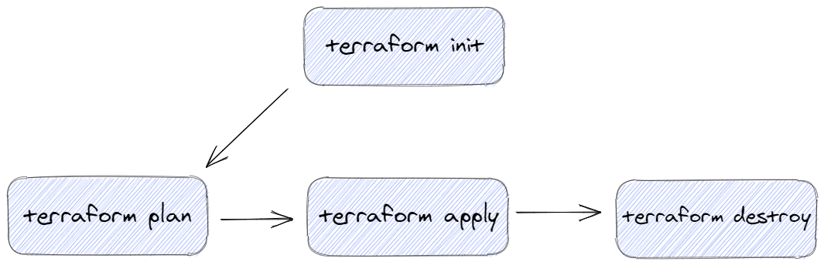
Resource Management: terraform

Slide 56
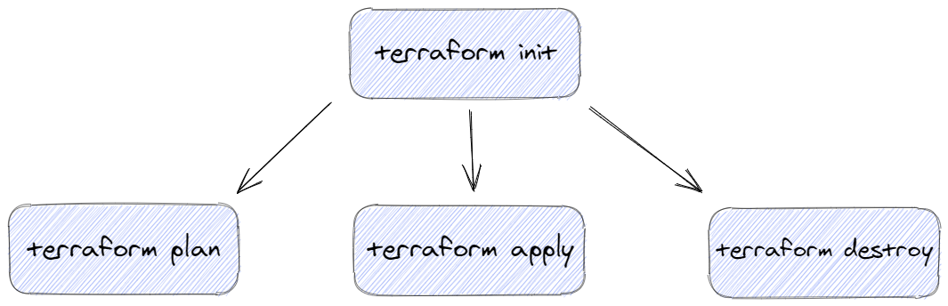
Resource Management: terraform

Slide 57
Resource Management
Demo
Notes:
Terraform demo

Slide 58
Summary
Notes:
Terraform demo

Slide 59
Summary
On-premise: you manage it
Cloud: someone else manages it for you
IaaS/SaaS/PaaS
Both have pros and cons
Resource management

Slide 60
Cloud-starter tips
Start within free-tier
Set billing alerts at 50-90% of your limits
Delete services after tests
Clouds evolve all the time. Even for services you think you know, always check docs

Slide 61
Cloud-starter tips
Compare GCP to others: single table
Compare Azure to others: GCP and AWS
+ IBM, Oracle, Alibaba at Compare Clouds

Slide 62
Additional materials
Recommended:
(whitepaper) Cloud Computing definitions by National Institute of Standards and Technology
(tutorial) https://learn.hashicorp.com/terraform

Slide 63
Additional materials
Optional:
(article) Small vs Big IaaS clouds
(article) We Burnt $72K testing Firebase: eng and ru
Internet Archive Book Scanning uses bare-metal podcast and video
(youtube) Google Data Center
(youtube) What is Cloud by Scott Hanselman

