Slide 1
Cloud Computing

Slide 2
whoami
Igor Kliushnikov
Senior Software Engineer @ Deep Network GmbH
Github
Twitter
Medium
Linkedin

Slide 3
About course
Learning Objectives:
Understand “Cloud” landscape and building blocks
A toolset to work with clouds
Mappings between cloud providers
Try it out

Slide 4
About course
Lectures:
Presentation
Video
Demo
Homework:
Exercises
Capstone Project

Slide 5
Course plan
Learning session 1
Intro
What is cloud

Slide 6
Course plan
Learning session 1
What is cloud
What do we need to run a product?
Pitfalls of on-premise solutions
What is Cloud?
Cloud types
Cloud pros/cons
Cloud Resource Management

Slide 7
Course plan
Learning session 2
Core Services

Slide 8
Course plan
Learning session 2
Core Services
Compute
Storage
Network
Databases
Events and Messaging

Slide 9
Course plan
Learning session 3
Security
Identity and Access Management (IAM)

Slide 10
Course plan
Learning session 3
Security
What is security in cloud
Security areas
Breach scenarios
Security levels: infrastructure, application, data, user
Case studies: Public Key Infrastructure (PKI), Secrets management, Configuration management, Disaster recovery, Custom policies, Expect security services to fail

Slide 11
Course plan
Learning session 3
Identity and Access Management (IAM)
Identity
Authentication
Authorization
OAuth, OpenID, SAML Protocols
Clouds: AWS/GCP IAM, AAD
Role-based Access Control (RBAC)

Slide 12
Course plan
Learning session 4
Monitoring and Observability
Pricing

Slide 13
Course plan
Learning session 4
Monitoring and Observability
What is Monitoring and Observability
Logs
Metrics
Traces
Audit
Alerts
Available solutions

Slide 14
Course plan
Learning session 4
Pricing
Snowflake pricing
Pay-as-you-go vs pre-paid vs spot instances
Consumption pricing
Storage pricing
Traffic pricing
Cloud bill calculator
Cost analysis

Slide 15
Course plan
Learning session 5
Capstone projects presentations
Course Summary

Slide 16
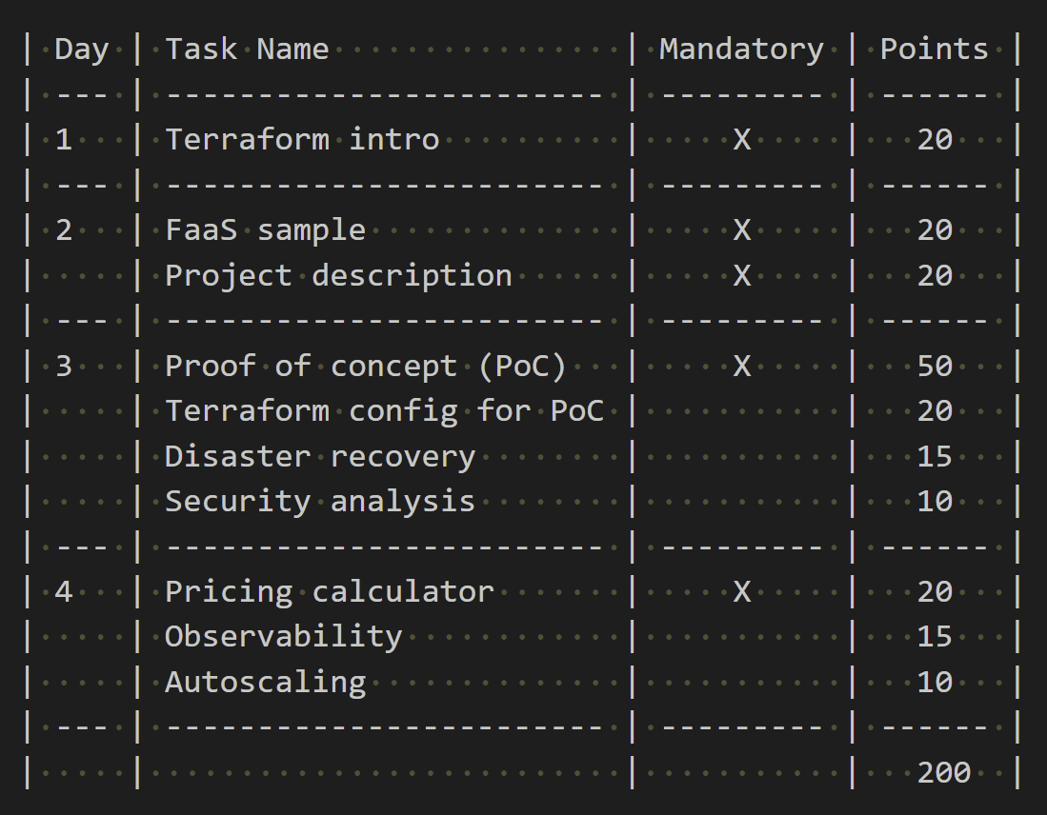
Grading
200 points overall
120 points to pass
Homework summary

Slide 17
Course materials
All materials are available as git-repo
Github/cloud_computing_course

Slide 18
Prerequisites
Used tools:
git and GitHub
Bash
terraform
[optional] VSCode
[optional] docker
[optional] diagrams.net (former draw.io)

