Slide 1
Cloud Computing

Slide 2
Course plan
Learning session 3 (July 15-17)
Security
Identity and Access Management (IAM)

Slide 3
Security
It is easy to spin up a new perfectly configured resource in cloud
And it is the same easy to spin up a vulnerable

Slide 4
Security lesson plan
What is security in cloud
Security areas
Breach scenarios
Security levels: infrastructure, application, data, user
Case studies:
Public Key Infrastructure (PKI)
Secrets management
Configuration management
Disaster recovery
Custom policies
Expect security services to fail

Slide 5
Security
But Cloud Provider takes care about security…

Slide 6
Security
Cloud Provider is responsible for protecting your data from other tenants.
Protecting your data from intruders/hackers - is your task.

Slide 7
Security
Security is about dealing with Risk:
Accidental deletion
Theft
Privacy
Compliance

Slide 8
Security
Cloud Provider often gives tools to deal with security risks

Slide 9
Security
Security comes with a price:
increased cost and complexity
decreased maintainability

Slide 10
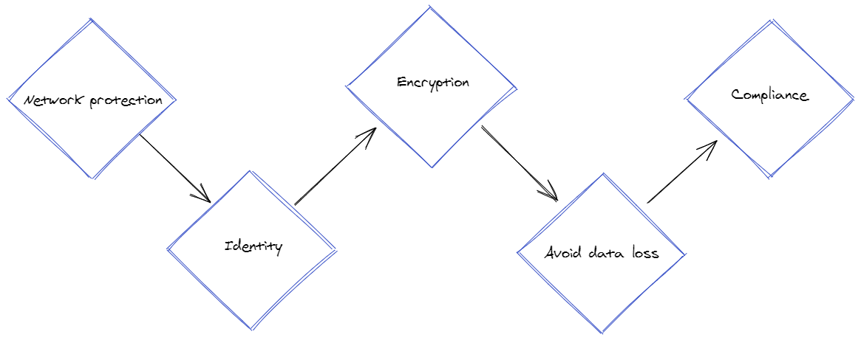
Security Areas

Slide 11
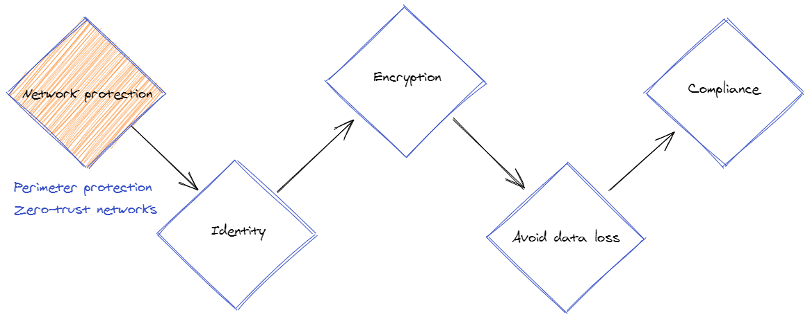
Security Areas
Notes:
Firewall, security-groups, DDoS protection, JIT-VM/Jumphost/Bastion-host/Shielded-VMs

Slide 12
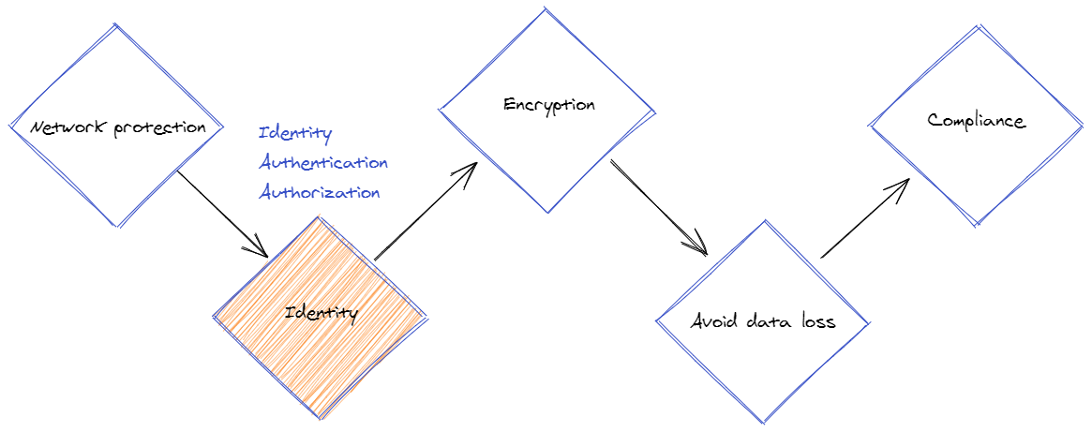
Security Areas
Notes:
Azure AD, AWS AIM, RBAC

Slide 13
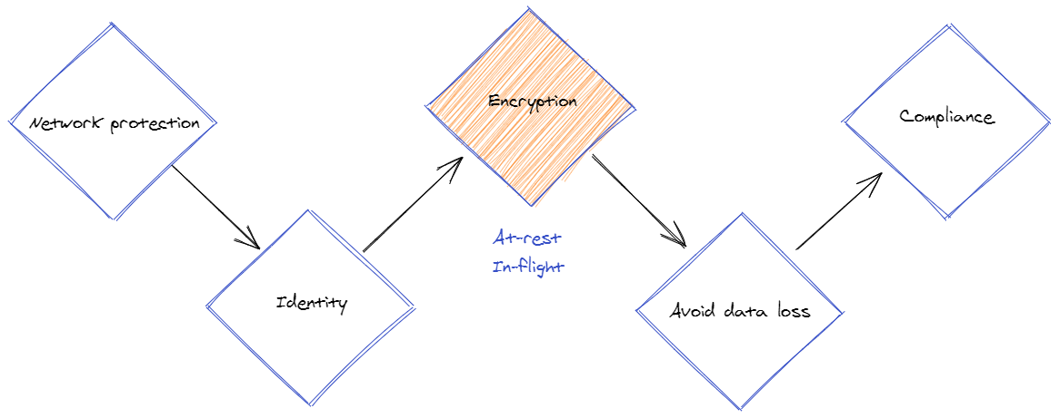
Security Areas

Slide 14
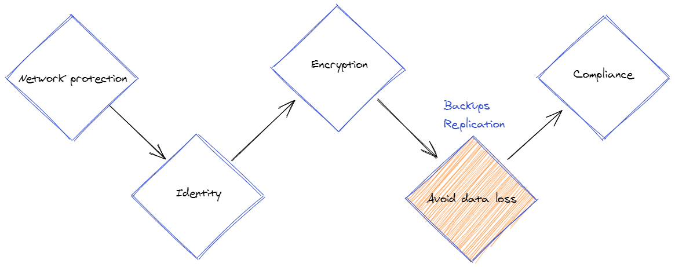
Security Areas

Slide 15
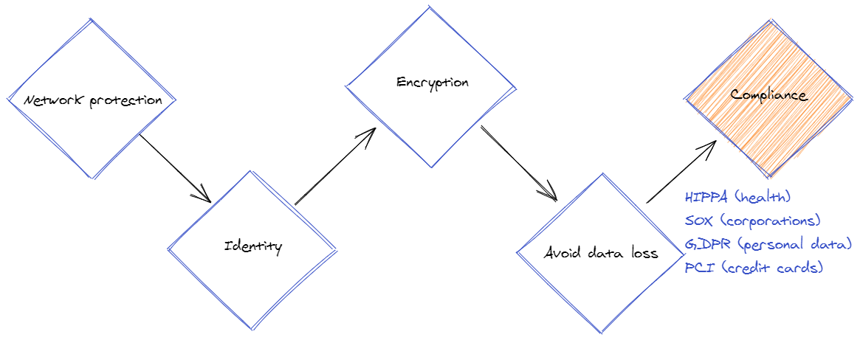
Security Areas
Notes:
Know in which domain you are, and which standard applies to it (mostly about data)

Slide 16
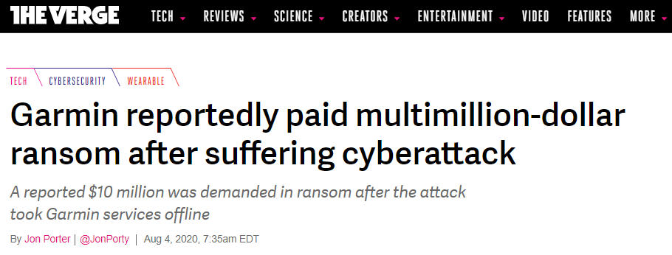
Breach scenarios
Ransomware: threat to publish data or blocks access
https://www.theverge.com/2020/8/4/21353842/garmin-ransomware-attack-wearables-wastedlocker-evil-corp
Notes:
There is even negotiation companies to get discounts

Slide 17
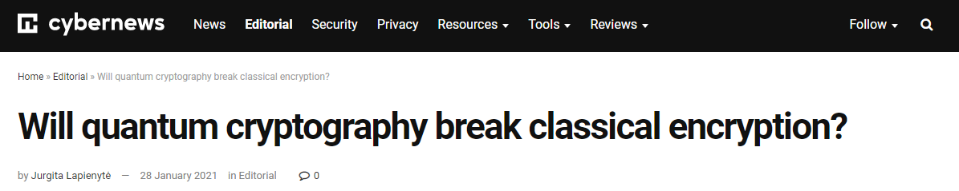
Breach scenarios
Encryption break: from weak encryption algorithms and weak key generators to server-side vulnerabilities and leaked keys

Slide 18
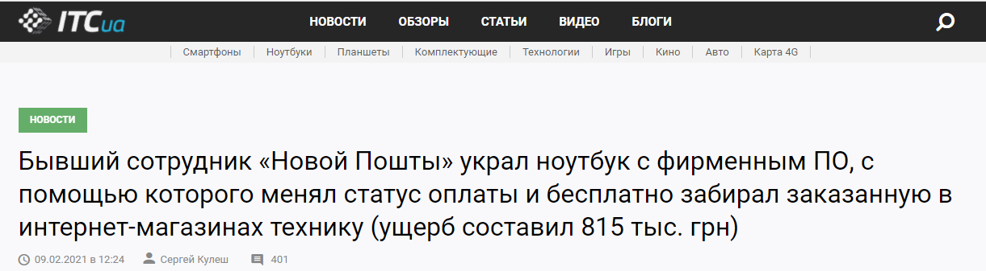
Breach scenarios
Physical theft: taking of another person's property or services
https://itc.ua/news/byvshij-sotrudnik-novoj-poshty-menyal...

Slide 19
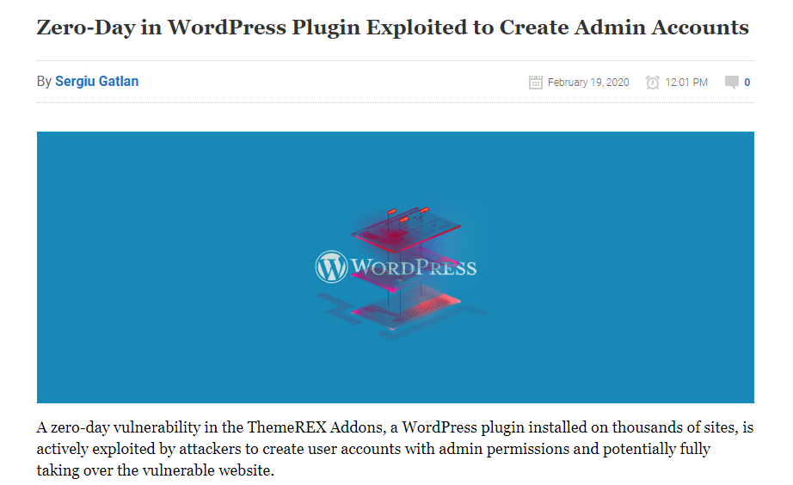
Breach scenarios
CVE exploitation
https://www.bleepingcomputer.com/news/security/zero-day-in-wordpress-plugin-exploited-to-create-admin-accounts/

Slide 20
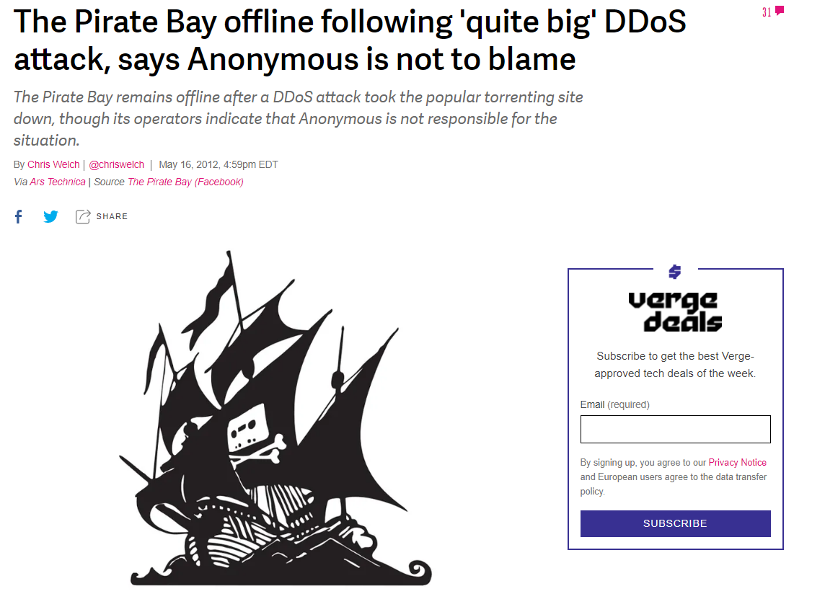
Breach scenarios
DDOS
https://www.theverge.com/2012/5/16/3024861/pirate-bay-offline-ddos-attack

Slide 21
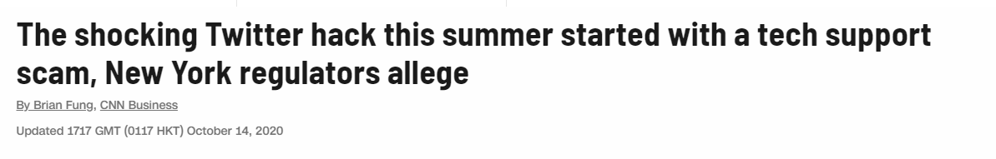
Breach scenarios
Employee data theft / Social engineering
https://edition.cnn.com/2020/10/14/tech/twitter-hack-tech-support-scam/index.html
Notes:
+ https://www.dfs.ny.gov/Twitter_Report
A lot comes from phishing…

Slide 22
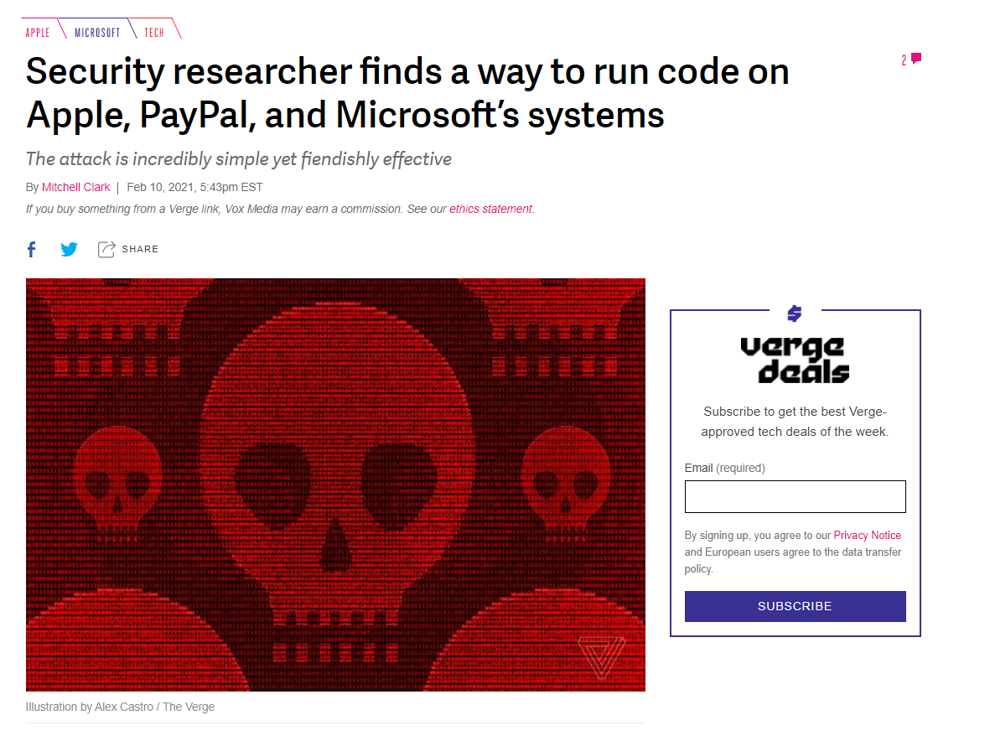
Breach scenarios
Supply Chain Attacks
https://www.theverge.com/2021/2/10/22276857/security-researcher-repository-exploit-apple-microsoft-vulnerability

Slide 23
Security levels
Infrastructure-level security
Server-side data encryption
Network traffic protection (in-flight)
OS, firewalls
IAM/RBAC
Notes:
Encrypt data in database/storage
Add (s) to your protocol: HTTPs, sFTP, …
Strict firewall rules, OS hardening
Least-privilege identity

Slide 24
Security levels
HTTPs is needed even inside private network: How to contact google sre dropping a shell in cloud sql

Slide 25
Security levels
Application-level security:
Client-side data encryption
Logs: infrastructure, access-logs, OS, db, api/app
Monitoring: metrics, notifications/alerts
Configuration Management: patches, versioning, trusted artifacts
Notes:
Encrypt data before sending it over the wire
Gather logs from all your resources and store them at least a few weeks
Expose metrics, watch them, alert
Patch your dependencies, use explicit (ideally immutable) versions, sign artifacts and verify your supply chain

Slide 26
Security levels
Data-level security
DB level
Table/object level
Record level
Field level (e.g. one column has more sensitive data than others)

Slide 27
Security levels
User-interface level
Least privilege
Do not use root
Strong passwords
MFA and PIM
Secrets rotation
Custom policies
Audit logging
Notes:
Human and machine identities should be allowed only a minimal needed set of permissions
Enforce strong passwords and multiple factors auth
Rotate secrets frequently and set expiration dates
Codify your system policies and enforce resources to follow them
Log who does what and when

Slide 28
Case studies
Public Key Infrastructure (PKI)
Notes:
Demo:
- Show certificate trusted by public authority

Slide 29
Case studies
Secrets management
Put expiration date on a secret
Scoped tokens instead of full-access keys
Keep secrets out of code
Notes:
Demo:
Storage account key vs SAS-token
Azure Key Vault

Slide 30
Case studies
Configuration management
Patch dependencies
Scan for CVE
Sign commits, container-images, assemblies
Immutable versions, build once
Notes:
Demo:
Scan with trivy
Build container, use it by sha

Slide 31
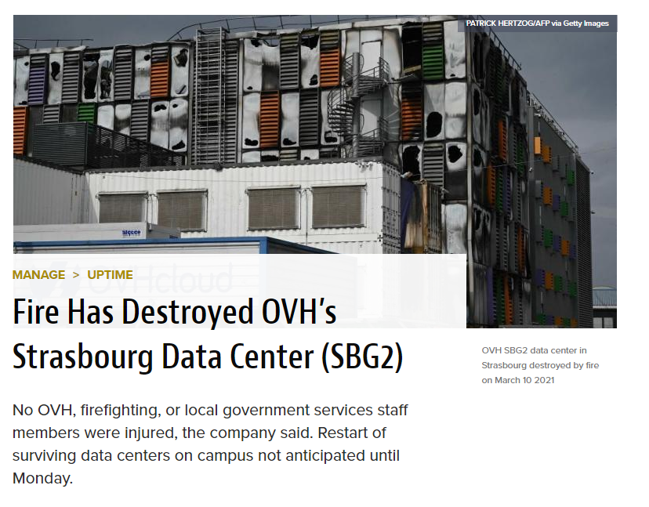
Case studies
Disaster recovery
Backup data
Document restore process
https://www.datacenterknowledge.com/uptime/fire-has-destroyed-ovh-s-strasbourg-data-center-sbg2

Slide 32
Case studies
Custom policies
Codify rules
Verify adherence to rules at deployment time
Monitor/enforce rules at runtime

Slide 33
Case studies
Expect security services to fail
For example, Parler content was dumped because twilio integration faded away

Slide 34
Course plan
Learning session 3 (July 15-17)
Security
Identity and Access Management (IAM)

Slide 35
Identity Access Management Lesson Plan
Common Terminology:
Identities, Groups
Permissions, Roles
Scopes
Role-based Access Control (RBAC)
Access Control Lists (ACL)
Authentication
Authorization
OAuth, OpenID, SAML Protocols
Clouds: AWS/GCP IAM, AAD

Slide 36
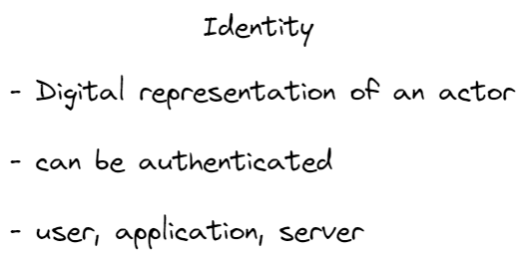

Slide 37
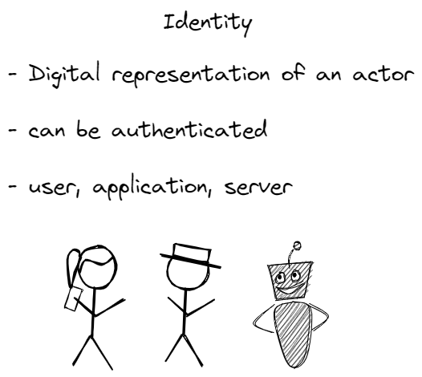

Slide 38
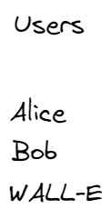

Slide 39
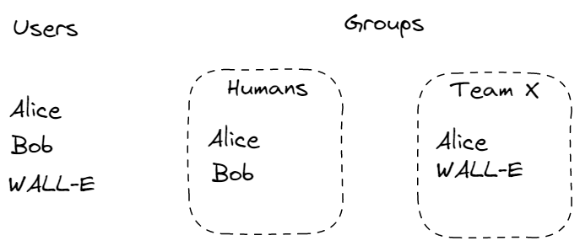

Slide 40
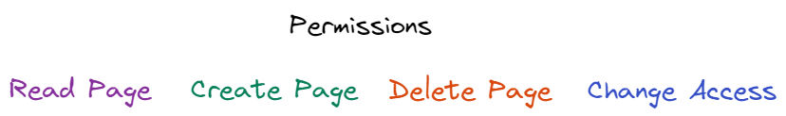

Slide 41
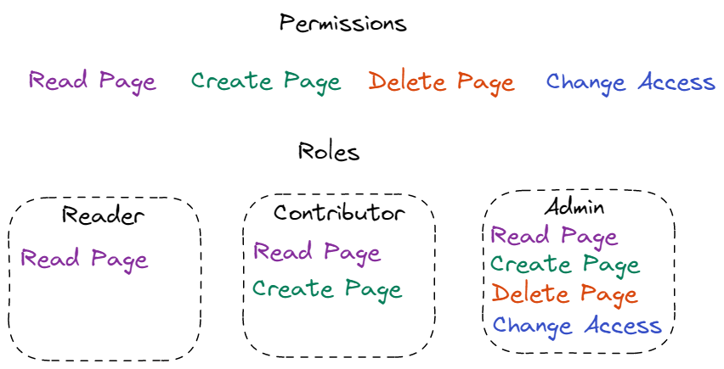

Slide 42
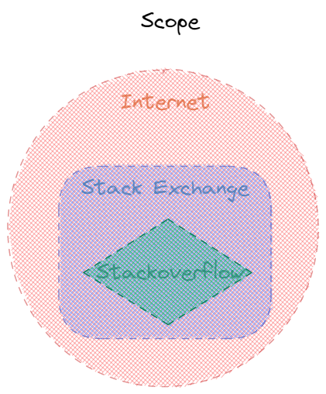

Slide 43
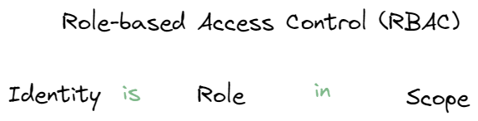

Slide 44
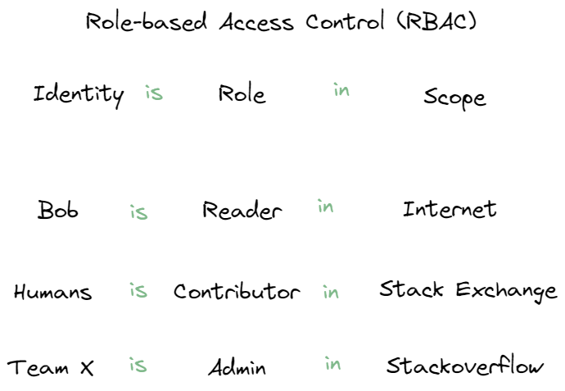

Slide 45
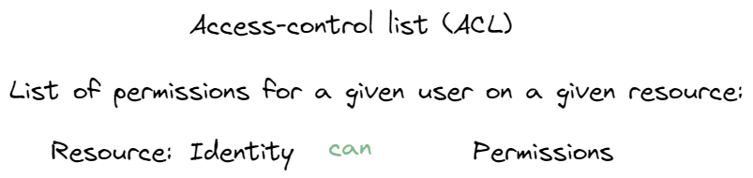

Slide 46
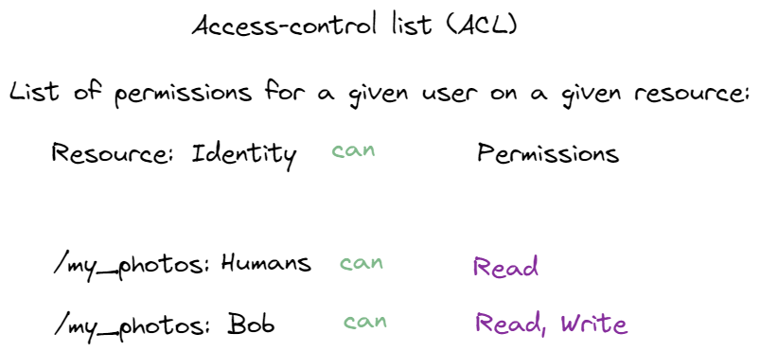

Slide 47
Identity Access Management
Azure RBAC explained

Slide 48
Identity Access Management
Authentication – verification that an identity is who/what they claims

Slide 49
Identity Access Management
Authentication could be based on
Password
Certificate
Token
Biometrics (fingerprint, face identification, etc)

Slide 50
Identity Access Management
Authorization – verify that exact identity is permitted to perform an operation

Slide 51
Identity Access Management
SAML
Open standard to exchange authentication and authorization data.
First published in 2001, SAML 2.0 in 2005
XML-based markup + protocol

Slide 52
Identity Access Management
OAuth
Open standard to delegate access [authorization]
First published in 2006
OAuth 2.0 published in 2012

Slide 53
Identity Access Management
OpenID – authentication protocol first published in 2006.
OpenID Connect (OIDC) – the third version of OpenID protocol, published in 2014

Slide 54
Identity Access Management
An Illustrated Guide to OAuth and OpenID Connect

Slide 55
Identity Access Management
AWS IAM
GCP IAM
Azure Active Directory (AAD)

Slide 56
Identity Access Management
All of them covers authentication and authorization:
Verifies Identities
Manage Identities access to Resources via Permissions
Aggregate Identities into Groups
Aggregate Permissions into Roles

Slide 57
Identity Access Management
Plus
Identity management
Auditing – logs to answer the question “who did what, where and when?”
Policies – enforce rules

Slide 58
Identity Access Management
Demo
Kubernetes RBAC
Azure Active Directory

Slide 59
Identity Access Management
Demo
Review “security” aspect of FaaS template

Slide 60
Additional resources
(article) What is DDOS attack
(article) How to break encryption
(article) Public Key Infrastructure
(article) What is good Runbook

