Slide 1


Bank of Baroda Hackathon - 2022
Technology Partner
Your Team Name : Random Scala
Your team bio :
Date :20/09/2022

Slide 2
Problem Statement?
Why did you decide to solve this Problem statement?
Our team has decided to solve this problem statement because:
Our Video intelligence software can trigger real-time alerts when pre-configured features or behaviours are detected within a specified time frame.
Receiving count-based alert when more than a certain number of objects and also for concurrent number of objects .
Bank or Police can determine whether immediate response is required and act accordingly based on the timely alert notifications.
Face Recognition for Accelerating Response and Investigation:
In compliance with local regulations, a bank can configure rules based on face recognition, triggering alerts when face matches are detected.
Even in cases where proactive action is not possible, face recognition and video content analysis can also help banks/police department quickly understand incidents and accelerate investigations.
Video footage can be filtered based on faces – leveraging face recognition to identify suspects in video evidence, to focus video search and isolate relevant objects.
Streamlining Customer Service at the Bank
As video content is aggregated over time, the metadata can be leveraged and visualized to track trends and drive informed decision-making based on actionable intelligence.
For instance, a bank might leverage heatmaps to understand where crowding occurs, and to determine the cause.
Certain building entrances and exits aren’t fully utilized, causing crowding in other areas. For all these possibilities, the bank can devise data-driven solutions based on video content analysis.

Slide 3
User Segment & Pain Points:
Which user /advertiser segment would be early adopter of your product & why?
Small scale stores and supermarkets can highly benefit from our project because our project setup is designed to be cost efficient and highly effective in terms of performance.
Jewelry shops can benefit from our project because if they install this product, they can feel much secure, their perception can change and making it public can automatically reduce chances of theft in their shops.
Preventing ATM Fraud with Video Analysis:
For many banks, video surveillance starts outside the branch building at the ATM.
Many banks affix cameras near their ATMs to monitor queues and investigate card skimming .

Slide 4
Pre-Requisite:
What are the alternatives/competitive products for the problem you are solving?
Many video analytics company have already given solution in many ways.
The competitive products are honey well,axis communication , pure tech intelligence,avigilon etc.
All these tech giants use facial recognition as a key process for identifiying persons.
These tech buddies have low accuracy rate in their video analytical solutions.
Pure tech intelligence uses AI based technology but their accracy is very low.
Facebook.

Slide 5

Azure tools or resources:
-> Microsoft Azure tools are to be used by us for our prototype, if our idea gets selected. -> We have planned to use azure back up service for data back up. -> We have planned to use Azure video indexer(enhances digital asset management and media libraries)by analysing audio and video content -> In this tool, we are going to use Face API(An AI service that analyzes faces in images) tool if our idea gets selected.
Once a footage or video is given as input it automatically gets backup in the azure backup service
Azure video indexer helps us to extract visual and speech meta data from the video given by user.
Face API provides AI algorithm which detects and recognise human faces with their expression to a great extent.

Slide 6
Any Supporting Functional Documents:
We are going to present a solution based on:
Recognising faces of people
Count the no of people getting detected.
Full body detection
FULL BODY DETECTION:
https://github.com/sharonsamraj47/Detect-people-count.git
COUNT OF PEOPLE DETECTED:
https://github.com/sharonsamraj47/People-tracking.git

Slide 7
Function architecture:
Camera
Data
Acquisition
Video
Encoding
Object
Detection
Object
Analysis
Object tracking
or
Image sensing
Video
Acquisition
Application Specific Information
Processing
Display

Slide 8
Key Differentiators & Adoption Plan
How is your solution better than alternatives and how do you plan to build adoption?
We assure that our solution can enhance video analytics experience to a great extent.
We can provide an accuracy of 70-75% for the solution we provide.
We will also try our maximum to train our module and provide much better accuracy while submitting protototype.
Our solution can assure you to give the false/positive feedback mechanism in a precise way.
when we submit our prototype, we can ass you that we can give a prototype based on the solution expected and it would be higly efficient than the products which are present in the market.

Slide 9
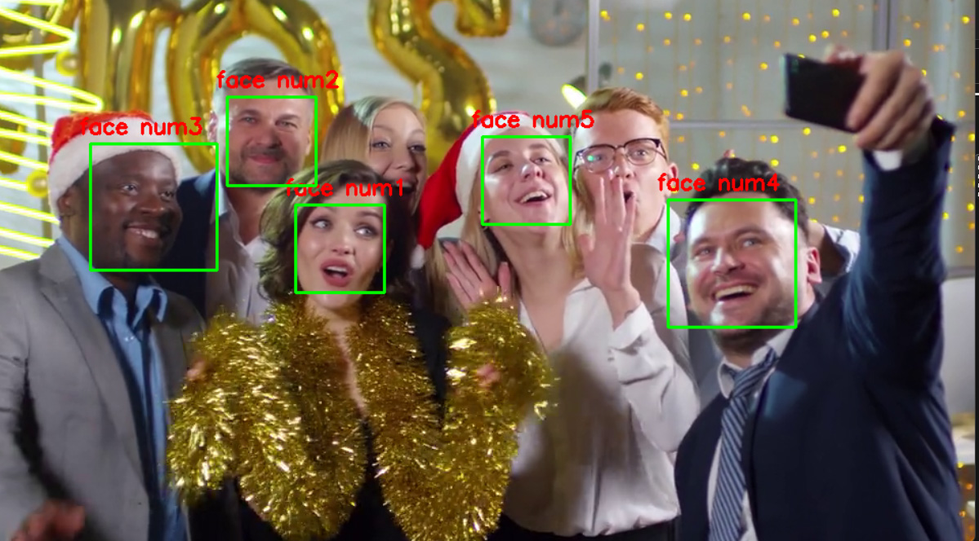
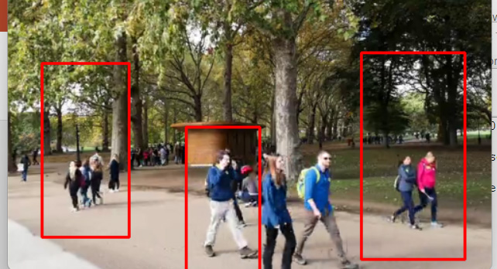
GitHub Repository Link & supporting diagrams, screenshots, if any
How far it can go?
https://github.com/sharonsamraj47/Detect-people-count.git
https://github.com/sharonsamraj47/People-tracking.git

Slide 10
Thank You
Team member names:
Sharon Samraj J
Vignesh V
Srihari Kishore K
Siva Ganesh N

