Slide 1


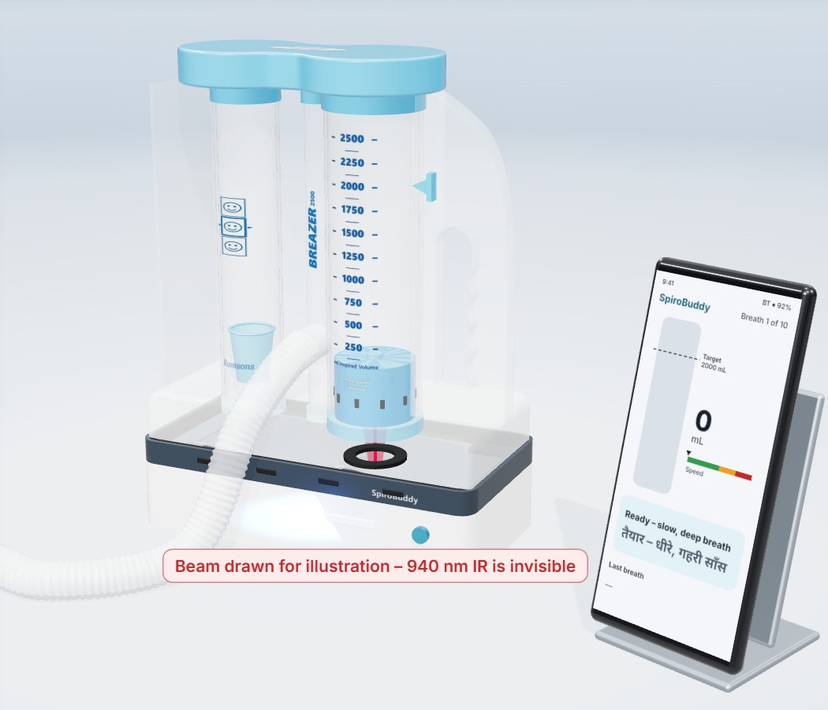
Clip-on unit under an ordinary breathing exerciser
Health & Well-being · SDG 3
SpiroBuddy
After surgery, the hospital stays connected to the patient at home.
Every breath, coached and counted.
- By [ADD: team name]
Live demo: spirobuddy.onrender.com
Simulated breaths and fictional patients. The device is not built yet.
3D design model - device not built yet
DOLPHIN TANK INDIA • SOCIAL IMPACT HACKATHON
Notes:
Good afternoon. I'm [name], from team SpiroBuddy, in the Health and Well-being track.
After surgery, patients go home with a plastic breathing exerciser and are told to use it every hour, and nobody, not the nurse, not the family, not even the clinical trials, has checked whether they actually do; SpiroBuddy makes that visible.

Slide 2
Problem Statement
After surgery, patients are told to do a breathing exercise every hour. Nobody sees whether they do it.
WHAT?
Patients go home with a breathing exerciser (an incentive spirometer) and a paper prescription. Nobody can see if the exercise is done, or done right.
1 in 10
adults having surgery gets a lung complication
LAS VEGAS study, 29 countries, 2017
WHO?
Older patients after heart, chest and abdominal surgery; their ward nurses; their families.
86%
of US nurses and therapists say patients don't use the exerciser properly. Top reason: forgetting
Eltorai et al., Respir Care 2018
WHY NOW?
87% of households have a mobile phone, and flat-rate insurance makes every extra bed-day the hospital's own cost.
6%
of 60 patients in a Chennai hospital did the exercise properly on day 1 after surgery
J Pharm Bioallied Sci 2024 (small study)
HOW BIG?
About 49 lakh major operations a year in India's public records, an undercount.
Why the evidence looks weak, and what we fix: reviews find the exerciser on its own makes little difference. But those trials rarely recorded whether patients actually did the exercise. SpiroBuddy makes that visible.
Sources: LAS VEGAS, Eur J Anaesthesiol 2017 · Eltorai et al., Respir Care 2018 (1,681 respondents) · J Pharm Bioallied Sci 2024 · LASI Wave 1 (87%) · Ayushman Bharat HBP 2022 rate list · Cochrane 2014 and a 2024 cardiac-surgery review (evidence)
DOLPHIN TANK INDIA • SOCIAL IMPACT HACKATHON
02
Notes:
After an operation, many patients go home with this: an incentive spirometer, a plastic breathing exerciser. Breathe in slowly, the disc rises, hold, ten times every waking hour. About one in ten adults having surgery gets a lung complication. Now the strange part. Reviews say the exerciser on its own makes little difference. But those trials almost never checked whether patients actually did it. Eighty-six percent of nurses say patients don't use it properly, mostly because they forget. In a Chennai study, only six percent did it right on day one. Nobody can see who is doing it. We make it visible.

Slide 3
Social Impact & SDG Alignment
Our impact metric is one number, counted automatically: sessions done ÷ sessions due.
Primary beneficiaries
Patients recovering at home after major surgery
Nurses, who see which patient needs a call
Families, updated only with the patient's consent
Expected outcome: more of the prescribed sessions really done, and done right. We will not claim fewer complications until a proper study shows it.
SDG 3 target | Our honest link
3.8 (main): access to quality care | Follow-up of a standard post-surgery exercise reaches the home, in the patient's language
3.4: non-communicable disease | Supports recovery after heart and cancer surgery. We do not claim to change death rates
3.c: health workforce | One nurse sees which of many patients needs a call
Impact metric | Today (demo) | Opening pilot (planned)
Sessions done ÷ sessions due | Counted automatically; simulated breaths, fictional patients | Measured on one ward: 30 patients, 3 months. No Indian baseline exists yet
Breaths done correctly (speed, depth, hold) | Labelled by a model trained on simulated breaths | Real breaths recorded and the model re-trained before the pilot
28% → 58%
of waking hours with exercise, when patients got an hourly reminder
US randomised trial, 145 bypass patients. JAMA Surgery 2019
SDG wording checked against the UN targets. The pilot size is a plan; we state no numeric outcome target.
DOLPHIN TANK INDIA • SOCIAL IMPACT HACKATHON
03
Notes:
Our impact metric is one number: the share of due hourly sessions completed. It is counted automatically. In a US trial, hourly reminders alone doubled the share of waking hours with exercise, from twenty-eight to fifty-eight percent. In our opening pilot, thirty patients on one ward, we will measure that same number on an Indian ward, and report it whatever it is. This serves SDG 3: target 3.8, access to quality care, and 3.4, recovery from heart and lung disease. We will not claim fewer complications until a proper study shows it.

Slide 4
Target Beneficiaries
The people who need it most cannot be asked to learn a complicated app.
Ravi, 58 - the patient
Going home after abdominal surgery. Speaks Hindi; uses the family phone.
Pain: forgets the exercise or breathes too fast, and nobody sees. Paper prescriptions get lost.
Needs: a voice in his language, one big button, no typing.
Only 41% of older Indians own a smartphone
HelpAge India 2025
Sister Anjali - the ward nurse
Teaches the exercise once, at discharge.
Pain: cannot check every patient every hour.
Needs: one list with the most urgent patient on top, and an alert only when someone needs a call.
2.6 nurses per 1,000 people; the WHO benchmark is 3
Rajya Sabha reply, July 2026
Amit - the son, far away
Works in another city and worries.
Pain: can only ask on the phone.
Needs: a short daily update, and only if his father agrees to share it.
2 in 3 older Indians live with their children; 3 in 4 older women can't read
LASI Wave 1
User journey: discharge with a plan → coached practice at home → nurse sees who needs a call → pharmacy counter → follow-up visit
Interview findings: [ADD: 3 interviewees - role, city] · [ADD: one short quote, used with permission]
The three personas are illustrative, not real people. They are based on published research and appear in the demo.
DOLPHIN TANK INDIA • SOCIAL IMPACT HACKATHON
04
Notes:
Who is affected? Older patients after heart, abdominal and chest surgery. India records about forty-nine lakh major operations a year, and that is an undercount. Ward nurses, who teach it once and can't watch every patient every hour. And families. Two in three older Indians live with their children, but three in four older women can't read. We spoke to [number and roles of interviewees]. One told us: "[best quote]".

Slide 5
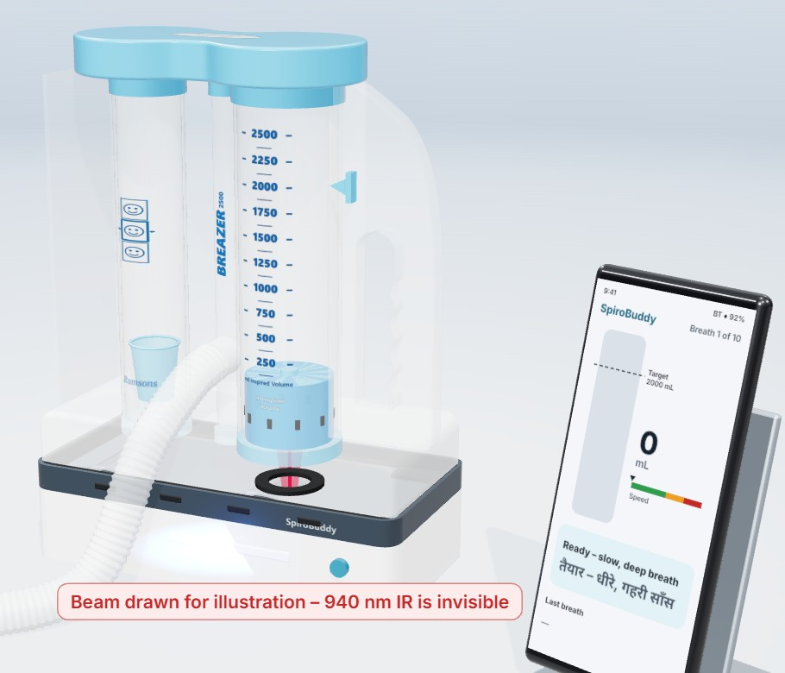
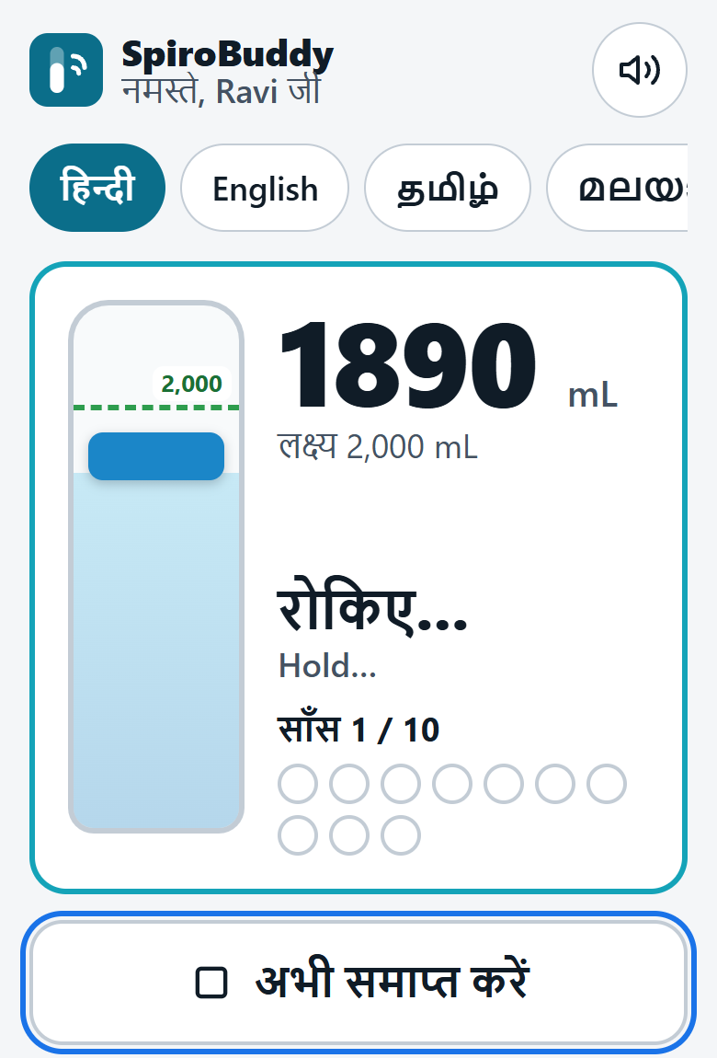
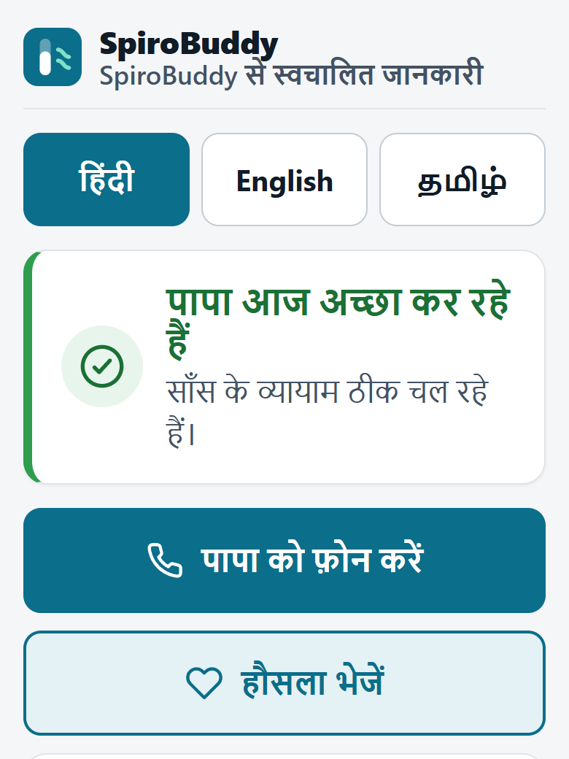
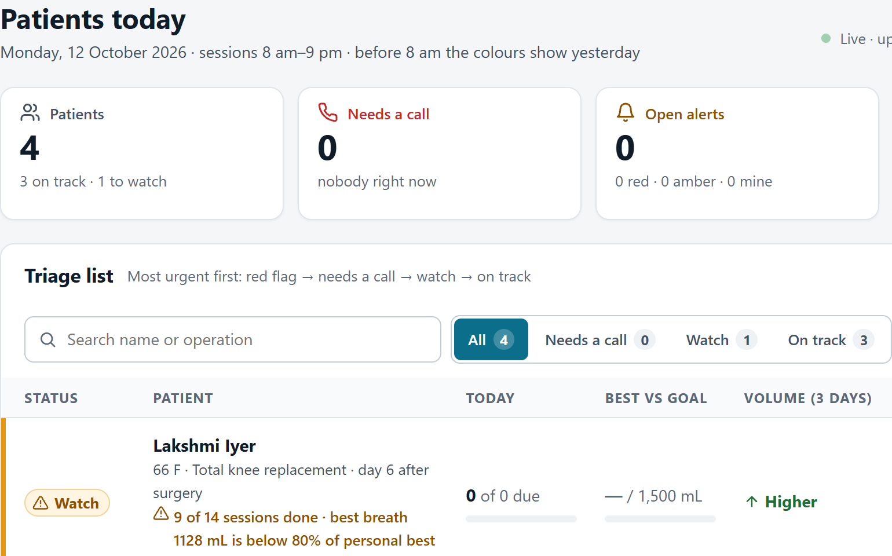
Solution Overview
Pillar 1: proof that the breathing exercise was really done.
1
Clip-on unit
2
Voice coach
3
Nurse list
4
Family update
A small base under an ordinary breathing exerciser reads how high the disc rises.
Coaches every breath in the patient's language: slower, hold, well done.
Shows who is falling behind. Fixed rules, not AI, pick who needs a call.
A family member who opted in, with the patient's consent, sees today's progress.
3D design model · not built yet
Simulated breaths
Live · demo data
Live page · WhatsApp simulated
Problem: nobody sees → Solution: measure, coach, show → Outcome we measure: sessions done ÷ sessions due
Screenshots 2-4: Demo data - fictional patient. Picture 1: 3D design model - device not built yet.
DOLPHIN TANK INDIA • SOCIAL IMPACT HACKATHON
05
Notes:
SpiroBuddy is the adherence and coaching layer for breathing exercise. The ordinary exerciser stands on a small base. A laser sensor reads how high the disc rises. A voice coaches each breath in the patient's own language: slower, hold, well done. The nurse sees who is falling behind. And a family member who opted in, with the patient's consent, gets one short WhatsApp update a day.

Slide 6
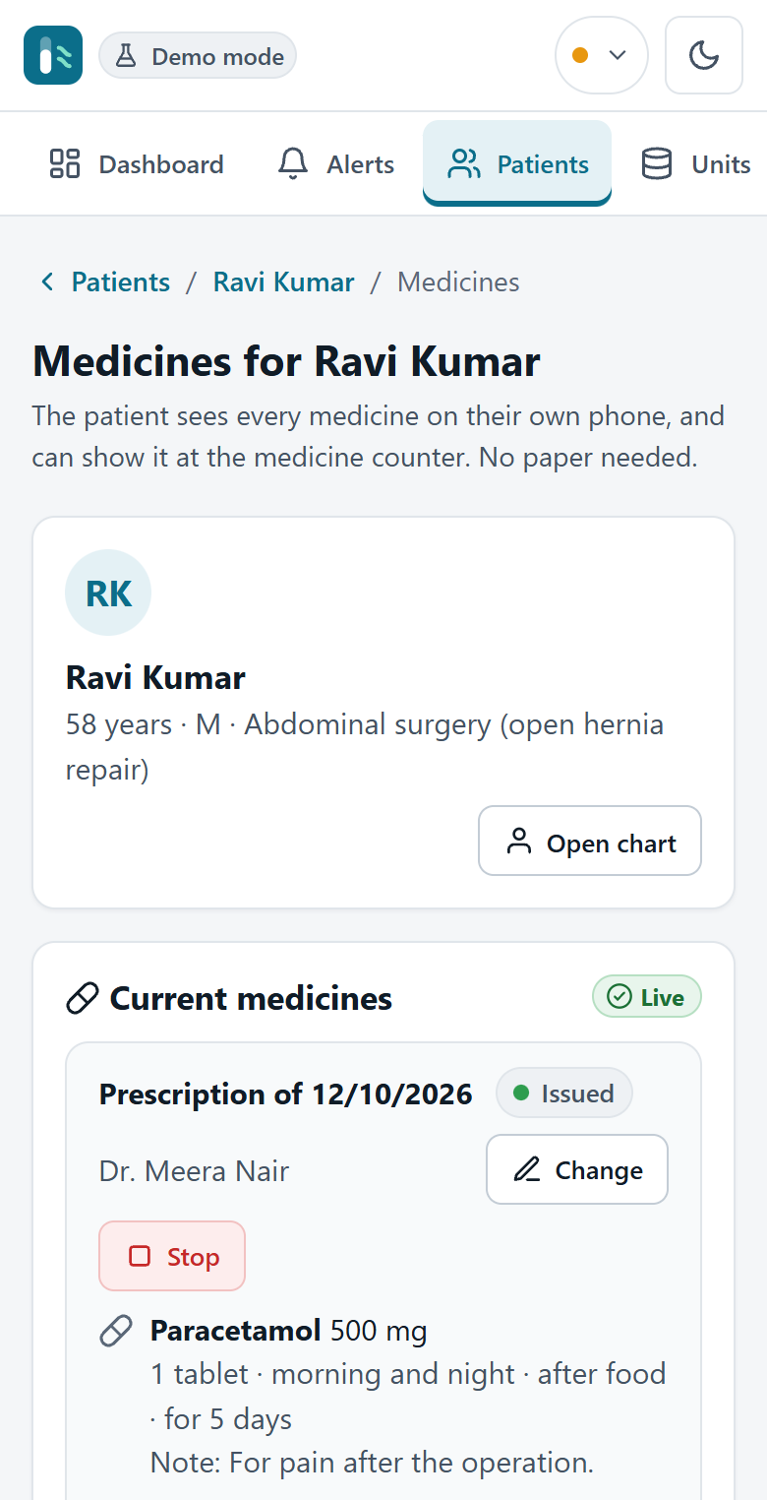
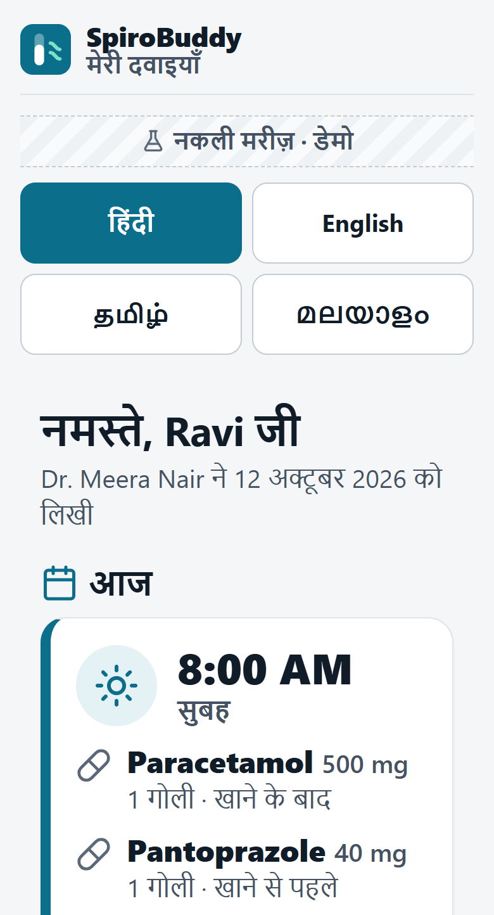
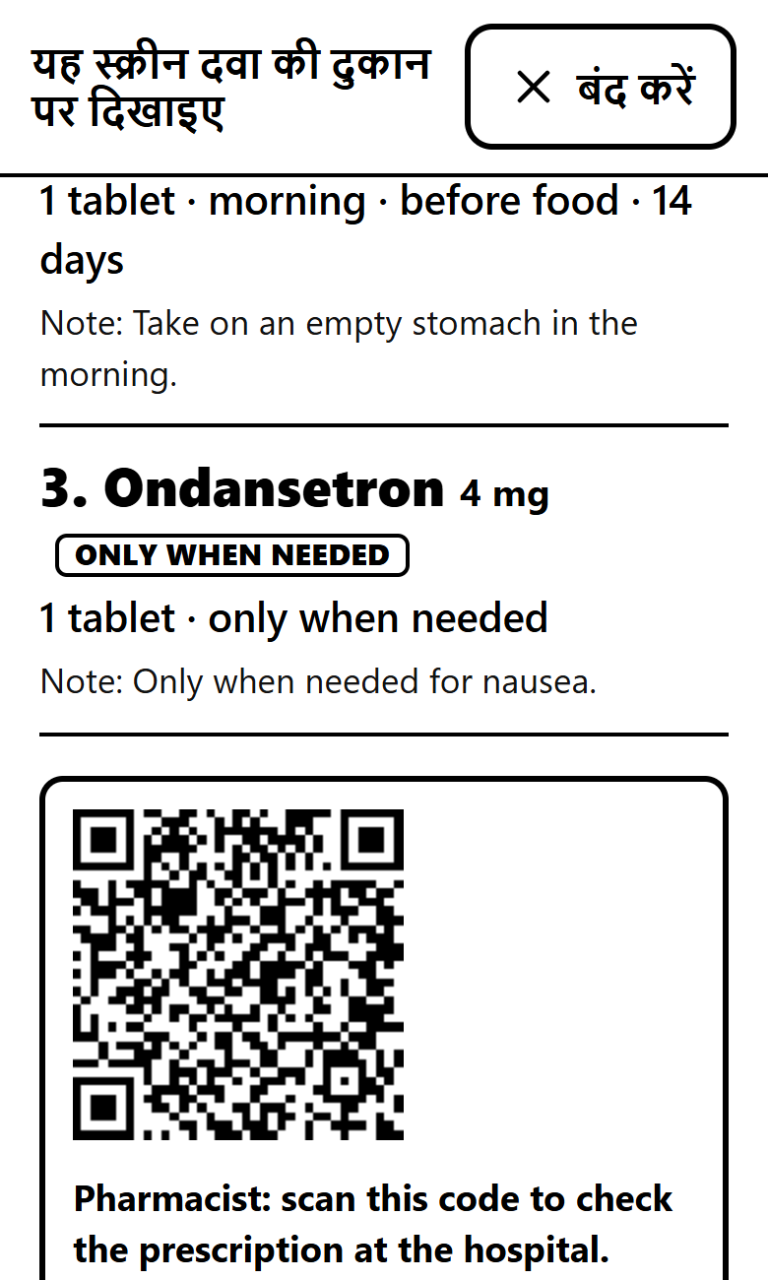
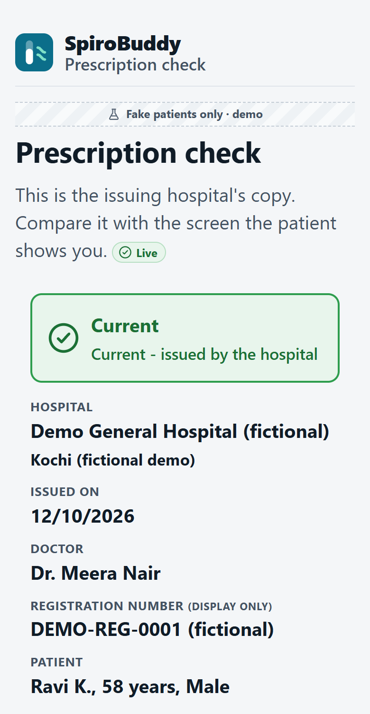
Solution Overview: The Prescription
Pillar 2: the doctor's prescription goes straight to the patient's phone. No paper to lose.
1 The doctor types the prescription
2 The patient sees it, in Hindi
3 Shown at the pharmacy counter
4 The chemist scans the QR and checks
Live on the demo site
The doctor writes it. No AI reads a photo.
Saved under the patient's hospital registration number.
The QR opens the hospital's own copy, marked Current.
A tap on "I took it" is shown as reported, never as taken.
Only the doctor can change or stop a medicine.
Demo data, fictional patient. Not yet tested with a real pharmacy.
Real screenshots from the demo site (12 Oct 2026), cropped. Demo data - fictional patient; the hospital and the doctor are fictional too.
DOLPHIN TANK INDIA • SOCIAL IMPACT HACKATHON
06
Notes:
(The 5-minute script has no separate lines for this slide. Say the headline.) The doctor types the prescription in the hospital software. The patient sees every medicine on their own phone, in their own language, and shows that screen at the pharmacy counter. The chemist scans the QR and sees the hospital's own copy, marked current. It is not AI reading a prescription photo. Demo data; not yet tested with a real pharmacy.

Slide 7
Innovation & Differentiation
Trackers and hospital apps already exist. Our difference: any hospital, built for the elderly, in the patient's language.
Existing alternative | What it does today | What SpiroBuddy adds
Paper tally sheet, or a phone call from the ward | Counts sessions, if someone fills it in | Counts sessions automatically and records how each breath is done: speed, depth, hold
Smart spirometer trackers (InSee, USA) | Reads the piston with an infrared sensor. Fits one US spirometer; cleared for hospital use only | Home use, voice coaching in Indian languages, a nurse list and a family update
Hospital-chain apps and ABHA health-locker apps | Serve one chain's own patients, or store health records | Any hospital or clinic, built for the elderly, in the patient's language, shown at the pharmacy counter
What is new
Not the sensor: InSee showed that tracking the disc works. New is the whole chain for Indian homes: measure, coach by voice, show the nurse and the family, and carry the doctor's prescription on the same phone.
Why the weak evidence is our opening
Reviews found little benefit from the exerciser alone, but the trials almost never recorded actual use. That is exactly the number we measure.
InSee: US FDA clearance K241152, 21 Aug 2025; IEEE Spectrum 2020 · Evidence: Cochrane 2014; 2024 cardiac-surgery review. We do not claim that nothing similar exists.
DOLPHIN TANK INDIA • SOCIAL IMPACT HACKATHON
07
Notes:
InSee in the US already reads the disc with a laser, in hospitals. We take the idea home, in Indian languages. Hospital-chain apps and ABHA health-locker apps exist too; our line is: any hospital or clinic, built for the elderly, in the patient's language, shown at the pharmacy counter.

Slide 8
Technology Architecture
Simple parts that run today. Three small AI helpers; the safety rules are fixed rules, not AI.
Patient + unit
unit not built; breaths simulated
Patient web app
phone, big text, voice
API server
Python, FastAPI
AI layer
three small helpers
Database
Postgres; hospitals kept apart
Dashboards
nurse, doctor, family
AI 1 · Breath model
Labels each breath: good, too fast, too shallow, no hold. Trained on simulated breaths; simple rules run as a backup.
AI 2 · Voice
Speaks 10 Indian languages and English. Recorded clips and the browser voice still work when the internet is down.
AI 3 · Daily summary
A language model writes three plain sentences from the day's numbers. A fixed template is the fallback. It never diagnoses.
Not AI, on purpose
Red-flag words trigger a fixed message: contact your nurse / call 112. Alerts, triage and reminders follow fixed rules.
Stack: web pages in plain HTML, CSS and JavaScript, so nothing to install · Python FastAPI server · Postgres database · hosted in the cloud (Render)
Security and privacy: staff logins with hashed passwords · every record carries its hospital · an audit log of every write · limits on login tries, AI calls and uploads
Flow follows the template: user → application → APIs → AI layer → database → dashboard. Every AI or internet feature has an offline fallback.
DOLPHIN TANK INDIA • SOCIAL IMPACT HACKATHON
08
Notes:
Where is the AI? Three places. A small model labels each breath: good, too fast, too shallow, no hold. It is trained on simulated breaths, so its accuracy on real patients isn't measured yet, and simple rules run as a backup. A voice service speaks ten Indian languages and English, with recorded clips for offline use. A language model writes a short daily summary. It never diagnoses. Alerts come from fixed rules, on purpose.

Slide 9
Responsible Technology
Responsible by design: the software coaches and records. It never gives medical advice.
The AI never diagnoses
It coaches and summarises only. No dose advice and no drug-interaction checks, on purpose.
Red flags reach a person
A fixed word list triggers a fixed message, "contact your nurse / call 112", and a nurse alert. No AI is involved.
Consent and STOP
Family updates only if the patient consents and the family member opts in. STOP ends them. Itemised consent screen: in development.
Hospitals kept apart
Every record carries its hospital, checked on each request and covered by tests. An audit log records who did what.
Fake patients only
The demo holds no real health data and collects no government ID. No outside body has reviewed the product yet.
No money in the apps
Nothing about payments, bills or insurance in the hospital, nurse or patient apps.
Accessible: large text, one action per screen, voice in the patient's language, no typing. Law: designed for India's DPDP Act 2023; we claim nothing until it is checked.
DOLPHIN TANK INDIA • SOCIAL IMPACT HACKATHON
09
Notes:
(No separate lines in the 5-minute script.) The AI never diagnoses; it coaches and summarises. Red-flag words trigger a fixed "contact your nurse or call 112" message from word lists, not AI. Alerts follow fixed rules. Fake patients only today. Consent from the patient, in their language; the family member opts in; one word, STOP, ends messages. Nothing to do with payments in the hospital, nurse or patient apps.

Slide 10
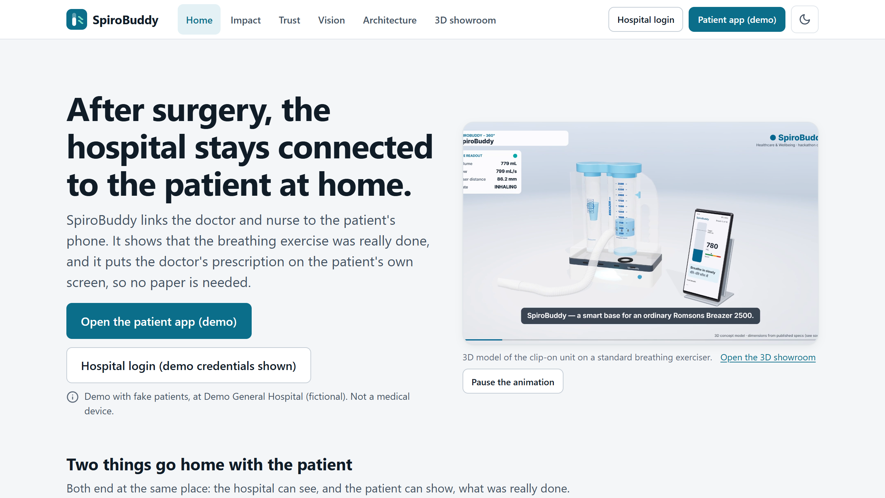
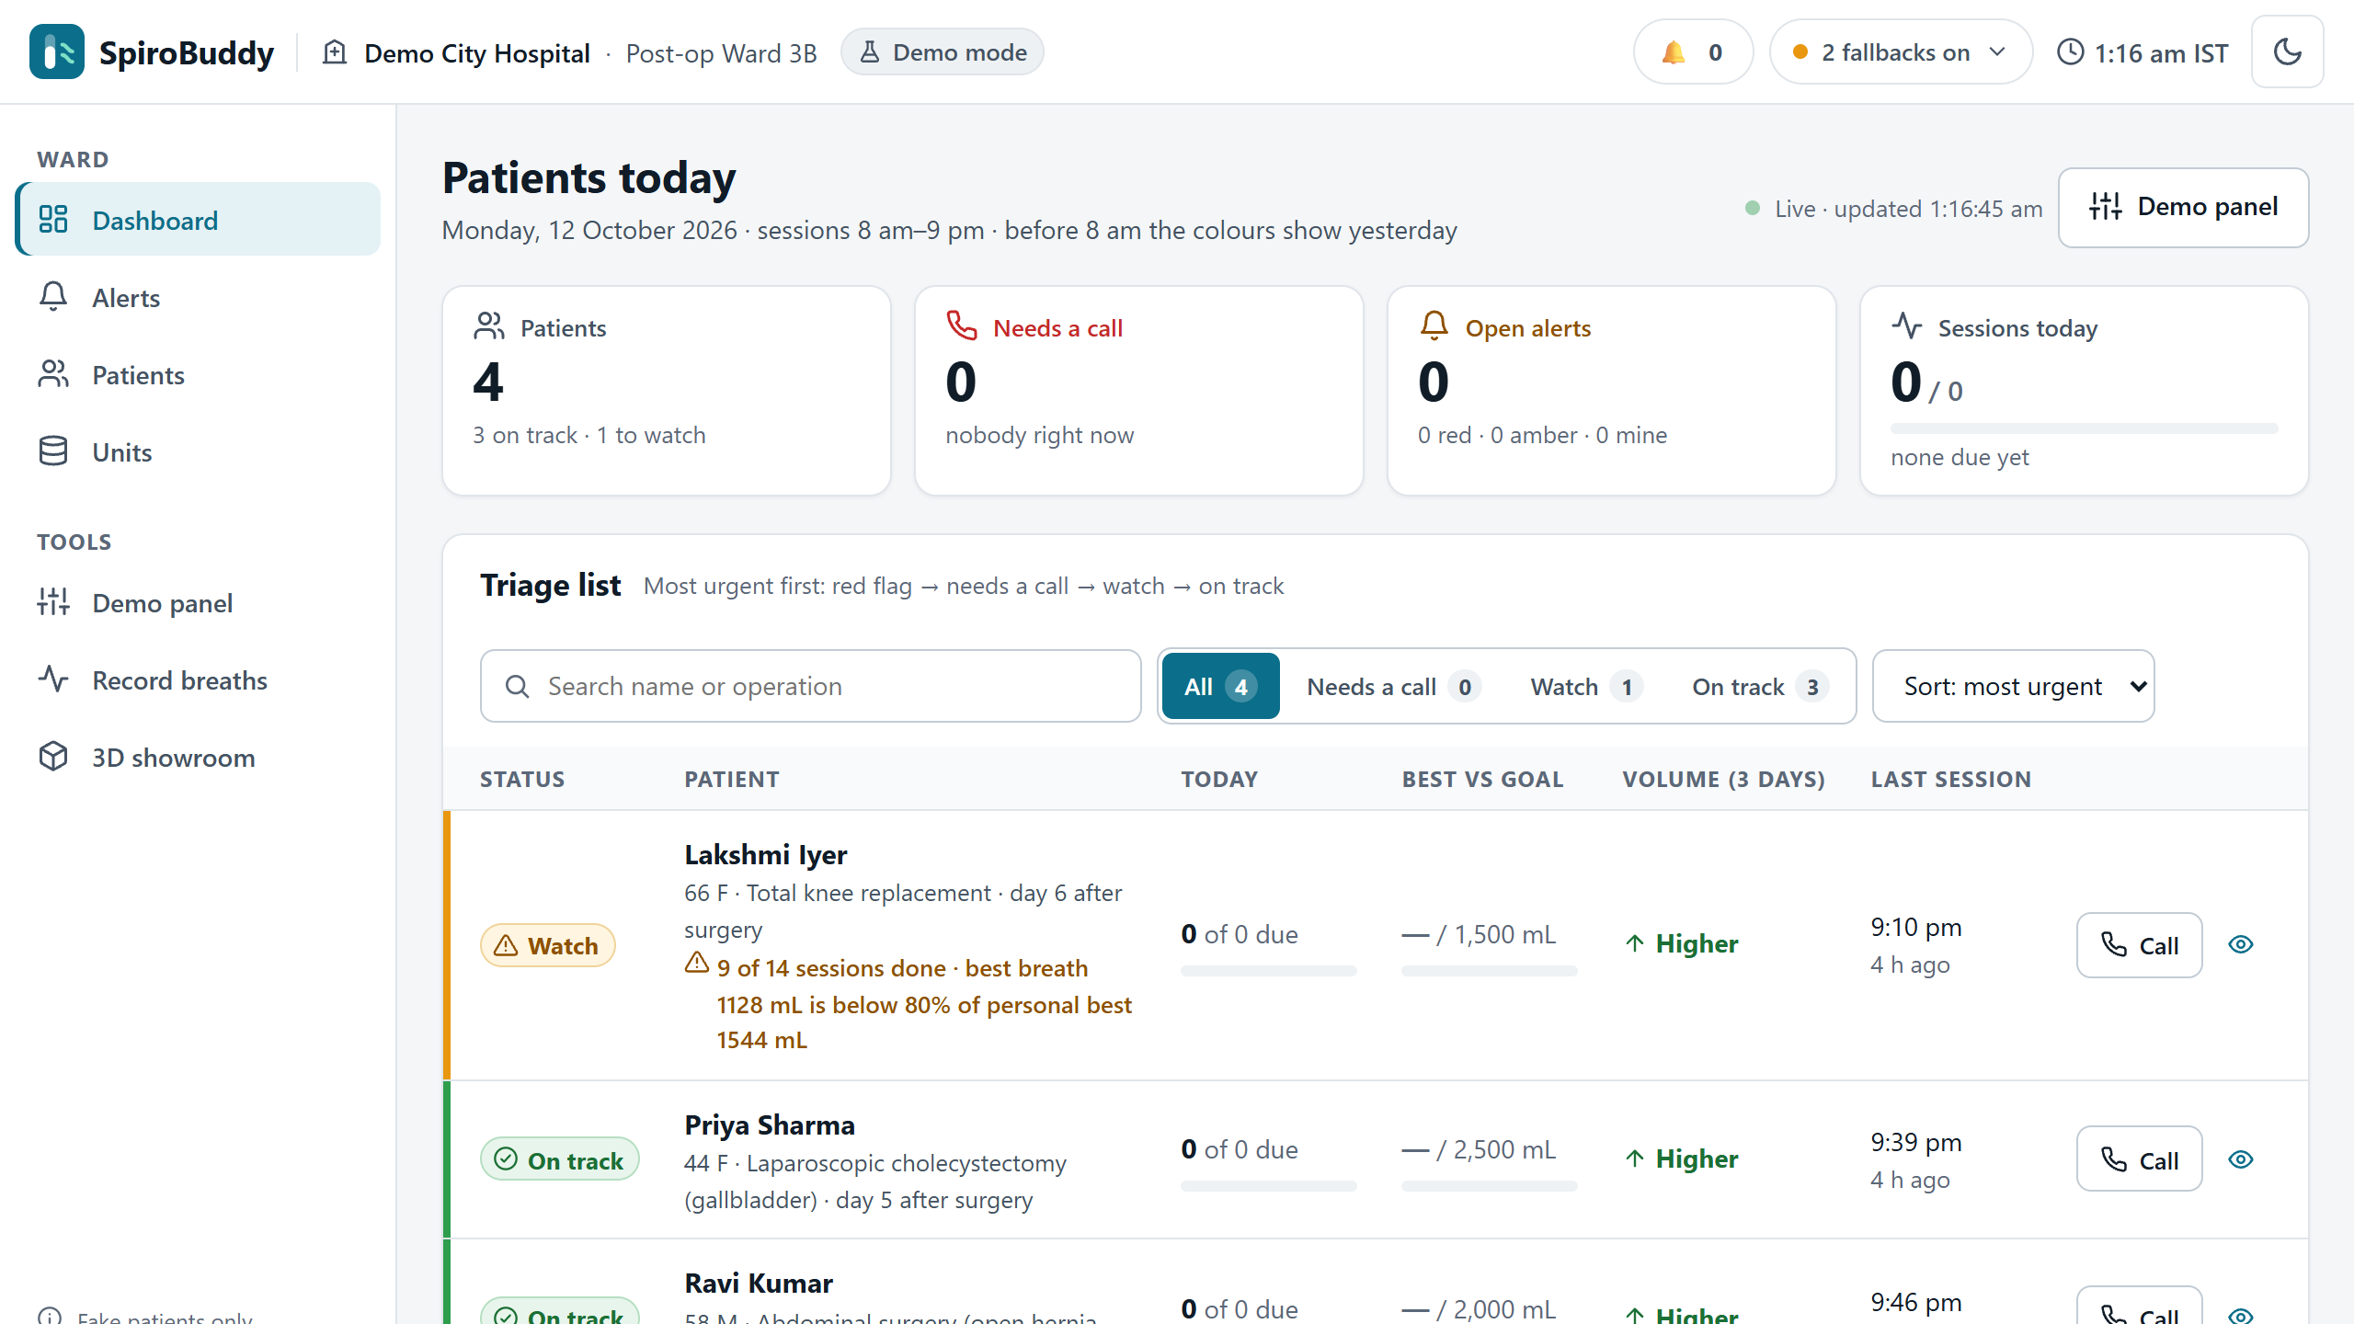
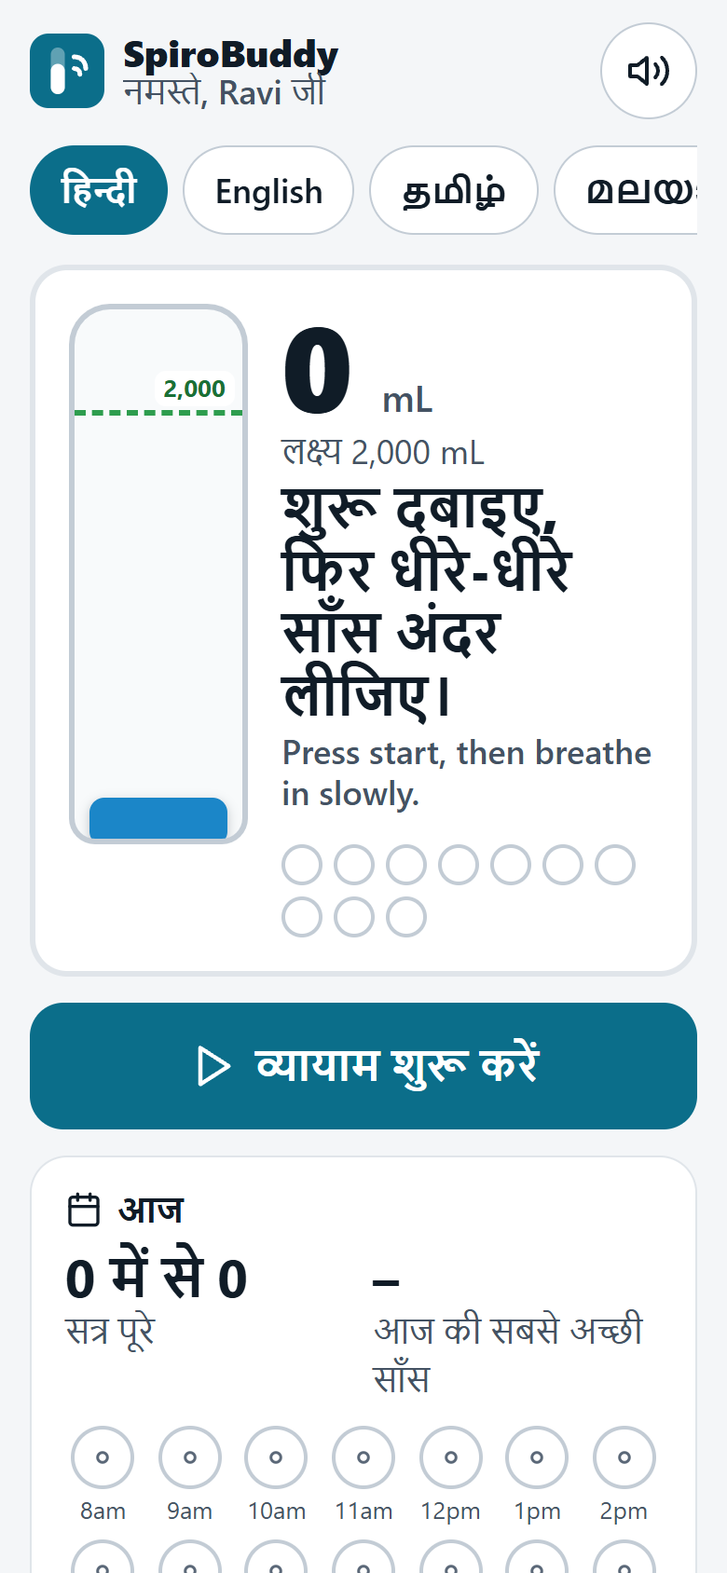
MVP / Prototype Screens
It runs today, end to end, at spirobuddy.onrender.com - with simulated breaths and fictional patients.
Patient app: Hindi coach
Public site: the problem, the product and its limits
Nurse dashboard: the patient who needs a call is on top
Try the flow: open the site → Patient app (demo) → Start → make a demo breath → Hospital login → nurse list → Medicines → show at the pharmacy.
Live: site, staff logins, dashboard, prescription
Simulated: breaths, WhatsApp, calls
Not built: the device
Real screenshots, 12 Oct 2026, from a local copy of the demo site. Demo data - fictional patients. The free server can take a moment to wake.
DOLPHIN TANK INDIA • SOCIAL IMPACT HACKATHON
10
Notes:
Let me show you the live site. We have no hardware yet, so breaths come from a simulator. I start a session. [Good breath] Listen: the coach speaks Hindi. [Too fast] Too fast. It says "slower" at once, and the screen turns amber. [Finish now] The session saves itself. Nothing to type. [I do not feel well] One safety button. It shows a fixed message: contact your nurse, or call one-one-two. That part uses no AI.
Now the nurse's screen. [dashboard] Ravi is at the top, with his red flag. Every row shows sessions done out of sessions due today. [demo panel, missed slots, send summary] If Ravi misses two sessions, a ladder starts: a reminder, a family message, a nurse alert, then the nurse calls. These sends are previews, not real messages yet.

Slide 11
MVP / Prototype: Honest Status
Honest status: the software works, the device is not built, and no patient has used it yet.
Working today
Simulated
Not yet
Public site and staff logins; hospitals kept apart
Nurse triage list and alerts, by fixed rules
Patient app with a voice coach in 10 Indian languages and English
The doctor's prescription on the patient's phone, pharmacy screen and QR check
400+ automated tests
Breaths: from a built-in simulator
Breath model: 95.8% on simulated breaths. Real-patient accuracy is not measured
WhatsApp updates and phone calls: previews, not real sends
Every patient, staff member and hospital in the demo is fictional
The clip-on unit: a design and a 3D model only
Real breaths from real people
Any patient, any pilot, any result
Any review by a regulator or outside body
A test with a real pharmacy
Readiness: TRL 3-4. Software about TRL 4: it runs end to end on a live site with simulated breaths. Device TRL 3: a design and a 3D model. In development now: patient login with hospital registration number + PIN.
Every status label on the site comes from one list in the code (backend/app/features.py): Live / Simulated / In development / Planned.
DOLPHIN TANK INDIA • SOCIAL IMPACT HACKATHON
11
Notes:
Honestly: about TRL three to four. The software works end to end, live. The sensor unit is not built, and nothing is tested on patients.

Slide 12
Market Validation
What we know so far comes from published studies. No pilot, no survey and no users yet.
Validation activity | Result so far
Interviews | [ADD: 3 interviewees - role, city]
Survey responses | None yet
Pilot users | None yet. No patient has used SpiroBuddy
Waitlist | None
Desk research | Evidence, law and costs mapped before building. Every number here carries its source or the word estimate
What published research already tells us
28% → 58%
of waking hours with exercise, when patients got an hourly reminder
US randomised trial, 145 patients. JAMA Surgery 2019
6% → 72%
did the exercise properly: day 1, then day 3 after teaching
Chennai hospital, 60 patients. J Pharm Bioallied Sci 2024
246 of 260
TB survivors completed 12 weeks of home lung rehab with phone follow-up
5 Indian centres, no comparison group. Indian J Med Res 2025
[ADD: one short interview finding or quote, used with permission]
Next step: interviews with hospital teams on who pays (the price is not yet tested with a hospital), then the 30-patient ward pilot.
DOLPHIN TANK INDIA • SOCIAL IMPACT HACKATHON
12
Notes:
(No separate lines in the 5-minute script.) We mapped evidence, law and costs before building. We measure what the trials almost never recorded: actual use. We have no pilot, no survey and no users yet. [Add the interviews here once they are done: say "we interviewed N people", never more than that.]

Slide 13
Scalability
One shared platform, each hospital kept apart. Growth is staged; every stage after today is Planned.
Today
1 pilot hospital
10 hospitals
100 hospitals
State programmes
Live demo
Planned
Planned
Planned
Planned
₹2,500
about 10
about ₹1,000
₹0.12
parts per unit
estimate
loans per unit
assumption
per patient episode
planned price, estimate
per WhatsApp update
Meta India rate card
Digital scale: a hospital's doctors, departments and patients can be moved in from a spreadsheet or a FHIR file, with a practice run before anything is saved (Planned).
Automation: reminders, the escalation ladder and the daily summary run by themselves (message sends are simulated today).
Partners and next group: hospital nurse and physio teams to begin with; later TB survivors (Planned). India's draft 2024 TB rehab guidance lists the incentive spirometer for supervised sessions.
Costs are team estimates, none is measured. WhatsApp: Meta India utility rate. TB: RBIPMT 2024 draft guidance (ntep.in).
DOLPHIN TANK INDIA • SOCIAL IMPACT HACKATHON
13
Notes:
Today one web service and one database run our demo with fictional patients. Planned growth is staged: one pilot hospital, ten, a hundred, then state programmes. Each patient episode should cost five to seven hundred rupees, an estimate; our planned price is about one thousand. Next, TB survivors: India's draft TB rehab guidance lists this exerciser.

Slide 14
Scalability: Arogya Sathi Roadmap
The bigger picture: Arogya Sathi ("health companion"), with the SpiroBuddy breathing coach.
Hospital
Whole-hospital view: check-ins, check-outs, beds
Device modules
The spirometer clip-on is device module 1. More Bluetooth devices can plug into the same screens later (Planned).
Planned
Department
Registers patients; bed board, appointments, nurse roster
Planned
Each hospital's own look
Its name, logo and colour inside the app after login (Planned). Safety messages stay fixed.
Doctor
Today's patients, records, prescriptions. "My day" page: Planned
Live: prescriptions
Nurse
Duty, rooms, tasks and alerts. Her phone app: Planned
Live: triage list
About the name
Arogya Sathi is a working name for the planned whole-hospital app. This entry and the live site stay named SpiroBuddy.
Patient
Prescriptions, pharmacy screen, breathing coach. Dose reminders: in development
Live / Simulated
A roadmap, not a claim: everything here beyond what the demo site marks Live or Simulated is Planned.
DOLPHIN TANK INDIA • SOCIAL IMPACT HACKATHON
14
Notes:
(No separate lines in the 5-minute script.) The bigger picture is Arogya Sathi, "health companion", with the SpiroBuddy breathing coach: hospital, department, doctor, nurse and patient accounts under one hospital. The spirometer is device module one. Today the doctor's prescription, the nurse's list and the patient app run on the demo site; the rest is the roadmap.

Slide 15
Business & Sustainability Model
The hospital pays: under flat-rate insurance, every extra bed-day comes out of its own pocket.
Revenue (planned) | Costs (estimates)
About ₹1,000 per patient episode; the unit is lent at discharge and reused | About ₹2,500 of parts per unit, reused across about 10 patients (assumption)
Later: a subscription per hospital, with add-on modules such as the spirometer (Planned) | ₹0.12 per WhatsApp update; phone calls only to escalate
Patients and families never pay. No money is handled inside the hospital, nurse or patient apps | About ₹500-700 to serve one patient episode. Hosting is free for the demo only
₹2,307
average cost of one ward bed-day. Our ₹1,000 is less than half
57 hospitals, 11 states. BMJ Open 2023
₹1,62,400
flat Ayushman Bharat payment for a bypass, 10-day stay built in
HBP 2022 rate list
Sustainability plan: a grant funds the pilot (one NIDHI-PRAYAS grant, up to ₹10 lakh, could cover it) → a paid pilot with one hospital → a per-episode fee, later a subscription.
Honest gap: the price is not yet tested with any hospital. How the fee fits inside a PM-JAY package is a question for our hospital interviews.
All prices and costs are team estimates; none is measured. Sources: HBP 2022 rate list (state copy) · CHSI, BMJ Open 2023 · Meta India rate card.
DOLPHIN TANK INDIA • SOCIAL IMPACT HACKATHON
15
Notes:
Who pays? The hospital. Under Ayushman Bharat, a bypass is paid at a fixed rate, so every extra bed-day comes out of the hospital's pocket. A ward day costs about twenty-three hundred rupees. Our unit costs about twenty-five hundred rupees, is lent at discharge and reused. We charge about one thousand rupees per patient episode, less than half a ward day.

Slide 16
Risks & Mitigation
Our biggest risks are an unbuilt device and unproven adoption. Each one has a named next step.
Type | Risk | Impact | Mitigation
Operational | The clip-on unit is not built. The sensor chip is ±2 cm out of the box (ST datasheet) | No real breaths can be recorded | Bench-test one unit and calibrate it to each exerciser's printed marks. The coach also runs from a simulator or a manual tap
Adoption | Older patients without smartphones; busy nurses; a chemist may not accept a phone screen | Low use at home; no trust at the counter | Voice, big buttons and the family's phone. Alerts only when a call is needed. The QR opens the hospital's own copy; pharmacy acceptance is still to be tested
Technology | The breath model has seen only simulated breaths. The internet or an AI service may be down | Wrong labels; a silent app | Record real breaths and re-train before any pilot. Rules run as a backup; every AI feature has an offline fallback
Regulatory | A device that measures and alerts: we expect Class B under India's Medical Devices Rules. The DPDP Act applies | No patient study without the right permissions | CDSCO's written view and a registered ethics committee before enrolling anyone. We claim only practice and recording
DOLPHIN TANK INDIA • SOCIAL IMPACT HACKATHON
16
Notes:
(No separate lines in the 5-minute script.) We expect Class B under India's device rules, and will confirm with CDSCO before any patient study. The breath model is trained on simulated breaths; recording real breaths comes before any pilot.

Slide 17
Implementation Roadmap
Next: build one unit, record real breaths, get the regulator's written view, then run a 30-patient pilot.
90 days
180 days
365 days
Build and measure
Permissions and pilot
Report and widen
Bench-test one clip-on unit
Record real breaths and re-train the breath model
Patient login with hospital registration number + PIN (in development now)
Each hospital's own name and logo inside the app
A registered ethics committee and CDSCO's written view, before any patient
Start a 30-patient, 3-month pilot at one hospital (about ₹5.5 lakh, middle estimate)
Department page with a bed board; the doctor's "My day" page
Report the pilot's number, whatever it is
Arogya Sathi apps in the Play Store and App Store, once a pilot hospital agrees
A reader for three-ball exercisers; rehab for TB survivors
A plan, not a promise: everything on this slide is Planned or In development.
DOLPHIN TANK INDIA • SOCIAL IMPACT HACKATHON
17
Notes:
Next: build one unit, record real breaths, then a thirty-patient pilot, with an ethics committee and the regulator's written view before that. We expect Class B under India's device rules.

Slide 18
Team Structure
A small team where each person owns one part and can explain it.
[ADD: photo]
[ADD: photo]
[ADD: photo]
[ADD: photo]
[ADD: founder name]
Lead · pitch · video
Owns: Problem, users, money
[ADD: name]
[ADD: role]
Owns: Sensor and the unit design
[ADD: name]
[ADD: role]
Owns: Breath detection and the model (trained on simulated breaths)
[ADD: name]
[ADD: role]
Owns: Alerts, WhatsApp, consent, safety words
[ADD: college or organisation, city, state]
Advisors / mentors: [ADD: names and roles, or "none yet - mentoring is part of our ask"]
DOLPHIN TANK INDIA • SOCIAL IMPACT HACKATHON
18
Notes:
We are [names, one role each]. Each of us owns one part and can explain it in sixty seconds.

Slide 19
Financial Requirements
Our near-term need is one pilot: about ₹5.5 lakh (middle estimate).
Category | Amount | What it covers
Product development | About ₹2,500 of parts per unit (estimate) | Building and bench-testing the clip-on unit. A hand-built cable prototype is about ₹1,365
Marketing | None planned | We need introductions to hospital teams, not advertising
Operations | About ₹5.5 lakh (middle estimate) | A 30-patient, 3-month pilot at one hospital. Hosting is free for the demo only
Funding requirement | About ₹5.5 lakh for the pilot | One NIDHI-PRAYAS grant (up to ₹10 lakh) could fund it
Read this as estimates: these are our own figures from shop prices and published rate cards, not quotes from a supplier or a hospital.
All amounts are team estimates. The NIDHI-PRAYAS figure is the grant's upper limit, not money we hold.
DOLPHIN TANK INDIA • SOCIAL IMPACT HACKATHON
19
Notes:
(No separate lines in the 5-minute script.) Bench-test one unit, record real breaths, then a 30-patient pilot. Units are lent and reused, so hospitals buy no hardware. One NIDHI-PRAYAS grant could fund the pilot.

Slide 20

Ask & Next Steps
Our ask: one hospital team to pilot with, and guidance on the regulatory steps.
Pilot partner
An introduction to one hospital's nurse or physiotherapy team
Scan for the demo
Mentorship
The CDSCO steps for a device that measures, and help with a NIDHI-PRAYAS application
Funding
About ₹5.5 lakh for a 30-patient, 3-month pilot (middle estimate)
After surgery, the hospital stays connected to the patient at home.
SpiroBuddy. Every breath, coached and counted.
spirobuddy.onrender.com
Opens the patient app (demo). Simulated breaths, fictional patients. The free server can take a moment to wake.
Queries & feedback: [ADD: leader's name, email, phone]
DOLPHIN TANK INDIA • SOCIAL IMPACT HACKATHON
20
Notes:
We are [names, one role each]. Our ask: an introduction to one hospital's nurse or physio team for that pilot, and guidance on the regulatory steps. SpiroBuddy. Every breath, coached and counted. Thank you.

