Slide 1
Cryptocurrency Growth Analytics
Kalib, Matteo, Sharon, Sunitha

Slide 2
Top 15 Cryptocurrencies
Based on market cap values (greater than $1B): https://www.investopedia.com/news/16-cryptocurrencies-have-market-caps-greater-1b/
Bitcoin (BTC)
Ethereum (ETH)
Litecoin (LTC)
IOTA (MIOTA)
Ripple (XRP)
DASH
NEM (XEM)
Monero (XMR)
Bitcoin Gold (BTG)
Ethereum Classic (ETC)
Cardano (ADA)
EOS
Stellar Lumens (XLM)
NEO
BitConnect (BCC)

Slide 3
Main Research Questions
Is there a cryptocurrency that correlates with Bitcoin?
What is the year to year growth of the different cryptocurrencies?
What is the historical volatility of the different cryptocurrencies?
Which cryptocurrency shows the highest intraday volatility?

Slide 4
Bitcoin VS other cryptocurrencies

Slide 5
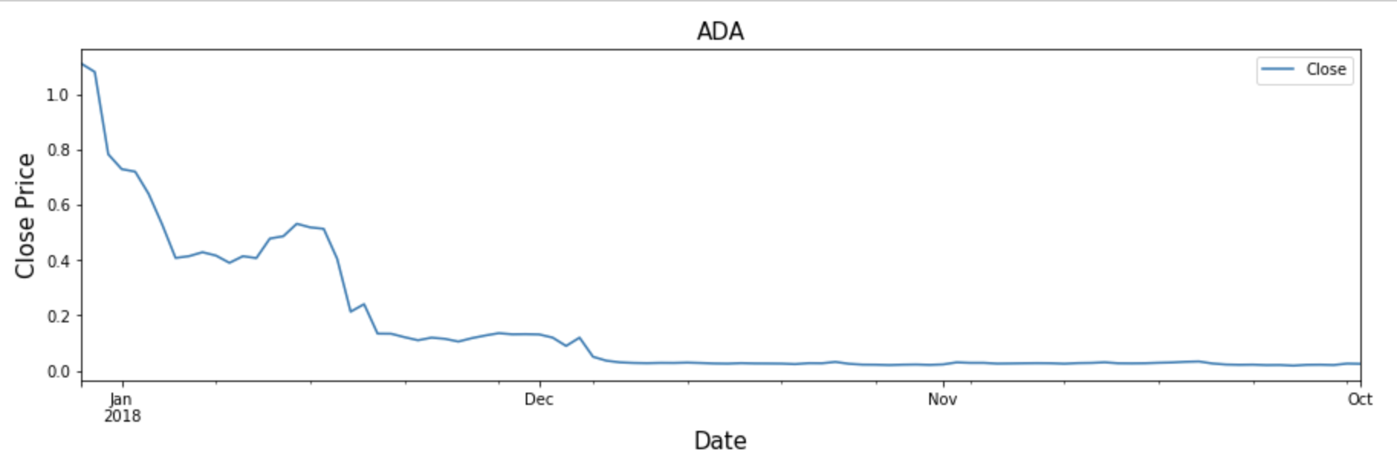
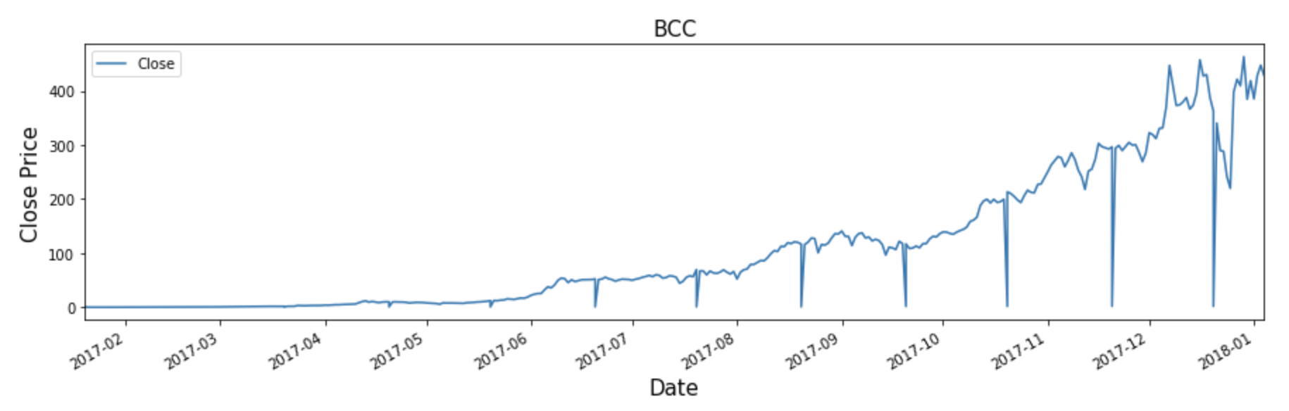
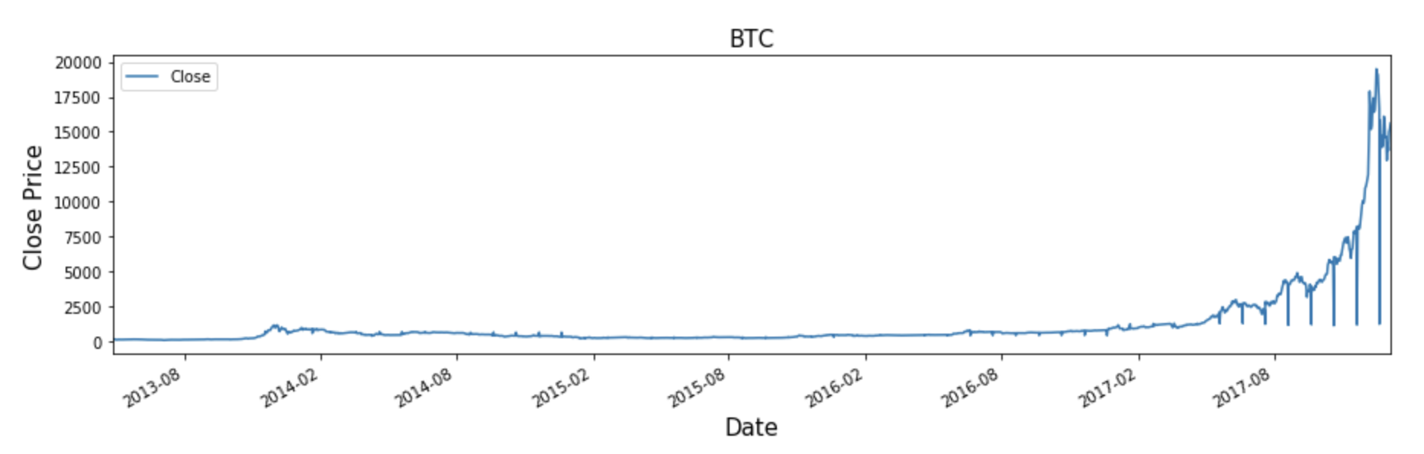
Historical closing values of cryptocurrency:

Slide 6
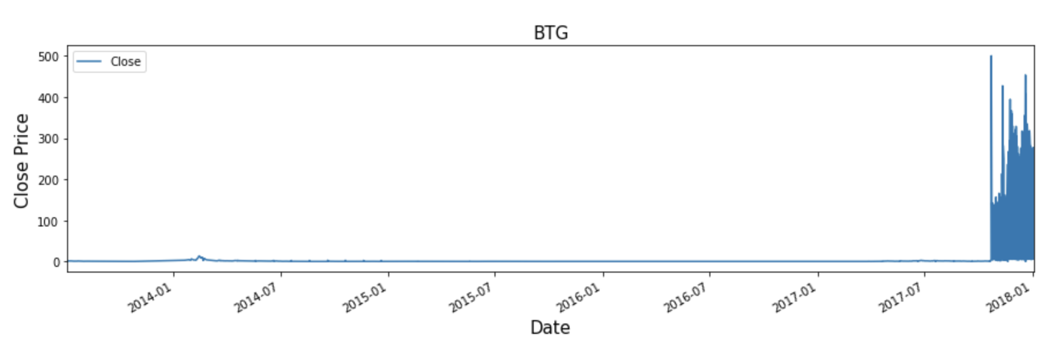
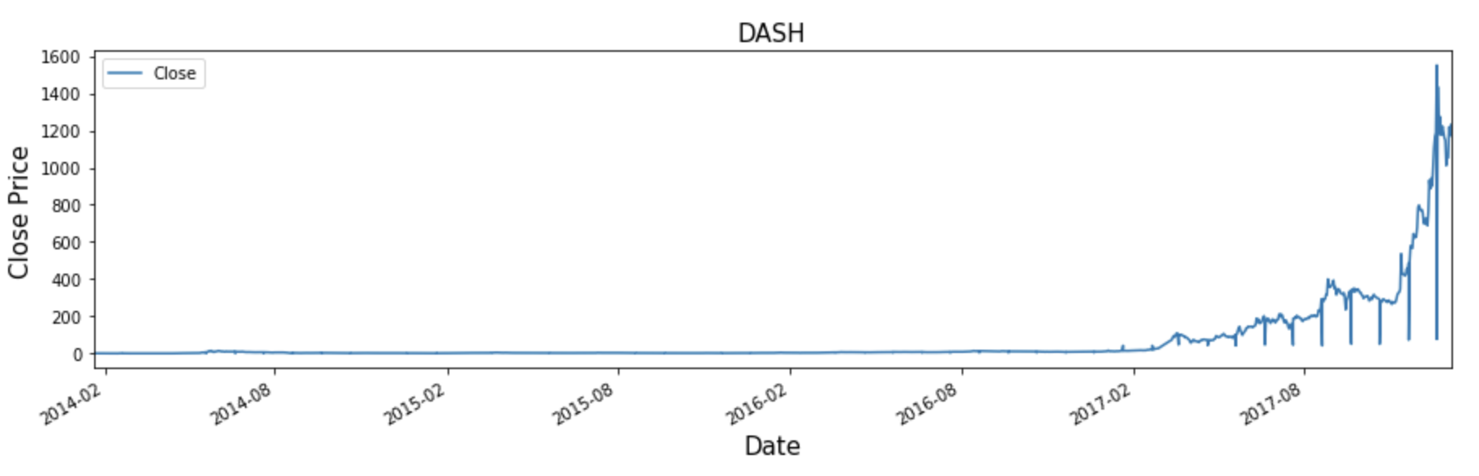
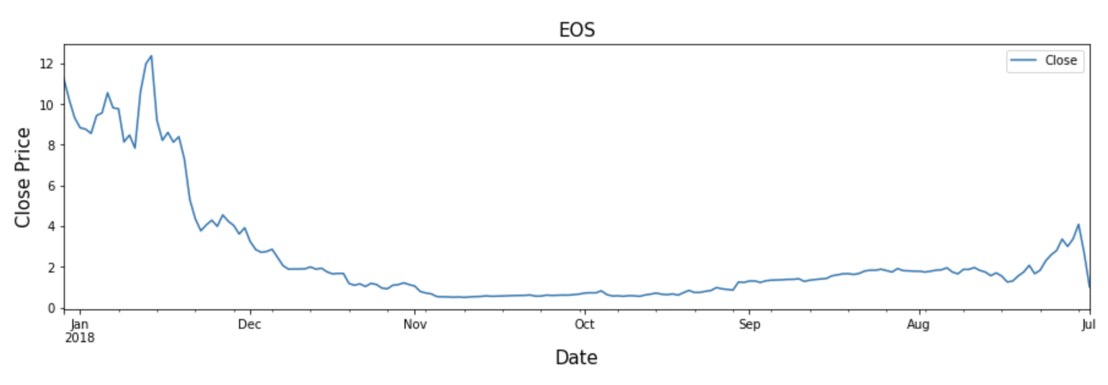
Historical closing values of cryptocurrency:

Slide 7
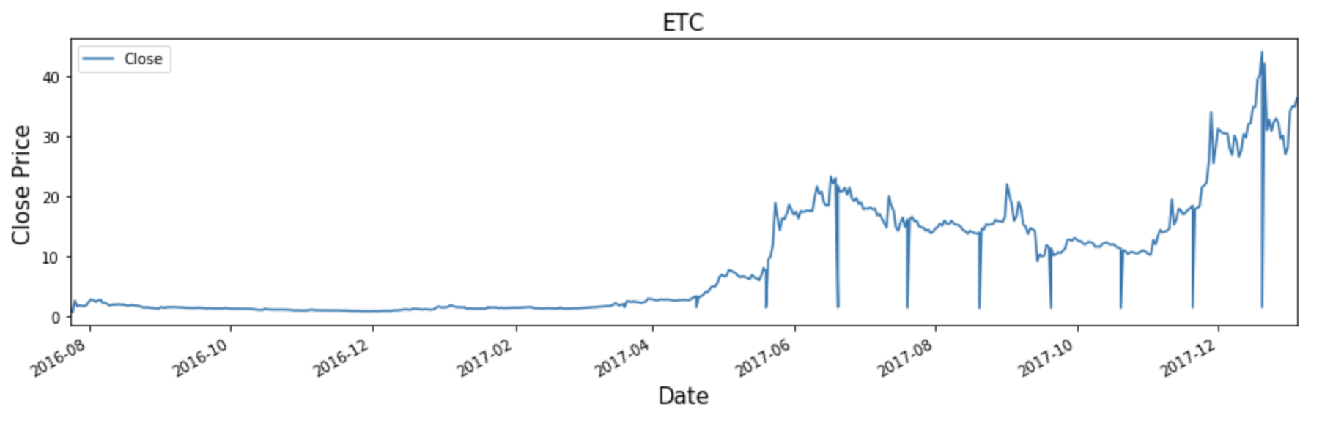
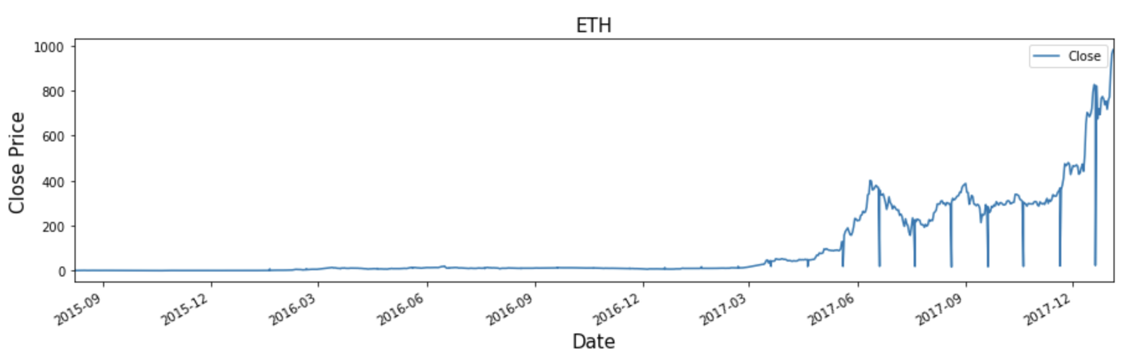
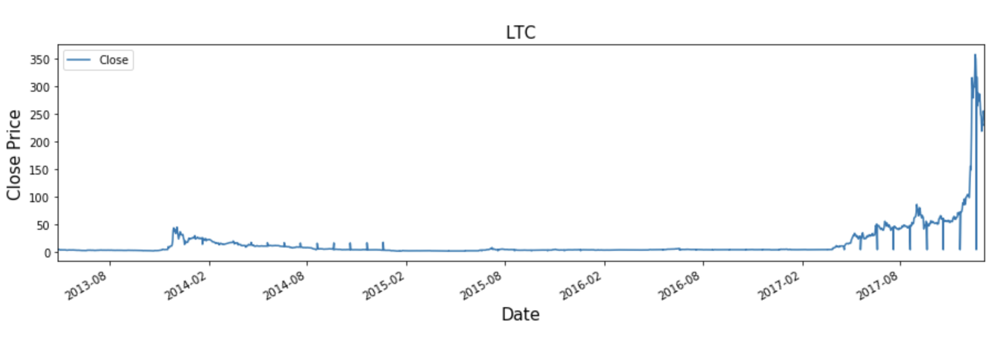
Historical closing values of cryptocurrency:

Slide 8
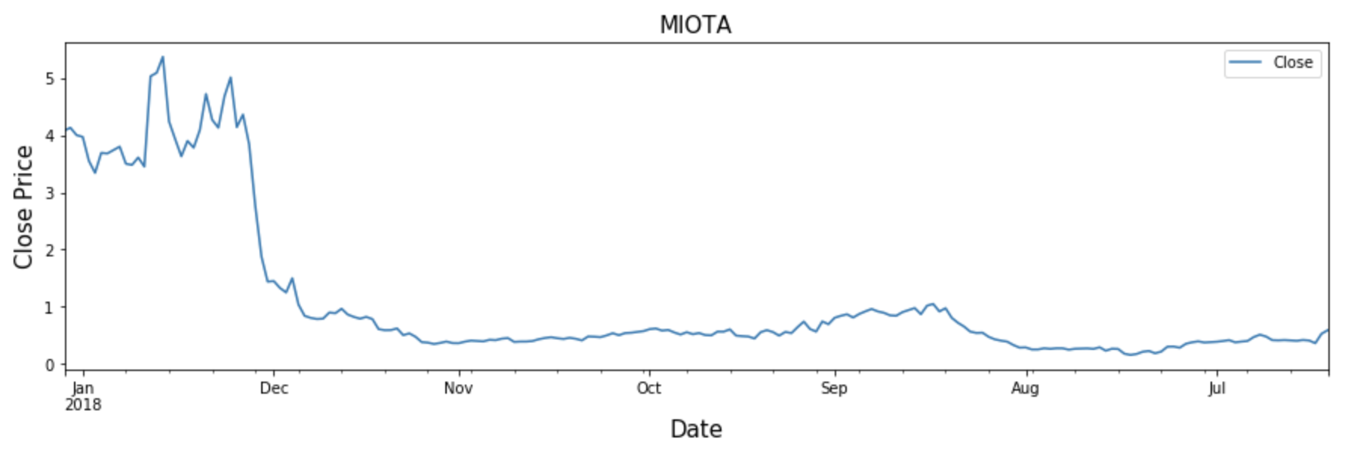
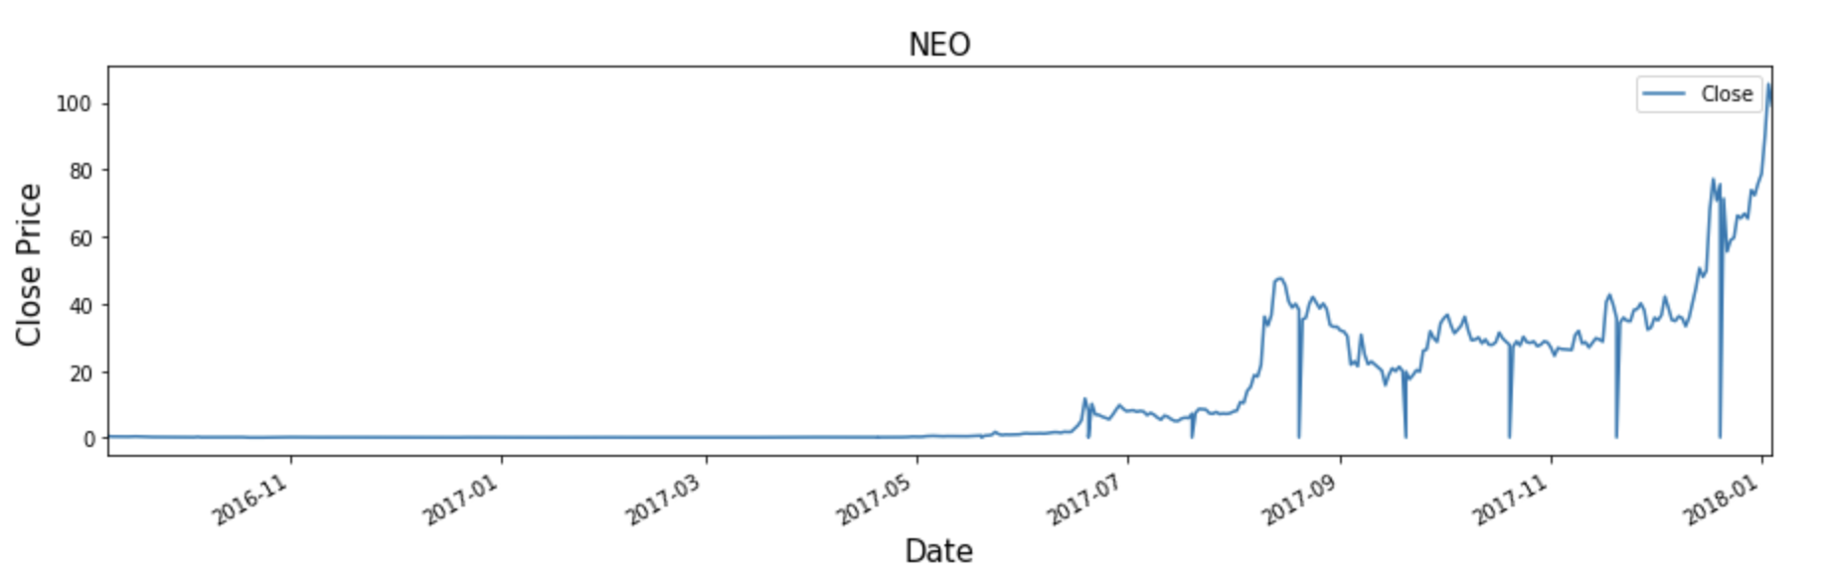
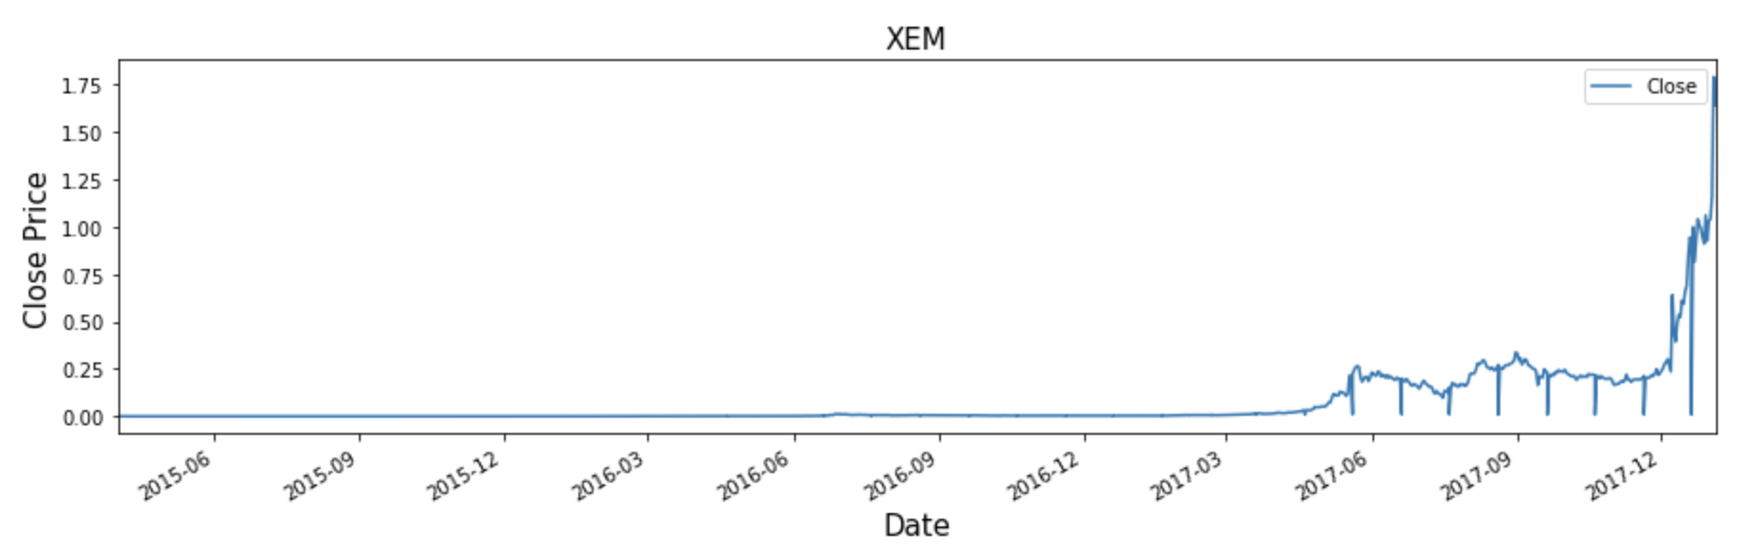
Historical closing values of cryptocurrency:

Slide 9
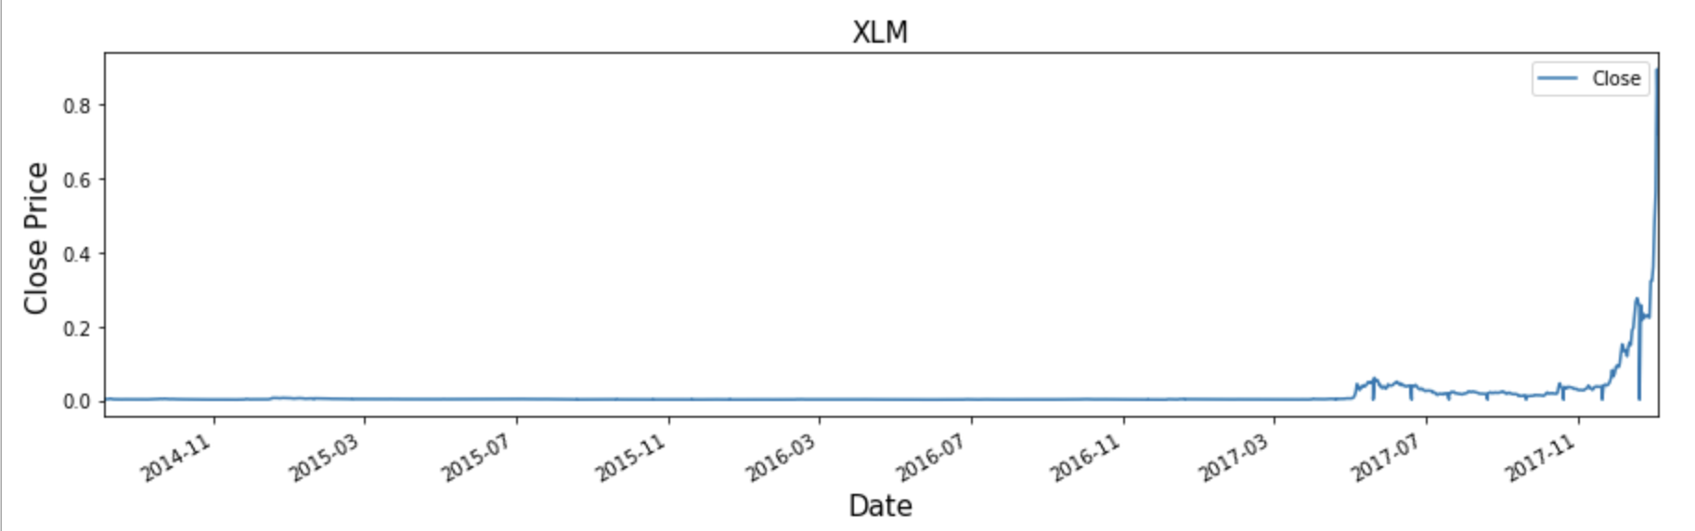
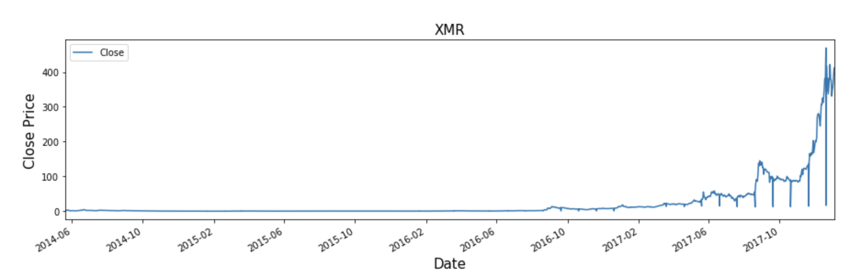
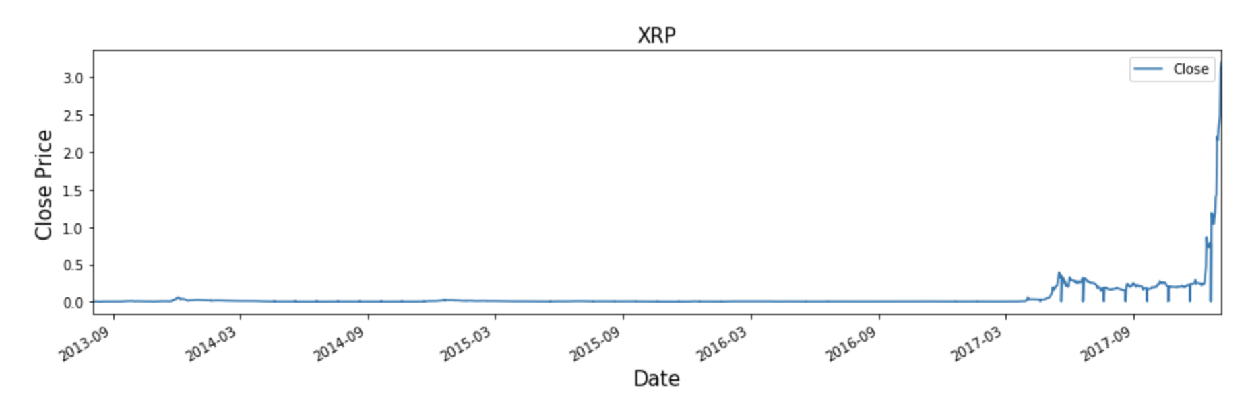
Historical closing values of cryptocurrency:

Slide 10
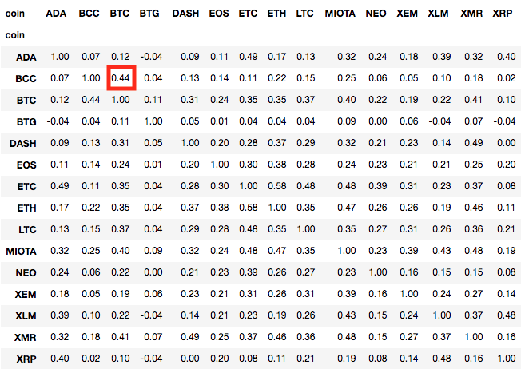
Historical comparison of closing values of cryptocurrencies

Slide 11
Year to year growth of cryptocurrencies

Slide 12
Yearly Average Price of Closing Price
Coin | 2013 | 2014 | 2015 | 2016 | 2017
BTC | 259.022195 | 528.016474 | 273.088678 | 570.4225 | 4025.355234
DASH | 0 | 3.702727 | 2.768017 | 8.079093 | 249.619972
ETH | 0 | 0 | 0.93669 | 9.829121 | 225.126584
BCC | 0 | 0 | 0 | 0 | 105.383692
XMR | 0 | 1.562703 | 0.492039 | 3.707115 | 76.281901
LTC | 6.70313 | 9.83146 | 2.702121 | 3.799918 | 50.295069
BTG | 0.490674 | 1.229107 | 0.154945 | 0.07 | 45.402754
NEO | 0 | 0 | 0 | 0.184732 | 15.527741
ETC | 0 | 0 | 0 | 1.252453 | 12.030799
EOS | 0 | 0 | 0 | 0 | 2.345604
MIOTA | 0 | 0 | 0 | 0 | 1.04755
XRP | 0.013716 | 0.009532 | 0.008843 | 0.006923 | 0.204904
XEM | 0 | 0 | 0.000147 | 0.003379 | 0.180882
ADA | 0 | 0 | 0 | 0 | 0.129111
XLM | 0 | 0.002721 | 0.00281 | 0.002005 | 0.034105
Refer to daily closing price charts of all the COINS in the next slide:
Trend/Growth (Slope) of BCC is steeper than other COINs and can be the next BTC.
DASH comes next to BCC
Top 3 are BTC, BCC and DASH

Slide 13
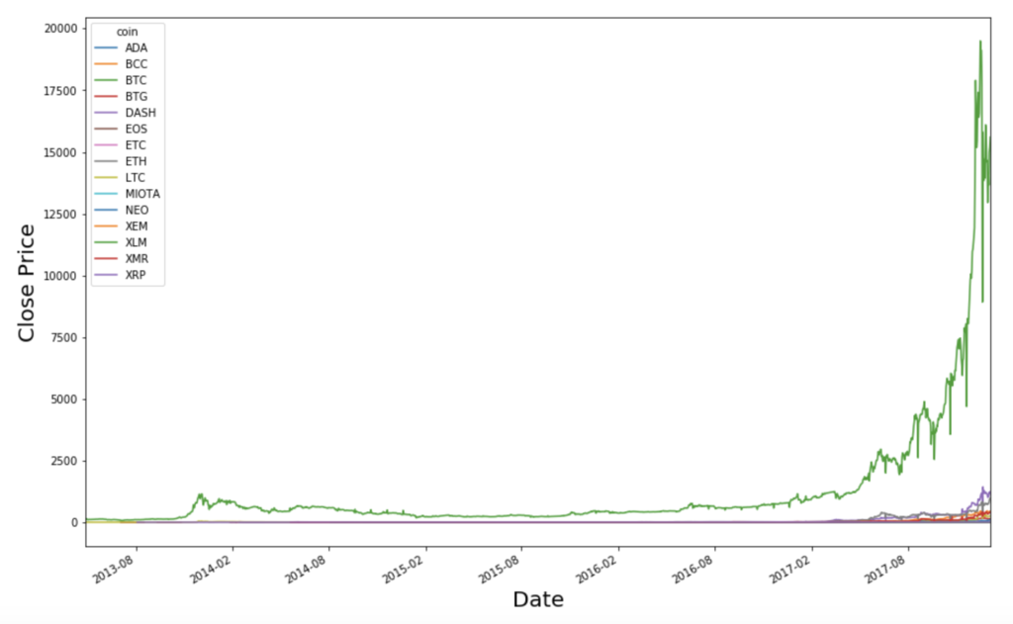
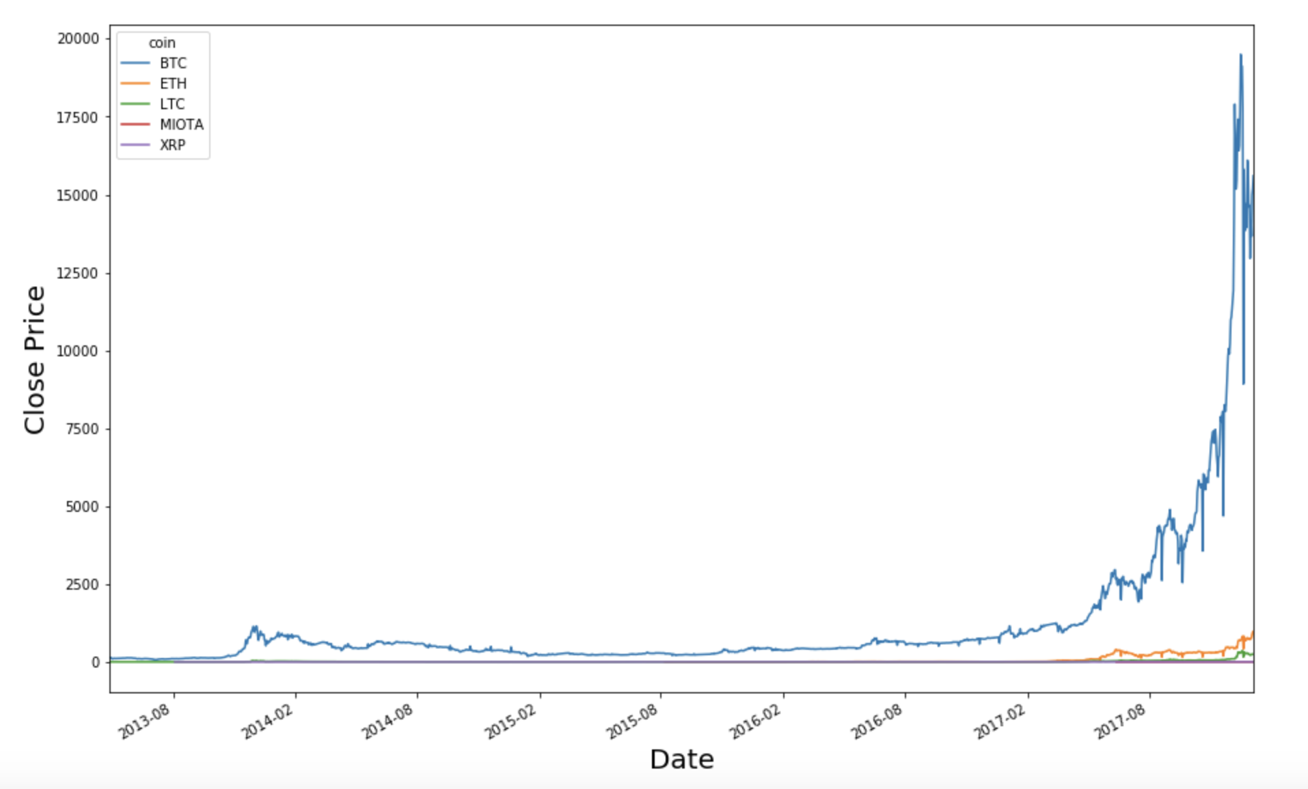
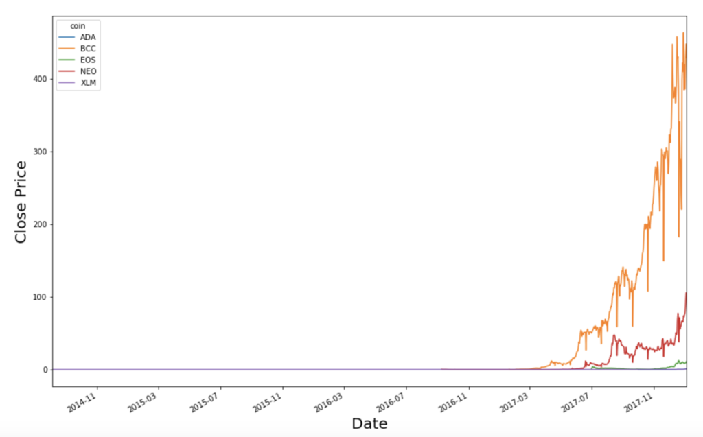
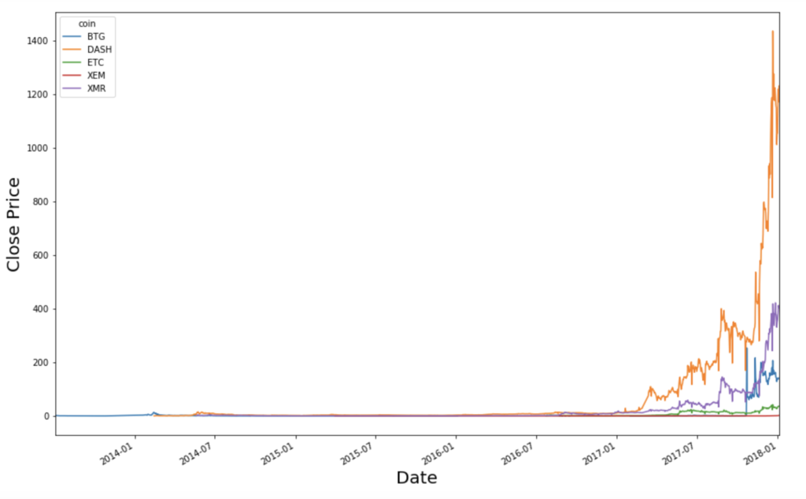
Trend (slope) of BTC
Trend (slope) of BCC
Trend (slope) of DASH
Trend (slope) of BTC

Slide 14
Cryptocurrency Volatility
Notes:
As you all know, the cryptocurrencies are very volatile, the market is constantly going up and down. So, the next question that we explored was the volatility among the different cryptocurrencies. To analyze volatility, we calculated the historical volatility values of each of the top 15 cryptocurrencies. Historical volatility is essentially the average deviation from the average price over a specific period of time, in this case, over 2017 since it provides us with the most accurate and recent values.

Slide 15
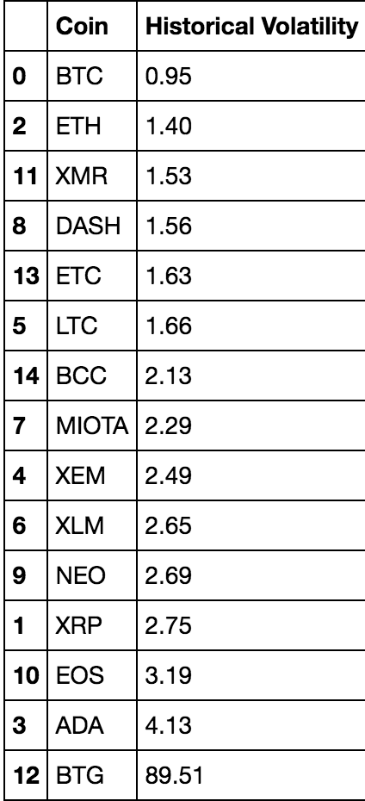
Comparing Historical Volatility Values
Bitcoin (BTC) had the lowest volatility value
Bitcoin Gold (BTG) had the highest volatility value
Notes:
These are the results. As you can see, BTC has the lowest volatility value whereas BTG has the highest volatility value.

Slide 16
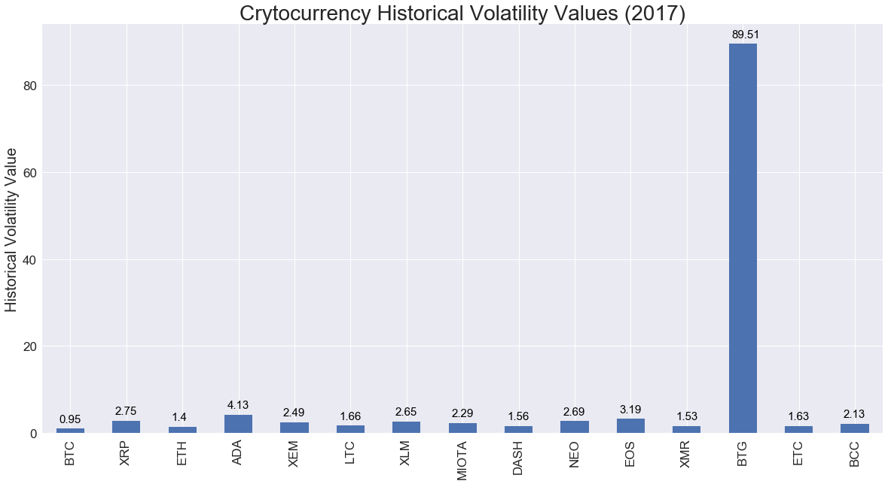
Notes:
We then created a bar graph of the different historical volatility values in order to visualize and compare the values. As you can see BTG has the highest historical volatility value by far compared to the others.

Slide 17
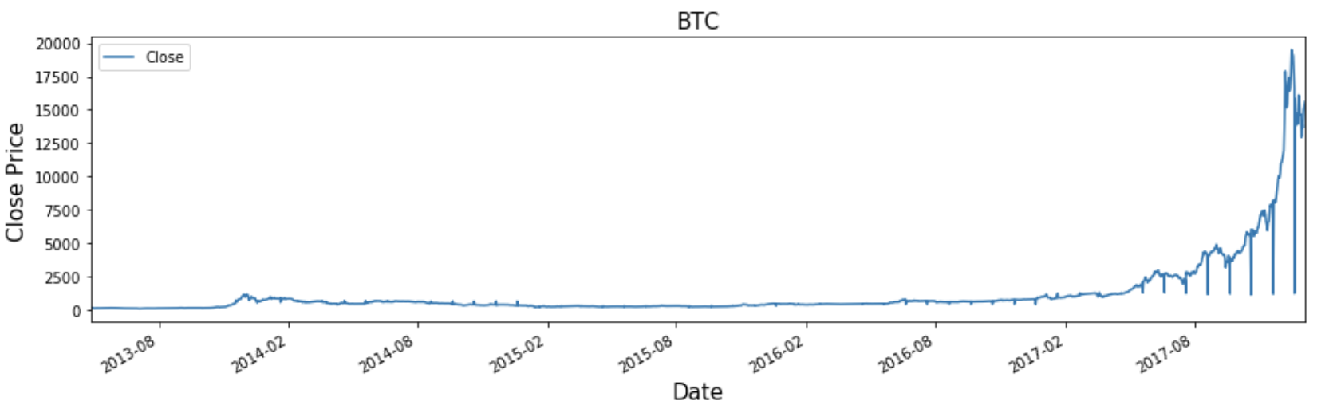
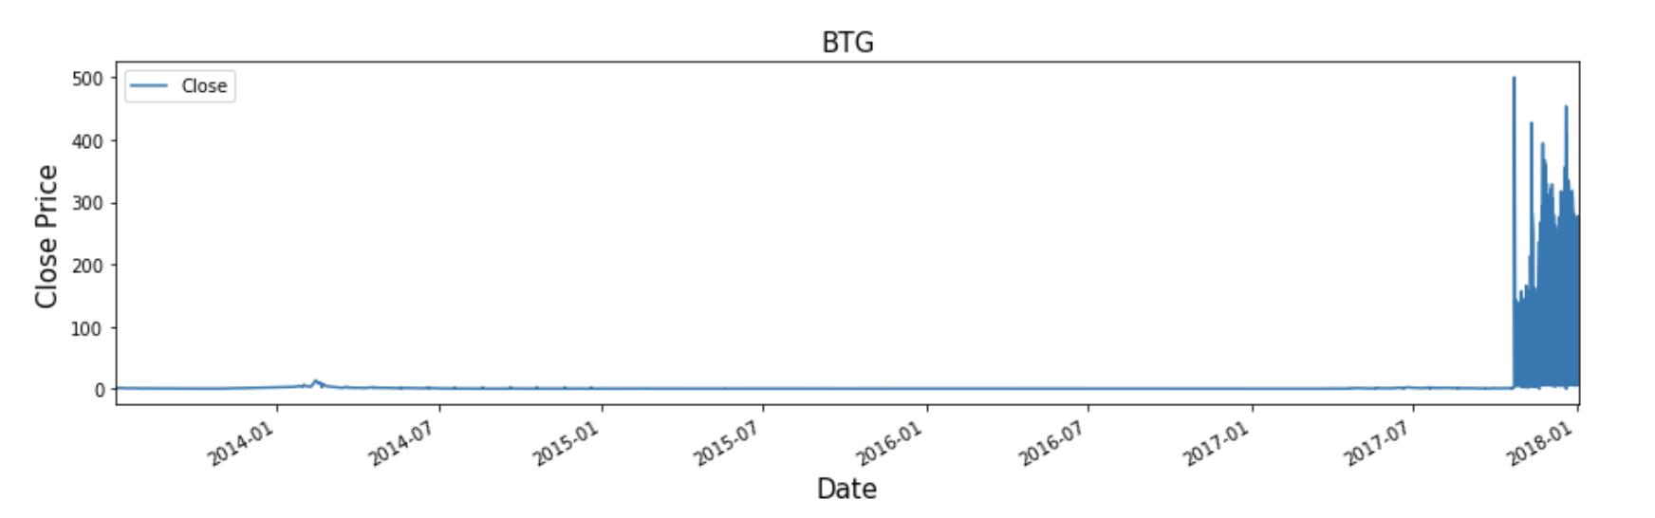
Bitcoin VS Bitcoin Gold
Notes:
We believe that it is possible that historical volatility is correlated to how long each cryptocurrency has been in the market. BTC has been in the market the longest, since 2009 and it has the lowest HVV whereas BTG has been in the market the shortest since Oct 2017 and it has the highest HVV. The graphs show this, see how volatile BTG is compared to BTC and it was flat prior to this year because it didn’t exist yet.

Slide 18
A day in the life of a day trader

Slide 19
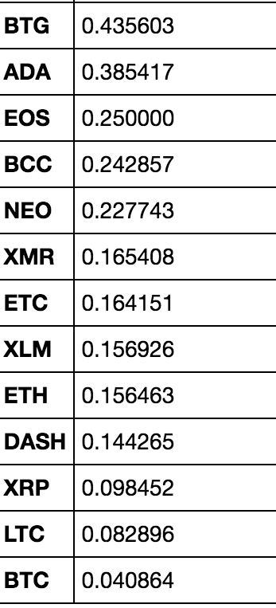
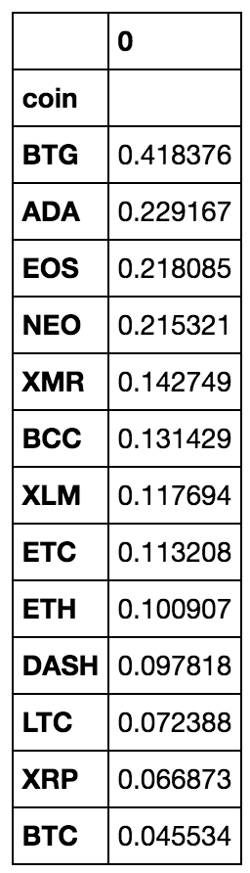
Propensity within a day to grow or fall more than 10%
Growth From Open
Drop From Open
Notes:
Propensity within a day to grow or fall more than 10%

