Slide 1

Rockbuster Sales Analysis
Sharon Thapa

Slide 2
Introduction
Rockbuster Stealth LLC is a movie rental company that has stores around the world. Facing stiff competition from streaming services such as Netflix and Amazon Prime, the Rockbuster Stealth management team is planning to use its existing movie licenses to launch an online video rental service in order to stay competitive.

Slide 3
KEY Questions
What is the average rental durations of all videos?
Which movie made the most/least contribution to the revenue?
Which countries are Rockbuster customer based in?
Where are customers with a high lifetime value based?
Do sales figures vary between geographic regions?

Slide 4
Insight on Rentals & Customers
● The min rental duration is 3 and max rental duration is 7.
● Our database includes 599 customers and 1000 movies.
● Rental rates are between $0.99, $2.99, and $4.99, with average being $2.98.

Slide 5

Top 10 countries

Slide 6
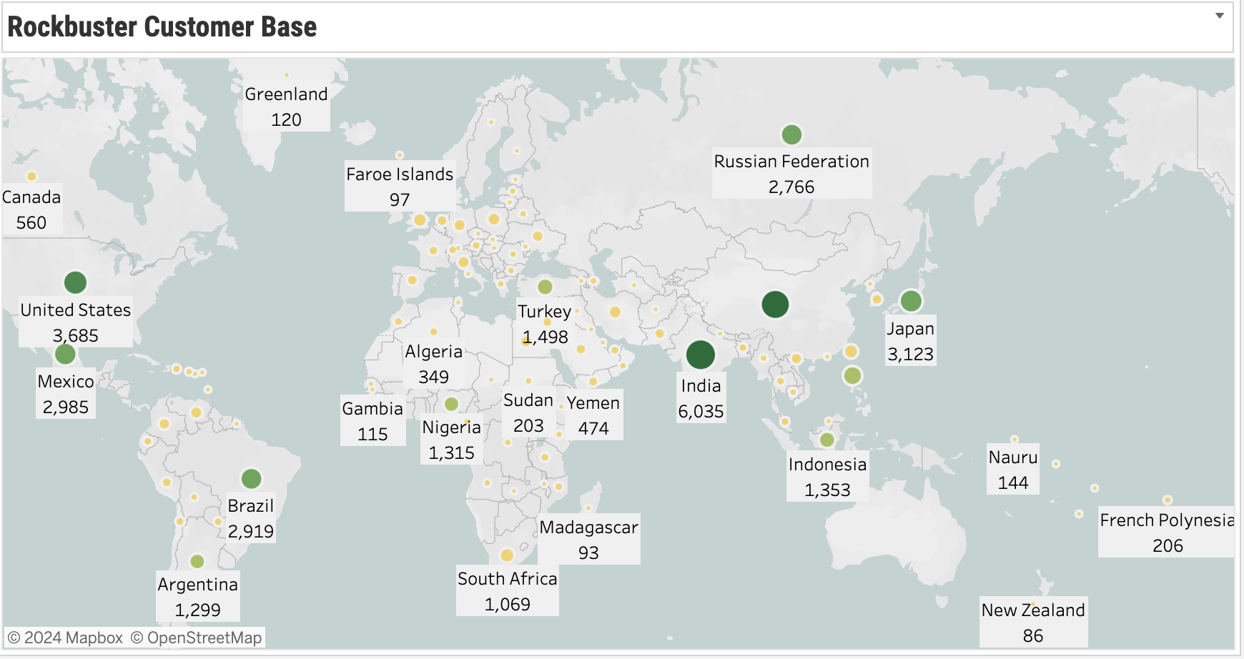
India has the biggest customer base followed closely by China
Tableau viz:

Slide 7
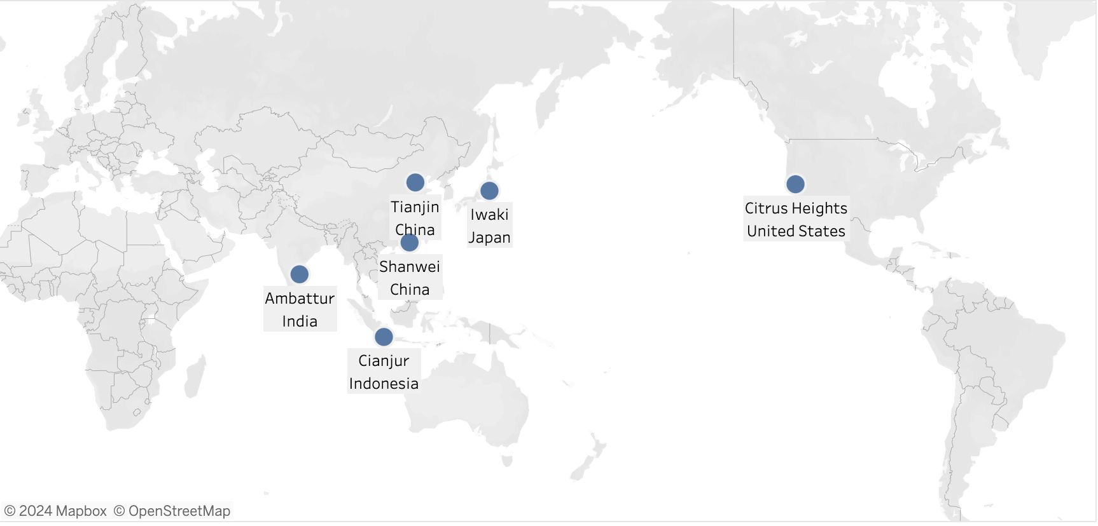
6 of the cities from the top 10 countries also appear in the high value cities.
Tableau

Slide 8
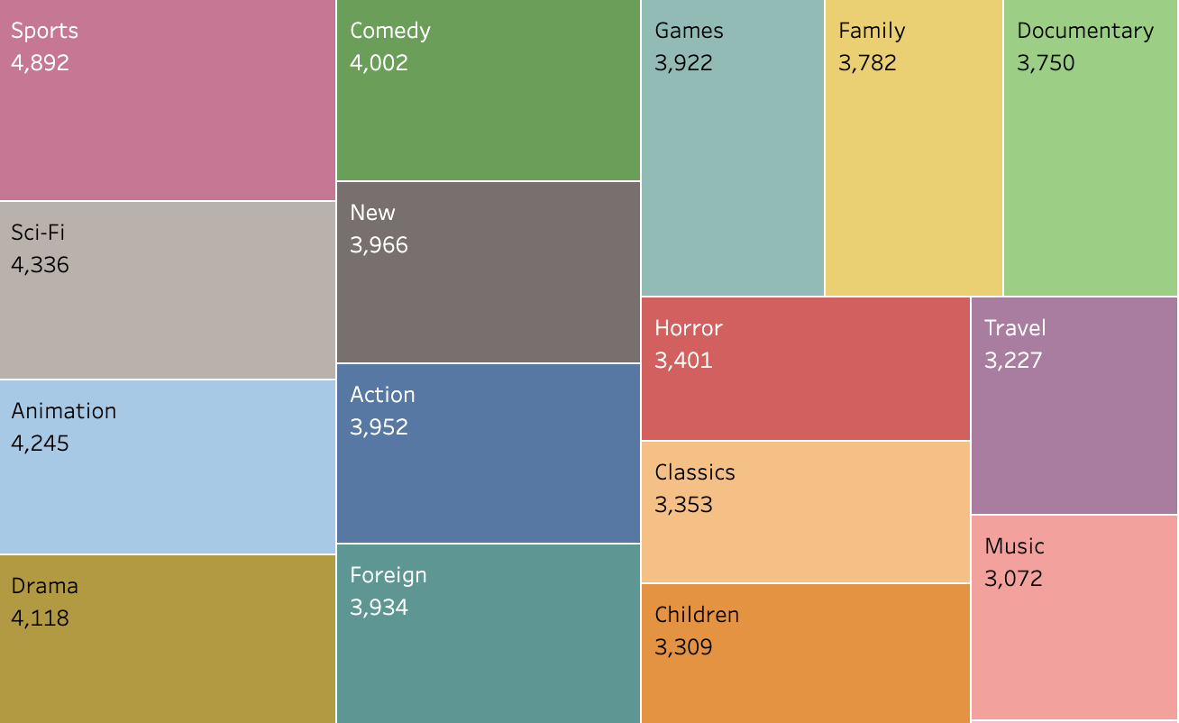
Sports genre contributed the most to the revenue followed by Sci-fi then Animation
Tableau

Slide 9
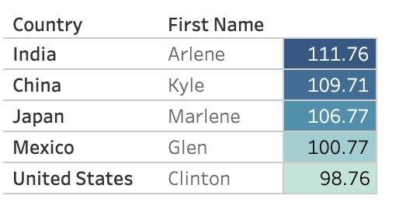
Top Customer and their location
Tableau

Slide 10
Recommendations
Rockbuster should focus their marketing efforts in India and China as they bring the most customers.
Sports, sci-fi, animation, drama and comedy are the genre that brings in the most revenue.
Loyal customers should get additional benefits such as coupons, discounts and may be even referral bonuses.

Slide 11
For further inquiries, please contact: sharon.thapa@gmail.com

Slide 12
Thank you

