Slide 1
QUANTITATIVE FINANCE · FIN 4975
AI Stocks vs.
Traditional Stocks
Has the AI Boom Created Abnormal Market Performance?
Presented By Sharon Vera
NVDA · MSFT · AMD · META · GOOGL · AVGO vs KO · PG · WMT · JPM · XOM · JNJ
Sample Period: Jan 2020 – May 2026 · N=1,605 observations · Benchmark: SPY
1 / 9

Slide 2
Research Question & Hypothesis
What are we testing, and what do we expect to find?
Research Question
Hypotheses
Has the launch of large language models — specifically ChatGPT in November 2022 — created statistically significant abnormal returns in AI-related stocks relative to traditional defensive stocks?
Can those returns be explained by known risk factors, or do they represent genuine alpha?
H₁
AI stocks generate abnormal returns vs. traditional stocks over the full sample
H₂
This outperformance is statistically significant (p < 0.05)
H₃
AI returns cannot be fully explained by market risk (positive alpha)
H₄
The ChatGPT launch (Nov 2022) triggered a measurable structural shift
2 / 9

Slide 3
Data & Methodology
Sources, portfolios, and analytical framework
AI Portfolio
Traditional Portfolio
Data & Methods
NVDA — NVIDIA Corp.
KO — Coca-Cola
Yahoo Finance (yfinance)
MSFT — Microsoft
PG — Procter & Gamble
Daily adjusted close prices
AMD — Advanced Micro Devices
WMT — Walmart
Jan 2020 – May 2026
META — Meta Platforms
JPM — JPMorgan Chase
Equal-weighted portfolios
GOOGL — Alphabet
XOM — ExxonMobil
1,605 daily observations
AVGO — Broadcom
JNJ — Johnson & Johnson
CAPM & Dummy regression
Post-ChatGPT break: Nov 2022
3 / 9
Manual OLS via NumPy

Slide 4
Performance Overview
Full sample summary statistics (Jan 2020 – May 2026, N=1,605 daily obs.)
893%
147%
152%
1.431×
AI Portfolio
Cumulative Return
(9.93× growth)
Traditional Portfolio
Cumulative Return
(2.47× growth)
SPY Benchmark
Cumulative Return
(2.52× growth)
AI Beta vs SPY
(Trad β = 0.622)
42%
1.22
34.4%
0.718
AI Annualized Return
(Trad 15.6% | SPY 16.6%)
AI Sharpe Ratio
(Trad 0.92 | SPY 0.81)
AI Ann. Volatility
(Trad 17.1% | SPY 20.4%)
CAPM R²
(AI vs SPY)
AI portfolio delivered 9.93× growth vs 2.47× traditional (2.52× SPY). AI annualized return of 42% with a Sharpe ratio of 1.22 — superior risk-adjusted performance. However, AI volatility (34.4%) is 2.0× that of the traditional portfolio (17.1%).
4 / 9

Slide 5
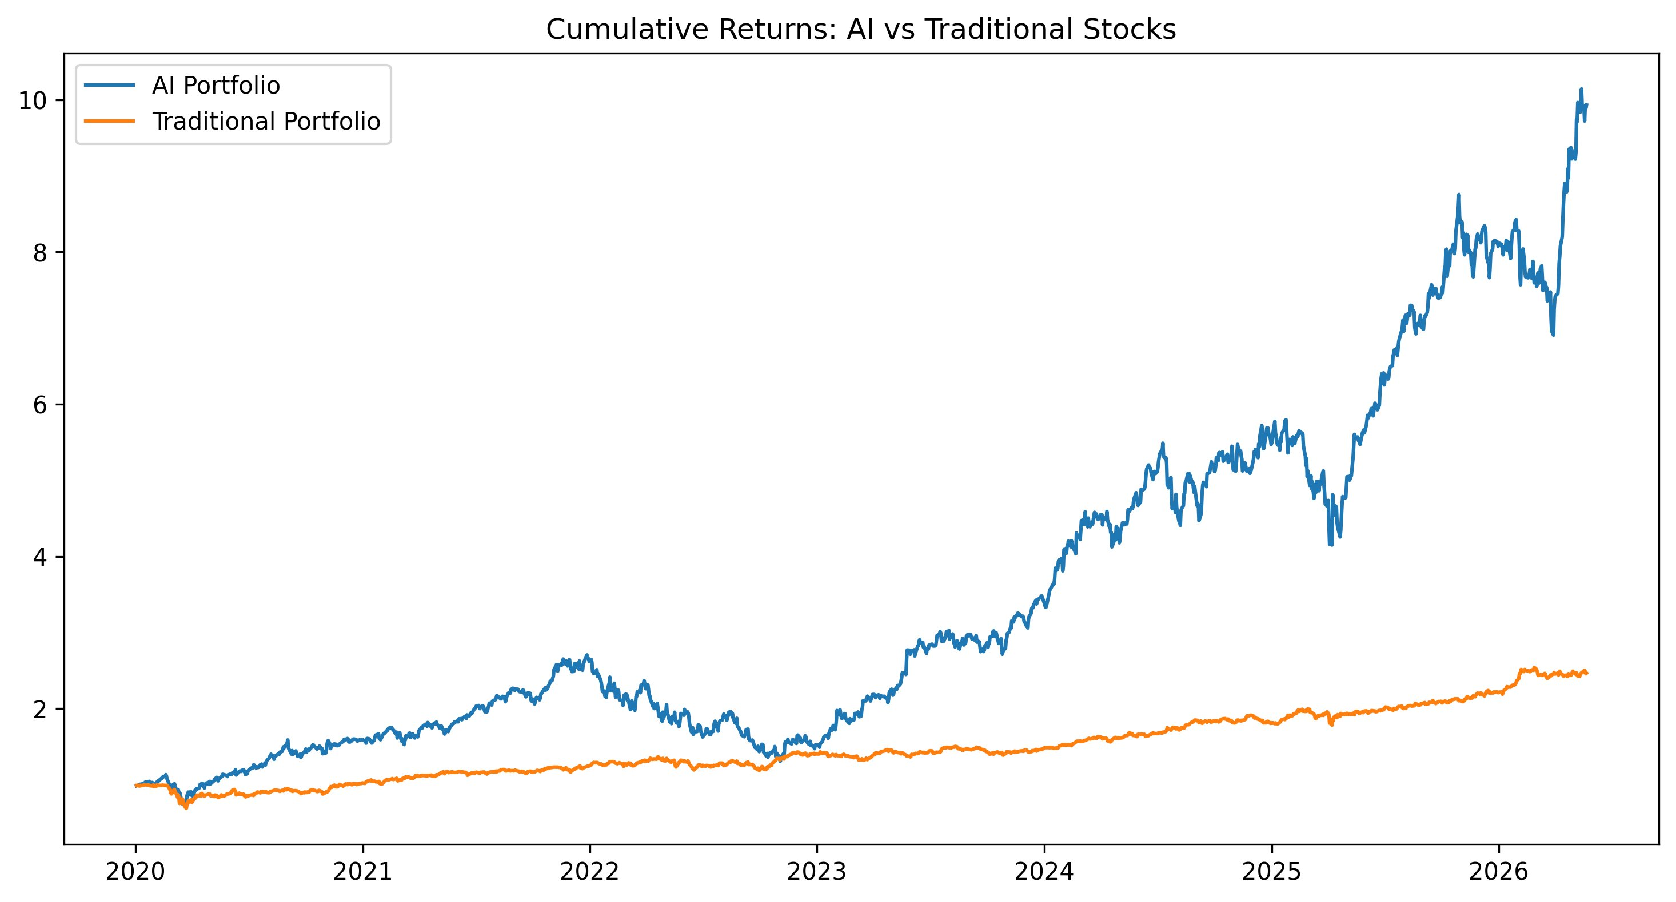
Cumulative Returns: Growth of $1
AI reached 9.93× vs 2.47× traditional and 2.52× SPY (Jan 2020–May 2026)
5 / 9
ChatGPT launched Nov 30, 2022 — visible inflection in AI portfolio. Pre-ChatGPT AI daily mean: 0.089% | Post-ChatGPT: 0.232% (2.6× increase in daily return).

Slide 6
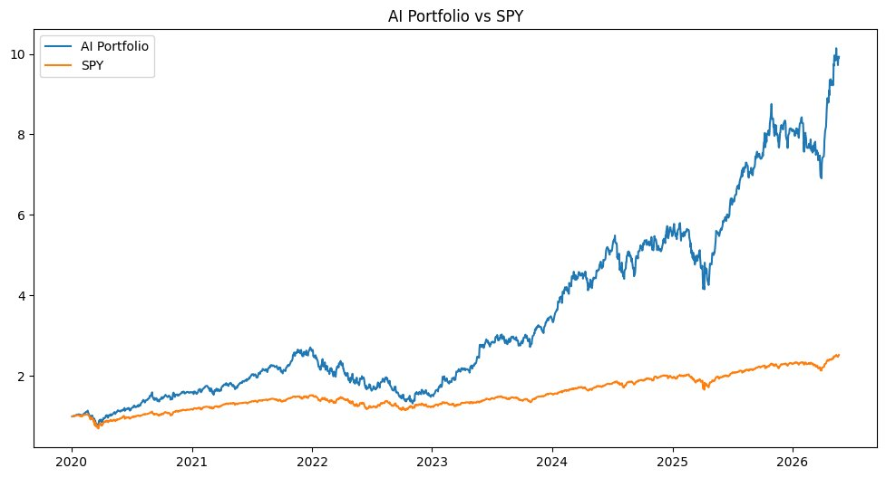
AI Portfolio vs SPY Benchmark
AI dramatically outpaces the broad market — divergence accelerates post-2023
AI: 893% total return | β = 1.431 | α = +7.2 bps/day
SPY: 152% total return | β = 1.00 | Sharpe = 0.81
6 / 9

Slide 7
CAPM Regression Results
Daily AI returns regressed on SPY — N=1,605 observations, R²=0.718
Model: AI_Portfolio Return = α + β · SPY Return + ε
Variable | Coefficient | t-Statistic | P-Value | Interpretation
α (Intercept / Alpha) | 0.000725 | 2.520 | 0.012 ✓ | Statistically significant daily excess return
β (Beta vs SPY) | 1.4310 | 63.951 | < 0.001 ✓ | AI moves 43% more than the market
R² (Goodness of Fit) | 0.7180 | — | — | 71.8% of AI returns explained by SPY
Observations | 1,605 | — | — | Jan 2020 – May 2026 (daily)
✓ Alpha Is Statistically Real
⚠ High Market Sensitivity
α = 0.000725 per day | t = 2.52 | p = 0.012
β = 1.431 → 43% amplification of market moves up AND down
7 / 9

Slide 8
Post-ChatGPT Structural Break Test
Did the November 2022 ChatGPT launch cause a measurable shift in AI returns?
Regression Specification
Test Results
AI_Return = α + β₁ · Post_ChatGPT + ε
Where:
• Post_ChatGPT = 1 if date ≥ Nov 30, 2022
= 0 otherwise
Pre-ChatGPT obs: 733 days
Post-ChatGPT obs: 872 days
If β₁ > 0 and significant → ChatGPT triggered a structural increase in AI performance.
Pre-ChatGPT AI mean
0.089% / day
Post-ChatGPT AI mean
0.232% / day
β₁ Dummy Coefficient
+0.001433
t-Statistic
1.319
p-Value
0.187
Significance
Not significant (p > 0.05)
8 / 9
Interpretation: Dummy is positive (+0.0014) but p=0.187 — not statistically significant at the 5% level. Raw daily means show a 2.6× increase post-ChatGPT, consistent with sustained trend momentum rather than a single-event break.

Slide 9
Individual Stock Performance
Annualized returns for each stock (Jan 2020–May 2026)
AI Portfolio stocks (NVDA, AMD, AVGO, GOOGL, META, MSFT)
Traditional Portfolio stocks (WMT, JPM, XOM, JNJ, KO, PG)
9 / 9

Slide 10
Conclusions &
Investment Implications
✓
Alpha is statistically real (p=0.012)
AI stocks earn α=0.000725 per day — statistically significant. Over 1,605 observations this produces 42% annualized excess return vs. 16.6% for SPY.
✓
Superior risk-adjusted returns (Sharpe 1.22 vs 0.81)
Despite 34.4% annualized volatility (2.0× traditional), the AI portfolio's Sharpe ratio of 1.22 dominates both traditional (0.92) and SPY (0.81).
~
No clean ChatGPT structural break (p=0.187)
Dummy coefficient is positive but insignificant. Post-ChatGPT daily mean (0.232%) is 2.6× pre-ChatGPT (0.089%), but driven by sustained momentum, not a discrete break.
→
Portfolio implication: high-conviction, high-risk allocation
Beta of 1.431 amplifies market moves by 43%. Optimal allocation depends on risk tolerance; consider tactical sizing and hedging during high-volatility regimes.
"Factor investing requires constant evaluation. Signals can strengthen or weaken as market structure evolves — but 9.93× growth in 6 years is hard to ignore."
10 / 10

