Slide 1
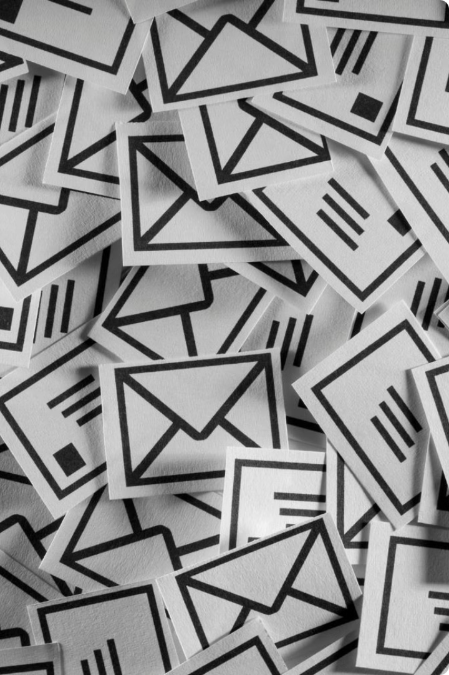
Introduction to Spam Classification
Spam emails are unwanted and unsolicited messages that clog our inboxes. Spam classification aims to identify and filter out these messages, improving our email experience.

Slide 2
Natural Language Processing (NLP) Techniques
1
Tokenization
2
Stemming & Lemmatization
The process of breaking down text into individual words or units, known as tokens, is essential for analyzing and processing the language.
These techniques reduce words to their base forms, removing inflectional endings and variations, thereby standardizing words for analysis.
3
Part-of-Speech Tagging
4
Sentiment Analysis
Understanding the grammatical role of each word in a sentence allows us to extract context-specific information, enriching the analysis.
By analyzing the emotional tone of text, we can identify potentially malicious or deceptive messages often associated with spam.

Slide 3
Feature Engineering for Spam Detection
Word Frequency
N-gram Analysis
Link Analysis
Certain words frequently appear in spam emails. Analyzing word frequency can help identify suspicious patterns and classify messages as spam.
Sequences of words, known as n-grams, can reveal patterns and phrases that are more common in spam emails. For example, "free money" or "click here" are common n-grams.
Examining the links contained in an email, including the domain name and URL structure, can help detect malicious or suspicious URLs associated with spam.

Slide 4
Supervised Learning Algorithms
Naive Bayes
Support Vector Machines (SVMs)
A probabilistic classifier that calculates the probability of an email being spam based on the occurrence of words in the email.
SVMs find a hyperplane that separates spam from legitimate emails, using a mathematical approach to classify new emails.
Decision Trees
Random Forests
Decision trees use a series of rules based on features of the email to classify it as spam or not. The rules are structured like a tree.
An ensemble method combining multiple decision trees, each trained on a different subset of the data, to improve the accuracy and robustness of the spam classifier.

Slide 5
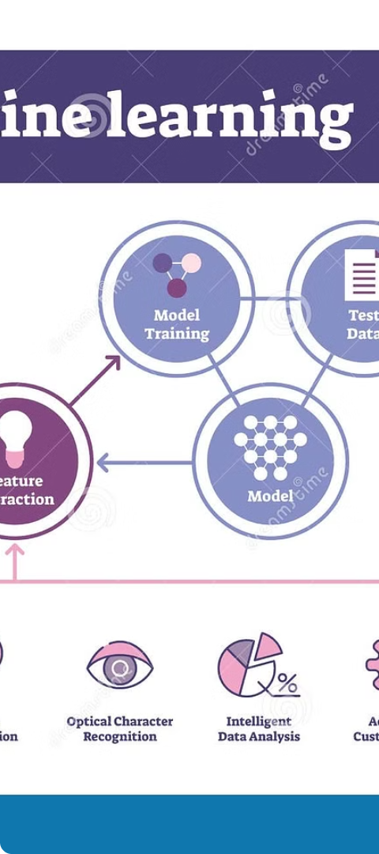
Model Training and Evaluation
1
Data Preparation
The first step involves preparing and cleaning the dataset, including removing noise and handling missing values.
2
Model Training
The chosen algorithm is trained on the prepared dataset, learning patterns and relationships between features and the spam classification label.
3
Model Evaluation
The trained model is tested on a separate dataset to assess its performance, using metrics like accuracy, precision, and recall.

Slide 6
Handling Imbalanced Datasets
Oversampling
Duplicating minority class instances to balance the dataset.
Undersampling
Removing instances from the majority class to reduce the imbalance.
Synthetic Minority Oversampling Technique (SMOTE)
Generating synthetic instances for the minority class to increase its representation in the dataset.
Cost-sensitive Learning
Assigning different costs to misclassifications, penalizing misclassification of the minority class more heavily.

Slide 7




Real-world Deployment Challenges
Evolving Spam Techniques
Spammers continuously evolve their tactics, making it challenging for spam filters to keep up and accurately detect new spam variations.
False Positives
Sometimes, legitimate emails are mistakenly classified as spam, leading to inconvenience and potential loss of important communication.
Computational Resources
Training and running complex spam classification models can be computationally intensive, requiring significant resources and infrastructure.

Slide 8



Conclusion and Future Directions
Advancements in NLP
User Feedback Integration
Combating Zero-day Spam
Further advancements in NLP, including deep learning techniques, hold promise for developing more sophisticated and effective spam classification models.
Integrating user feedback into the spam classification system can help improve its accuracy and adapt to evolving spam patterns.
Research on detecting and classifying zero-day spam, which uses novel techniques not yet known to existing filters, is crucial for future spam protection.

