Slide 1

Unstacking the overflow…
A closer look at the data science community
By Rush Bhardwaj | Josh Chen | Sameen Haroon | Sharon Xu

Slide 2
Agenda for today
1
Introduction
Project context and motivation
2
Big data tools & techniques
The Google ecosystem, what we used, and some useful tips
3
Project findings
Descriptive and predictive insights
4
Conclusion
Takeaways and potential next steps

Slide 3



1
Introduction
Our project focuses on the intersection of big data tools, techniques and trends
Big Data
Stack Overflow Data
Technology
Objective
Enormous data
Fast generation
Low cost
Diverse types
Growing demand for data analytics skill
Most popular data science platform
High quality programming questions
Reflect interests in data analytics field
Google Cloud Platform
Public dataset on BigQuery
Support clusters for distributed computing
Integration with broader Google technology stack e.g. for web analytics
Uncover trends & insights related to data science
Broaden understanding of big data ecosystem
Explore text mining implementation with large-scale data

Slide 4
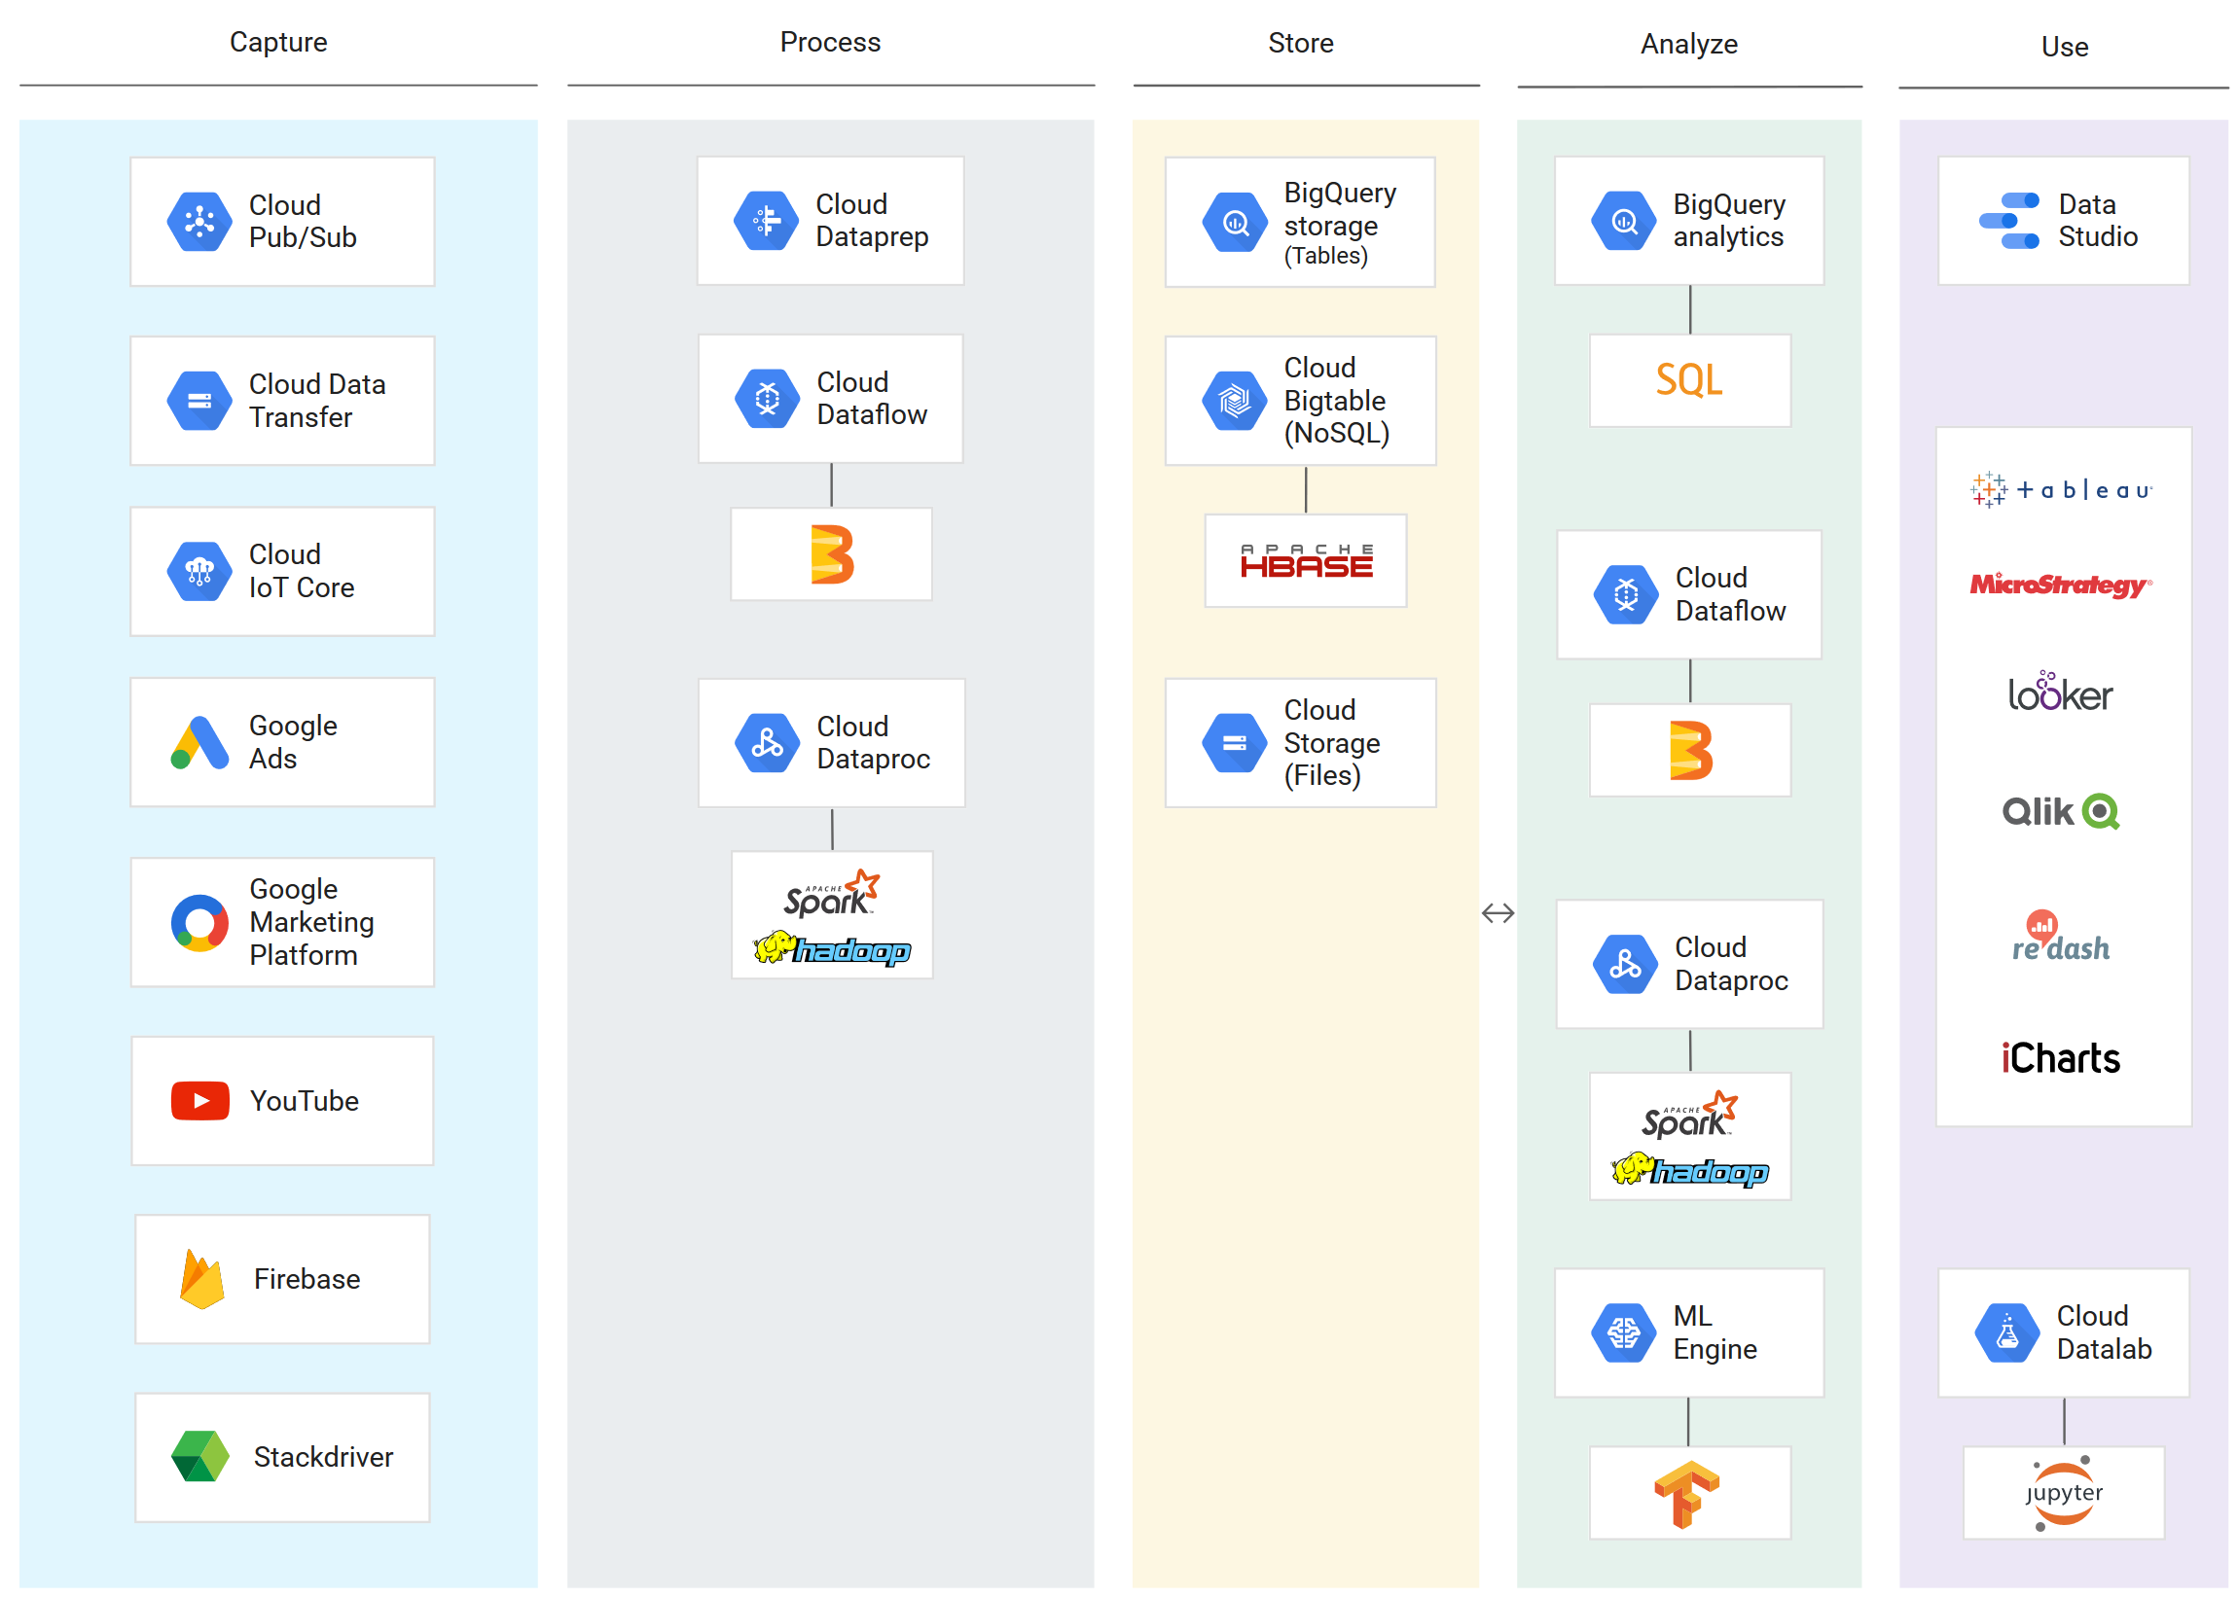
2
Big data tools and techniques
The Google Cloud Platform (GCP) is part of a tech ecosystem that supports the full spectrum of business data needs

Slide 5



2
Big data tools and techniques
We leveraged a variety of big data technologies within GCP and other familiar tools
Big Query
Google Cloud Storage
Cloud Dataproc
Tableau
What it is:
Enterprise data warehouse which uses SQL to enable interactive analysis of massive datasets.
What it is:
Unified cloud storage which is highly integrated with Google cloud big data ecosystem.
What it is:
Cloud service used for running open source ecosystem e.g. Spark and Hadoop clusters
What it is:
Business intelligence tool for analyzing and visualizing data to gather rich insights.
What we used it for:
Data storage, retrieval, basic processing
What we used it for:
Data storage, retrieval
What we used it for:
Data processing, machine learning
What we used it for:
Data visualization via live API connection
Technologies used with supporting big data tools and languages, including Spark ML and SQL

Slide 6








2
Big data tools and techniques
Along the way, we learned some useful things about how to work with these tools in the big data ecosystem
Stack overflow public data
Google Big Query
Compute Engine
Google Storage
Apache Hadoop
Google Storage
CSV / JSON files
Tableau
Google Big Query
To support business operations, it’s possible to transfer data between BigQuery, Cloud Dataproc, and Tableau for capture, processing, machine learning and visualization.

Slide 7
3
Project findings: descriptive
We examined stack overflow community data generated during the past 10 years
16M+
questions posted
3.2M
unique users
53M+
votes on posts
212GB
of total data
Working data scaled down to about 26GB

Slide 8
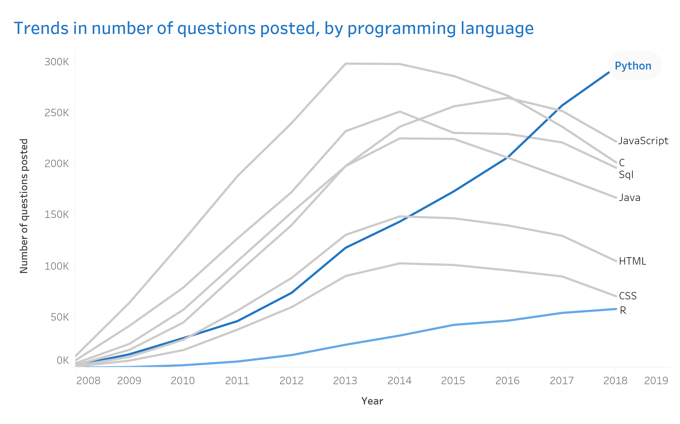
3
Project findings: descriptive insights
What we found: Python emerges as the fastest growing language based on question volume
Observations
Sustained growth in number of questions posted about Python
Over 300K questions posted about Python in 2018
R also growing, but with smallest relative volume (about 60K)
Most other languages, including computer science (Java, C) and web programming (JavaScript, HTML) with decreasing volume by 2016

Slide 9
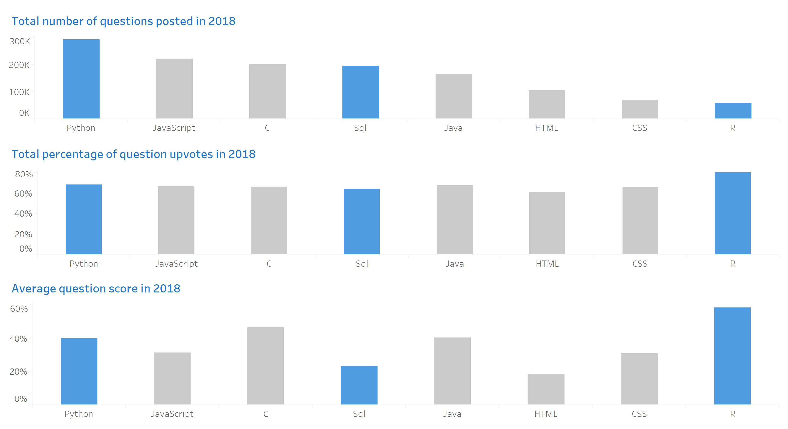
3
Project findings: descriptive insights
What we found: While Python leads in questions asked, R leads in percentage of question upvotes and average score

Slide 10
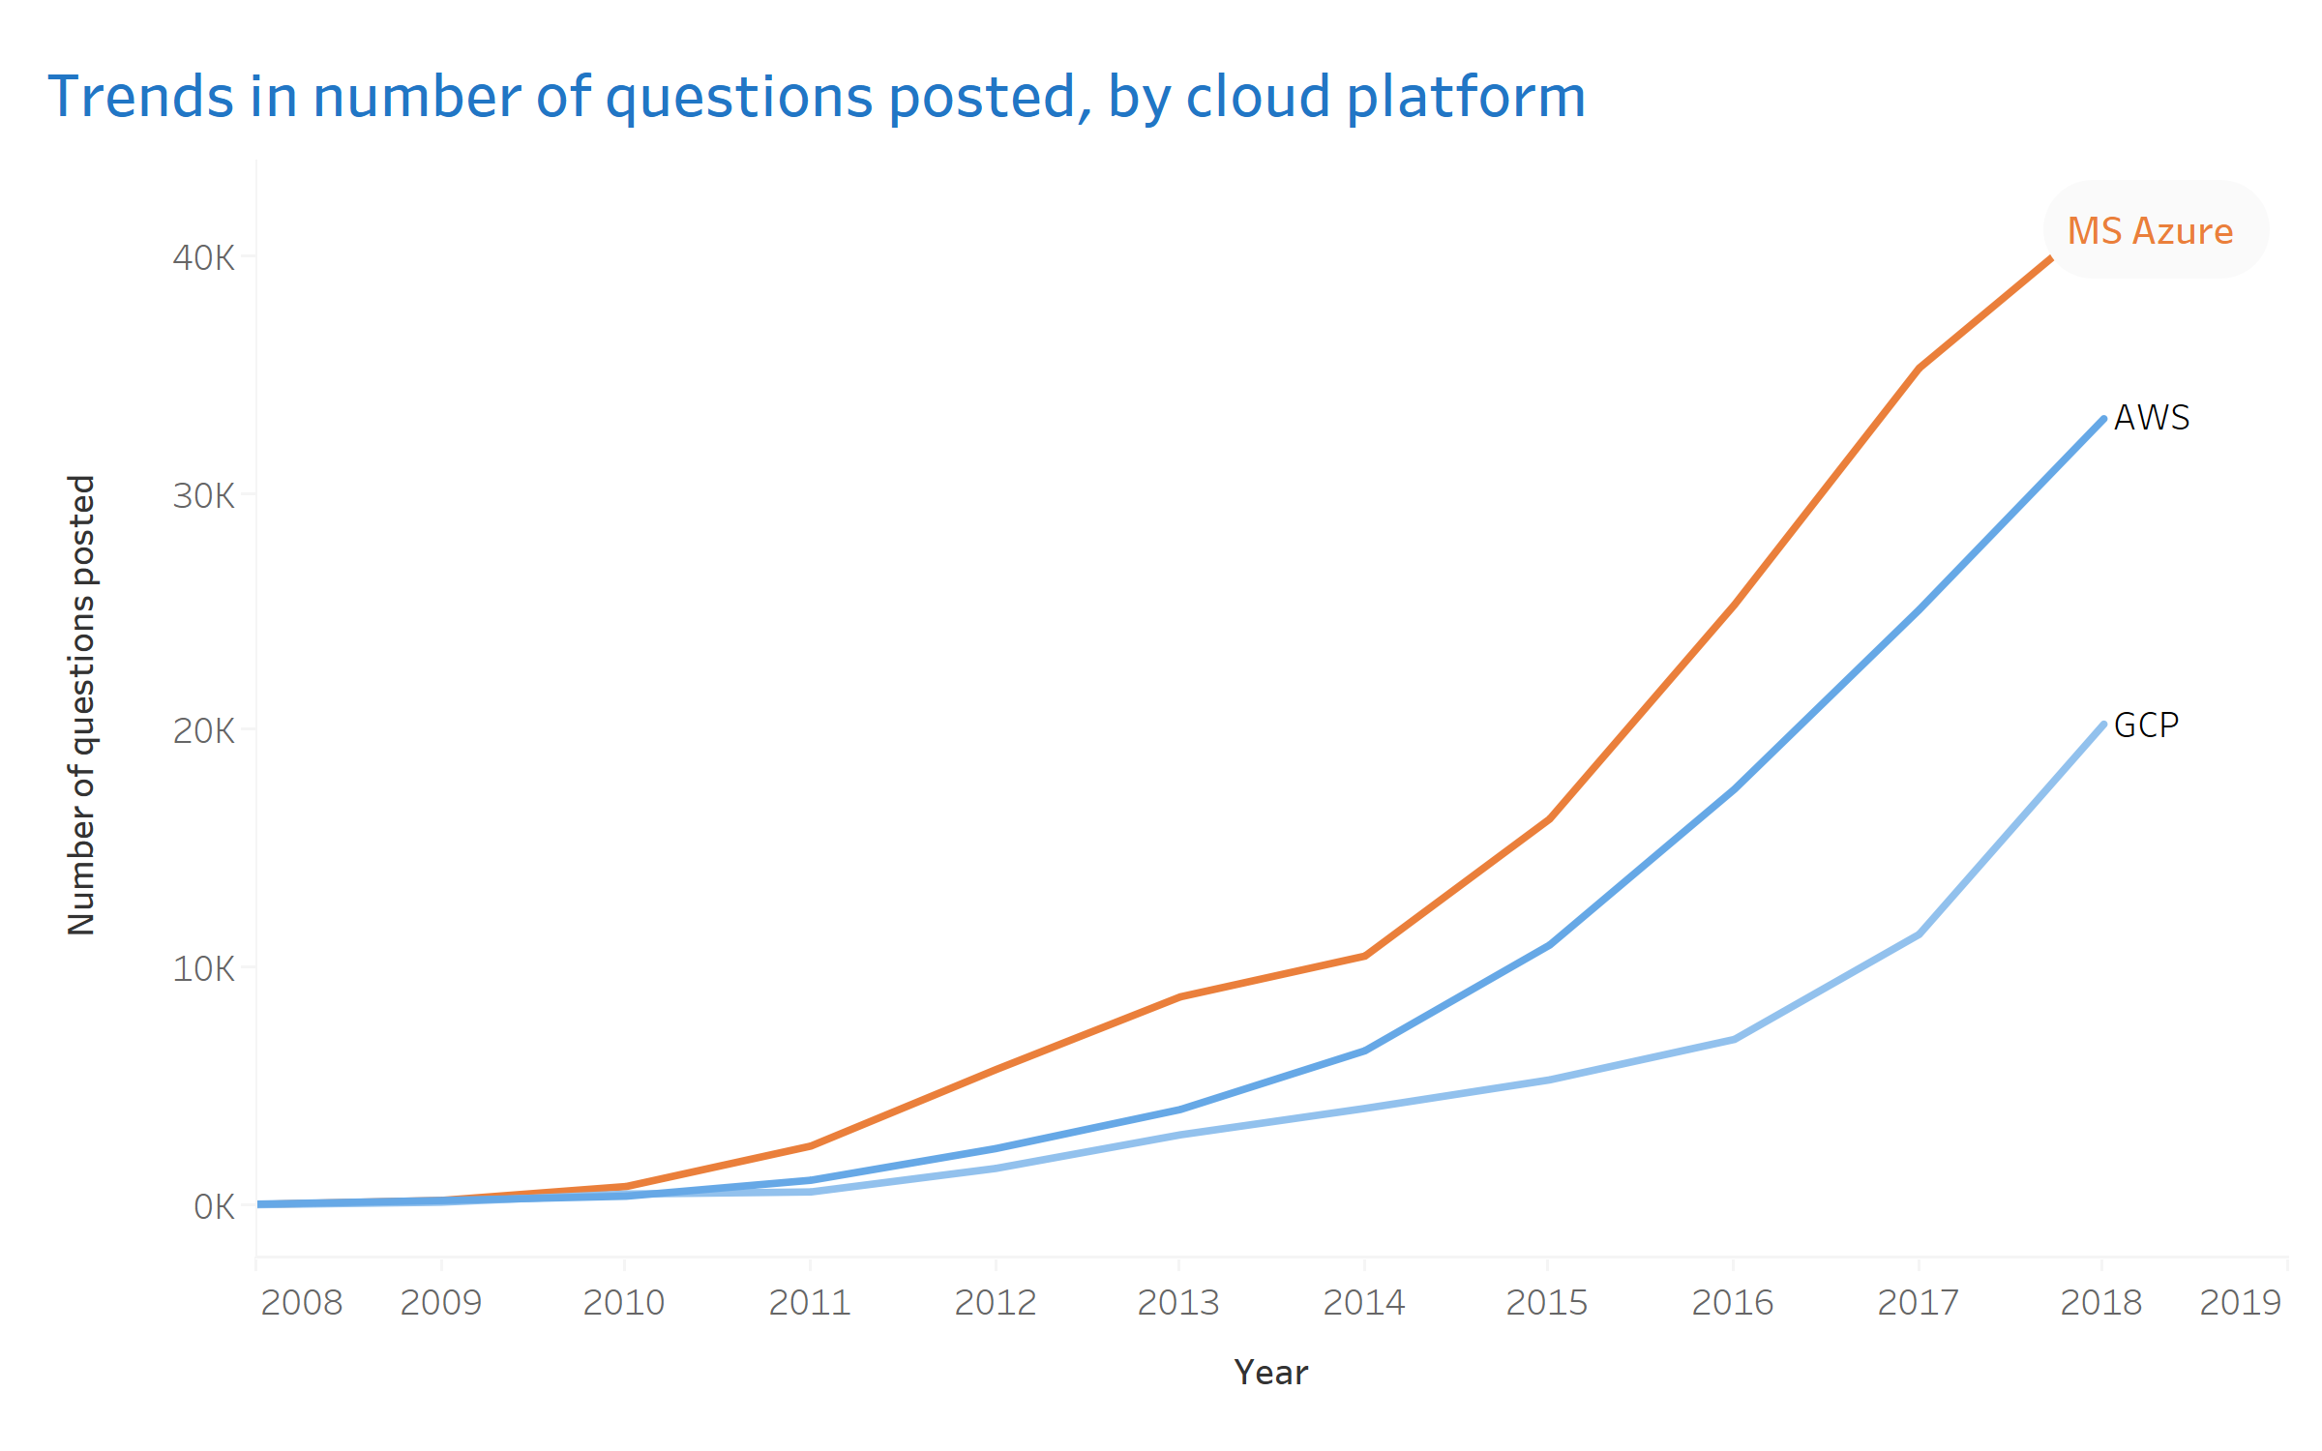
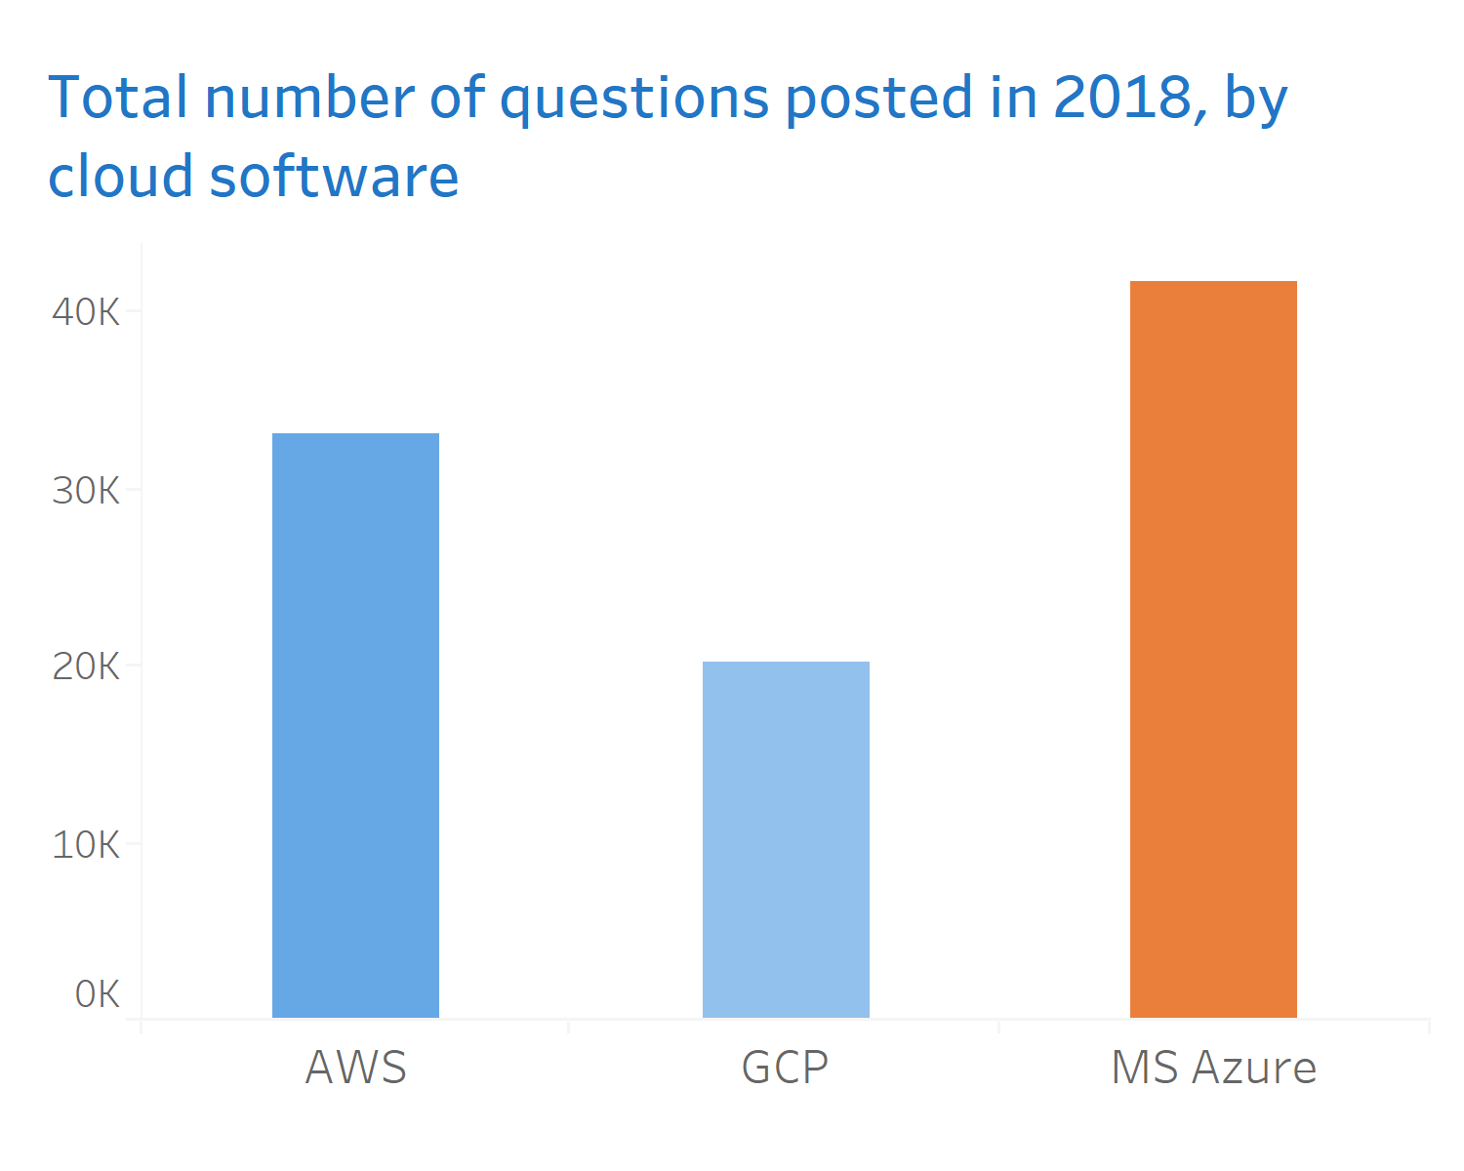
3
Project findings: descriptive insights
What we found: More people are asking questions about Microsoft Azure than Google or Amazon Cloud Computing

Slide 11
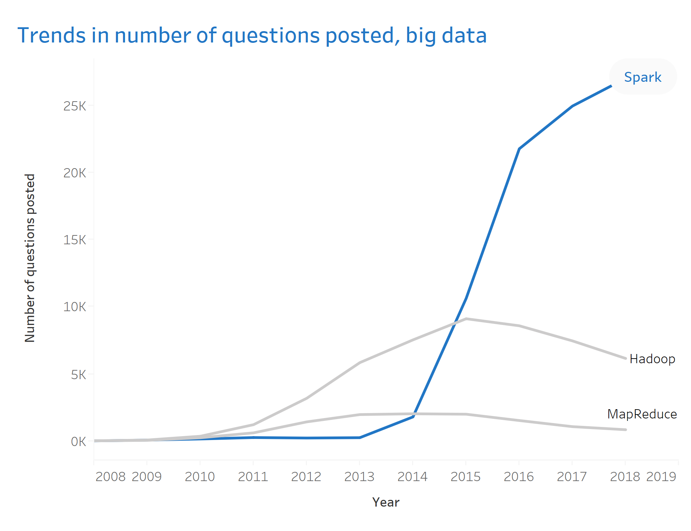
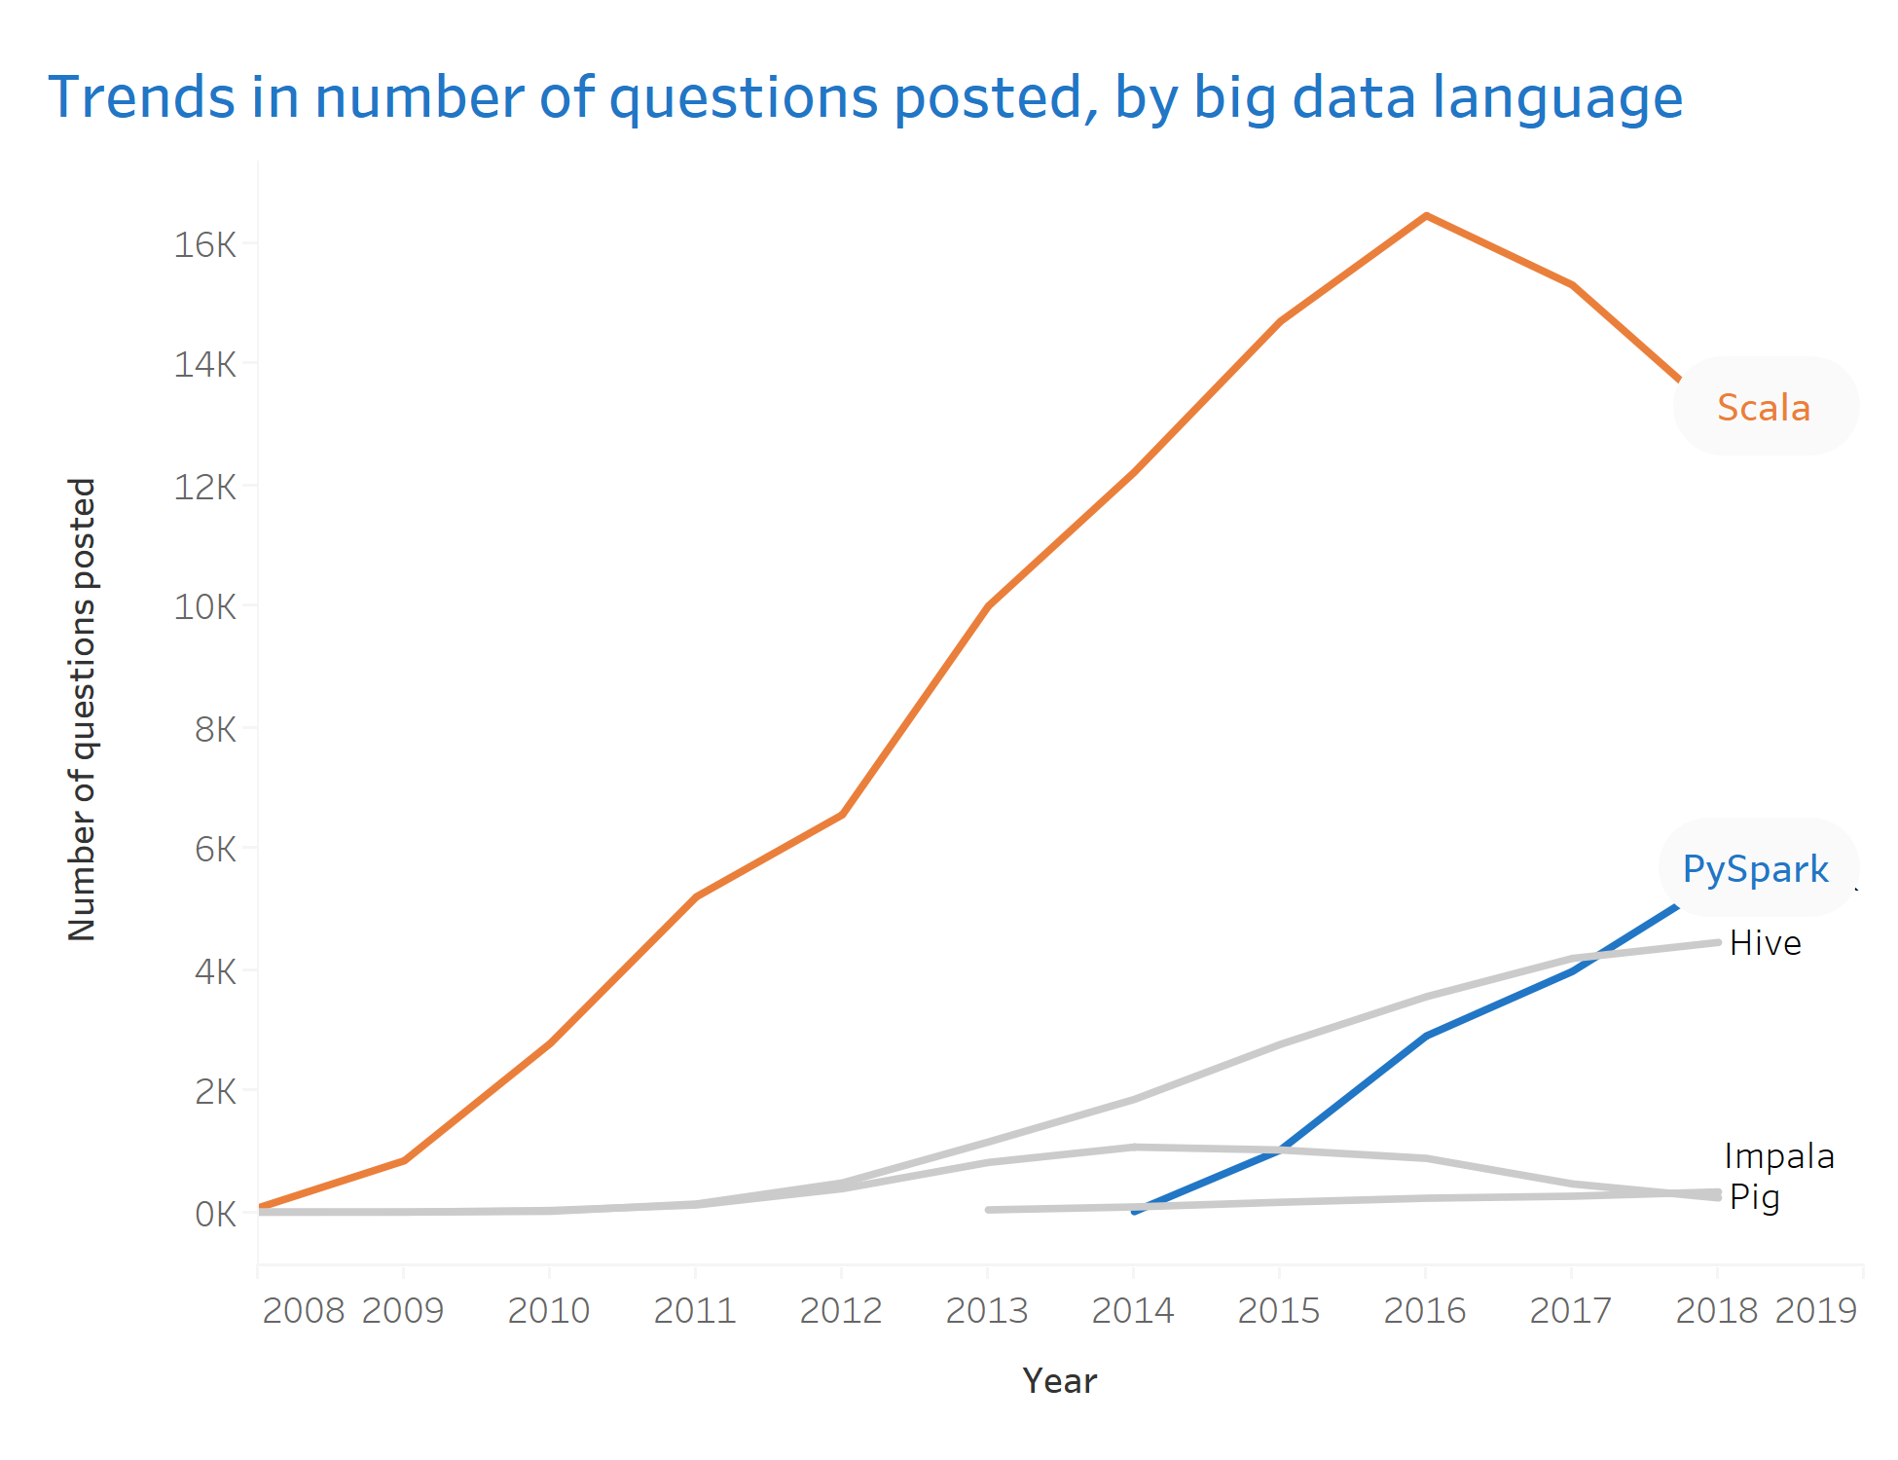
3
Project findings: descriptive insights
What we found: Growth in questions about spark best capture the big data trend, with rapid increase in PySpark as well

Slide 12
3
Project findings: predictive insights
Clicking a bit deeper, we also worked to identify trending topics in Python and R using text mining with Spark ML
Process for identifying trending topics
Processed data also used to explore question overlap
Open GCP Dataproc cluster
Connected to big query table on Hadoop
Prepare data using spark.sql
split tags, combined post title and post body to one text column, subset data to 2018
Trained LDA clustering models on spark using distributed computing
Example of processed data
Attribute | Content
Title | How to use an array as an input of a dense layer
Words | [array, input, dense, layer]
Count vector | (1678,[44,50,769],[1.0,1.0,1.0])
IDF vector | (1678,[44,50,769],[4.58,3.89,5.83])
Define stop words and filter out special characters
Cosine similarity used to assess overlap between pairs of questions
Run LDA model to find significant, distinctive topics
Get frequency count for words in each post into a sparse vector
Example Question 1
Example Question 2
Overlap
How to convert bytes data to string without changing data using python
How to convert a string into a float when reading from a text file
0.27
Get the importance of each word using TF-IDF

Slide 13
3
Project findings: predictive insights
We identified 5 significant and distinct topics that mapped to Python across post questions in 2018…
Topic 1 | Topic 2 | Topic 3 | Topic 4 | Topic 5
Module installation | Dataframes, plots | Neural networks | Web development | Data types
install | column | tensorflow | django | list
pip | row | model | server | string
path | list | loss | user | value
command | dataframe | training | class | array
module | class | shape | form | function
running | data | input | message | number
files | text | return | password | score
version | color | data | return | name
run | plot | nan | test | data
installed | value | none | data | time
Notes:
Cluster 0 – High-priced, often discounted
Cluster 1 – High baske

Slide 14
3
Project findings: predictive insights
…and another set of 5 significant and distinct topics that mapped to R across post questions in 2018
Topic 1 | Topic 2 | Topic 3 | Topic 4 | Topic 5
Module installation | Dataframes, matrix | Data visualization | Shiny, data types | Functions, files
install | matrix | plot | shiny | function
package | column | color | server | node
source | row | size | output | import
warning | columns | ggplot | int | raster
version | sample | image | num | times
checking | value | group | date | files
status | null | description | chr | excel
failed | var | altenter | text | run
age | amp | description | list | get
packages | function | class | column | name
Notes:
Cluster 0 – High-priced, often discounted
Cluster 1 – High baske

Slide 15



4
Conclusion
Moving forward, there is an opportunity to expand upon our approach with additional analyses and broader application
Broaden scope of data
Explore additional modeling
Extend applications & tools
Delve deeper into known user data e.g. impact of reputation scores
Our focus has been on patterns on questions, rich information available on answers and comments
Can build models that identify duplicated posts or recommend answers
Look to automatically suggest question tags based on content as users type
Predict high quality answers
Look into using similar tools and technologies for business applications, e.g. based on marketing and website data
Explore how such analyses would be done in MS Azure

Slide 16
Thank You

