Slide 1
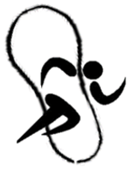

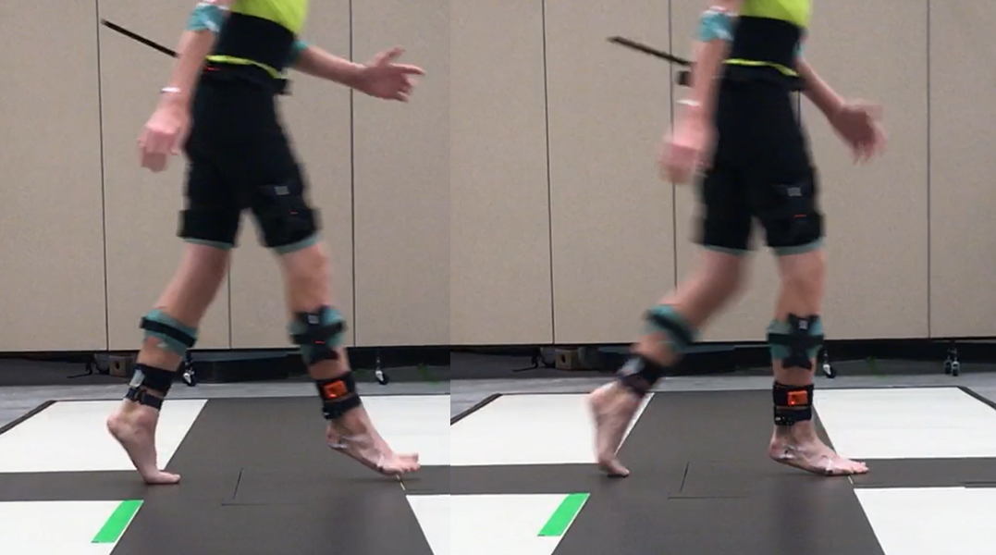
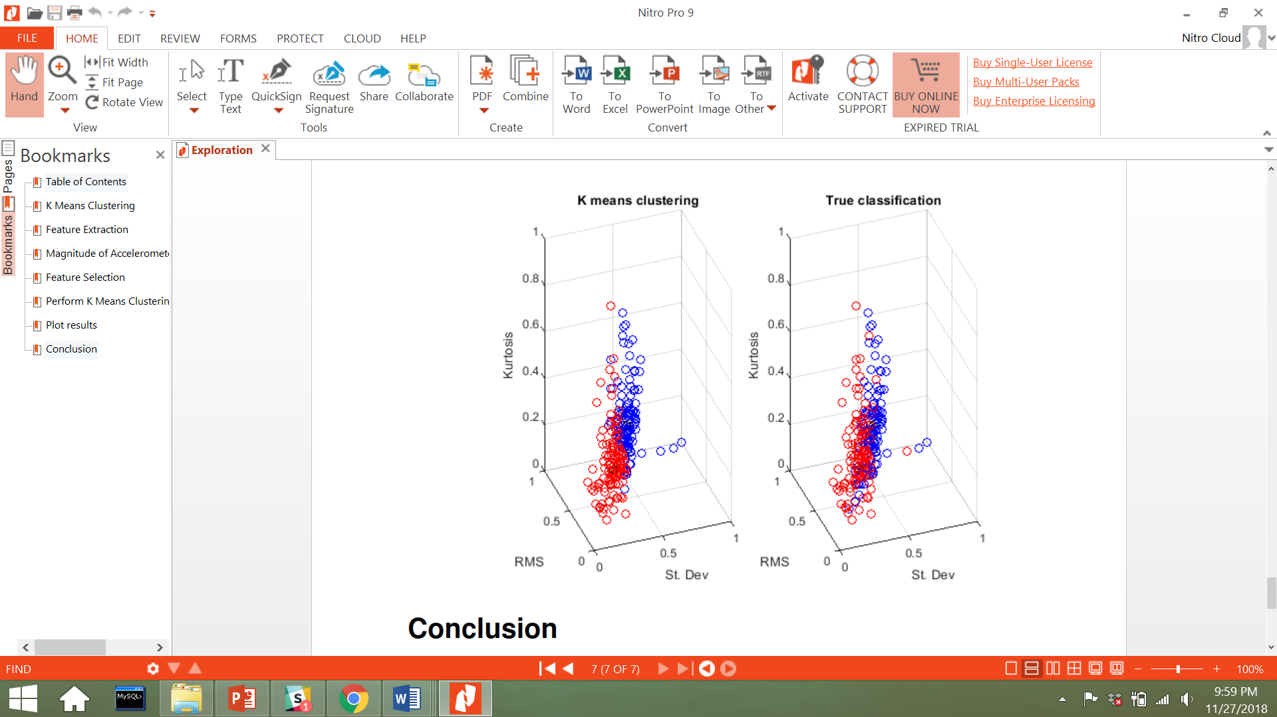
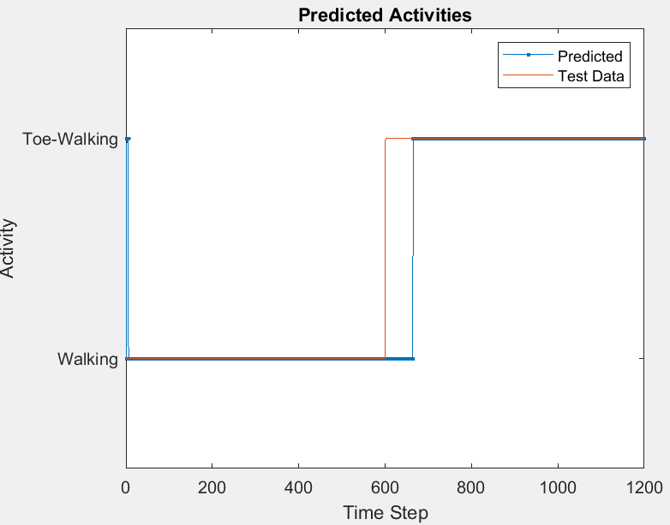
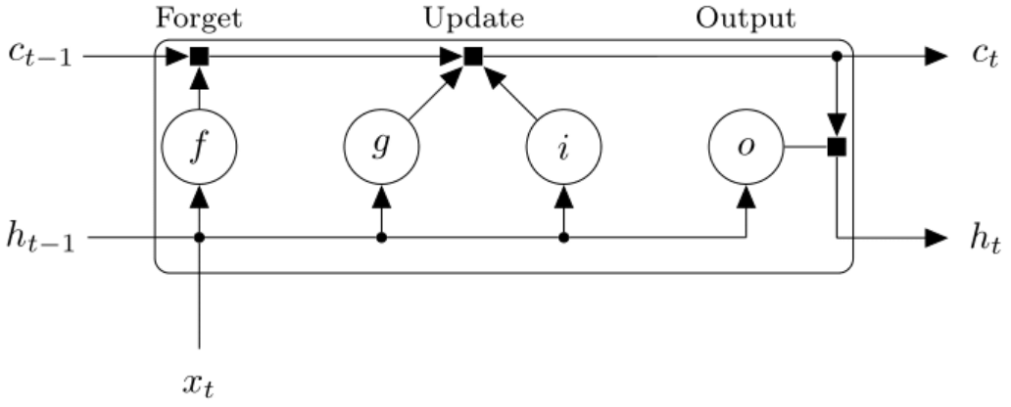
Wearable Sensor-based Gait Classification in Idiopathic Toe Walking Adolescents
Sharon Kim, Advisor: Dr. Rahul Soangra & Dr. Marybeth Grant-Beuttler
Idiopathic Toe-Walking (ITW) –habitual walking on the balls of the feet
Estimated to occur in 7 to 24% of children^{1,2}
Does not adopt normal heel-toe gait, and instead adopts toe-toe gait
Risk of falling increases
Risk of developmental delays increase
Results
Conclusion
Introduction
Results Conclusion
LSTM model performed better in classifying than the K-Means clustering method, and data did not have to be pre-processed to get a high accuracy score.
K-Means clustering provided results that were easier to understand graphically
Clinical Relevance
Wearable sensors should be integrated with machine learning/deep learning algorithms
Integration has the capability to transform current on-going therapy methods
Wearable sensors that can classify movement can be used to monitor patients longitudinally for their improvements in gait.
These novel techniques can also be applied to help estimate the efficacy of treatment in patients
Acknowledgements
Thank you to the CHOC Foundation and the Kay Family foundation who provided subjects for this research and for their continual support in the medical field
References
1. Dietz F, Khunsree S. Idiopathic Toe Walking: To Treat or Not to Treat, That is the Question. Iowa Orthop J. 2012;32:184-188.
2. Eiff MP, Steiner E, Judkins DZ. What is the appropriate evaluation and treatment of children who are “toe walkers”? J Fam Pract. 2006;55(5):447-450.
K-Means Clustering
Data Pre-Processing
Truth data was first collected and used to train the model
Magnitude of the accelerometer & magnitude of gyroscope were calculated and normalized
Mean, standard deviation, covariance, root mean square(RMS), kurtosis, and skew were calculated
Tested for multi-collinearity through calculating the variance inflation factors (VIF)
Features with the highest VIF were eliminated
Mean | Cov. | Skew | St. Dev | RMS | Kurtosis
2615.8 | 39.1 | 7.9 | 398.4 | 4435.8 | 7.0
X | 38.8 | 7.5 | 28.0 | 6.7 | 6.6
X | X | 7.2 | 4.7 | 4.5 | 6.3
X | X | X | 3.8 | 3.8 | 1.1
Table 1. VIFs were calculated starting with 6 features. Each feature was eliminated one by one until the VIF score was less than 5. The remaining 3 features that were used to for k-means clustering were standard deviation, RMS, and kurtosis.
Clustering Performance
Remaining features after VIF elimination were standard deviation, RMS and kurtosis
Accuracy score: 82%
Specificity score: 83%
Sensitivity score: 86%.
Objective
The objective of this research was to use machine learning classification methods to classify toe-toe walking vs. heel-toe walking
After building an accurate model, the goal was to use the model to quantify the efficiency of intervention.
LSTM
The Long short term memory (LSTM) model performed best when it was built for an individual person
The graph displays the performance of the model.
Training score: 99.5%
Prediction score: 94.3%.
Methods
Subjects – 5 adolescents (13± 5 years) patients with idiopathic toe walking characteristics
Participants wore inertial sensors at the L5-S1 joints to capture accelerometer and gyroscope data at a frequency of 100 Hz..
Notes:
Equi-test Balance Manager (EBM) --
Bruininks-Oseretsky (BOT-2) --
Foot Posture Index (FPI-6) --
Ankle passive range of motion (PROM) --
what it is on top of picture
bottom of picture = analysis i.e. “of degree of supination/pronation”, “position of foot in quiet stance” for FPI
TABLE FOR DATA: row for each subject, column for FPI score L/R, PROM L/R, BOT-2 score
other area for details about balance manager data/subtests
PROM: No subjects demonstrated 10 degrees bilaterally, 2 unable to get to neutral (brief verbal comment, can be bullets)
Copy references over directly from abstract
turn in by 11/9...ish (12th is hard deadline)
she has to print it
EBM data is a strategy issue, not so much an impairment issue
there are impairments present, (intact sensory-wise) but strategy is poor
shortness in gastroc impacts ability to stay in stance on adaptive test
there is an impairment level issue (not strong enough to keep them upright), but the main issue is strategic
for latency pic
use 1 and 2A
LOS
use 2A and 3 and 5
Sensory Analysis
also add a picture of the SOT graph with all 6 conditions
show a range
2A and 3
put sensory analysis right next to these for 2A and 3
For submission:
make Dr. GB presenting author
primary topic: ITW
secondary topic: Balance control
by Friday 5pm (submit it in morning)
Key words: balance, children, ITW, gait
Dept: PT Dept
Tests and measures:
a separate section for balance manager 1st*** → dividied into SOT, MT, AT, LOS
1 table for each with scores from BOT-2, FPI, and PROM
*do it all in teh same order….talk about balance manager 1st in each section, followed by BOT, etc etc etc
References
1.Engelbert, R., Gorter, JW., Uiterwaal, C., van de Putte, E., Helders, P. (2011) Idiopathic toe-walking in children, adolescents and young adults: a matter of local or generalised stiffness? BMC Musculoskeletal Disorders 12:61.
2. Shulman, LH., Sala, D.A., Chu, MLY, McCaul, PR., Sandler, BJ. (1997) Developmental implications of idiopathic toe walking. J Pediatr 130: 541-6.
3. Williams, CM., Tinley, P., Curtin, M., Wakefield, and Nielsen, S. (2014) Is Idiopathic Toe Walking Really Idiopathic? The Motor Skills and Sensory Processing Abilities Associated With Idiopathic Toe Walking Gait. Journal of Child Neurology 29(1): 71-8 7: 409-433.

