Slide 1

EDA - CAR SALES

Slide 2
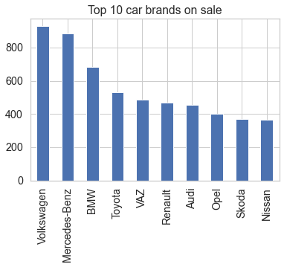
The Top 10 Car brands on sale

Slide 3
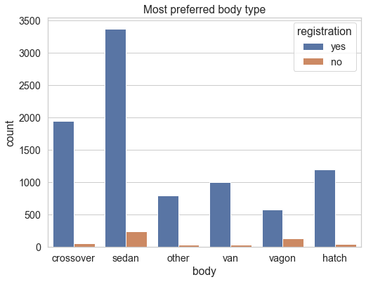
Most Preferred Body type

Slide 4
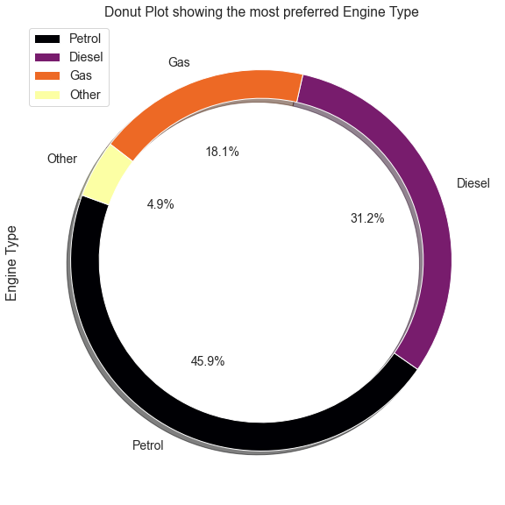
Most Preferred Engine Type

Slide 5
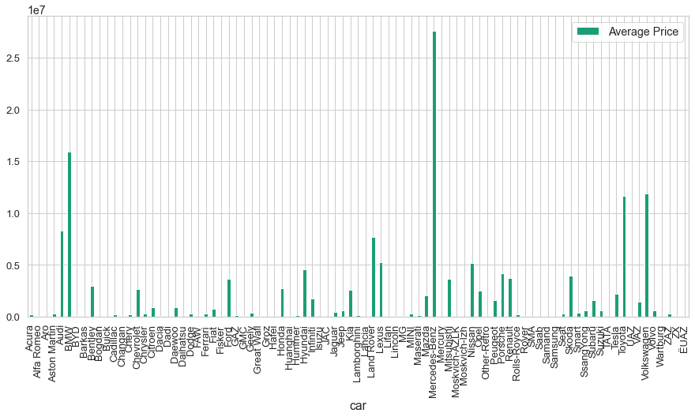
Average price of all Car Brands

Slide 6
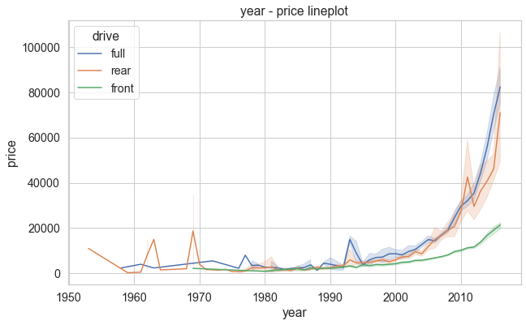
Variation of Price over the years

Slide 7
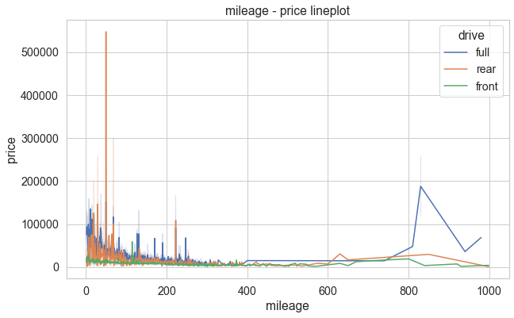
Variation of Price over mileage

Slide 8
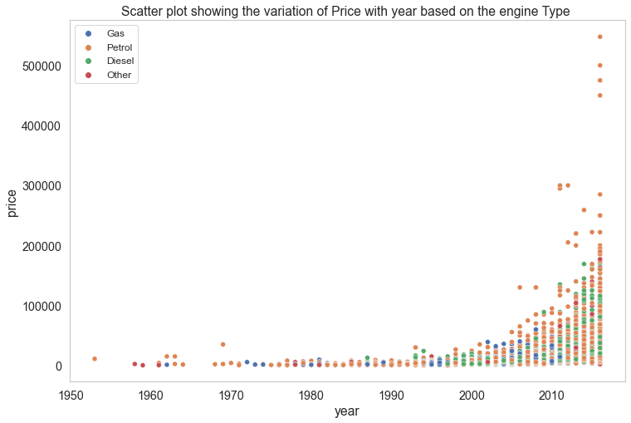
Variation of Price with year based on Engine Type

