Slide 1
RENGGO
Live Escalation War Room
Mid-call multi-agent collaboration with Band SDK for complex customer support
Sharofiddin Azizmatov · Co-Founder of Renggo
Abolfazl Kalat Zadeh · Full-Stack Developer
Alexandru Iancu · Software Engineer
Built for the Band of Agents Hackathon

Slide 2


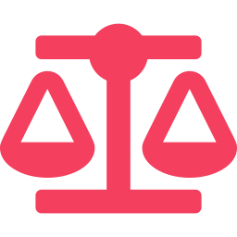

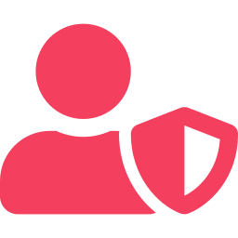
THE PROBLEM
Frontline bots win the routine — and hit a wall on the hard calls
The High-Stakes Wall
The Routine AI Success
Policy-Heavy Queries
Frontline voice systems like Renggo excel at low-complexity, real-time tasks.
Resolving disputes requires searching vast, conflicting company guidelines.
Answering FAQs
Authenticating users
Retrieving accounts
Compliance Risks
Uncontrolled LLMs risk violating legal regulations or promising unauthorized compensation.
Human Authorization Needed
They fail because they are single-threaded and lack context reasoning.
High-value actions need human approval, but voice bots cannot wait on a phone call.

Slide 3
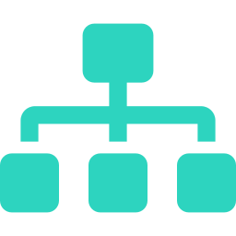


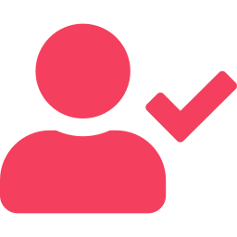
THE SOLUTION
Safe & Dynamic Delegation
When a caller has a complex problem, Renggo delegates the query to a private backend “War Room” using the Band SDK.
Triage Agent
Knowledge Agent
LangGraph
RAG Retrieval
Classifies the escalation, flags severity, and outputs a requires_human_approval flag.
Audits policy manuals, finds matching guidelines, and assigns a confidence score.
The live bot keeps the customer engaged with natural callback updates, while specialized agents debate, check compliance, and seek authorization — asynchronously.
Compliance Agent
Supervisor UI
GPT-4o-mini
Human-in-the-Loop
The War Room
Four specialized entities, one resolution.
Double-checks proposed solutions against corporate rules to ensure safe execution.
A web portal letting human managers authorize high-value resolutions in one click.

Slide 4

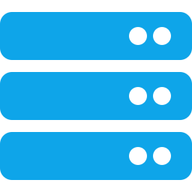
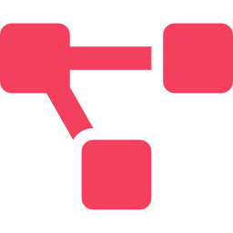

SYSTEM ARCHITECTURE
From voice channel to agentic mesh
1
2
3
Frontline Voice AI
Bridge API
War Room
Renggo
FastAPI
Band SDK
Full-duplex Gemini Live stream
Triggered via Function Flow Nodes
Gathers caller ID & dispute, POSTs to bridge
Control plane: voice stack to agent mesh
Tracks calls, escalation IDs, resolutions
Exposes polling endpoints for live status
Instantiates the collaborative Band room
Routes Triage to Knowledge to Compliance
Integrates human supervisor approval
Flow: Renggo triggers the Bridge API via a Function Node → Bridge initiates the Band room → Agents resolve → Renggo polls and reads the resolution.

Slide 5

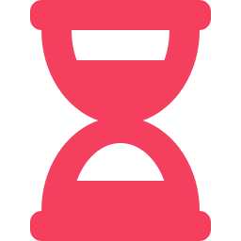
LIVE SHOWCASE & SCENARIOS
Test it live — two escalation paths
PATH 1 — THE FAST PATH
Billing Dispute
“I was double charged in March.”
Triage classifies as billing_dispute (severity=low, requires_approval=false). Knowledge RAG resolves immediately. Compliance validates. Bot speaks the resolution in-call (~15s).
TEST IT LIVE
Call
+1 (808) 720-2508
PATH 2 — THE SLOW PATH
Hardship Refund
Dial in to experience the full-duplex integration. Talk to a live voice agent, state a dispute, and witness the backend orchestration kick in.
“I lost my job and cannot pay this month’s bill.”
Triage classifies as hardship_refund (severity=high, requires_approval=true). Voice agent promises a callback and clears the line. Backend continues asynchronously. Supervisor approves via Band UI.

Slide 6


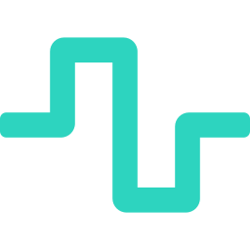
FUTURE POTENTIAL
Where this goes next
Generic Architecture
Safe LLM Execution
Future of Voice Support
Infinite Domains
Guarded Outcomes
True Automation
The bridge and multi-agent setup are entirely domain-agnostic. Swap the knowledge base and set new compliance constraints to instantly power insurance, travel, or medical support.
A dedicated compliance agent alongside human-in-the-loop approvals removes the business risk of rogue LLM actions — giving enterprise operators total trust.
Unifying low-latency full-duplex voice with deep asynchronous multi-agent reasoning creates the first support setup capable of complex logic in real-time.

