Slide 1
Polynomial Lagrange Interpolation
Numerical Computing
Project
Class Id: 103745
Instructor Name: Adnan Ullah Khan
Group Members:
Sharoz Raees 9852
Kehkashan Akram 9825

Slide 2
Description:
This project is to find polynomial by using the LaGrange interpolation method for a given data set.
The function we are using in the whole project is f(x)= 1/(1+25x^3) for x E[-1,1].
Our Project is divided into three parts:
Write a program for the langrange interpolation function Pn(x) which interpolates the following n+1 points {(xj,f(xj)),j=0,1,2,…,n} by using the uniform interpolation nodes xj=(2j/n)-1. where our function is f(x)= 1/(1+25x^3).plot the graph of function f(x) and polynomial Pn(x).
again for new xj when xj=(2j/5n)-1 write program for Pn(x) and f(x) then plot graph
now compare the both graphs output in one graph where n=10

Slide 3
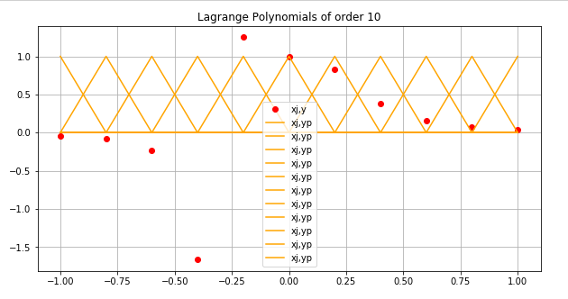
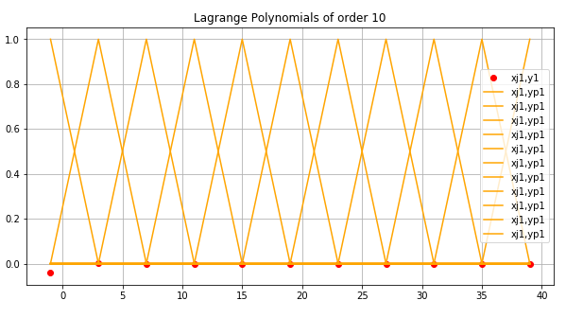
We made lagrange function to get polynomial
We are using 10 degree of polynomial n=10
We are using x all values in between -1 and 1
And to find xj we use j=0,1,…,10
Those xj values are put in f(x) and lagrange function
Yellow lines show Pn(x) lagrange output and xj graph
Red dots show the f(x) xj and y
In first graph xj=(2j/n)-1.
In second graph xj=(2j/5n)-1

Slide 4
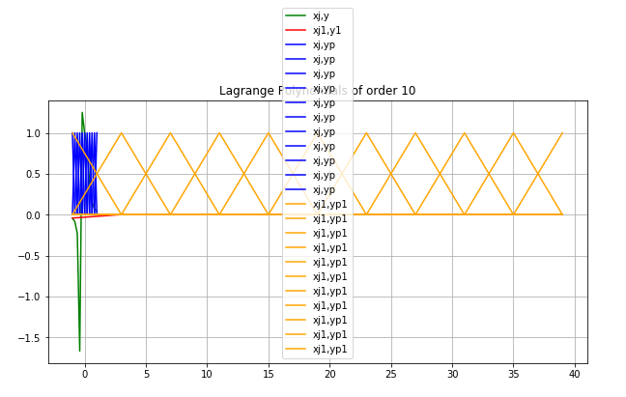
Comparsion of both above graphs:
Yellow shows the Pn(x) graph when xj =(2j/n)-1.
Blue shows Pn(x) when
xj =(2j/5n)-1.
Green shows f(x) when xj =(2j/n)-1.
Red shows f(x) when xj =(2j/5n)-1.

Slide 5
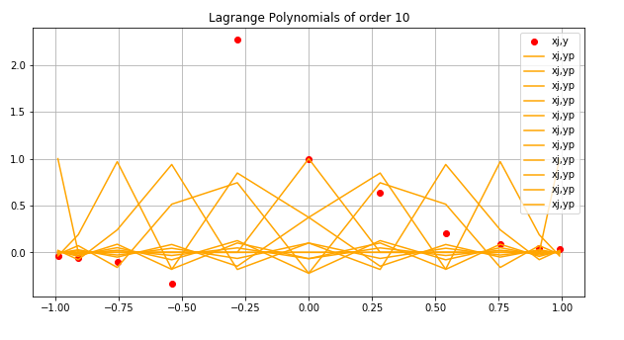
Do the same by using Chebysher polynomial as xj=cos((pi/2)((2j+1)/(n+1))),j=0,1,2,…,n.
Here we are using 10 degree polynomial
Yellow shows the Pn(x) when xj=cos((pi/2)((2j+1)/(n+1))),j=0,1,2,…,n.
Red shows the f(x) when xj=cos((pi/2)((2j+1)/(n+1))),j=0,1,2,…,n.
We are using j=0,1,2,..,10
Using j value to find xj to put in f(x) and in lagrange

Slide 6
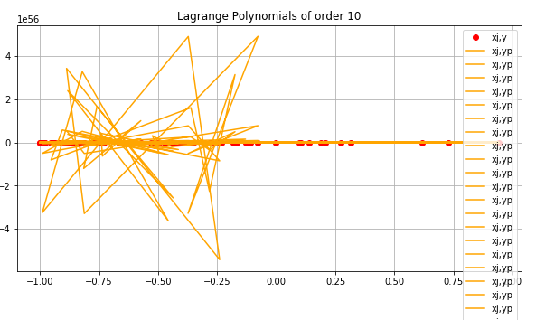
Write a program for thr polynomial by fitting 100 random data from (x,f(x)) for x belongs to [-1,1].plot polynomial and the f(x) on the same graph
Here we gernate 100 random points from -1 to 1
Those points are our x
Those x are put in f(x) and lagrange function to find y and polynomial of 10 degree
Random points will change after refresing and it will show new graph every time
Yellow lines are Pn(x) when we are using 100 random numbers as x
Red points show the f(x) when using 100 random points as x between -1 and 1

