Slide 1
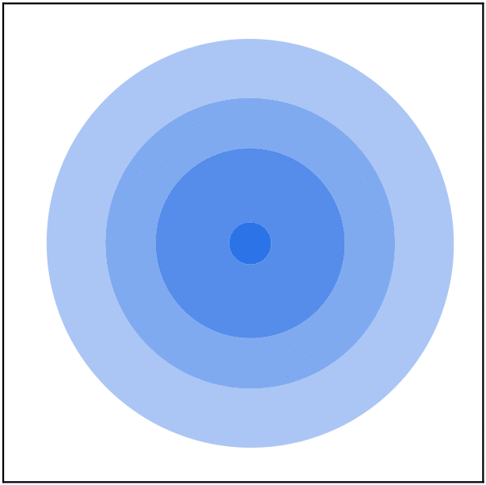

























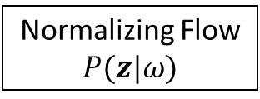




$$θ^{(i)}\sim ℚ^{post, (i)} (χ^{\left(i\right)},n^{(i)})$$
$$χ^{(i)}$$
$$θ_{2}$$
$$n^{(1)}=N_{H}P(z^{(1)}|ω)$$
$$χ^{post, (i)}$$
Normalizing Flow
$$P(z|ω)$$
$$χ^{prior}$$
$$f_{φ}(x^{(1)})$$
$${χ^{(1)}=g}_{ψ} (z^{(1)})$$
$$θ_{1}$$
$$θ_{2}$$
$$f_{φ}(x^{(2)})$$
$$z^{(1)}$$
$$χ^{(i)}$$
$$n^{(2)}=N_{H}P(z^{(2)}|ω)$$
$$χ^{prior}$$
$$z^{(2)}$$
$${χ^{(2)}=g}_{ψ}(z^{(2)})$$
$$χ^{post, (i)}$$
$$f_{φ}(x^{(3)})$$
$$z^{(3)}$$
$$θ_{2}$$
$$θ_{1}$$
$$n^{(3)}=N_{H}P(z^{(3)}|ω)$$
$$χ^{(i)}$$
$$χ^{prior}$$
$${χ^{(3)}=g}_{ψ}(z^{(3)})$$
$$χ^{post, (i)}$$
$$θ_{1}$$
Input space
Feature space
Exponential family parameter space

