Slide 1
Course Notes Set 4: Cleanroom Software Engineering
Computer Science and Software Engineering
Auburn University

Slide 2
Cleanroom Software Engineering
Based on the efforts of Harlan Mills, Richard Linger, and Michael Dyer from the 1960s through the 1980s; Incubated in the IBM Federal Systems Division.
Evolved from
structured programming
modular design
formal specifications
functional verification
chief programmer teams
top down software development
statistical quality control
incremental development
At its heart, Cleanroom represents a shift away from conventional testing and debugging toward certified reliability of software before release.

Slide 3
Cleanroom Software Engineering
A primary goal is to avoid dependence on costly defect-removal processes by writing code increments right the first time and verifying their correctness before testing.
The focus is on defect prevention rather than defect correction: Zero-defect software is the goal.
U.S. 1980 Census software: 25Kloc program, controlling 25 distributed machines, no failures observed during the 10 months in which it operated.
IBM Wheelwriter software: 65Kloc program, millions of users since it was introduced in 1984, no failures ever observed.
Shuttle flight software: 500Kloc, no failures in flight (but failures have occurred at other times)
Represents a paradigm shift from the traditional practices to rigorous, engineering based practices
Mathematical function theory is the basis for development
Applied statistics is the basis for testing

Slide 4
Cleanroom Software Engineering
Represents the first practical attempt to put software development under statistical quality control with a well-defined strategy for continuous process improvement.
A unique Cleanroom process model is needed; the techniques alone are not sufficient.
Formal correctness verification is not suitable in an environment where software errors are accepted as inevitable and the focus is on debugging.
Statistical quality control cannot be meaningfully applied on executions of programs with high error content.
However, other process models such as the waterfall and spiral can be “transformed” into a Cleanroom process through the integration of the cleanroom methods, techniques, and mindset.

Slide 5
The Cleanroom Process
Organized into components [Dyer, 1992] which can be applied in isolation, in combination, or within the defined Cleanroom process itself (preferred).
Software Specification
Software Development
Software Correctness Verification
Independent Software Product Testing
Software Reliability Measurement
Statistical Process Control
The process is based on developing and certifying a pipeline of software increments that accumulate into the final system.

Slide 6
Cleanroom Activities
There are five major activities involved in a Cleanroom process
Specification
Increment Planning
Design and Verification
Statistical Testing
Certification
Two to three independent teams may exist and work concurrently
Development Team
Testing (or Certification) Team
Documentation Team

Slide 7
The Cleanroom Process
Key:
Processes
Work Products
Specification
Function Usage
Customer Requirements
Functional Specification
Usage Specification
Incremental Development Planning
Incremental Development Plan
Box Structure Spec. and Design
Correctness Verification
Usage Modeling
Test Case Generation
Source Code
Test Cases
Statistical Testing
Failure Data
Improvement Feedback
Measures of
Operational Performance
Quality Certification Model
[Adapted from”Cleanroom Process Model,” Richard Linger, IEEE Software, March 1994]

Slide 8
The Cleanroom Process
Customer
Requirements
Requirements Spec
Usage Spec
Incremental
Development Plan
Incremental Design
Documentation
Test Case Generation
Correctness Verification
No
Correct?
Yes
Statistical Testing
Certification Model
No
Certified?
Yes
Incremental
Certified System
[Adapted from “Integrated CASE for Cleanroom Development,” Hevner, et al., IEEE Software, March 1992]

Slide 9
Specification
Two specifications are produced: functional and usage.
Functional Specification
Defines the required external system behavior in all circumstances of use.
Forms the basis for incremental software development.
Usage Specification
Defines usage scenarios considering:
User - person, hardware device or other software; subclasses may exist
Use - a particular work session or transaction; bounded by specific start and end events
Environment - platform, OS environment, system load, etc.
Forms the basis of statistical testing and quality certification.

Slide 10
Increment Planning
On the basis of the functional and usage specifications, a plan is formulated for developing the software in well-defined increments which will accumulate into a final system.
Each increment is developed through a full Cleanroom process of Specification, Design, Verification, Testing, and Certification.
A pipeline of increments is created to produce the complete system.
Each increment defines a complete system with added functionality from previous increments.
Increments are defined according to
Size - increments should be relatively small and of manageable size
Concurrency - potential for parallel development can be exploited
Cohesiveness - increments should be cohesive with respect to their functional requirements

Slide 11
Incremental Development
...
Development
Inc 1
Inc 2
Inc 3
Inc N
...
Testing and Certification
Inc 1
Inc 1,2
Inc
1,2,3
Inc
1..N
The Configuration
Inc 1
Inc 1
Inc 2
Inc 3
Inc 4
Inc N

Slide 12
Incremental Development
[From Pressman 5th Edition]

Slide 13
Design and Verification
The development team carries out a design and correctness verification cycle for each increment.
The certification team works in parallel, using the usage specification to generate test cases that reflect the expected use of the accumulating increments.

Slide 14
Box Structured Design
Box structures are used to systematically move from an abstract specification to a detailed design providing implementation detail.
Box structures model system components as abstractions in three increasingly detailed forms:
Black Box
Gives an external view of the component.
Provides description of functional requirements without details on the internal structure and operations.
Describes the user-visible system inputs and responses.
State Box
Gives an intermediate view of the component.
Decomposes the black box into an internal state representation and an internal black box.
Clear Box
Gives a detailed view of the component.
Replaces the internal black box with a detailed design using structured programming constructs.

Slide 15
Box Structured Development
System development is a process of stepwise box decomposition.
[From Pressman 5th Edition]

Slide 16
Box Structures
Black Box
Stimulus
Response
State Box
State
Black Box
Stimulus
Response

Slide 17
Box Structures
Clear Box
State
Black Box
Black Box
Stimulus
Response

Slide 18
Box Structure Principles
Referential Transparency
The behavior of a black box is the same regardless of where in the system it is referenced.
The implementation of a black box is independent of the implementation of other parts of the system.
Referencing a black box is equivalent to referencing its corresponding clear box representation throughout the system.
E.g., ‘7’ could be substituted for ‘5+2’.
Transaction Closure
Ensures that a sound and complete set of transactions is identified to achieve the required system behavior.
Black box level - system stimuli are necessary and sufficient to generate the required responses.
State box level - defined transactions must be necessary and sufficient for the acquisition and preservation of all state data and the state data must be necessary and sufficient for the completion of all transactions.
Clear box level - procedural design and the internal black boxes must include all transactions.

Slide 19
Box Structure Principles
State Migration
State data should be stored at as low a level as possible, but as high as necessary or expedient.
Downward migration
As new black boxes are created in a clear box, any state item referenced solely in a given black box may be migrated downward into that black box.
Upward migration
When state items are duplicated in several places, it can be moved to the nearest common parent.
Common Services
Reusable boxes
May be created or referenced from a library of reusable components.
If from a library, the common service is a pre-certified component.
Can reduce system size and complexity.

Slide 20
Correctness Verification
The procedural control structures of structured programming are single-entry, single-exit structures, thus producing no side-effects in control flow.
When it executes, a given control structure simply transforms data from an input state to an output state. This transformation is called as the structure’s program function.
Example: For integer x >= 0, the program function of the iteration control structure below is, in English, “Set odd x to 1, even x to 0.”
while (x > 1) {
x = x - 2;
}

Slide 21
Correctness Verification
In designing clear box procedures, you define an intended function, then refine it into a control structure and new intended functions.
Intended functions are recorded in the design and attached to the corresponding control structure refinements.
So, clear boxes are composed of a finite number of control structures, each of which can be checked for correctness against its intended function.
To verify the correctness of each control structure, you derive its program function (the function it actually computes) and compare it to its intended function, as recorded in the design.
A correctness theorem formally defines how to do this for each control structure in terms of language independent correctness conditions.

Slide 22
Correctness Verification
Sequence: Does g followed by h do F?
// Intended Function: F
{
g();
h();
}

Slide 23
Correctness Verification
Selection: Whenever cond is true does g do F
AND
whenever cond is false does h do F?
// Intended Function: F
if (cond) {
g();
}
else {
h();
}

Slide 24
Correctness Verification
Iteration: Is termination guaranteed?
AND
Whenever cond is true does g followed by F do F
AND
whenever cond is false does doing nothing do F?
// Intended Function: F
while (cond) {
g();
}

Slide 25
Correctness Verification
During a team review, every correctness condition of every control structure is verified in turn.
Each team member must agree that each condition is correct. Thus, an error is possible only if every team member incorrectly verifies a condition.
If an informal approach cannot produce a unanimous decision, formal proofs of correctness can be employed.
This is more efficient and produces better code than unit testing.

Slide 26
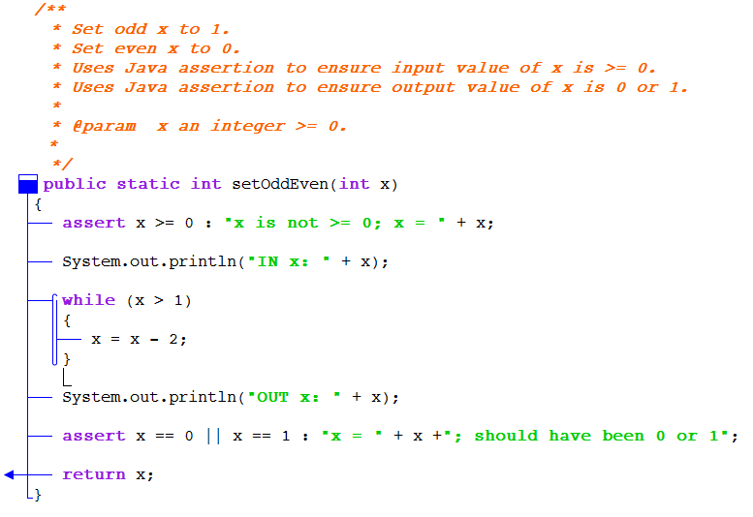
Aids for Verification
Visualizations (e.g., CSD - Control Structure Diagram)
Language supported assertions (e.g., Java)

Slide 27
Statistical Testing
Testing software according to the way users intend to use it.
The entire focus is on external system behavior, not the internals of the design or implementation.
The certification team’s goal is not to debug, but to certify the software’s quality. This requires deep knowledge of expected usage but no knowledge of design or implementation information.
Three steps
Specify usage probability distributions
Derive test cases that are randomly generated from usage probability distributions.
Execute test cases, assess results, and compute quality measures.

Slide 28
Certification
Based on the data gathered during statistical testing, the software can be given a certified reliability.
Reliability is expressed as MTTF and is computed according to specific mathematical reliability models
Sampling model
Component model
Certification model

