Slide 1
Course Notes Set 8: Software Testing Overview
Computer Science and Software Engineering
Auburn University

Slide 2
Why Do We Test?
Bad dog! No biscuit! You must test, test, test!
Beizer and Parnas have insightful comments on the inevitability of errors and the necessity of constructive testing.

Slide 3
How Do We Test?
We huddled around the door … Inside, a recently hired software
designer had spread out source listings on the table, and carefully
passed a crystal hanging from a long chain over the source code.
Every so often the designer marked a circle in red on the listing.
(From a true story told by Paul Jorgensen)

Slide 4
Why is Testing So Hard?
The magnitude of a thorough test suite can be overwhelming.
Testing is highly detailed.
Testing is time consuming.
Testing requires technical sophistication.
Testers must be good developers.
Testers must have a solid understanding of formal languages, graph theory, and algorithms (at least).
Testing should be treated as a craft.
Testing requires up front planning.

Slide 5
Thinking About Testing
Phase 0: Testing = Debugging
Phase 1: Testing is an act whose purpose is to show that the software works.
Phase 2: Testing is an act whose purpose is to show that the software does not work.
Phase 3: Testing is an act whose purpose is not to prove anything, but to reduce the perceived risk of failure to an acceptable level.
Phase 4: Testing is not an act; rather, it is a mindset that involves development and coding practices along with a systematic approach to exercising the software.
[Adapted from Software Testing Techniques, 2nd Edition, by Boris Beizer, Van Nostrand Reinhold, 1990]
Notes:
Phase 4 – Mindset is thinking of how to test from the beginning.

Slide 6
General Testing Objectives
The fundamental intent of a testing process is to uncover an error.
A good test case is one with a high probability of finding an as-yet undiscovered error.
A successful test is one that uncovers an as-yet undiscovered error.
[Adapted from The Art of Software Testing, by Glenn Myers, John Wiley & Sons, 1979]

Slide 7
What Testing Shows
errors
requirements conformance
performance
an indication
of quality
Testing can never be used to show the absence of errors, only their presence.
[Adapted from Software Engineering A Practitioner’s Approach 5th Edition, by Pressman, McGraw-Hill, 2000]

Slide 8
Indications Based on the Results of Testing
Severe errors discovered
Indicates software quality and reliability are suspect.
Design modification is perhaps required.
Further testing is needed
Basic software functions are working properly and errors discovered are easily corrected
Software quality and reliability are acceptable OR
Tests are inadequate to uncover severe errors
No errors discovered
Suggests that the test configuration may be inadequate
The perfect software has been written!

Slide 9
Basic Definitions
Error – a mistake.
Fault – the result of an error. Defect is a synonym.
Failure – occurs when a fault executes.
Incident – symptom associated with a failure that alerts a user to its occurrence.
Test –exercising software with test cases.
Test case – has an identity, associated with program behavior, has a set of inputs, has a list of expected outputs.
[Adapted from Software Testing A Craftman’s Approach, by Jorgensen, CRC Press, 1995]
Notes:
KC story: NASA has over 7,000 test cases for controller for shuttle rocket engine. Takes 18 months to run all test cases.
Test cases are expensive and an important asset.

Slide 10
Testing Life Cycle
error
fix
Requirements Specification
Fault Resolution
fault
error
Design
Fault Isolation
fault
error
Coding
incident
Fault Classification
fault
Testing
[Adapted from Software Testing A Craftman’s Approach, by Jorgensen, CRC Press, 1995]

Slide 11
Test Information Flow
Software Configuration
Errors (defects/failures)
Debug
Test Results
Evaluation
Corrections
Testing
Error Rate Data
Reliability Model
Expected Results
Test Configuration
Predicted Reliability

Slide 12
Fault Classifications
It can be useful to classify faults in several ways.
Development phase in which the fault was introduced
Severity of their consequences (when a corresponding failure occurs)
Difficulty to solve
Risk of leaving unresolved
For example: Beizer’s severity classification
10 levels
Mild, moderate, annoying, disturbing, serious, very serious, extreme, intolerable, catastrophic, infectious
[Adapted from Software Testing A Craftman’s Approach, by Jorgensen, CRC Press, 1995]

Slide 13
IEEE Std 1044-2009
IEEE Standard Classification for Software Anomalies (IEEE Std 1044-2009) provides a highly detailed classification.
provides for the core set of attributes for classification of failures and defects
Provides valuable info across projects, organizations
Better communication among developers, managers, etc.
establish a common set of attributes that support industry techniques for analyzing software defect and failure data (tools)

Slide 14
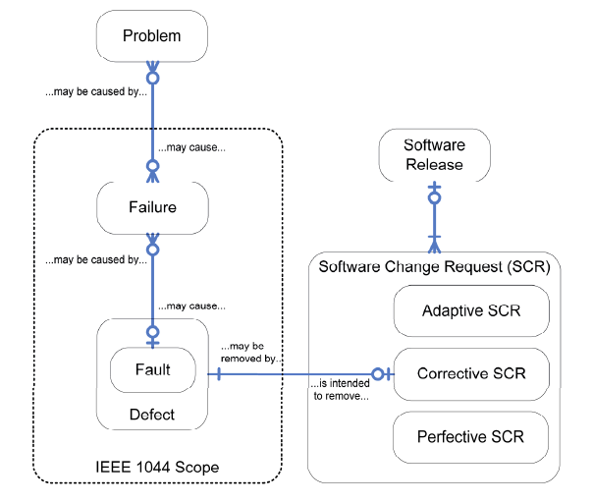
IEEE Std 1044-2009
Figure 1 —Relationships modeled as an entity relationship diagram

Slide 15
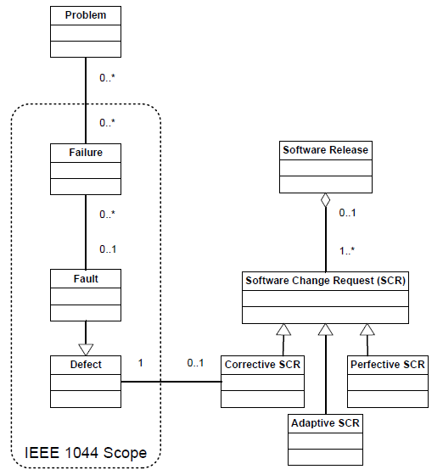
IEEE Std 1044-2009
Figure 2 —Relationships modeled as a UML class diagram

Slide 16
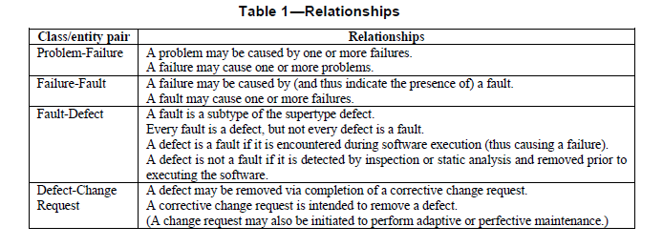
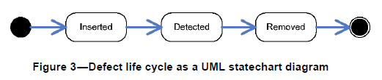
IEEE Std 1044-2009

Slide 17
IEEE Std 1044-2009
For details and examples, see PDF file in Course_Notes folder 08p_IEEE Std 1044-2009.pdf

Slide 18
Test Cases
Test cases are valuable – just as valuable as the source code.
Test cases need to be developed, reviewed, used, managed, and saved.
Information to include: Test case ID, purpose, pre-conditions, inputs, expected outputs, post-conditions, and execution history (date, result, version, run by)
[Adapted from Software Testing A Craftman’s Approach, by Jorgensen, CRC Press, 1995]
Notes:
Star the definition of “test case”.

Slide 19
Test Cases, Specs, and Programmed Behaviors
U
S
P
S = Specified behaviors
P = Programmed behaviors
T = Tested behavior
U = All possible behaviors
2
5
6
1
4
3
We want to make region 1 as large as possible.
7
T
[Adapted from Software Testing A Craftman’s Approach, by Jorgensen, CRC Press, 1995]

Slide 20
Test Case Design
"Bugs lurk in corners
and congregate at
boundaries ..."
Boris Beizer
OBJECTIVE
to uncover errors
CRITERIA
in a complete manner
CONSTRAINT
with a minimum of effort and time
[Adapted from Software Engineering A Practitioner’s Approach 5th Edition, by Pressman, McGraw-Hill, 2000]

Slide 21
Testing Principles
Tests should be traceable to requirements.
Tests should be planned early.
The Pareto principle applies.
Testing should start small and then ramp up.
You can’t test everything.
Testing should be done by an independent party.
[Adapted from 201 Principles of Software Development, by A. Davis, McGraw-Hill, 1995]
Notes:
Pareto principle: 80% of failures can be traced to 20% of the all faults.
The “20%” are called the “vital few”. We would like to remove these first.

Slide 22
Exhaustive Testing
loop < 20 X
There are 10¹⁴ possible paths. If we execute one test per
millisecond, it would take 3,170 years to test this program.
[Adapted from Software Engineering A Practitioner’s Approach 5th Edition, by Pressman, McGraw-Hill, 2000]

Slide 23
Selective Testing
Selected path
loop < 20 X
[Adapted from Software Engineering A Practitioner’s Approach 5th Edition, by Pressman, McGraw-Hill, 2000]

Slide 24
Who Tests the Software?
developer
independent tester
Understands the system
Must learn about the system,
but, will test "gently"
but, will attempt to break it
and, is driven by "delivery"
and, is driven by quality
[Adapted from Software Engineering A Practitioner’s Approach 5th Edition, by Pressman, McGraw-Hill, 2000]

Slide 25
Software Testability
Software should be designed to be readily tested.
Software testability refers to a measure of how easily a program can be tested.

Slide 26
Elements of Testability
Operability—it operates cleanly
Observability—the results of each test case are readily observed
Controlability—the degree to which testing can be automated and optimized
Decomposability—testing can be targeted
Simplicity—reduce complex architecture and logic to simplify tests
Stability—few changes are requested during testing
Understandability—of the design
[Adapted from comments made by James Bach]

Slide 27
Approaches to Software Testing
We will apply different testing methods to tell us how to design test cases.
We will apply different testing strategies to tell us when and in what context to perform tests.

Slide 28
Software Testing
white-box
methods
black-box
methods
Methods
Strategies
[Adapted from Software Engineering A Practitioner’s Approach 5th Edition, by Pressman, McGraw-Hill, 2000]

Slide 29
Testing Methods
Structural (White Box) Testing
Knowing the internal workings of a program, tests can be conducted to assure that the internal operation performs according to specification, and all internal components have been exercised.
Test cases are based on internal structure of the program and a specific level of coverage.
Functional (Black Box) Testing
Knowing the specified functions that a product has been designed to perform, tests can be conducted to demonstrate that each function is fully operational.
Test cases are based on external behavior rather than internal structure.

Slide 30
Testing Strategies
Requirements Specification
System
Testing
Preliminary
Design
Integration
Testing
Detailed
Design
Unit Testing
Coding
[Adapted from Software Testing A Craftman’s Approach, by Jorgensen, CRC Press, 1995]

