Slide 1
Weather2Ride
Michael Sharp

Slide 2
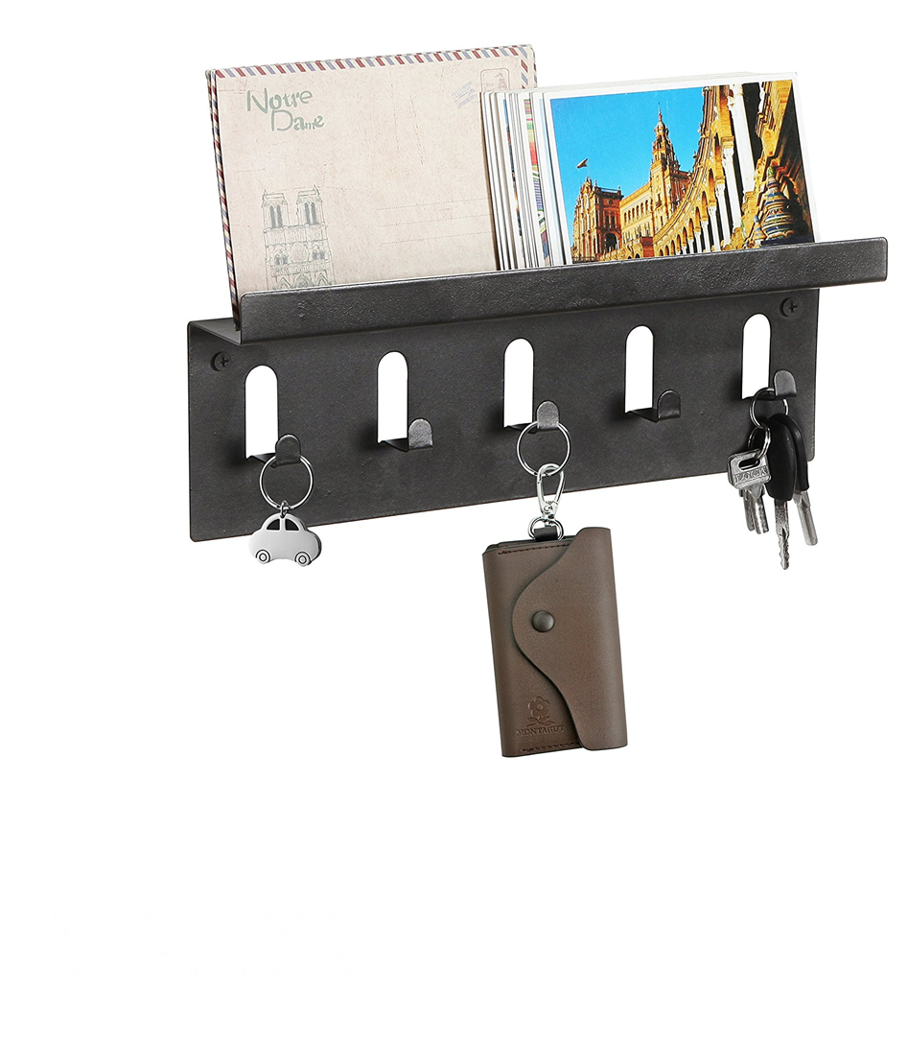
Device description
The weather2ride device is a small device that will check the hourly weather and tell you weather you should ride your motorcycle or not. The device will notify the user with a flashing light if weather is bad during peak riding times. Bad weather is would be if it is to cold or if it is raining.

Slide 3
Real world usefulness and project validity
The largest four markets are in Asia with over 30 mill riders in each country
Over 8 mill in the US
Current apps only find data based on the over all days data.
Similar products are app based so still need to check phone

Slide 4
System functionality
Weather database
Weather2Ride
Chip
Software Breaks down hourly data
Compares hourly data to min riding conditions
Sets Light if weather is bad

Slide 5
Scalability and Reliability
The product does not need to be on all day
Only needs to check once
Only needs to be large enough to house the chip and a light
Future scalability would be to add connectivity to google home and alexa
Dependent on weather sites staying up to date

Slide 6
Quality of user experience
The device is designed to sit next to your keys or on the night stand. This way the user would be able to see the light on the way out the door and grab the correct keys for the weather. With this integration into the users life there would be no need for the extra steps of opening apps of turning on phones.

