Slide 1
Exploration of Mumbai using Foursquare API
Sharad S Ramnarayanan

Slide 2
Business problem
Thousands of people relocate to Mumbai every year due to transfers or for better job prospects
Knowing details about a place and identifying other locations similar to a place will help these people narrow down their search for a location to stay
This project is an attempt to cluster the locations in Mumbai into similar groups using foursquare API and K-Means clustering

Slide 3
Data
Location wise pin code along with the longitude and latitude is the primary requirement
Data for India extracted from www.geonames.org
The data is cleaned and the pin codes specific to Mumbai is extracted along with the corresponding locations, latitude and longitude data
Sample data from www.geonames.org after necessary cleansing – 239 locations across 104 pin codes
Pin code | Place | State | City | Latitude | Longitude
400001 | Mumbai G.P.O. | Maharashtra | Mumbai | 18.629 | 72.892
400001 | Bazargate | Maharashtra | Mumbai | 18.629 | 72.892
400001 | Town Hall (Mumbai) | Maharashtra | Mumbai | 18.629 | 72.892
400001 | Tajmahal | Maharashtra | Mumbai | 18.629 | 72.892
400001 | Stock Exchange | Maharashtra | Mumbai | 18.629 | 72.892

Slide 4
Methodology
Using foursquare API the top 100 venues within a radius of 500 m from each location is captured along with their latitude and longitude
The resultant data is converted into a pandas data frame
The top 10 most common venues for each neighborhood is identified and this is converted into a pandas data frame which leads to an output that gives the top ten most common venue for each neighborhood
Based on the common venue characteristic the neighborhoods are segmented into clusters using k-means clustering. A total of 8 clusters was used

Slide 5
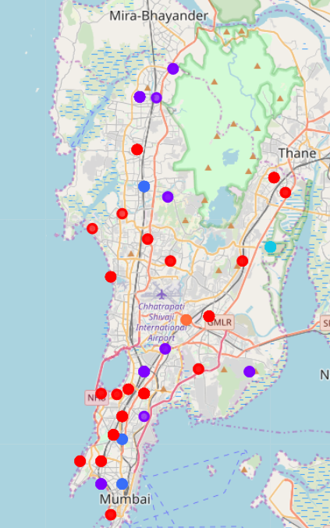
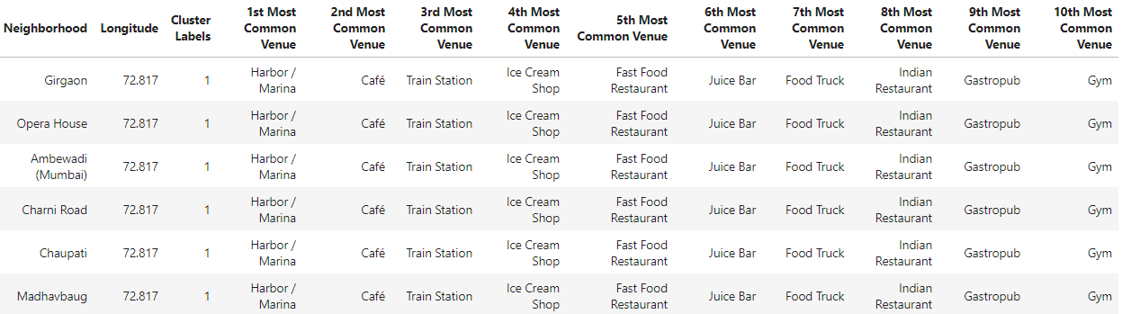
results
The output gives an indication of the kind of area each location is and what are the nearby areas that share similar characteristic. This will help the professionals new to Mumbai to get a quick idea about each location.

Slide 6
Discussion & Limitation to analysis
The extent to which foursquare has captured data in Mumbai may not be as much as it has been done in major cities in US or UK.
The output may hence be very different if the extent of mapping by foursquare is a more improved one.
Pin code wise latitude and longitude data available in geonames also has some issues associated with it in terms of accuracy.
Authentic Government of India data is not available.
Over a period of time as more data is available the output quality will improve.

Slide 7
Thank You

