Slide 1

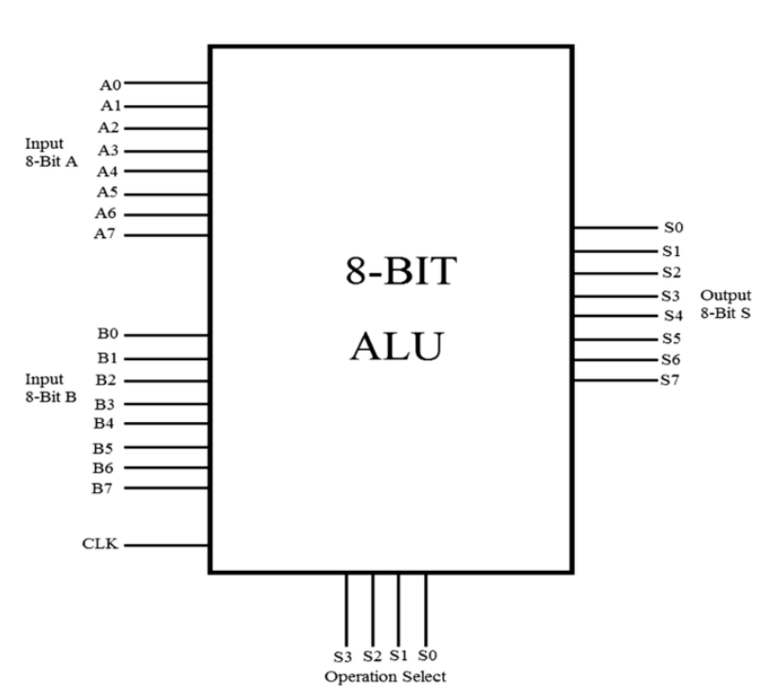
Proper GDS2 stream out with IO pad instantiation
RTL-GDS for an clock based 8 bit ALU
Architecture
Department of Electronics & Communication Engineering

Slide 2
Proper GDS2 stream out with IO pad instantiation
I/O planning
At top view of design we basically have an 8 bit ALU with [7:0]A , [7:0]B , [3:0]sel , 1 clk and 1 rst. So totally input are 8+8+4+1+1= 22 inputs and outputs are [7:0]res so 8 output pins hence . Totally 30 I/O pins . Through our RTL code we will only logically instantiate these 30 pins . But for Area calculations we will take few more
2 more dummy pins hence 32 and for every 8 I/O pin we will take 1VDD and 1VSS pin , hence totally 32+8=40 pins. Each IO pin take 16mA current , hence the chip should be able to sustain at least 32*16mA=512mA current.
Department of Electronics & Communication Engineering

Slide 3
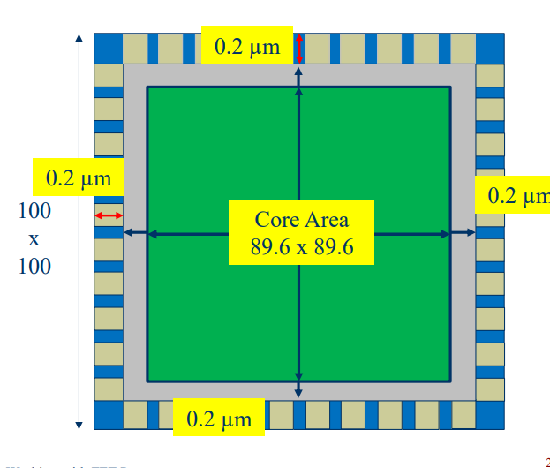
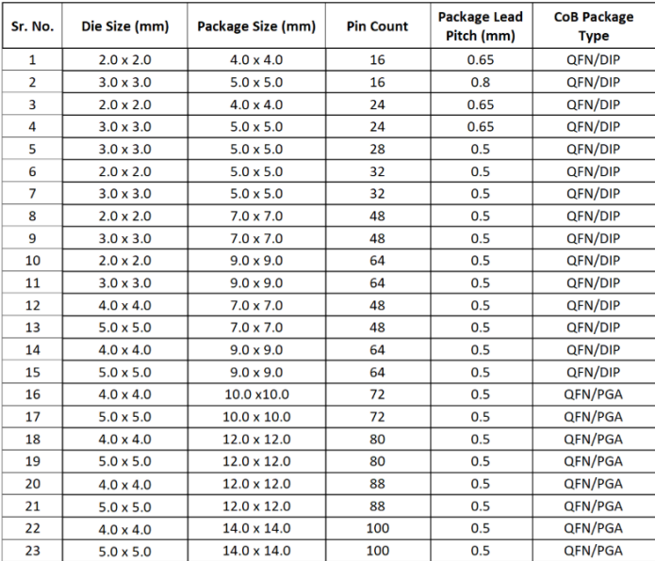
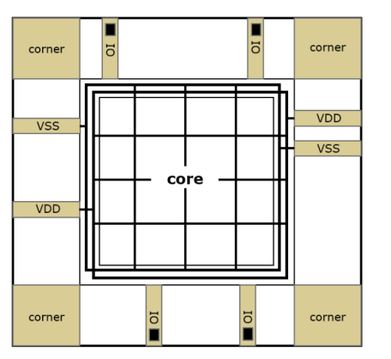





Area Planning
Proper GDS2 stream out with IO pad instantiation
15.6um
Department of Electronics & Communication Engineering

Slide 4
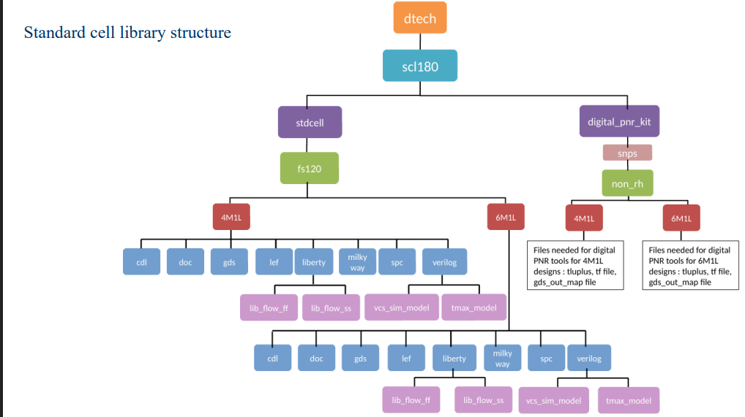


Proper GDS2 stream out with IO pad instantiation
Understanding the scl180 library
Department of Electronics & Communication Engineering

Slide 5
RTL code( pad instantiation part)
Proper GDS2 stream out with IO pad instantiation
pc3c01 pc3c01_1 (.CCLK(alu_clk), .CP(main_clk) ); pc3d01 pc3d01_1 (.PAD(main_clk_pad), .CIN(alu_clk) ); pc3d01_2 (.PAD(main_reset_pad), .CIN(main_reset) );
// A[7:0] pc3d01 pc3d01_3 (.PAD(A_pad[0]), .CIN(A[0]) ); pc3d01 pc3d01_4 (.PAD(A_pad[1]), .CIN(A[1]) ); pc3d01 pc3d01_5 (.PAD(A_pad[2]), .CIN(A[2]) ); pc3d01 pc3d01_6 (.PAD(A_pad[3]), .CIN(A[3]) ); pc3d01 pc3d01_7 (.PAD(A_pad[4]), .CIN(A[4]) ); pc3d01 pc3d01_8 (.PAD(A_pad[5]), .CIN(A[5]) ); pc3d01 pc3d01_9 (.PAD(A_pad[6]), .CIN(A[6]) ); pc3d01 pc3d01_10 (.PAD(A_pad[7]), .CIN(A[7]) ); // B[7:0] pc3d01 pc3d01_11 (.PAD(B_pad[0]), .CIN(B[0]) ); pc3d01 pc3d01_12 (.PAD(B_pad[1]), .CIN(B[1]) ); pc3d01 pc3d01_13 (.PAD(B_pad[2]), .CIN(B[2]) ); pc3d01 pc3d01_14 (.PAD(B_pad[3]), .CIN(B[3]) ); pc3d01 pc3d01_15 (.PAD(B_pad[4]), .CIN(B[4]) ); pc3d01 pc3d01_16 (.PAD(B_pad[5]), .CIN(B[5]) ); pc3d01 pc3d01_17 (.PAD(B_pad[6]), .CIN(B[6]) ); pc3d01 pc3d01_18 (.PAD(B_pad[7]), .CIN(B[7]) );
// sel[3:0] pc3d01 pc3d01_19 (.PAD(sel_pad[0]), .CIN(sel[0]) ); pc3d01 pc3d01_20 (.PAD(sel_pad[1]), .CIN(sel[1]) ); pc3d01 pc3d01_21 (.PAD(sel_pad[2]), .CIN(sel[2]) ); pc3d01 pc3d01_22 (.PAD(sel_pad[3]), .CIN(sel[3]) ); //===================================== // Output Pad Instantiations //===================================== // result[7:0] pc3o05 pc3o05_1 (.I(result[0]), .PAD(result_pad[0]) ); pc3o05 pc3o05_2 (.I(result[1]), .PAD(result_pad[1]) ); pc3o05 pc3o05_3 (.I(result[2]), .PAD(result_pad[2]) ); pc3o05 pc3o05_4 (.I(result[3]), .PAD(result_pad[3]) ); pc3o05 pc3o05_5 (.I(result[4]), .PAD(result_pad[4]) ); pc3o05 pc3o05_6 (.I(result[5]), .PAD(result_pad[5]) ); pc3o05 pc3o05_7 (.I(result[6]), .PAD(result_pad[6]) ); pc3o05 pc3o05_8 (.I(result[7]), .PAD(result_pad[7]) );
Department of Electronics & Communication Engineering

Slide 6
always @(*) begin case (sel) 4'b0000: alu_out = A + B; // Addition 4'b0001: alu_out = A - B; // Subtraction 4'b0010: alu_out = A + 1; // Increment 4'b0011: alu_out = A - 1; // Decrement 4'b0100: alu_out = A * B; // Multiplication 4'b0101: alu_out = (B != 0) ? A / B : 8'b00000000; // Division 4'b0110: alu_out = A << 1; // Logical left shift 4'b0111: alu_out = A >> 1; // Logical right shift 4'b1000: alu_out = A & B; // AND 4'b1001: alu_out = A | B; // OR 4'b1010: alu_out = A ^ B; // XOR 4'b1011: alu_out = ~A; // NOT A 4'b1100: alu_out = ~(A & B); // NAND 4'b1101: alu_out = ~(A | B); // NOR 4'b1110: alu_out = ~(A ^ B); // XNOR 4'b1111: alu_out = 8'b00000000; // Clear output default: alu_out = 8'b00000000; endcase end // Registered output always @(posedge main_clk or posedge main_reset) begin if (main_reset) result <= 8'b00000000; else result <= alu_out; end endmodule
Proper GDS2 stream out with IO pad instantiation
Actual Logic
Department of Electronics & Communication Engineering

Slide 7
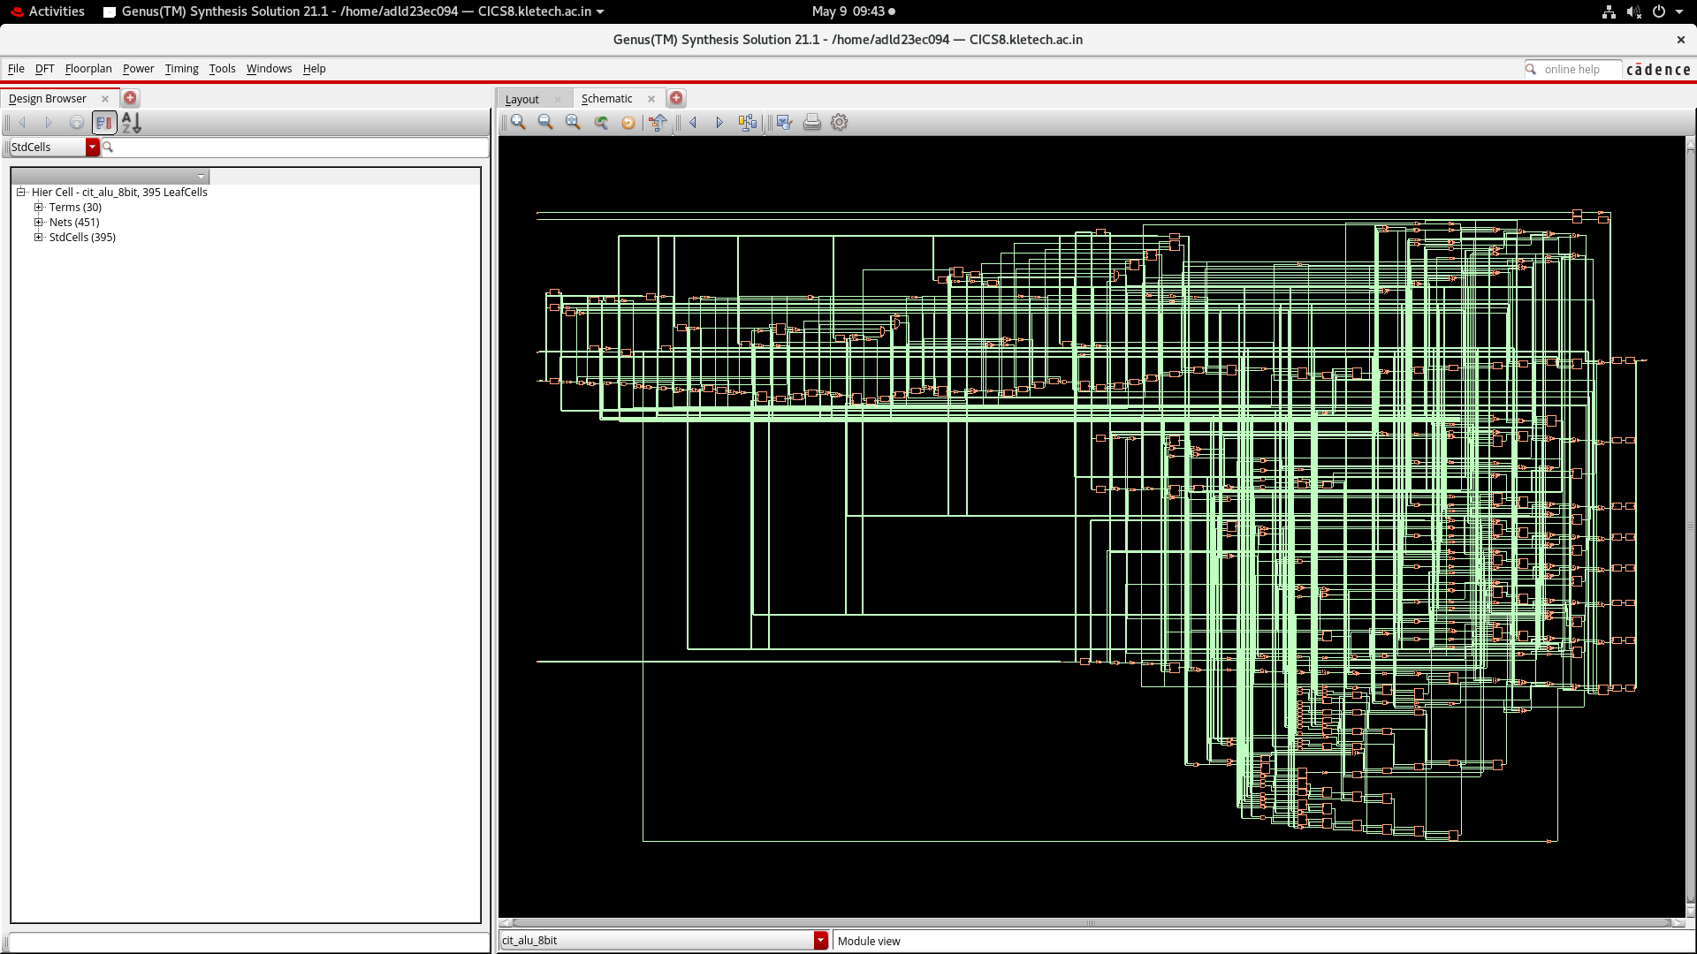
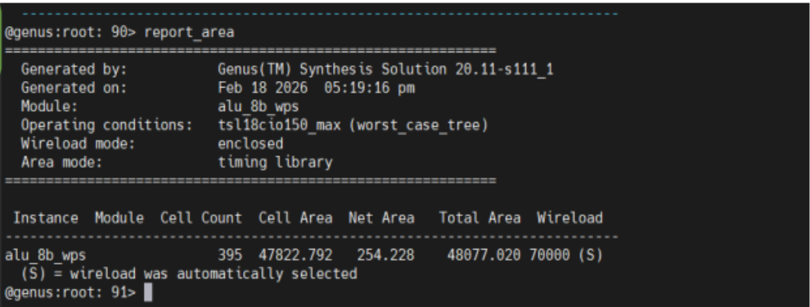
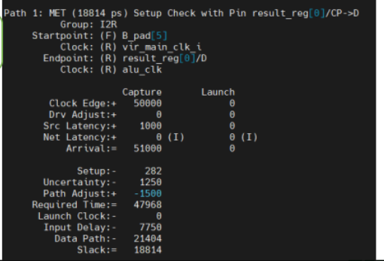
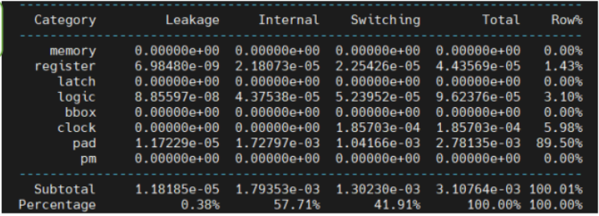
Proper GDS2 stream out with IO pad instantiation
Results after synthesis
Department of Electronics & Communication Engineering

Slide 8
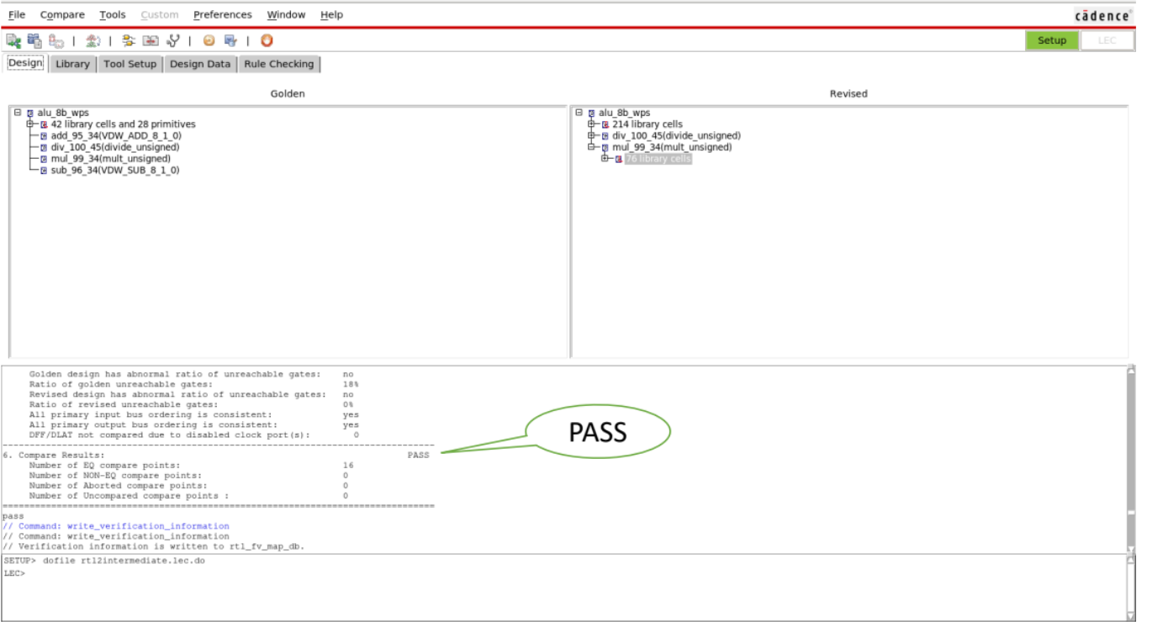
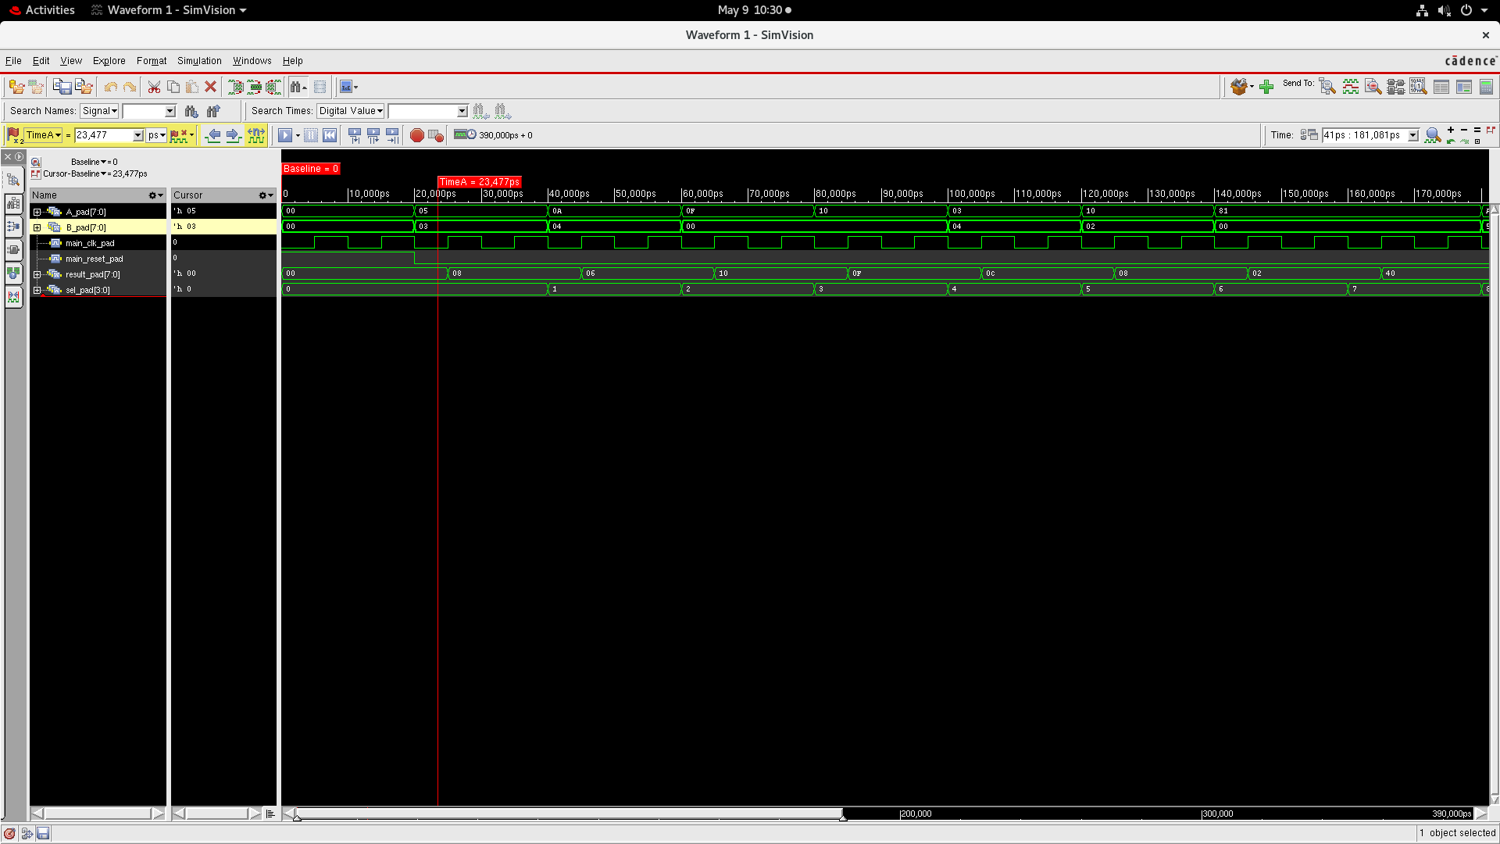

LEC and GLS
Proper GDS2 stream out with IO pad instantiation
Department of Electronics & Communication Engineering

Slide 9
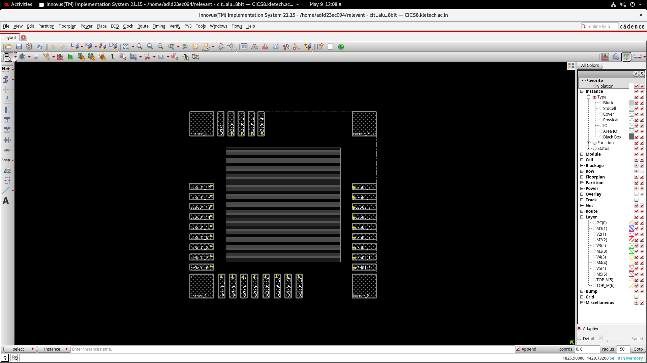
Layout generation in Innovus
Proper GDS2 stream out with IO pad instantiation
Department of Electronics & Communication Engineering

Slide 10
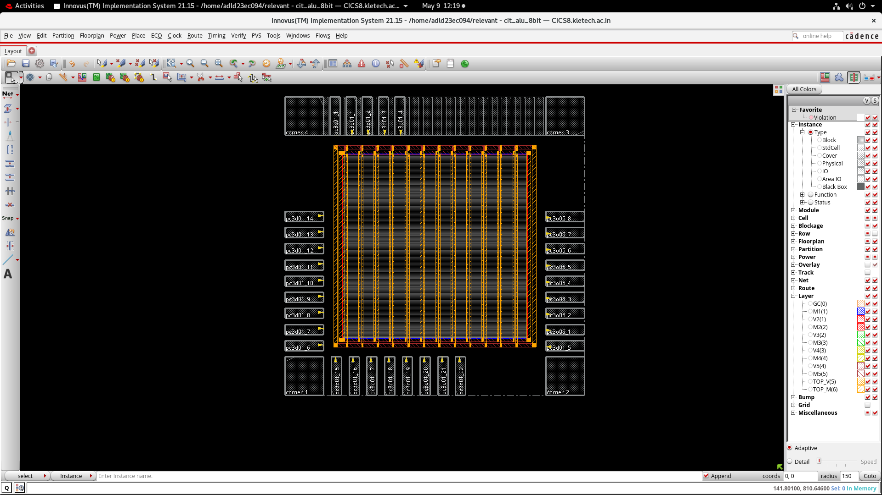
Power Rail connections
Proper GDS2 stream out with IO pad instantiation
Department of Electronics & Communication Engineering

Slide 11
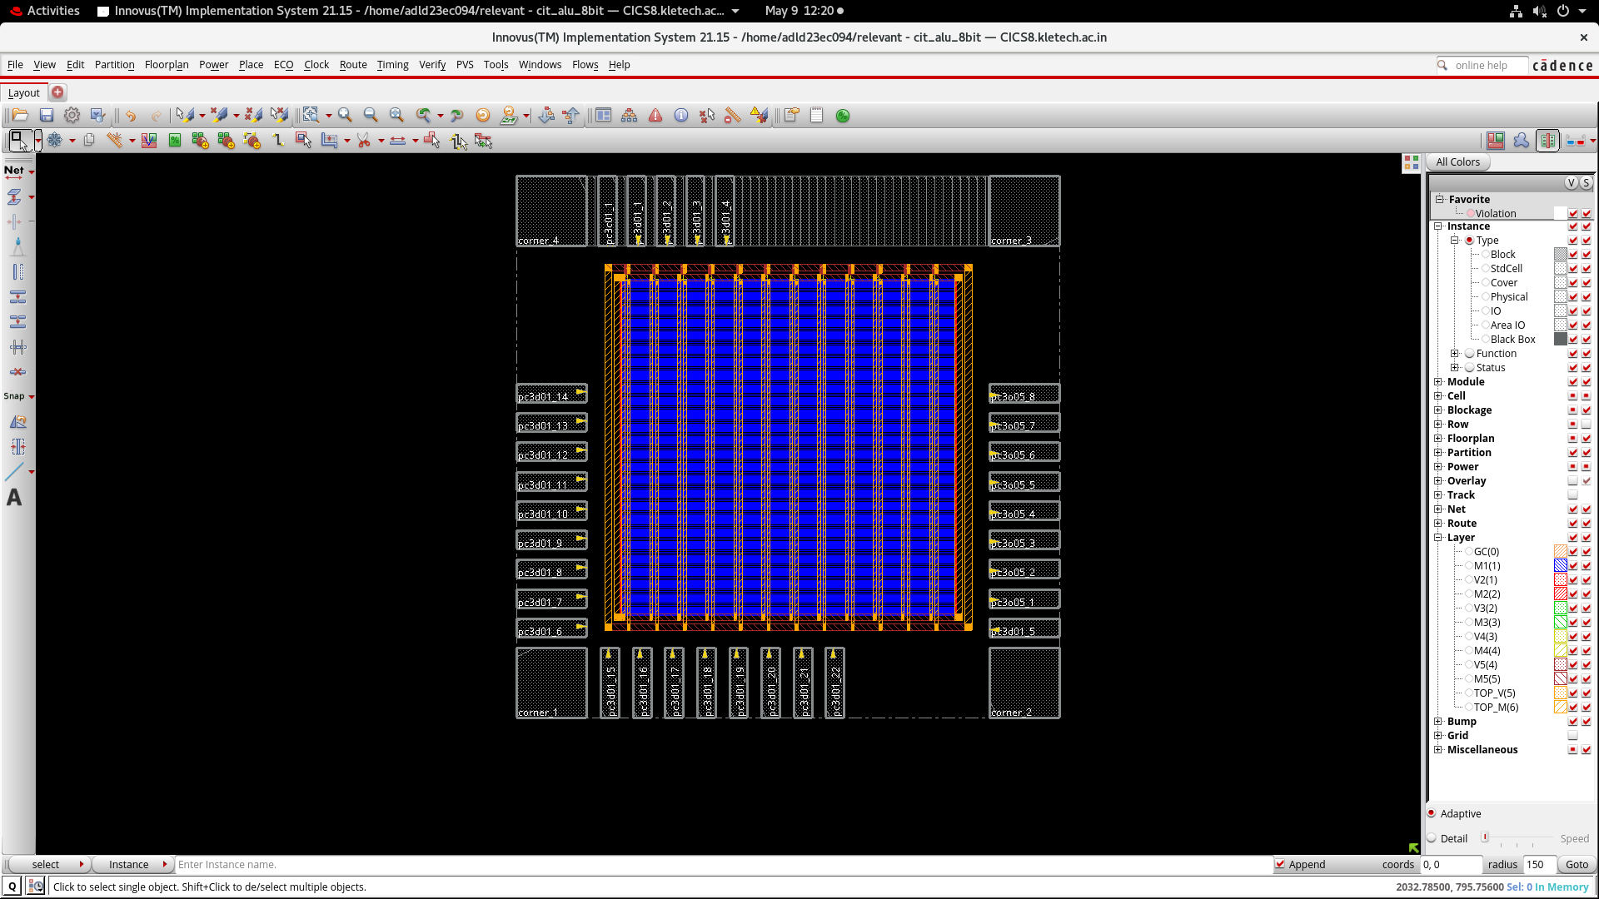
After IO fillers
Proper GDS2 stream out with IO pad instantiation
Department of Electronics & Communication Engineering

Slide 12
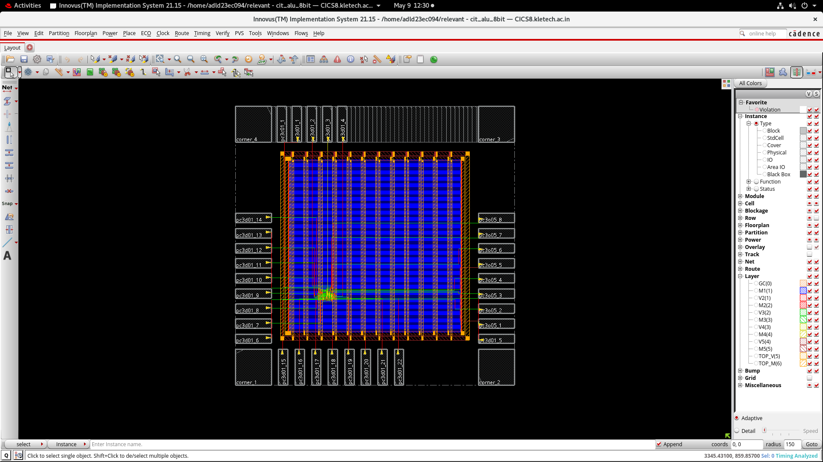
Nano-Routing initiation ( Pre-CTS)
Proper GDS2 stream out with IO pad instantiation
Department of Electronics & Communication Engineering

Slide 13
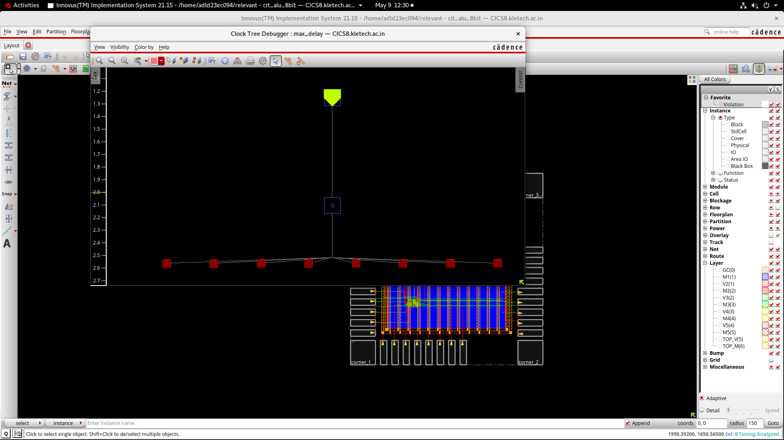
Post CTS
Proper GDS2 stream out with IO pad instantiation
Department of Electronics & Communication Engineering

Slide 14
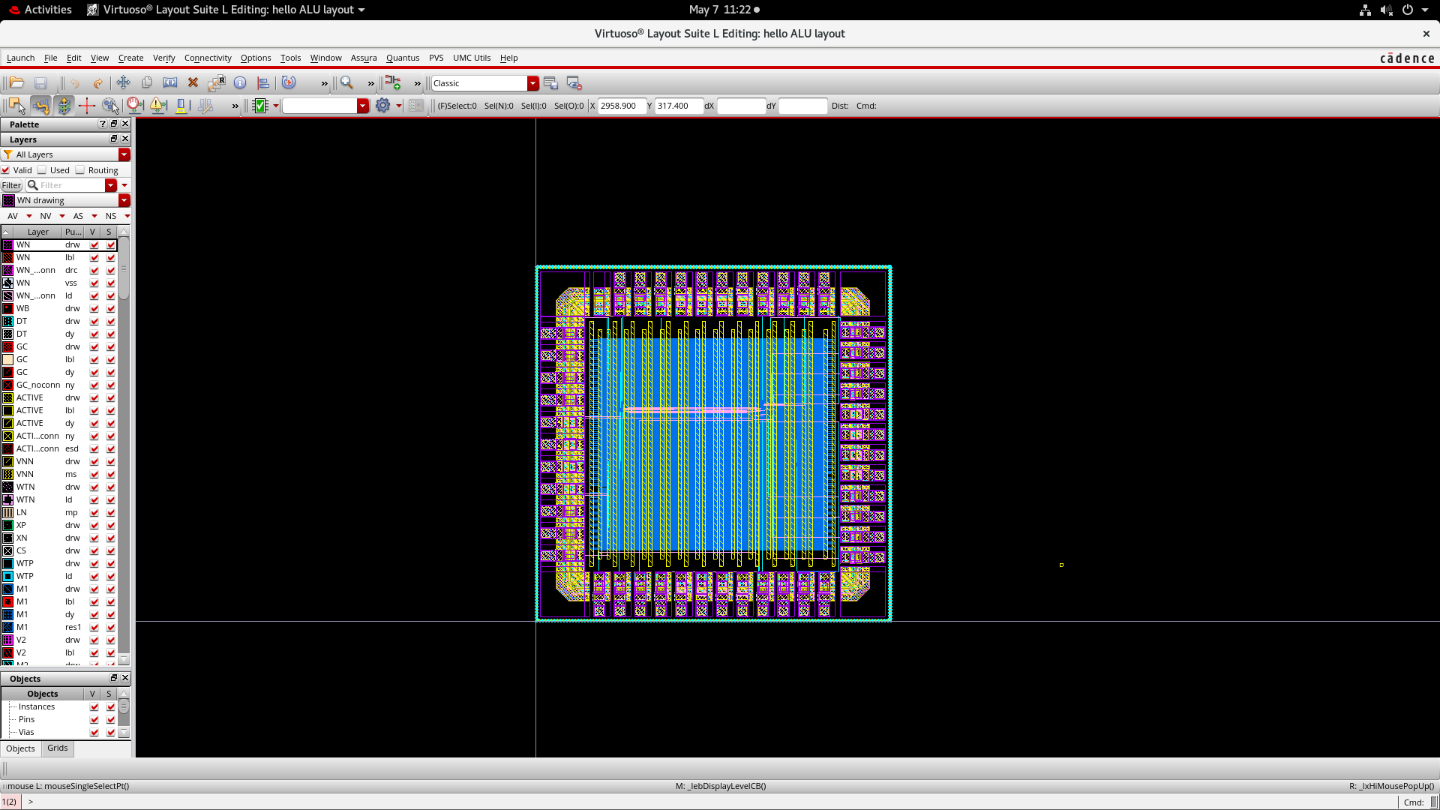
GDS2 streamed in Virtuoso
Proper GDS2 stream out with IO pad instantiation
Department of Electronics & Communication Engineering

