Slide 1

Project Report on CAR PRICE PREDICTION
By:
Sharanya susheel

Slide 2
Business Problem
Its always fascinating to see how we could predict things better when we have large sums of historic data. The world has advanced a lot in terms of technology, medicine, education and many other verticals with the right use of historic data.
One such vertical where it can make a huge impact is the car industry, as the main reasons are, highly fluctuating price which depends on expected booking, actual booking, events and a lot more factors. Now that we all know some basics like the weekends are expensive and holiday season its expensive, we actually don’t know the best price we can book at any given point of the time in the year. Imagine if we could get alerts and recommendations when the price is actually low or offered the best. It does save a lot of money for the travelers and moreover it can also help regulate the demand and availability for business consistency with the airline companies. And it is not mere historic data evaluation done by us, which becomes cumbersome after a point in time with large sums of data, it is how we write algorithms for machines to process and learn large sums of data to help us achieve business objective, which simply is called machine learning.
Using regression method in machine learning, it has helped us overcome the said concern. We need to identify the data and time variables, missing values, heat map to help us create data frame, which further will help us build our model. We have also used RandomForestRegressor, LinearRegression, KNeighborsRegressor and DecisionTreeRegresssor, cross validation using randomized search CV for achieving the results.

Slide 3
Approach to Data Cleaning
Firstly we check the information of the given dataset because it tells that how many rows and columns are present in our dataset and data type of the columns whether they are object, integer or float.
Drop duplicate rows if present in dataset. Then we check for the null values present in our dataset.
If null values are present then fill it via mean, median or mode. Or also you can remove that rows but kindly check it properly.
After that we check the summary statistics of our dataset. This part tells about the statistics of our dataset i.e. mean, median, max value ,min values and also it tell whether outliers are present in our dataset or not.

Slide 4
Approach to Data Cleaning (Cntd…)
* We also check the correlation of our dataset to check the correlation of the columns with each other. If columns are highly correlated with each other let’s say 90% or above then remove those columns to avoid multi colinearity problem.
* We extract data from date column and make new columns like day, month and year to see the outcomes with our target column that is label.
* We delete the pcircle column because it has only one unique value that tells that collected data is only for one circle.
* We cannot remove outliers because more than 20% of our data are removed.

Slide 5
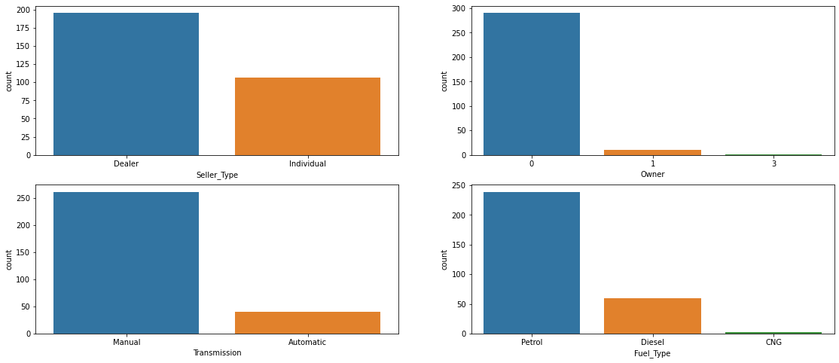
Visualization.
*
from the above graphs we can observe the following: 1)The number of dealer cars is higher than the individual cars 2)The number of manual cars is higher than that ofautomatic cars 3)The number of the third party owners is comparitvely low 4)The number of cars with CNG type of fues is very low compared to that with petrol and diesel.

Slide 6
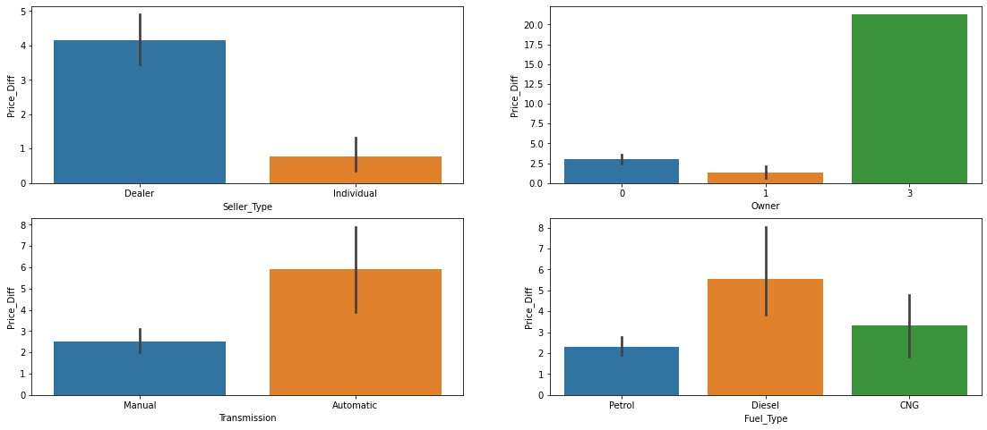
Visualization cont…
* We plot histogram to displays the shape and spread of continuous sample data.
From the above graphs we can observe that the catergorical data has some sort of pattern regarding car's present price and selling price.

Slide 7
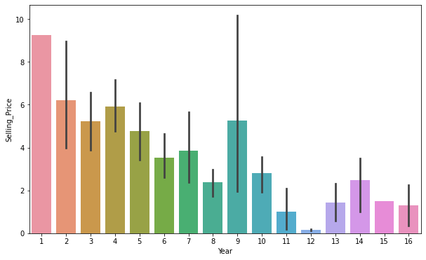
* We also see the customers labels i.e defaluter/Non-defaulter according to date and month with count plot.
Car usage in years andits selling price has a negative correlation
so we can say that as many years car gets used the value decreases.
Present price and selling price are positively correlated
From the graph we can also see that the selling price is not decreasing gradually except in one case.

Slide 8
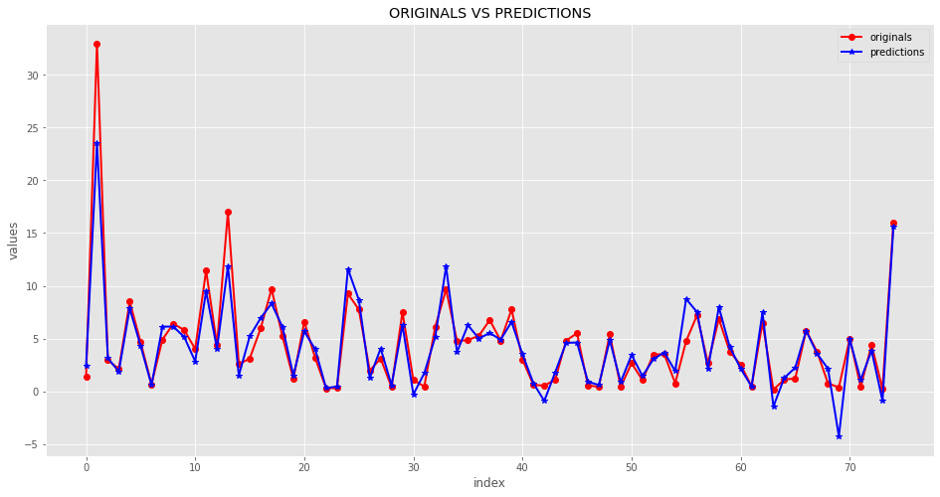
Modelling part
* We know that this is regression problem

Slide 9
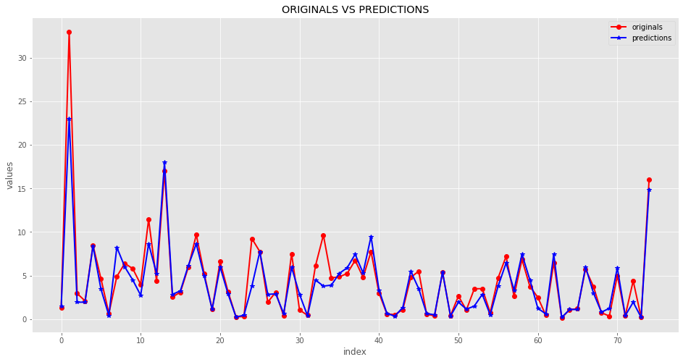

Slide 10
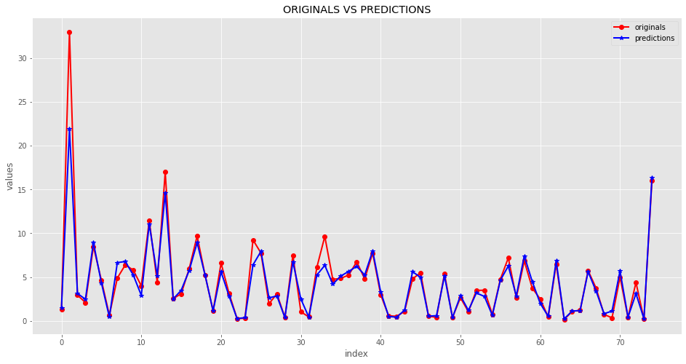

Slide 11
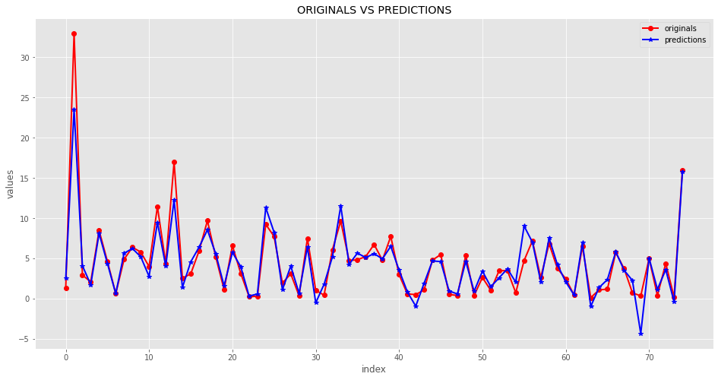

Slide 12
Conclusion
Random forest has a high r2 score which is a better model compared to the others

