Slide 1

SpecialMinds
G. NARAYANAMMA INSTITUTE OF TECHNOLOGY AND
SCIENCE
(AUTONOMOUS)
(FOR WOMEN)
See beyond disability, See ability

Slide 2
BATCH MEMBERS:
22251A05G9 : HAFSA KHAJA
22251A05H0 : HANIAH FATIMA
22251A05H7 : M. MOUNIKA
22251A05J6 : SUMAYYA KALEEM
INTERNAL GUIDE:
DR. P. SUNITHA DEVI , Assistant Professor,CSE dept, GNITS

Slide 3
INTRODUCTION
Special Minds is a transformative tool that helps parents and teachers recognize early symptoms of learning disabilities, enabling timely intervention and support. By fostering understanding and acceptance, it promotes an inclusive environment where children are valued for their unique qualities. This app empowers parents to better address their child's needs, driving inclusivity and normalizing learning disabilities.

Slide 4
LITERATURE SURVEY
Sl. No | Author | Purpose | Limitation
1 | C. Daetz et al (2007) | Understanding parental involvement, timely interventions | Parents understanding and acceptances
2 | J. R. Murph et al (2015) | Difference between autism risks and diagnosis | Conveying risks to students and parents
3 | H. Singh et al (2019) | AI and ML for detecting disabilities | Technology integration
4 | Kasturi Baarik et al (2023) | Tailoring educational approaches | Finding skilled practitioners

Slide 5
PROBLEM STATEMENT
The absence of a standardized Disability Screening Checklist for Schools impedes the identification of students with disabilities, hindering inclusive education efforts as per NEP 2020 and the RPwD Act 2016. To address this, NCERT has developed the PRASHAST app for school-based screening, aiming to generate school-level reports for certification. However, effective implementation and integration into existing school systems remain a challenge.

Slide 6
EXISTING SYSTEMS
“PRASHAST” (Proficiency Rationalisation and Analysis through State-of-the-art Software Tools), an app developed by the Indian education board. PRASHAST aims to identify and analyze the mental abilities of students. It’s likely designed to assist educators in understanding students’ strengths and weaknesses to better tailor educational approaches. It has questionnaire and surveys that students can answer, assessing which along with response time the student’s mental thinking levels, cognitive thinking, and his ability to grasp and understand things etc. Can be determined. The app creates a dashboard of student,s performance and presents it to his/her guardian and grants a score for different criterias

Slide 7
PROPOSED SYSTEM
The proposed system, Special Minds, is a user-friendly mobile app designed to detect learning disabilities in children early. It is accessible to everyone, allowing parents, teachers, and caregivers to log in and select from various quiz topics related to disabilities like autism, low vision, and cerebral palsy. The app presents a timed questionnaire (10 minutes) and provides immediate scoring with feedback indicating if the child’s abilities are fine, average, or need care. Developed using Android Studio with Java and Kotlin, Special Minds securely stores data and results, facilitating early intervention with timely support and tailored educational strategies.

Slide 8
OBJECTIVES
The objectives of Special Minds are to collect relevant questions on various learning disabilities, gather answers from users through a structured questionnaire, analyze the responses to generate a score, and display the result to indicate whether the child’s abilities are fine, average, or need special care.

Slide 9
SpecialMinds can detect:
Loco Motor Disability
Low Vision
Cerebral Palsy
Autism
Mental Illness

Slide 10
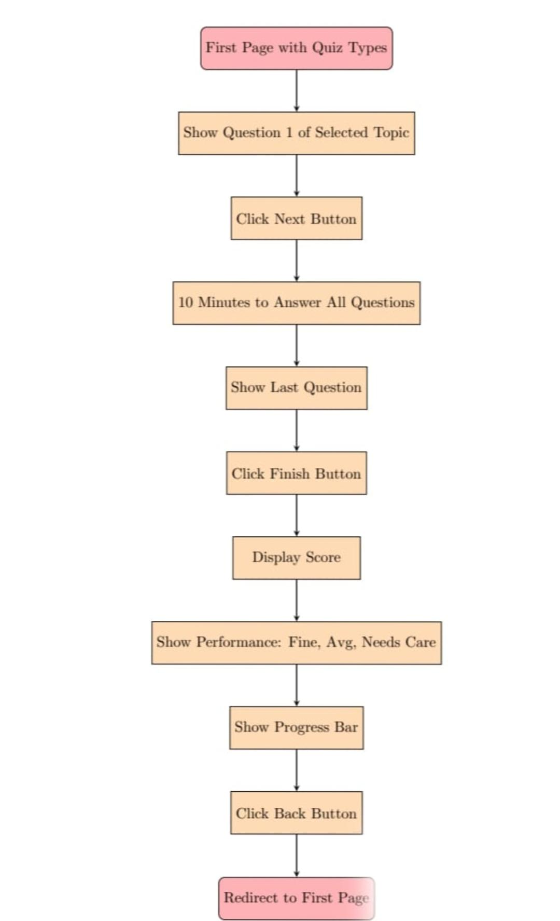
METHODOLOGY

Slide 11
SOFTWARE AND HARDWARE REQUIREMENTS
Mobile Development Framework: Android SDK Database: Firebase Firestore Cloud Services: Firebase Suite (Firestore, Analytics, Cloud Functions) Architecture Components: Android Jetpack Components (ViewModel, LiveData, Navigation Component)

Slide 12
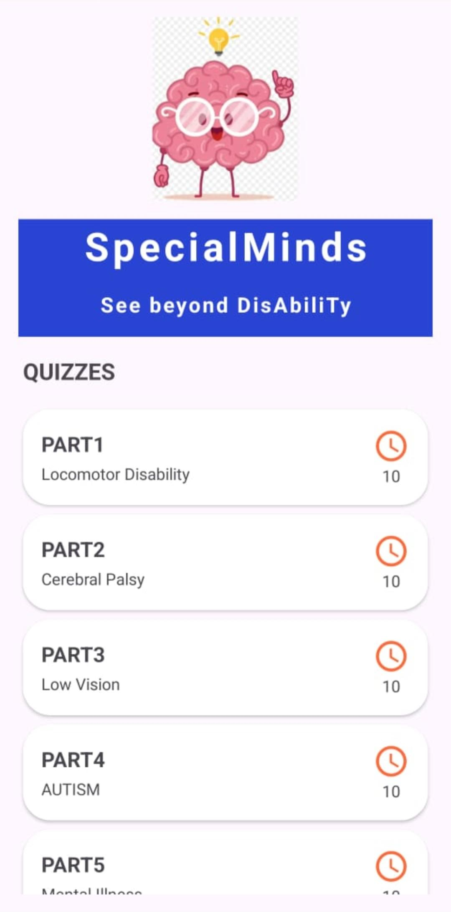
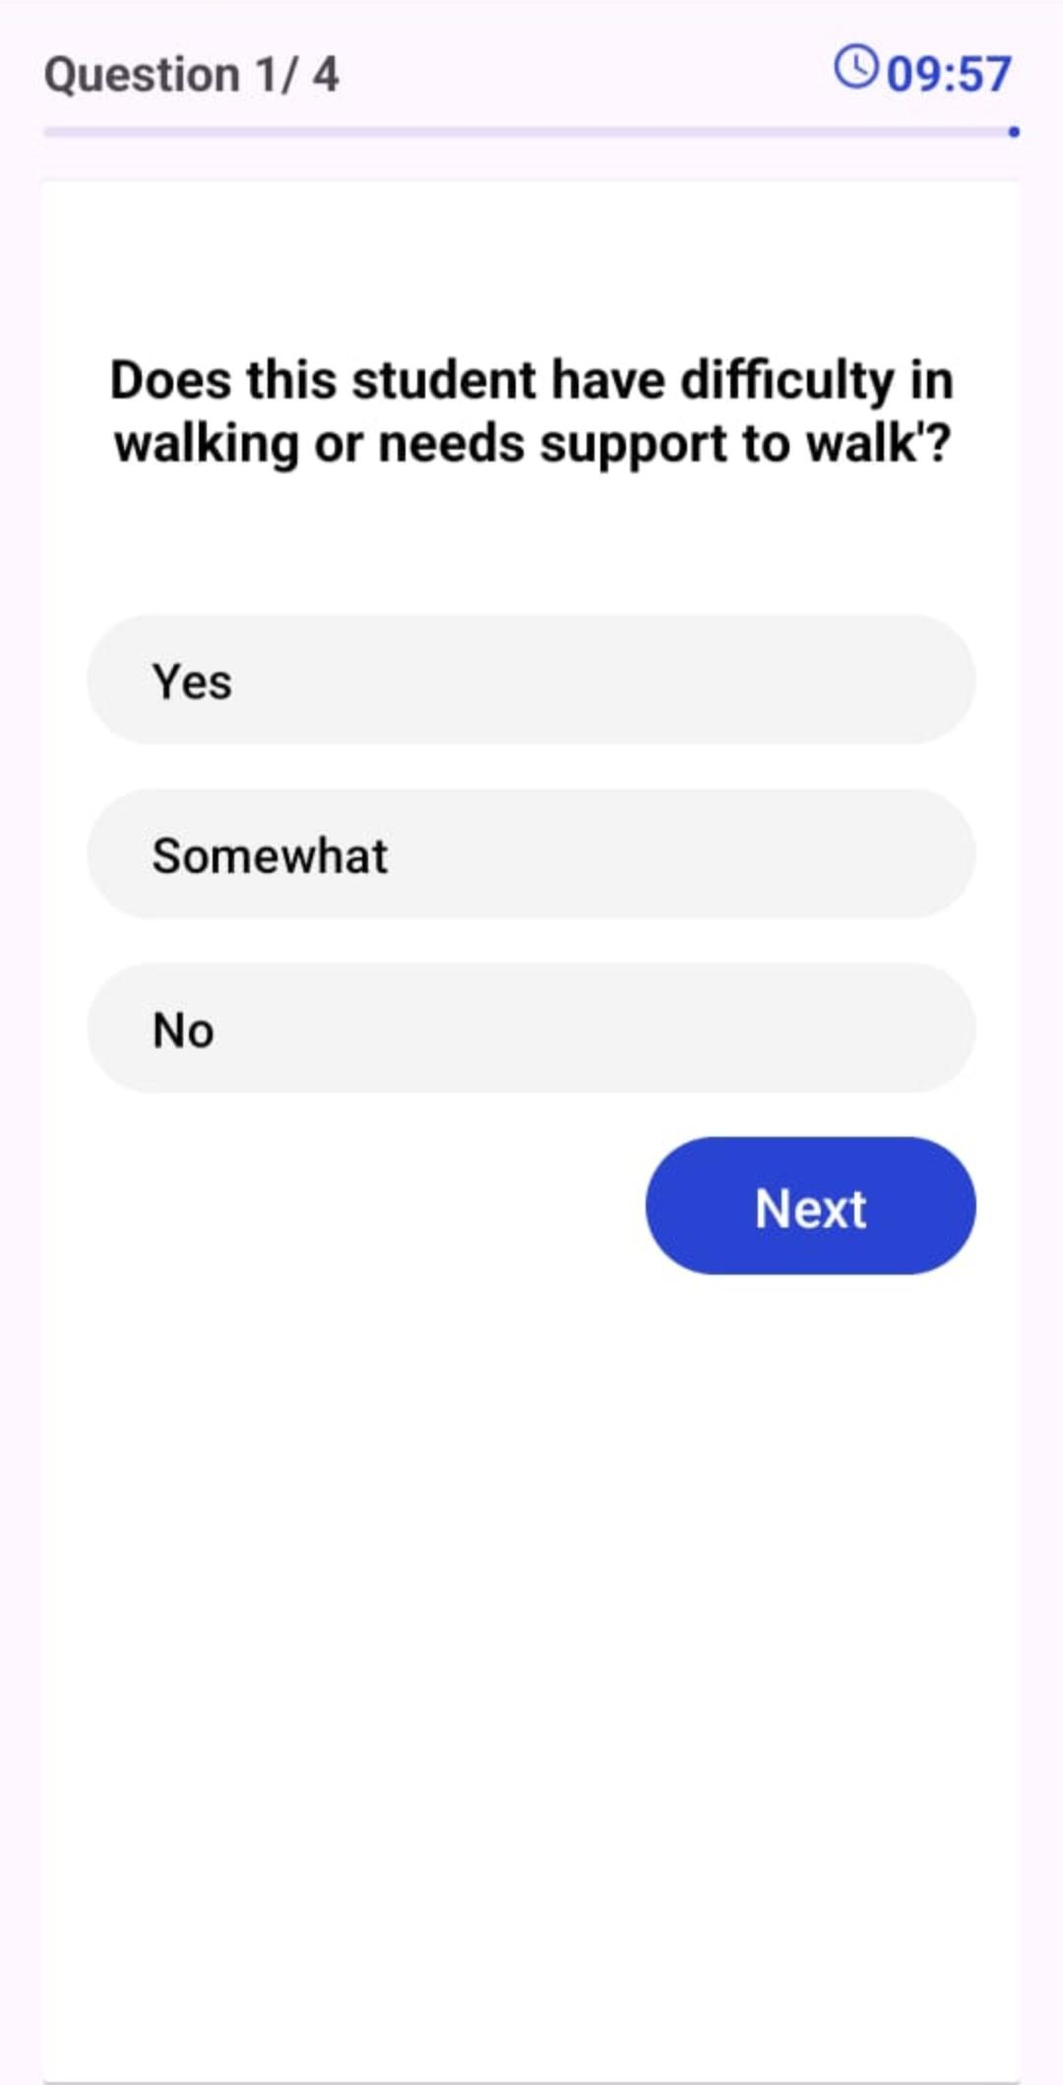
RESULTS

Slide 13
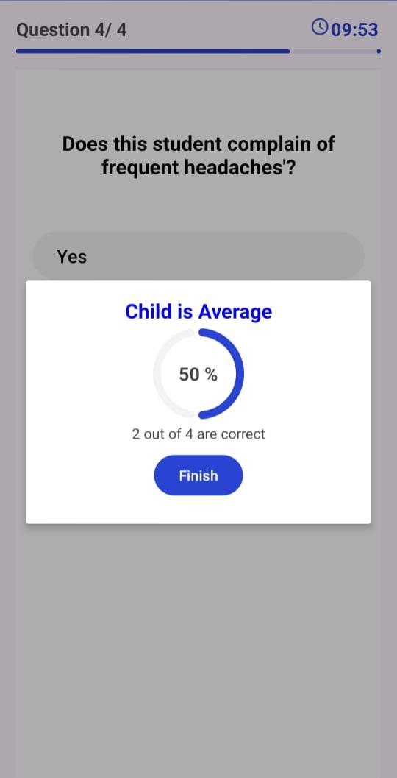
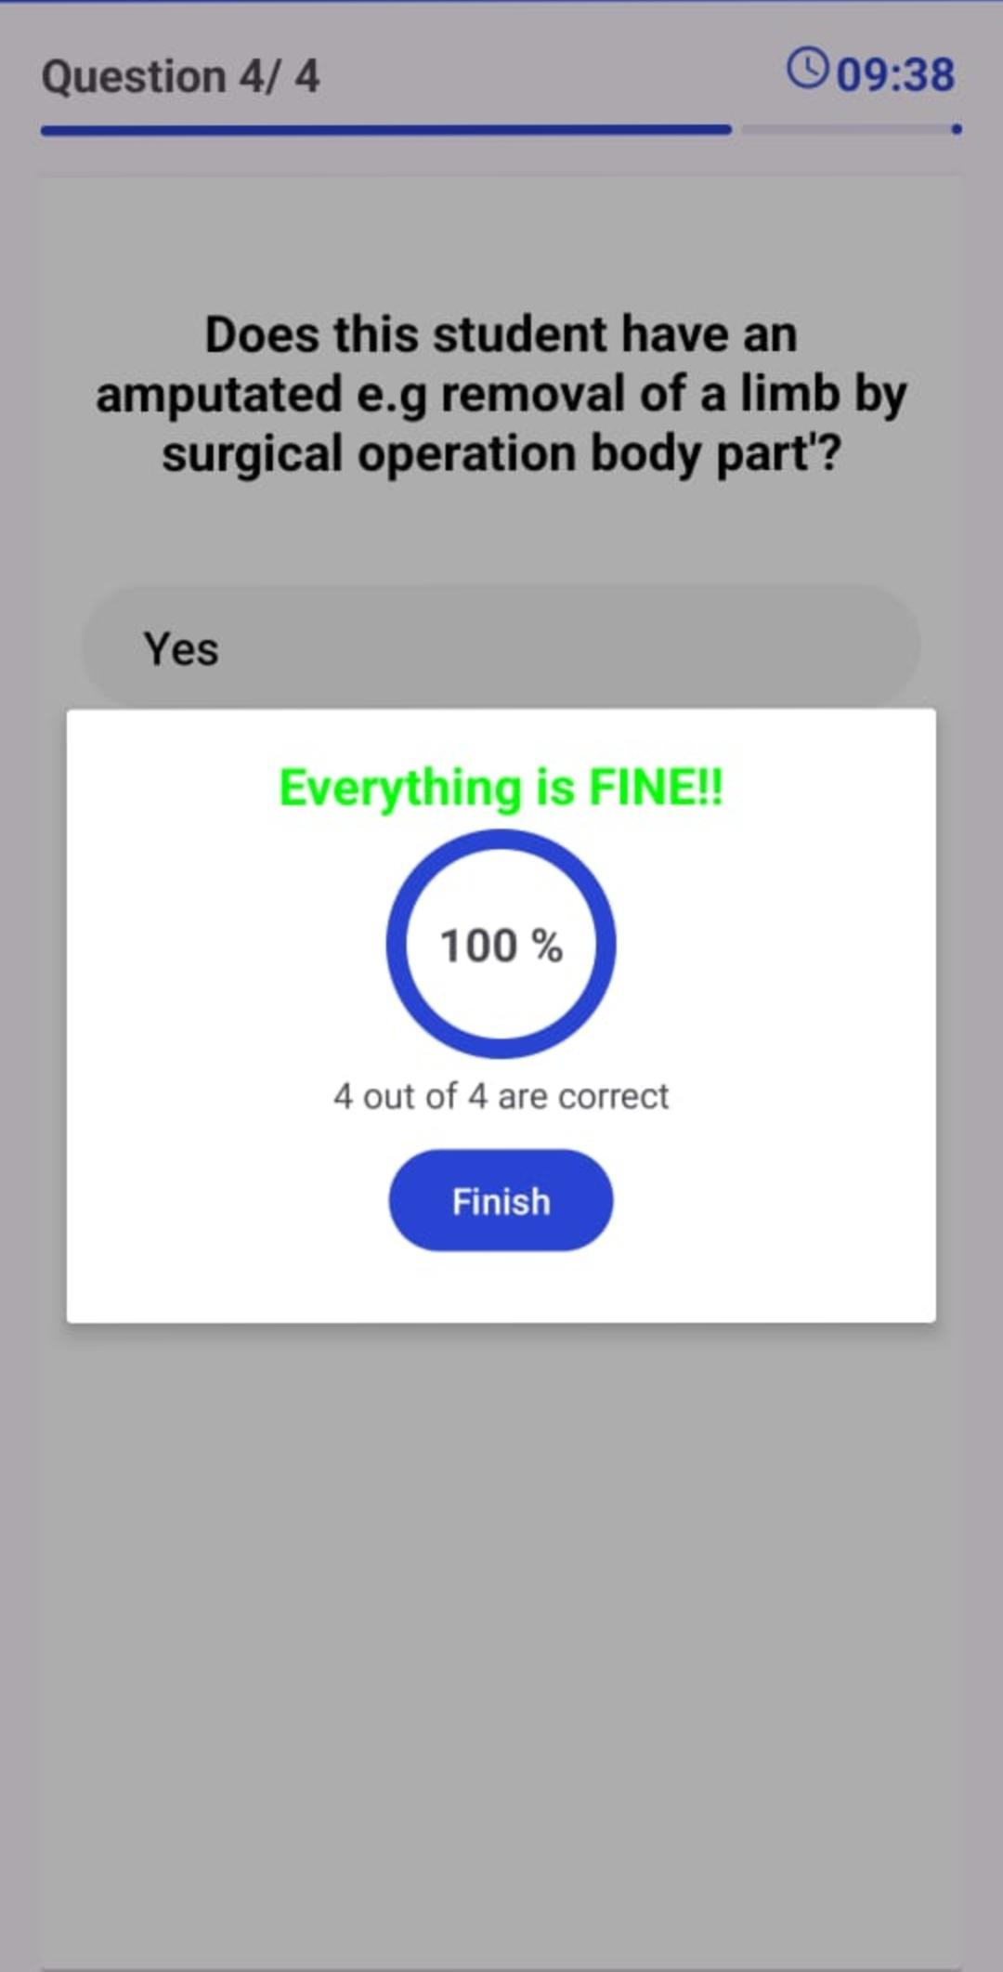
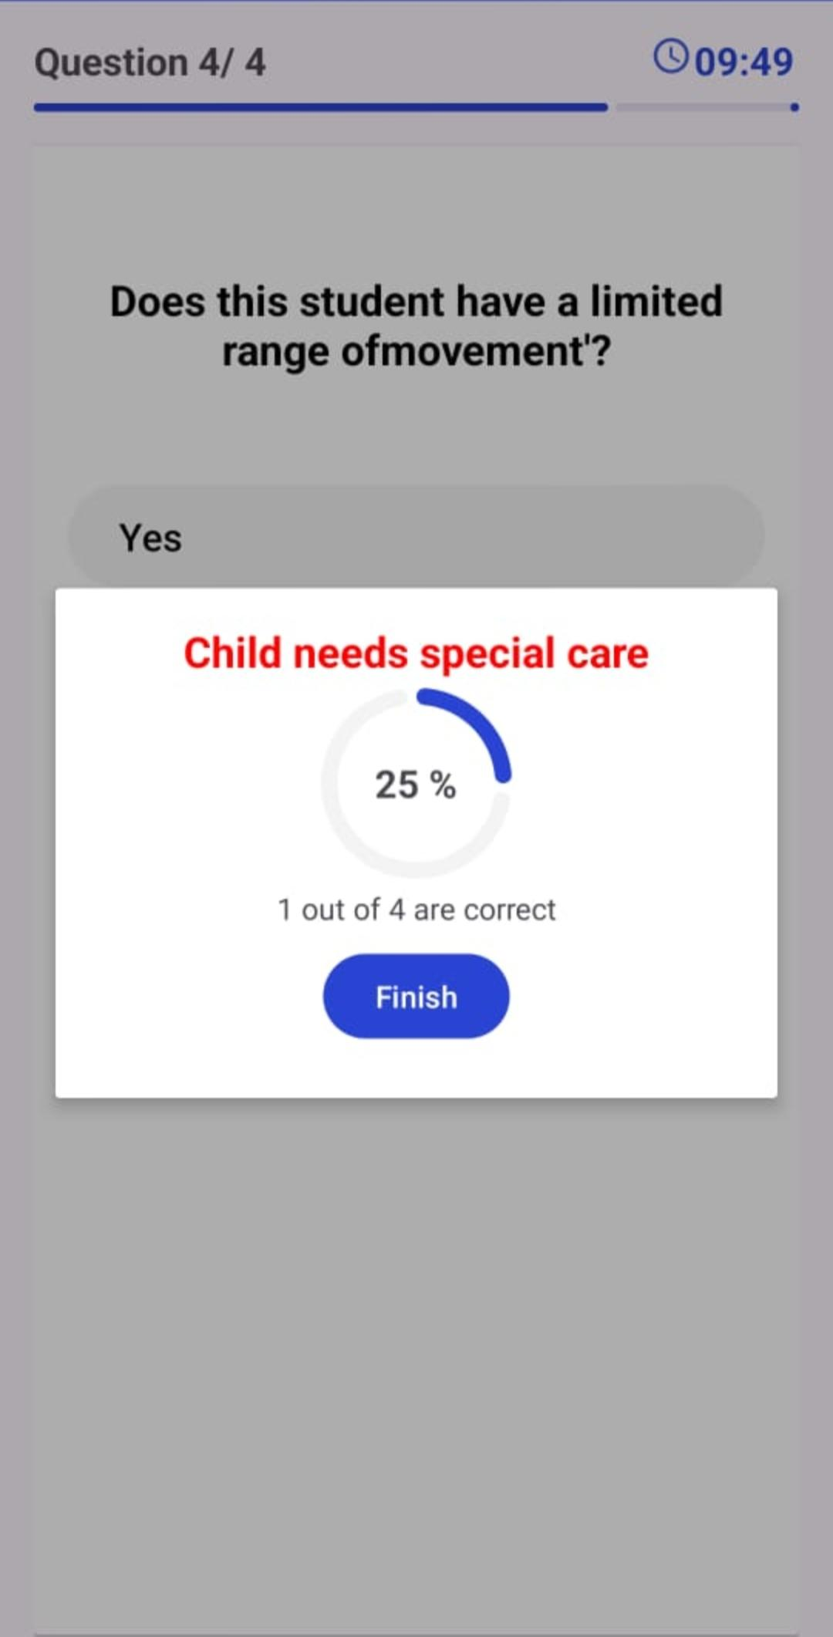
RESULTS

Slide 14
Conclusions
In conclusion, Special Minds provides an accessible, efficient, and secure tool for early detection of learning disabilities in children. By collecting answers, analyzing scores, and delivering clear results, the app empowers parents and educators to take timely action, ensuring better support and care for children’s developmental needs.

Slide 15
FUTURE SCOPE
Expert consultancy
Diversification of question bank
Multilingual support

Slide 16
References
https://link.springer.com/article/10.1007/s10803-012-1546-4
https://www.researchgate.net/publication/51385666_Parental_Compliance_After_Screening_Social_Development_in_Toddlers
https://ieeexplore.ieee.org/document/9411531
https://www.researchgate.net/publication/378919988_Intelligent_approaches_for_early_prediction_of_learning_disabilities_in_children_using_learning_patterns_A_survey_and_discussion

