Slide 1

Final Report
Bank Marketing Campaign
Jan 15, 2023
Group Name: Evolve Data
Name: Dmitry Sharukhin
Email: sharuhinda@gmail.com
Country: Russia
College/Company: Finval GC
Specialization: Data Science

Slide 2

Agenda
Problem Description
Summary of EDA Results
Dataset Preprocessing and Encoding
Models and Results
Alternative Approach: Clustering
Conclusions and Recommendations

Slide 3
Problem Description
Client:
ABC Bank
Description:
ABC Bank wants to sell its term deposit product to customers and before launching the product they want to develop a model which help them in understanding whether a particular customer will buy their product or not (based on customer's past interaction with bank or other Financial Institution)
Bank wants to use ML model to shortlist customer whose chances of buying the product are more so that their marketing channel (tele marketing, SMS/email marketing etc.) can focus only to those customers in order to save resources (which is directly involved in the cost (resource billing)) and their time
Objectives:
Create ML model to shortlist customer whose chances of buying the product are more so that their marketing channel (tele marketing, SMS/email marketing etc.) can focus only to those customers

Slide 4
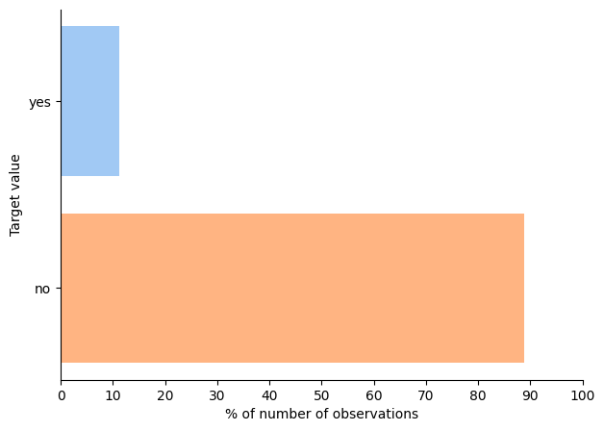
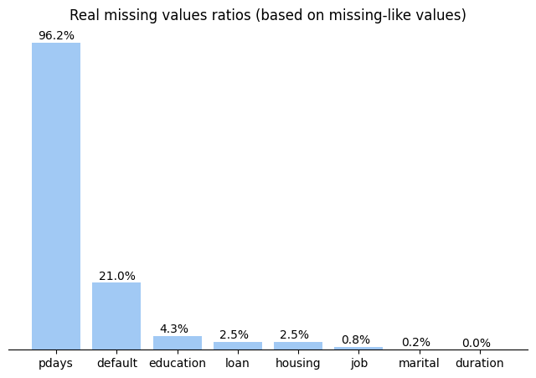
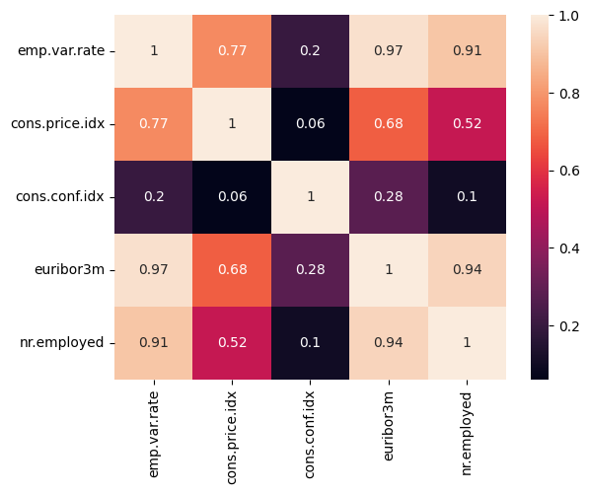
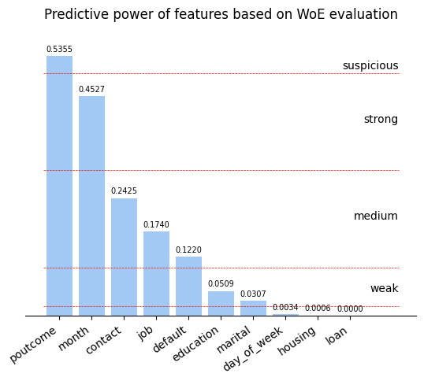
Summary of EDA Results
We are dealing with
HIGHLY imbalanced dataset (positive labels << negative labels)
There are many missing-like values
There are some correlated features which can help to impute missing values or make troubles when modelling
Weight-of-Evidence was chosen as one of encoding approaches to try

Slide 5
Dataset Preprocessing and Encoding
As the dataset is highly imbalanced, all preprocesses and encodings did not drop any row
(but redundant columns were dropped if necessary)
Impute missing-like values
Common most frequent value strategy
Bin / cutoff
Cutoffs were made for highly skewed features with few observations
Encoding
Natural ordinal encoding (month No., day No., ‘yes’/’no’ →1/0)
No imputing in some cases of WoE encoding
Cross-feature most-frequent values strategy
One-hot encoding
WoE encoding
Binning for WoE encoding
11 variants of datasets were created by applying different techniques to different features and combining them
Pipelines were created to process initial test dataset according to each option’s rules

Slide 6
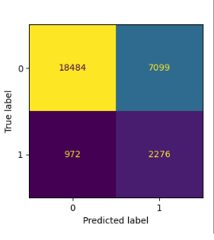
Models and Results
Choosing metric
Clients that will NOT be called during campaign and refuse to open deposit if they would
Clients that will be called during campaign but refuse to open deposit
(HIGHER COST OF CAMPAIGN)
Clients that will NOT be called during campaign but agree to open deposit if they would
(LOST INCOME)
Clients that will be called during campaign and agree to open deposit
Based on assumption that potential income in positive case is significantly higher than cost per call, the target is to reduce False Negatives.
RECALL is the target metric then

Slide 7
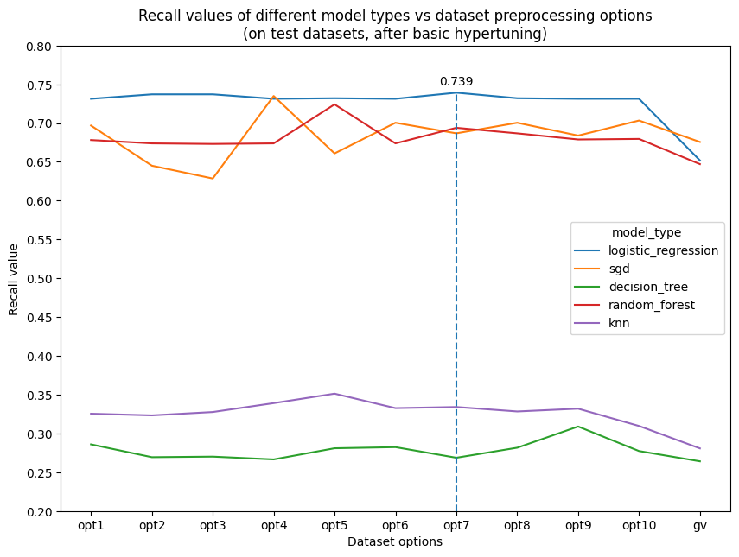
Models and Results (continue)
5 models were tested on each version of dataset created:
Logistic Regression
Stochastic Gradient Descent
Decision Tree
Random Forest
k Nearest Neighbors
Basic hyperparameters tuning was performed on each model using GridSearchCV class from scikit-learn package with 5-fold stratified cross-validation.
Recall was assigned as optimization metric
Logistic Regression shows best results on almost all dataset variants.
And it’s robust against preprocessing and encoding options

Slide 8
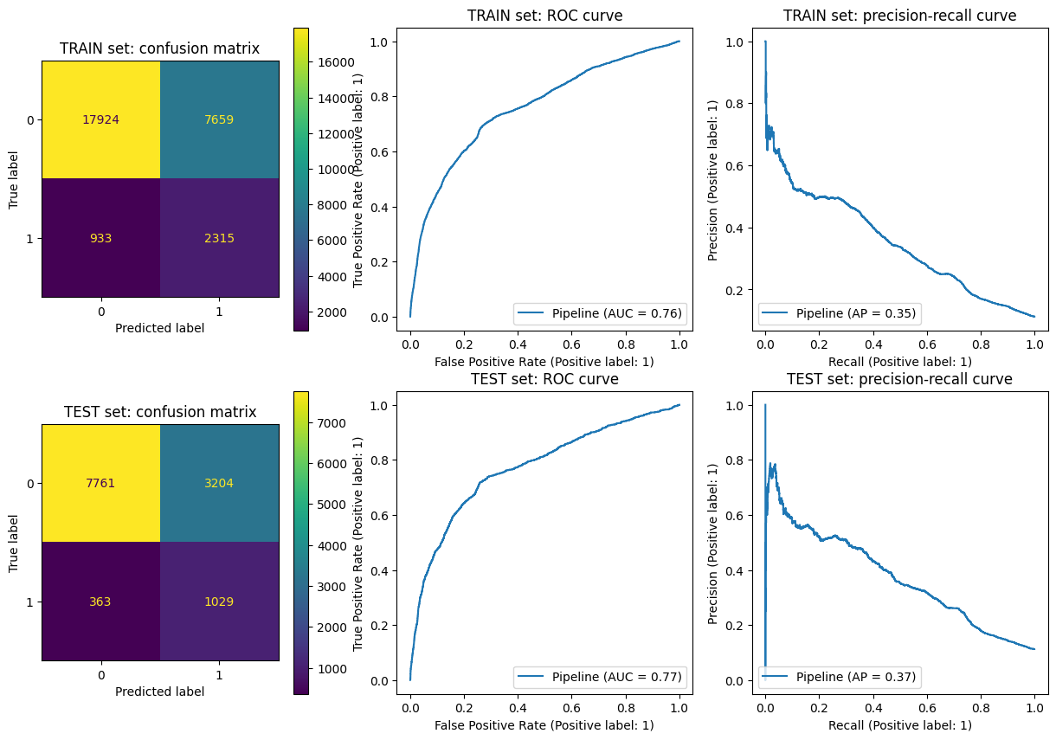
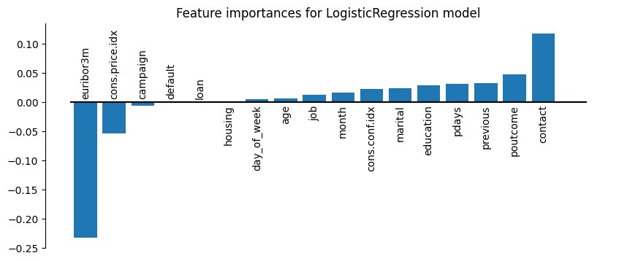
Models and Results (continue)
Best model results

Slide 9
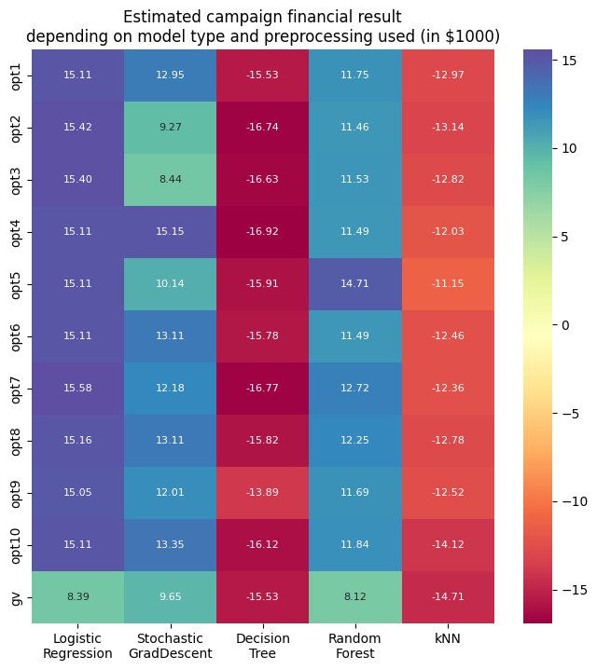
Models and Results (continue)
Evaluation of financial results
Indicator | Value
Average bank margin | 1%/yr
Average deposit sum | $31 600
Mobile call cost | $0.15 /minute
Average call duration | 3.4 minutes (mean value from dataset)
Average margin from 1 deposit per month (possible duration of the campaign) | 31 600 * 0.01 / 12 ~ $26.3 /mo
Average cost of call | 3.4 * 0.15 ~ $0.5
Information to evaluate campaign financial results for each model type was found in Internet
Each model’s confusion matrix was built on test sets.
Information from table above was transformed to similar form and estimated financial result was calculated.
It shows that Logistic Regression model is leading not only on recall value but also on financial results
Financial result of each outcome type (per 1 call)
TN = $ 0.00 | FP = $ -0.50
FN = $ -25.8 (lost income) | TP = $ 25.8 (26.3 - 0.5)

Slide 10
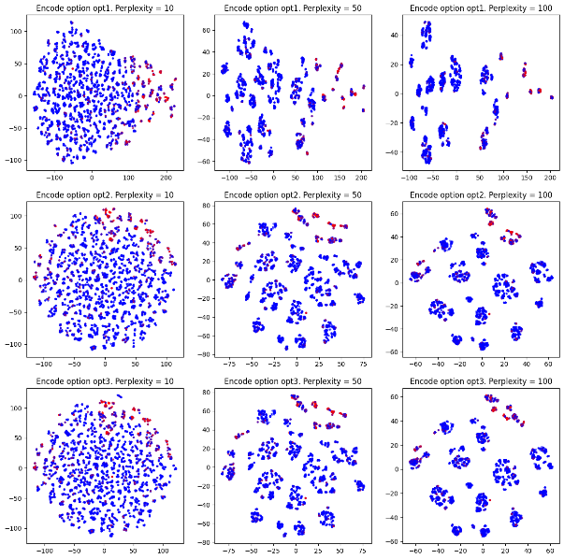
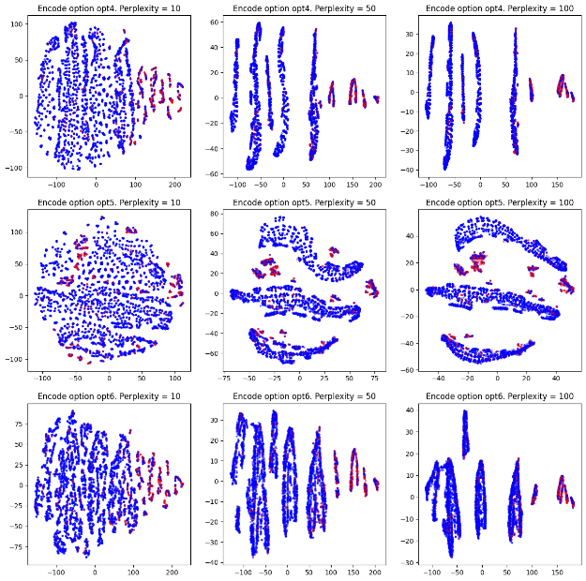
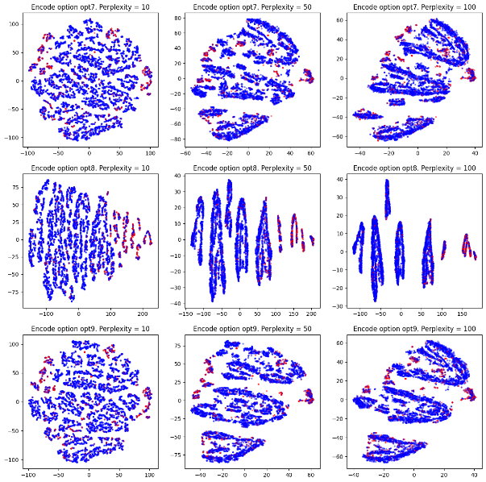
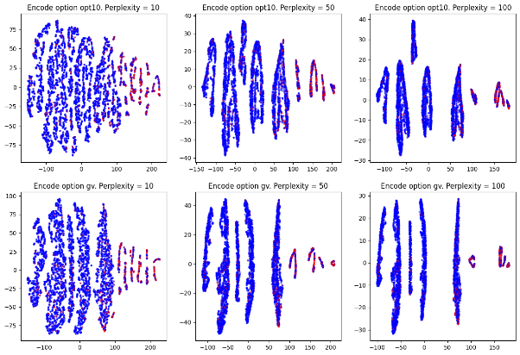
Alternative Approach: Clustering
Based on the task description we assumed that clustering technique may help to determine groups of customers with high or low probability of opening deposit
We used t-SNE method to visualize preprocessed datasets. But took only about 8000 random observation from each using stratified sampling
Some preprocessing methods results in well-shaped clusters. These clusters have visually different density of positives (red dots).
We chose opt4 preprocessing option to experiment with it

Slide 11

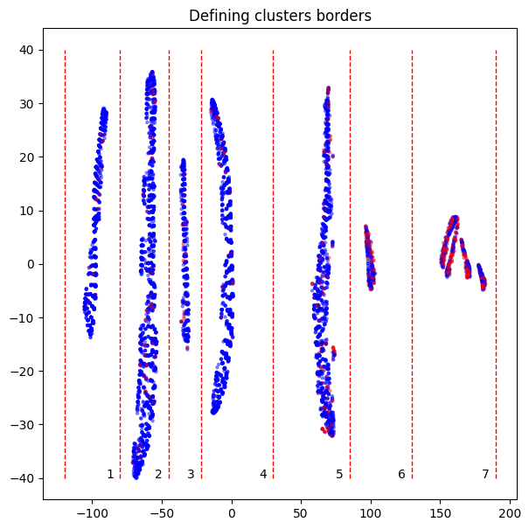

Alternative Approach: Clustering (continue)
Despite there are 7 clusters on the chart, 4 of them (1 to 4) have near the same low probability of positives (5-6%)
We trained KMeans clustering model from scikit-learn to make 4 clusters on train set.
The results show that clustering was performed successfully as we got probabilities we expected
Applying model to test dataset was successful too – probabilities in each of clusters defined by model stay with respect to ones in train dataset
Considering success of clustering technique, we suggest to use it to define groups of customers. Then bank can prioritize calls according to probabilities of positive income
Recall value in this case will be equal to 1.0 as all customers from cluster are supposed to get a call

Slide 12
Conclusions and Recommendations
Conclusions:
- Initial dataset was transformed using 11 different combinations of imputing and encoding
- 5 types of models were trained and evaluated on created datasets
- Logistic Regression model showed high robustness to encoding method and highest recall values on almost all dataset options
- Unsupervised clustering method was alternatively developed and tested on dataset
Final recommendations:
Use Logistic regression as main predictive model to determine if the customer will open a deposit
Try to fine tune model hyperparameters further to improve model efficiency
Use simple (ordinal and binary) encoding and imputing based on “most frequent” strategy (preprocessing option 7)
Analyze sensitivity of models’ financial results to the level of costs relative to income value

Slide 13
THANK YOU

