Slide 1

Exploratory Data Analysis
Bank Marketing Campaign
Jan 15, 2023
Group Name: Evolve Data
Name: Dmitry Sharukhin
Email: sharuhinda@gmail.com
Country: Russia
College/Company: Finval GC
Specialization: Data Science

Slide 2

Agenda
Problem Description
Overall Dataset Characteristics
Approach
EDA
Conclusions and Recommendations
Technical Details

Slide 3
Problem Description
Client:
ABC Bank
Description:
ABC Bank wants to sell its term deposit product to customers and before launching the product they want to develop a model which help them in understanding whether a particular customer will buy their product or not (based on customer's past interaction with bank or other Financial Institution)
Bank wants to use ML model to shortlist customer whose chances of buying the product are more so that their marketing channel (tele marketing, SMS/email marketing etc.) can focus only to those customers in order to save resources (which is directly involved in the cost (resource billing)) and their time
Objectives:
Create ML model to shortlist customer whose chances of buying the product are more so that their marketing channel (tele marketing, SMS/email marketing etc.) can focus only to those customers

Slide 4
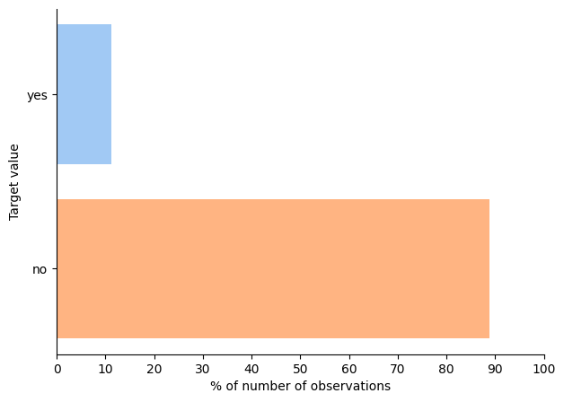
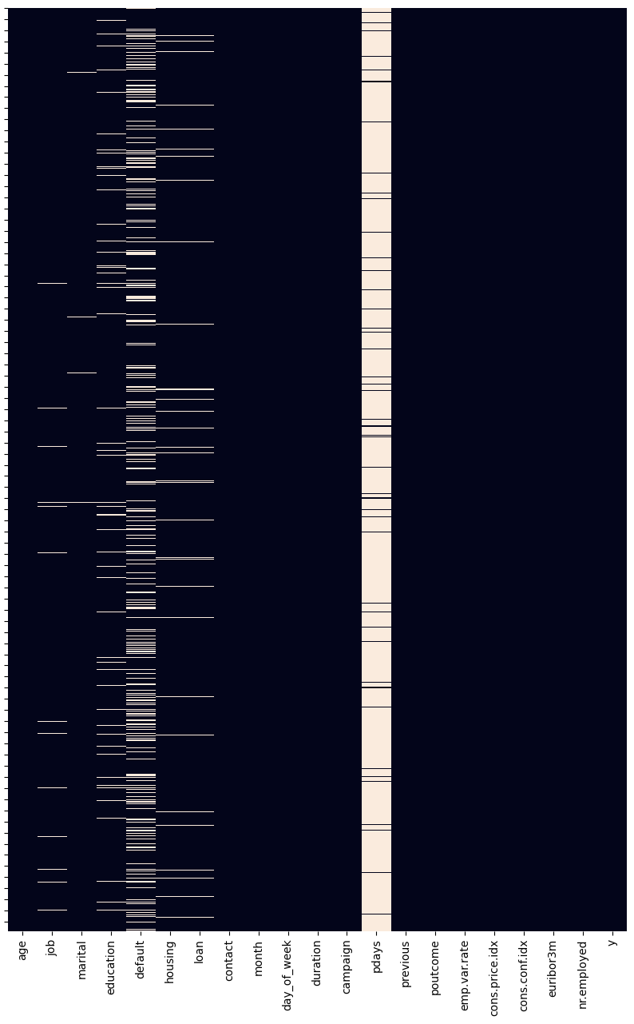
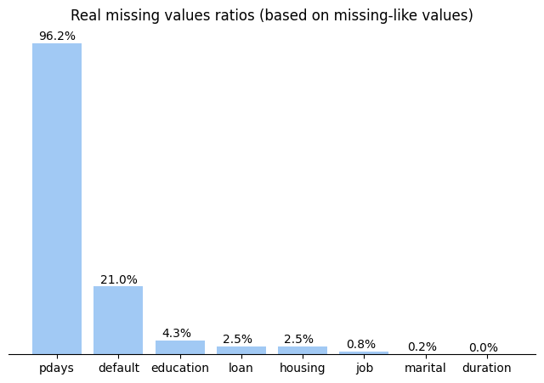
Overall Dataset Characteristics
The dataset is HIGHLY imbalanced (positive labels << negative labels)
Some features contain many missing-like values
(these are ‘unknown’ and 999)

Slide 5
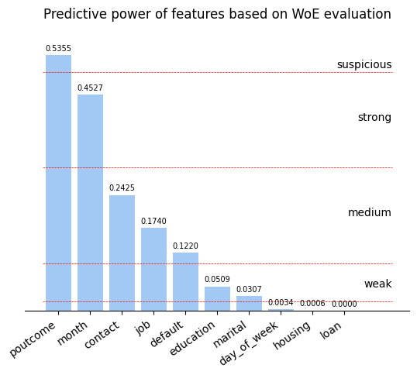
Approach
For analysis purposes we divided all features on personal, marketing and macroeconomic categories
Because of low frequency of positive observations in the dataset we must be very careful about dropping rows.
Ideally not dropping at all
We will use the approach known as Weight-of-Evidence to keep all observations safe.
This approach is based on relative odds of events (odds to have ‘yes’ vs. odds to have ’no’) and can be used even for missing data considering it as a separate category
This approach also allows to evaluate the “usefulness” or predictive power of features

Slide 6
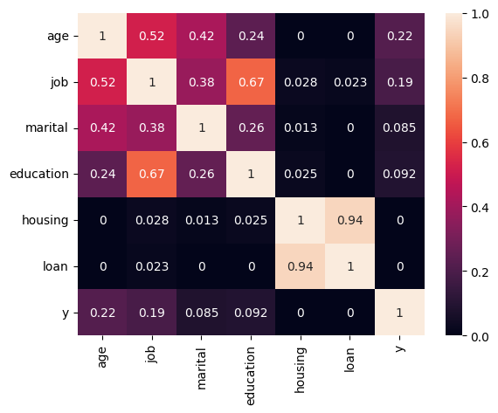
EDA: Personal Features
There are several features having relatively strong correlation (association strength) with each other.
It may help with imputing missing values
There are no features having high correlation (association strength) with target

Slide 7
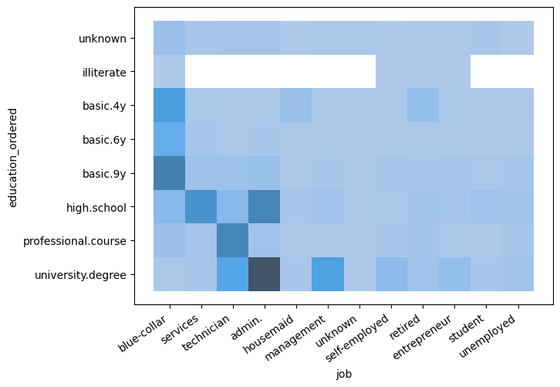
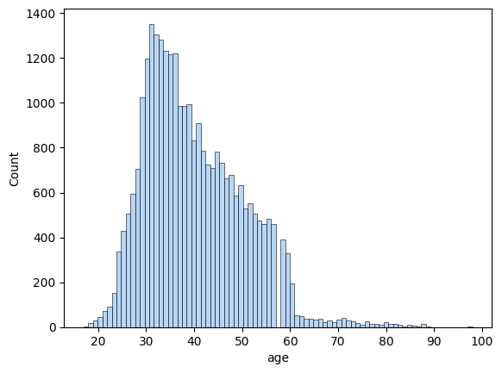
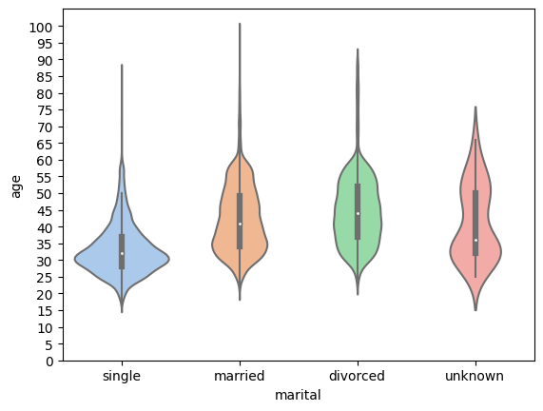
EDA: Personal Features (continue)
There are obvious modal values for jobs between education levels and vice versa we could use to impute missing values in these columns.
We are going to use ‘most frequent’ strategy to impute missing values for each job vs education correspondence
Frequency distribution of age is non-normal with significant drop after 60.
As savings are tend to be more attractive to elder people, we cannot drop that values. We will try to bin those values to gain additional predictive strength for model instead
There are no clear-defined differences between groups in marital status.
We are going to use ‘most frequent’ strategy to replace ‘unknown’ values

Slide 8
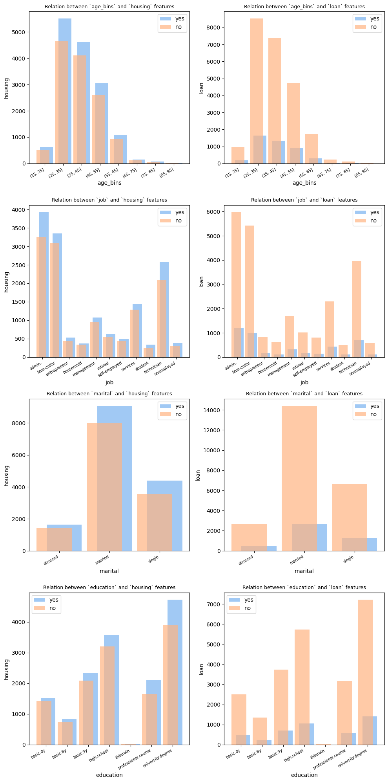
EDA: Personal Features (continue)
Most frequent values for personal and housing loans stay the same across other personal features
Using general ‘most frequent’ strategy to replace ‘unknown’ values is safe for these columns

Slide 9
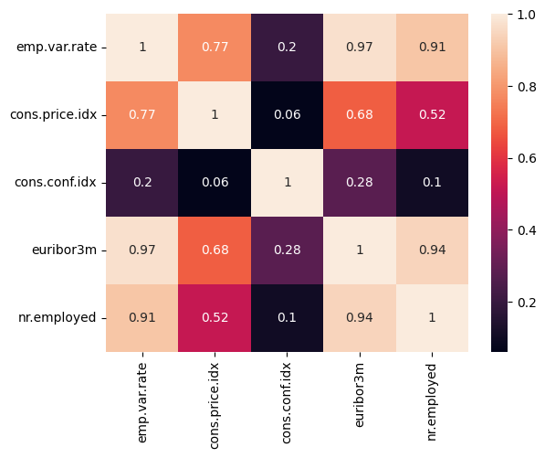
EDA: Macroeconomic Features
There are several macroeconomic indicators with high correlation with each other. This can create undesirable consequences for some types of models

Slide 10
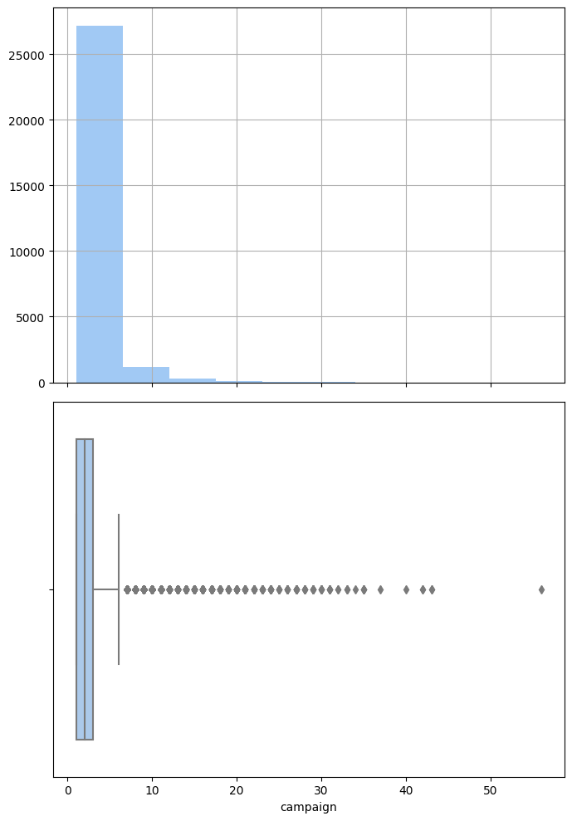
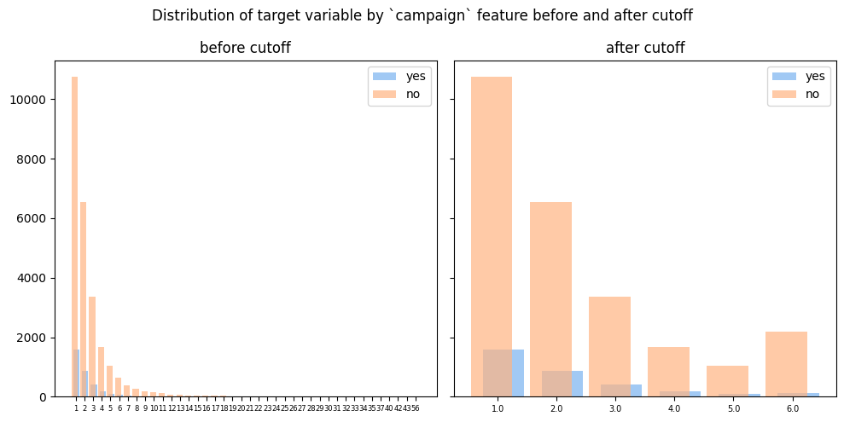
EDA: Marketing Features
‘Campaign’ feature is hugely skewed (long right tail).
We are going to cut-off outliers. We consider as outliers all values greater than Q3+1.5*IQR
It allows not to drop rows with potentially valuable info and creates a more reasonable set of values to apply Weight-of-Evidence evaluations

Slide 11
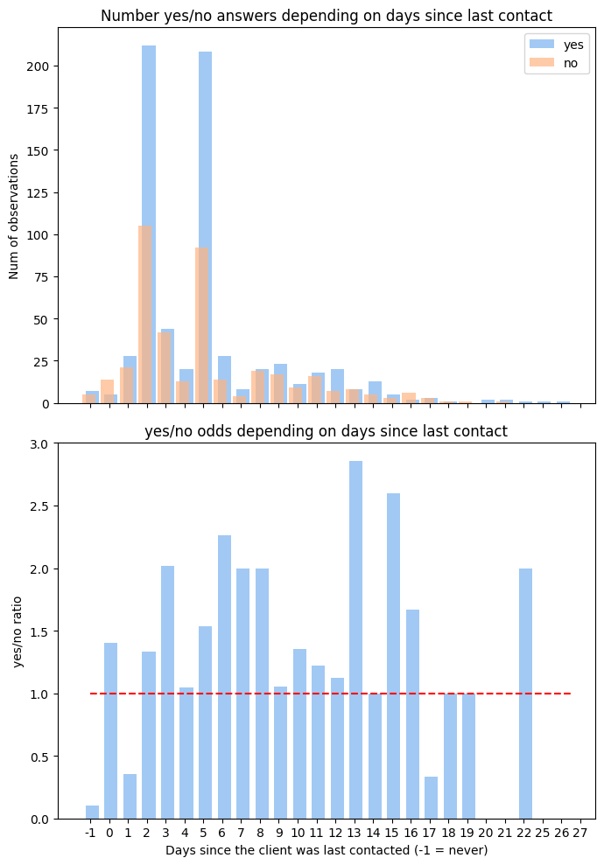
EDA: Marketing Features (continue)
Overall odds to get positive result are much higher if the client was contacted before

Slide 12
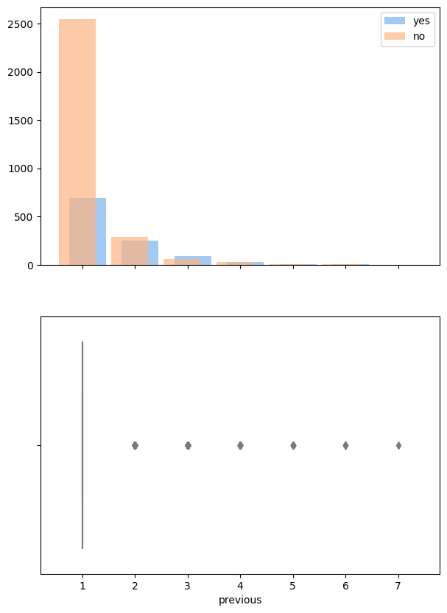
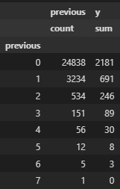
EDA: Marketing Features (continue)
In order to use WOE approach here we have to provide each category contains >5% of sample size
Considering 3 as a cutoff value will provide necessary category size

Slide 13
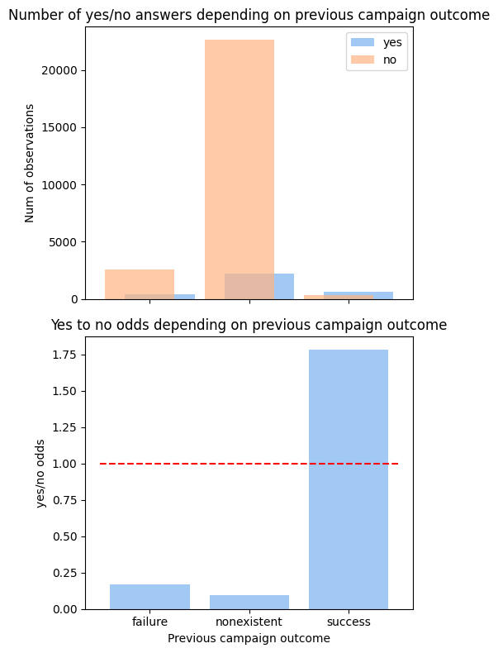
EDA: Marketing Features (continue)
Overall odds to get positive result are much higher if the previous campaign succeeded

Slide 14
Conclusions and Recommendations
Conclusions:
- Based on the Weight of Evidence (WoE) approach the predictive power of features was evaluated.
- All features were left except ‘duration’
- Dataset is highly imbalanced so missing-like data was retained to encode it later
Final recommendations:
Perform features encoding using 3 main strategies (and their mixed options with dropping any of high correlated and/or low variance features) and compare their impact on model’s metrics:
- use WoE approach to encode all category and category-like features without imputation
- use WoE partially only on truly categorical features without imputation, convert numeric features to reasonable values and cutoff outlying values
- don’t use WoE on any feature, impute values and encode categorical features by ordinary way

Slide 15
Technical Details
Problem type:
Binary classification
Requirement for model interpretability
Appropriate model types:
Logistic Regression (simple linear model with direct evaluation of probability)
Bayes Naïve Classifier (conditional probability-based type)
Decision Tree (highly interpretable)
Random Forest or other tree-based models like LightGBM and CatBoost (interpret using SHAP package)
K Nearest Neighbors (explained by distance)
Notes:
- Highly imbalanced dataset will require classes weighting or using oversampling technique
- 3 highly correlated features found. They are 'euribor3m', 'nr.employed' and 'emp.var.rate' (Pearson’s r > 0.9). This leads to potential multicollinearity problem for some ML model types

Slide 16
THANK YOU

