Slide 1

Exploratory Data Analysis
G2M insight for Cab Investment firm
Nov 18, 2022

Slide 2

Agenda
Problem Summary
Approach
EDA
EDA Summary
Conclusions and Recommendations

Slide 3
Case background
Client:
XYZ, a private firm in US
Description:
Due to remarkable growth in the Cab Industry in last few years and multiple key players in the market, it is planning for an investment in Cab industry and they want to understand the market before taking final decision
Objectives:
provide actionable insights to help XYZ firm in identifying the right company for making investment
give recommendations on investments

Slide 4
Data Sources’ Content Analysis: Assumptions and Insights
Data Sources: 4 .csv files which can be linked by either identification fields or string field
Main assumptions:
“Cost of Trip” feature is total cost summing up waiting time fee, cost of trip distance by counter and other direct costs applied;
Observed differences are due to companies’ price policies and marketing campaigns; no other factors;
All customers are valid credit card holders (based on age of some customers <21 years)
Insights:
Number of transactions exceeds number of trips detailed records (not all the trips info is available)
As there are near 80 100 transactions (22% from analyzed transactions quantity) without trip details, we should try to found features that could make it possible to classify transactions as belonging to a particular company
Data discrepancies:
“Population” feature values not suite the official US Census Bureau data (for example, population of Miami, FL in 2016 was 453,579 but the value of 1,339,155 provided, Boston has official population 673,184 but provided value is 248,968)

Slide 5
Approach
Investment Decision
Current Profitability
Perspective Profitability
Profitability:
Margin = Total Revenue – Total Costs
Total Revenue = Trips Quantity * Average Trip Distance * Average Revenue per 1 km
Total Costs = Trips Quantity * Average Trip Distance * Average Costs per 1 km

Slide 6
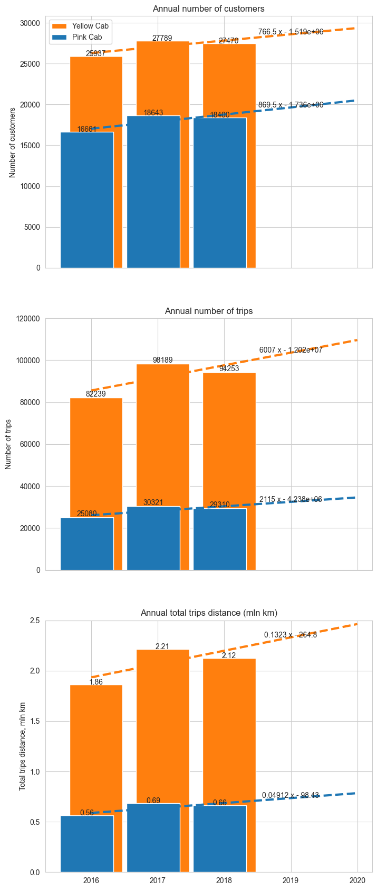
Overall characteristics
Number of customers grows almost equal
“Pink Cab”’s number of customers grows slightly faster but not enough to influence on investments decision
“Yellow Cab” grows in annual number of trips substantially faster than “Pink Cab” does
“Yellow Cab” grows in annual trips distance also substantially faster than “Pink Cab” does
Based on the performance in physical terms, “Yellow Cab” looks better than “Pink Cab”

Slide 7
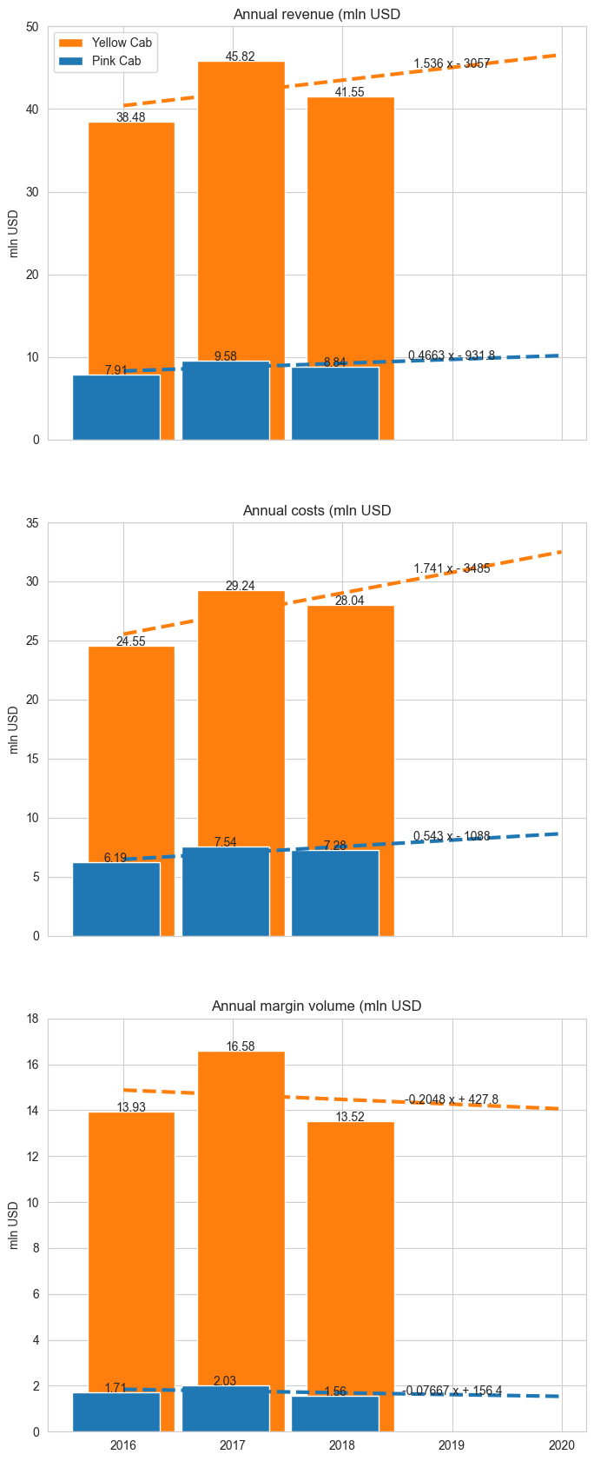
Financial indicators
“Yellow Cab” grows in annual revenue substantially faster than “Pink Cab” does
BUT “Yellow Cab”’s annual costs grows substantially faster as well.
“Yellow Cab”’s margin is around 7x higher than “Pink Cab”’s margin
BUT it is descending faster
Both companies’ annual costs grow faster than annual revenues
Changes in costs in 2018 looks positive but it is not enough to make a trend

Slide 8
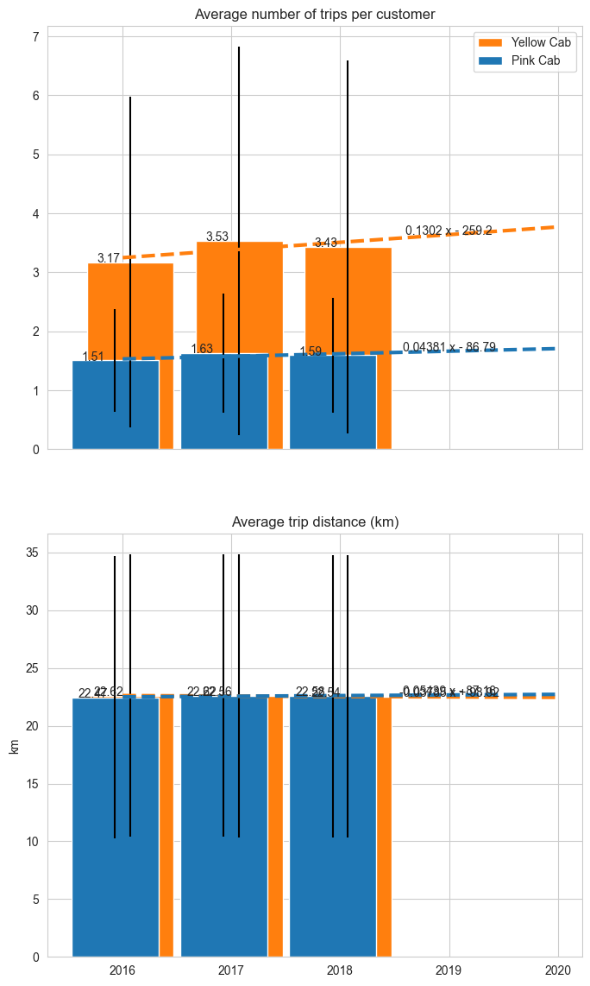
Specific physical indicators
“Yellow Cab” has higher average number of trips per customer than “Pink Cab”.
The slope of the trend of “Yellow Cab” is much steeper also
Both companies has average trip distance values near equal.
Standard deviation ranges are also similar

Slide 9
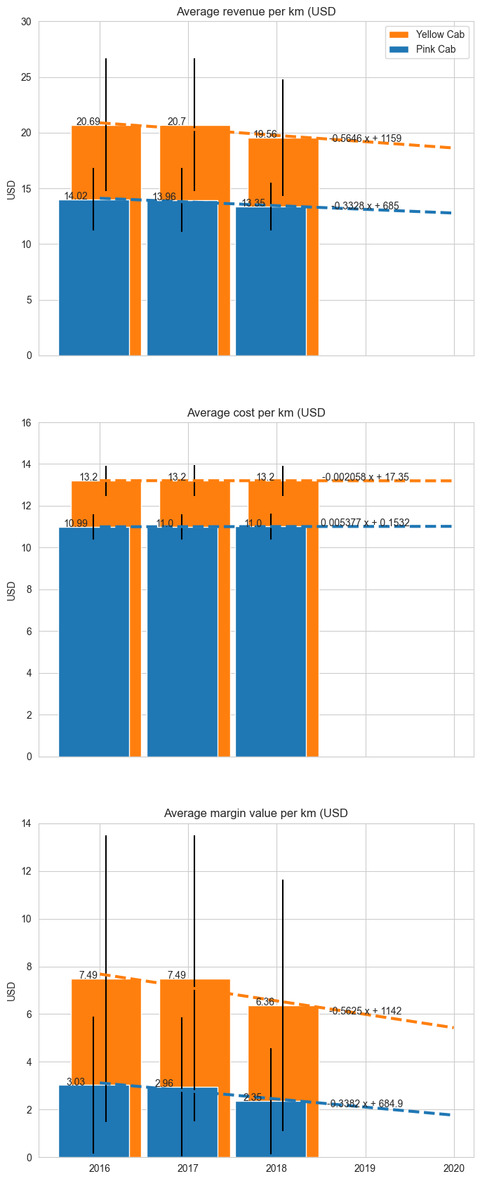
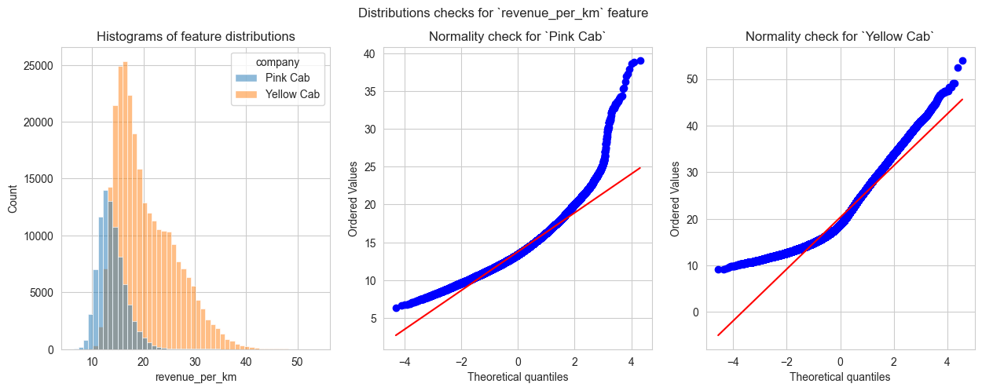
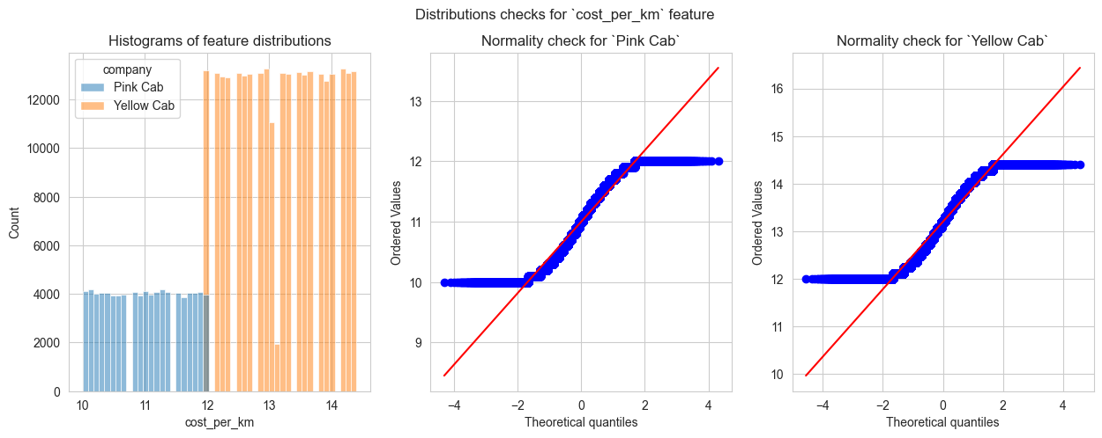
Specific financial indicators
Both companies have their average revenue per 1 km values decreasing.
“Yellow Cab”’s value is decreasing faster than “Pink Cab”
Both companies has different but stable average level of cost per 1 km. The difference is statistically significant
Both companies have their 1 km profitability decreasing
If current trends continue, “Yellow Cab” and “Pink Cab” will pass the break-even point in 2030 and 2025 respectively

Slide 10
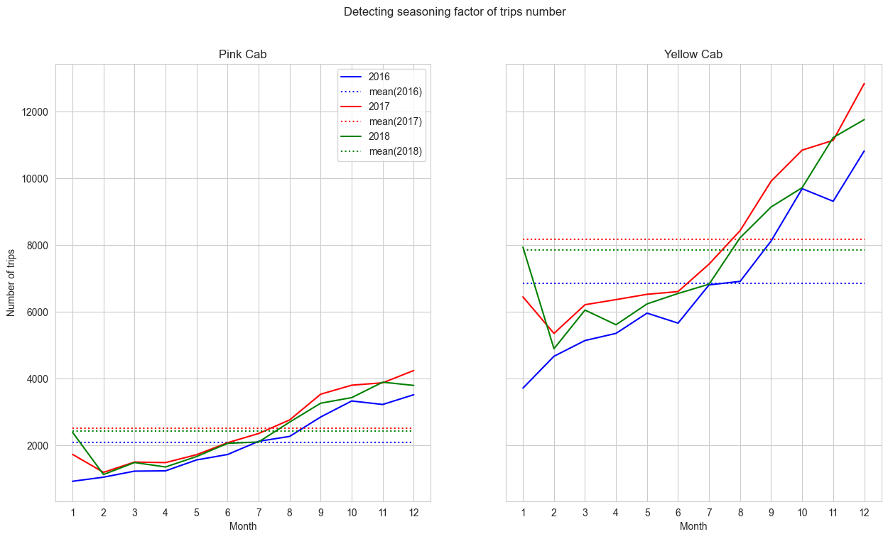
Seasonality analysis
Both companies have strongly marked seasonality in their businesses
“Yellow Cab” has substantially wider seasonal range in number of trips
Seasonality was relatively stable in 2016-2018 and had repeating pattern

Slide 11
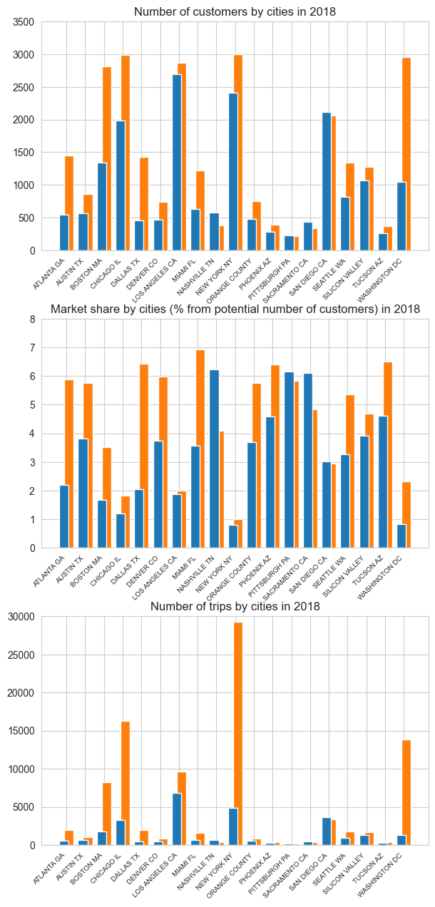
Geographical analysis (Physical indicators)
Both companies have similar number of clients in all cities except of 4 (Atlanta, Boston, Dallas and Washington) in which “Yellow Cab” significantly outperforms “Pink Cab”
Market share of both companies is not too high but “Yellow Cab” has higher market share in most of cities
“Yellow Cab” has abnormally high number of trips in 4 cities (Boston, Chicago, New York, Washington

Slide 12
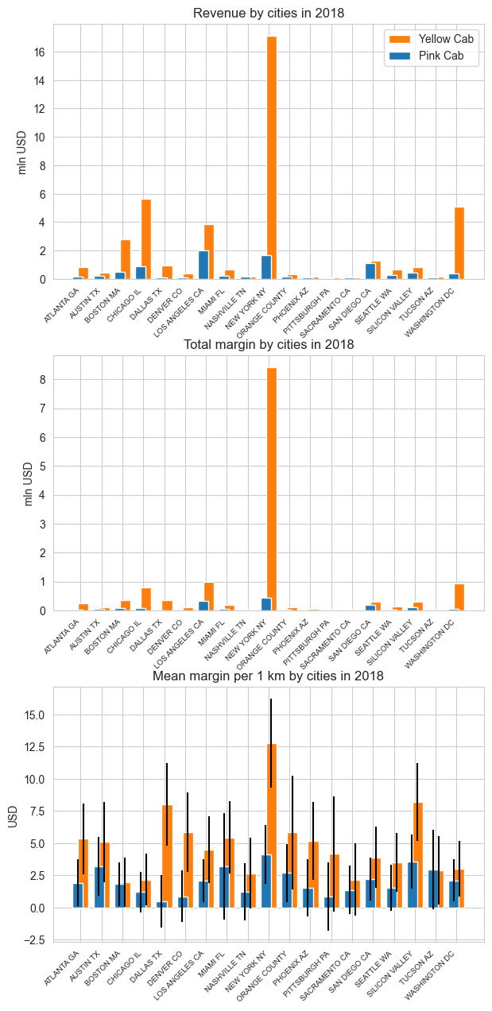
Geographical analysis (Financial indicators)
“Yellow Cab” had 83% of revenue in 2018 earned in 5 cities (Boston, Chicago, Los Angeles, New York and Washington) including 41% of revenue in New York alone.
Revenue structure was stable in 2016-2018
“Yellow Cab” had 85% of margin in 2018 earned in same 5 cities including 62% of margin in New York alone
“Yellow Cab” outperforms “Pink Cab” on margin per 1 km indicator in almost all cities.
In several cities “Pink Cab” operates with near-zero margin

Slide 13
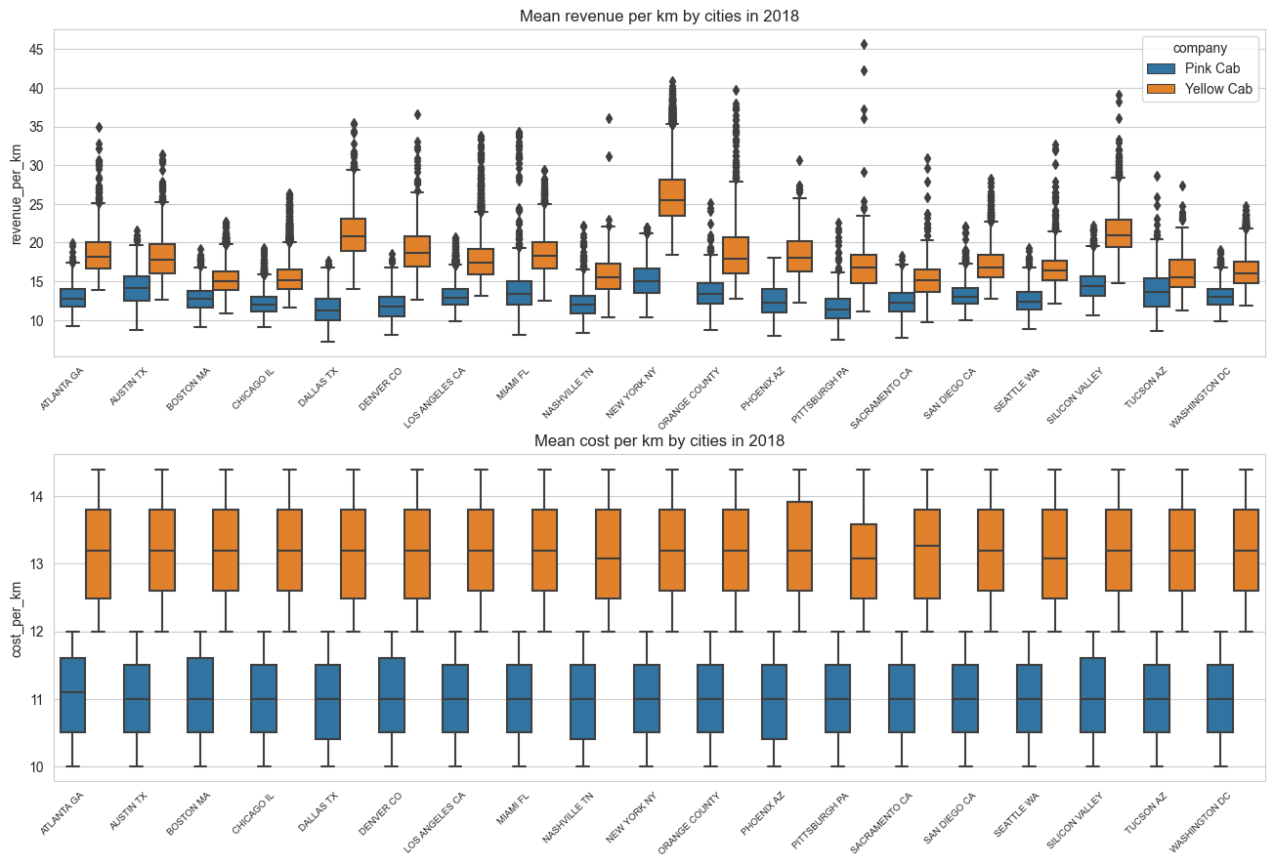
Geographical analysis (Exploring margin anomalies)
Both companies have the same average cost per 1 km level across all cities
In all cities “Yellow Cab” demonstrates higher revenue per 1 km level. This difference is statistically significant
The largest gap between companies’ revenue per 1 km is in New York which is the “most abnormal” city in terms of margin value

Slide 14
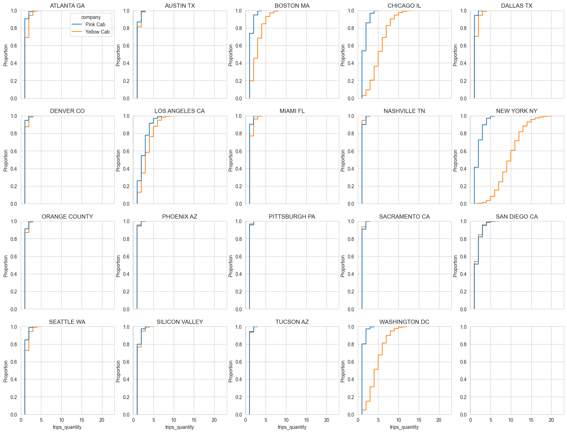
Geographical analysis (Exploring margin anomalies)
We can clearly see the differences in distributions of the number of trips per customer indicator: as in most cities maximum value didn’t exceed 5 trips per customer, in “anomaly” cities it exceeded 10 up to 20 for “Yellow Cab” in New York.
Combined with high margin per 1 km this gave an outstanding total margin value
This situation demands more exploration as such a strong dependency on 1 city is risky

Slide 15
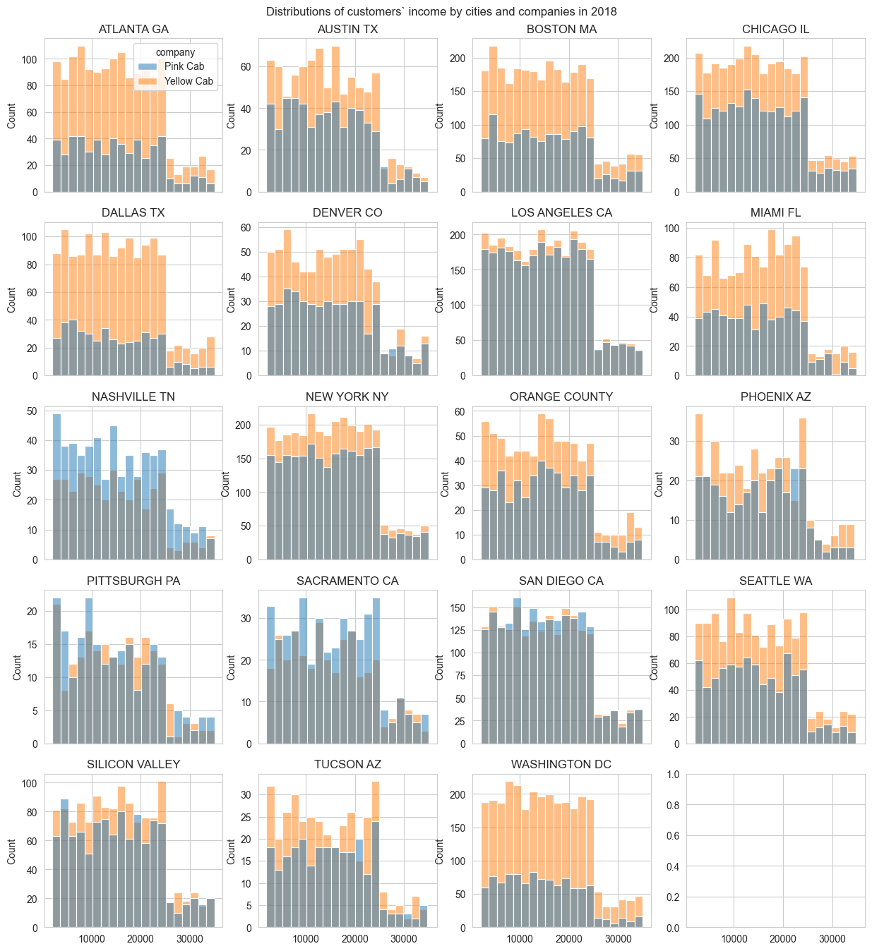
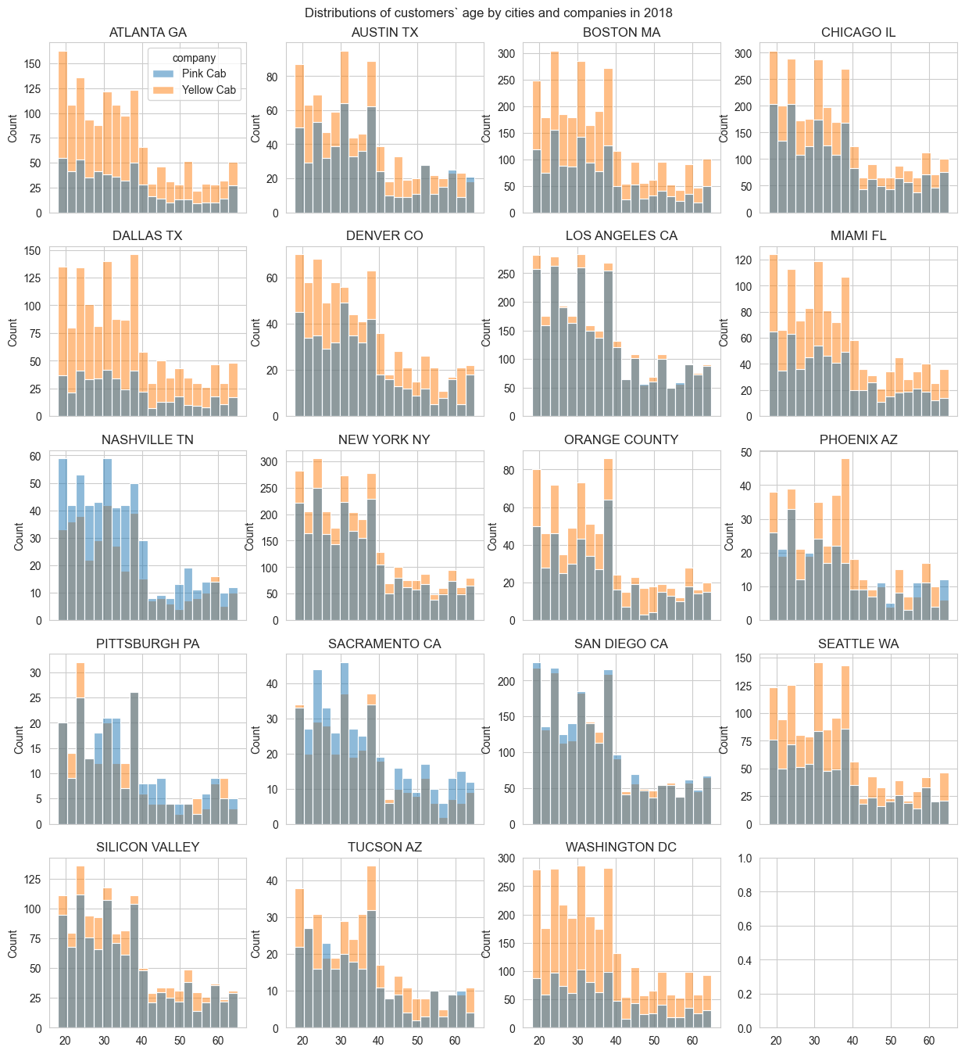
Customers segmentation (Geographical position)
Trying to find dependency between customers’ location and income: failed
Trying to find dependency between customers’ location and age: failed
All distributions are similar and there are no differences in distributions except of frequencies. Thus, we can’t use this for classification

Slide 16
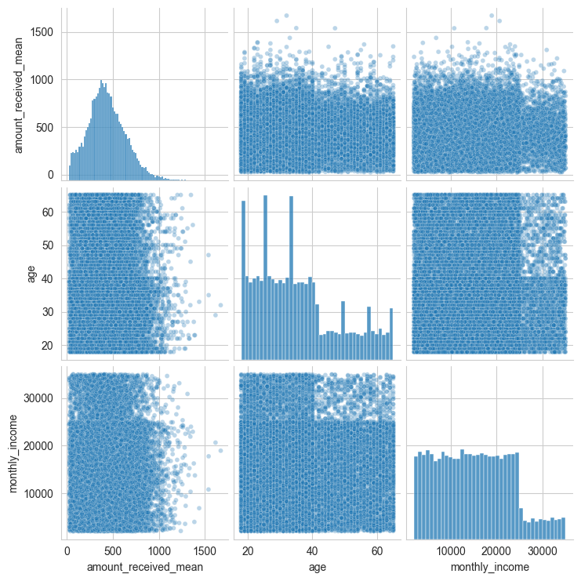
Customers segmentation (other features)
Correlation testing: failed
There's no visible correlation between age and monthly income features and amount received per trip.
All statistical coefficients are small with respective p-values greater than significance level (0.05) thus displaying no linear or other correlation between values

Slide 17
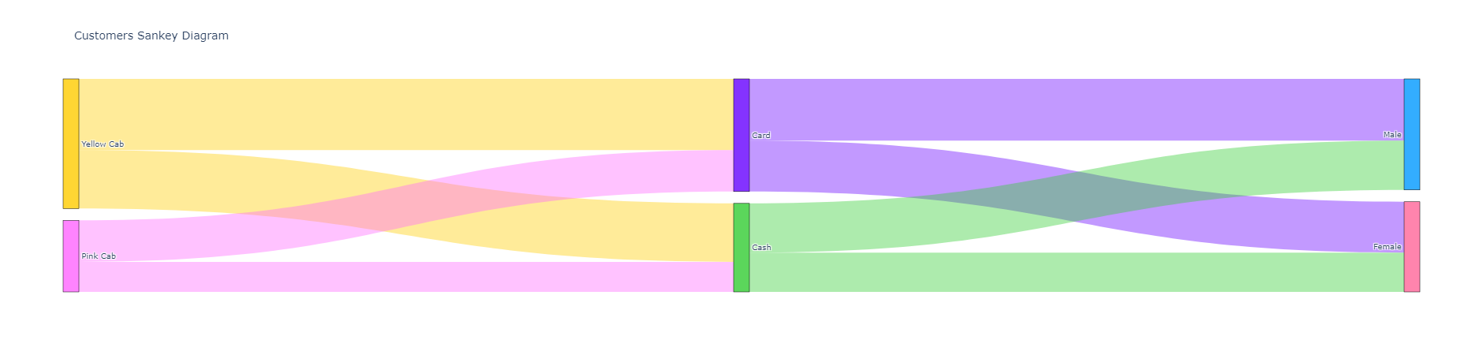
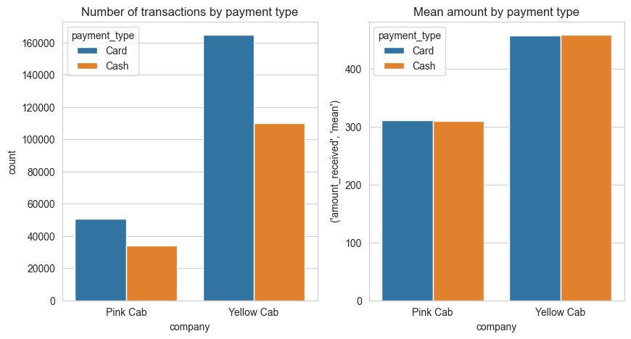
Customers segmentation (other features)
Trying to find dependencies between company, payment types and customers’ gender: failed
There's no visible dependencies between features being analyzed.

Slide 18
Conclusions and recommendations
Let’s recap:
Both companies’ annual costs grow faster than annual revenues. Thus, the margin of both companies is descending
“Yellow Cab”’s margin is around 7x higher than “Pink Cab”’s margin, but it is descending faster and is based on 1-city margin: 62% of margin is in New York alone. This situation demands more exploration as such a strong dependency on 1 city is risky
In physical terms both companies show growth, but “Yellow Cab” grows faster than “Pink Cab”
Both companies have their 1 km profitability decreasing. If current trends continue, “Yellow Cab” and “Pink Cab” will pass the break-even point in 2030 and 2025 respectively
Both companies have strongly marked seasonality in their businesses. Seasonality is relatively stable in 2016-2018 and had repeating pattern
Market share of both companies is not too high but “Yellow Cab” has higher market share in most cities
In all cities “Yellow Cab” demonstrates higher revenue per 1 km level
Recommendations:
Considering descending margin of both companies, low profitability of “Pink Cab” and 1-city dependency of “Yellow Cab”, DO NOT invest in neither “Yellow Cab” nor “Pink Cab” until full understanding of margin drop reasons and possibilities to rectify the situation

Slide 19
THANK YOU

