Slide 1
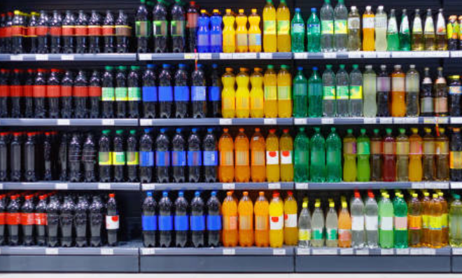
Cold drinks inventory management system

Slide 2
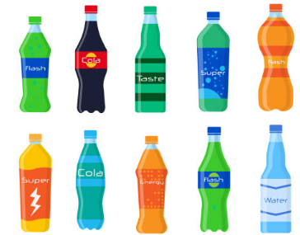
Project Introduction:
This Web application helps managing inventory systems using PC.
The mobiles displays the streaming of items in the front-end.
Deep learning model detects the items and automatically the number of items in the inventory gets updated and the updated inventory list will be shown in the front-end.

Slide 3




Software Requirements:
Inventory items are being detected using YOLOv5 model.
The front-end is developed by using Streamlit.
Backend is developed by using Python.
Inventory Items are stored in SQLite database.

Slide 4
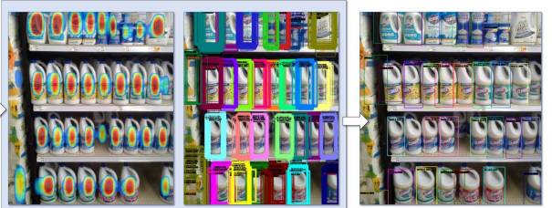
Data Set:
Data Set : SKU-110K
SKU-110K, the images are collected from thousands of supermarket stores and are of various scales, viewing angles, lighting conditions, and noise levels.
All the images are resized into a resolution of one megapixel.

Slide 5
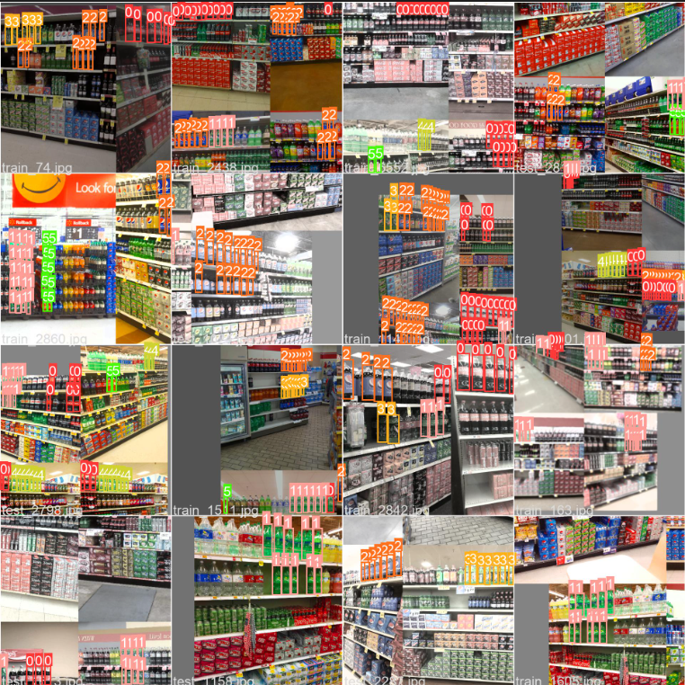
Data Set Labelling

Slide 6
Literature Survey
TITLE: A Study of Inventory Management System Case Study
PUBLISHER: Tariq Hussain Sheikh
Inventory management is to find the quantity of inventories that will fulfil the demand, avoiding overstocks. This paper presents a case study for the steel manufacturing industry (Small Scale Industry) on inventory management. The relationship between the inventory management and company performance was determined based on inventory days and return on asset (ROA) analysis.
TITLE: A Deep Learning-Based Inventory Management and Demand Prediction Optimization Method
PUBLISHER: Chuning Deng and Yongji Liu
Inventory management , as the key part of supply chain management, plays a very important role in reducing the overall cost of supply chain management. Generally, too much or too little inventory can have a bad result. For example, excessive inventory can result in the oversupply situation, since the amount of stored products has exceeded the market demands greatly.

Slide 7
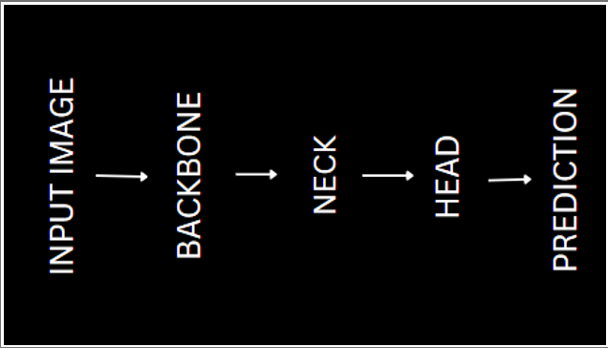
Architecture:
Model Name :YOLOv5
As YOLO v5 is a single-stage object detector, it has three important parts like any other single-stage object detector.
Model Backbone
Model Neck
Model Head

Slide 8
Backbone
Model Backbone is mainly used to extract important features from the given input image.
In YOLO v5 the CSPDarkNet (CSP — Cross Stage Partial Networks) are used as a backbone to extract rich in informative features from an input image.
It employs a CSPNet strategy which partition the feature map of the base layer into two parts and then merges them through a cross-stage hierarchy.
Darknet is fast and highly accurate which are the key requirements for the YOLO family.

Slide 9
Neck
PANet (Path Aggregation Network) is used as a neck in YOLO v5 to get feature pyramids.
Feature pyramids are a basic component in recognition systems for detecting objects at different scales.
The model’s neck role is to collect features from different stages. The neck is composed of several top-down paths and several bottom-up paths.
PANet uses features from all the layers, and decides which ones are useful.

Slide 10
Head
Yolo Layer is used as head. It uses anchor boxes to construct final output vectors with class probabilities, object-ness scores, and bounding boxes.
The head is responsible for :
the objectness score (the probability an object is within the anchor)
the class (a number i.e. 1 which corresponds to a class e.g. a person)
the class confidence (the chance that the above class is correct)
the bounding box coordinates i.e. [x, y, w, h] [120, 300, 200, 400]
The input is first passed to CSPDarknet for feature extraction, and then fed to PANet for feature fusion(Feature Pyramid). Finally, Yolo Layer outputs detection results (class, score, location, size).

Slide 11
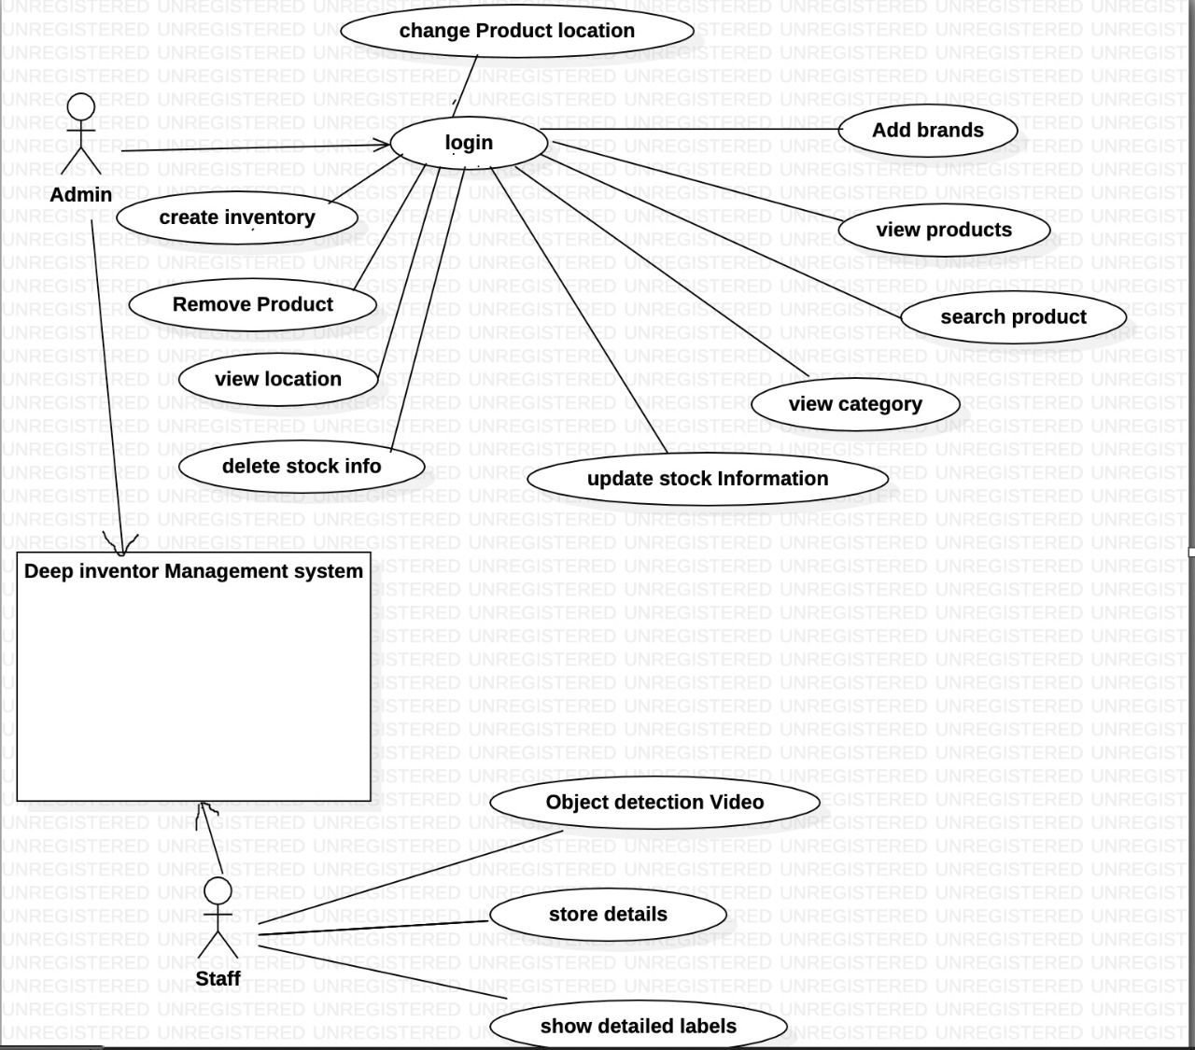
USE CASE DIAGRAM:

Slide 12
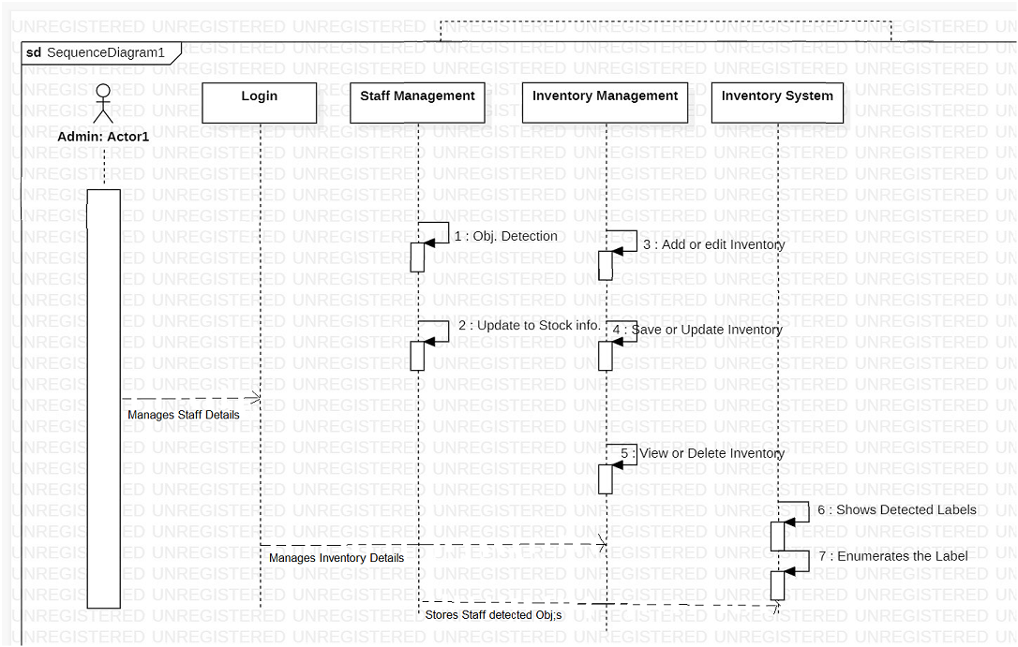
SEQENCE DIAGRAM:

Slide 13
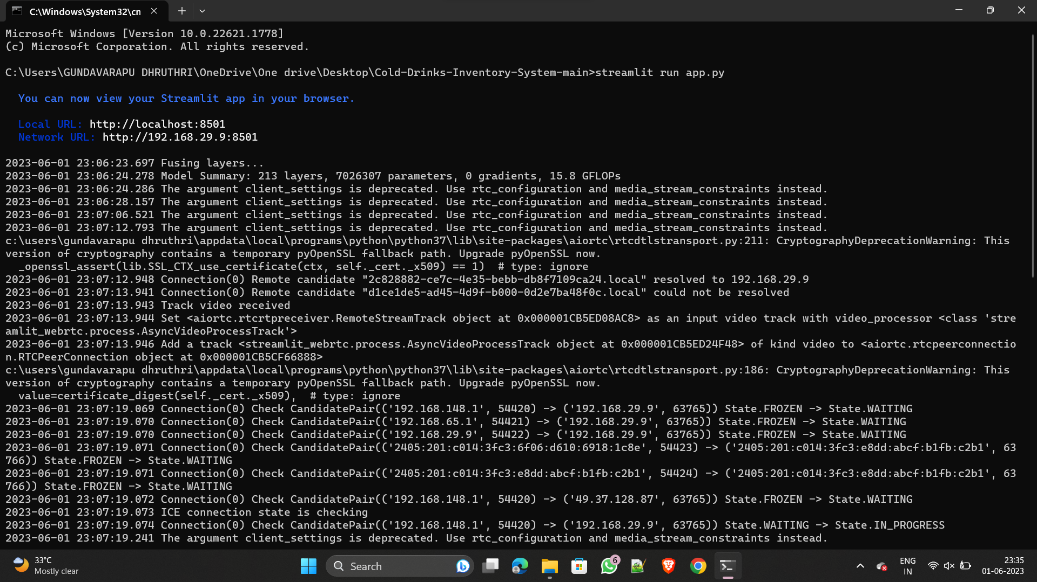
Running on Command Prompt

Slide 14
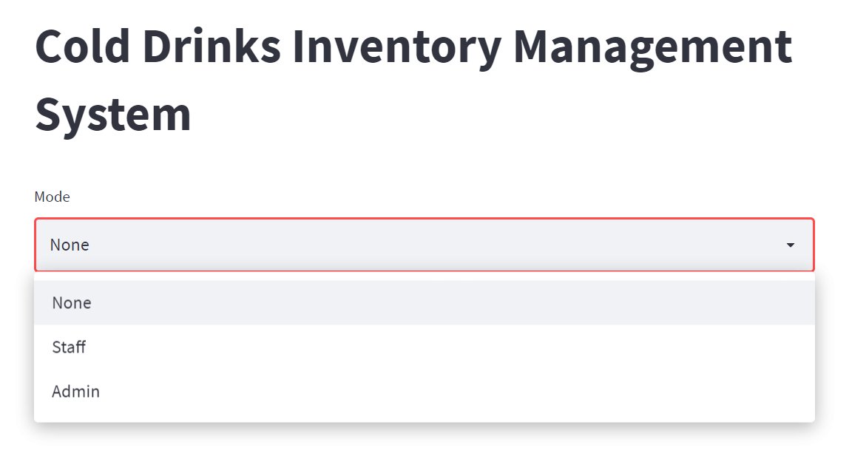
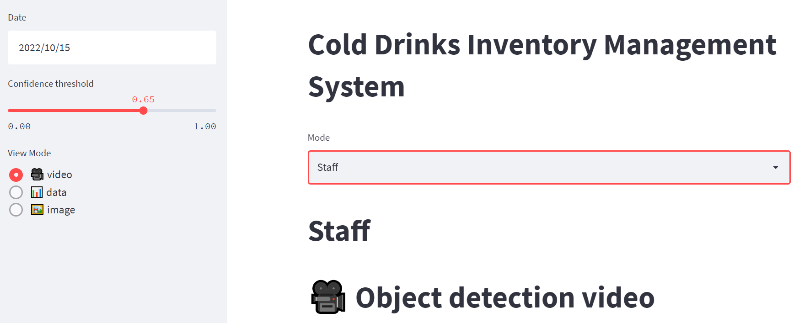
Work Flow

Slide 15
TEST CASES
S. No | Test Case Name | Test Case Procedure | Expected Result | Obtained Result | Pass/ Fail
1 | Item name | Cool Drinks | Should Detect | Detected | Pass
2 | Camera module | Turn on Camera, Click the Photo | Photo Should be Captured from Video mode | Photo Captured Lively | Pass
3 | Adding Item | Item Name | Item should be Added | Added Successfully | Pass
4 | Staff mode | Select the mode | Should land on Staff Mode page | Landed to Staff mode page Successfully | Pass
5 | Image Upload | Image File | Uploading | Uploaded | Pass
6 | View Inventory | Count of Cool Drinks | Say 10 | Views 10 items | Pass
7 | Generate Output Data | Click on store while capturing the image | Should store the data into the database. | Stored in CSV file and Excel file. | Pass

Slide 16
FUTURE ENHANCEMENTS
Inventory tracking and monitoring: Accurately recording and updating inventory levels, locations, and movements in real-time.
Demand forecasting: Utilizing historical data and predictive analytics to forecast future demand patterns and adjust stock levels accordingly.
Reorder management: Automating the reordering process, generating purchase orders, and optimizing order quantities and timings.
Vendor management: Managing relationships with suppliers and optimizing procurement processes to ensure timely and reliable stock replenishment.
Stock classification and categorization: Classifying inventory items based on their value, demand, and criticality to prioritize management efforts and allocate resources effectively.
Data analysis and reporting: Analyzing inventory data to identify trends, optimize inventory levels, and generate meaningful reports for decision-making.

Slide 17
CONCLUSION
Overall, the deep inventory management system for cool drinks offers numerous advantages. It improves operational efficiency for staff members, prevents stockouts, reduces errors in inventory management, and enhances the customer experience. By leveraging deep learning technology and the YOLOv5 model, the system provides a reliable and efficient solution for managing inventory stock in the context of cool drinks.

Slide 18
REFERENCES
https://www.camcode.com/asset-tags/what-is-an-inventory-management-system/
https://www.hindawi.com/journals/wcmc/2021/9969357/
https://medium.com/@RemiStudios/artificial-intelligence-for-inventory-management-c8a9c0c2a694
https://addepto.com/blog/inventory-management-using-machine-learning/
https://www.ijert.org/research/inventory-management-using-machine-learning-IJERTV9IS060661.pdf
https://ieeexplore.ieee.org/document/9835853
https://www.researchgate.net/publication/342529859_Inventory_management_using_Machine_Learning

Slide 19
THANK YOU
Presented By S. MUDASSIR
G DHRUTHI
K. SATHVIK
M.SWETHA

