Slide 1
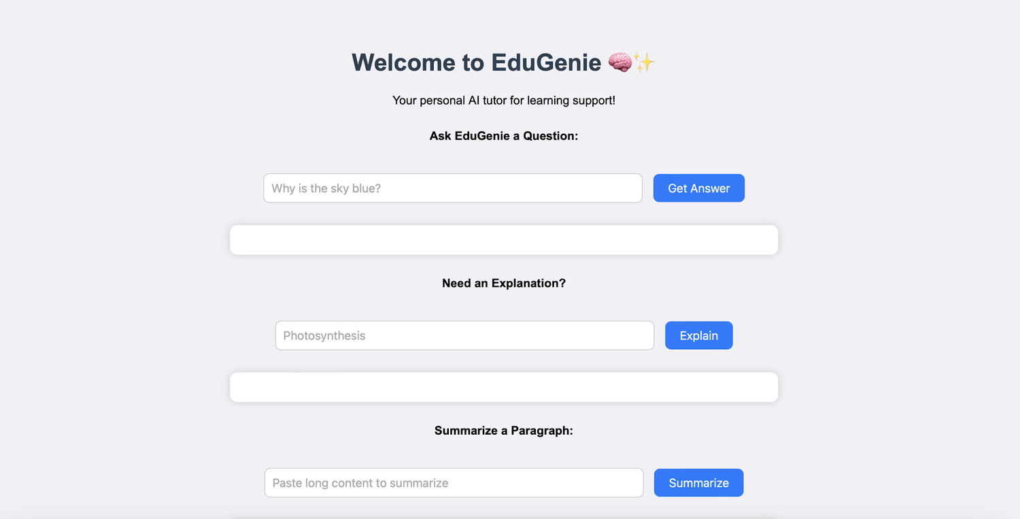
AI-POWERED LEARNING ASSISTANT
EduGenie
Google Gemini Powered Learning Assistant
EduGenie web interface
Submitted by Tella Divya Sree
Mentor Siri
Date 11/04/2025
Gemini 1.5 Pro
FastAPI
LaMini-Flan-T5

Slide 2





PROJECT OVERVIEW
What is EduGenie?
A lightweight AI-powered educational assistant that simplifies learning through generative AI, built for students of all academic levels.
Ask questions
Smart, concise answers to academic queries
Simplified explanations
Built with FastAPI and a simple HTML+CSS frontend, it blends local efficiency with cloud power and runs well even on a Mac M1.
Complex concepts in easy language
Generate quizzes
MCQs from any topic or passage
5
2
5
Learning recommendations
Personalized beginner-to-advanced paths
AI modules
AI models
API endpoints
Summarize passages
Long text made revision-ready
EduGenie · Google Gemini Powered Learning Assistant
2

Slide 3
USE CASES
Learning Scenarios
SCENARIO 1
SCENARIO 2
SCENARIO 3
Ask a Question
Test Understanding
Plan a Path
A student exploring oceans and rivers asks EduGenie, “Which is the largest ocean?” and gets a clear answer instantly.
A student wants to gauge her grasp of the Pythagoras Theorem and clicks “Generate Quiz.”
A learner exploring SQL requests a structured plan: beginner to advanced topics, timelines and suggestions.
Q&A Module
Quiz Module
Learning Path Module
EduGenie · Google Gemini Powered Learning Assistant
3

Slide 4






TECHNOLOGY
Tech Stack & Prerequisites
Setup checklist
1
Install Python 3.10+, add it to PATH, verify with python --version
Python 3.10+
FastAPI
Uvicorn
Core language
Backend REST API
ASGI server
2
Sign in to Google AI Studio and create a project
3
Enable the Gemini API, generate a key and store it securely
Jinja2
HTML + CSS
Gemini API
4
pip install fastapi uvicorn jinja2
HTML templating
Frontend UI
Google AI key
EduGenie · Google Gemini Powered Learning Assistant
4

Slide 5
SYSTEM DESIGN
How EduGenie Works
Learner
Frontend · HTML + CSS form
FastAPI Backend · routes request
Explanation
Q&A
Quiz
Summary
Learning Path
/explain
/qa
/quiz
/summarize
/learn/recommendations
LaMini-Flan-T5 · local
Gemini 1.5 Pro
Gemini 1.5 Pro
Gemini 1.5 Pro
Gemini 1.5 Pro
Result is returned to the frontend and shown below the input box, ready for the next question
EduGenie · Google Gemini Powered Learning Assistant
5

Slide 6


MILESTONE 1 · MODEL SELECTION
Two Models, One Assistant
CLOUD · VIA API
LOCAL · ON DEVICE
Gemini 1.5 Pro
LaMini-Flan-T5-783M
+
Used for
Q&A, summarization, quiz generation, learning paths
Benefits
Advanced reasoning, structured outputs and cloud inference
Used for
Concept explanation
Benefits
Instruction-tuned, lightweight, CPU-compatible
EduGenie · Google Gemini Powered Learning Assistant
6

Slide 7

MILESTONE 1 · ARCHITECTURE
Project Folder Structure
Backend
main.py connects every API endpoint to its module
EduGenie/
├── main.py # FastAPI app
├── explanation_module.py # Concept explanation logic
├── qna.py # Question answering
├── quiz_module.py # Quiz generation
├── summary_module.py # Summarization
├── learning_path.py # Learning recommendations
├── templates/index.html # HTML frontend
├── static/style.css # Styling
└── requirements.txt # Python dependencies
AI modules
One file per capability: explain, Q&A, quiz, summary, path
Frontend
templates/index.html styled by static/style.css
EduGenie · Google Gemini Powered Learning Assistant
7

Slide 8
MILESTONE 2 · CORE FUNCTIONALITY
Five Modules, One Learning Engine
Explanation
Q&A
Quiz
LaMini-Flan-T5 · local
Gemini 1.5 Pro
Gemini 1.5 Pro
Simplified, beginner-friendly explanations of complex concepts in concise language.
Precise, context-aware answers to general knowledge and academic questions.
Three MCQs with four options each from any passage, returned as structured JSON.
Summary
Learning Path
Same pattern everywhere
Gemini 1.5 Pro
Gemini 1.5 Pro
Build prompt → call model → handle errors → return result
Condenses long paragraphs into concise versions, ideal for quick revision.
Beginner-to-advanced roadmap by difficulty, with videos, articles and books.
EduGenie · Google Gemini Powered Learning Assistant
8

Slide 9
MILESTONE 2 · QUIZ MODULE
How a Quiz Is Generated
1
2
3
4
5
Passage
Structured prompt
JSON response
Clean
Parse
Learner submits a topic or text
Sent to Gemini asking for 3 MCQs as JSON
Each question has 4 options and the correct answer
clean_json_block strips Markdown code fences
Result becomes a Python list for the API
3 MCQs · 4 options each
Built-in error handling
Relevant questions with plausible distractors, delivered as JSON for easy integration.
If generation or parsing fails, a detailed error message is returned for debugging.
EduGenie · Google Gemini Powered Learning Assistant
9

Slide 10

MILESTONE 2 · BACKEND API
RESTful Endpoints with FastAPI
METHOD
ENDPOINT
WHAT IT DOES
INPUT → OUTPUT
GET
/qa
Answers a question with Gemini
question → answer
POST
/explain/
Explains a topic in simple language
topic → explanation
POST
/summarize/
Condenses a long passage
text → summary
POST
/quiz
Builds 3 MCQs from text
text → quiz
GET
/learn/recommendations
Creates a beginner-to-advanced path
topic → recommendation
Missing input returns a clear 400 error message instead of failing silently.
EduGenie · Google Gemini Powered Learning Assistant
10

Slide 11
MILESTONE 3 · FRONTEND
A Simple, Responsive Web Interface
HTML form · index.html
Task dropdown: Explain, QnA, Quiz, Summary, Recommend Path
Text area for user input
Submit button
CSS styling · style.css
Responsive design
Styled buttons, input areas and result container
Submit form
POST to FastAPI
Result appears below
EduGenie · Google Gemini Powered Learning Assistant
11

Slide 12

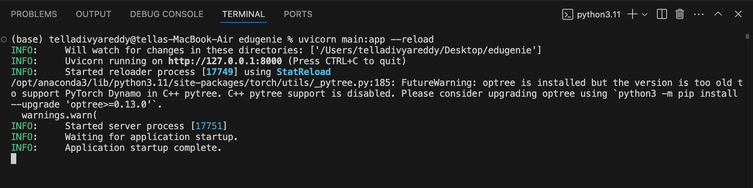
MILESTONE 4 · DEPLOYMENT
Run Locally & Test
ACTIVITY 4.1 · RUN LOCALLY
ACTIVITY 4.2 · FUNCTIONAL TESTING
$ uvicorn main:app --reload
→ http://127.0.0.1:8000
Ask a question
Get an explanation
Generate a quiz
Summarize content
Get a personalized learning plan
Server startup in the terminal
EduGenie · Google Gemini Powered Learning Assistant
12

Slide 13
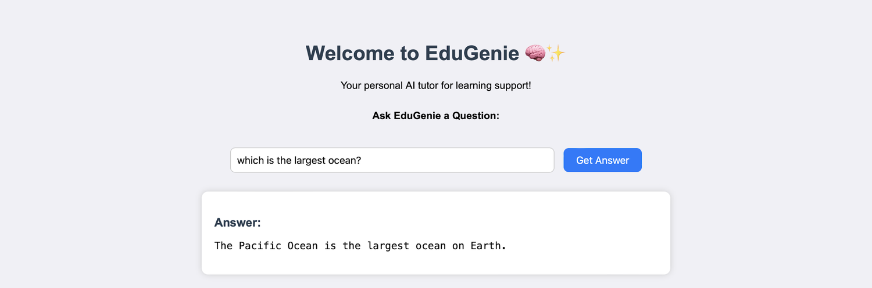
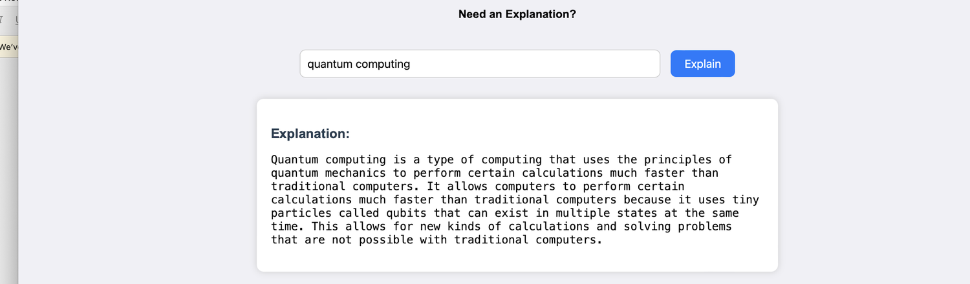
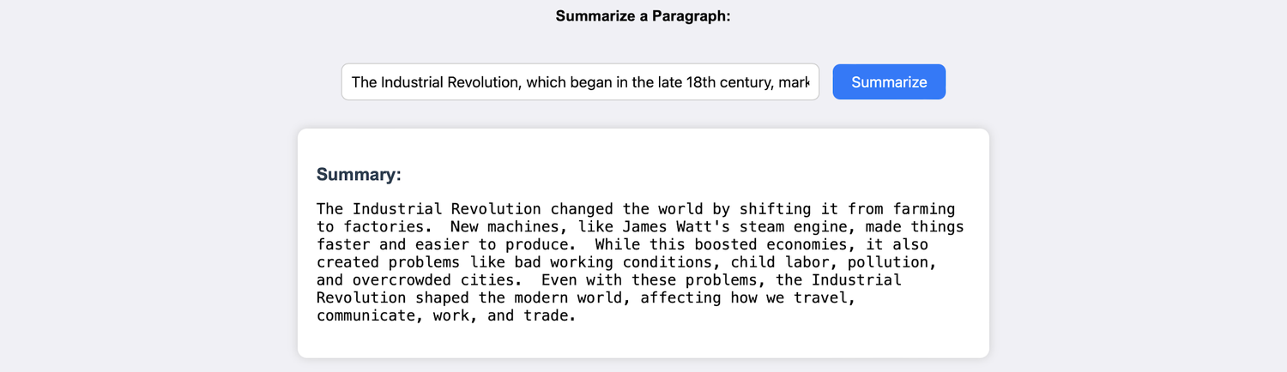
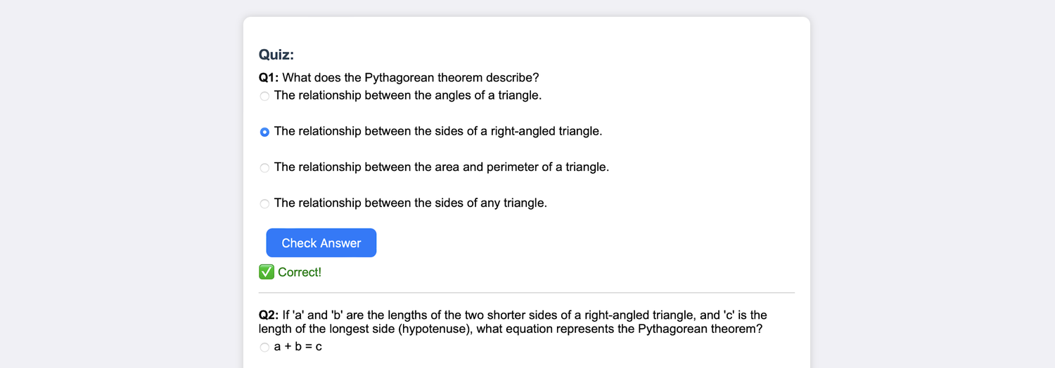
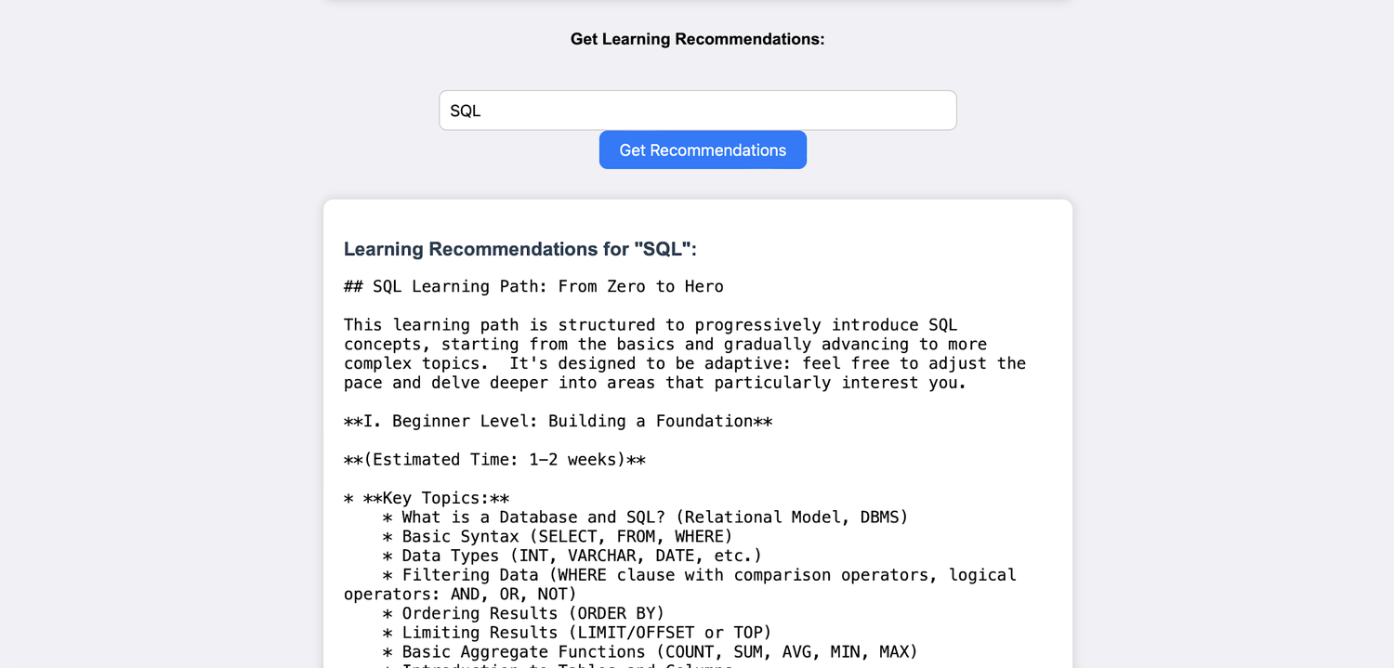
EXPLORING EDUGENIE
The Application in Action
Ask a question
Explain a topic
Summarize a paragraph
Generate a quiz
Learning recommendations
3 questions, 4 options each; corrects wrong answers
Beginner to advanced, with resources and steps
EduGenie · Google Gemini Powered Learning Assistant
13

Slide 14






REFLECTION
Challenges & What’s Next
Challenges overcome
Accuracy of AI-generated responses
Performance across devices
Personalization vs. general usability
Data privacy concerns
Voice interaction
Multilingual support
Mobile app
Hands-free learning
Reach a global audience
Learn anywhere, offline
KEY LEARNINGS
Prompt engineering
Cloud integration
Progress dashboards
Gamification
LMS & group study
User-centric design
Scalable architecture
Visualize the learning journey
Badges, streaks, challenges
Moodle, Google Classroom
Also planned: image and PDF input for snapshot-based doubt solving, smart notifications, adaptive learning paths and real-time sync.
EduGenie · Google Gemini Powered Learning Assistant
14

Slide 15

CONCLUSION
Smart, scalable and learner-first
EduGenie is a foundation for personalized, inclusive and intelligent education, bridging gaps in access, comprehension and adaptability.
Simplifies concepts
Instant Q&A and quizzes
Personal paths
Thank you
Tella Divya Sree · Mentor: Siri · 11/04/2025

