Slide 1
An Efficient Deep Learning Framework for Intelligent Energy Management in IoT Networks

Slide 2
Abstract
Green energy management is an economical solution for better energy usage, but the employed literature lacks focusing on the potentials of edge intelligence in controllable Internet of Things (IoT). In our system, we have to predict or analyse the household power consumption. Here, we are used household power consumption dataset is taken from dataset repository. Then we have to implement the preprocessing step for avoid wrong prediction.
The system is developed the different deep learning algorithms such as long short term memory (LSTM) and gate recurrent unit (GRU) for analysing the energy consumption.
Finally, the experimental results shows that some performance metrics such as mean Absolute Error (MAE), mean Squared Error (MSE) and Root Mean Squared Error (RMSE). Then, we have to compare the results and we conclude that GRU is efficient.

Slide 3
Objectives
The main objective of our project is,
• To predict or to analyze the household power consumption.
• To implement the different deep learning algorithm such as LSTM and GRU.
• To prove the GRU is efficient when compared with long short term memory.
• To enhance the overall performance for classification algorithms.

Slide 4
Introduction
Energy management at smart grids via automated techniques for future load forecasting is an interesting area of research. Smart grids are the secure and trust-worthy locations to distribute the electric energy among diverse sets of consumers such as smart homes and industries.
The electric energy retails chain includes production at power plants, distribution at smart grids, and consumption at residential or commercial buildings and industrial sectors. The amount of energy produced in power plants that is distributed at grids is entirely influenced by its usage at consumer side.
Majority of the consumers are non-experts of energy demands from electric grids, resulting financial loss and futile energy expenditure. Similarly, the producers want to minimize the cost and obtain an optimized level of energy generation, farming the need of appropriate scheduling and management strategies.

Slide 5
Existing system
In existing system, Green energy management is an economical solution for better energy usage, but the employed literature lacks focusing on the potentials of edge intelligence in controllable Internet of Things (IoT).
Therefore, in this article, we focus on the requirements of todays’ smart grids, homes, and industries to propose a deep learning based framework for intelligent energy management. We predict future energy consumption for short intervals of time as well as provide an efficient way of communication between energy distributers and consumers.
We apply several preprocessing techniques to deal with diverse nature of electricity data, followed by an efficient decision-making algorithm for short-term forecasting and implement it over dependable resource constrained devices. We perform extensive experiments and witness 0.15 and 3.77 units reduced MSE and RMSE for residential and commercial datasets, respectively.

Slide 6
Disadvantages
It doesn’t efficient for large volume of data’s.
The prediction is not efficient.
The performance is low.
Time consumption is high.

Slide 7
Proposed system
The proposed model is introduced to overcome all the disadvantages that arises in the existing system.
In this system, we have to take the household power consumption dataset as input. Then we have to implement the pre-processing step for avoid wrong prediction.
Then we have to split the dataset into test and train. Test data is used for predicting the model and train data is used for evaluating the model.
After that, we have to implement the two different deep learning algorithm such LSTM and GRU to predict or to analyse the power consumption.
The experimental results shows that, some performance metrics such as MAE, MSE and RMSE. In proposed system, we have to improve the performance rate when compared with existing system.

Slide 8
Advantages
It is efficient for large number of datasets.
Time consumption is low.
The Process was implemented with removing the unwanted data.

Slide 9
FLOW DIAGRAM

Slide 10


Checking Missing Values
Preprocessing
Drop unwanted columns
Household power consumption dataset
INPUT DATA
Data Splitting
Test
Train
Min Max Scalar
Normalization/Scaling
LSTM
Classification
GRU
Mean Absolute Error
Mean Squared Error
Root Mean Squared Error
Performance Metrics
Compare the results

Slide 11
Modules
Input Data
Preprocessing
Data splitting
Feature scaling
Classification
Result Generation

Slide 12
MODULES DESCRIPTION

Slide 13
Input Data
The input household power consumption dataset was collected from dataset repository.
The data selection is the process of analyzing the energy consumption.
In python, with the help of panda’s package we have to read an input data.
In our dataset, the dataset contains the information about the Voltage, Global intensity, Global_active_power and so on.

Slide 14
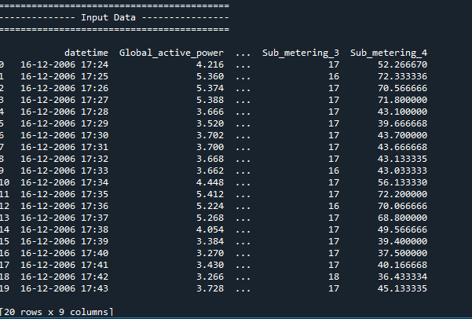
Input Data

Slide 15
Preprocessing
Data pre-processing is the process of removing the unwanted data from the dataset.
Pre-processing data transformation operations are used to transform the dataset into a structure suitable for machine learning.
This step also includes cleaning the dataset by removing irrelevant or corrupted data that can affect the accuracy of the dataset, which makes it more efficient.
Missing data removal
Missing data removal: In this process, the null values such as missing values and Nan values are replaced by 0.
Missing and duplicate values were removed and data was cleaned of any abnormalities.

Slide 16
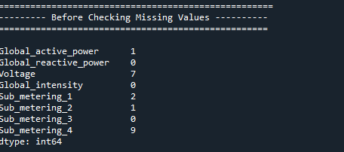
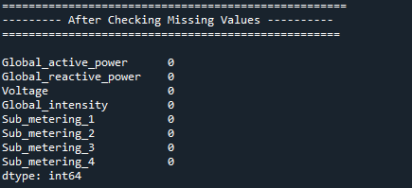
Preprocessing

Slide 17
Feature Scaling
In our process, we have to implement the feature scaling such as min mas scalar.
Feature scaling is a method used to normalize the range of independent variables or features of data. In data processing, it is also known as data normalization and is generally performed during the data preprocessing step.
The min-max scalar form of normalization uses the mean and standard deviation to box all the data into a range lying between a certain min and max value. For most purposes, the range is set between 0 and 1.

Slide 18
Data splitting
Data splitting is the act of partitioning available data into two portions, usually for cross-validator purposes.
One Portion of the data is used to develop a predictive model and the other to evaluate the model's performance.
Separating data into training and testing sets is an important part of evaluating data mining models.
Typically, when you separate a data set into a training set and testing set, most of the data is used for training, and a smaller portion of the data is used for testing.

Slide 19
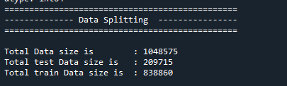
Data splitting

Slide 20
Classification
In our process, we have to implement the deep learning algorithm such as GRU and LSTM.
A gated recurrent unit (GRU) is part of a specific model of recurrent neural network that intends to use connections through a sequence of nodes to perform machine learning tasks associated with memory and clustering, for instance, in speech recognition.
Long Short-Term Memory (LSTM) networks are a type of recurrent neural network capable of learning order dependence in sequence prediction problems.
The key difference between GRU and LSTM is that GRU's bag has two gates that are reset and update while LSTM has three gates that are input, output, forget.
GRU is less complex than LSTM because it has less number of gates. If the dataset is small then GRU is preferred otherwise LSTM for the larger dataset.

Slide 21
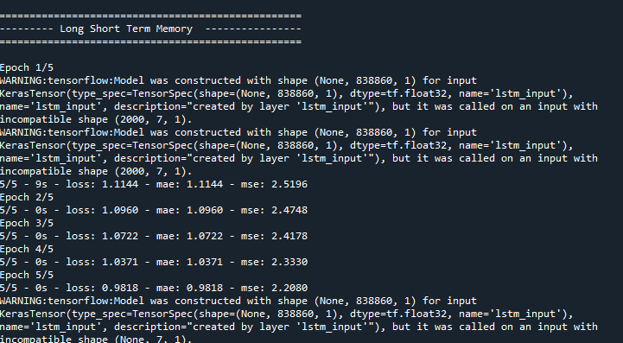
Classification

Slide 22
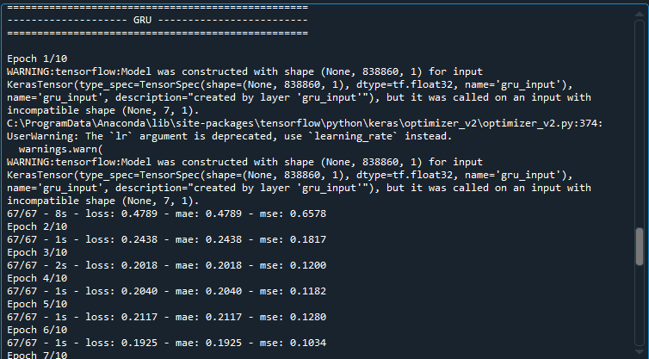
Classification

Slide 23
Result Generation
The Final Result will get generated based on the overall classification and prediction. The performance of this proposed approach is evaluated using some measures like,
Mean Absolute Error (MAE)
Mean Squared Error (MSE)
Root Mean Squared Error (RMSE)
Then, we have to predict or to forecast the co2 emission.

Slide 24
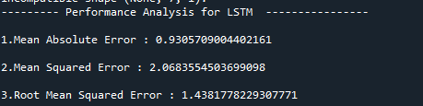
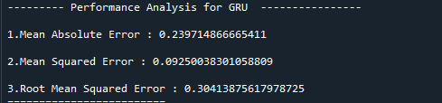

Result Generation

Slide 25
System requirements
SOFTWARE REQUIREMENTS:
O/S : Windows 7.
Language : Python
Front End : Anaconda Navigator – Spyder
HARDWARE REQUIREMENTS:
System : Pentium IV 2.4 GHz
Hard Disk : 200 GB
Ram : 4GB

Slide 26
LITERATURE SURVEY

Slide 27
Title | Year | Author | Methodology | Advantages | Disadvantages
Household Power Consumption Prediction Method Based on Selective Ensemble Learning | 2019 | YIYING ZHANG | In this paper, K-means algorithm is used to cluster the household power consumption, and then the clustering results are combined with the meteorological information. In the stage of power consumption prediction, a Filter Iterative Optimization Ensemble Strategy (FIOES) is proposed to selectively ensemble the basic learners and get the final prediction model. | • The main advantage of the Ranking method is that it is simple and fast. There are also advantages in generalization performance and the calculation method of the difference between learners. | • The proposed FIOES is effective for almost all power consumption prediction, which means that FIOES has good generalization ability.

Slide 28
Title | Year | Author | Methodology | Advantages | Disadvantages
Multiple Electric Energy Consumption Forecasting Using a Cluster-Based Strategy for Transfer Learning in Smart Building | 2020 | Seungmin Rho | Therefore, this study develops a robust framework for the Multiple Electric Energy Consumption forecasting (MEC) of a smart building using Transfer Learning and Long Short-Term Memory (TLL), the so-called MEC-TLL framework. In this framework, we first employ a k-means clustering algorithm to cluster the daily load demand of many profiles in the training set. In this phase, we also perform Silhouette analysis to specify the optimal number of clusters for the experimental datasets. | There are two main approaches that use Machine Learning to solve the electrical energy consumption forecasting problem in smart buildings, including occupant-centric and energy/devices-centric. | • This study develops an effective framework for multiple electric energy consumption forecasting in smart buildings, namely MEC-TLL, which utilizes the concept of transfer learning.

Slide 29
Title | Year | Author | Methodology | Advantages | Disadvantages
Predicting the Energy Consumption of Residential Buildings for Regional Electricity Supply-Side and Demand-Side Management | 2019 | SHOUPENG SHEN | The sensors used for building energy consumption measurement systems are multi-sourced and asynchronous, and the measurement and control system may encounter network fluctuations or network interruption in the long-time operation process, which results in some abnormal and missing values. After the characterization, the features of all the data types are divided into the same standard. | • This will help increase the accuracy and efficiency. Moreover, we will study the electricity energy scheduling strategy according to the prediction for electricity energy consumption ratings of residential buildings based on an entire region. | • The comparison results demonstrate that the optimized SVM model based on the SMOTE-ENN improves the classification performance by an average of 24.1% in terms of accuracy, 26.03% in terms of precision, 24.01% in terms of recall and 25.35% in terms of F-measure.

Slide 30
Title | Year | Author | Methodology | Advantages | Disadvantages
Individual Household Electric Power Consumption Forecasting using Machine Learning Algorithms | 2019 | Aaditi Parate | At the level of individual households, the ability to accurately predict consumption of electricity power significantly reduces prices by appropriate systems for energy storage. Therefore, the energy efficient power networks of the future will require entirely new ways of forecasting demand on the scale of individual households. | • Many researchers wrote about the ARIMA model, AR model, MA model and also worked with these models on the consumption of electricity. • I find the ARIMA model easy as compared to the other models and also the ARIMA model gives a better accuracy then the other models. | • A line plot of the forecast is also created, showing the RMSE in kilowatts for each of the seven lead times of the forecast. • We can see an interesting pattern. We might expect that earlier lead times are easier to forecast than later lead times, as the error at each successive lead time compounds

Slide 31
Conclusion
We conclude that, the household power consumption dataset was taken from dataset repository as input. We are developed the two deep learning algorithms such as long short term memory and gate recurrent unit. Finally, the result shows that some performance metrics such as mae, mse and rmse.

Slide 32
Future Enhancement
In the future, we should like to hybrid the two different machine learning. In future, it is possible to provide extensions or modifications to the proposed clustering and classification algorithms to achieve further increased performance.
Apart from the experimented combination of data mining techniques, further combinations and other clustering algorithms can be used to improve the performance.

Slide 33
References
[1] Yeboah, Samuel Asuamah, Manu Ohene, and T. B. Wereko. ”Forecasting aggregate and disaggregate energy consumption using arima models: a literature survey.” Journal of Statistical and Econometric Methods 1.2 (2012): 71-79.
[2] Miao, Junwei. ”The Energy Consumption Forecasting in China Based on ARIMA Model.” (2015).
[3] Crompton, Paul, and Yanrui Wu. ”Energy consumption in China: past trends and future directions.”Energy economics 27.1 (2005): 195-208.
[4] Yazdan, Gudarzi Farahani, Varmazyari Behzad, and Moshtaridoust Shiva. ”Energy consumption inIran: past trends and future directions.” Procedia-Social and Behavioral Sciences 62 (2012): 12-17.

Slide 34
Thank You…

