Slide 1


SPEECH EMOTION RECOGNITION
Presented by ,
SHARUN KUMAR C R
IndServ21a164
GROUP NO : 48
Notes:
We designed this template so that each member of the project team has a set of slides with its own theme. Members, here’s how you add a new slide to just your set:
Mark where you want to add the slide: Select an existing one in the Thumbnails pane, click the New Slide button, then choose a layout.
The new slide gets the same theme as the previous one you selected.
Careful! Don’t annoy your fellow presenters by accidentally changing their themes. That can happen if you choose a theme Variant from the Design tab, which changes all of the slides in the presentation to that look.

Slide 2
Project Description
Objective
Detecting emotions is one of the most important marketing strategy in today’s world.
For this reason, i have decided to do a project where we could detect a person’s emotions just by their voice .
A example smart car slowing down when one is angry or fearful. As a result this type of application has much potential in the world that would benefit companies and also even safety to consumers

Slide 3
DATA SETS
We got audio datasets with around 3000 audio files which were in the wav format from the following websites: http://neuron.arts.ryerson.ca/ravdess/?f=3, http://kahlan.eps.surrey.ac.uk/savee/Download.html
The first website contains speech data which is available in three different format.
1.Audio Visual – Video with speech
2.Speech – Audio only
3.Visual – Video only
We went with the Audio only zip file because we are dealing with finding emotions from speech. The zip file consisted of around 2500 audio files which were in wav format.
The second website contains around 500 audio speeches from four different actors with different emotion

Slide 4
LABELLING
The next step involves organizing the audio files.
Each audio file has a unique identifier at every position , at the 3rd position of the file name which can be used to determine the emotion the audio file consists.
We have 8 different emotions in our dataset.
(e.g., 01-01-05-01-02-01-12.mp4) then this audio contain angry speech
Labels | emotion
0 | Neutral
1 | Calm
2 | Happy
3 | Sad
4 | Angry
5 | Fearful
6 | Disgust
7 | Surprised

Slide 5
FEATURE EXTRACTION
LIBROSA
I used Librosa library in Python to process and extract features from the audio files
Using the librosa library I was able to extract features i.e MFCC(Mel Frequency Cepstral Coefficient)
Librosa is a python package for music and audio analysis.
It provides the building blocks necessary to create music information retrieval systems
MFCC
In sound processing, the mel-frequency cepstrum (MFC) is a representation of the short-term power spectrum of a sound

Slide 6
MODELS USED
The next steps involve shuffling the data, splitting into train and test and then building a model to train our data.
I had built 3 types of model:
MLP Classifier
SVM Classifier
Convolutional Neural Network(CNN)
The MLP and SVM were not suitable as it gave me low accuracy. As My project is a classification problem where were categorize the different emotions, CNN worked best for me.

Slide 7
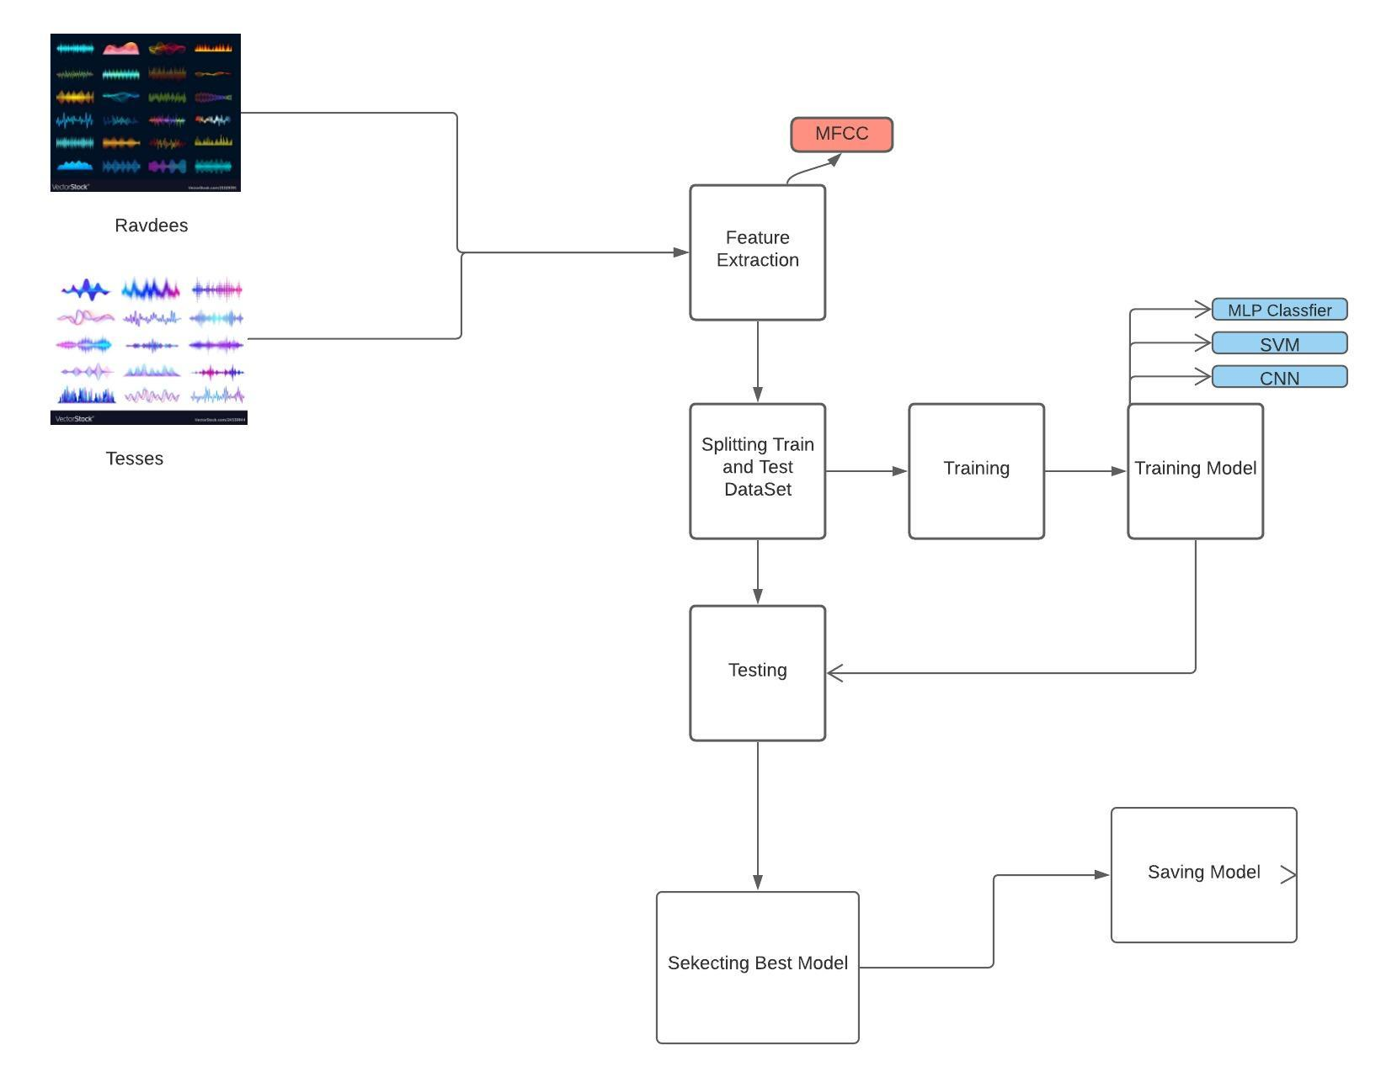
SER Working Flow Chart

Slide 8
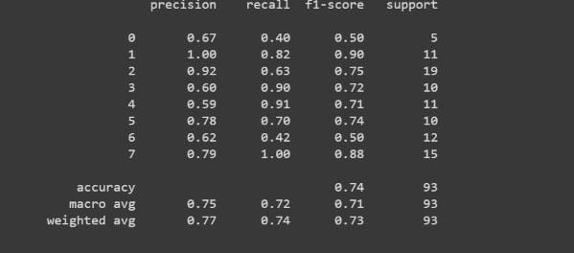
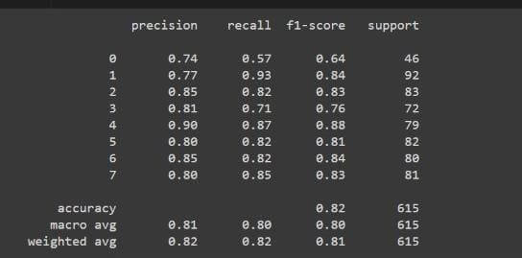
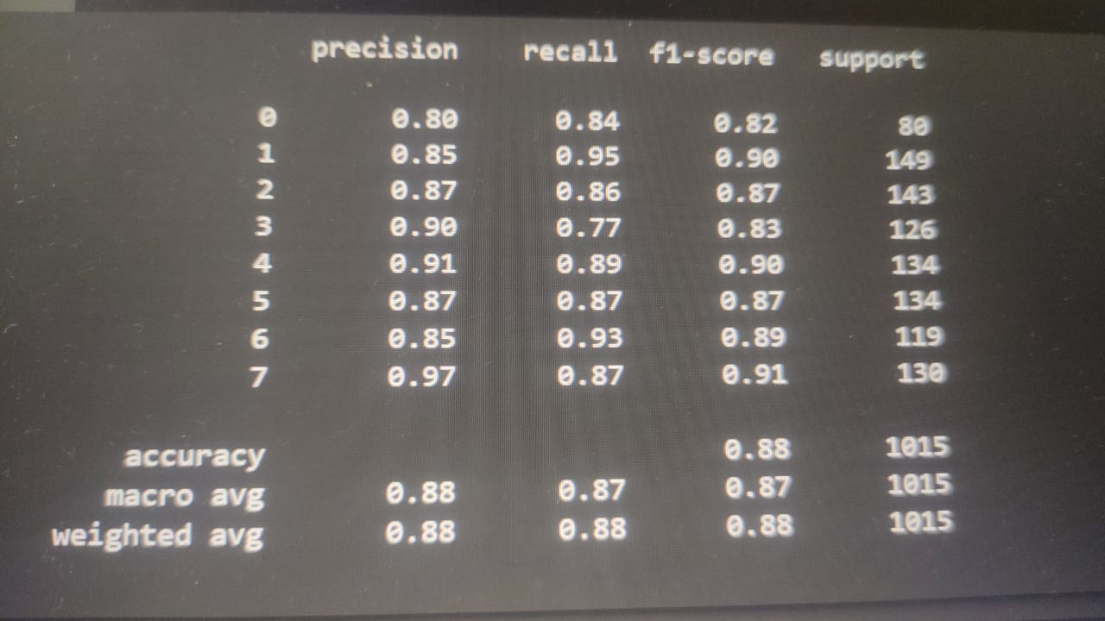
Classification report
MLP
SVM
CNN

Slide 9
RESULT & CONCLUSION
CONCLUSION
RESULT
After building numerous different models, I have found My best model as CNN model for our emotion classification problem.
I achieved a validation accuracy of 88% with my existing model.
Combining the two datasets, RAVDESS & TESS, increased accuracy
Further Improvement: More data can be collected to increase model accuracy and performance on all emotion classes. Can improve the model further by predicting emotions on real time data. Also can incorporate other learning mechanisms to compute the percentage of emotions for audio with mixed emotion.
MODEL | ACCURACY
MLP | 75%
SVM | 81%
CNN | 88%

Slide 10

THANK YOU !!!

