Slide 1

AI-Driven “Money Mule” Detection: Protecting Banking Infrastructure from Financial Crimes
SRN : PES1PG25CA201
Name: Sharvani M
Project Domain: Banking and Finance(Section D)
Goal: SDG 9- Industry, Innovation and Infrastructure

Slide 2

AIML
Abstract
Detects "Money Mules"—individuals who move illegal funds through legitimate accounts.
Uses large-scale transaction logs(csv) to identify suspicious behaviour.
Applies Unsupervised Learning to find hidden patterns without needing a pre-labeled fraud data.
Clusters accounts into categories: Normal, High-activity, and Suspicious(Mule like).
Helps banks prevent money laundering and strengthens financial infrastructure.
Includes a Streamlit Dashboard for real-time risk scoring.

Slide 3
AIML
Abstract
Problem Statement :
Criminals use real bank accounts (mules) to "layer" and hide stolen money.
Traditional rule-based systems are too slow and easy to bypass.
Manual monitoring of millions of transactions is impossible for humans.
Banks need an automated, data-driven way to flag high-risk accounts.

Slide 4
AIML
Dataset
Source URL: https://www.kaggle.com/datasets/ealaxi/paysim1
Dataset Name: PaySim Synthetic Financial Dataset
Size / Shape: 6,362,620 rows, 11 columns
Simple description about the dataset:
A synthetic CSV dataset simulating mobile money transactions.
Includes transaction types like TRANSFER and CASH_OUT (key for mule detection).
Features: amount, oldbalanceOrg (sender balance before), newbalanceOrig (sender balance after), nameDest (receiver ID).

Slide 5
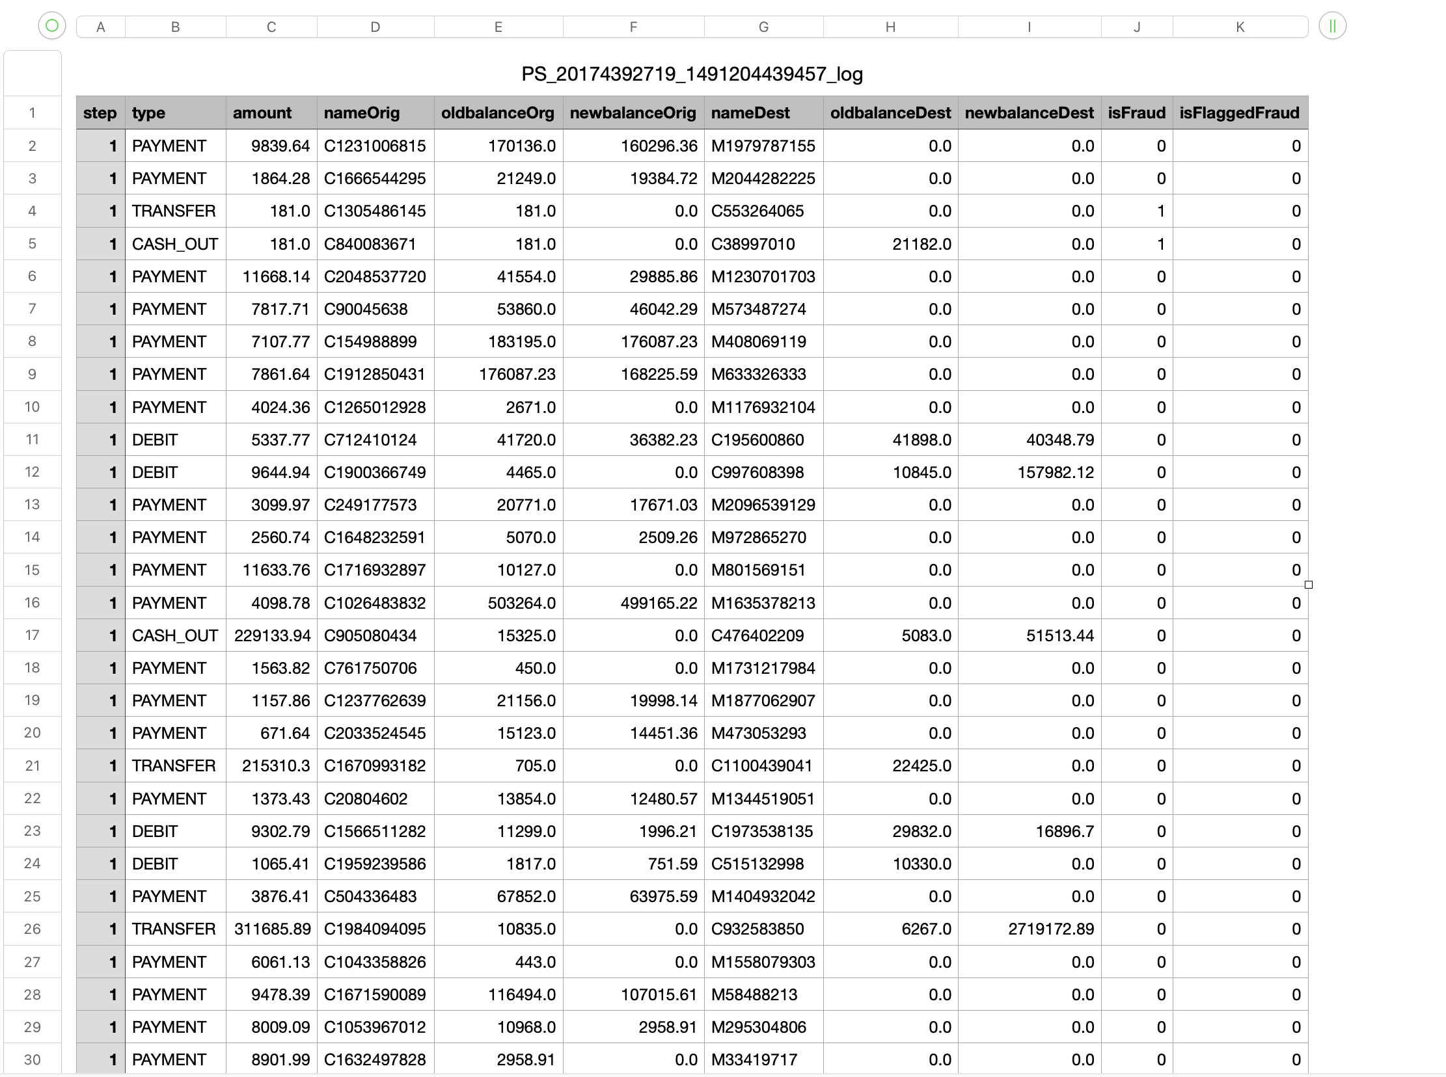
AIML
Dataset Snapshot
Raw Data

Slide 6
AIML
Methodology
Unsupervised Learning
What are you trying to do: Clustering and Anomaly Detection (grouping transactions by behavior to isolate suspicious "outliers").
What is your choice of Algorithms (tentative) :
K-Means Clustering (to group behavioral patterns).
Isolation Forest (to detect anomalies/mules).
Elbow Method (to find the optimal number of clusters).
UI Tool (tentative): Streamlit (for an interactive dashboard to upload CSVs and view results).
Cloud Platform (tentative): Streamlit Community Cloud (for easy, free web hosting).

Slide 7
THANK YOU

