Slide 1


Audio2Art: Transforming Voice Prompts into Visual Creations using Transformers
Team Members:
Khushi Bung
Egala Srinidhi Reddy
Surla Ravali
Pallakonda Nandhika
Karnati Sharvani

Slide 2
Introduction :
The Audio2Art system is an AI-powered tool that transforms voice commands into stunning digital artwork. By combining speech recognition with AI-generated images, this system enables users to describe an idea verbally and see it converted into a unique visual representation.
The entire process is fast, seamless, and user-friendly, allowing anyone to create AI-generated art using just their voice. With applications in digital art, content creation, and accessibility, the Audio2Art system makes creativity more accessible and efficient

Slide 3
Problem Statement :
Users struggle to find intuitive ways to generate artwork using just their voice.
Existing AI art generators require text inputs, limiting accessibility and creativity.
Proposed Solution:
An AI-powered application using voice recognition and transformers to create stunning artwork from voice prompts.
Real-time rendering and customization options for generated images.

Slide 4
REQUIREMENTS :
Technical Requirements:
Programming Language: Python
Backend: speechrecognition(googles’ speech recognition service) for voice recognition, Stable Diffusion for image generation.
Frontend: Streamlit Web Framework
Database: Not required initially (API-based queries)
Functional Requirements:
Ability to capture voice input and convert it to text.
Generate images from text using transformer-based models
Provide users with customization options (styles, color themes, resolution).
Constraints & Challenges:
Ensuring accurate voice-to-text conversion.
Optimizing image generation for real-time feedback.

Slide 5
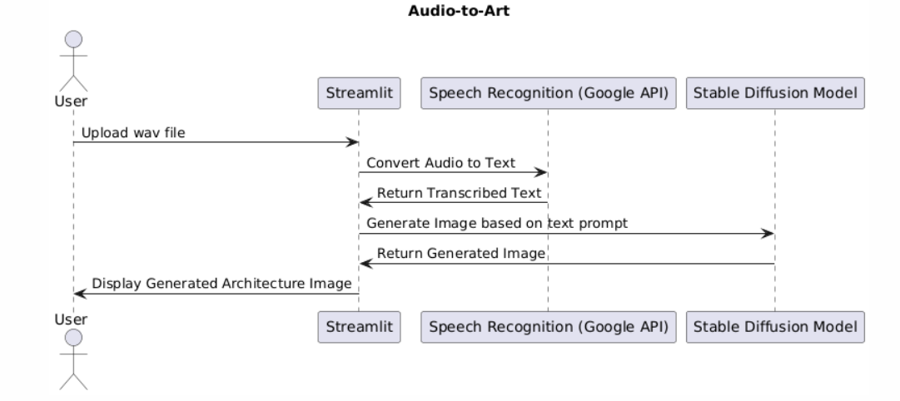
PROJECT DESIGN

Slide 6
USER OVERFLOW: Step 1: User speaks a prompt (e.g., "A futuristic city at sunset"). Step 2: Voice-to-text conversion occurs. Step 3: The text prompt is processed for image generation. Step 4: The final image is displayed, with customization options.

Slide 7
CONCLUSION:
The Audio-to-Art system bridges the gap between speech and visual creativity, making it easier for users to create AI-generated images using just their voice. With its combination of speech recognition, AI-powered image generation, and user-friendly features, this system is revolutionizing the way we interact with AI in digital art.

Slide 8
THANK YOU !

