Slide 1

CVR COLLEGE OF ENGINEERING
(An Autonomous Institution, NBA, NAAC Accredited and Affiliated to JNTU, Hyderabad)
Vastunagar, Mangalpalli (V), Ibrahimpatnam (M), Rangareddy (D),Telangana-501510
DEPARTMENT OF CSE (DS)
B. Tech III Year II Semster Industry Oriented Mini Project
Project Review - 2

Slide 2
Electric Vehicle Energy Demand Prediction
By
Khushi Bung(23B81A6785)
Karnati Sharvani (23B81A67A7)
Ethineni Vishnu Vardhan (23B81A67C7)
Under the guidance of
Mr. Hari Shankar Punna
Sr. Asst. professor
Department of CSE (DS)

Slide 3
ABSTRACT
The project titled “Electric Vehicle Energy Demand Prediction” focuses on building an intelligent system capable of predicting EV charging demand using Machine Learning and Deep Learning techniques.
The system integrates:
Data preprocessing pipeline
Multiple predictive models (Linear Regression, ANN, LSTM)
Automated model selection
Real-time prediction interface using Streamlit
The dataset includes features such as time, weather conditions, number of EVs, charging capacity, and energy parameters. Advanced preprocessing techniques like feature engineering, encoding, and normalization are applied.
The trained models are evaluated using metrics like RMSE, MAE, and R² score. The best-performing model is automatically selected and deployed for real-time predictions.This system helps optimize EV charging infrastructure, reduce grid overload, and support smart energy management systems.

Slide 4
INTRODUCTION
Electric Vehicles are gaining widespread popularity due to their environmental benefits, reduced carbon emissions, and improved energy efficiency. However, large-scale EV integration poses challenges to existing power grids because EV charging demand varies significantly based on time, user behavior, and external factors. Traditional energy demand forecasting techniques are not sufficient to handle such dynamic and nonlinear patterns. Machine learning and deep learning approaches provide effective solutions by learning complex relationships from historical data. This project explores and compares linear and nonlinear models to accurately predict EV energy demand, helping in efficient power system planning and smart grid management.

Slide 5
LITERATURE SURVEY
Early research on Electric Vehicle (EV) energy demand prediction mainly used statistical models such as Linear Regression, which provided simple demand estimates but failed to model nonlinear charging behavior.
Time-series forecasting techniques like ARIMA were later introduced to capture temporal patterns in EV charging data. These models showed better short-term prediction accuracy but performed poorly for long-term forecasting.
With the growth of data availability, machine learning approaches gained attention for EV demand prediction due to their ability to learn complex relationships from historical data.
Artificial Neural Networks (ANN) have been widely used to model nonlinear patterns in EV energy consumption and have demonstrated improved accuracy over traditional statistical methods.
Recent studies emphasize the effectiveness of Long Short-Term Memory (LSTM) networks for EV energy prediction, as they can capture long-term temporal dependencies using memory cells.
Comparative studies reveal that deep learning models, especially LSTM, consistently outperform linear and traditional time-series models in terms of prediction accuracy.
These findings motivate the adoption of hybrid and deep learning-based approaches for accurate and reliable EV energy demand forecasting.

Slide 6
Challenges:
• Difficulty in capturing complex nonlinear relationships in EV charging data using traditional models • Limited accuracy of statistical and time-series models for long-term prediction • Requirement of large datasets for training deep learning models • High computational cost associated with ANN and LSTM models • Handling dynamic factors such as time, weather, and user behavior • Lack of real-time prediction capability in many existing systems

Slide 7
PROBLEM STATEMENT
The increasing penetration of electric vehicles results in highly variable and uncertain energy demand patterns that traditional forecasting models cannot accurately predict. Poor prediction accuracy may lead to grid instability, inefficient load distribution, and increased operational costs. Therefore, there is a need for an intelligent prediction system capable of accurately forecasting EV energy demand using advanced data-driven techniques.
The EV Energy Demand Prediction System aims to accurately forecast charging demand using real-time inputs like location, time, and weather. It automatically selects the best model and provides a user-friendly interface for easy prediction and analysis.

Slide 8
OBJECTIVES
Develop a preprocessing pipeline to clean, transform, and prepare EV charging data
Train multiple models (Linear Regression, ANN, LSTM) to capture different data patterns
Compare model performance using RMSE, MAE, and R² score
Deploy a real-time prediction system using Streamlit
Visualize EV demand trends and model results for better analysis

Slide 9
EXISTING WORK
Most existing systems for Electric Vehicle (EV) energy demand prediction rely on basic statistical methods or single machine learning models to estimate charging demand. These systems typically use historical data and limited parameters such as time, number of vehicles, or weather conditions. While some advanced approaches use machine learning or deep learning models, they are often developed as standalone solutions without integrating preprocessing, model comparison, and real-time prediction in a single platform.
LIMITATIONS
Limited accuracy due to use of single models
Poor handling of complex and dynamic demand patterns
High computational requirements for advanced models
Lack of real-time prediction and deployment
No integration of preprocessing, training, and inference in one system

Slide 10
PROPOSED SYSTEM
The system accepts inputs such as time, weather conditions, number of electric vehicles (EVs), and charging station capacity. These inputs are processed through a preprocessing pipeline that performs data cleaning, feature engineering, encoding, and scaling. The processed data is then used to train multiple machine learning and deep learning models including Linear Regression, Artificial Neural Network (ANN), and Long Short-Term Memory (LSTM). The system evaluates all trained models using performance metrics such as RMSE, MAE, and R² score, and automatically selects the best-performing model. This selected model is then used during the inference stage to predict real-time EV energy demand through an interactive user interface.

Slide 11
LIST OF MODULES
Data Collection Module: Collects historical electric vehicle charging and energy consumption data from available datasets.
Data Preprocessing Module: Cleans the data by handling missing values, removing noise, and normalizing inputs.
Feature Engineering Module: Selects and transforms relevant features to improve model learning and prediction accuracy.
Linear Model Module: Implements traditional forecasting models such as Multiple Linear Regression and ARIMA for baseline prediction.
ANN Model Module: Uses Artificial Neural Networks to capture nonlinear relationships in EV energy consumption patterns.
LSTM Model Module: Applies Long Short-Term Memory networks to model temporal dependencies in EV charging data.
Performance Evaluation Module: Evaluates model performance using error metrics such as R2-Score, MAE and RMSE.
Result Visualization Module: Displays prediction results and performance comparisons using graphical visualizations.

Slide 12
SOFTWARE REQUIREMENTS
Requirement | Purpose
Python 3 | Core programming language
Pandas | Data preprocessing and handling
NumPy | Numerical operations
Scikit-learn | ML models and evaluation
TensorFlow | ANN and LSTM model implementation
Joblib | Save/load ML models and scalers
Streamlit | Web interface for prediction
Plotly | Visualization of graphs and charts
JSON | Store best model configuration (model selection)
OS Libraries | File and directory handling

Slide 13
HARDWARE REQUIREMENTS:
Requirement | Purpose
RAM (4GB minimum) | Handle dataset and model processing, Store datasets and models
GPU (Optional) | Faster training for deep learning
System (Windows/Linux/Mac) | Run the application
Browser | Access Streamlit UI

Slide 14
FUNCTIONAL REQUIREMENTS:
Requirement | Purpose
Load Dataset | Read EV charging data from CSV files
Preprocess Data | Clean, encode, and scale data for model training
Train Models | Train Linear Regression, ANN, and LSTM models
Evaluate Models | Compare models using RMSE, MAE, and R² score
Select Best Model | Automatically choose the best performing model
Save & Load Models | Store and retrieve trained models for reuse
Real-Time Prediction | Predict EV demand based on user input
Visualization | Display graphs and results in dashboard

Slide 15
NON FUNCTIONAL REQUIREMENTS:
Requirement | Purpose
Accuracy | Ensure reliable prediction results
Performance | Fast training and prediction
Usability | Easy-to-use Streamlit interface
Scalability | Handle larger datasets in future
Maintainability | Modular and readable code structure
Reliability | System should work without failure

Slide 16
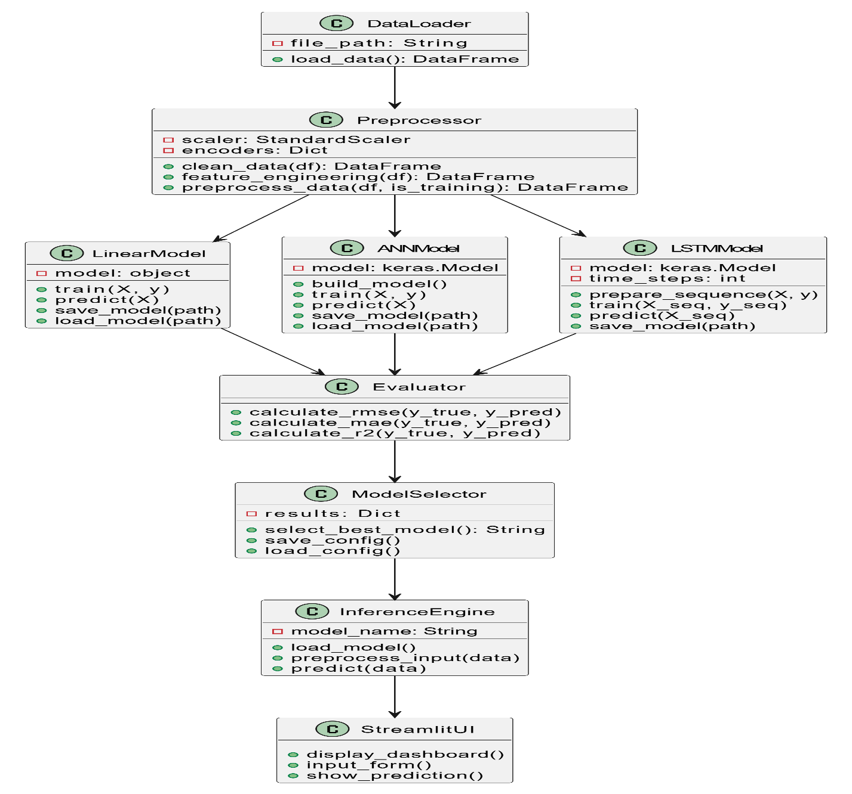
CLASS DIAGRAM:
Class Diagram for EV Energy
Demand prediction system
This diagram shows the structure of the EV Demand Prediction System, including modules like data preprocessing, model training (Linear, ANN, LSTM), evaluation, and prediction. It explains how these components work together to generate accurate demand forecasts.

Slide 17
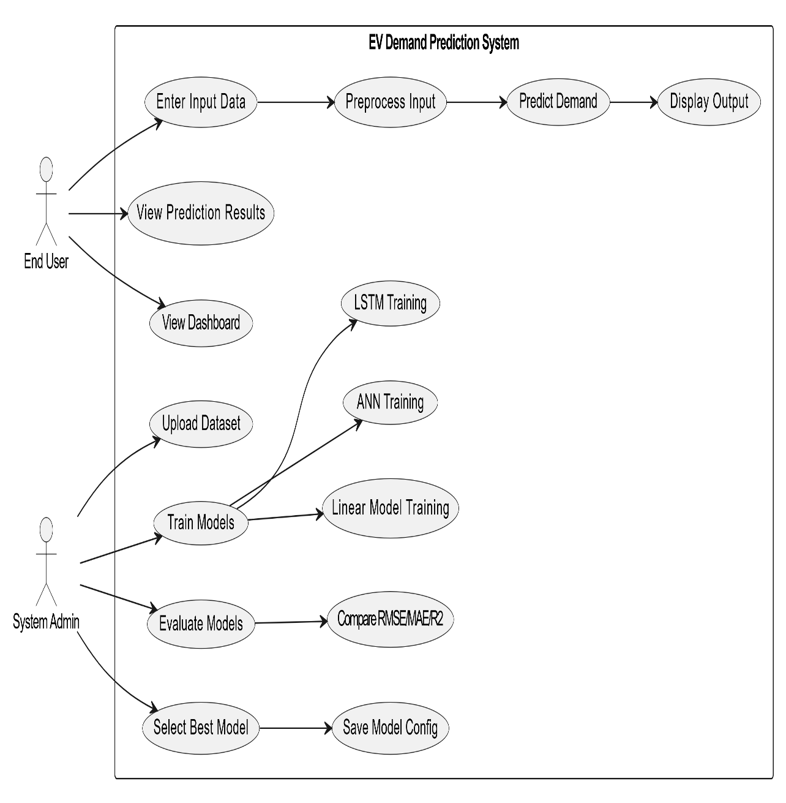
USE CASE DIAGRAM:
Usecase Diagram for EV Energy Demand prediction system
This diagram shows how end users and system admins interact with the EV Demand Prediction System. It includes actions like entering input for prediction and managing model training, evaluation, and selection.

Slide 18
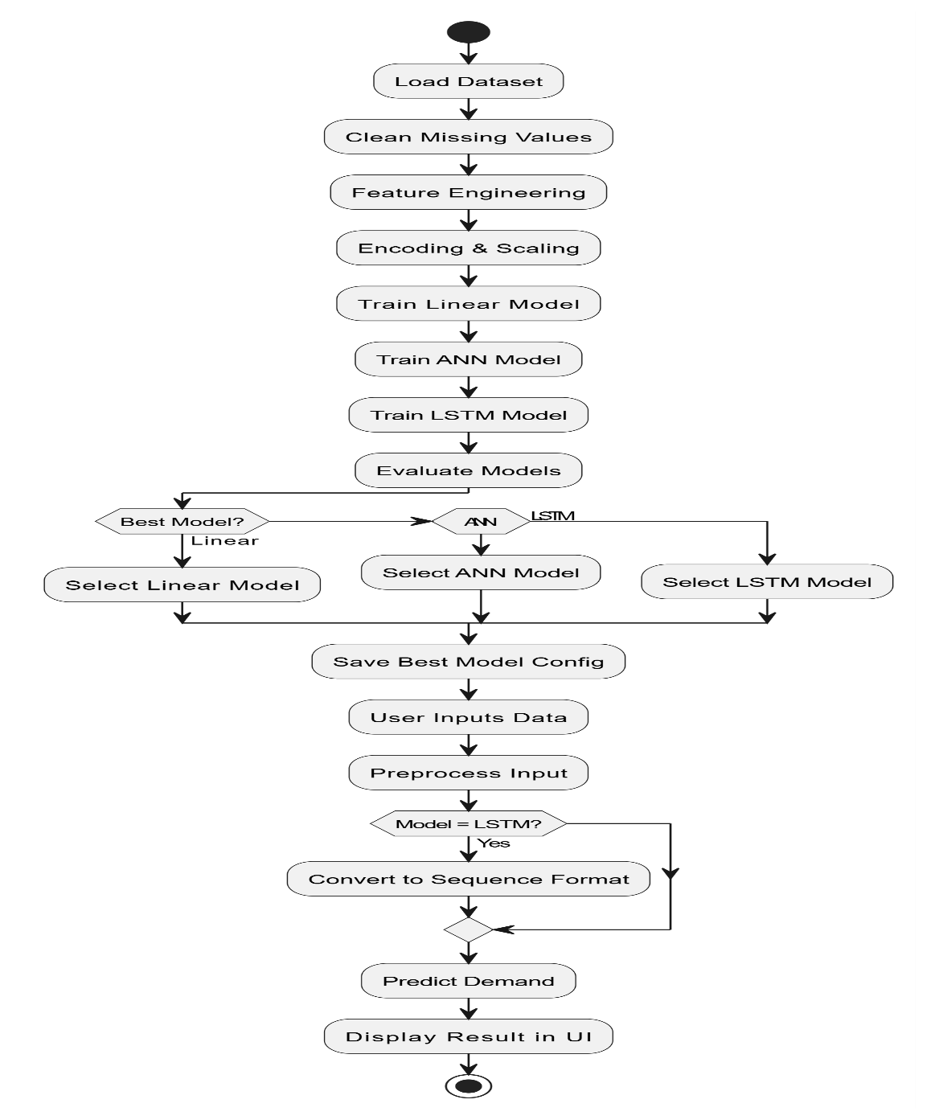
ACTIVITY DIAGRAM
Activity Diagram for EV Energy Demand prediction system
This diagram represents the workflow of the EV demand prediction process from dataset loading to final result display. It explains how data is processed, models are trained, and the best model is used for prediction.

Slide 19
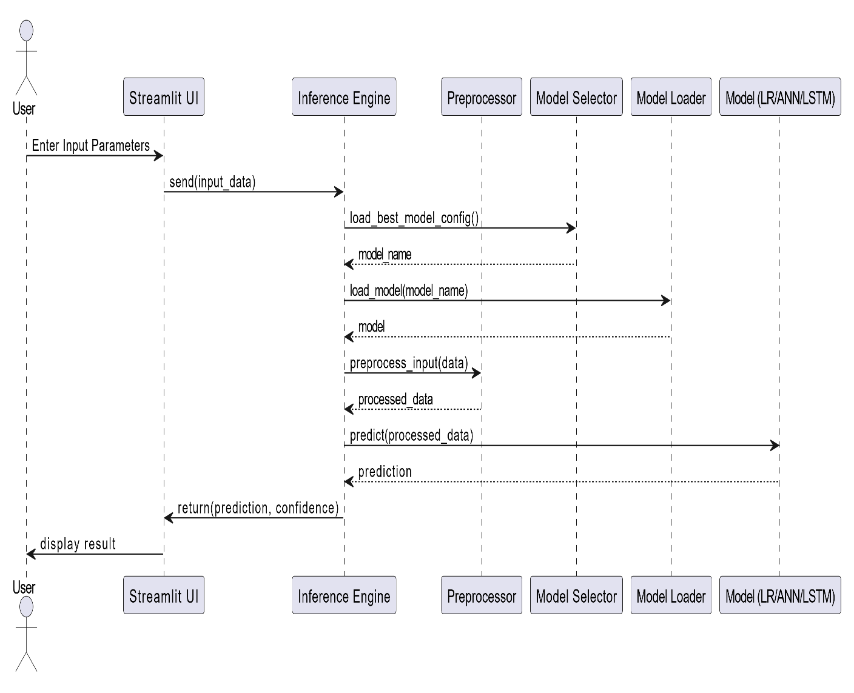
SEQUENCE DIAGRAM
Sequence Diagram for EV Energy Demand prediction system
This diagram shows how different components of the EV Demand Prediction System communicate during prediction. It illustrates the flow from user input in the UI to preprocessing, model loading, and result generation.

Slide 20
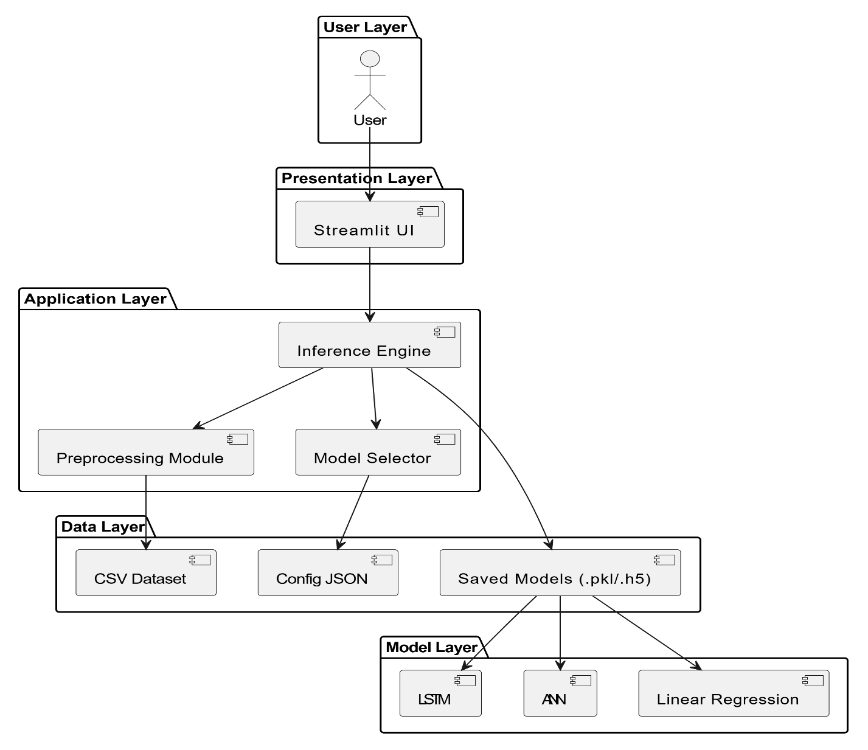
SYSTEM ARCHITECTURE
System Architecture for EV Energy Demand prediction system
This diagram shows the overall design of the EV Demand Prediction System with layers like UI, application logic, data storage, and models. It explains how all parts integrate to deliver demand predictions.

Slide 21
Implementation
The implementation of the EV Energy Demand Prediction System is carried out in a structured pipeline consisting of data preprocessing, model training, model evaluation, and real-time prediction using a web interface.
PROJECT STRUCTURE
preprocessing/ → Data cleaning & feature engineering
models/ → Linear, ANN, LSTM models
training.py → Train all models
inference.py → Prediction logic
app.py → Streamlit UI
SETUP
pip install -r requirements.txt
DATA PREPROCESSING
Remove missing values & duplicates
Feature engineering (Hour, PeakHour)
Encoding categorical variables
Scaling numerical features

Slide 22
Code Snippet:
df = df.drop_duplicates() df = df.fillna(method='ffill').fillna(method='bfill') df['Hour'] = df['Time'].apply(lambda x: int(str(x).split(':')[0])) df['IsPeakHour'] = df['Hour'].apply(lambda h: 1 if (7<=h<=10 or 17<=h<=20) else 0) df['Hour_Sin'] = np.sin(2 * np.pi * df['Hour']/24) df['Hour_Cos'] = np.cos(2 * np.pi * df['Hour']/24)
Model Training
Run training:
python training.py
Code Snippet:
lr_model, lr_metrics = train_linear_model() ann_model, ann_metrics = train_ann_model() lstm_model, lstm_metrics = train_lstm_model(time_steps=24)
What happens internally:
Linear Regression Model : Trained as baseline model
ANN Model : Learns nonlinear relationships
LSTM Model : Uses time-series sequences (24 time steps) , Captures temporal dependencies

Slide 23
MODEL EVALUATION: RMSE, MAE ,R² Score
rmse = np.sqrt(mean_squared_error(y, preds)) mae = mean_absolute_error(y, preds) r2 = r2_score(y, preds)
BEST MODEL SELECTION
best_model_name = max(results, key=lambda x: results[x]['R² Score'])
Automatically selects best model
MODEL SAVING
joblib.dump(model, 'linear_model.pkl') model.save('lstm_model.h5’)
Reuse without retraining.
Best model config is saved in: models/best_model_config.json
Linear model → .pkl file
ANN & LSTM → .h5 file
Scalers & encoders → .pkl
This allows reuse without retraining.

Slide 24
Inference (Prediction Logic)
df_input = pd.DataFrame([input_data])
df_processed = preprocess_data(df_input, is_training=False)
prediction = model.predict(df_processed.values)
The inference module performs:
Load best model from JSON config
Convert user input into dataframe
Apply preprocessing (same as training)
Handle model-specific input (LSTM sequence)
Generate prediction
Output:
Demand (MW)
Confidence score
Running the Application
Start the Streamlit app:
streamlit run app.py
Opens browser with:
Dashboard (graphs, trends)
Prediction page (user input → output)
Model evaluation page

Slide 25
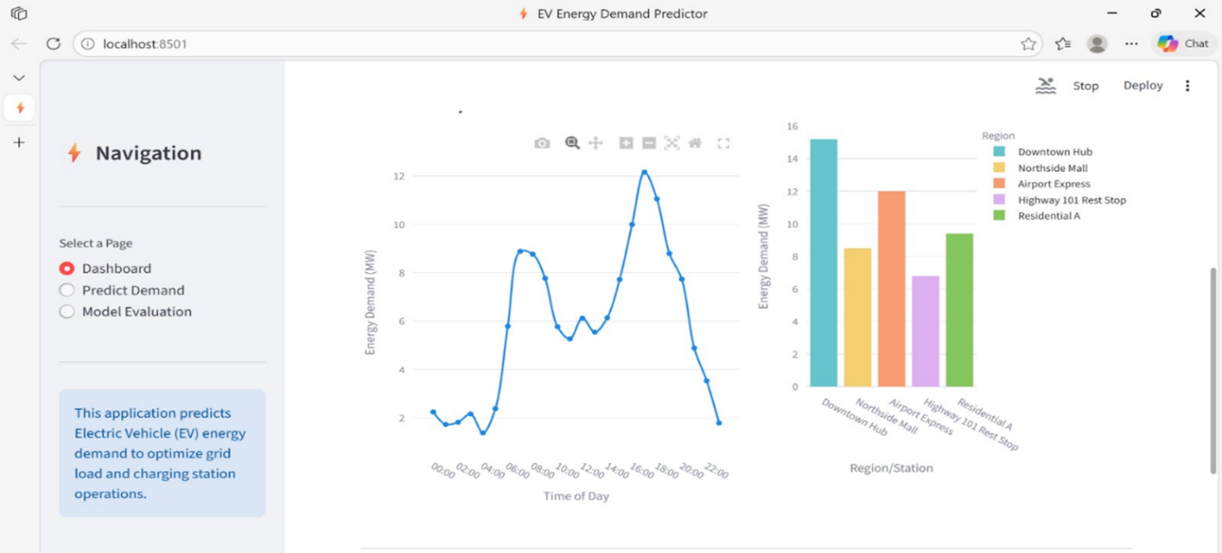
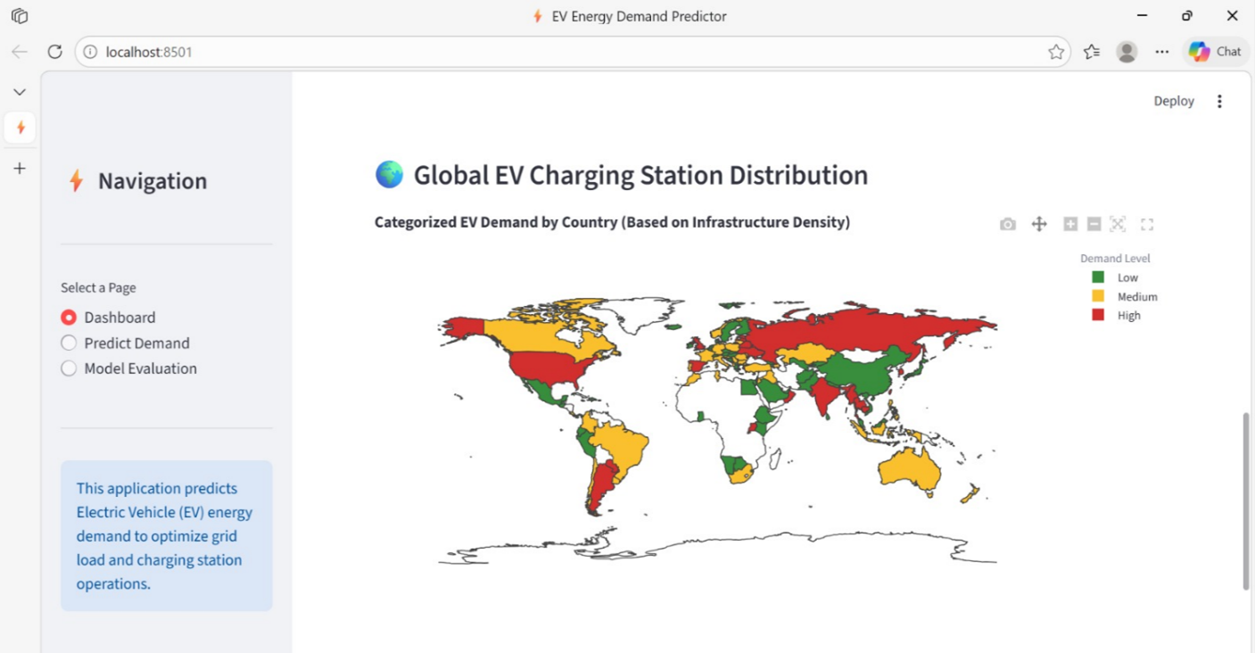
User Interaction Flow
User enters inputs:
Time
Weather
Number of EVs
Capacity
System:
Preprocesses input
Loads best model
Predicts demand
Output:
Predicted demand (MW)
Confidence (%)
Warning if capacity exceeded
Dashboard:
The dashboard provides a visual overview of EV energy demand using graphs and maps. It helps users understand demand patterns across time and regions for better analysis and decision-making.

Slide 26
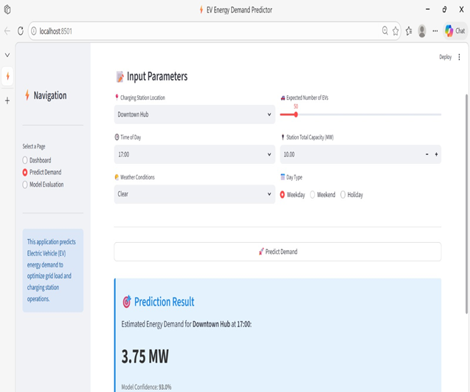

Prediction page:
The prediction page allows users to input parameters like location, time, weather, and EV count to estimate energy demand. It uses the trained model to generate real-time predictions along with confidence levels.
Evaluation page:
The evaluation page compares the performance of different models such as Linear Regression, ANN, and LSTM. It displays metrics like MAE, RMSE, and R² to identify the best model for accurate EV demand prediction.

Slide 27
RESULTS AND DISCUSSIONS
The system was trained using Linear Regression, ANN, and LSTM models for predicting EV energy demand. The models were evaluated using RMSE, MAE, and R² score.
The Linear Regression model showed moderate performance as it cannot capture complex relationships in the data. The ANN model improved accuracy by handling nonlinear patterns. However, the LSTM model performed the best as it effectively captures time-based variations in EV charging demand.
Based on the evaluation, the LSTM model was selected as the best model for deployment. The results indicate that the system can accurately predict EV energy demand and support efficient energy management.
TESTING
Testing was carried out to ensure the proper functioning of the system at all stages. The following aspects were tested:
Correct preprocessing of data including handling missing values and feature generation
Successful training and evaluation of all models
Accurate selection of the best model based on performance metrics
Proper functioning of the prediction module during inference
Smooth working of the Streamlit interface and correct display of results

Slide 28
CONCLUSION
The developed EV Energy Demand Prediction System provides an effective and intelligent solution for forecasting electric vehicle charging demand using machine learning and deep learning techniques. The system integrates key stages such as data preprocessing, feature engineering, model training, evaluation, and real-time prediction into a single streamlined framework.
By implementing and comparing multiple models, including Linear Regression, ANN, and LSTM, the system ensures higher prediction accuracy through automatic model selection. The use of LSTM significantly improves performance by capturing temporal and sequential patterns in energy demand data.
The system also offers a user-friendly interface for easy interaction and visualization, making it suitable for practical applications. Overall, the solution is efficient, scalable, and reliable, contributing to better grid load management and optimized EV charging infrastructure.
FUTURE SCOPE
Integration with real-time IoT data from charging stations
Deployment on cloud platforms for scalability
Use of advanced deep learning models for better accuracy
Improvement in LSTM input sequences for more realistic predictions

Slide 29
References: [1] “Electric Vehicle Energy Demand Prediction Using Machine Learning Techniques,” IEEE Research Paper. [2] Scikit-learn Documentation. Available: https://scikit-learn.org [3] TensorFlow Documentation. Available: https://www.tensorflow.org [4] Géron, A., Hands-On Machine Learning with Scikit-Learn, Keras, and TensorFlow, O’Reilly Media, 2019. [5] Brownlee, J., Deep Learning for Time Series Forecasting, Machine Learning Mastery, 2018. [6] International Energy Agency (IEA), “Global EV Outlook Report,” Available: https://www.iea.org

