Slide 1
Hypothesis Testing with ANOVA
ANalysis Of VAriance

Slide 2
When to use Anova
Analysis of variance, or ANOVA, is a statistical method that separates observed variance data into different components to use for additional tests
We use anova rest when we want to compare 2 or more populations and their subgroups
We can also check how the subgroups interact with each other quatitaively
Anova technique is extremely useful when we want to compare populations when the populations have several levels or subgroups

Slide 3
Types Of ANOVA
Univariate
Or
One Way
Bi variate
Or 2 ways
Multivariate
Or MANOVA

Slide 4
One Way ANOVA
A one-way ANOVA evaluates the impact of a sole factor on a sole response variable. The one-way ANOVA is used to determine whether there are any statistically significant differences between the means of three or more independent (unrelated) groups.
One-way ANOVA is Used to test whether or not there is a statistically significant difference between the means of three or more groups when the groups can be split on a single factor
One Way or One Factor ANOVA assesses only one dependent variable at a time.

Slide 5
Two Way Anova
A two-way ANOVA is an extension of the one-way ANOVA. With a two-way, you have two independent variable affecting a dependent variable.
A Two-Way Anova is used to determine whether or not there is a statistically significant difference between the means of three or more independent groups that have been split on two factors.
The purpose of a two-way ANOVA is to determine how two factors impact a response variable, and to determine whether or not there is an interaction between the two factors on the response variable.

Slide 6
Comparision between One Way and Two way Anova
One Way Anova
Two way Anova
Analysis of a independent factor( usually categorical )that has an effect on dependent variable(usually continuous)
Gender $$$
Treatment Recovery Time
Car Models Price
Analysis of 2 independent factors on a dependent variable
Gender $$$
Level of Education
Treatment Recovery Time
Age
Location Price
Hours

Slide 7
One Way or One Factor Anova
In one factor anova there is one factor and various groups in distribution.
Variabilty between the means(MSE)/variability with in the distributions(MSC)
It is a measure of over all mean/ Internal spread
Variance Total = Variance Between + Variance With in
Fstatistic = SS(Between)/df(between) /SS(with in)/df(with in)

Slide 8
Assumptions of One way Anova
Normality – all populations that we’re studying follow a normal distribution. So, for example, if we want to compare the exam scores of three different groups of students, the exam scores for the first group, second group, and third group all need to be normally distributed.
Equal Variance – the population variances in each group are equal or approximately equal.
Independence – the observations in each group need to be independent of each other

Slide 9
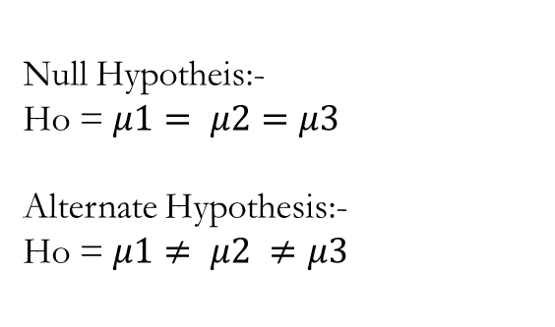
Null Hypotheis:-
Ho = $μ1= μ2=μ3$
Alternate Hypothesis:-
Ho = $μ1≠ μ2 ≠μ3$
Medication1(20mg) | Medication 2(50Mg) | Medication 3(100Mg)
9 | 7 | 4
8 | 6 | 3
7 | 9 | 2
8 | 7 | 3
7 | 7 | 4
8 | 7 | 3
9 | 6 | 2

Slide 10
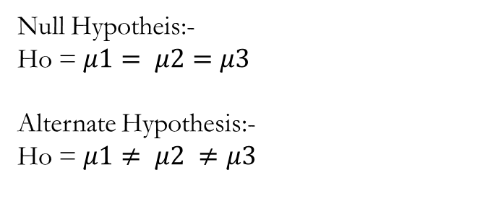
10 Year | 11 Year | 12 Year
4 | 6 | 8
6 | 6 | 9
8 | 9 | 13
4 | 7 | 12
8 | 10 | 14
9 | 13 | 16
Null Hypotheis:-
Ho = $μ1= μ2=μ3$
Alternate Hypothesis:-
Ho = $μ1≠ μ2 ≠μ3$

Slide 11
2 factor or 2 way ANOVA without Replication
In 2 way anova the number of groups come from the combination of expression of the two factors.
Does Factor 1 has influence on dependent variable
Does Factor 2 have influence on dependent Variable
Is there a interaction effect between 2 factors

Slide 12
H01= Gender has no effect on significant scores
Ha1 = Gender has effect on significant scores
H02= Age Has no significant effect on scores
Ha2 = Age Has significant effect on scores
H03 = The interaction of Gender and age has no effect on the scores.
Ha3 = The interaction of Gender and age has effect on the scores.
Gender | 10 Year | 11 Year | 12 Year
Boys | 4 | 6 | 8
Boys | 6 | 6 | 9
Boys | 8 | 9 | 13
Girls | 4 | 7 | 12
Girls | 8 | 10 | 14
Girls | 9 | 13 | 16

Slide 13
Sources and Credits
INeuron Statisitcs Pre-Recordings
Khan academy statistics
Brandon Foltz statistics
https://www.statology.org/one-way-anova-python
Intro to two way anova :- https://www.youtube.com/watch?v=lZFmFuZGQTk

Slide 14
THANK YOU

