Slide 1

Product Recommendation System - Capgemini Hackathon
Project By - Sharvari Ballal
LinkedIn - https://www.linkedin.com/in/sharvari-ballal-8b967a114/
GitHub - https://github.com/sharvari21

Slide 2
Brief Synopsis
This is a Data Science project with Problem Statement given for Capgemini Tech Challenge 2021.
This project covers analysing 2 databases of sales transactions of Electronics and Modcloth items.
Task is to build a recommendation system from these 2 datasets.
Using the Python & its supporting libraries, I have created the analysis and recommendation system in a .ipynb format Jupyter Notebook.
We can recommend products to user based on ratings, units sold and associations rules between products & categories.

Slide 3
Problem Being Solved
Problem Statement:
Use Case
Develop a product recommendation engine and detect the bias in recommendation if any. Two data sets are provided to you and you have to use them to build your solution. The solution should be able to provide recommendations based on the data and detect the bias if any.
Data Set:
Electronics.csv
ModCloth.csv

Slide 4
Technology/Tool/Stack
-Python used for building this recommendation system, the Jupyter Notebook is used to write queries.
-Pandas and Numpy libraries used to perform EDA and feature engineering.
-Matplotlib, Seaborn libraries used to enhance the visualization of data.
-scipy.sparse library is used for importing csr matrix
-sklearn.neighbors library is used for importing Nearest Neighbor

Slide 5
Solution Architecture
K Nearest Neighbor Algorithm
For this problem statment, I am using K Nearest Neighbor algorithm. KNN used as a good baseline for recommender system development. KNN first calculates the “distance” between the target product and every other product in the dataset. It ranks its distances and returns the top K nearest neighbor products as the most similar product recommendations. In which Cosine similarity will be applying, each and every product will be represented as vector and by using cosine similarity we can find the distance between two products by creating angle in between them and establishing relationship between them. Let's get started by very first step importing libraries!
Step 1 : Importing Libraries, loading data to form Dataframes & Preliminary Data Exploration
Step 2 : Data Cleaning (removing duplicate values and dealing with missing values)
Step 3 : Feature Engineering & Exploratory Data Analysis.
Step 4 : Data Visualization

Slide 6
Step 5 : Finding the total ratings count according to the item per User given
Step 6 : Define the popularity threshold from which we can select the most rated product
Step 7 : Implementing KNN Algorithm
Convert the table into 2D matrix and fill the missing values with zero, because we will calculate distance between rating vectors. Then transfer the ratings of the matrix dataframe into the scipy sparse matrix for more efficient calculation. Finding the Nearest Neighbor we used unsupervised algorithm with sklearn neighbor. The algorithm to compute the nearest neighbor is "brute" and metric is "cosine" so that the algorithm will calculate the cosine similarity between rating vector. After that we fit the model.

Slide 7
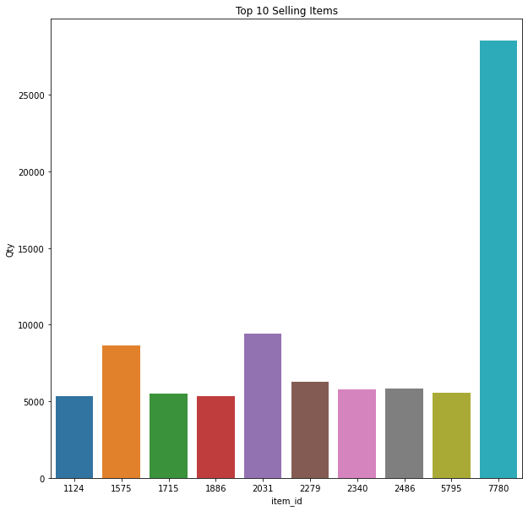
Prototype/ MVP Demo Video/Screenshots
Data visualization graphs as follows:
Fig 1: Top 10 Selling Items

Slide 8
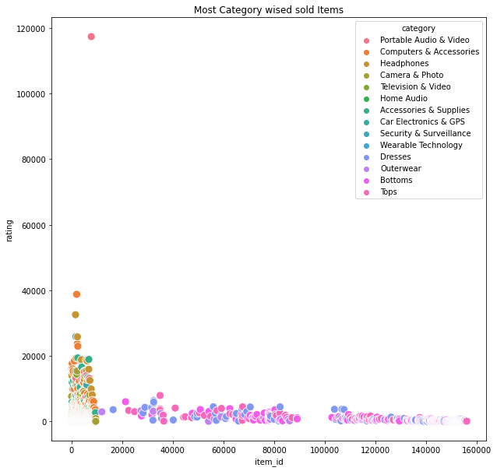
Fig 2: Most Category wised sold Items

Slide 9
Future enhancements
1
Building Website to showcase the recommendations
We can deploy the project on website using Flask /Django Framework
Building Chatbot
2
We can build chatbot internally or by using GCP (Dialogflow) or AWS (Lex) which given conversational experience and gives item & brand recommendations.

Slide 10
Thank You

