Slide 1
MatGraphRAG: An Explainable Graph Based Retrieval Augmented Reasoning System for Intelligent Materials Discovery
Second Review — Phases 1–3: Knowledge Graph Construction, GraphRAG Retrieval & Crystal Structure Encoding
Group – 7
Dhakshin – CB.SC.U4AIE24313
Naga Shiva – CB.SC.U4AIE24315
Rajashree T – CB.SC.U4AIE24346
Sharvesh – CB.SC.U4AIE24355
Amrita School of Artificial Intelligence, Amrita Vishwa Vidyapeetham, Coimbatore
October 23, 2026

Slide 2
Introduction
Materials form the foundation of modern technologies — batteries, semiconductors, solar cells and electronic devices.
Their composition and crystal structure determine the properties that govern performance.
Finding materials with suitable properties is therefore crucial for designing real-world technologies.
The search space is enormous — the Materials Project indexes 154,377 inorganic materials.
Materials, properties, structures and applications are deeply interrelated, yet current tools store them as isolated rows in a table.

Slide 3
Problem Statement
Existing material search tools return raw data or text-similarity matches.
They do not reason about the real relationships between materials, properties, and applications.
Recommendations, when produced, are not traceable to any underlying evidence.
Consequences:
  Researchers must manually cross-reference multiple databases.
  LLM-based answers risk hallucinating unsupported material claims.
  No audit trail from a recommendation back to the source record.
This project builds a materials knowledge graph and a GraphRAG-based retrieval system that answers natural-language queries with explainable, evidence-traceable recommendations.

Slide 4
Objectives
Build (Phase 1): construct a Materials Knowledge Graph from real Materials Project data using deterministic, rule-based classification — fully auditable, zero LLM calls.
Retrieve (Phase 2): implement GraphRAG relationship-aware retrieval — parse a natural-language question into structured constraints and traverse the graph.
Explain (Phase 2): generate recommendations grounded only in retrieved graph evidence — every claim traceable to a specific edge or record.
Encode (Phase 3): integrate CGCNN crystal-structure embeddings for structure-aware retrieval and elemental substitutability.
Scale: migrate to Neo4j and expose the system through a backend API and visualization dashboard.

Slide 5
Literature Review
# | Year | Title | Technique | Inference | Limitations
1 | 2024 | LLaMP: Large Language Model Made Powerful for High Fidelity Materials Knowledge Retrieval | Multi agent LLM system querying trusted scientific databases | Retrieves materials knowledge and generates grounded responses | Document retrieval only; no graph based reasoning
2 | 2024 | HoneyComb: A Flexible LLM Based Agent System for Materials Science | Extensible LLM agent framework integrating scientific tools | Flexible tool-augmented materials research assistant | No explicit knowledge graph; no relationship aware retrieval
3 | 2024 | LLaMat: Foundational Large Language Models for Materials Research | Materials specific foundation model trained on literature | Strong domain specific language understanding | Knowledge is static; no structured graph reasoning
4 | 2024 | From Local to Global: A Graph RAG Approach to Query Focused Summarization | Entity extraction, graph construction, multi hop retrieval | Graph structure improves multi hop reasoning over text | Generic framework; not designed for materials science

Slide 6
Literature Review (Cont.)
# | Year | Title | Technique | Inference | Limitations
5 | 2018 | Crystal Graph Convolutional Neural Networks (CGCNN) | Atoms as nodes, bonds as edges; graph convolution + pooling | Accurate property prediction from crystal structure | Prediction only; no retrieval or reasoning
6 | 2021 | ALIGNN: Atomistic Line Graph Neural Network | Line graph encoding of bond angles | Improved property prediction over CGCNN | No integration with knowledge graphs or RAG
7 | 2013 | The Materials Project: A materials genome approach | Open DFT computed database, 154,377 materials | Large-scale structured property data freely accessible | Raw database; no reasoning or recommendation layer
Ours |  | MatGraphRAG | Materials KG + GraphRAG retrieval + CGCNN embeddings | Explainable, evidence-traceable recommendation | —
Research Gap
No prior system combines a materials knowledge graph, relationship-aware GraphRAG retrieval, and structure-aware CGCNN encoding into a single explainable discovery pipeline.

Slide 7
Research Gap and Novelty
Research Gap:
Material databases make data available, but only as isolated records.
Traditional RAG retrieves by text similarity, not by real relationships.
Knowledge graphs encode relationships but are not connected to LLM reasoning.
CGCNN / ALIGNN use crystal structure, but only for property prediction.
Novelty of This Work:
First system integrating a materials knowledge graph + GraphRAG retrieval + CGCNN structural encoding.
Deterministic construction — rule-based, zero LLM calls, so every node and edge is auditable and reproducible.
Explainability built into the edge itself — each suitable_for edge stores the exact rule text that fired.
Six grouping axes (element, chemical system, symmetry, property bucket, oxidation state, formula pattern) so materials relate even with zero shared elements.

Slide 8
Dataset — Materials Project
Source: Materials Project REST API — computed properties plus human-readable structure descriptions. MP indexes 154,377 materials in total.
Why not the full catalog?
Material–material similarity is quadratic — 154,377 materials means ∼11.9 billion pairs.
An exhaustive pull produces a sparse, disconnected graph; Phase 1’s goal is a densely interconnected one.
Sampling — 8 chemistry-driven clusters: battery cathodes (oxide, phosphate), semiconductors (III–V, II–VI, group IV), binary oxides, perovskite oxides, magnetic spinel oxides. Stability cutoff E_hull ≤ 0.08 eV/atom; radioactive and synthetic elements excluded.
Result: 8 clusters → ∼2,000 raw candidates → 794 unique materials after deduplication by formula.
Properties: band gap, formation energy, energy above hull, density, magnetization and symmetry at 100% coverage; oxidation states 93%; elastic 18%; dielectric 20%.

Slide 9
Methodology — Overview
Proposed System Architecture:
Materials Project API → material properties.
Knowledge graph construction — entities and relationships.
GraphRAG retrieval — relationship-aware multi-hop traversal.
LLM reasoning — grounded generation over retrieved evidence.
Explainable material recommendation — final output.
Three implementation phases:
● Phase 1 — Knowledge Graph Construction
[COMPLETE]
● Phase 2 — GraphRAG Retrieval and Recommendation
[COMPLETE]
● Phase 3 — Crystal Structure Encoding
[COMPLETE]
Notes:
All three phases are complete: the knowledge graph, GraphRAG retrieval with grounded explanations, and crystal structure encoding with the pre-trained CGCNN models wired into material ingestion. The following slides add the architecture diagrams.

Slide 10
Methodology — Overall System Architecture
Data sources
Materials Project API
summary + robocrys
Cached raw JSON
794 records
User input
MP id · formula · CIF
materials.yaml
clusters · buckets · rules
Knowledge graph
Build pipeline
fetch → enrich → write
Cognee DataPoints
identity-keyed nodes
Kuzu + LanceDB
graph + vector stores
BGE-M3 embeddings
local Ollama, 1024-d
Reasoning services
Query parser
LLM + rule fallback
Graph retriever
traverse · filter · rank
Evidence → grounding
cited, checked claims
Material ingestion
MP · formula · CGCNN
Interfaces
FastAPI service
/query · /ingest · /graph
Dashboard
ask · add · structure
Graph explorer
import & match
CLI scripts
build · ask · evaluate
Notes:
The system in four layers, top to bottom: data sources, the knowledge graph, reasoning services, and the interfaces that expose them. Every service reads the same Cognee-managed graph and vector stores.

Slide 11
Methodology — Phase 1 Construction Pipeline
1. FETCH (mp_client.py) — one query per cluster pattern, sorted by stability; deduplicate by formula; cache to data/raw/ for reproducibility.
2. ENRICH (enrich.py) — no LLM: classify band gap / stability / magnetic ordering into buckets, apply application-domain rules, compute similar_to neighbours.
3. WRITE (pipeline.py) — Cognee pipeline writes the graph store and vector store together, deduplicating on each node’s identity key.
4. VERIFY (verify.py) — node/edge counts and structural queries read directly from the graph store; renders an interactive visualization.
Grouping mechanisms (all deterministic):
Buckets: band gap (metal / narrow / semiconductor / wide), stability (stable / metastable / unstable), magnetic ordering.
Domain rules: battery cathode, semiconductor device, photocatalyst, dielectric, magnetic material — each rule’s text stored on the edge.
Categorical fields: oxidation states and formula patterns group directly, no thresholds needed.

Slide 12
Methodology — Phase 1 Architecture
Materials Project API
154,377 inorganic materials
materials.yaml
8 clusters · buckets · rules
1 · FETCH
cluster queries · dedupe by formula
configures
MATERIALS KNOWLEDGE GRAPH
1,504 nodes · 14,686 edges
4 · VERIFY
counts · structural checks
794 cached records
properties + crystal structures
Material 794
FormulaPattern 261
ChemicalSystem 143
OxidationState 131
graph.html
interactive visualization
2 · ENRICH (no LLM)
buckets · domain rules · similar_to
SpaceGroup 106
Element 46
3 · BUILD GRAPH
Cognee pipeline → Kuzu + LanceDB
PropertyClass 11
CrystalSystem 7
Explainability
each suitable_for edge stores the rule text that fired
ApplicationDomain 5
Zero LLM calls · every node and edge reproducible from the local cache
Notes:
The Phase 1 build as a diagram. Materials Project data is fetched per cluster, cached, enriched by deterministic rules and written through Cognee into the knowledge graph, which is then verified and visualised.

Slide 13
Methodology — Graph Schema
Node types — 1,504
Relationship types
Type | Count
Material | 794
FormulaPattern | 261
ChemicalSystem | 143
OxidationState | 131
SpaceGroup | 106
Element | 46
PropertyClass | 11
CrystalSystem | 7
ApplicationDomain | 5
Edge | Properties
contains | —
has_space_group | —
member_of | —
classified_as | —
suitable_for | rule: fired text
similar_to | weight: cosine
crystal_system | —
has_oxidation_state | —
has_formula_pattern | —
Design principle: continuous values stay as attributes; anything used for grouping becomes a node; derived material–material relations become weighted edges. similar_to uses top-5 nearest neighbours by cosine similarity over a 10-dimensional z-scored property vector.

Slide 14
Methodology — Graph Schema Diagram
Chemical system · 143
Oxidation state · 131
Formula pattern · 261
member_of
has_oxidation_state
has_formula_pattern
Element · 46
contains
Material · 794
has_space_group
Space group · 106
crystal_system
classified_as
suitable_for + rule
Crystal system · 7
similar_to (weight)
Property class · 11
Application domain · 5
Material
Notes:
The schema as a graph. Material is the centre; every grouping dimension is a shared hub node, space groups roll up into crystal systems, and similar_to links materials directly with a cosine weight.

Slide 15
Methodology — Phase 2 GraphRAG Pipeline
Q stable, cobalt-free Li cathode materials with a band gap above 2 eV
LLM (JSON schema) → typed constraints; rule-based fallback; values checked against graph vocabulary
battery_cathode · band_gap ≥ 2 · stable · contains Li · no Co
1 Parse
Seed constraint nodes, traverse back to materials, intersect, enforce numeric ranges, rank
39 of 77 reached materials pass every constraint; top: LiScO2
2 Retrieve
Flatten into atomic facts [E1] [E2] …: an MP field or a graph edge with its rule text
[E4] LiScO2 band_gap = 3.904 eV
3 Evidence
LLM writes claims citing fact ids, or a templated explanation without an LLM
“LiScO2 is a stable cathode candidate … [E4]”
4 Explain
Checker: ids exist, every number matches a cited fact, no unretrieved materials
69 / 69 claims grounded (100%)
5 Ground
The LLM never selects or filters materials. Numeric limits, exclusions and rules are enforced exactly on graph attributes and edges.
Notes:
Phase 2: the LLM only parses the question and phrases the explanation. Retrieval enforces every constraint exactly; evidence becomes numbered facts; a deterministic checker verifies every citation and number.

Slide 16
Methodology — New Material Ingestion
1
Input
2
Property source
3
Deduplicate
4
Build nodes
MP id, formula, CIF or POSCAR
dashboard, API or CLI
MP record → mp
formula → derived
CGCNN → predicted ± error
formula → MP node
StructureMatcher
else new struct-… id
same NodeFactory
identity keys reuse hubs
only missing hubs added
5
Relate
6
Relation report
7
Explain & ground
8
Preview / persist
hubs by selectivity
similar_to (frozen scale)
compositional neighbours
properties + provenance
rules fired / not fired / cannot evaluate
LLM or template
claims checked against facts
in-memory overlay
or saved, replayed on rebuild
Provenance:
mp
derived
guessed
predicted
Predicted facts are hedged in explanations and drawn dashed.
CGCNN (pre-trained, txie-93) supplies properties only when the input is a bare crystal structure.
Notes:
How a new material is added. The property source depends on the input and every value keeps its provenance. Deduplication resolves to existing nodes where possible. The same NodeFactory as the full build attaches the material to existing hubs, then relating, reporting, explanation and grounding follow; the result is previewed or persisted.

Slide 17



Methodology — How a New Material Connects
contains → Element
has_space_group
Related materials
Hubs are reused
similar_to · property cosine
Identity keys attach LiTaO3 to existing nodes; only Li-O-Ta is new.
Ta · shared with 51
Li · shared with 245
O · shared with 758
R3c (#161) · 2
→ Trigonal
Ba3Hf2O7 | 0.976
SrTa4O11 | 0.967
Na2Ta4O11 | 0.956
K2Ta4O11 | 0.954
Ba4Hf3O10 | 0.953
has_oxidation_state
Ranked by selectivity
LiTaO3
new · from MP
Sharing R3c (2 materials) says more than sharing O (758).
Ta⁵⁺ · shared with 38
Li⁺ · shared with 227
O²⁻ · shared with 697
compositional neighbours
Ta3O8 | 0.953
NaTa7O19 | 0.952
Ta2O5 | 0.952
Related materials
classified_as / suitable_for
pattern / chem. system
Top-5 similar_to on the build-time scale, plus nearest compositions.
wide_gap · 145
stable · 366
dielectric · 220
(rule fired)
ABC3 · shared with 45
Li-O-Ta · new node
Notes:
Worked example from the running system: LiTaO3 is not in the graph, so it is fetched from Materials Project and related. It attaches to existing hubs, ranked by how few materials share them; the only new node is its chemical system. Related materials come from similar_to on the frozen build-time scale and from composition.

Slide 18
Results — Verified Graph Statistics
Edges — 14,686 total
Application domains
Relationship | Count
similar_to | 3,969
has_oxidation_state | 2,319
contains | 2,269
classified_as | 2,135
suitable_for | 1,506
has_formula_pattern | 794
has_space_group | 794
member_of | 794
crystal_system | 106
Domain | Materials
semiconductor_device | 474
magnetic_material | 328
photocatalyst | 249
battery_cathode | 237
dielectric | 218
Total | 1,506
Counts read directly out of the graph store on every build — not estimated. Domain totals match the suitable_for edge count exactly; a material can belong to more than one domain, and each edge stores the rule that qualified it.

Slide 19
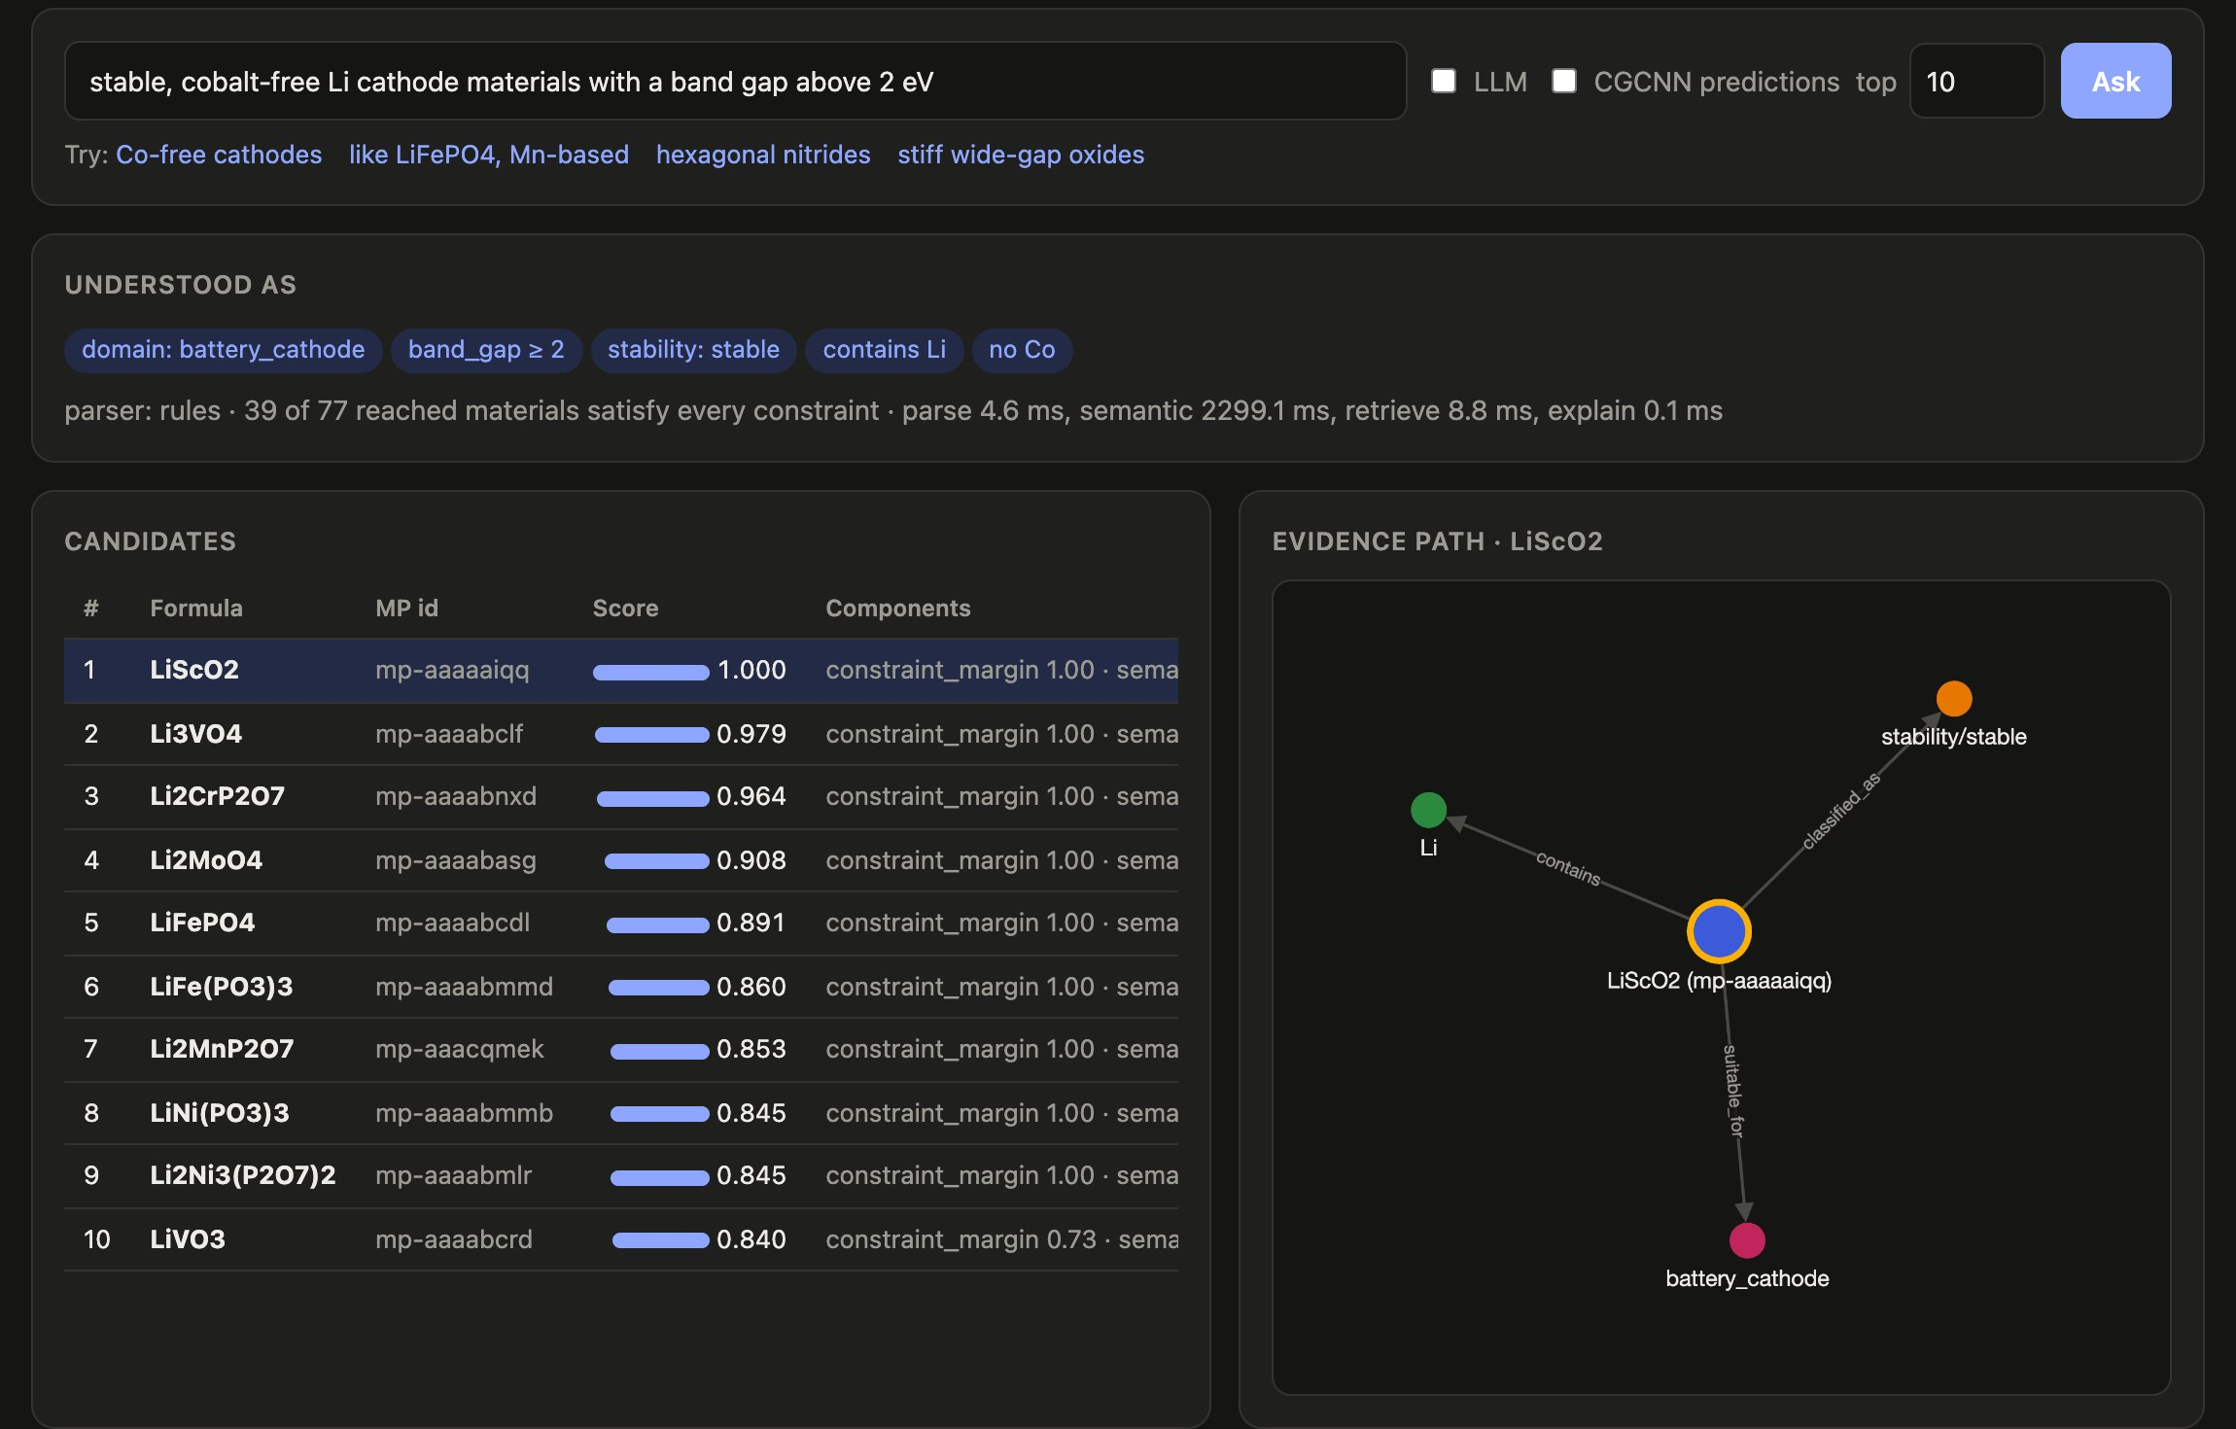
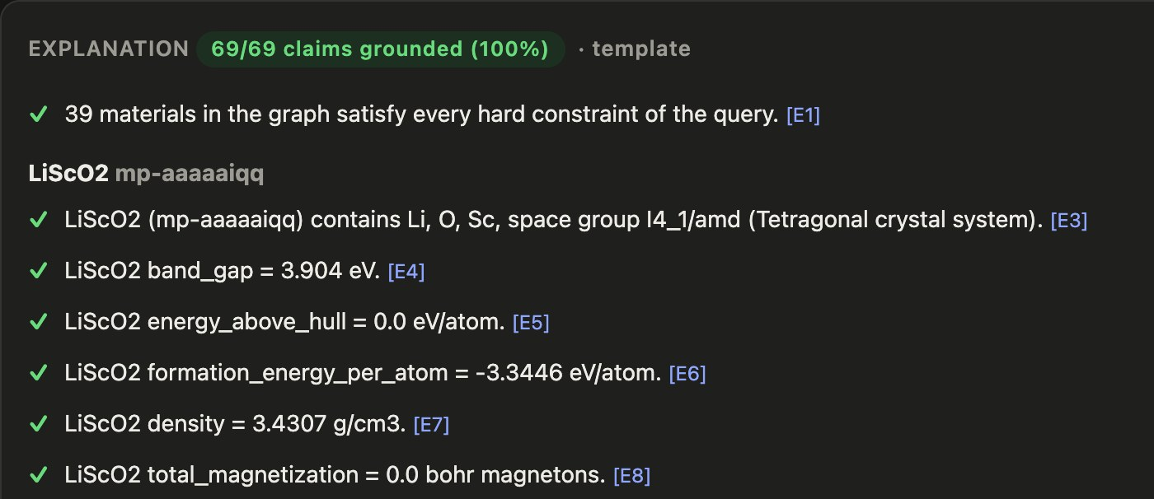
Results — Demo: Asking a Question
1
Understood as: parsed constraints, including “no Co”.
2
Candidates: ranked with a score breakdown.
3
Evidence path: the graph edges behind the top result.
4
Grounded explanation: every claim cites a fact id; the checker verified 69 / 69 claims.
Captured with the rule-based parser and templated explanation (LLM off); retrieval and grounding are the same path.

Slide 20
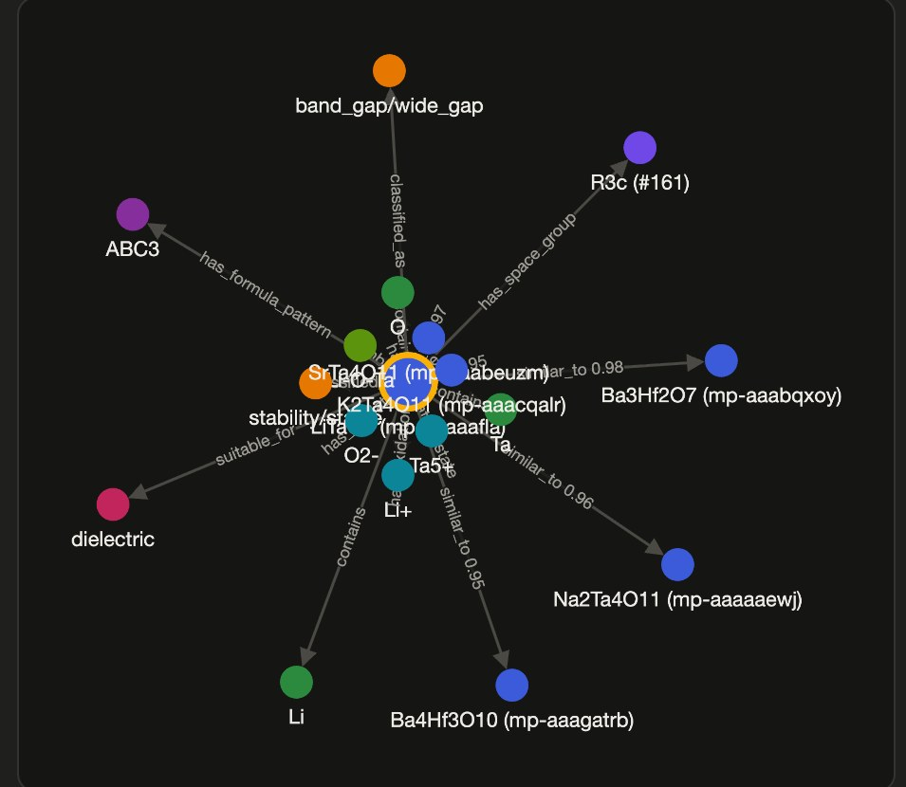
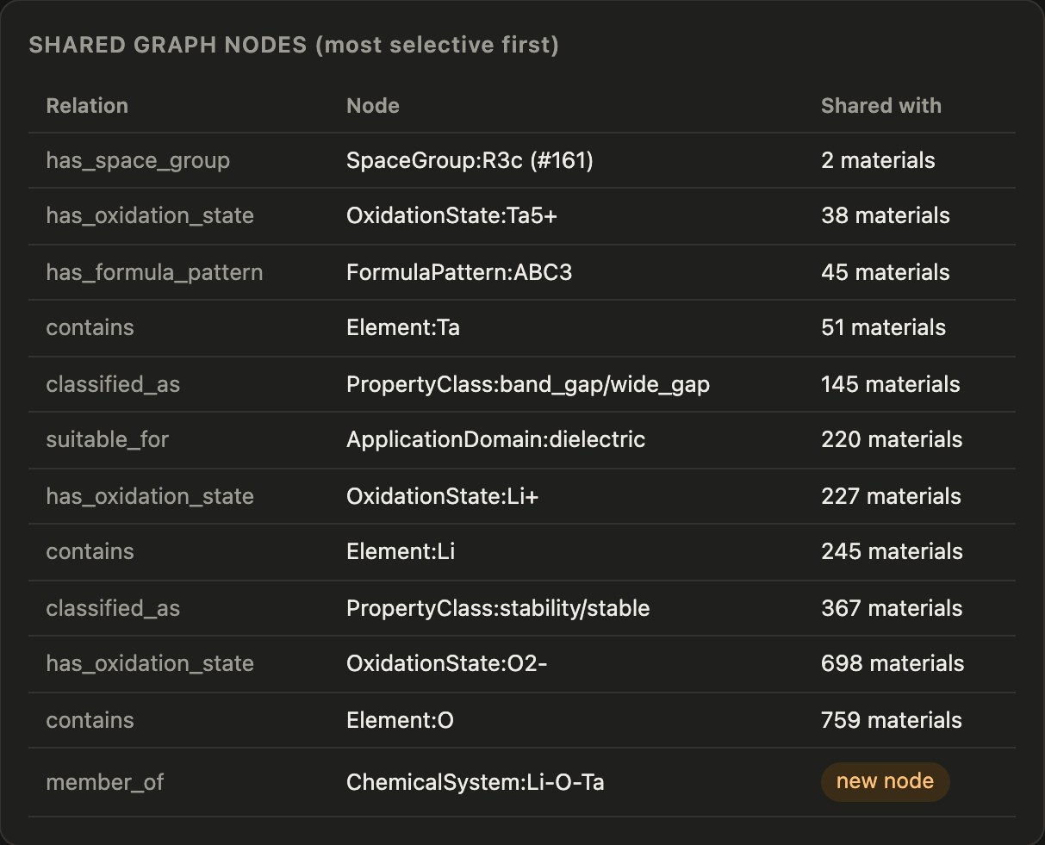
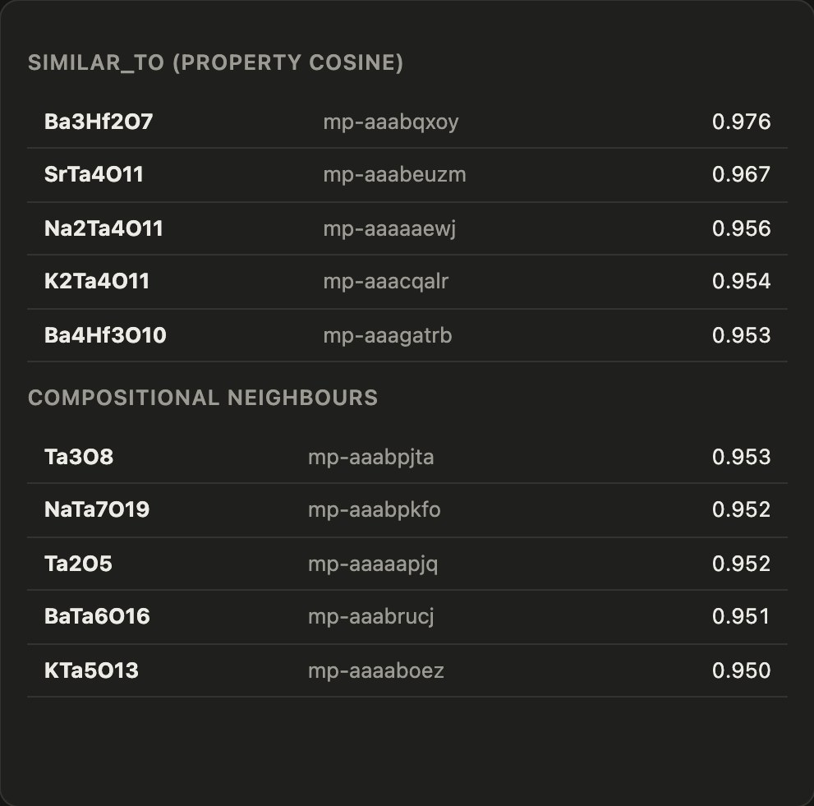
Results — Demo: Adding a New Material
1
How it connects: LiTaO3 fetched from Materials Project and previewed in memory until saved.
2
Shared graph nodes: most selective first; ChemicalSystem Li-O-Ta is the only new node.
3
Related materials: similar_to by property cosine, plus compositional neighbours.

Slide 21
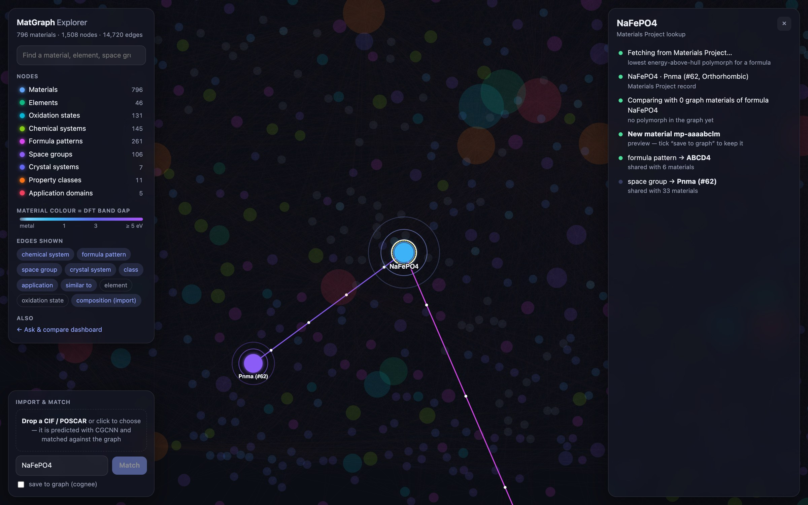
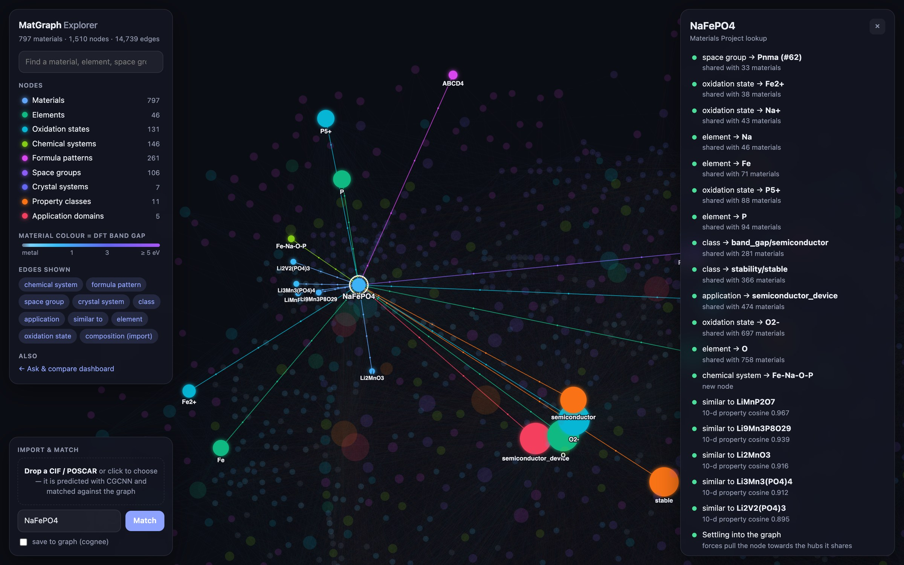
Results — Demo: Graph Explorer Import & Match
≈ 5 s — wiring to hubs
≈ 20 s — settled into the graph
1
Look up
2
Match
NaFePO4 fetched from Materials Project (a CIF would be predicted with CGCNN).
Compared with same-formula materials: no polymorph in the graph yet.
3
Wire
4
Settle
New node linked to each shared hub, rarest first: ABCD4 (6) … O (760).
similar_to neighbours added; forces pull the node into place.

Slide 22
Conclusion and Future Work
Achieved:
794-material knowledge graph with 14,686 edges, built with zero LLM calls.
Every claim in an explanation cited and machine-checked.
New materials connect through shared hubs and similar_to edges.
Crystal structure encoding: pre-trained CGCNN predicts properties for uploaded CIF / POSCAR files, added to the graph as labelled predictions.
Future work:
Element substitution (substitutable_with).
Neo4j migration (a configuration swap) and a Next.js frontend with CI/CD.

Slide 23

References
Y. Chiang, et al., “LLaMP: Large Language Model Made Powerful for High-Fidelity Materials Knowledge Retrieval and Distillation,” 2024.
H. Zhang, et al., “HoneyComb: A Flexible LLM-Based Agent System for Materials Science,” 2024.
V. Mishra, et al., “LLaMat: Foundational Large Language Models for Materials Research,” 2024.
D. Edge, et al., “From Local to Global: A Graph RAG Approach to Query-Focused Summarization,” Microsoft Research, 2024.
T. Xie and J. C. Grossman, “Crystal Graph Convolutional Neural Networks for an Accurate and Interpretable Prediction of Material Properties,” Phys. Rev. Lett., vol. 120, 145301, 2018.
K. Choudhary and B. DeCost, “Atomistic Line Graph Neural Network for improved materials property predictions,” npj Comput. Mater., vol. 7, 185, 2021.
A. Jain, et al., “The Materials Project: A materials genome approach to accelerating materials innovation,” APL Materials, vol. 1, no. 1, 011002, 2013.
S. P. Ong, et al., “Python Materials Genomics (pymatgen),” Comput. Mater. Sci., vol. 68, pp. 314–319, 2013.

