Slide 1
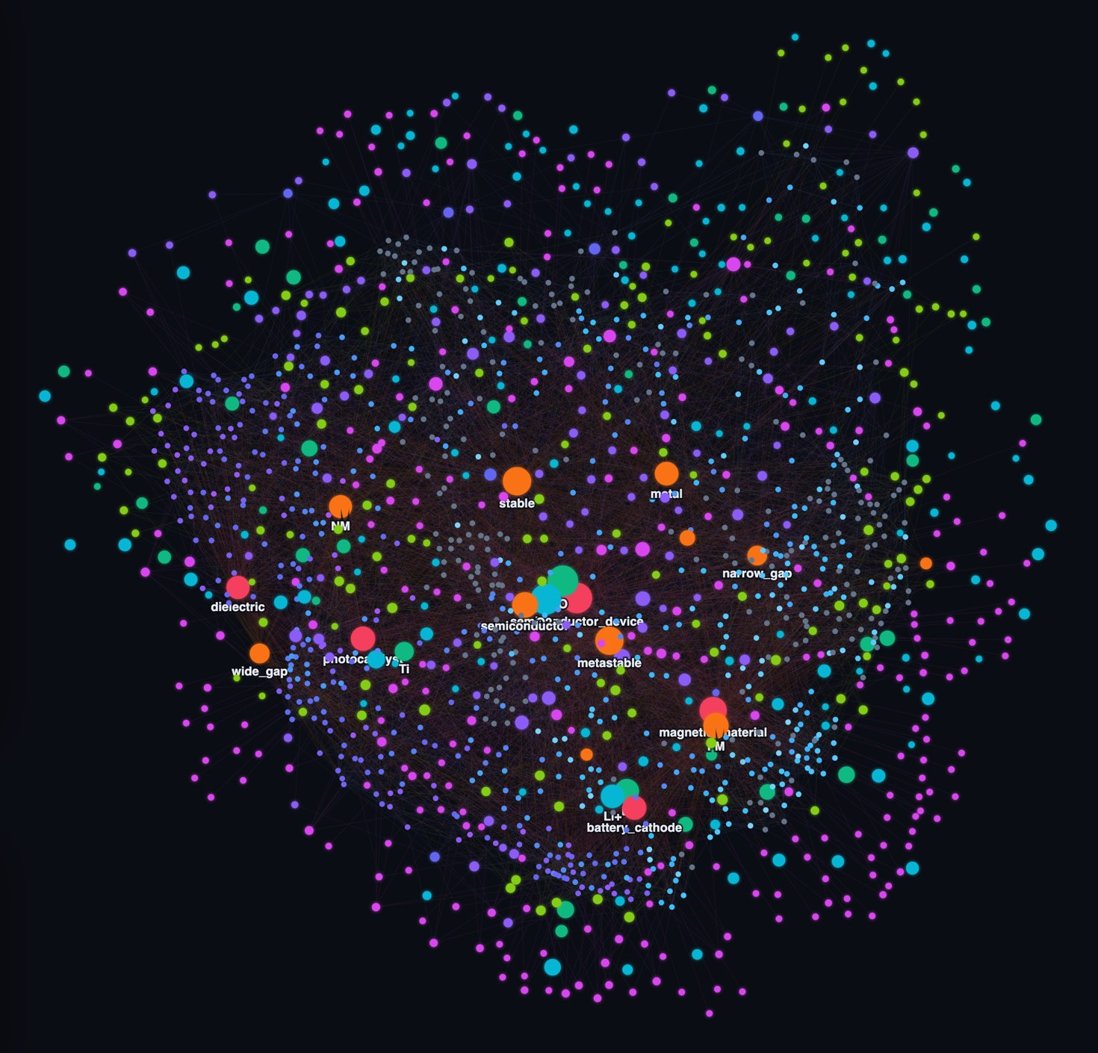
MatGraphRAG
An explainable graph-based retrieval-augmented reasoning system for intelligent materials discovery
[Your name] · [Register / roll number]
Guide: [Name, designation]
[Department, institution]
[Review / event] · [Date]
Notes:
Introduce MatGraphRAG: a knowledge graph built from Materials Project data, with graph-based retrieval and evidence-backed explanations on top. The image on the right is the live graph explorer showing all 794 materials and their shared hub nodes.

Slide 2





Materials data is searchable, not reasoned over
PROBLEM STATEMENT
“Find stable, cobalt-free Li cathode materials with a band gap above 2 eV”
…and show exactly why each one qualifies. Today no tool answers this exactly, explains it, and lets you verify it.
Flat records
Look-alikes, not answers
Untraceable LLM answers
New materials in isolation
Materials Project indexes 154,377 materials as isolated rows. Shared elements, structure families and ionic chemistry stay implicit.
Vector RAG ranks by text similarity: 69.6% of its top-10 results violate the query’s hard constraints.
Generated recommendations can invent values, and a researcher cannot tell which claim came from where.
A new formula or crystal structure has no context: what is it related to, and why?
Notes:
The core problem. Materials databases are large but flat. Similarity search returns look-alikes rather than materials that satisfy numeric constraints (69.6% violations for vector RAG on our benchmark). Plain LLM answers are not traceable. And a new material cannot be placed in the context of known ones.

Slide 3
Four objectives
OBJECTIVES
1
Build a materials knowledge graph
2
Answer questions by graph retrieval
From Materials Project data, with deterministic rules and no LLM, reproducible from a local cache.
Turn natural language into typed constraints, then enforce numeric ranges and exclusions exactly on the graph.
3
Explain with verified evidence
4
Connect new materials
Every claim cites a graph edge or a Materials Project record, and a deterministic checker verifies each citation.
Add a material by MP id, formula or crystal structure and link it to its related materials and elements.
Notes:
Four objectives: construct the graph deterministically; retrieve by traversal with exact filtering; explain with citations that a checker verifies; and connect new materials — by Materials Project id, formula, or crystal structure — to the existing graph.

Slide 4
Why existing retrieval falls short
BACKGROUND
Capability | Vector RAG | Fixed-hop GraphRAG | MatGraphRAG
Exact numeric constraints (band gap ≥ 2 eV) | ✗ | ✗ | ✓
Exclusions (no cobalt) | ✗ | ✗ | ✓
Multi-hop relations through shared entities | ✗ | ✓ | ✓
Claims cited and checked against the data | ✗ | ✗ | ✓
New materials placed in the graph | ✗ | ✗ | ✓
Crystal-structure input | ✗ | ✗ | ✓
Vector RAG: embeddings over material profiles. Fixed-hop GraphRAG: entity seeds plus one-hop expansion, no attribute filtering. Results on slide 13.
Notes:
Two common baselines. Vector RAG finds text that looks similar but cannot enforce 'band gap above 2 eV' or 'no cobalt'. Fixed-hop GraphRAG reaches the right entities but also cannot apply numeric ranges or exclusions. Neither verifies its claims or places new materials.

Slide 5
794 materials from eight chemistry-driven clusters
DATASET
154,377
materials in Materials Project
Clusters
Li–TM oxides
layered / spinel battery cathodes
Li–TM phosphates
olivine battery cathodes
8 clusters
declarative queries in materials.yaml
III–V semiconductors
{B, Al, Ga, In} × {N, P, As, Sb}
II–VI semiconductors
{Zn, Cd, Hg} × {O, S, Se, Te}
~2,000
raw candidates, sorted by stability
Group IV semiconductors
Si, Ge, C, Sn and binaries
Binary oxides
wide-gap and functional oxides
794
unique materials after deduplication
ABO₃ perovskites
dielectric / ferroelectric
AB₂O₄ spinels
magnetic oxides
Property coverage
100%
core properties
93.1%
oxidation states
19.9%
dielectric data
18.0%
elastic data
Notes:
Using all 154k materials would make pairwise similarity intractable and produce a sparse graph, so the dataset is assembled from eight chemistry-driven clusters defined in config/materials.yaml. Results are deduplicated by formula across clusters, keeping the most stable polymorph: about 2,000 candidates become 794 unique materials. Core properties cover all of them; elastic and dielectric data cover under 20%.

Slide 6
System architecture
ARCHITECTURE
Data sources
Knowledge graph
Reasoning services
Interfaces
Materials Project API
summary + robocrys endpoints
Build pipeline
fetch → enrich (rules) → write → verify
Query parser
LLM (OpenRouter) + rule fallback
FastAPI service
/query · /materials/ingest · /graph
Cached raw JSON
794 records, reproducible builds
Cognee DataPoints
identity-keyed nodes and edges
Graph retriever
traverse, filter exactly, rank
Dashboard
ask, add material, from structure
User input
MP id · formula · CIF / POSCAR
Kuzu + LanceDB
graph store and vector store
Evidence → explain → ground
cited claims, checked
Graph explorer
animated import & match
BGE-M3 embeddings
local Ollama, 1024-d
Material ingestion
MP · composition · pretrained CGCNN
CLI scripts
build, ask, add, evaluate
Notes:
Four layers. Data comes from the Materials Project API and is cached as raw JSON; users can also supply MP ids, formulas or crystal structures. The knowledge graph layer builds and stores the graph with Cognee over Kuzu and LanceDB, with BGE-M3 embeddings from a local Ollama. Reasoning services parse questions, retrieve and rank, build evidence, explain and ground; the ingestion service adds new materials, using a pretrained CGCNN when only a structure is given. Everything is exposed through FastAPI, a dashboard, a graph explorer and CLI scripts.

Slide 7



Graph schema: 9 node types, 9 edge types
KNOWLEDGE GRAPH
Chemical system · 143
Oxidation state · 131
Formula pattern · 261
Design principle
Values stay attributes
member_of
has_oxidation_state
has_formula_pattern
Exact band gap, density and moduli live on the Material node, for filtering.
Element · 46
contains
Material · 794
has_space_group
Space group · 106
Groups become nodes
Anything used to group or traverse (element, space group, class…) is a shared hub.
crystal_system
suitable_for + rule
Crystal system · 7
classified_as
Relations carry evidence
similar_to (weight)
similar_to keeps its cosine weight; suitable_for keeps the rule text that fired.
Property class · 11
Application domain · 5
Material
Notes:
Material is the centre of the schema. Continuous values stay as attributes on the Material node so they can be filtered exactly. Anything used for grouping becomes a shared hub node with an identity key — element, oxidation state, chemical system, formula pattern, space group and crystal system, property class and application domain. Material-to-material similarity is a weighted edge, and suitable_for edges store the rule text that fired.

Slide 8
Construction pipeline: deterministic, no LLM
CONSTRUCTION
1
Fetch
2
Enrich
3
Write
4
Verify
mp_client.py
enrich.py
pipeline.py
verify.py
One query per cluster sub-pattern
Dedupe by formula across clusters
Batch-fetch robocrys text
Bucket band gap, stability, magnetism
Fire domain rules, keep the rule text
Top-5 similar_to on a 10-d z-scored vector
Cognee DataPoint pipeline
Identity keys dedupe shared hubs
Graph and vectors written together
Node and edge counts vs manifest
Every material has a contains edge
Distinct vector collections per field
0 LLM calls
1,504 nodes
14,686 edges
794 cached JSON records
Notes:
Four stages. Fetching is separate and cached, because it is the slow, rate-limited part. Enrichment applies deterministic rules: band-gap and stability buckets, application-domain rules that keep their rule text, and top-5 similarity on a z-scored 10-dimensional property vector. Cognee writes graph and vectors in one pass, deduplicating hubs by identity key. Verification checks counts and structure on every build. No LLM is involved anywhere.

Slide 9
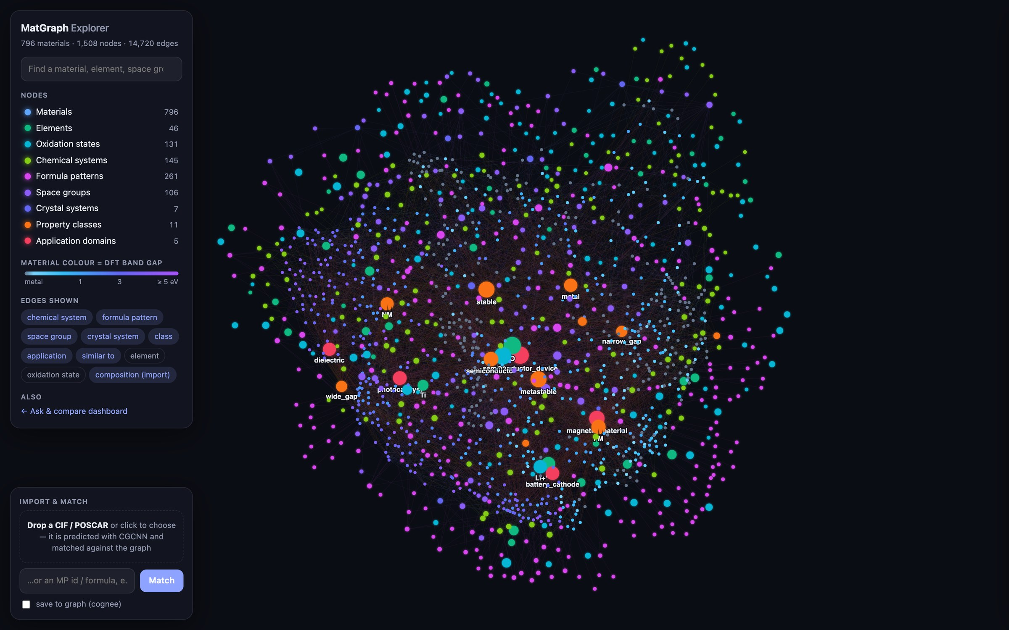
Shared hubs make the graph dense
CONNECTIVITY
95%
of materials contain oxygen — any two oxides are two hops apart
87%
share the O²⁻ oxidation state; Li⁺ alone links 227 materials
44
materials share the ABC3 pattern with no element in common
3,969
weighted similar_to edges: top-5 neighbours, cosine ≥ 0.6
Live graph explorer (/explorer): node colour = type; material colour = DFT band gap
Notes:
Because hubs are shared, the graph connects far more than the material count suggests. Oxygen links 95% of materials; the O2- oxidation state links 87%. Formula patterns group by stoichiometric shape, so BaTiO3 and CaHfO3 are neighbours via ABC3 without sharing an element. On top of that, similar_to edges add weighted shortcuts between materials with similar property profiles. No material is an isolated island.

Slide 10
GraphRAG pipeline: question to grounded answer
RETRIEVAL
Q stable, cobalt-free Li cathode materials with a band gap above 2 eV
1 Parse
2 Retrieve
3 Evidence
4 Explain
5 Ground
LLM with JSON-schema output → typed constraints; rule-based fallback; values checked against graph vocabulary.
Seed constraint nodes, traverse back to materials, intersect, enforce numeric ranges, then rank.
Flatten into atomic facts [E1] [E2] …: an MP field or a graph edge with its rule text.
LLM writes claims that cite fact ids, or a templated explanation without an LLM.
Checker: ids exist, every number matches a cited fact, no unretrieved materials.
battery_cathode · band_gap ≥ 2 · stable · contains Li · no Co
39 of 77 reached materials pass every constraint; top: LiScO2
[E4] LiScO2 band_gap = 3.904 eV
“LiScO2 is a stable cathode candidate … [E4][E15]”
69 / 69 claims grounded (100%)
The LLM never selects or filters materials. Numeric limits, exclusions and rules are enforced exactly on graph attributes and edges.
Notes:
Five steps. The LLM only parses the question into typed constraints and phrases the explanation. Retrieval seeds the constraint nodes, traverses back to materials and enforces every numeric limit and exclusion exactly; ranking combines constraint margin, anchor proximity, BGE-M3 semantic similarity and stability. Evidence becomes numbered atomic facts, the explanation cites them, and a deterministic checker verifies every citation and every number. For this query 69 of 69 claims were grounded.

Slide 11
Adding a new material: ingestion architecture
INGESTION
1
Input
2
Property source
3
Deduplicate
4
Build nodes
MP id, formula, CIF or POSCAR
dashboard, API or CLI
MP record → mp
formula only → derived
CGCNN → predicted ± error
formula → existing MP node
structure → StructureMatcher
no match → new struct-… id
same NodeFactory as the build
identity keys reuse hubs
creates only missing hubs
5
Relate
6
Relation report
7
Explain & ground
8
Preview or persist
hubs ranked by selectivity
similar_to, frozen z-scale
compositional neighbours
properties with provenance
rules fired / not fired / cannot evaluate
LLM or templated text
each claim checked against facts
in-memory overlay, queryable
or saved, replayed on rebuild
Provenance labels
mp
derived
guessed
predicted
Predicted facts are hedged in explanations and drawn dashed.
Notes:
A new material can arrive as a Materials Project id, a formula or a crystal structure. The property source depends on the input: the MP record, only what the formula determines, or a pretrained CGCNN for a bare structure, each labelled with its provenance. Deduplication resolves formulas to existing MP nodes and uses StructureMatcher for structures. The same NodeFactory as the full build creates the nodes, so identity keys attach the material to existing hubs. Relating ranks the shared hubs, finds similar_to and compositional neighbours and evaluates the application rules. The report can be explained and grounded, and the material is either previewed in memory or persisted and replayed on rebuild.

Slide 12



How a new material connects: LiTaO3
INGESTION
contains → Element
has_space_group
Related materials
Hubs are reused
Ta · shared with 51
Li · shared with 245
O · shared with 758
R3c (#161) · 2
→ Trigonal system
similar_to · property cosine
Identity keys attach LiTaO3 to existing nodes; only Li-O-Ta is created.
Ba3Hf2O7 | 0.976
SrTa4O11 | 0.967
Na2Ta4O11 | 0.956
K2Ta4O11 | 0.954
Ba4Hf3O10 | 0.953
Ranked by selectivity
has_oxidation_state
LiTaO3
new · from MP
Ta⁵⁺ · shared with 38
Li⁺ · shared with 227
O²⁻ · shared with 697
Sharing R3c (2 materials) says more than sharing O (758).
compositional neighbours
Ta3O8 | 0.953
NaTa7O19 | 0.952
Ta2O5 | 0.952
Related materials
classified_as / suitable_for
pattern / chem. system
wide_gap · 145
stable · 366
dielectric · 220 (rule fired)
ABC3 · shared with 45
Li-O-Ta · new node
Top-5 similar_to on the build-time scale, plus the nearest compositions.
Notes:
A worked example from the live system: LiTaO3 is not in the graph, so it is fetched from Materials Project and related. It attaches to existing element, oxidation-state, space-group and formula-pattern hubs; the only new node is its chemical system Li-O-Ta. Hubs are ranked by selectivity: R3c is shared with only 2 materials, oxygen with 758. Its dielectric rule fires (band gap 3.7 eV, non-magnetic). Related materials come from two sources: similar_to edges using the frozen build-time property scale, and compositional neighbours.

Slide 13
Retrieval results: exact answers, zero violations
RESULTS
0.910
nDCG@10, vs 0.308 for vector RAG and 0.598 for fixed-hop GraphRAG
0%
top-10 constraint violations, vs 69.6% and 41.8%
1.000
nDCG@10 on single, multi-constraint, multi-hop and sparse-data tiers
Benchmark: 55 questions in 5 tiers. Relevance comes from an independent oracle over the raw Materials Project JSON, which imports nothing from the graph build or the retriever.
Notes:
Evaluated on 55 questions in five tiers, with relevance computed by an independent oracle over the raw Materials Project JSON. With correct constraints, graph retrieval matches the oracle exactly on four of five tiers. nDCG@10 is 0.910 against 0.308 for vector RAG and 0.598 for fixed-hop GraphRAG, and none of our top-10 results violates a constraint, against 69.6% and 41.8% for the baselines.

Slide 14
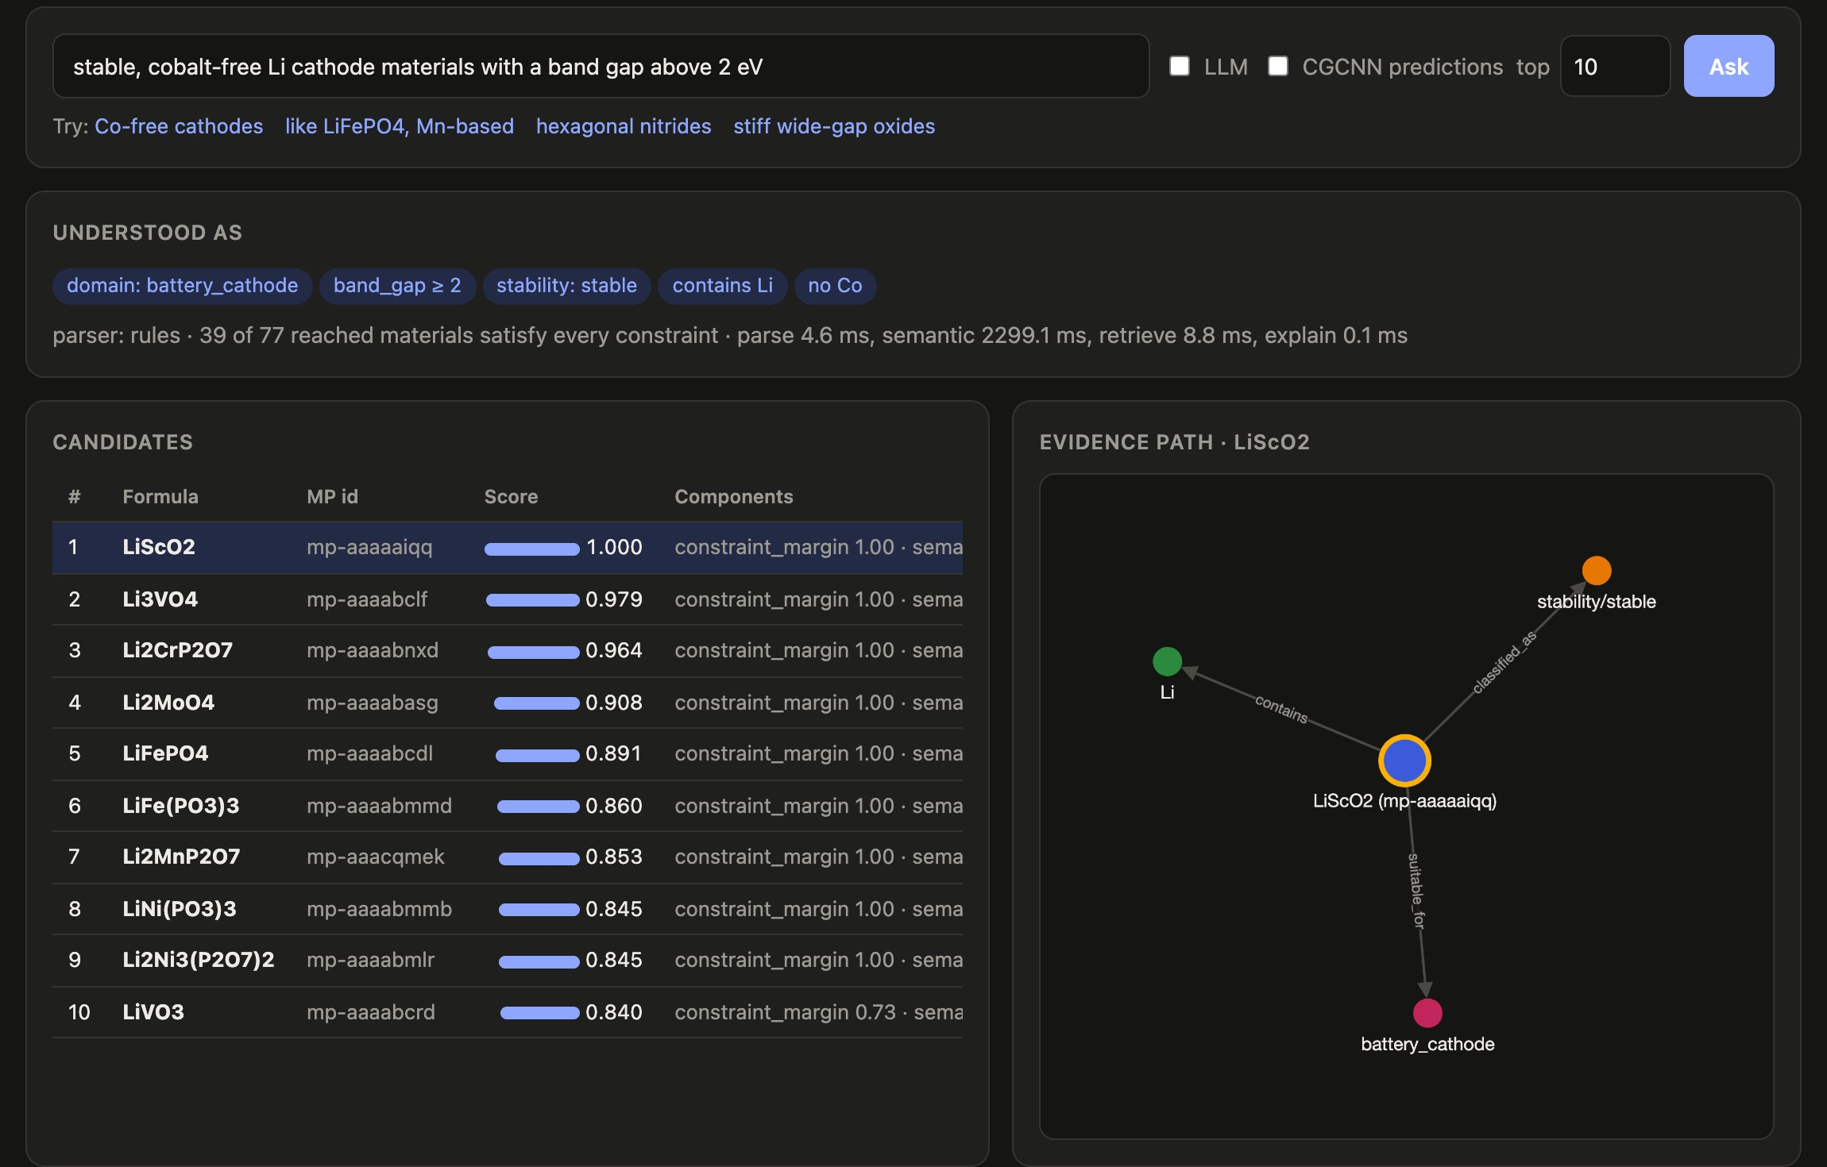
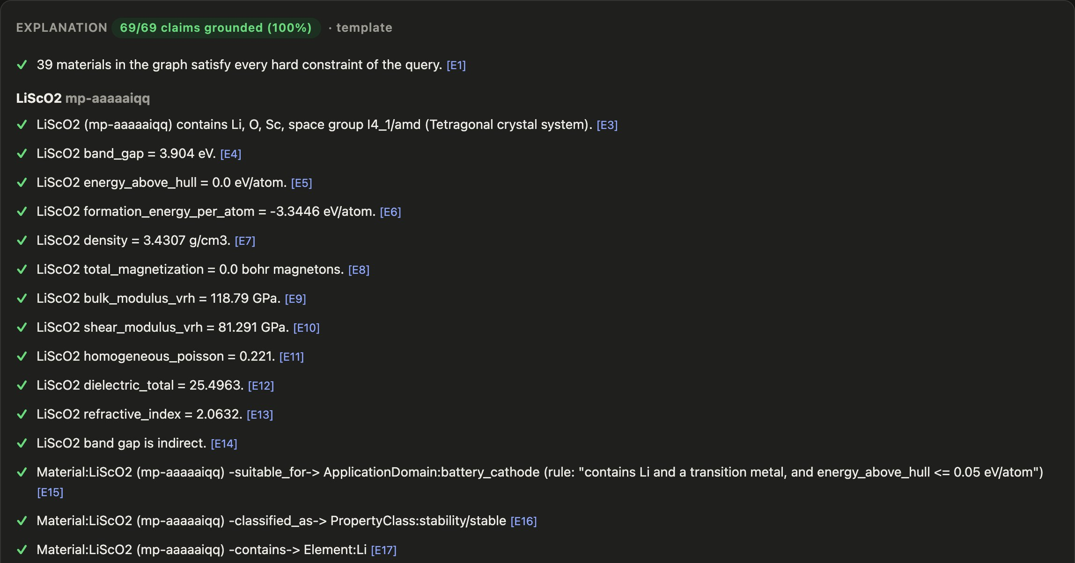
Demo: asking a question
DEMO
1
Understood as chips show the parsed constraints, including “no Co”.
2
Ranked candidates with a score breakdown and the evidence path of the selected one.
3
Grounded explanation every claim cites a fact id: 69 / 69 grounded.
Notes:
The dashboard answering the cathode question. The parsed constraints are shown as chips, candidates are ranked with their score components, and the evidence path for the selected material is drawn as a small graph. The explanation lists each claim with a tick when the checker grounds it. This capture used the rule-based parser and templated explanation (LLM switched off), which take the same path through retrieval and grounding.

Slide 15
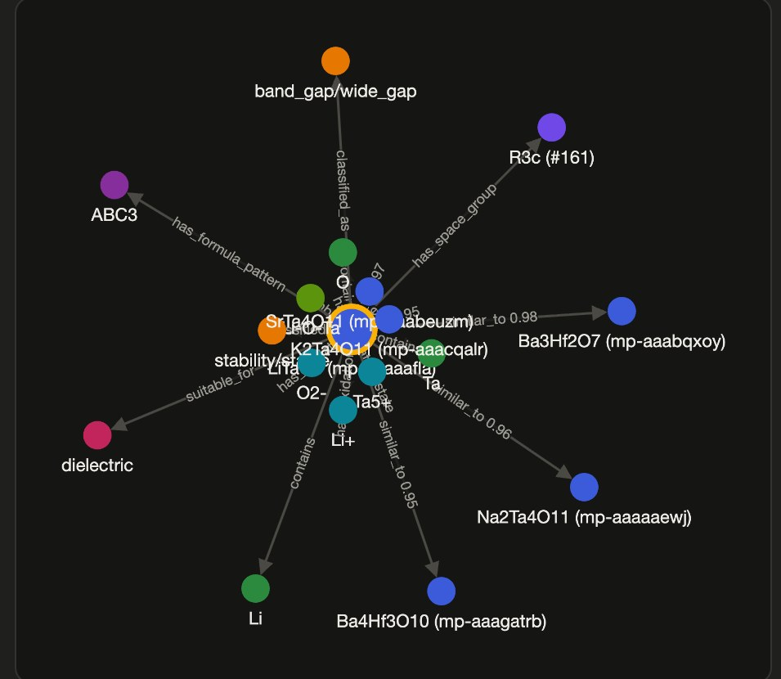
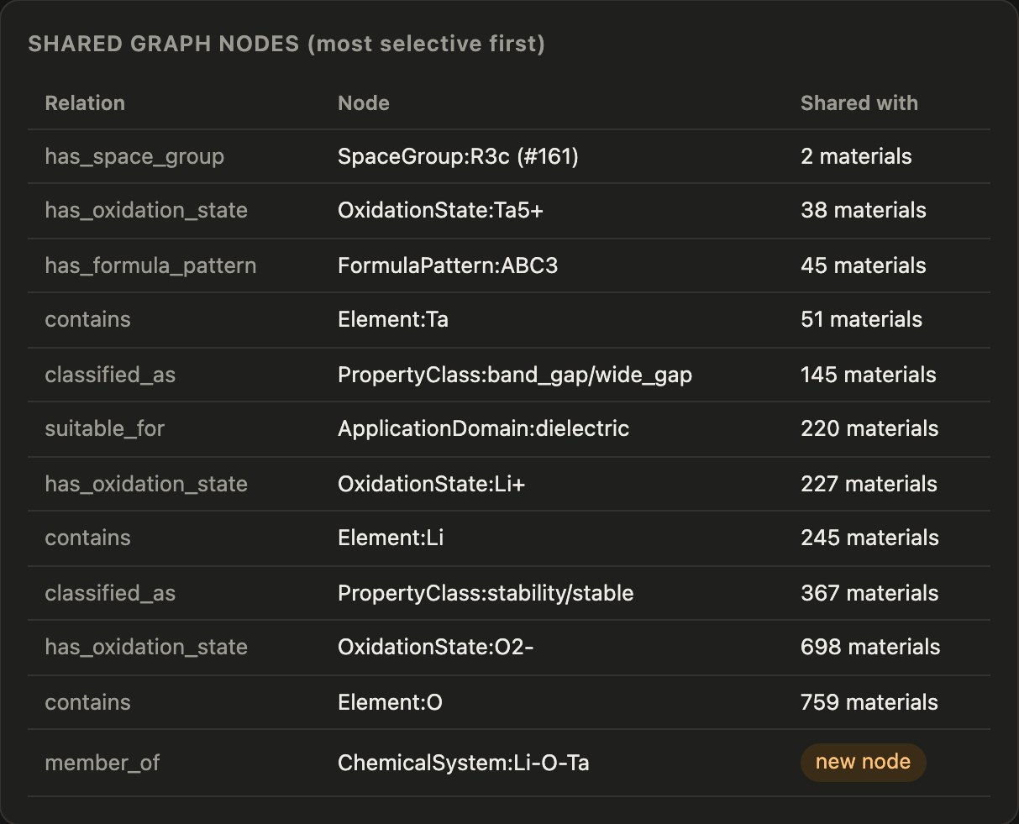
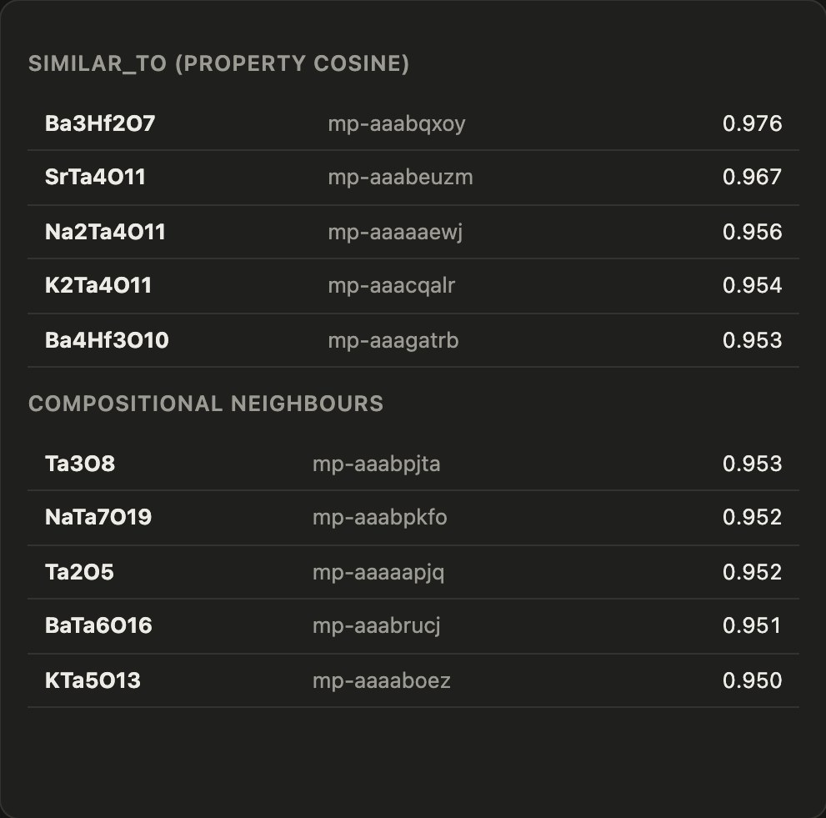
Demo: adding LiTaO3 to the graph
DEMO
1
How it connects
2
Shared graph nodes
3
Related materials
Fetched from Materials Project and previewed in memory until saved.
Most selective first; ChemicalSystem Li-O-Ta is the only new node.
similar_to by property cosine, plus compositional neighbours.
Notes:
The Add material tab with LiTaO3. The left panel draws how the material connects: elements, oxidation states, space group, formula pattern, classes, the dielectric domain and its five most similar materials. The tables list the shared nodes ranked by selectivity and the related materials with their scores. Nothing is saved unless 'save to graph' is ticked.

Slide 16
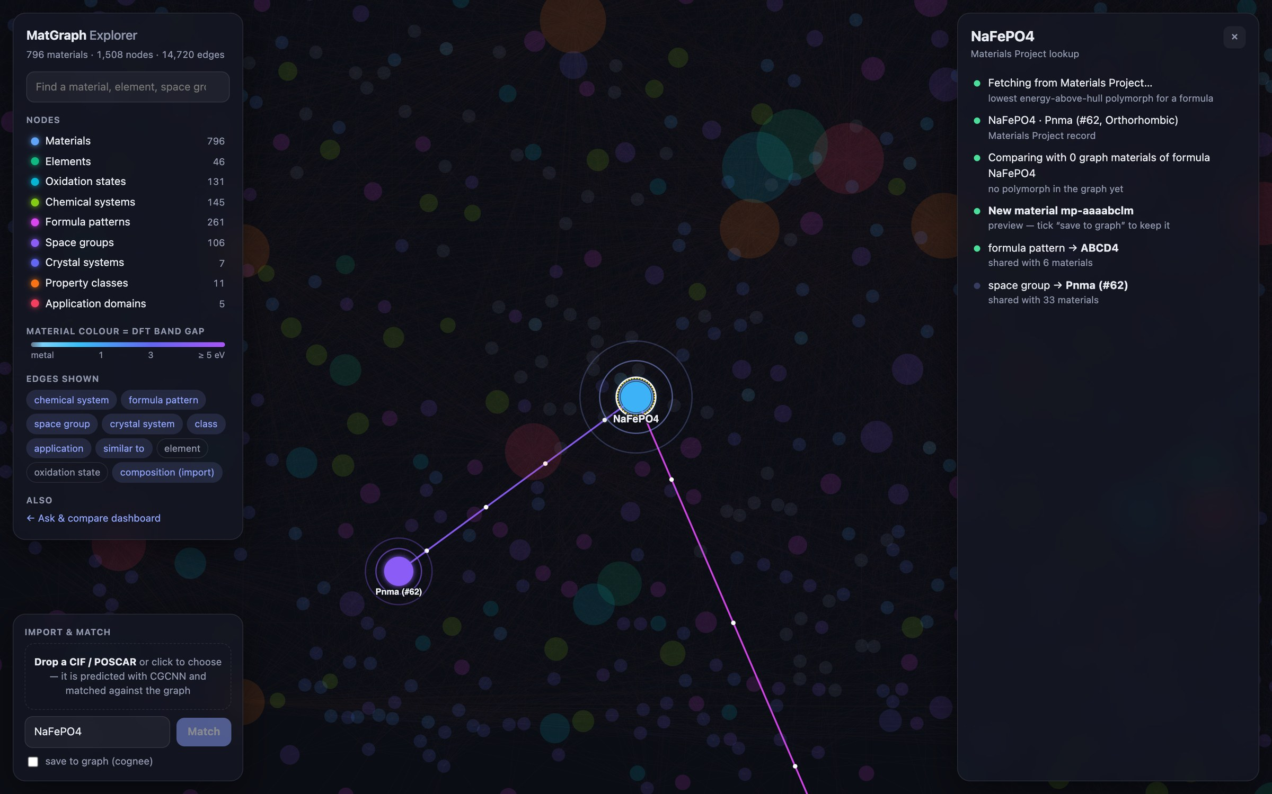
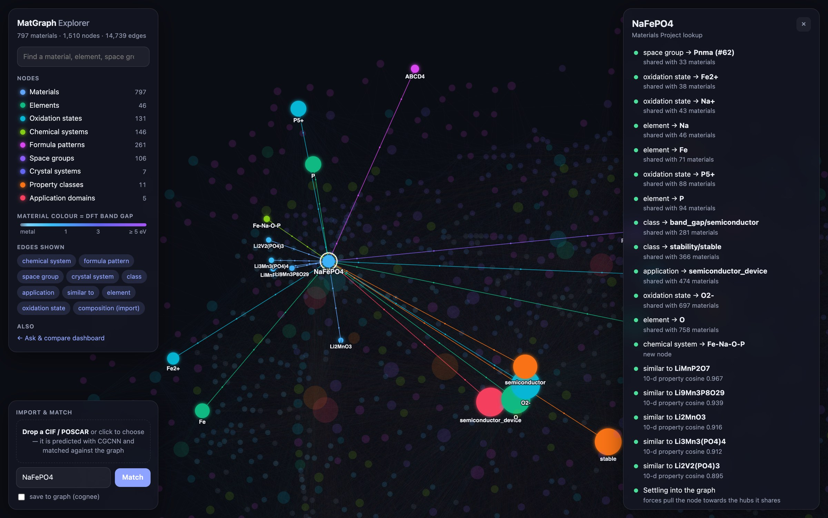
Demo: import & match in the graph explorer
DEMO
≈ 5 s · wiring
≈ 20 s · settled
1
Look up
2
Match
3
Wire
4
Settle
NaFePO4 fetched from MP (a CIF would be predicted with CGCNN).
Compared with same-formula materials: no polymorph in the graph.
New node linked to each shared hub, rarest first: ABCD4 (6) → O (760).
similar_to neighbours added; forces pull the node into place.
Notes:
The graph explorer animates the same ingestion. Here NaFePO4, which is not in the graph, is looked up in Materials Project and compared with same-formula materials. No polymorph matches, so a new node spawns and is wired to each shared hub in turn, most selective first, with similar_to neighbours last; the force layout then pulls it into place. Ticking 'save to graph' persists it through Cognee.

Slide 17
Conclusion and next steps
Delivered
Limitations
Next steps
794-material knowledge graph, 14,686 edges, built with zero LLM calls
GraphRAG answers: nDCG@10 0.910 with 0% constraint violations
Every claim cited and machine-checked
New materials connect through shared hubs and similar_to
Similarity queries: nDCG@10 0.517; property similarity is not a structural analogue
LLM question parsing is the end-to-end bottleneck; rules are the fallback
Elastic and dielectric data cover under 20% of materials
Structural embeddings and structurally_similar edges
Element substitution (substitutable_with)
Neo4j migration (a configuration swap)
Next.js frontend, Docker and CI/CD
Thank you — questions?
Notes:
To conclude: the knowledge graph is built deterministically, retrieval is exact and explanations are verifiable, and new materials are connected through shared hubs and similarity edges. The main open problem is structural similarity, which property-based similar_to does not capture; structural embeddings are the next step, followed by element substitution, Neo4j and deployment.

