Slide 1
Software-based Measurement Sketch using DPDK Pipeline University of Massachusetts – Lowell Instructor: Prof Yan Luo
Presented By:
Sharvil Shah
Jigar Makwana

Slide 2
Table of content
DPDK introduction
Introduction to Count-min sketch
Implementation of the algorithm
Results

Slide 3
DPDK
Data Plane Development Kit is basically a set of libraries and drivers for fast packet processing.
Designed to run on any processors.
Main libraries : multicore framework, huge page memory, ring buffers, poll-mode drivers for networking , crypto and eventdev

Slide 4
DPDK (cont..)
Receive and send packets within the minimum number of CPU cycles
Develop fast packet capture algorithms
Run third-party fast path stacks
However DPDK is not a networking stack and does not provide functions such as Layer-3 forwarding, IPsec, firewalling, etc.

Slide 5
Introduction to Count-min Sketch
Was invented in 2003 by Graham Cormode and S. Muthu Muthukrishnan.
Probabilistic data structure that serves as a frequency table of events in a stream of data.
Uses hash functions to map events to frequencies.
Goal of the count–min sketch is to consume a stream of events, one at a time, and count the frequency of the different types of events in the stream.

Slide 6
Implementation of count-min algorithm
Step 1: Get the 5 tuples from the packet header.(In our case we are dealing with IPv4 and use the source and destination IP only)
Step 2: Put the source and destination IP values in the 3 different hash function and get 3 different hash values. (which will be a decimal number between 0 to 1024).
- In the Conversion process take the IP (eg. 192.34.54.34) and convert that to decimal d, which will be a very large number (d>>>1024) (eg. 34545675445)
- Do the mode operation of d with 1024 which will give the number less that 1024 (d % 1024) ( 0<hv1,hv2,hv3<1024)

Slide 7
Implementation of count-min algorithm(Cont…)
Step 3:Map that hash value with the column in the hash table.
( eg. For the first hash function hv1 = 25 ,then the value in the hash table will be arr[0][25] )
Step 4:Increment the count at the position in the hash table.
( eg. The count at the position of arr[0][25] will get incremented by 1.)
Step 5: Do the same procedure for hv2 and hv3.
Step 6: Find the minimum of the three hash counts.
Step 7: Apply the condition and get the IP(source and destination) which hits the most.

Slide 8
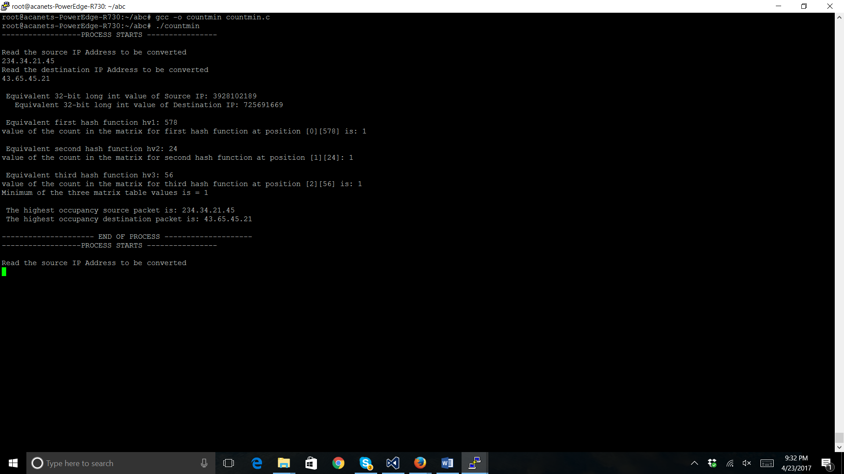
Results

Slide 9
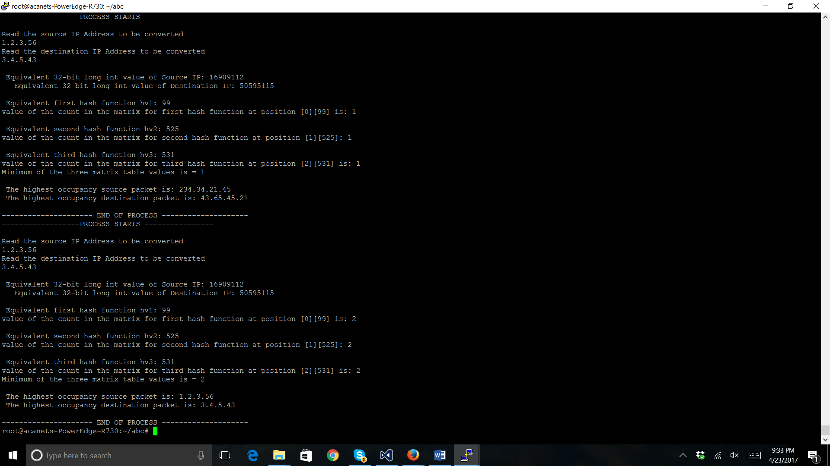

Slide 10
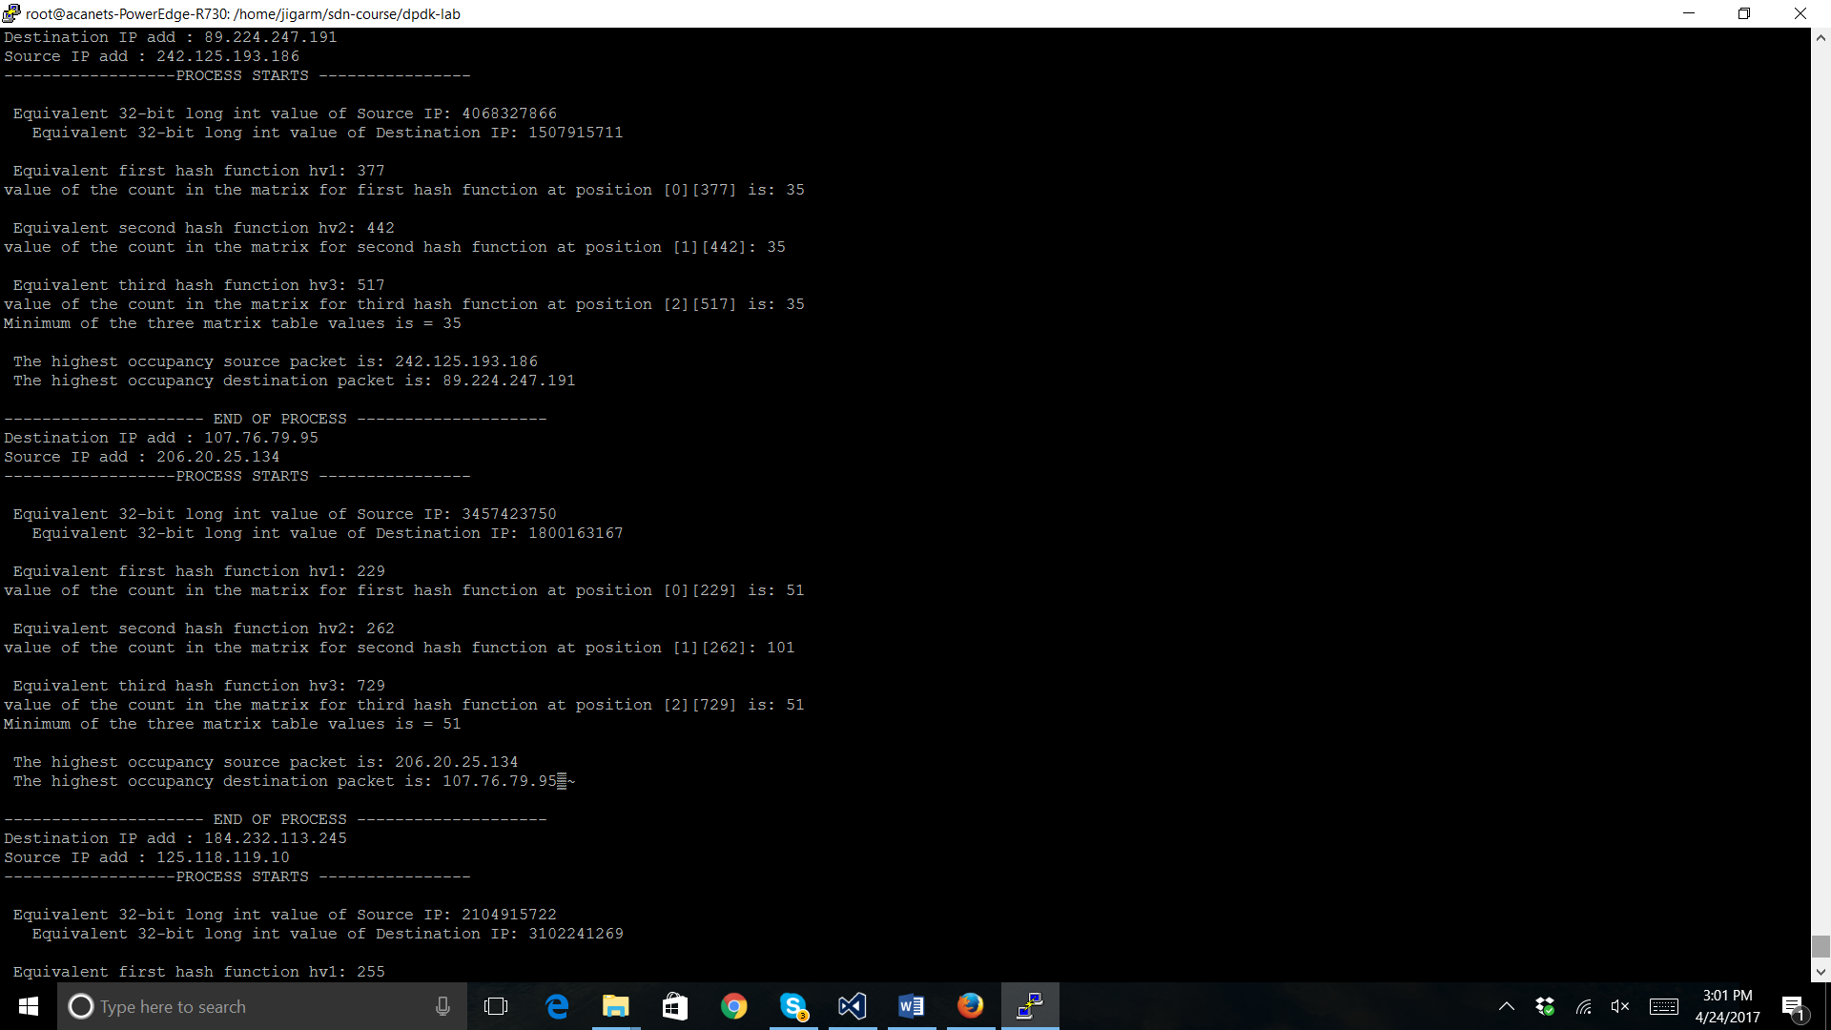


Slide 12
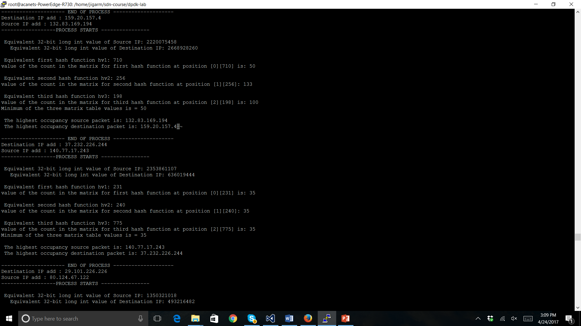

Slide 13
Thank you.

