Slide 1



STUDENT MENTAL HEALTH DETECTION USING MACHINE LEARNING
Presented By,
811722104127–Sahaana S
811722104145–Sharvini S
811722104166–Swetha M
811722104168–Thennarasi M
Guided By,
Ms. P. KARTHIKA., M.E AP/CSE
DD/MM/YYYY

Slide 2

ABSTRACT
Mental health disorders are a significant global challenge, yet conventional diagnostic methods are often time-intensive and susceptible to bias.
This study leverages advanced machine learning techniques, including SVM, Random Forests, and networks, to detect and predict conditions such as depression, anxiety, and stress.
Various data sources, including social media activity, physiological signals, and survey responses, were utilized to identify key patterns indicative of mental health conditions.
The results indicate strong predictive performance, with certain models achieving over 85% precision in classifying specific mental health disorders.
DD/MM/YYYY

Slide 3
OBJECTIVE
To explore and apply advanced machine learning algorithms for the detection and prediction of mental health conditions, enhancing the efficiency and objectivity of mental health assessments.
To integrate and analyze diverse data sources—including social media activity, physiological signals, and validated psychological surveys—to identify patterns associated with disorders such as depression, anxiety, and stress.
To evaluate and compare the performance of various machine learning models in terms of accuracy, precision, and reliability for effective classification of mental health disorders
DD/MM/YYYY

Slide 4
LITERATURE SURVEY
S.No. | Paper Title | Year | Remark
1 | Student Mental Health Detection Using ML | 2025 | Predicts mental health status using ML algorithms
2 | Early Detection of Student Stress via ML | 2024 | Detects early signs of stress based on academic and behavioral data
3 | Depression Risk Assessment in Students (ML Approach) | 2023 | Focused on identifying depression symptoms using supervised learning
DD/MM/YYYY

Slide 5
LITERATURE SURVEY
S.No. | Paper Title | Year | Remark
4 | AI-based Student Mental Wellness Classifier | 2025 | Classifies mental health states (normal, anxious, depressed)
5 | Predictive Analysis of Student Anxiety Levels | 2022 | Uses SVM and decision trees on student surveys
6 | Mental Health Prediction Using Academic Performance | 2023 | Correlates academic metrics with mental health outcomes
DD/MM/YYYY

Slide 6
LITERATURE SURVEY
S.No. | Paper Title | Year | Remark
7 | ML-Based Detection of Burnout in University Students | 2024 | Identifies burnout risk using behavioral and survey data
8 | Sentiment Analysis for Student Mental Health Monitoring | 2025 | Analyzes text inputs to detect emotional and mental state
9 | Student Mood Detection Using ML and IoT Data | 2023 | Combines wearable sensor data and ML to detect mood fluctuations
DD/MM/YYYY

Slide 7
EXISTING SYSTEM
Objective Definition – Define project goals, problem scope, and expected outcomes to guide development.
Experimental Planning – Design a structured methodology with planned resources, timelines, and variables.
Ethical Approval & Consent – Obtain ethical clearance and informed consent for human-involved studies.
Data Acquisition – Collect accurate and relevant raw data through sensors, surveys, or tools.
Data Preprocessing – Clean, normalize, and transform data to prepare it for modeling.
Model Development – Build, train, and test models using suitable algorithms on processed data.
Validation & Review – Assess model performance using metrics and refine based on results.
Deployment – Implement the system in a real-world setting and provide ongoing support.
DD/MM/YYYY

Slide 8
PROPOSED SYSTEM
Data Exploration Analyzing data patterns, distributions, and relationships to gain insights.
Data Cleaning Removing errors, handling missing values, and ensuring data quality.
Model Selection & Optimization ModuleChoosing the best algorithm and fine-tuning it for improved performance.
Training and Validation Teaching the model using training data and validating it to avoid overfitting.
Testing Evaluating the model’s accuracy and generalization using unseen data
DD/MM/YYYY

Slide 9
SYSTEM ARCHITECTURE
Objective Definition
Experimental Planning
Ethical Approval & Consent
Data Acquisition
Deployment
Validation & Review
Model Development
Data
preprocessing
DD/MM/YYYY

Slide 10
MODULE 1 : DATA EXPLORATION
Predict mental health outcomes using machine learning algorithms , the process starts with exploring the dataset to understand its structure.
Data preprocessing follows, addressing missing values, encoding categorical variables, and splitting the data into training and testing sets.
Data preparation includes handling missing values, transforming categorical variables, and dividing the dataset into training and testing subsets.
DD/MM/YYYY

Slide 11
MODULE 2 : DATA CLEANING
Data cleaning ensures the dataset is accurate, consistent, and reliable.
Duplicate records should be removed to avoid bias, and invalid or inconsistent data, like incorrect age values, must be fixed or excluded.
Duplicate records should be removed to avoid bias, and invalid or inconsistent data, such as erroneous age values, must be corrected or excluded.
DD/MM/YYYY

Slide 12
MODULE 3 : MODEL SELECTION & OPTIMIZATION MODULE
The Model Selection & Optimization module focuses on enhancing the accuracy and efficiency of mental health prediction.
It module involves selecting the best-performing model through techniques such as cross-validation, hyperparameter tuning and feature selection.
This process involves selecting the most effective model using methods like cross-validation and hyperparameter optimization.
DD/MM/YYYY

Slide 13
MODULE 4 : TRAINING AND VALIDATION
In this module, the dataset is split into training and validation sets to build and fine-tune the models.
Metrics such as accuracy, precision, recall, and F1-score are calculated to evaluate the models.
Validation is carried out by assessing the models on a distinct validation set to gauge their ability to generalize. Metrics such as accuracy, precision, recall, and F1-score are computed to assess model performance.
DD/MM/YYYY

Slide 14
MODULE 5 : TESTING
. The testing module uses the models trained in the previous module to evaluate their performance on a separate test dataset.
The models classify mental health conditions based on the input features and generate predictions for each test instance.
The testing phase utilizes models trained earlier to assess their performance on a separate test dataset, containing data that wasn't part of the training process.
DD/MM/YYYY

Slide 15
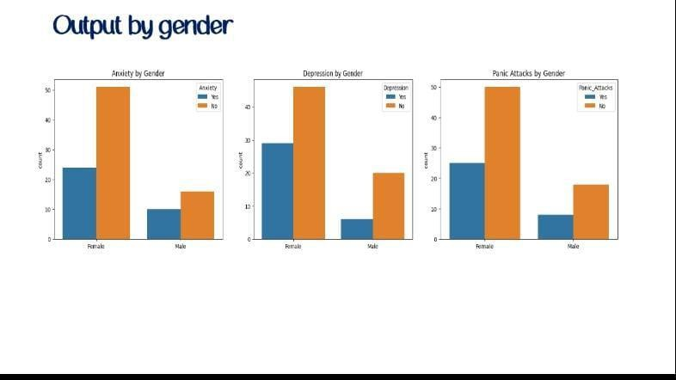
OUTPUT
DD/MM/YYYY

Slide 16
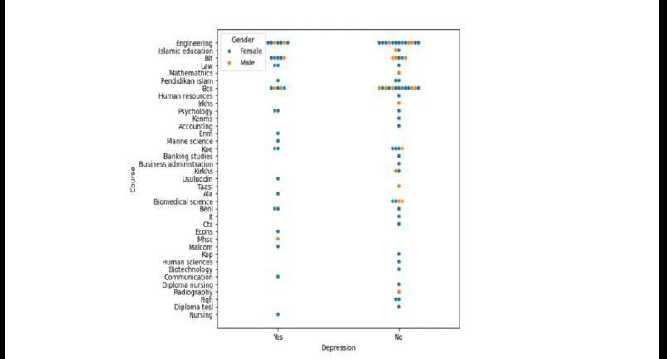
OUTPUT
DD/MM/YYYY

Slide 17
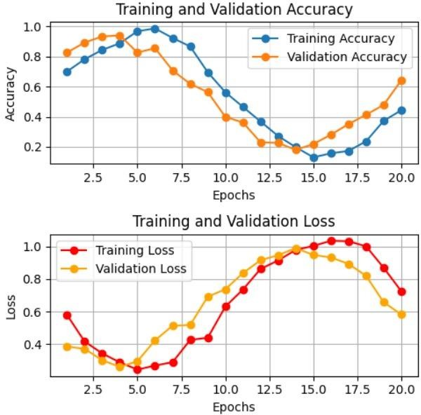
OUTPUT

Slide 18
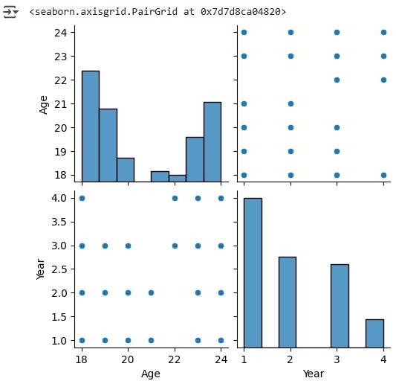
OUTPUT

Slide 19
CONCLUSION & FUTURE ENHANCEMENT
Promising Early Detection: Machine learning offers effective early detection of mental health issues by analyzing academic, behavioral, and emotional data, enabling timely interventions and improved student support.
Challenges and Limitations: Current systems face real-world challenges such as data privacy concerns, limited integration with existing infrastructure, and reliance on self-reported or incomplete data.
Scope for Future Enhancements: Future improvements include integrating wearable and IoT data, advancing emotion recognition through NLP, and delivering personalized mental health support tailored to each student’s needs.
DD/MM/YYYY

Slide 20
REFERENCES
Abd Rahman(2023) conducted a systematic review on the application of machine learning methods in mental health detection. IEEE Access, 8, 183952-183964.
Tomasik(2023) developed a machine learning algorithm to differentiate bipolar disorder from major depressive disorder using online questionnaires and blood biomarker data. Translational Psychiatry.
Tao (2024) explored remote patient monitoring using RFID technology and machine learning for the early detection of suicidal behavior sensors

Slide 21

DD/MM/YYYY

