Slide 1
Cardiovascular Disease Prediction
Sharvi Ranjan (PES1UG22EC918) Aditi Hulmani (PES1UG22EC921)
Meghana Venkamsetty (PES1UG22EC921)

Slide 2
Introduction
Cardiovascular diseases remain to be one of the leading causes of death worldwide. Thus, early detection and prediction is crucial for effective treatment and prevention. Machine learning has proven to be a powerful tool in healthcare for predicting heart diseases.
ML is used to model the probability of a binary outcome, such as the presence or absence of heart disease—based on input features.

Slide 3
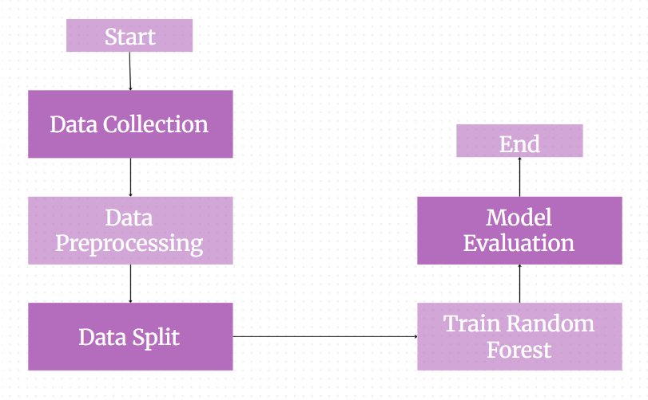
Methodology

Slide 4
Why Random Forest
Comparison of Random Forest with other models like K-NN, Logistic Regression, SVM, shows that it is the most suitable option.
Tends to perform very well with a large number of features and instances.
Can handle unscaled and mixed data types without extensive preprocessing.
Often more robust when the relationship between features and the target is noisy or less clear.
Less sensitive to hyperparameter choices compared to non-linear SVMs in many cases.
When interpretability and insights into feature importance are valuable.
When handling large and potentially noisy datasets.

Slide 5
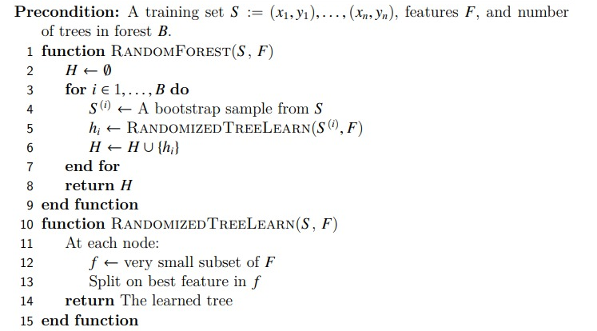
Algorithm

Slide 6
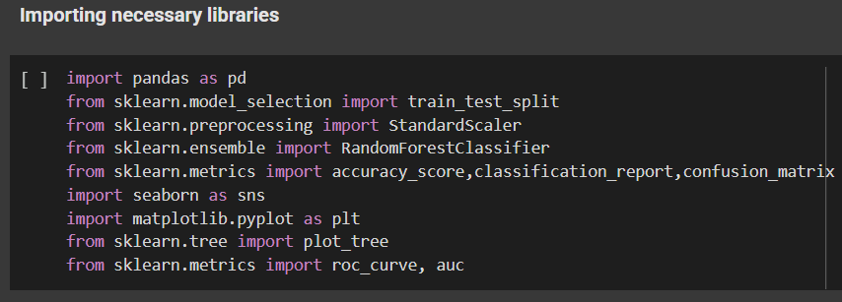
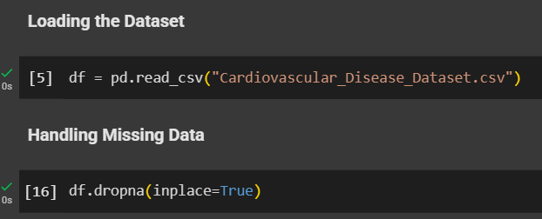
Results

Slide 7
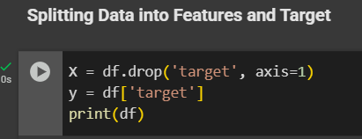
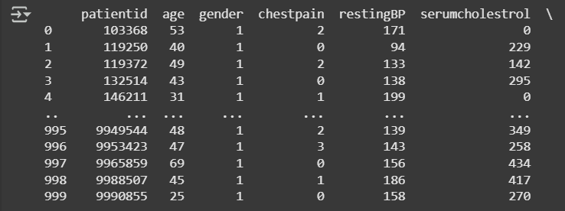
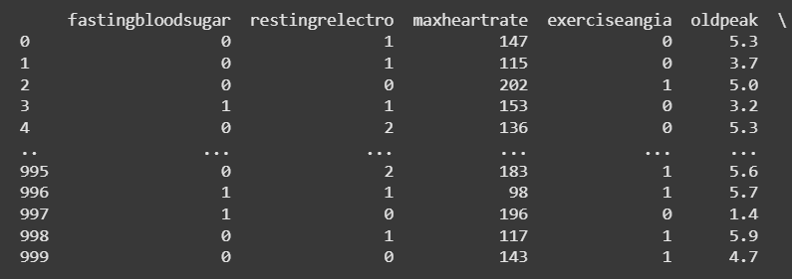
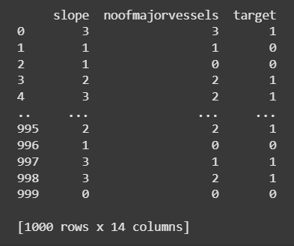

Slide 8
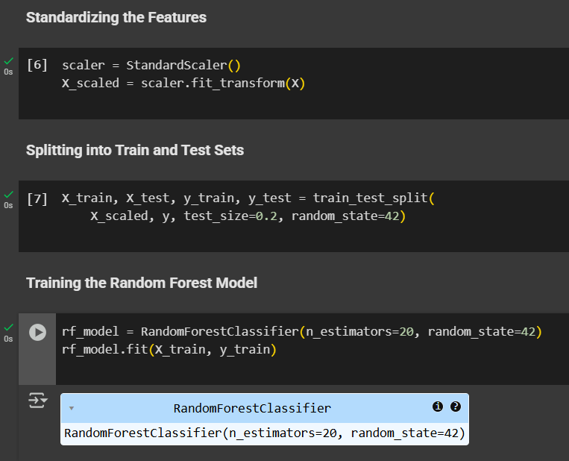

Slide 9
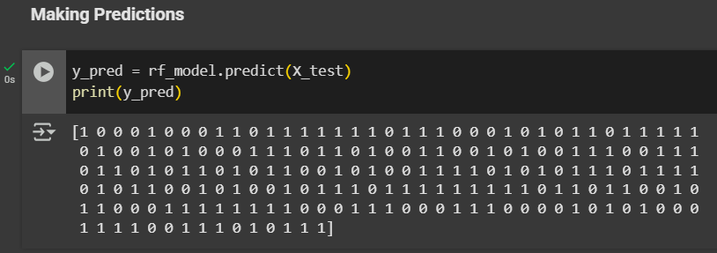
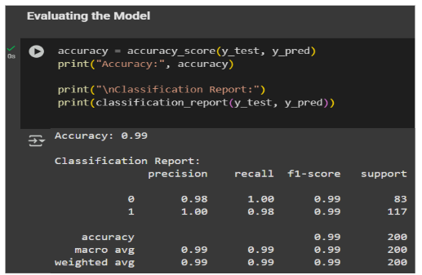

Slide 10
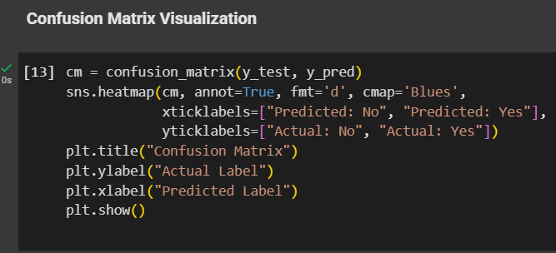
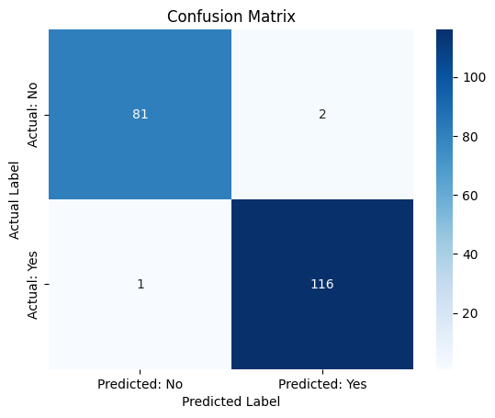

Slide 11
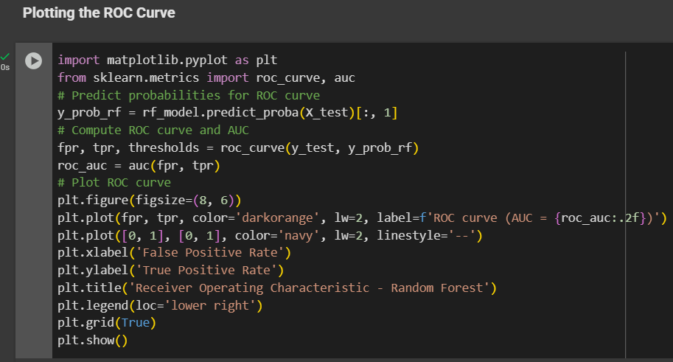
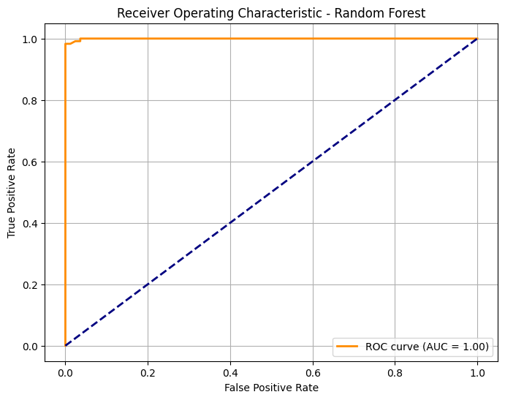

Slide 12
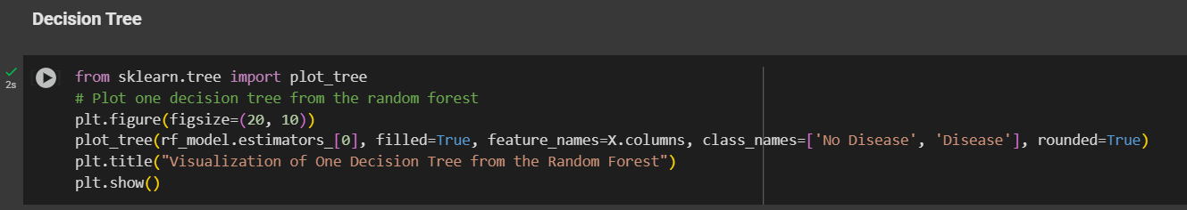
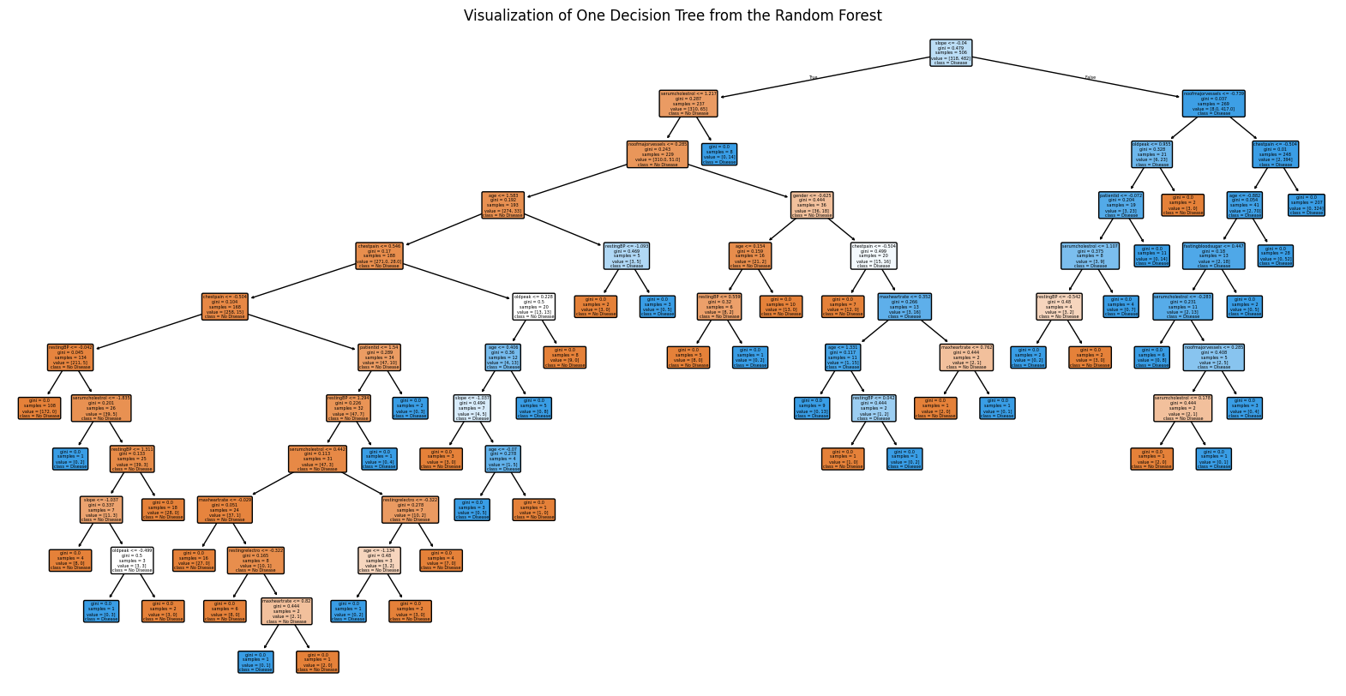

Slide 13
Comparison with other ML models
MODEL | ACCURACY
Random Forest | 99 %
SVM | 96.5 %
Logistic Regression | 96.5 %
K-NN | 95 %

Slide 14
References
Introduction to Machine Learning by Ethem Alpaydin
geeksforgeeks.org
kaggle.com

Slide 15
THANK YOU

