Slide 1


STARTUP SUCCESS FORECASTING: A DATA-DRIVEN APPROACH
INSY 5339: Principle of Data Mining
Dr. A.C. Sahoo
Professor of Practice
Group 13:
1) KASHISH TARIQUE- 1002157068
2) SHARWARI PATHAK-1002105519
3) SHRISHANAR SHRIPADARAO-1002173907
4) VINUTHA ANJANAPPA-1002157283

Slide 2

BUSINESS PROBLEM
Business Context
We're addressing the challenge of high failure rates among startups by identifying key factors that contribute to success.
we aim to simplify complex data, revealing insights that guide entrepreneurs and investors towards more informed decision-making and strategy development for enhancing startup success rates.
Business Problem Statement
In an increasingly competitive startup ecosystem, identifying the key factors that contribute to startup success is crucial for investors, founders, and policymakers.
Our project aims to predict the likelihood of startup success by analyzing various attributes and metrics such as funding rounds, company age, and market segments.
The challenge is to develop a reliable predictive model that can guide decision-making and optimize strategies to enhance the chances of a startup's success and sustainability in the market

Slide 3
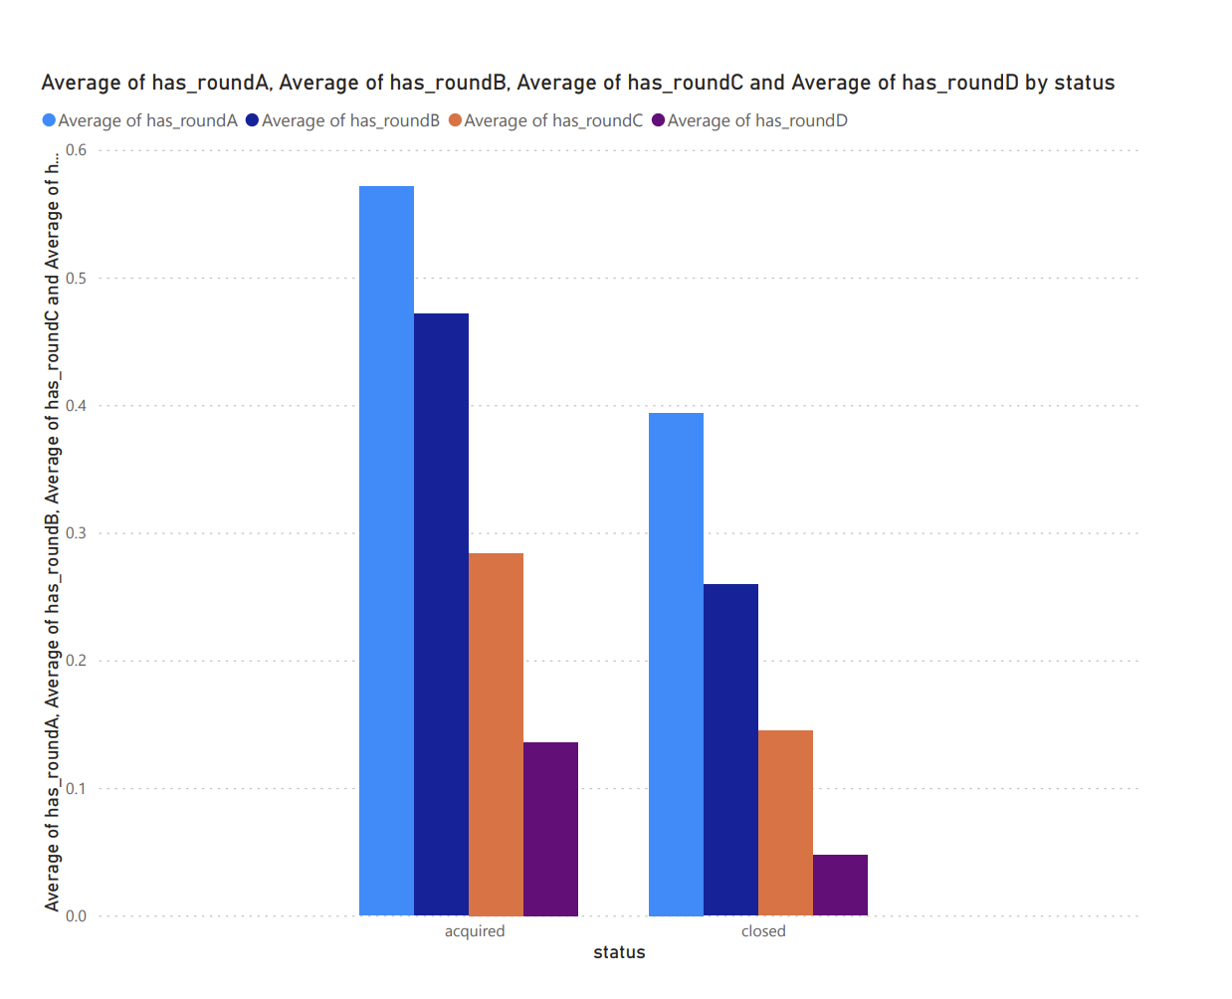
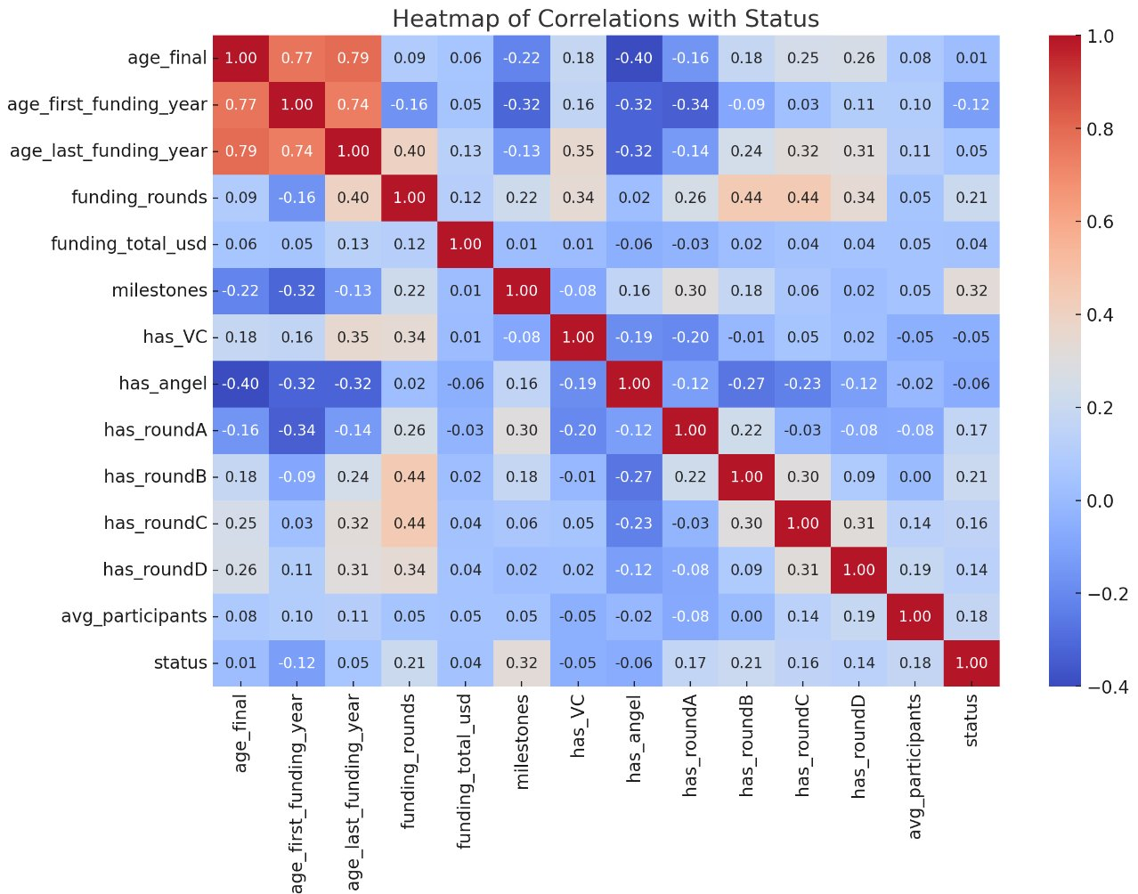
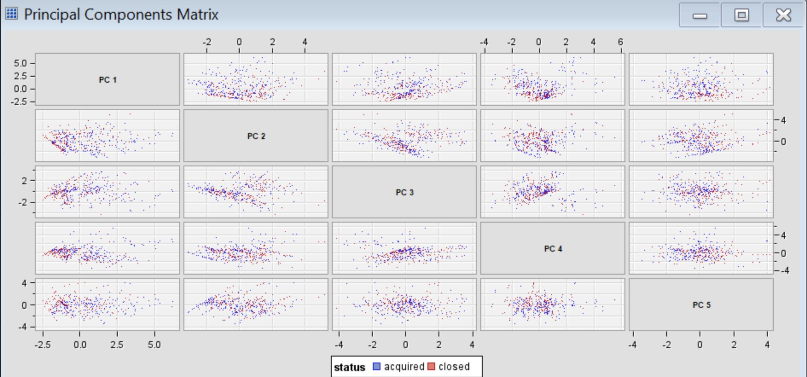
Description of Data
The dataset "startup_data_usa" was generated from an all-inclusive database of American startups.
The purpose of creating this dataset was to display a diverse array of businesses across various stages, industries, and geographic regions in the United States. Thus, it provides a representative sample of the startup scenario in the country.
Data Visualization
To gain insights from the dataset, we will employ various data visualization techniques:
Histograms
Bar Charts
Heatmaps
Data Transformation
You transform input variables to make the usual assumptions of regression more appropriate for the input data.
Utilizing dimensionality reduction techniques like PCA.

Slide 4
Data – Business Problem
For gauging the success rate of the startup company, we rely on the "status" variable as our target, which yields outcomes represented by 1s and 0s.
Subsequently, we utilize variables such as funding rounds, milestones, etc., as predictors for the target variable.
Models Implemented
Models
Decision Tree
Logistic Regression
Random Forest
Clustering
Models Implemented

Slide 5
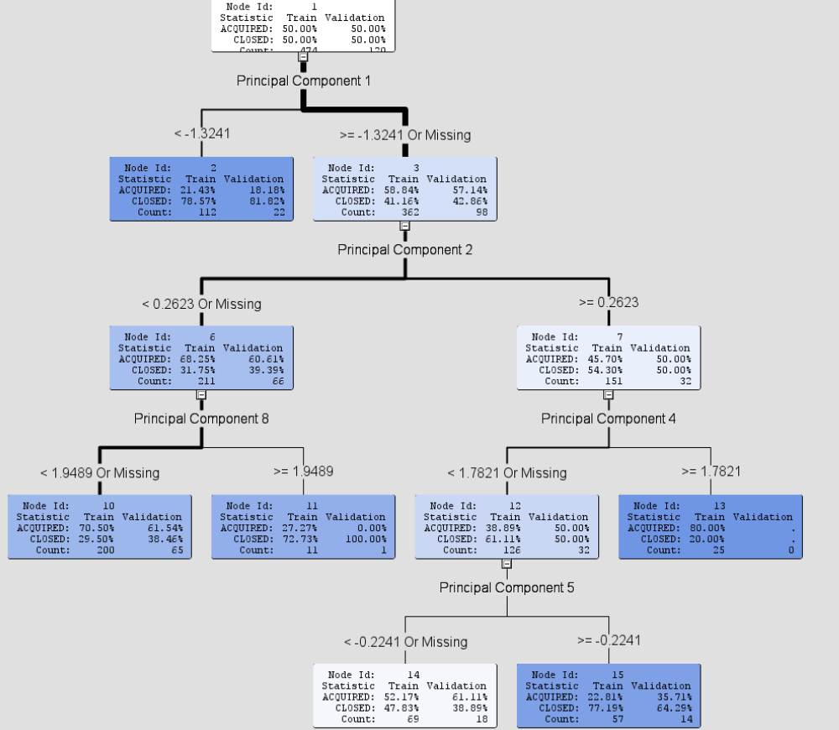
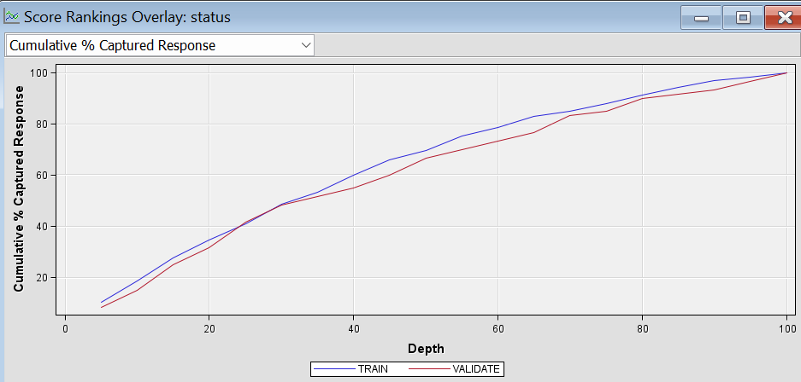
MODELS
Decision Tree:
Decision Trees enable us to depict the probabilistic pathways of the 'status' target variable, using significance independent variables such as 'milestones' and 'has_roundB’.
Which indicates the variables plays a more critical role in making predictions.
Logistic Regression:
Logistic regression was selected to predict the 'status' of startups due to its effectiveness in binary classification, yielding insights with a clear statistical foundation.
This method provided a solid balance between model complexity and interpretability, essential for understanding the impact of variables like 'city' and 'milestones' on startup outcomes.

Slide 6
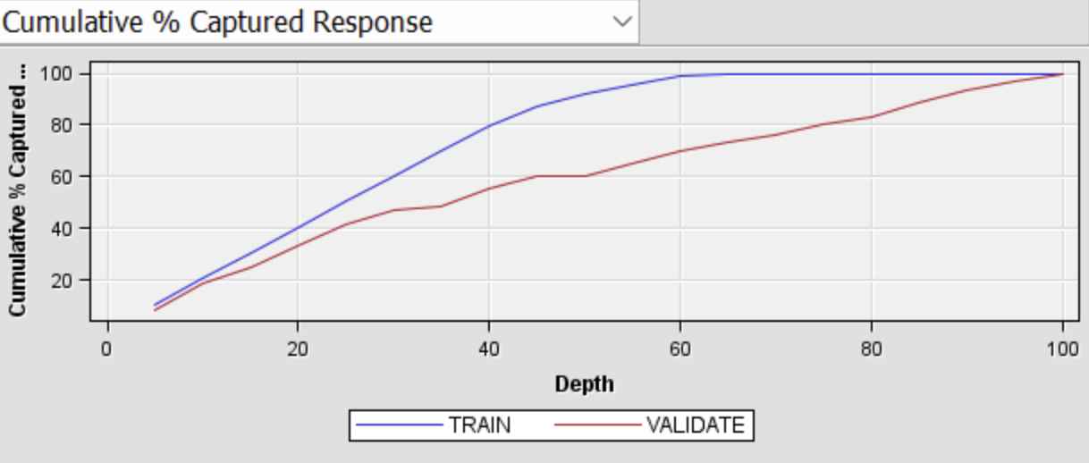
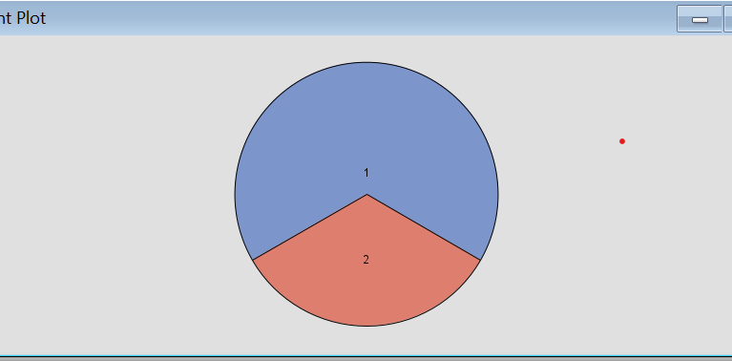
Random Forest
Random Forest provides a more nuanced analysis by constructing multiple decision trees and aggregating their predictions, offering a higher degree of accuracy.
This ensemble approach is less prone to overfitting compared to a single decision tree and is adept at handling the intricate interactions between our independent variables such as 'city', 'milestones', and 'category_code'.
It showcased a promising misclassification rate in our evaluations, indicating its robustness in predicting the 'status' of startups accurate
Clustering
Clustering enabled us to uncover natural groupings within the startup dataset, providing insights into distinct segments based on characteristics.
By identifying these clusters, we could tailor strategies for different segments, potentially offering more personalized recommendations for startups and investors.
The clustering technique helped in simplifying the complex startup ecosystem into manageable groups for targeted analysis and decision-making.

Slide 7
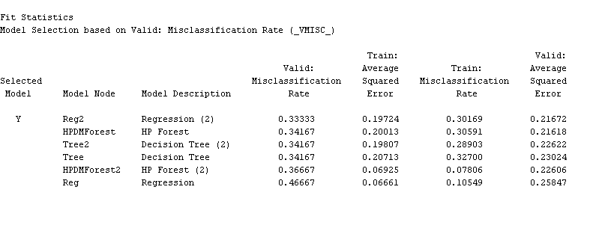
RESULT
In this project's analysis, the Regression (2) model has emerged as the most effective model based on the validation misclassification rate of approximately 0.333
Indicating its superior predictive accuracy among the evaluated models. Additionally, the Regression model exhibits competitive performance with a validation average squared error of 0.217.
Random Forest:
Valid: Misclassification rate: 0.36667
Decision Tree:
Valid: Misclassification rate: 0.34167
Logistic Regression:
Valid: Misclassification rate: 0.33333
Train : Misclassification rate: 0.30169
Train : Misclassification rate: 0.28903
Train: Misclassification rate: 0.07806

Slide 8

IMPLEMENTATION
Model Deployment
Monitoring and Maintenance
Decision Strategy Incorporation
Continuous Improvement
Implementation Ideas

Slide 9

Managerial Insights
Investment Strategies
Strategic Partnerships
Risk Management
Performance Monitoring
Business Incubation and Acceleration
Policy Development

Slide 10

THANK YOU

