Slide 1
EVENT-TIMERAF
Verified event-aware retrieval for 24-hour PM2.5 forecasting
VERIFIED SCOPE
Input 168 hours
Output 24 hourly PM2.5 values
Test 7,199 forecast origins
Best M04 context XGBoost
Status Pass with limitations
Los Angeles County | 2019-2024 | Faculty research update
github.com/shasabbir/event-time-raf
Notes:
Open with the problem and verified scope. State immediately that M04, not the full M09 model, is the strongest manifest-backed result.

Slide 2
Research question and evidence contract
02
What the experiment tests, and what it does not claim
Research question
Evidence contract
Can source-audited weather, calendar, and storm-event context improve leakage-safe retrieval and forecasting under distribution shift?
43/43 manifest SHA-256 checks pass
M00-M11 saved predictions reproduced
M12 excluded; created after the manifest
Events retrospective, not strict real time
Geography one county; no external validation
Input example: 7 days of hourly PM2.5 + aligned context
Target: the next 24 hourly PM2.5 values
Evaluation: MSE, MAE, RMSE, R² + paired bootstrap
No unsupported result remains in the corrected paper.
Verified against immutable run 20260723T112033170131Z
Notes:
Explain the immutable ZIP as the source of truth. The notebook does not silently choose between conflicting edited artifacts.

Slide 3
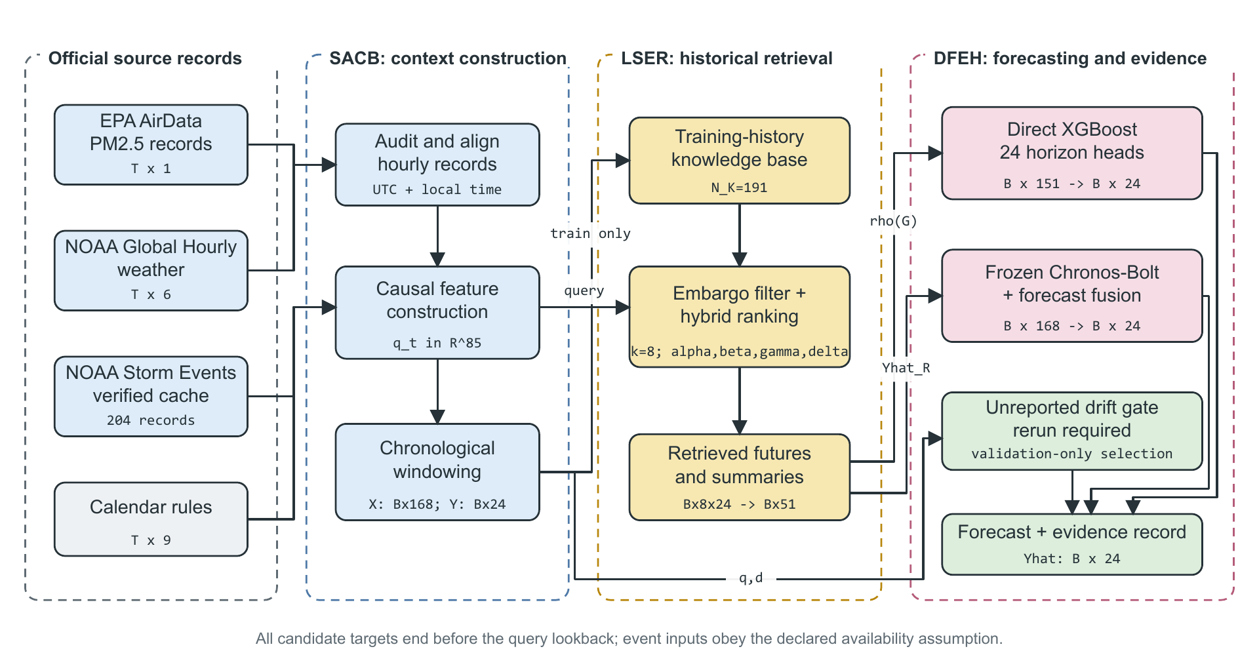
End-to-end framework
03
SACB -> LSER -> DFEH, with an auditable evidence record
Verified against immutable run 20260723T112033170131Z
Notes:
Walk left to right. Official sources enter SACB, only train-history candidates enter LSER, and DFEH evaluates direct XGBoost and frozen Chronos paths. Point out that the drift gate is marked unreported.

Slide 4
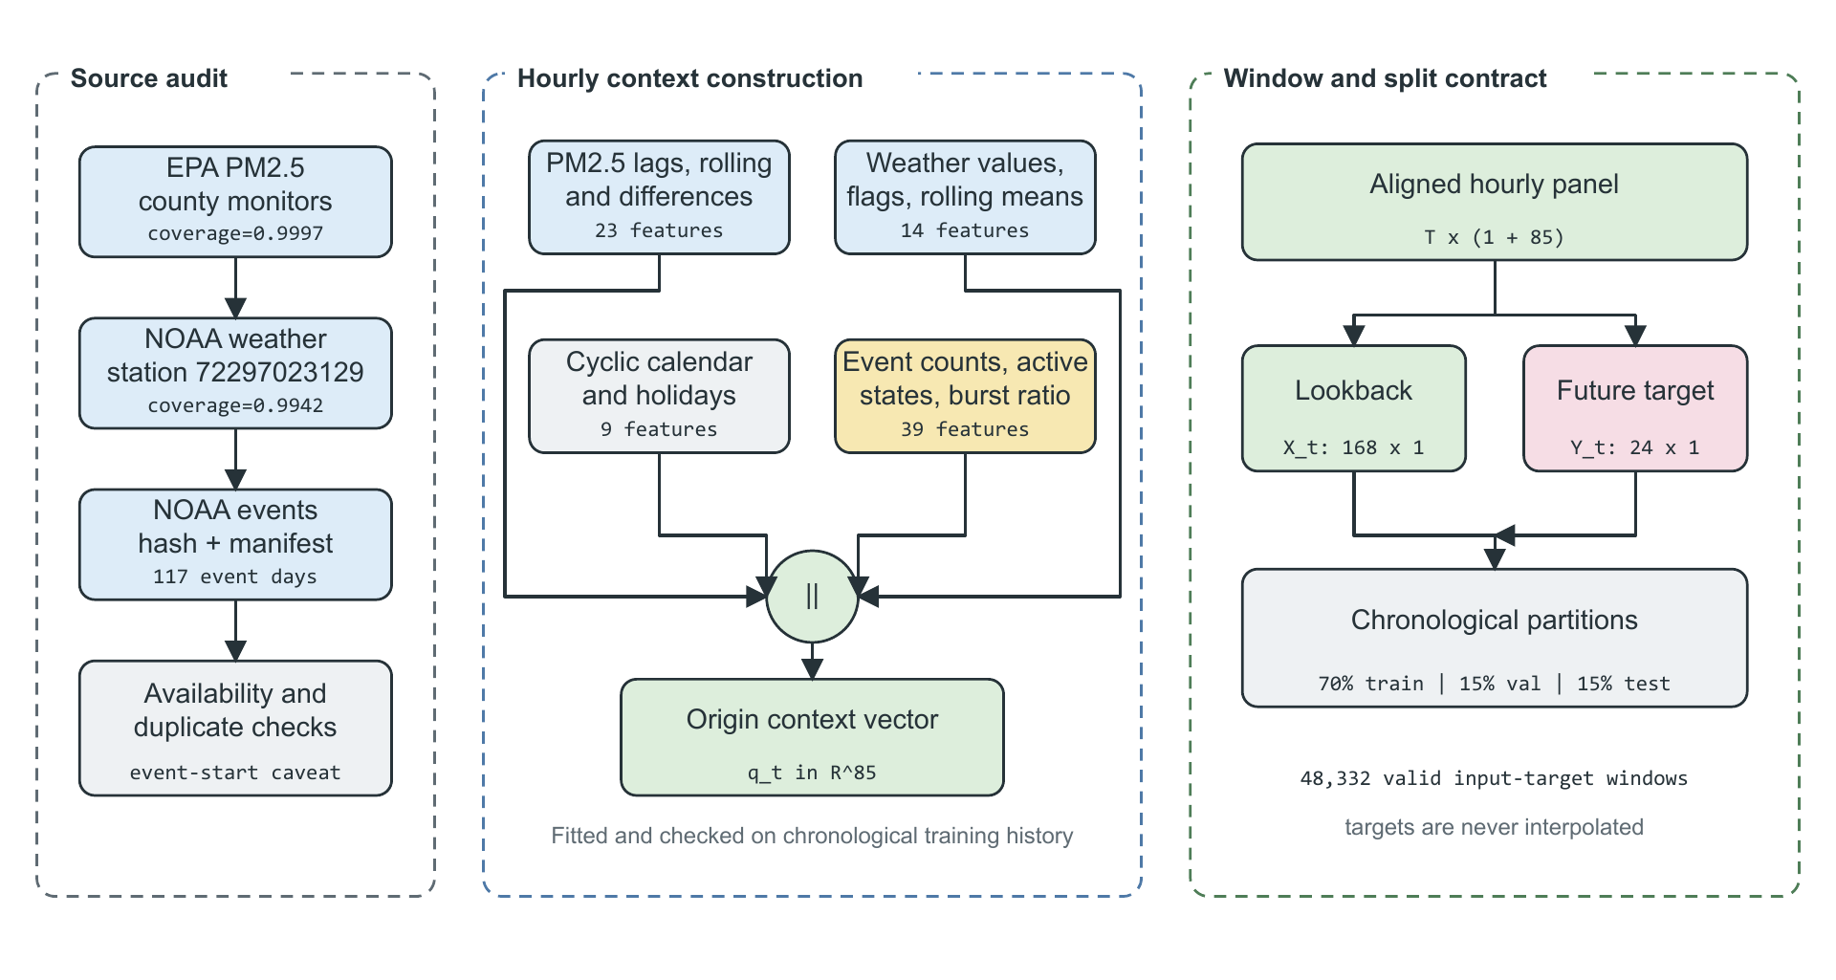
Module 1: Source-Audited Context Builder
04
Source checks, causal alignment, and chronological windows
Origin context
qₜ ∈ ℝ⁸⁵
Feature group | Count
PM2.5 history | 23
Weather | 14
Calendar | 9
Storm event | 39
Total | 85
Target values are never interpolated. Filling uses past observations only.
Verified against immutable run 20260723T112033170131Z
Notes:
Derive 85 from memory: 23 PM2.5, 14 weather, 9 calendar, 39 event. Explain that 86/40 was an AI draft counting error corrected from actual feature names.

Slide 5
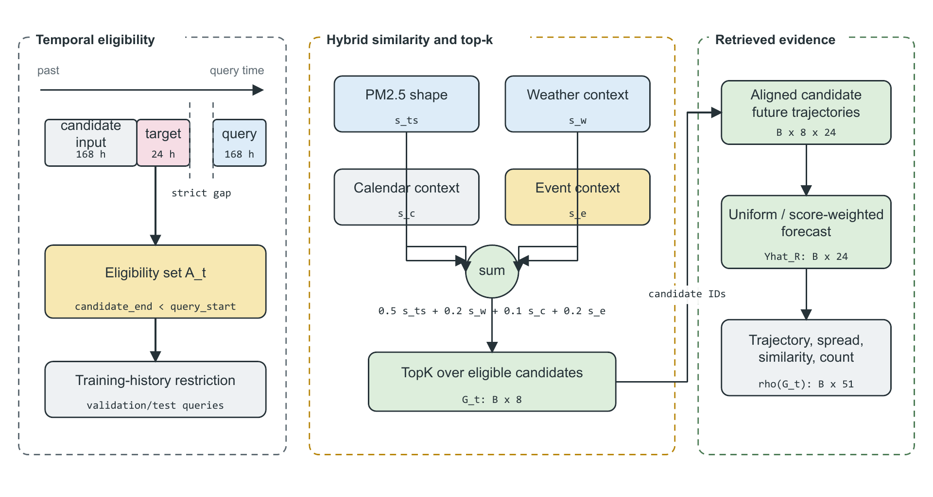
Module 2: Leakage-Safe Event-Context Retriever
05
Temporal eligibility before similarity ranking
Embargo
candidate target end < query input start
Hybrid score
0.5 shape + 0.2 weather + 0.1 calendar + 0.2 event
KB 191 non-overlapping train windows
Top-k k = 8; sensitivity {1,4,8,16}
Verified against immutable run 20260723T112033170131Z
Notes:
The leakage rule is stricter than candidate origin before query origin. The entire candidate future must end before the query lookback starts.

Slide 6
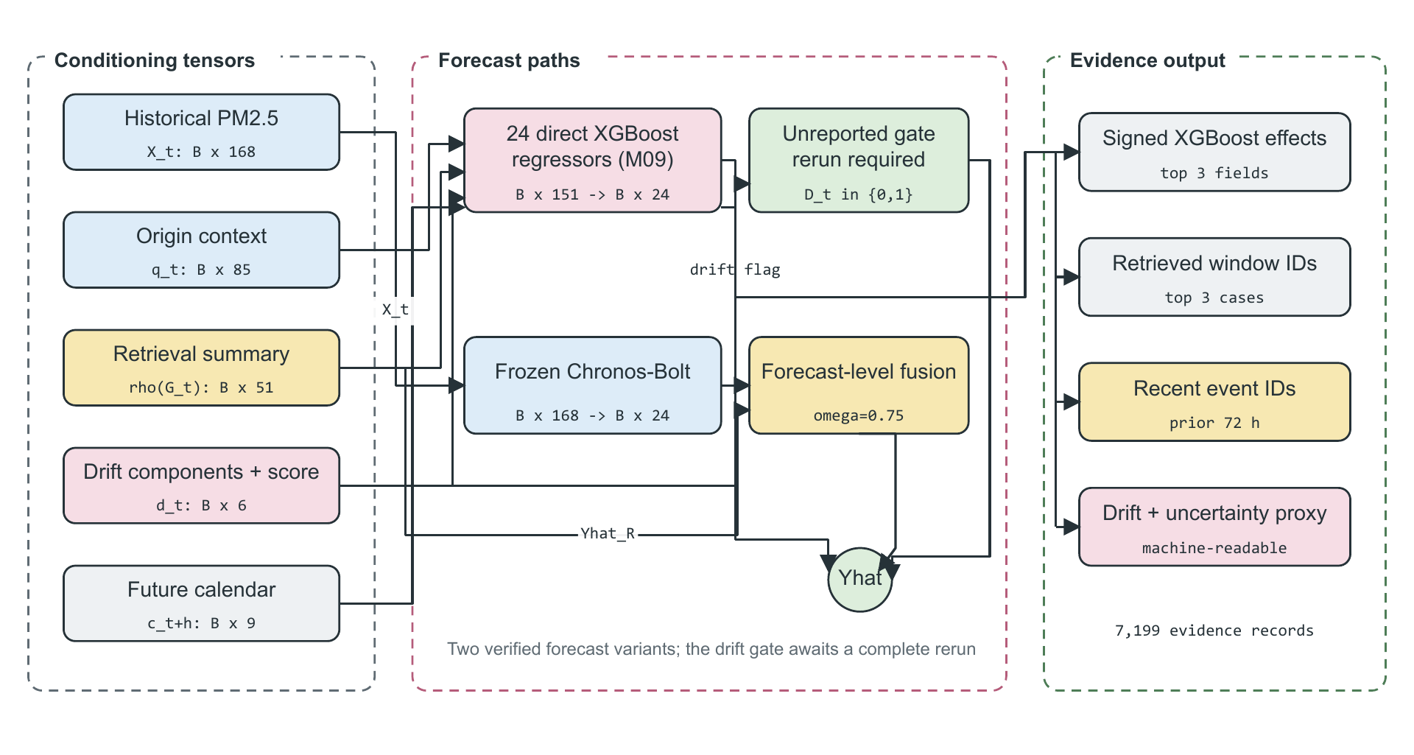
Module 3: Drift-Aware Forecast and Evidence Head
06
Two verified forecast paths; one excluded selector
Direct path
24 XGBoost regressors 151 inputs per horizon
Frozen path
Chronos-Bolt + retrieval ω selected on validation
Evidence output
feature effects, retrieved IDs, event IDs, drift, uncertainty
Drift gate: excluded until a complete manifest-backed rerun.
Verified against immutable run 20260723T112033170131Z
Notes:
Derive 151: 85 context + 51 retrieval summary + 6 drift fields + 9 future-calendar fields. The five drift components are robust-scaled on training data; the threshold is the validation 0.90 quantile.

Slide 7
Experimental protocol
07
Chronological evaluation and pre-specified model ladder
IDs | Purpose
M00-M02 | Persistence + seasonal
M03-M04 | XGBoost PM2.5/context
M05-M06 | Random/cosine retrieval
M07 | XGBoost + cosine
M08-M09 | Event-TimeRAF no/full drift
M10-M11 | Frozen Chronos/fusion
Data split
34,020
TRAIN
7,113
VALIDATION
7,199
TEST
172,776 test points
500 paired block-bootstrap resamples 24-hour blocks
Metrics
MSE: large-error penalty | MAE: absolute error | RMSE: PM2.5 units | R²: explained variation
Verified against immutable run 20260723T112033170131Z
Notes:
Explain that model choices and validation decisions precede test examination. Difference A minus B below zero favors A.

Slide 8
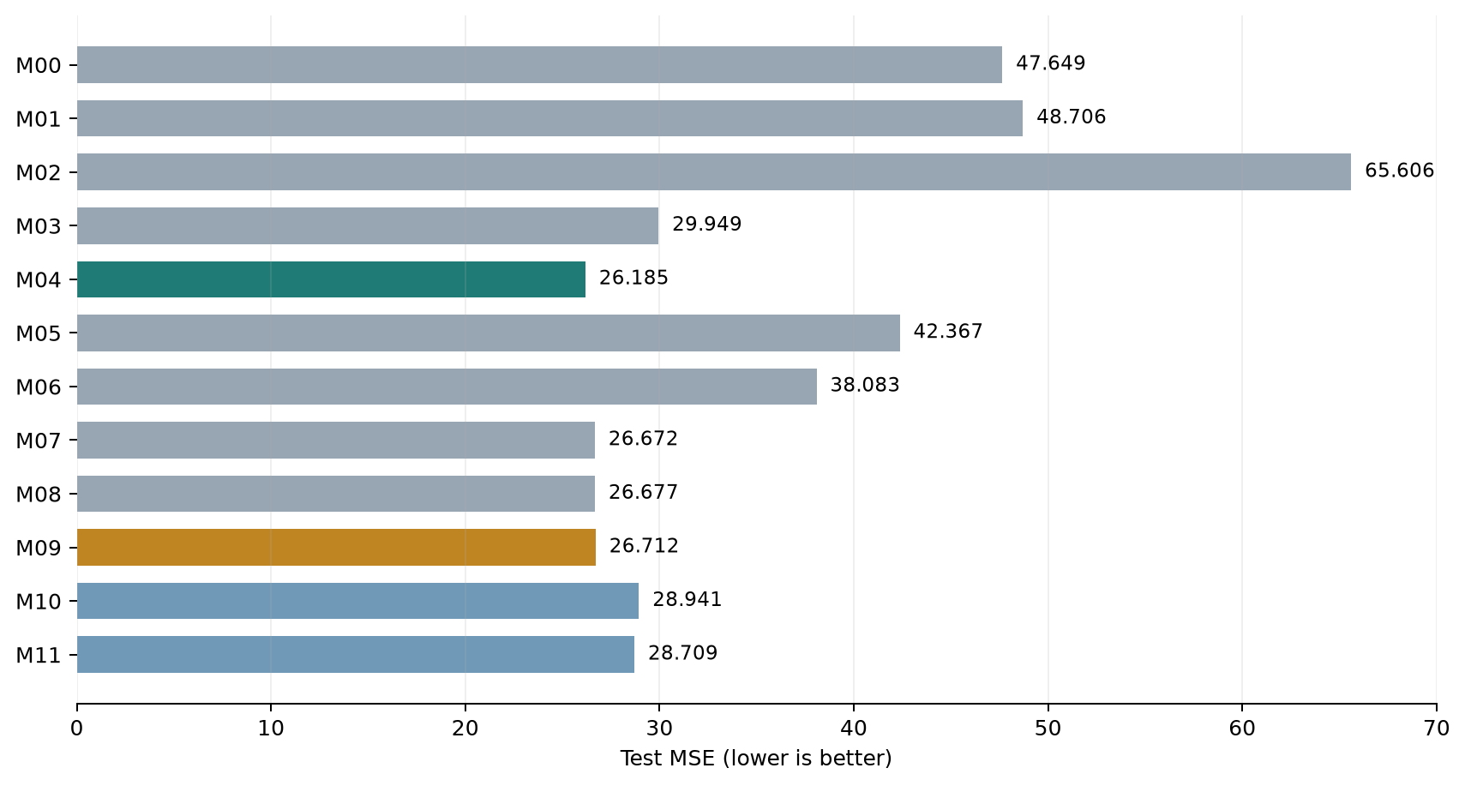
Verified test results
08
The strongest verified model is the context baseline M04
Key results
Model | MSE | MAE
M04 context | 26.185 | 3.125
M09 full | 26.712 | 3.149
M10 Chronos | 28.941 | 3.205
M11 fusion | 28.709 | 3.209
Interpretation
M09 does not beat M04 overall. M11 improves M10 MSE slightly, but not conclusively.
Verified against immutable run 20260723T112033170131Z
Notes:
Do not say the proposed full model wins. Say M04 is strongest, Event-TimeRAF is an audited framework, and retrieval gains are selective.

Slide 9
Ablation study, run for real
09
Paired MSE differences; negative values favor the first model
Comparison | ΔMSE | 95% interval | Conclusion
M04 - M03: weather/calendar | -3.764 | [-5.856, -2.071] | clear gain
M06 - M05: cosine/random | -4.284 | [-5.862, -2.759] | clear gain
M07 - M04: add retrieval | +0.487 | [0.015, 1.028] | worse
M08 - M07: event ranking | +0.005 | [-0.292, 0.275] | no clear gain
M09 - M08: drift fields | +0.035 | [-0.101, 0.161] | no clear gain
M09 - A00: event context | +0.083 | [-0.225, 0.354] | no clear gain
M11 - M10: Chronos fusion | -0.233 | [-0.665, 0.152] | favorable, uncertain
Justified: audited context and cosine ranking. Not justified: a uniform gain from event, drift, or retrieval features on top of M04.
Verified against immutable run 20260723T112033170131Z
Notes:
Every row is calculated from actual saved predictions. Explain confidence intervals: a crossing of zero means the direction is not conclusive under this bootstrap.

Slide 10
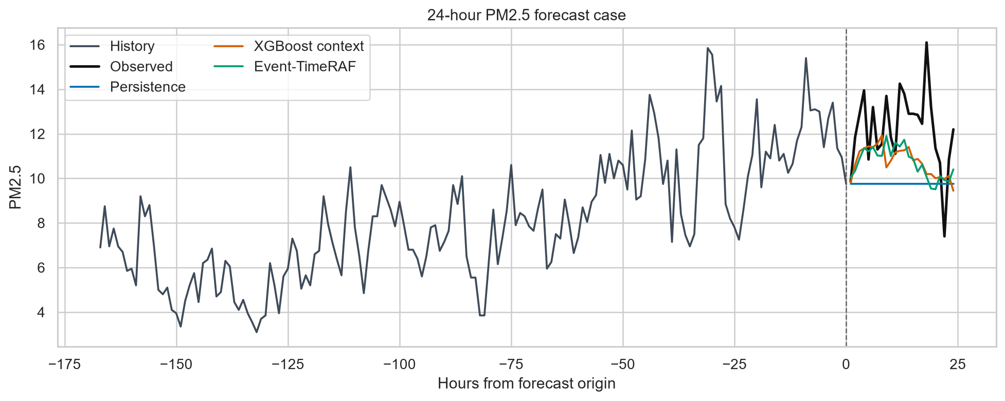
Explainability and scope limits
10
Traceable records without overclaiming operational readiness
Claims that remain limited
Event timing no publication timestamps
External validity one county only
Random replay requires NumPy 2.0.2 or saved evidence
Efficiency hardware identifiers were not recorded
TimeRAF scope no learned dual encoder or Channel Prompting
7,199 evidence records
Top XGBoost effects | retrieved IDs | event IDs | drift score | uncertainty proxy
These are reported limitations, not hidden failures.
Verified against immutable run 20260723T112033170131Z
Notes:
Explainability is a structured evidence record, not a causal explanation. Events are official but retrospective because issue times are unavailable.

Slide 11
What changed after verification
11
Live notebook: notebooks/03_paper_claim_verification.ipynb
AI draft | Verified correction
86 context / 40 event / 152 input | 85 context / 39 event / 151 input
M12 as the best final result | M12 removed: not manifest-backed
Generic drift equation | Five statistics + median/MAD + validation threshold
Operational event implication | Retrospective event sensitivity only
Live run order
1 Verify 43 hashes
2 Rebuild data and retrieval
3 Rerun M00-M11
4 Recompute metrics + ablations
5 Regenerate nine figures
6 Pass final claim gate
Bottom line
Expected runtime: about 2-3 minutes with the archived ZIP attached.
The study is successful as a reproducible, leakage-audited framework with selective retrieval gains, not as a claim that Event-TimeRAF beats every baseline.
Notebook, paper, verification log, slides, and source ZIP use the same archived run
Notes:
Finish with the qualified conclusion. Then open the notebook and run all cells. Keep the immutable ZIP in the project root or set FINAL_RUN_ZIP_OVERRIDE.

