Slide 1
4.1 INTRODUCTION
4.1 INTRODUCTION
The identifier used in the IP layer of the TCP/IP protocol suite to identify each device connected to the Internet is called the Internet address or IP address. An IP address is a 32-bit address that uniquely and universally defines the connection of a host or a router to the Internet. IP addresses are unique. They are unique in the sense that each address defines one, and only one, connection to the Internet. Two devices on the Internet can never have the same address.
The topics discussed in this section include:
Address Space
Notation
TCP/IP Protocol Suite
1

Slide 2
IP Addresses:
Classful Addressing
Objectives
Upon completion you will be able to:
Understand IPv4 addresses and classes
Identify the class of an IP address
Find the network address given an IP address
Understand masks and how to use them
Understand subnets and supernets
TCP/IP Protocol Suite

Slide 3

IP Addressing: introduction
223.1.1.1
IP address: 32-bit identifier for host, router interface
interface: connection between host/router and physical link
  router’s typically have multiple interfaces
  host may have multiple interfaces
  IP addresses associated with each interface
223.1.2.1
223.1.1.2
223.1.1.4
223.1.2.9
223.1.2.2
223.1.1.3
223.1.3.27
223.1.3.1
223.1.3.2
223.1.1.1 = 11011111 00000001 00000001 00000001
223
1
1
1

Slide 4

Note:
An IP address is a 32-bit address.
TCP/IP Protocol Suite

Slide 5
Note:
The IP addresses are unique.
TCP/IP Protocol Suite

Slide 6
Note:
The address space of IPv4 is
2³² or 4,294,967,296.
TCP/IP Protocol Suite

Slide 7
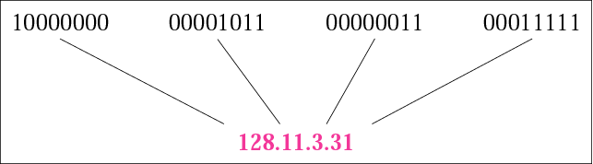
Figure 4.1 Dotted-decimal notation
TCP/IP Protocol Suite

Slide 8
IP Addressing
IP address:
  network part/prefix (high order bits)
  host part (low order bits)
  Additional hosts to 223.1.1 network would have address of 223.1.1.xxx
What’s a network ? (from IP address perspective)
  device interfaces with same network part of IP address
  can physically reach each other without intervening router
223.1.1.1
223.1.2.1
223.1.1.2
223.1.1.4
223.1.2.9
223.1.1.3
223.1.2.2
223.1.3.27
LAN
223.1.3.1
223.1.3.2
network consisting of 3 IP networks
(for IP addresses starting with 223,
first 24 bits are network address)

Slide 9
IP Addressing
223.1.1.2
223.1.1.1
223.1.1.4
How to find the networks?
Detach each interface from router, host
create “islands of isolated networks
There are 6 networks on right incl. that joining R1R2, R2R3, R1R3.
223.1.1.3
R1
223.1.9.2
223.1.7.0
R2
223.1.9.1
223.1.7.1
223.1.8.1
223.1.8.0
R3
223.1.2.6
223.1.3.27
223.1.2.1
223.1.2.2
223.1.3.1
223.1.3.2

Slide 10
4.2 CLASSFUL ADDRESSING
IP addresses, when started a few decades ago, used the concept of classes. This architecture is called classful addressing. In the mid-1990s, a new architecture, called classless addressing, was introduced and will eventually supersede the original architecture. However, part of the Internet is still using classful addressing, but the migration is very fast.
The topics discussed in this section include:
Recognizing Classes
Netid and Hostid
Classes and Blocks
Network Addresses
Sufficient Information
Mask
CIDR Notation
Address Depletion
TCP/IP Protocol Suite

Slide 11
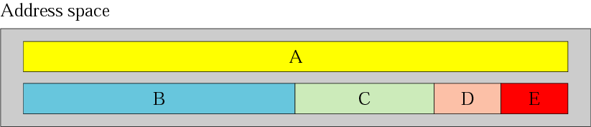
Figure 4.2 Occupation of the address space
TCP/IP Protocol Suite

Slide 12
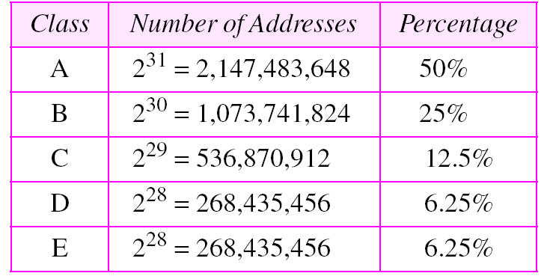
Table 4.1 Addresses per class
TCP/IP Protocol Suite

Slide 13
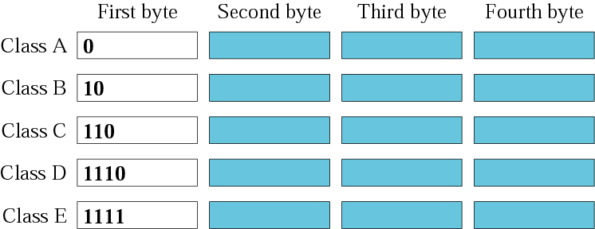
Figure 4.3 Finding the class in binary notation
TCP/IP Protocol Suite

Slide 14
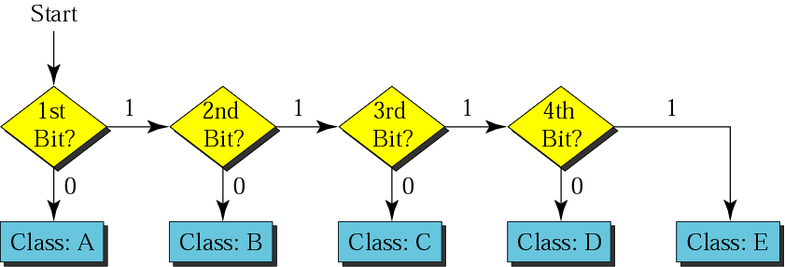
Figure 4.4 Finding the address class
TCP/IP Protocol Suite

Slide 15

Figure 4.5 Finding the class in decimal notation
TCP/IP Protocol Suite

Slide 16
Example 5
How can we prove that we have 2,147,483,648 addresses in class A?
Solution
In class A, only 1 bit defines the class. The remaining 31 bits are available for the address. With 31 bits, we can have 2³¹
or 2,147,483,648 addresses.
TCP/IP Protocol Suite

Slide 17
Example 1
Change the following IP addresses from binary notation to dotted-decimal notation.
a. 10000001 00001011 00001011 11101111
b. 11000001 10000011 00011011 11111111
c. 11100111 11011011 10001011 01101111
d. 11111001 10011011 11111011 00001111
Solution
We replace each group of 8 bits with its equivalent decimal number (see Appendix B) and add dots for separation:
a. 129.11.11.239 b. 193.131.27.255
c. 231.219.139.111 d. 249.155.251.15
TCP/IP Protocol Suite

Slide 18
Example 7
Find the class of each address:
a. 227.12.14.87 b.193.14.56.22 c.14.23.120.8
d. 252.5.15.111 e.134.11.78.56
Solution
a. The first byte is 227 (between 224 and 239); the class is D.
b. The first byte is 193 (between 192 and 223); the class is C.
c. The first byte is 14 (between 0 and 127); the class is A.
d. The first byte is 252 (between 240 and 255); the class is E.
e. The first byte is 134 (between 128 and 191); the class is B.
TCP/IP Protocol Suite

Slide 19
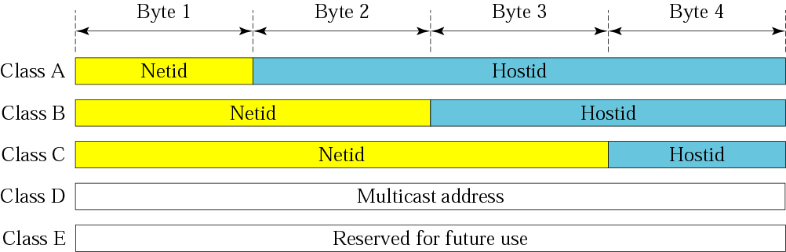
Figure 4.6 Netid and hostid
TCP/IP Protocol Suite

Slide 20
Note:
Millions of class A addresses are wasted.
TCP/IP Protocol Suite

Slide 21
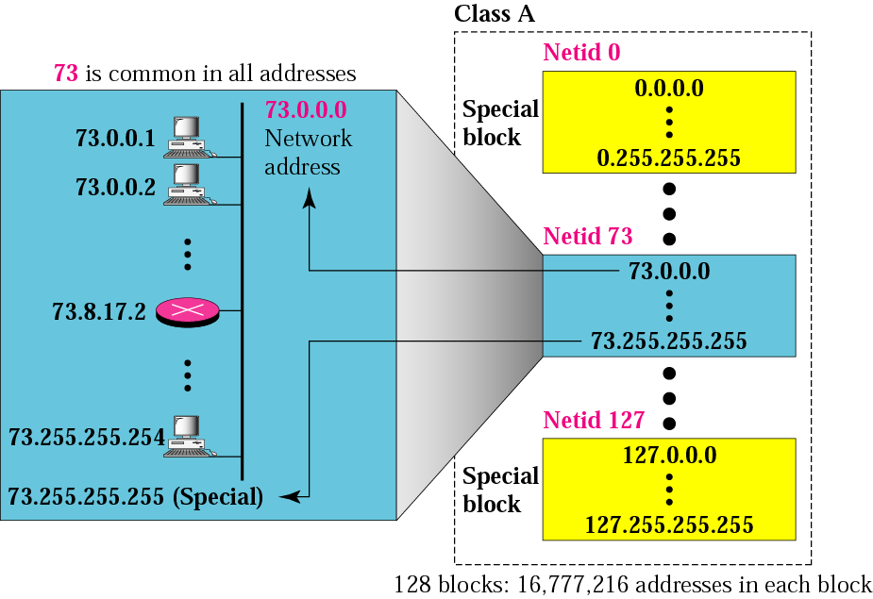
Figure 4.7 Blocks in class A
TCP/IP Protocol Suite

Slide 22
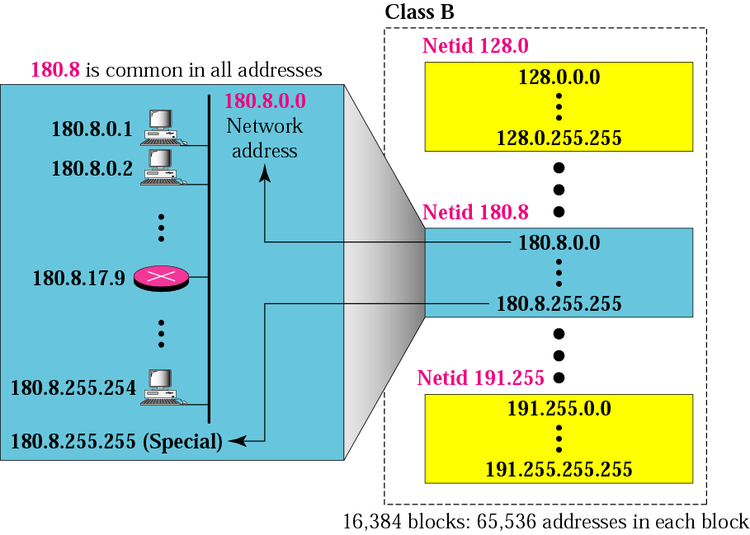
Figure 4.8 Blocks in class B
TCP/IP Protocol Suite

Slide 23
Note:
Many class B addresses are wasted.
TCP/IP Protocol Suite

Slide 24

Figure 4.9 Blocks in class C
TCP/IP Protocol Suite

Slide 25
Note:
The number of addresses in class C is smaller than the needs of most organizations.
TCP/IP Protocol Suite

Slide 26
Note:
Class D addresses are used for multicasting; there is only one block in this class.
TCP/IP Protocol Suite

Slide 27
Note:
Class E addresses are reserved for future purposes; most of the block is wasted.
TCP/IP Protocol Suite

Slide 28
Note:
In classful addressing, the network address (the first address in the block) is the one that is assigned to the organization. The range of addresses can automatically be inferred from the network address.
TCP/IP Protocol Suite

Slide 29
Example 9
Given the network address 17.0.0.0, find the class, the block, and the range of the addresses.
Solution
The class is A because the first byte is between 0 and 127. The block has a netid of 17. The addresses range from 17.0.0.0 to 17.255.255.255.
TCP/IP Protocol Suite

Slide 30
Example 10
Given the network address 132.21.0.0, find the class, the block, and the range of the addresses.
Solution
The class is B because the first byte is between 128 and 191. The block has a netid of 132.21. The addresses range from 132.21.0.0 to 132.21.255.255.
TCP/IP Protocol Suite

Slide 31
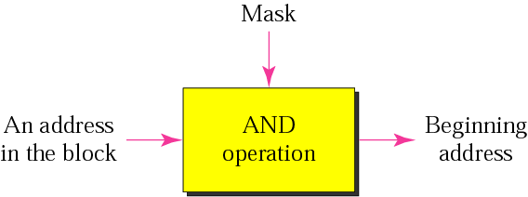
Figure 4.10 Masking concept
TCP/IP Protocol Suite

Slide 32
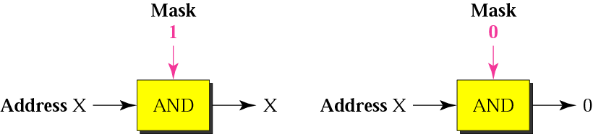
Figure 4.11 AND operation
TCP/IP Protocol Suite

Slide 33
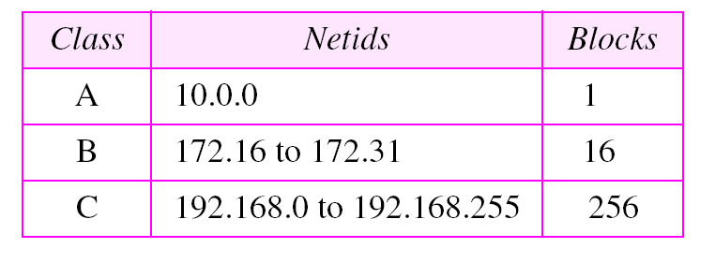
Table 4.5 Addresses for private networks
TCP/IP Protocol Suite

Slide 34
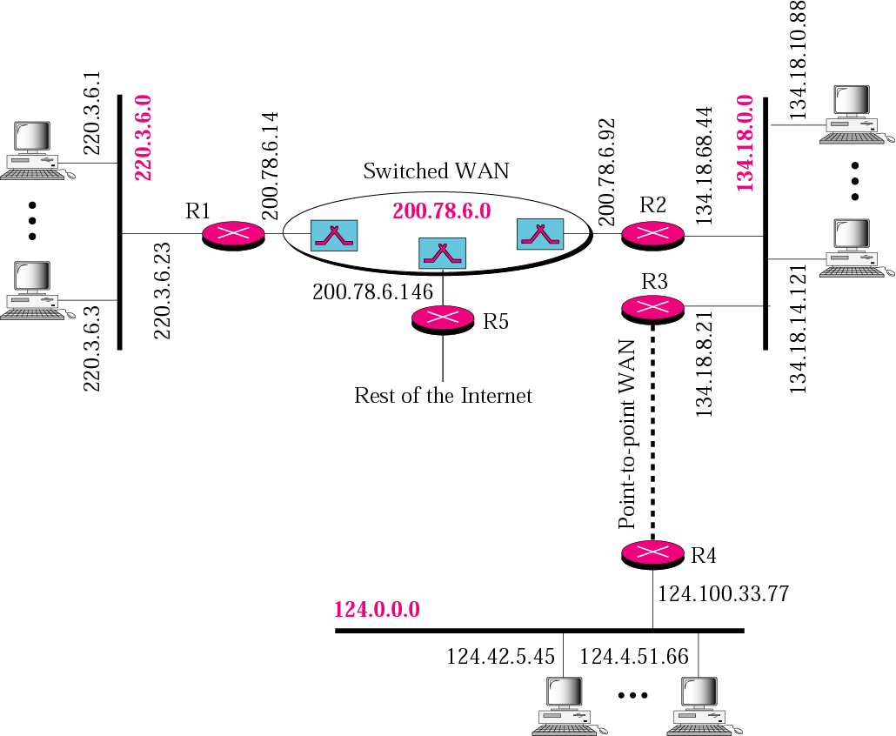
Figure 4.19 Sample internet
TCP/IP Protocol Suite

Slide 35
Classful addressing
Class A, B, C networks require 1, 2 and 3 bytes for the network portion.
E.g., Class C networks can accommodate only 2^8-2 = 254 hosts (2 are reserved). Small for most medium to large organizations.
However Class B supports 65,634 hosts – too large. An organization with 2000 hosts ended up with class B addressing – address space was ill used.
Therefore in 1993, Classless Interdomain Routing (CIDR) was introduced.

Slide 36
IP addressing: CIDR (RFC 1519)
CIDR: Classless InterDomain Routing
  network portion of address of arbitrary length
  address format: a.b.c.d/x, where x is # bits in network portion of address
Classful/CIDR addressing example:
  Prev. example with 2000 hosts. Therefore 2^16 – 2000 = 63K addresses were unused.
  CIDR: Network part: 21 bits. Host part: 2^11 = 2048 hosts.
network
part
host
part
11001000 00010111 00010000 00000000
200.23.16.0/21

Slide 37
IP addresses: how to get one?
Q: How does host get IP address?
Static
DHCP: Dynamic Host Configuration Protocol: dynamically get address from a server
  “plug-and-play”
(more shortly)

Slide 38
IP addresses: how to get one?
Q: How does network get network part of IP addr?
A: gets allocated portion of its provider ISP’s address space
ISP's block 11001000 00010111 00010000 00000000 200.23.16.0/20
(allocated to ISP). It is divided into 8 equal sized blocks.
Organization 0 11001000 00010111 00010000 00000000 200.23.16.0/23
Organization 1 11001000 00010111 00010010 00000000 200.23.18.0/23
Organization 2 11001000 00010111 00010100 00000000 200.23.20.0/23
... ….. …. ….
Organization 7 11001000 00010111 00011110 00000000 200.23.30.0/23

Slide 39
Hierarchical addressing: route aggregation
Hierarchical addressing allows efficient advertisement of routing
information: “Fly-by-night-ISP requests that all datagrams whose first
20 address bits match 200.23.16.0/20. The world doesn’t know that
within this there are 8 other orgs. each with their own networks.
Organization 0
200.23.16.0/23
Organization 1
200.23.18.0/23
“Send me anything
with addresses
beginning
200.23.16.0/20”
Organization 2
200.23.20.0/23
.
Fly-By-Night-ISP
.
.
.
.
Internet
Organization 7
.
200.23.30.0/23
ISPs-R-Us
“Send me anything
with addresses
beginning
199.31.0.0/16”

Slide 40
Note:
IP addresses are designed with two levels of hierarchy.
TCP/IP Protocol Suite

Slide 41
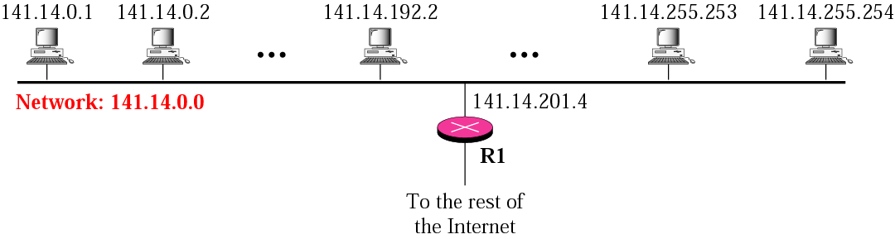
Figure 4.20 A network with two levels of hierarchy (not subnetted)
TCP/IP Protocol Suite

Slide 42
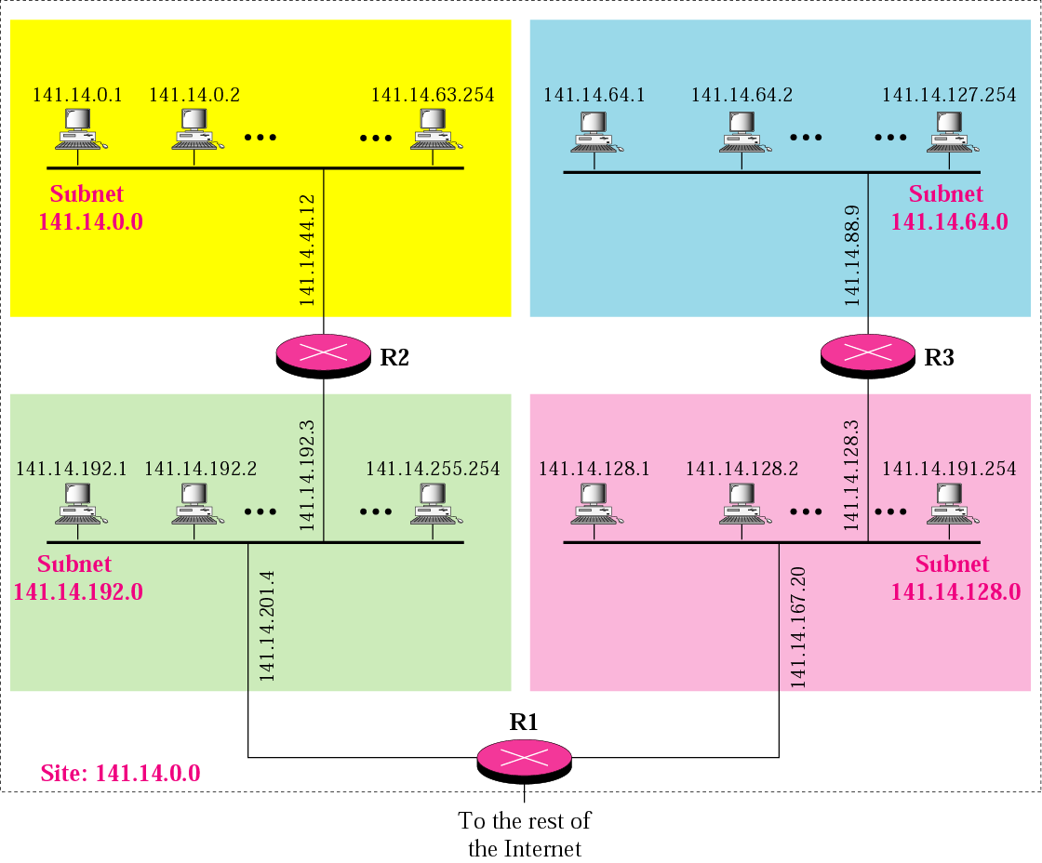
Figure 4.21 A network with three levels of hierarchy (subnetted)
TCP/IP Protocol Suite

Slide 43
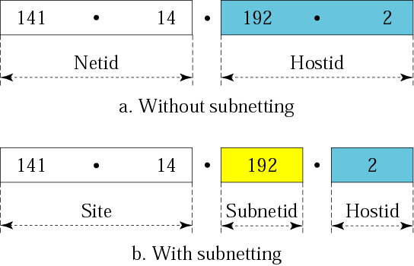
Figure 4.22 Addresses in a network with and without subnetting
TCP/IP Protocol Suite

Slide 44

Figure 4.23 Hierarchy concept in a telephone number
TCP/IP Protocol Suite

Slide 45
IP addressing: the last word...
Q: How does an ISP get block of addresses?
A: ICANN: Internet Corporation for Assigned
Names and Numbers (guidelines in RFC 2050)
  allocates addresses
  manages DNS
  assigns domain names, resolves disputes

Slide 46
Little more on DHCP
Network admin. can configure DHCP so that a given host gets a persistent IP address, i.e., each time a host joins the network it gets the same IP address.
Problem: Many ISP’s don’t have as many IP addresses as there are hosts.
Solution: If an ISP has 4000 customers but only 400 are online at a given time. In that case it might only need a block of 512 addresses (e.g., 200.23.30.0/23)
  Each time a host joins the network it is assigned a new and arbitrary IP address
  DHCP server updates list of available addresses

Slide 47
Getting a datagram from source to dest.
IP datagram:
forwarding table in A
misc
fields
source
IP addr
dest
IP addr
Dest. Net. next router Nhops
data
223.1.1 1
Simplified IP hdr above
datagram remains unchanged, as it travels source to destination
addr fields of interest
Let A send datagram to B
IP proto. in A sees 223.1.1 in forwarding table matching leading bits of IP address of B with one hop, i.e., B is on same network.
A puts datagram to link-layer protocol whose job it is to move datagram to B.
223.1.2 223.1.1.4 2
223.1.3 223.1.1.4 2
A
223.1.1.1
223.1.2.1
223.1.1.2
223.1.1.4
223.1.2.9
B
223.1.2.2
E
223.1.1.3
223.1.3.27
223.1.3.1
223.1.3.2

Slide 48
Getting a datagram from source to dest.
forwarding table in A
misc
fields
Dest. Net. next router Nhops
223.1.1.1
223.1.2.2
data
223.1.1 1
Starting at A, dest. E:
look up network address of E in forwarding table
E on different network
  A, E not directly attached
routing table: next hop router to E is 223.1.1.4
link layer sends datagram to router 223.1.1.4 inside link-layer frame
datagram arrives at 223.1.1.4
continued…..
223.1.2 223.1.1.4 2
223.1.3 223.1.1.4 2
A
223.1.1.1
223.1.2.1
223.1.1.2
223.1.1.4
223.1.2.9
B
223.1.2.2
E
223.1.1.3
223.1.3.27
223.1.3.1
223.1.3.2

Slide 49
Getting a datagram from source to dest.
forwarding table in router
misc
fields
Dest. Net router Nhops interface
223.1.1.1
223.1.2.2
data
223.1.1 - 1 223.1.1.4
Arriving at 223.1.4, destined for 223.1.2.2
look up network address of E in router’s forwarding table
E on same network as router’s interface 223.1.2.9
  router, E directly attached
link layer sends datagram to 223.1.2.2 inside link-layer frame via interface 223.1.2.9
datagram arrives at 223.1.2.2!!! (hooray!)
223.1.2.0/24 - 1 223.1.2.9
223.1.3 - 1 223.1.3.27
A
223.1.1.1
223.1.2.1
223.1.1.2
223.1.1.4
223.1.2.9
B
223.1.2.2
E
223.1.1.3
223.1.3.27
223.1.3.1
223.1.3.2

Slide 50
More on forwarding tables
Forwarding tables in routers are central
How are forwarding tables configured and maintained for large networks with multiple paths?
  These tables must allow good paths
As it turns out, routing algorithms have the role of configuring and maintaining these tables.

Slide 51
IP datagram format
IP protocol version
number
32 bits
total datagram
length (bytes)
header length
(bytes)
head.
len
type of
service
ver
length
for
fragmentation/
reassembly
“type” of data
flgs
fragment
offset
16-bit identifier
max number
remaining hops
(decremented at
each router)
time to
live
upper
layer
Internet
checksum
32 bit source IP address
upper layer protocol
to deliver payload to
32 bit destination IP address
Options (if any)
E.g. timestamp,
record route
taken, specify
list of routers
to visit.
how much overhead with TCP?
20 bytes of TCP
20 bytes of IP
= 40 bytes + app layer overhead
data
(variable length,
typically a TCP
or UDP segment)

Slide 52
IP datagram format (cont’d)
Version number: IPv4 or IPv6. Datagram format changes with this number. For now we will describe v4.
Header length: v4 datagram contains a variable number of options. It indicates where data starts
Type of service: Permits different types of v4 datagrams. Example: Cisco routers examine the first three bits and interprets these as defining different levels of service to be provided by the router. This is a policy issue and is determined by routers admin.
Datagram length: Total length of header + data (i.e., datagram). Theoretical max. is 2^16 but datagrams are rarely greater than 1500 bytes and are frequently set to 576 bytes.

Slide 53
IP datagram format (cont’d)
Identifier, flags, frag. offset: To be discussed.
Header length: v4 d’gram contains a variable number of options. It indicates where data starts
Time to live: TTL prevents d’grams from ending in router loops & living forever. TTL = TTL –1 on passage through router; TTL=0 means discard d’gram.
Protocol: Only used when IP d’gram reaches final destination. Value 6 means pass to TCP, 17 to UDP. The protocol # is the “glue” that holds the network and transport layers together.
Header checksum : Discussed in TCP (transport layer). Routers discard d’grams that have bit errors. Recomputed at each router as at least TTL changes.

Slide 54
IP datagram format (cont’d)
Identifier, flags, frag. offset: To be discussed.
Header length: v4 d’gram contains a variable number of options. It indicates where data starts
Time to live: TTL prevents d’grams from ending in router loops & living forever. TTL = TTL –1 on passage through router; TTL=0 means discard d’gram.
Protocol: Only used when IP d’gram reaches final destination. Value 6 means pass to TCP, 17 to UDP. The protocol # is the “glue” that holds the network and transport layers together.
Header checksum : Discussed in TCP (transport layer). Routers discard d’grams that have bit errors. Recomputed at each router as at least TTL changes.

Slide 55
IP datagram format (cont’d)
Source and dest IP addresses: We know about this. However, 255.255.255.255 is a special IP add. When a datagram has this IP, then the message is delivered to all hosts on the same network. Routers could also forward it to neighbouring networks.
Options: Options field permits extensions to IP header. Options are simply not used much today and are dropped in IPv6.
Data (payload): Most of the time, IP carries TCP or UDP, but ICMP messages could be carried too.

Slide 56
IP Fragmentation & Reassembly
network links have MTU (max.transfer size) - largest possible link-level frame.
  different link types, different MTUs
large IP datagram divided (“fragmented”) within net
  one datagram becomes several datagrams
  “reassembled” only at final destination
  IP header bits used to identify, order related fragments
fragmentation:
in: one large datagram
out: 3 smaller datagrams
reassembly

Slide 57
IP Fragmentation and Reassembly
IP header has identification (x), flag, and fragmentation fields
Example: 4000byte d’gram (20byte header + 3980 IP payload).
MTU = 1500bytes
Frag 1: 1480bytes + 20byte header
Frag 2: 1480bytes + 20byte header
Frag 3: 3980-2*1480 bytes + 20byte header
length
=4000
ID
=x
fragflag
=0
offset
=0
One large datagram becomes
several smaller datagrams
length
=1500
ID
=x
fragflag
=1
offset
=0
length
=1500
ID
=x
fragflag
=1
offset
=1480
length
=1040
ID
=x
fragflag
=0
offset
=2960

